Slide 1



A Survey of the Coast-wide Decline in Survival of West Coast Chinook
David Welch
Kintama Research Services Ltd., Nanaimo, BC, Canada david.welch@kintama.com Tel: +1-250-739-9044
David Welch Erin Rechisky Aswea Porter

Slide 2
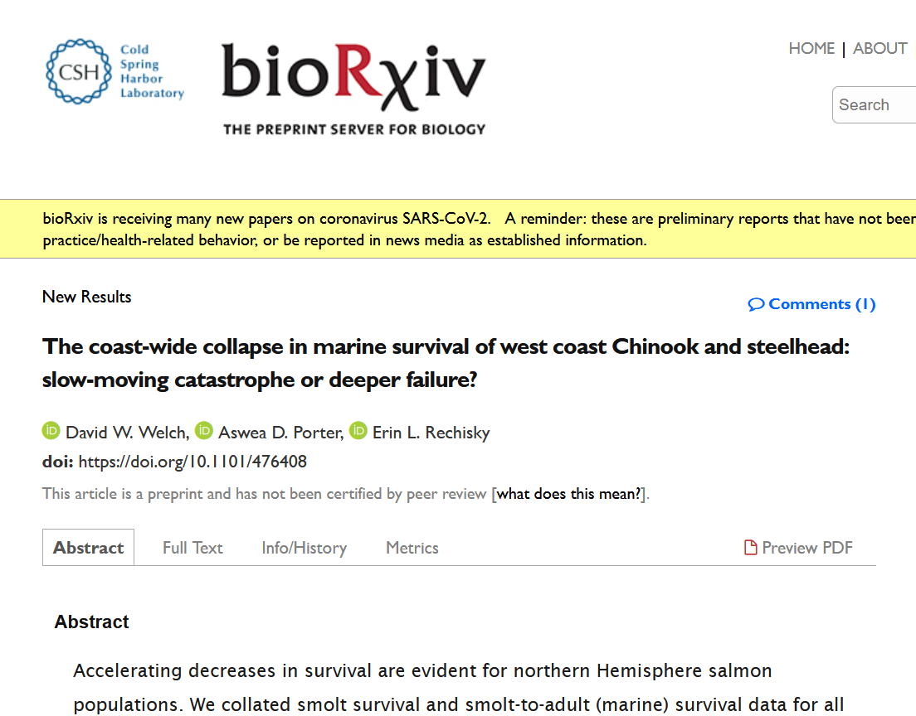
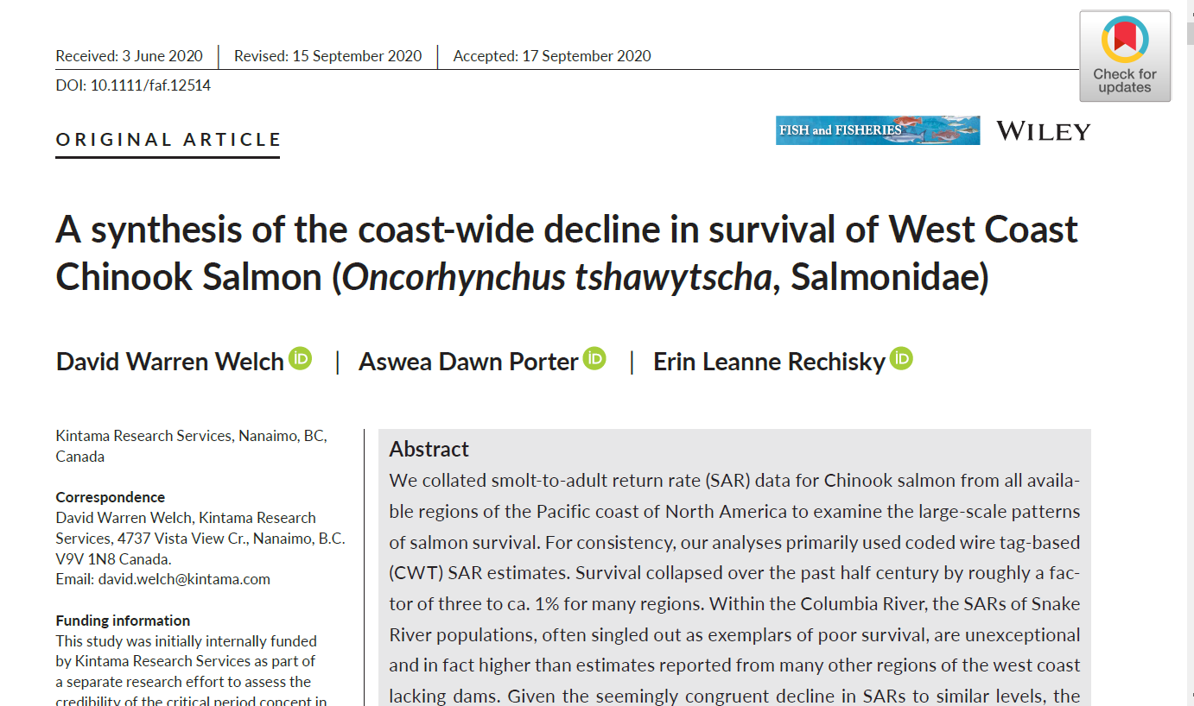
Two papers: BioRXiv Preprint & Fish & Fisheries Peer-Reviewed Paper

Slide 3
Differences between Old (BioRχive/PLoS ONE) & New (Fish & Fisheries) Manuscripts
OLD
Chinook & Steelhead
Alaska to Oregon
Combined tagging methods (CWT & PIT)
Combined H&W
Conclusions:
SARs have fallen to “about” the same level
No delayed mortality
NEW
Chinook (Only)
Added California
Separated tagging methods
Separated H&W
Conclusions:
Same
Same
PIT-based SARs deeply flawed

Slide 4
Setting the Scene
The climate is going to become ever more “warm and sunny”.
Unfortunately, salmon like it cool and shady.

Slide 5
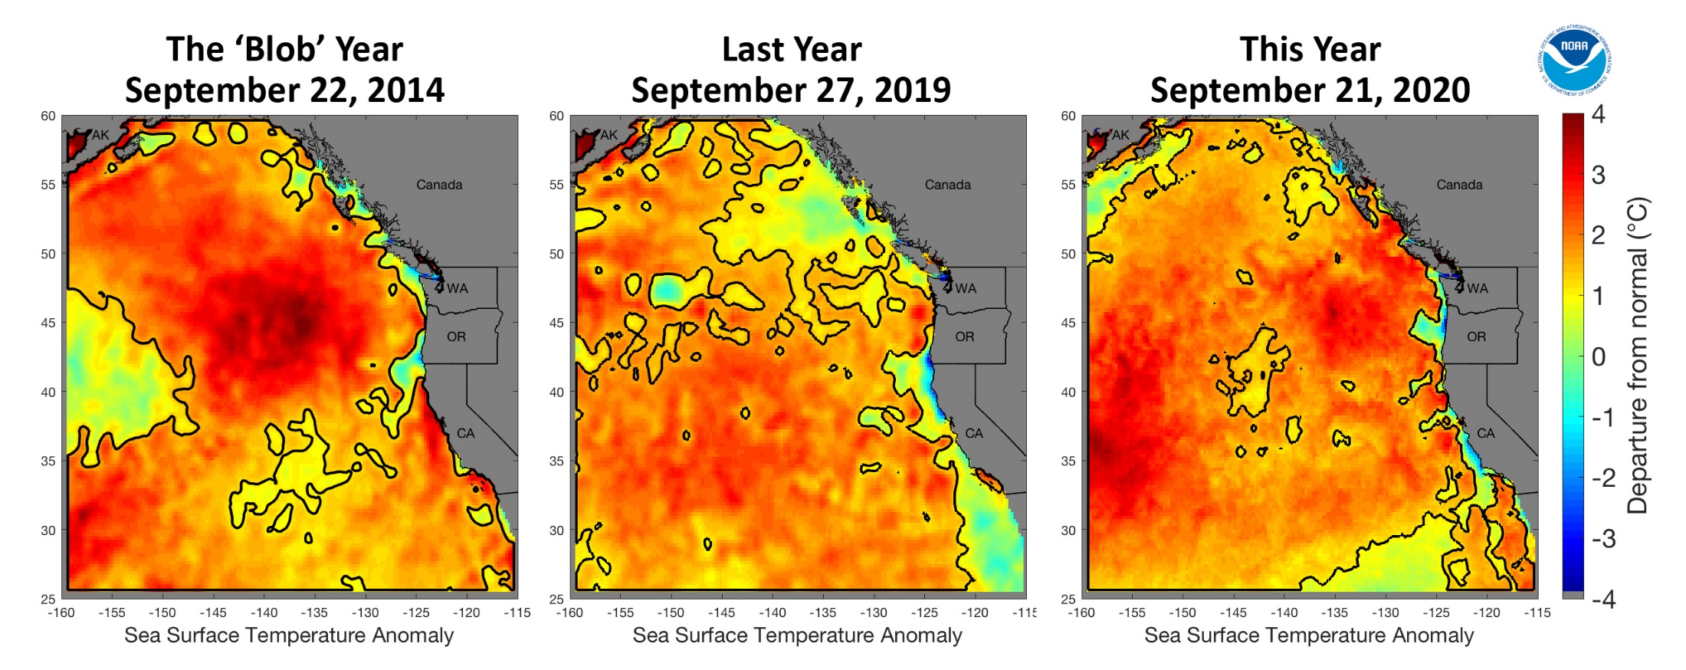
The New Normal? 2014-2020
“…in five of the last seven years, the California Current system has been dominated by large marine heatwaves, which are also the largest heatwaves on record for this area,” said Andrew Leising (NOAA SWFSC, La Jolla).
www.fisheries.noaa.gov/feature-story/string-marine-heatwaves-continues-dominate-northeast-pacific?utm_medium=email&utm_source=govdelivery

Slide 6
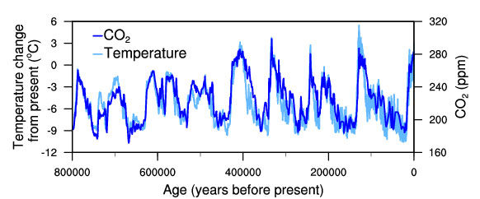
410 ppm CO2
(Current level!!)
Temperature change (light blue) and carbon dioxide change (dark blue) measured from the EPICA Dome C ice core in Antarctica (Jouzel et al. 2007; Lüthi et al. 2008).

Slide 7
The Near-Future
“Fore”casting sea temperature increases inevitably leads to the prediction of much warmer temperatures in the next 5-10 years
Entirely sensible (& inevitable) prediction because of the increasing concentrations of GHG in the atmosphere
This is really bad for salmon
My own view is that extensive work on salmon habitat improvements have not been successful in improving SARs.
We need to be more self-critical.

Slide 8
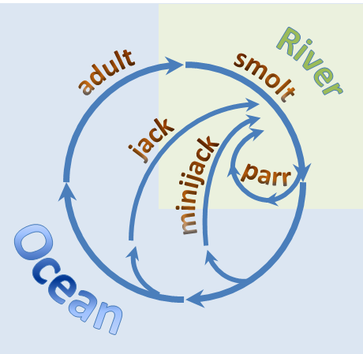
Measuring Smolt-to-Adult Survival (SARs)
Spawning & Fry Rearing
Smoltification
Adults Return to River
Freshwater Survival
Smolts Migrate Downstream
(<1 month)
3rd Winter in Ocean
Ocean Survival
Juveniles & Adults Migrate Through Ocean (2~3 yrs)
Ocean Entry
2nd Winter in Ocean
1st Winter in Ocean

Slide 9
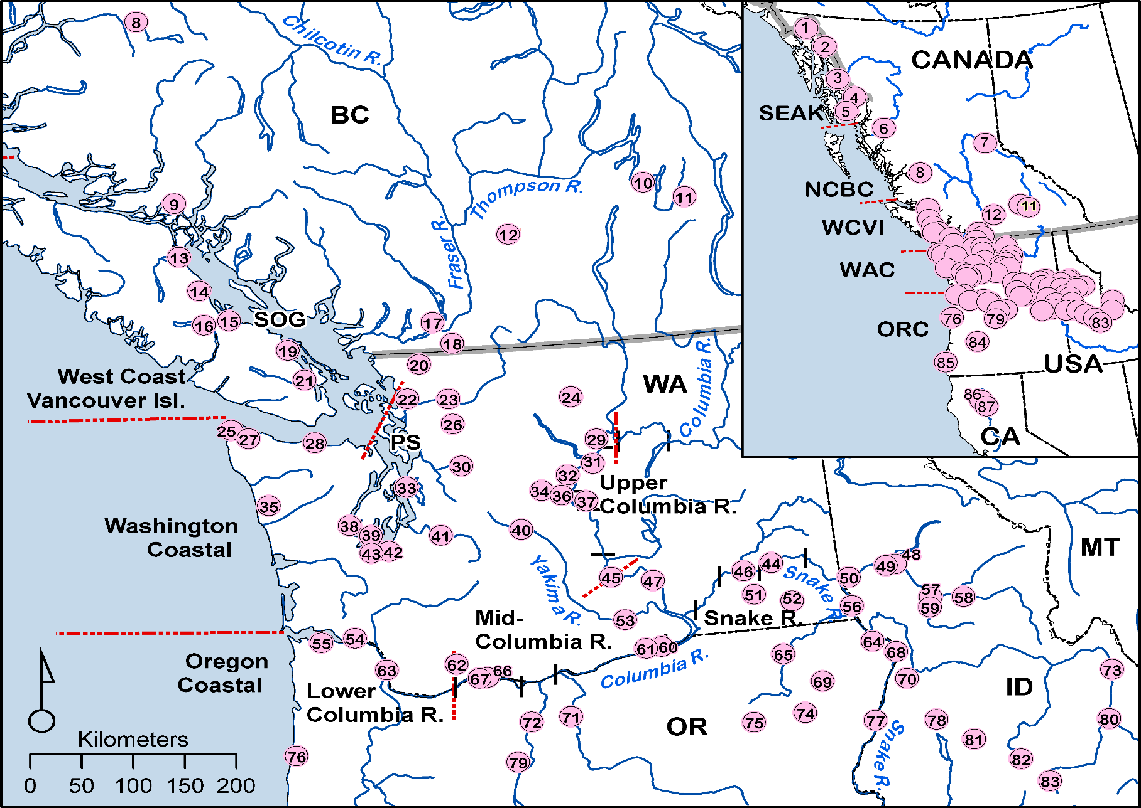
The Study Area-Chinook

Slide 10
Chinook SAR Data Broken Out by Methodology

Slide 11
The Bottom Line: SARs 2010-2014
Used CWT-based SAR estimates only
Restricted comparison to most recent 5 years
Used a resampling scheme, normalizing against median Snake River SAR (see MS)
Most regional SARs are worse (subyearling) or indistinguishable (yearling) from Snake R.

Slide 12
Chinook SARs Normalized by Snake River Median SARs (i.e., Relative Survival)
Compared SARs for the west coast of North America (excl. California)
SARs are scaled by dividing by annual Snake River values
So SAR_{SnakeRiver} =1
The major regional difference in SARs seen in earlier time periods no longer exists
Almost all regions now have SARs equivalent to the Snake River
Even AK & NCBC SAR difference now much smaller…and almost the same in the most recent years
How can we recover salmon if Alaska & N. BC can’t with near-pristine freshwater habitat??

Slide 13
Steelhead Regional SARs by Regime Period Relative to Snake R

Slide 14
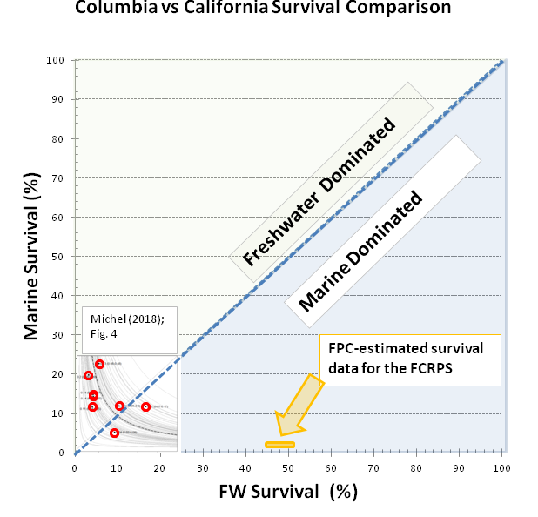
Why Are California (Sacramento R) Chinook SARs Greater than the Snake R?
Snake River (Columbia) freshwater survival is far better than the Sacramento
On the other hand, marine survival of Sacramento Chinook is far better than the Snake River Chinook.
As a result, SAR_{California}>SAR_{Snake}

Slide 15
As SARs Drop, Monitoring Increases

Slide 16
The Real Salmon Habitat Problem:
There are Many Habitats!!
…can we make enough modification to freshwater to compensate?
… And how do we do so??
And are we even approaching the problem in the right way?
If the Ocean is the problem…

Slide 17
Conclusions
Almost all regions of the west coast show large drops in salmon SARs over time
  This includes regions with essentially pristine freshwater habitats (➔SE Alaska, N. BC)
  We don’t know where in the life cycle survival is dropping but it is almost certainly marine.
  It is roughly associated with regime periods.
  Geographically widespread declines in SARs raise important questions about how effective recovery actions in freshwater can be.

Slide 18

ThankS FOR YOUR INTEREST!
David Welch Erin Rechisky Aswea Porter

Slide 19
Some Questions to Start the Discussion
Is Trinity R smolt survival to the river mouth currently measured?
Is the SAR known (ideally, for the same years)?
If so, then ocean survival can be measured:
      S_{ocean}=SAR/S_{FW}
This begins to define & bound the problem.
A rational discussion can then begin about whether it is realistic for freshwater survival (habitat) to be sufficiently modified to compensate for marine phase problems.
If not, we need to address marine survival problems directly.
Spoiler Alert! Freshwater density-dependence may counteract freshwater habitat interventions!

