Slide 1
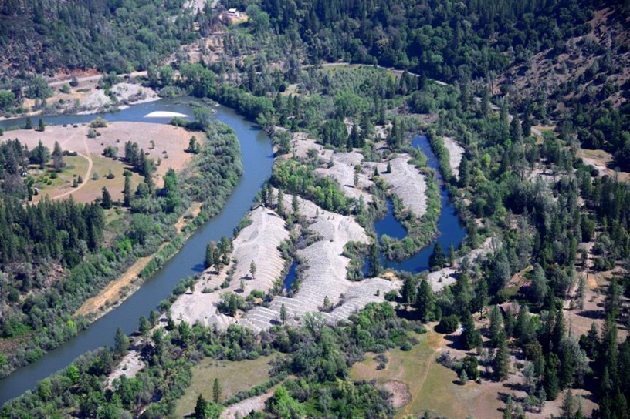
Temperature management as a potential rehabilitation design criterion:
Oregon Gulch

Slide 2
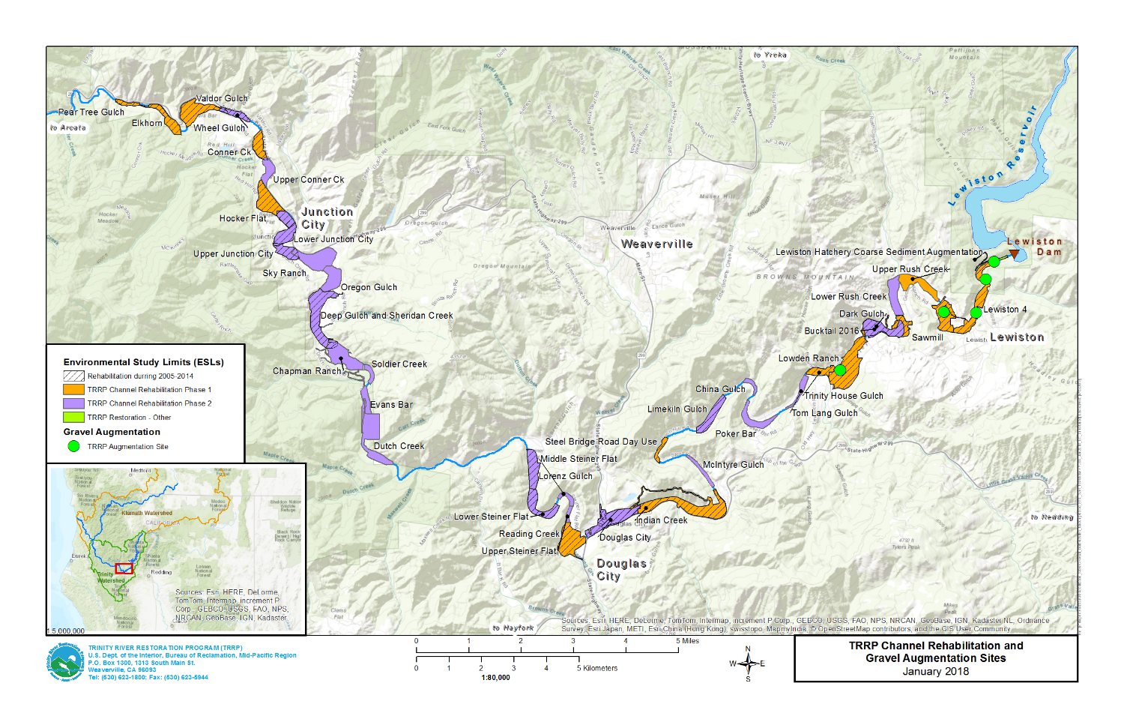
Oregon Gulch

Slide 3
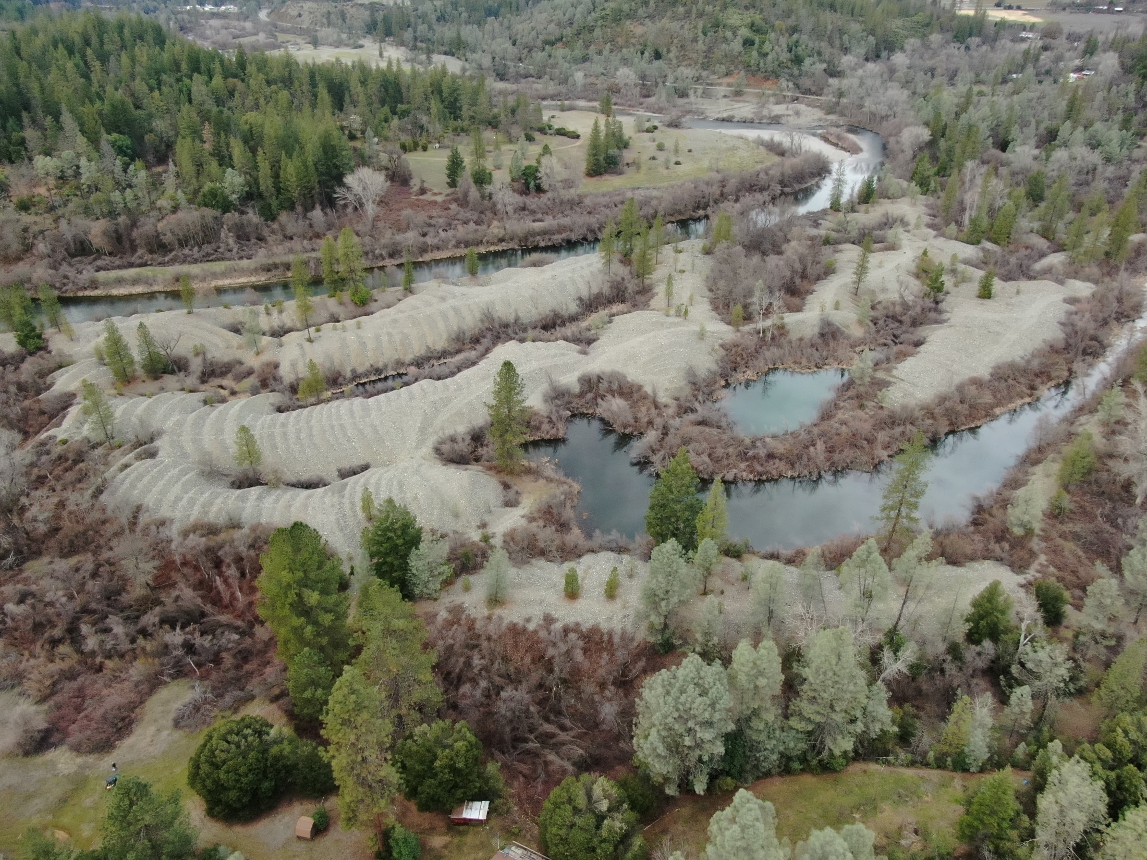

Slide 4
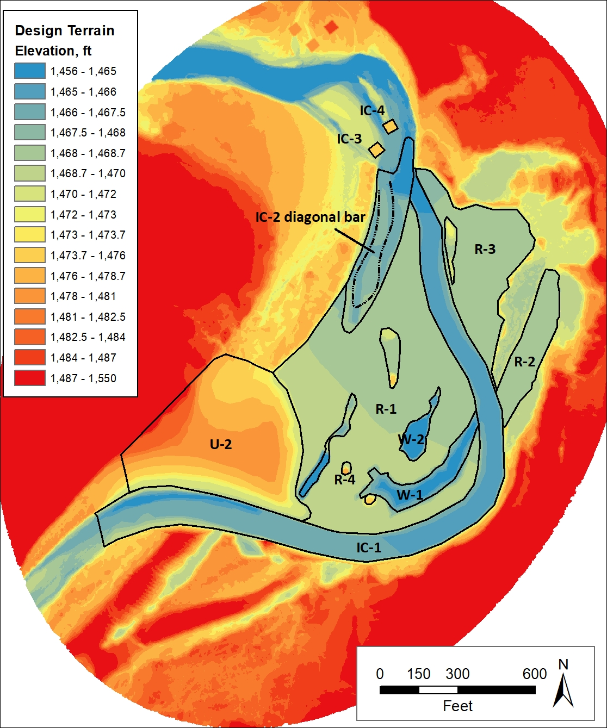

Slide 5
What does this design mean for water temperature management?
Stream temperature is a 4-dimensional aspect of physical habitat
Increases in geomorphic complexity increase temperature variability within a stream reach
Fish are mobile and can therefore select the locations in space that favor their growth and survival

Slide 6
Oregon Gulch
2-Dimensional Hydraulic Model
SRH-2d temperature module
Pre-project and design conditions
Six dates in early April, late April, late July
in 2018 (critically dry) and 2019 (wet)
Inputs: water temperatures from DC, meteorological data DRI RAWS station at Big Bar
Notes:
Meteorological includes time, cloudcover, airtemp, dewpnt, airpressure, windspeed, solar insolation

Slide 7
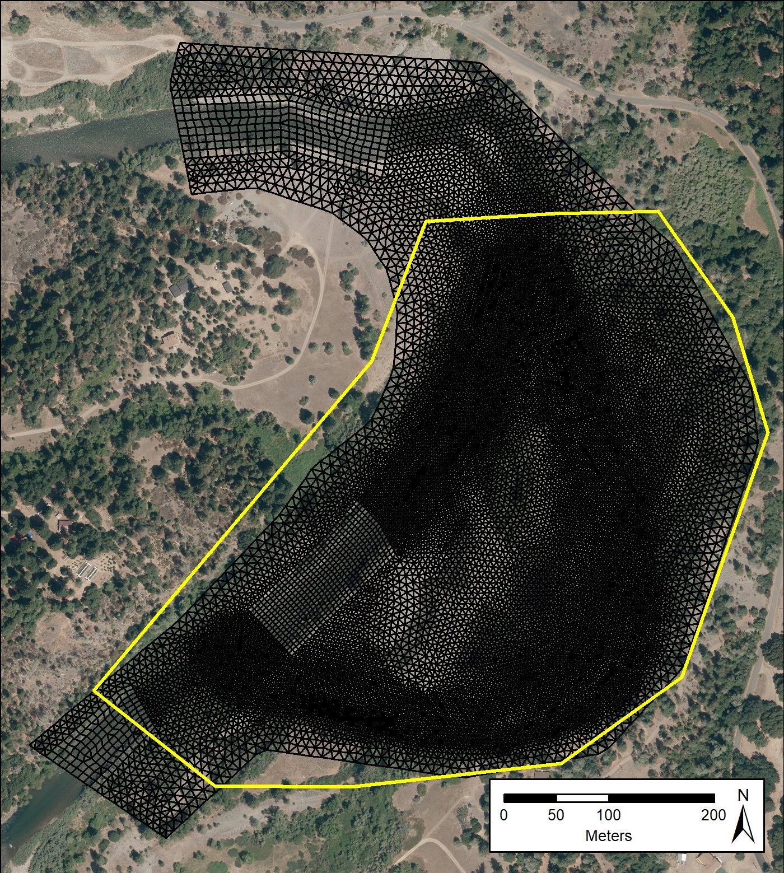
The Model Mesh
Notes:
25013 elements, average around 60 ft2, or less then 8 ft on a side.

Slide 9
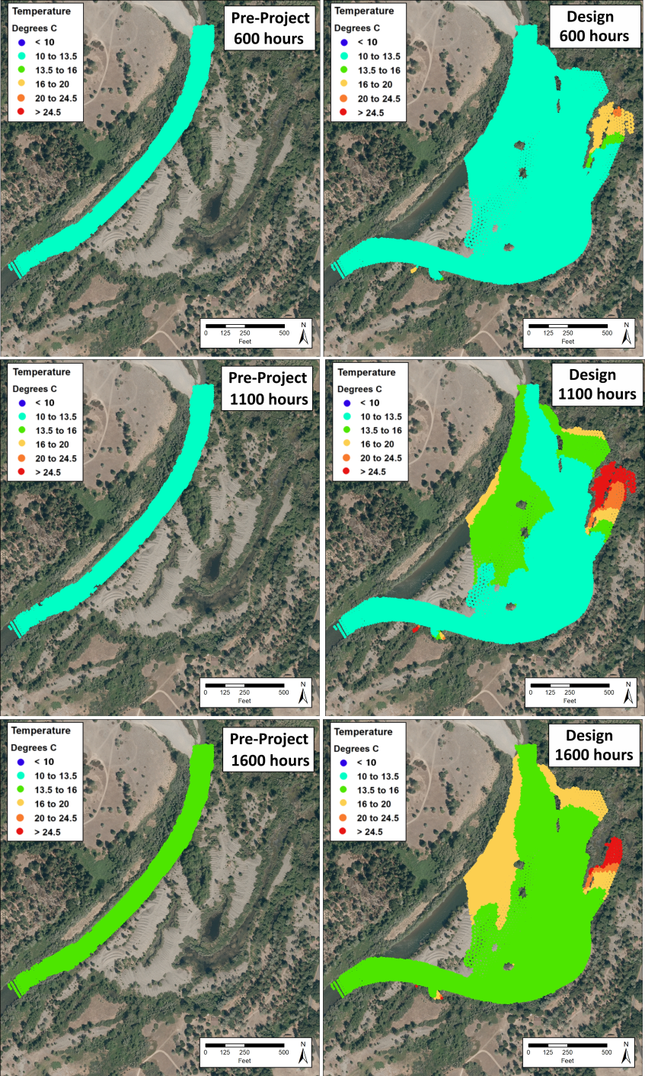
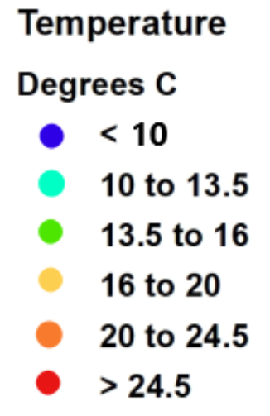
July 25, 2019
600 hours
1100 hours
1600 hours
Notes:
Growth reduced by > 20% at less than10 ºC.
Growth reduced by up to 20% at 10-13.5 ºC.
Growth reduced < 10% at 13.5-16 ºC.
Maximum growth but increase in disease at 16-20 ºC.
Growth reduced and high prevalence of disease at 20-24.5 ºC.
>24.5 ºC is unsuitable for salmonids.

Slide 10
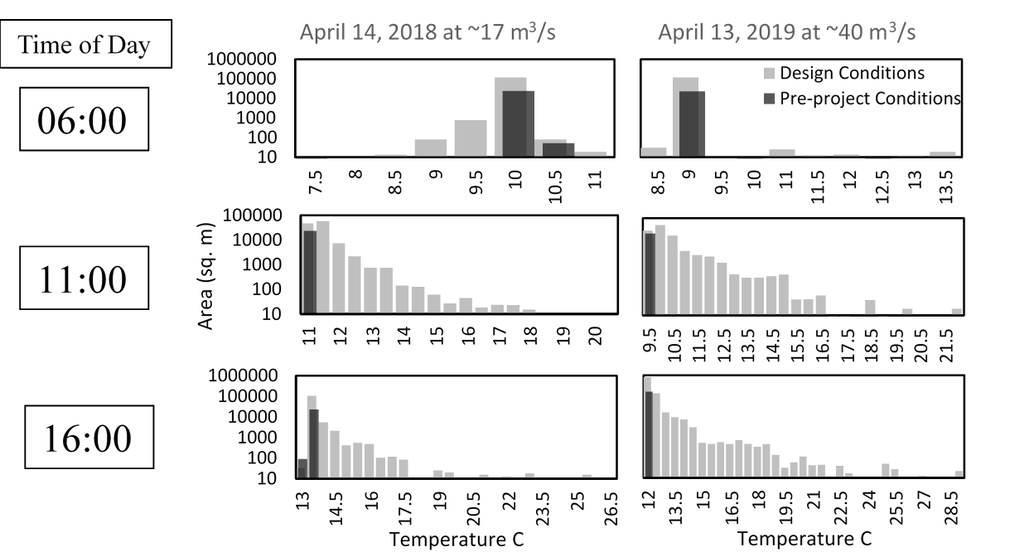
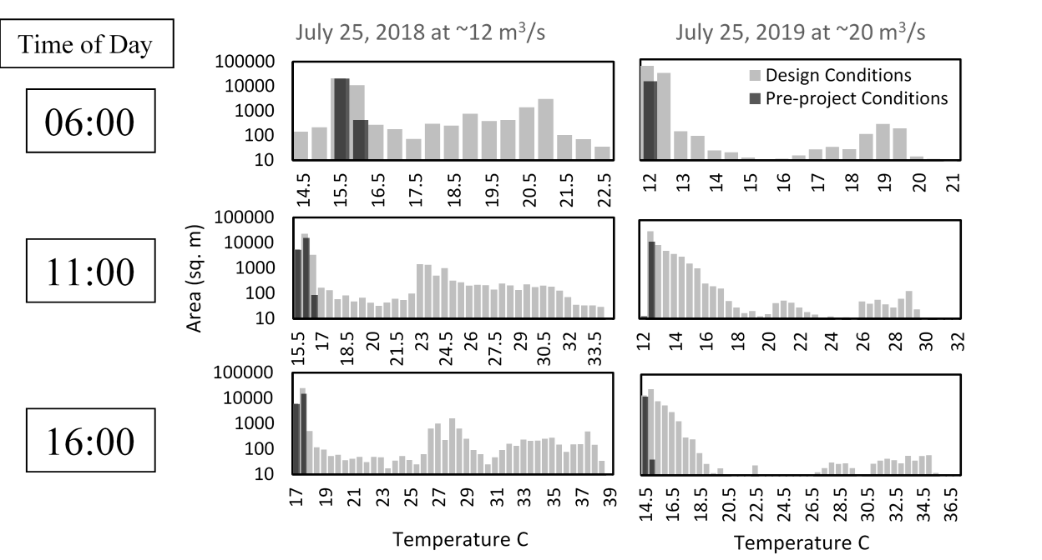
Early April
Late July

Slide 11
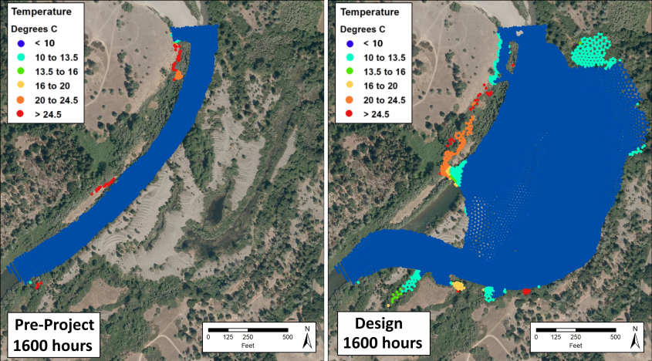
April 19, 2019
1600 hours
1100 hours
1600 hours

Slide 12
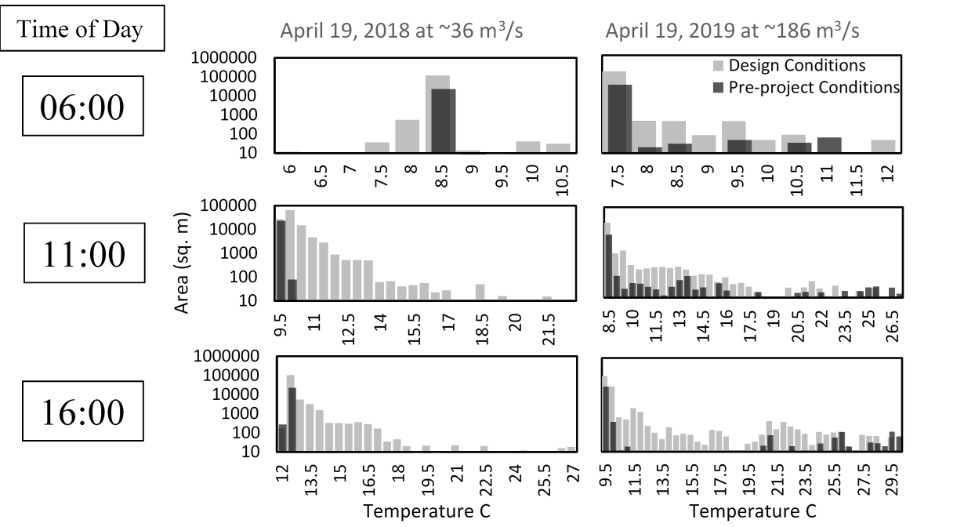
Late April
1270 cfs 6550 cfs

