Slide 1
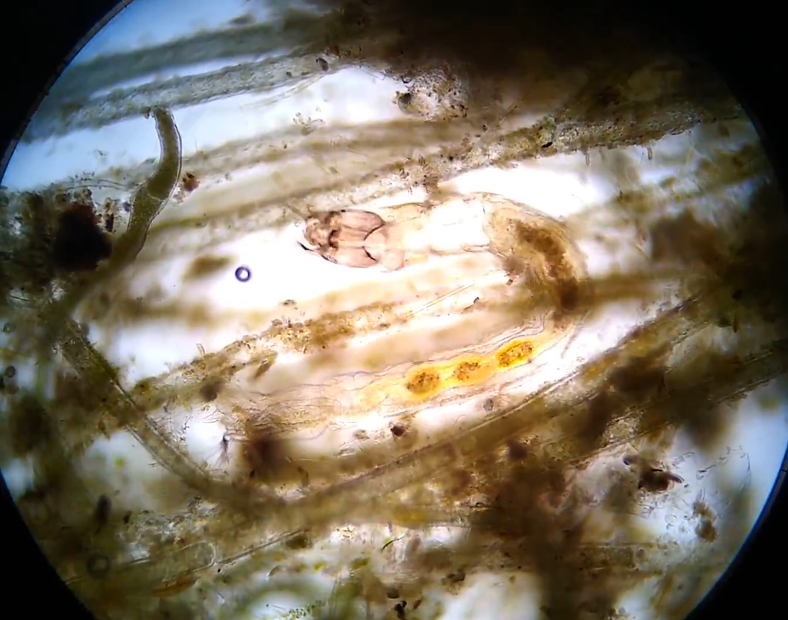
Trinity River Periphyton (~algae~)
Periphyton = attached to substrate
As opposed to…
Plankton = floating in water column

Slide 2
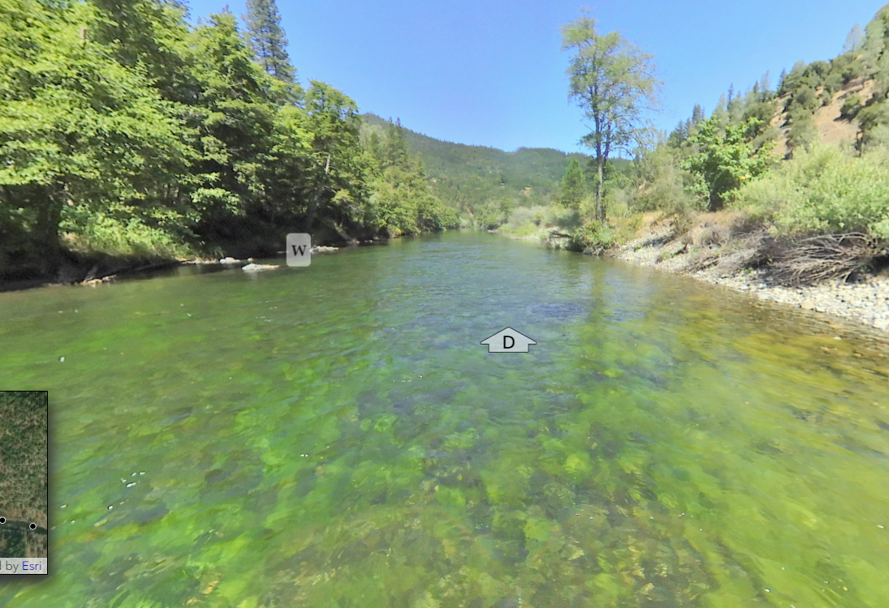
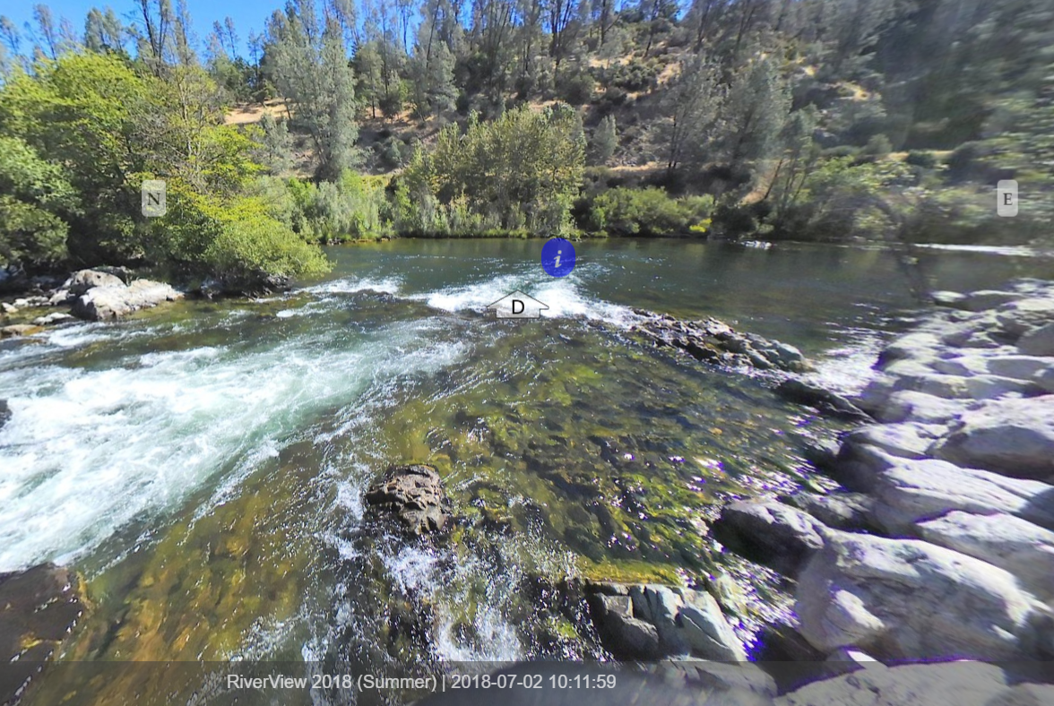
2018
Major “bloom” within the
restoration reach.
Numerous questions from
fishermen and other members
of the public.
No one remembered seeing
a bloom like that before.
Concerns raised:
  Nutrient loading from growers
  Management of the river
  Rotting algae could deplete
  oxygen levels.

Slide 3
What do we know? … Speculate?
Know:
  Algae are primary productivity – the foundation for a food web.
  The few samples examined under a microscope were all consistent with Cladophora. This genus is well known to host a diversity of other algae and invertebrates.
  Dr. Mary Power has been studying Cladophora in the Eel and other rivers as the foundation of the salmonid food web.
    Geomorphic flows in winter remove large grazer macroinvertebrates, with less grazing, Cladophora proliferates in spring and summer.
Speculate:
  Trinity River is well mixed so Oxygen levels should not be an issue beyond perhaps a few isolated backwaters.
  Possible cause: 2018 was a critically dry year so water levels came down early, allowing growth of algae to advance quickly.
  Possible cause: 2018 was a critically dry year, so flows may not have flushed algae out from prior year and system was primed for quick algal growth.
  Possible cause: nutrient loading that came from wildfires above the Lake (e.g. Coffee Creek).
  Possible cause: Given lateness of flows and coldness of Trinity water, and following Power’s observations, the 2017 water year may have been the geomorphic flow that removed grazers and it just took until 2018 for the pattern to reveal (and the critically dry flow to not reset).

Slide 4
People will continue asking… so what should we know on the Trinity?
Start shifting from speculation to knowledge
Geographic Patterns?
  Along length of restoration reach
  Relative to Tributary Inputs
  Relative to Reservoirs
Seasonal Patterns?
  Any correspondence to Hydrology? Geomorphic Events?
Chemistry?
  N, P
Good or Bad?
  What do we actually have here?
  What lives in it?
How can we gain knowledge
while minimizing TRRP Staff time and equipment?

Slide 5
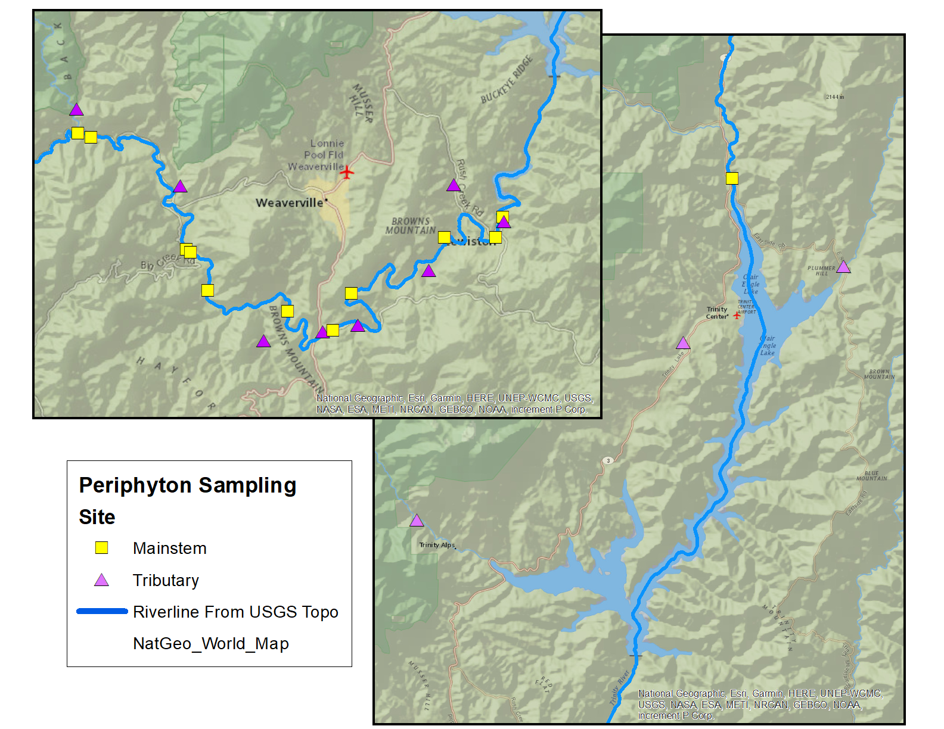
Study Design 1:
Spatial

Slide 6
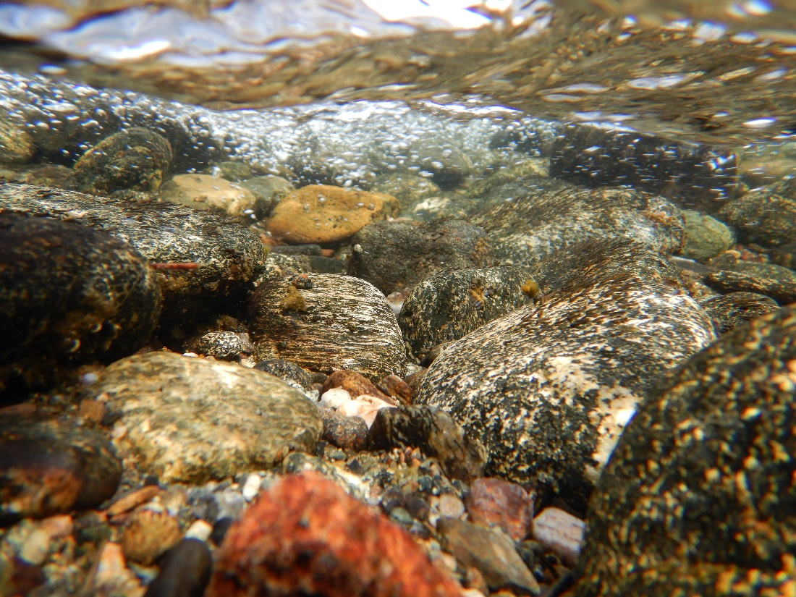
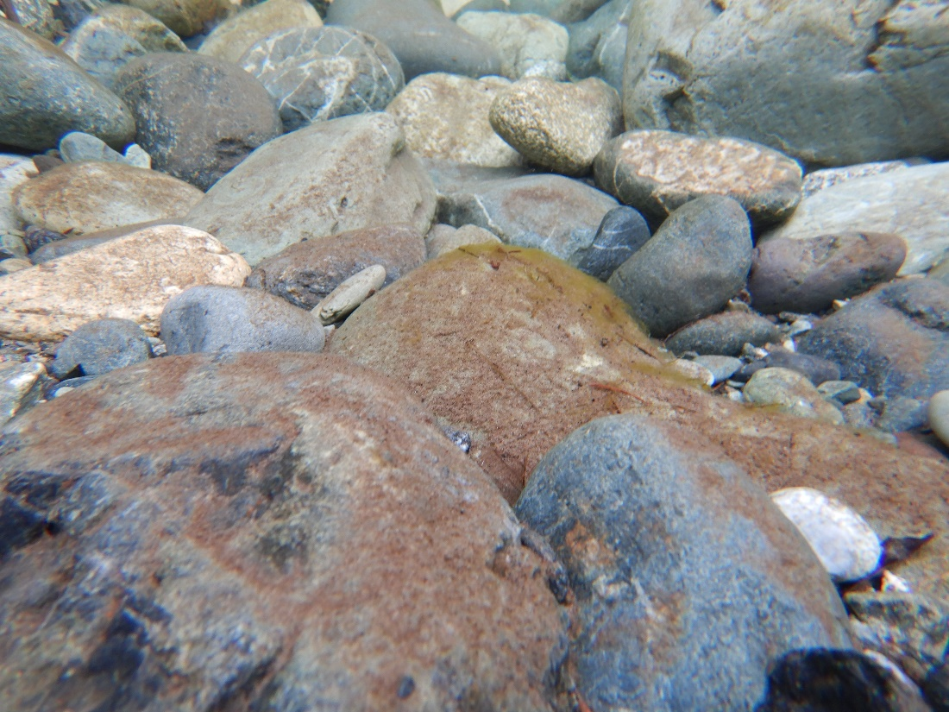
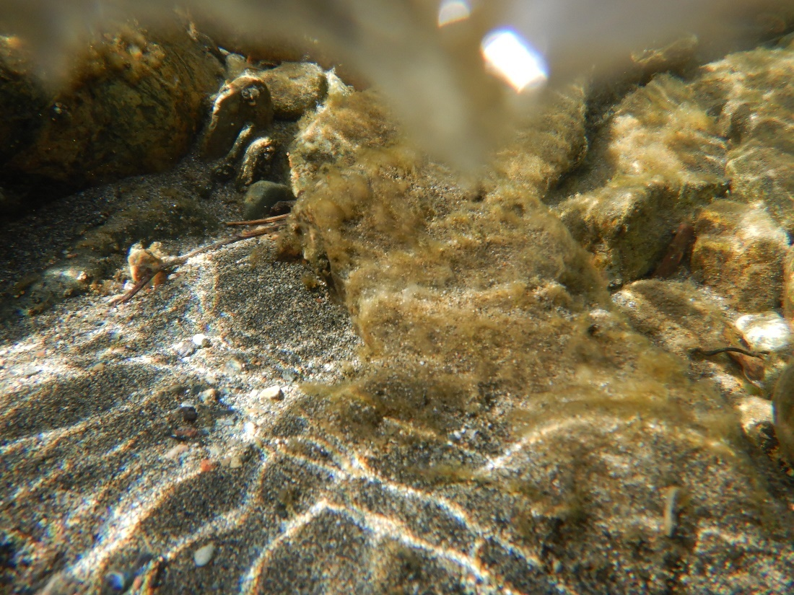
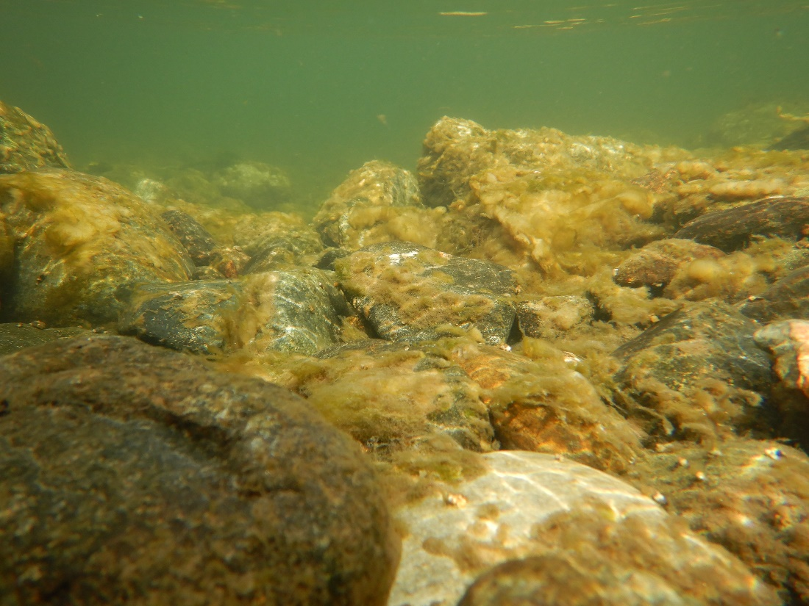
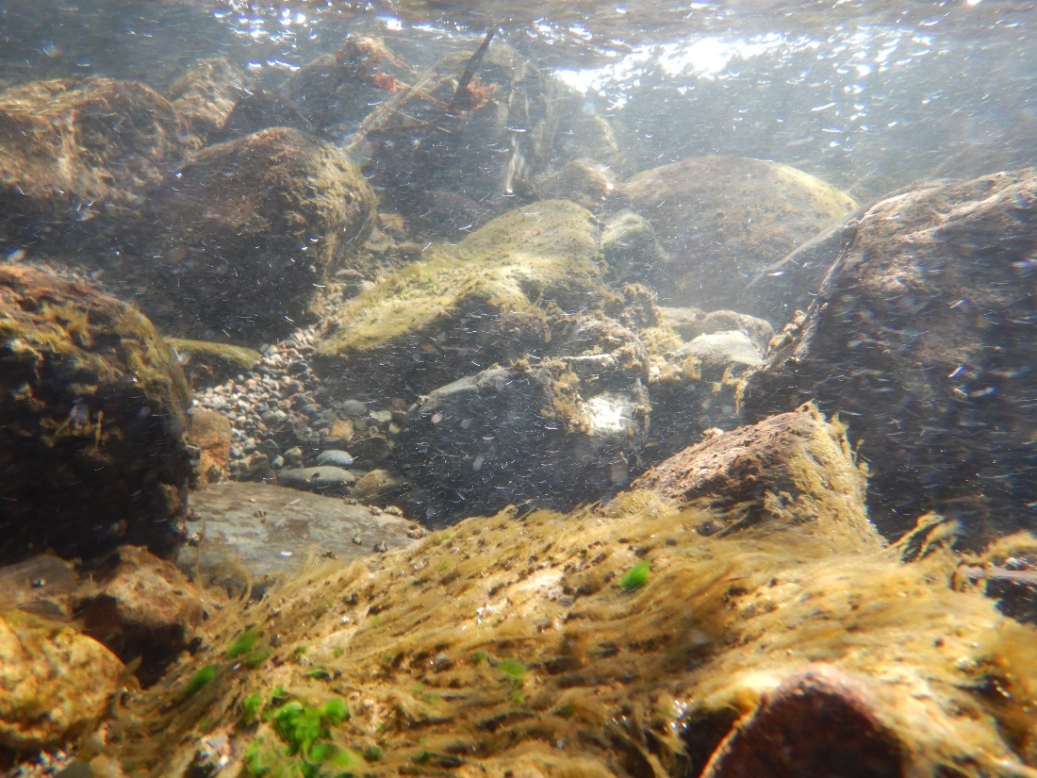
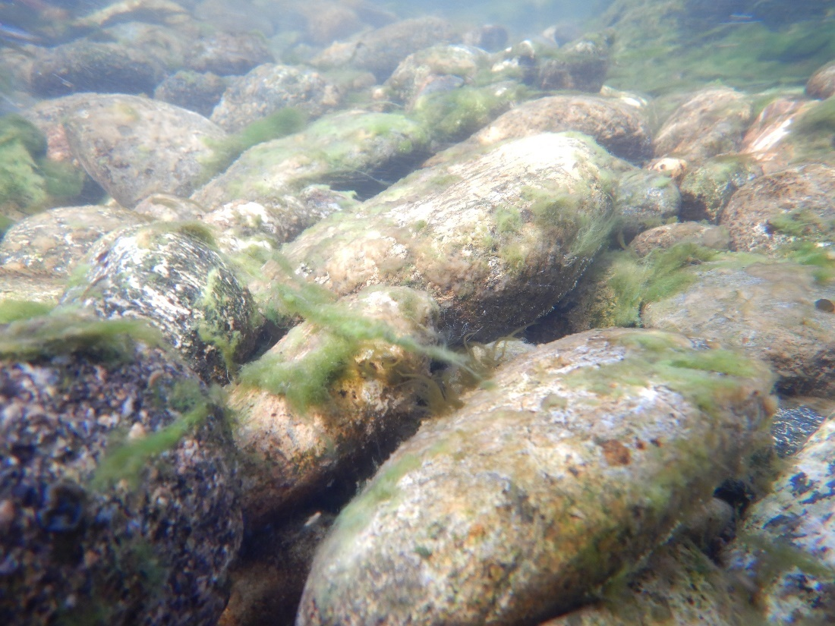
Study Design 2: Temporal
2020-04: Photographic monitoring of growth
2020-06: Photographic monitoring of growth
2020-07: Photographic monitoring of growth
2020-08: Photographic monitoring of growth / biodiversity sampling
2020-10: Photographic monitoring of growth
2020-12: Photographic monitoring of growth
2021-02: Photographic monitoring of growth / biodiversity sampling
2021-04: Photographic monitoring of growth
2021-06: Photographic monitoring of growth
2021-07: Photographic monitoring of growth
2021-08: Photographic monitoring of growth / biodiversity sampling
2021-10: Photographic monitoring of growth
2021-12: Photographic monitoring of growth
2022-02: Photographic monitoring of growth / biodiversity sampling
2022-04: Photographic monitoring of growth
2022-06: Photographic monitoring of growth
2022-07: Photographic monitoring of growth
2022-08: Photographic monitoring of growth / biodiversity sampling
2022-10: Photographic monitoring of growth
2022-12: Photographic monitoring of growth
2023-02: Photographic monitoring of growth / biodiversity sampling

Slide 7
Study Design 3: Chemistry
Currently not funded – nothing happening
Proposed for funding through Reclamation’s Science and Technology office
Would sample 21 sites in August of FY21 at estimated cost $3410
Noted that a similar request would likely be made for FY22

Slide 8
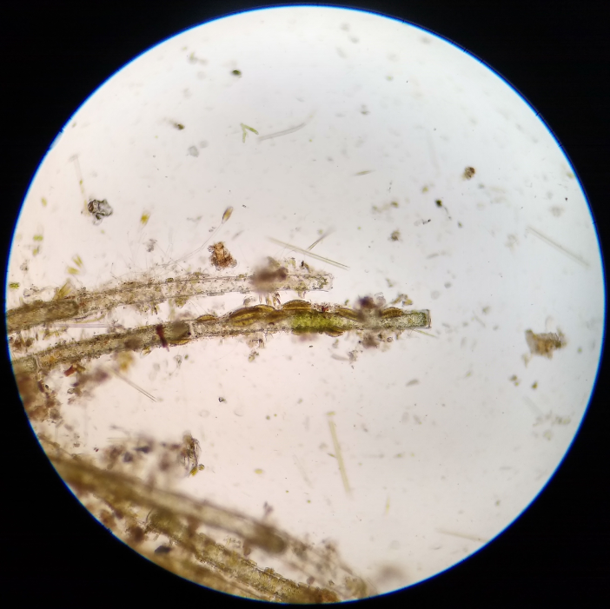
Study Design 4: Biodiversity
Scrub samples at all sites made during
February and August samplings
Intent is to capture diversity yet with uniform level of effort
across sites
PVC rings to delimit 3 areas on 2 rocks selected per site.
Areas within rings are scrubbed with a toothbrush that is washed into a ziplock bag. The scrubbed areas are also rinsed into the bag.
Bag allowed to settle.
A few drops are drawn from the bottom of the bag for microscopy.
  Identified or categorized by me (no experience with Periphyton, but 2.5 decades experience with lichens including their algae).
3 “blanks” are made during the sampling to test for cross contamination (rinsing the toothbrush into a bag with the same rinsing equipment)

Slide 9
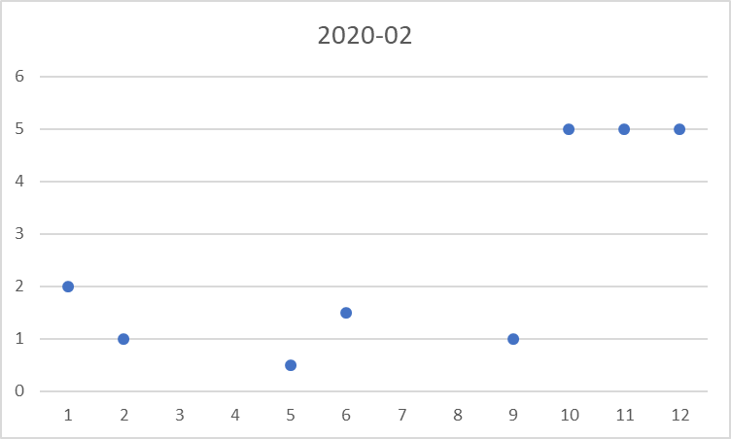
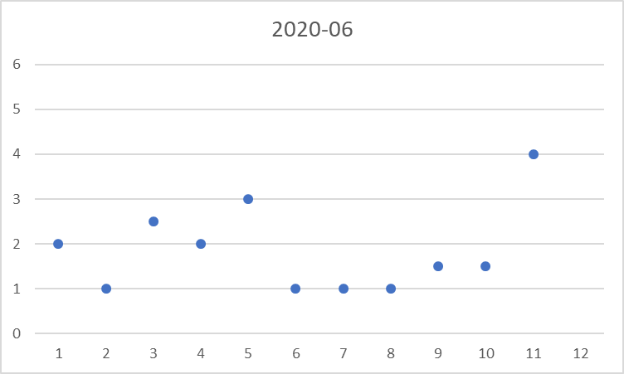
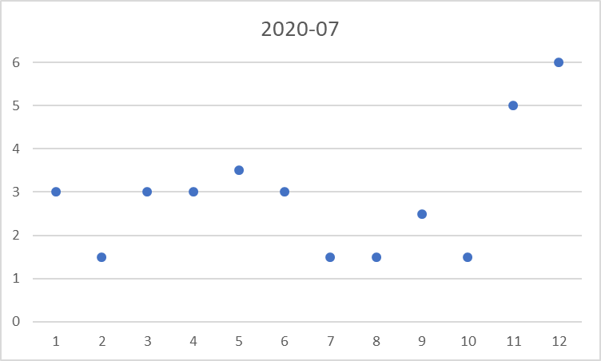
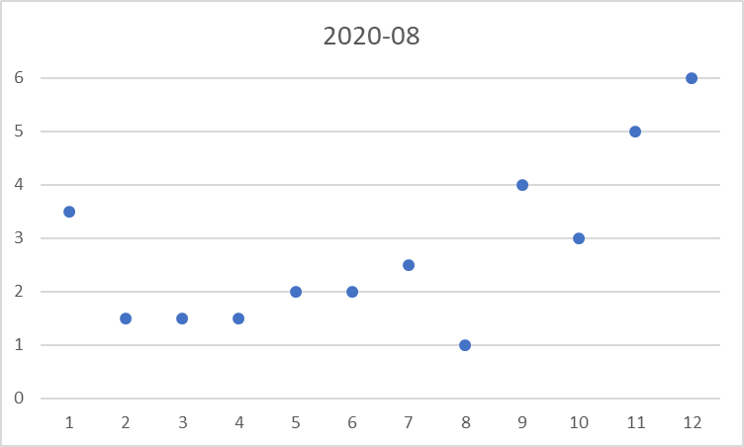
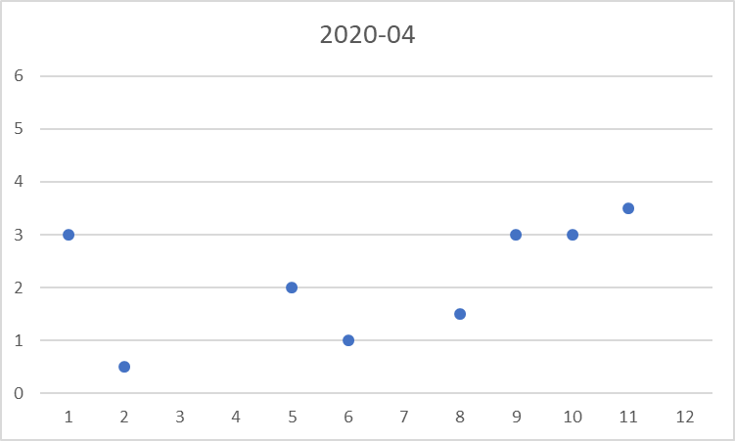
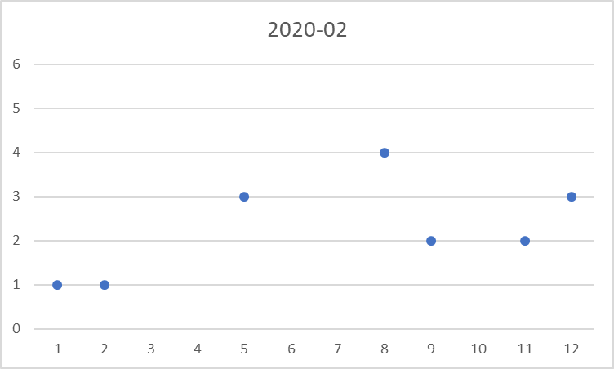
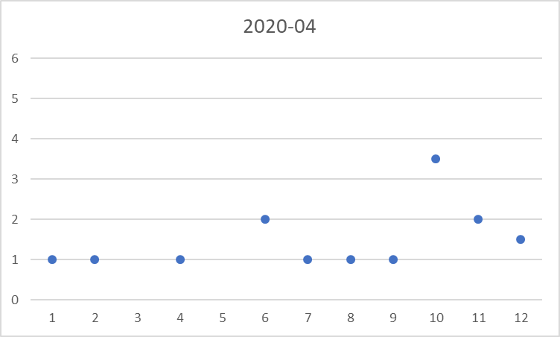
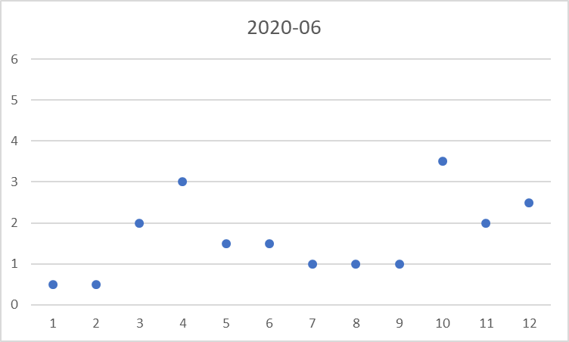
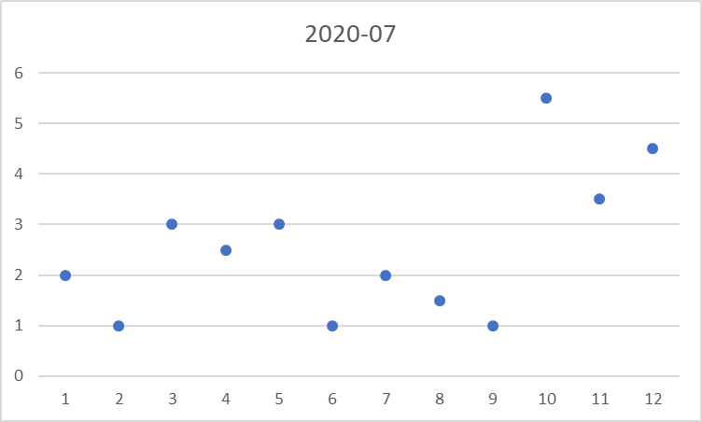
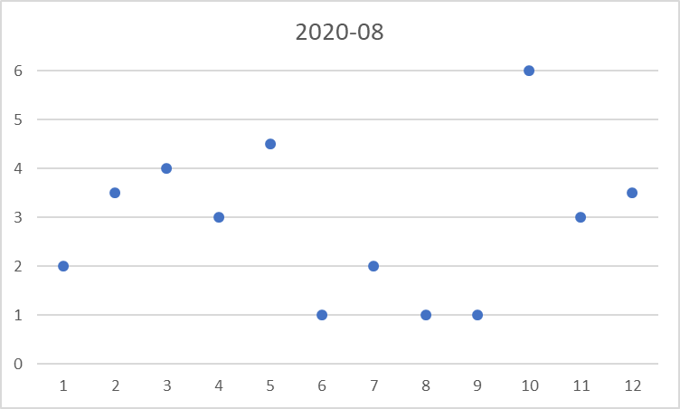
Results Thus Far: PhotoMonitoring
Mainstem
Tributaries
Deep Gulch (Rehab)
Mainstem @ Carville
Chapman (Rehab)
Lowden/Bucktail
Deadwood Creek
Above Weaver
Lewiston Dam
Weaver Creek
Browns Creek
Pigeon Point
Steelbridge
Canyon Creek
Indian Creek
Rush Creek
Stewarts Fork
Swift Creek
Pear Tree
Evens Bar
Weir Pool
North Fork
East Fork
Lorenz
Lewiston
GVC

Slide 10
Results Thus Far: Biodiversity
Microcystis
Filamentous Algae:
Bulbochaete
Cladophora
Desmidium
Microspora
Mougeotia
Oedegonium
Spirogyra (several spp.)
Stigeoclonium
Tribonema
Ulothrix
Vaucheria
Zygnema
6 more morphotypes
Diatoms:
Cocconeis
Cymbella
Didymosphenia
Encyonema?
Epithemia
Fragilaria
Nitzschia sigmoidea
Rhoicosphenia
Rhopaloidia
Tabellaria
20+ more morphotypes
Cyanobacteria:
Microcystis
Nostoc parmelioides
Oscillatoria
Tolypothrix
> 50 taxa

Slide 11
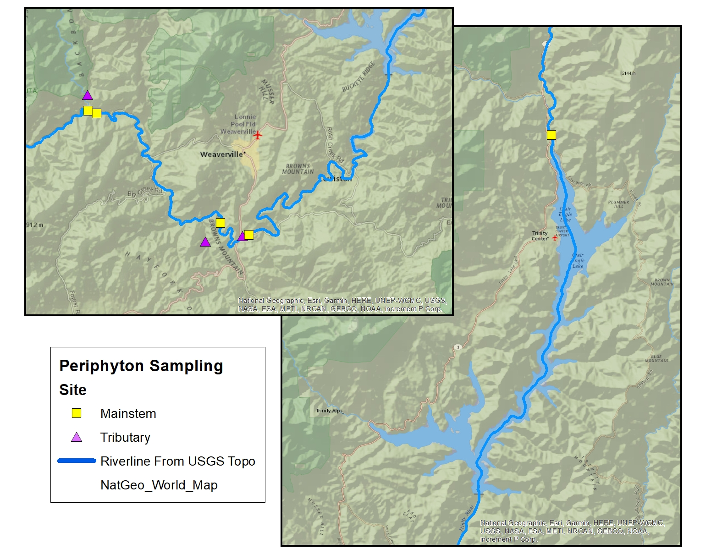
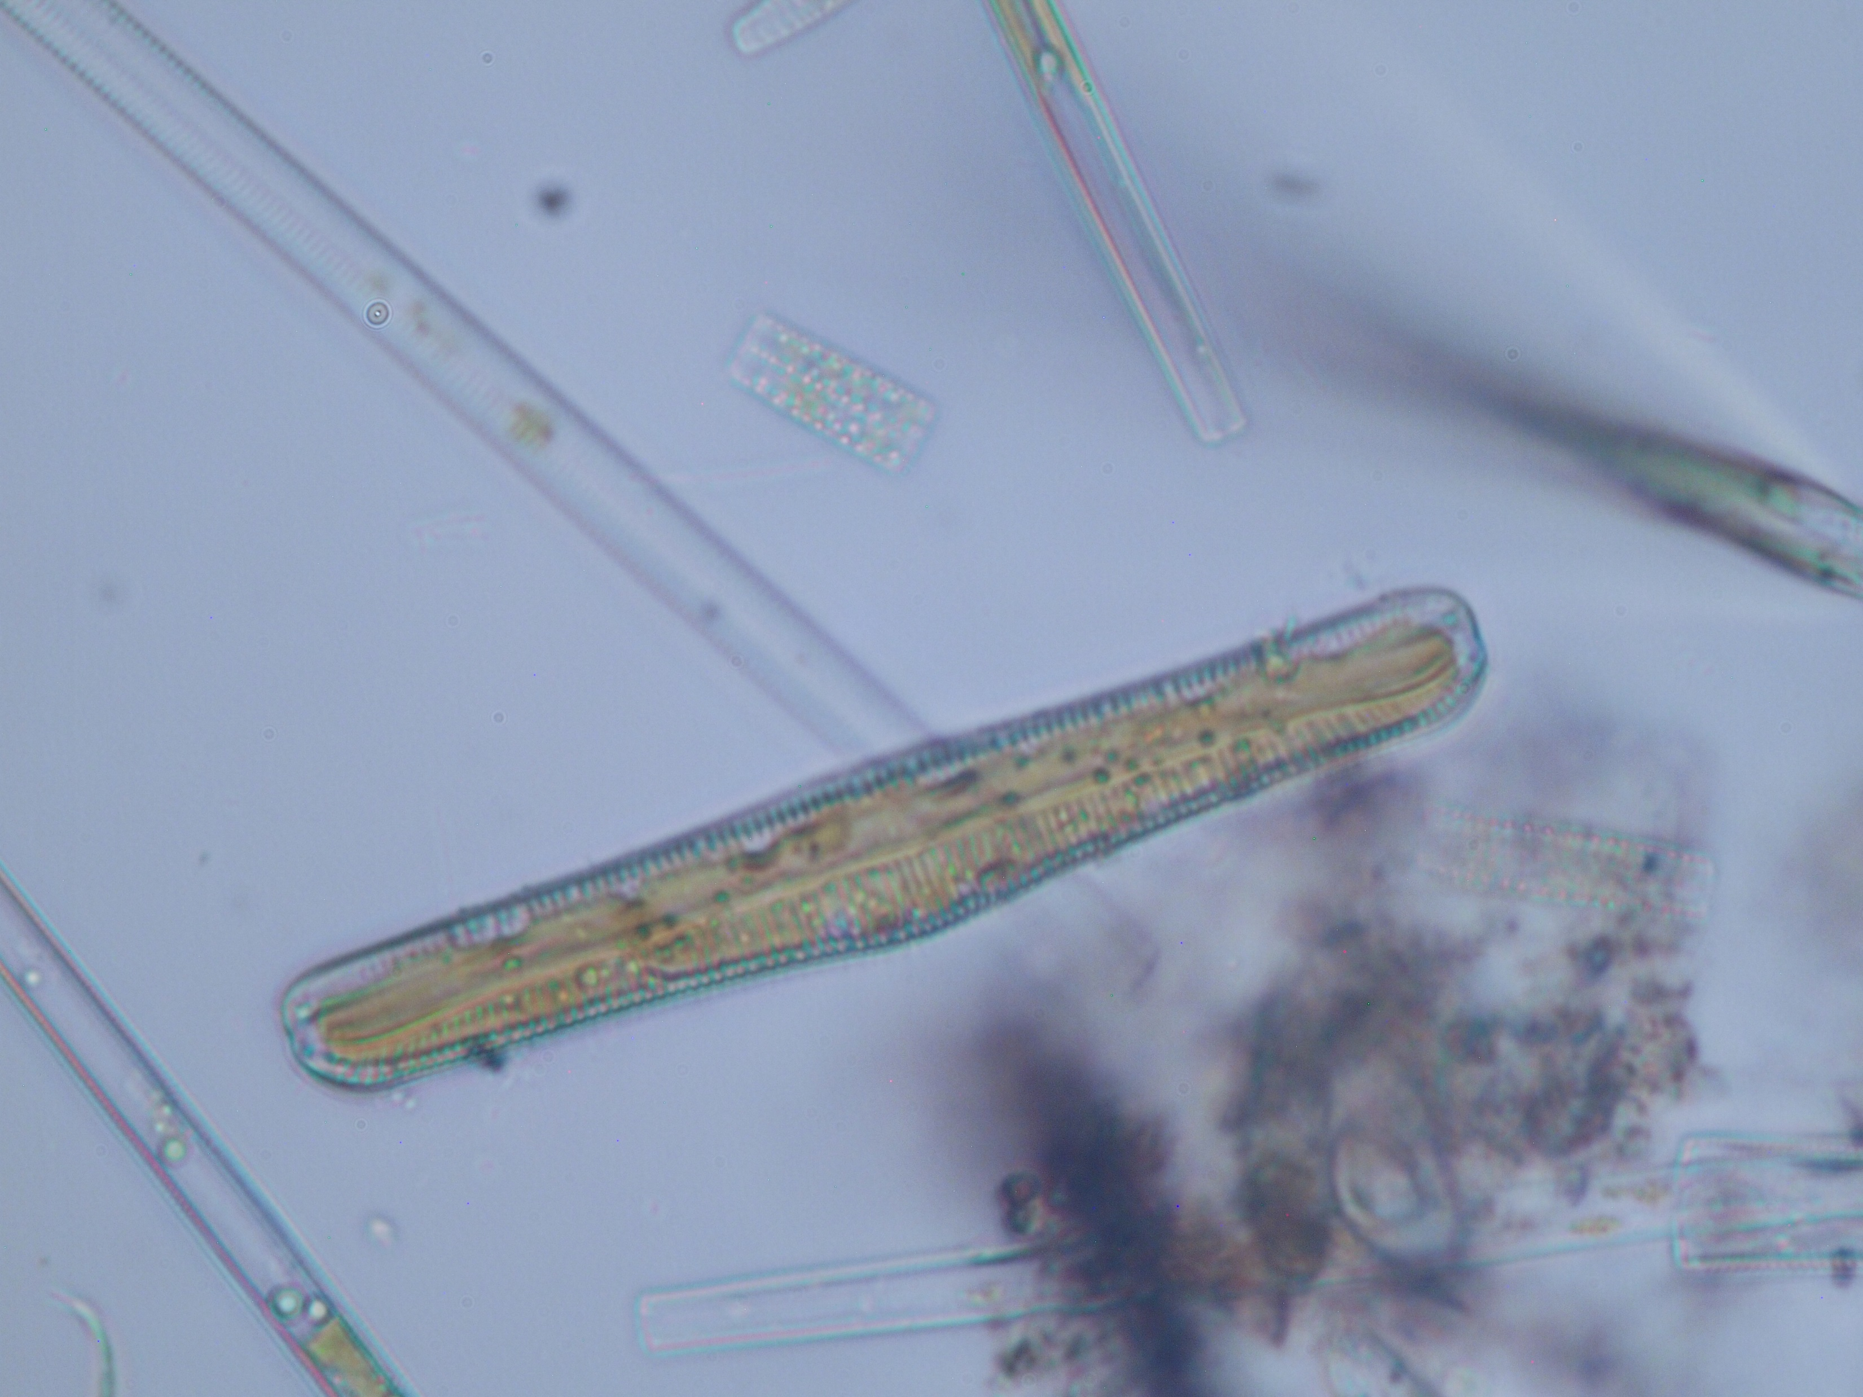
Diversity
Patterns:
Rhodopaloidia

Slide 12

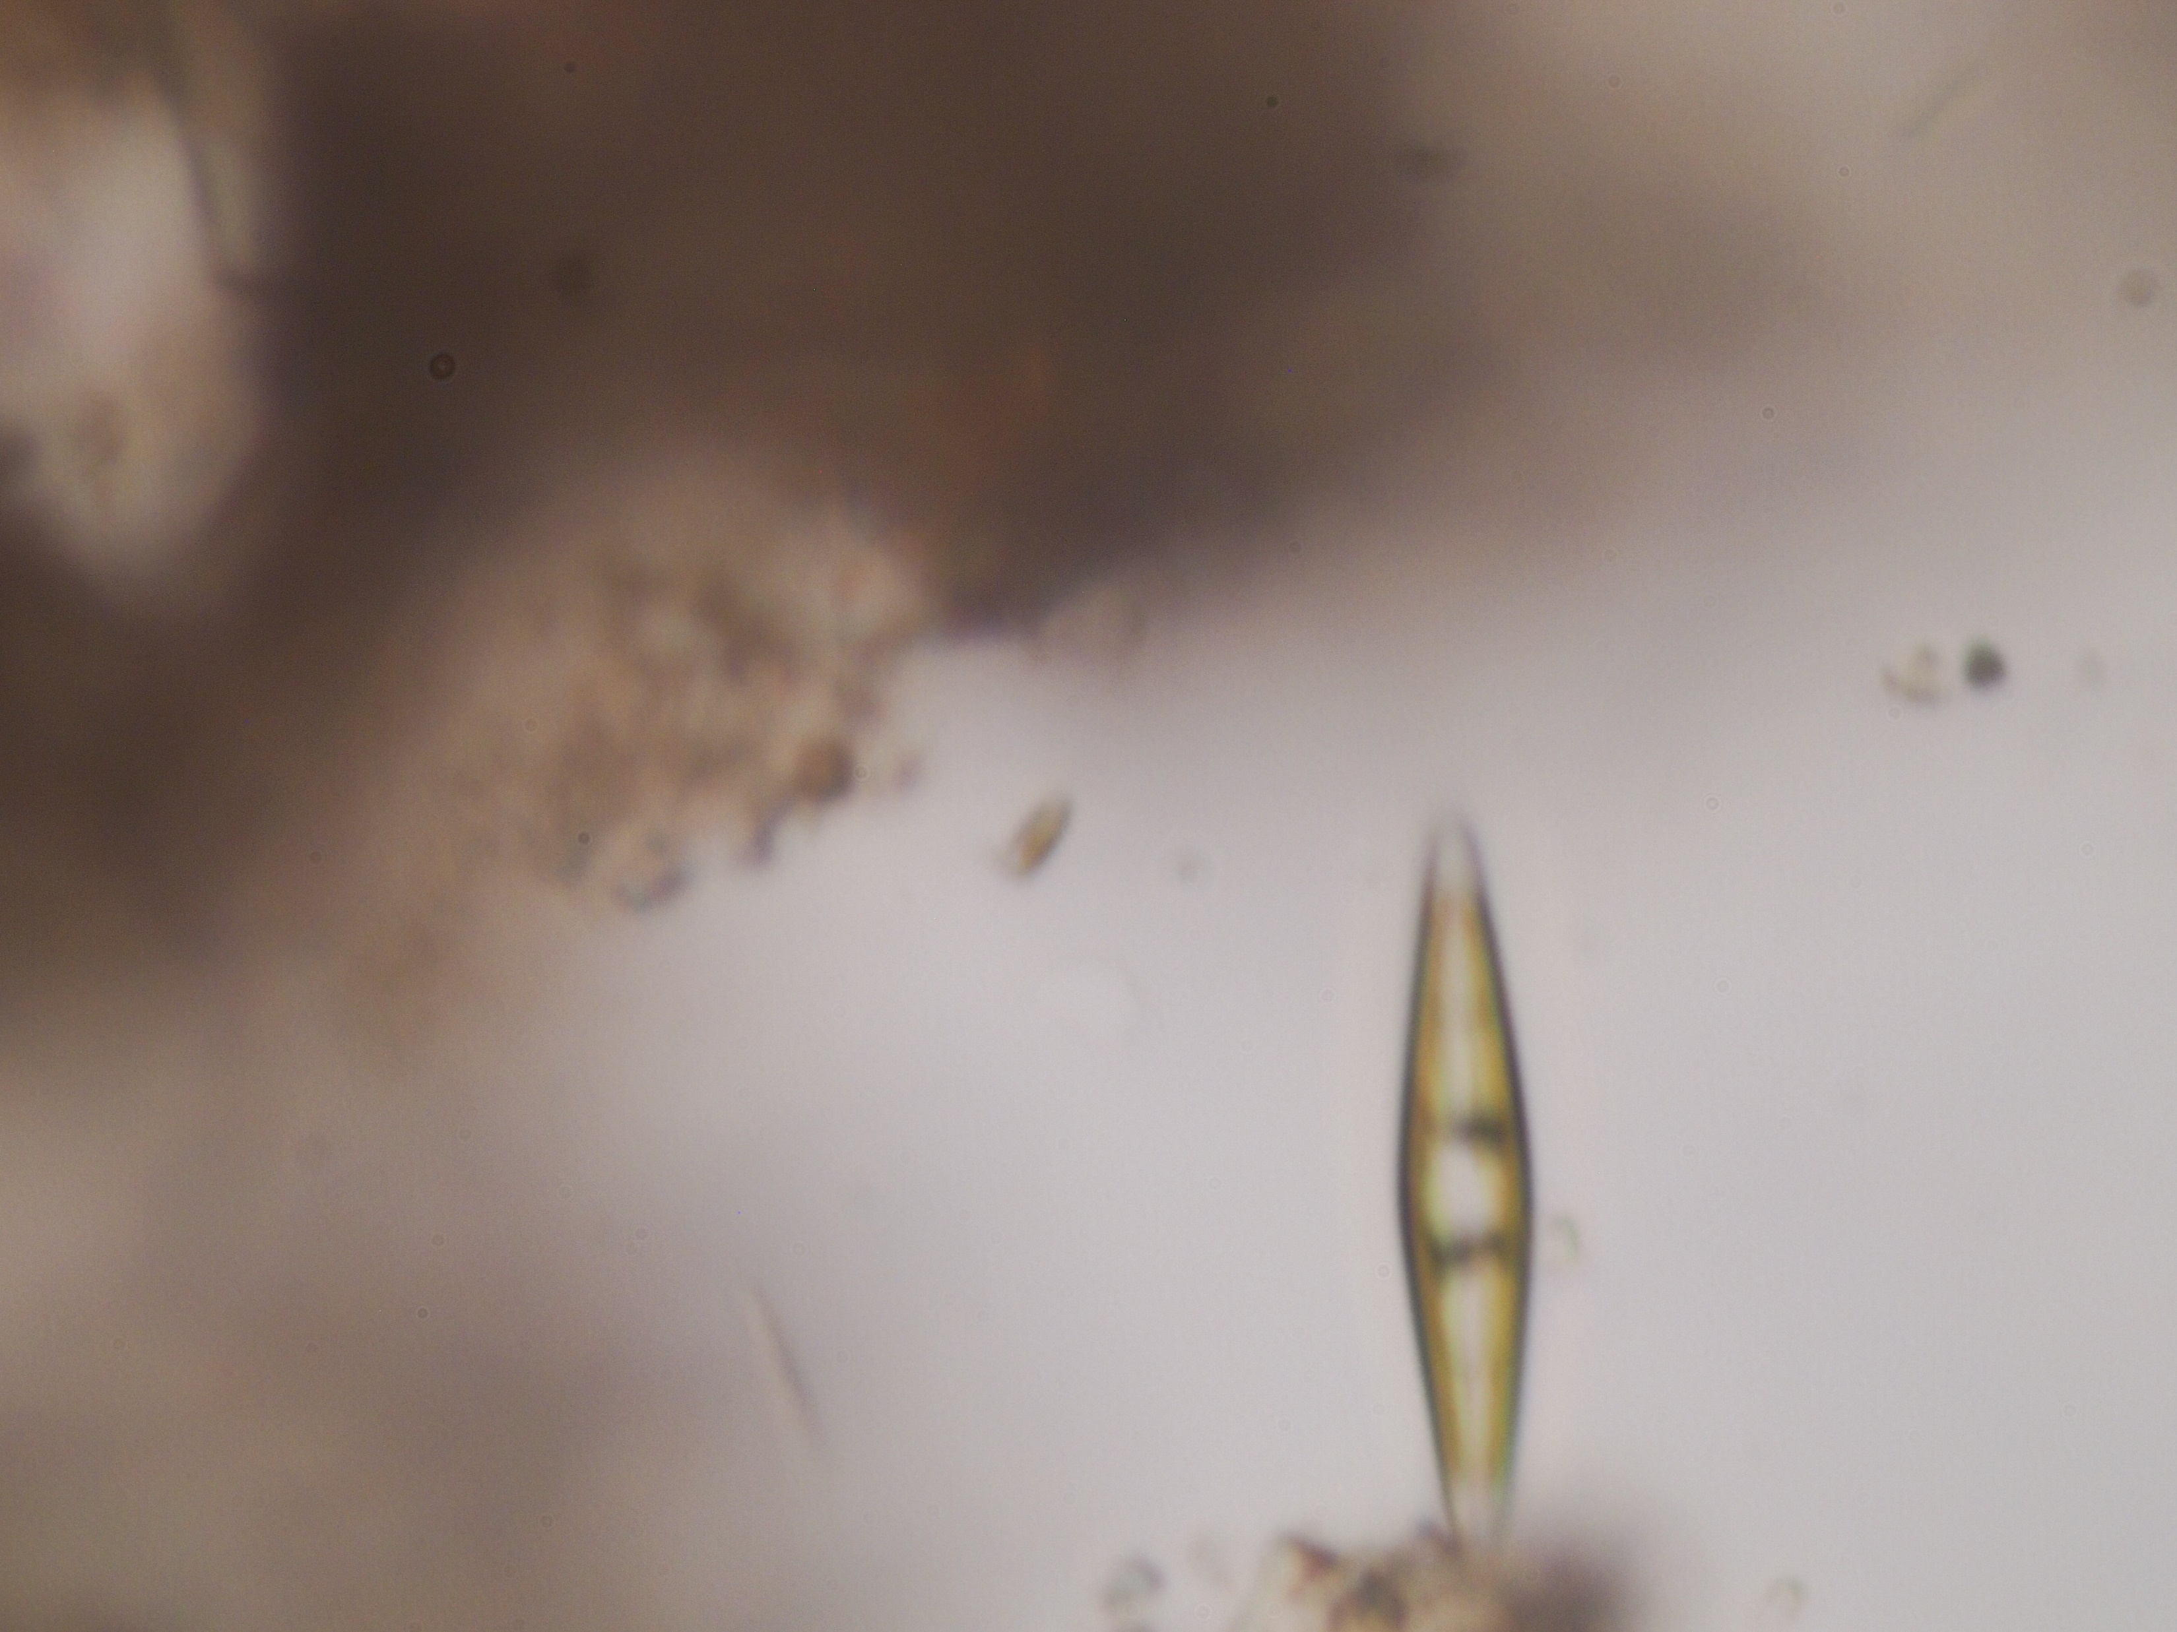
Diversity
Patterns:
ID pending

Slide 13

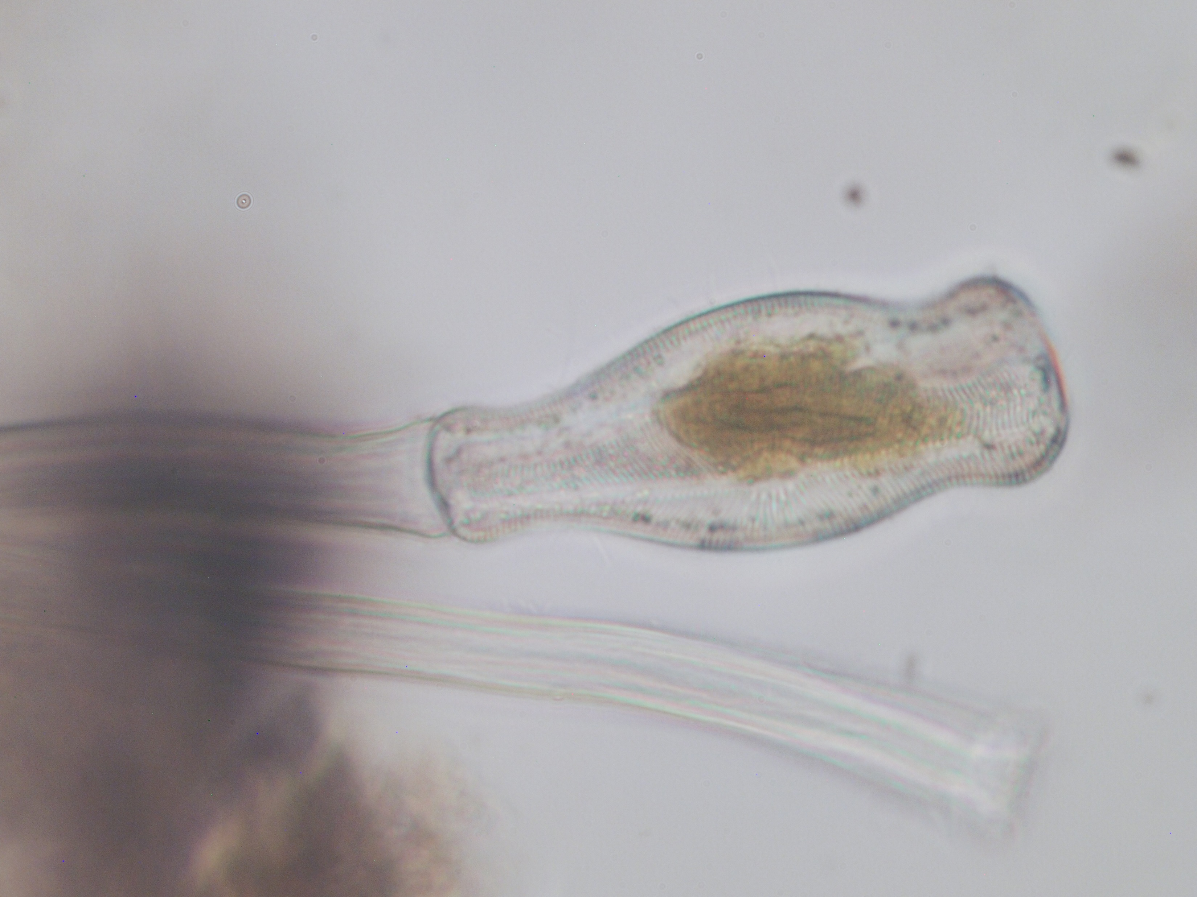
Diversity
Patterns:
Didymosphenia
(Rock Snot)
February 2020

Slide 14
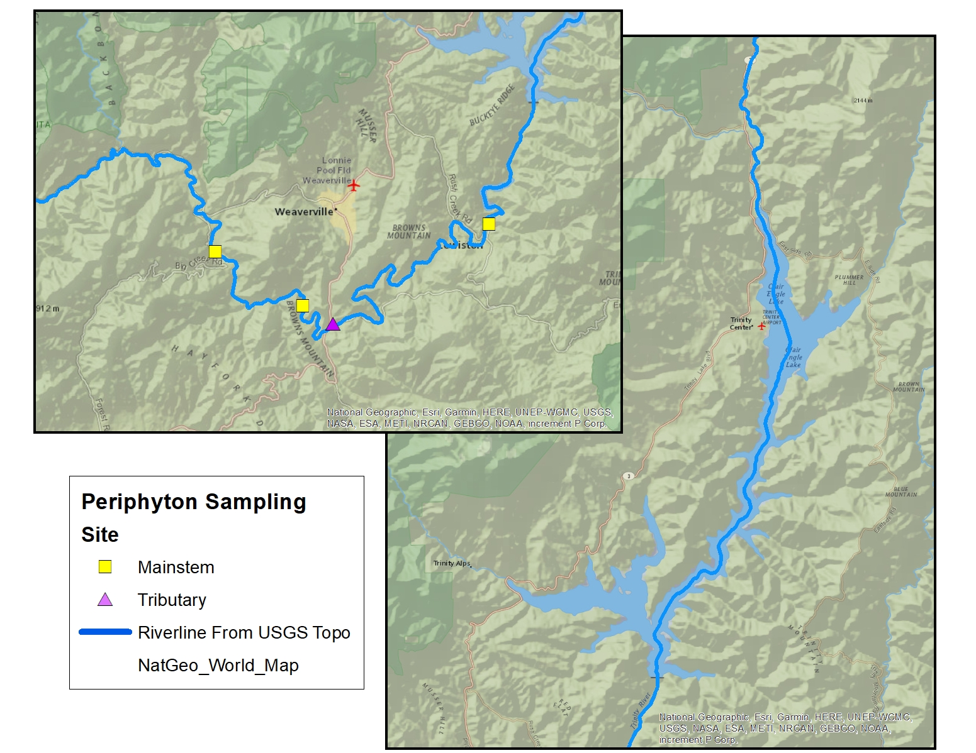
Diversity
Patterns:
Didymosphenia
(Rock Snot)
August 2020

Slide 15
Next Steps
Investigation Plan has been shared with the Riparian Aquatic Ecology Work Group
Intend to continue sampling for 3 years to capture interannual variation
Intend to write a small report on the 1st year of sampling
  Similar content and analysis level to this presentation
Intend to write a full report after the 3rd year of sampling.
  Thorough statistical analyses for patterns of growth over geography and time, plus community analysis of diversity and species assemblages.
  Will include literature review of indicator species and application to patterns on the Trinity.

