Slide 1
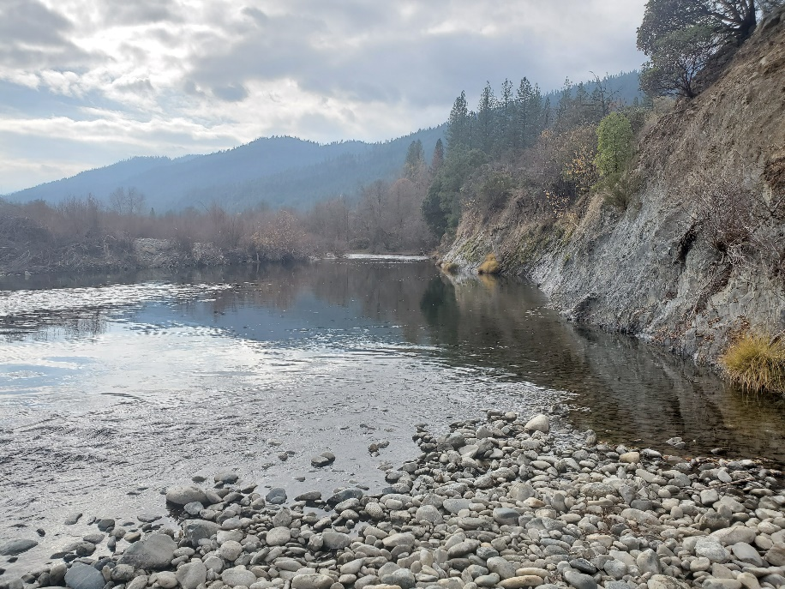

Upper Conner Creek Design Update
RIG Design Team Meeting
Hoopa Valley Tribe Design Team
September 1, 2020

Slide 2
Outline
Site Location
Status Summary
Meander Alternative
Stage-0 Alternative
Off-Channel Alternative
Next Steps
Notes:
Site Location – Discuss location relative to Junction City, river mileage and other existing projects. Show both Large view map and aerial imagery of site
Current vs. Proposed ESL – Show team the existing 2007 existing UCC ESL and our new proposed ESL for the project. Use parcel map so it will lead into next slide
Land Ownership, Mining Claim, Recreation – Work from parcel map and mining claim map. BLM and private – provide percentages and acreage. Fade to parcel map with mining claim include, river mileage it covers, owners names. For recreation use public access figure. Discuss boat launch and need to retain access through the project
Existing infrastructure – CAD figure, photos of riprap, bank abutments, culverts, etc.
Geotechnical – Show proposed test pit location map
Geomorphic – substrate figures showing bedrock, bedrock photos, XS figures, Parameters (compare to CDG)
Hydrology – show updated FDCs rearing time. Discuss flows and potential design flows.
Existing Condition HM – Begin with Model development (terrain generation, data collection, etc.), brief talk on calibration (show figures and stats), results from hydraulic model
Veg – EC Veg Map, Save Tree/Sensitive communities, Non-native figure
Fisheries – Redd Map, Carry Capacity Figure , Holding Habitat analysis
Herp – FYLF figure, turtle observations
Next Steps – draft conceptual designs and development design alternatives, draft 30% design and design report

Slide 3
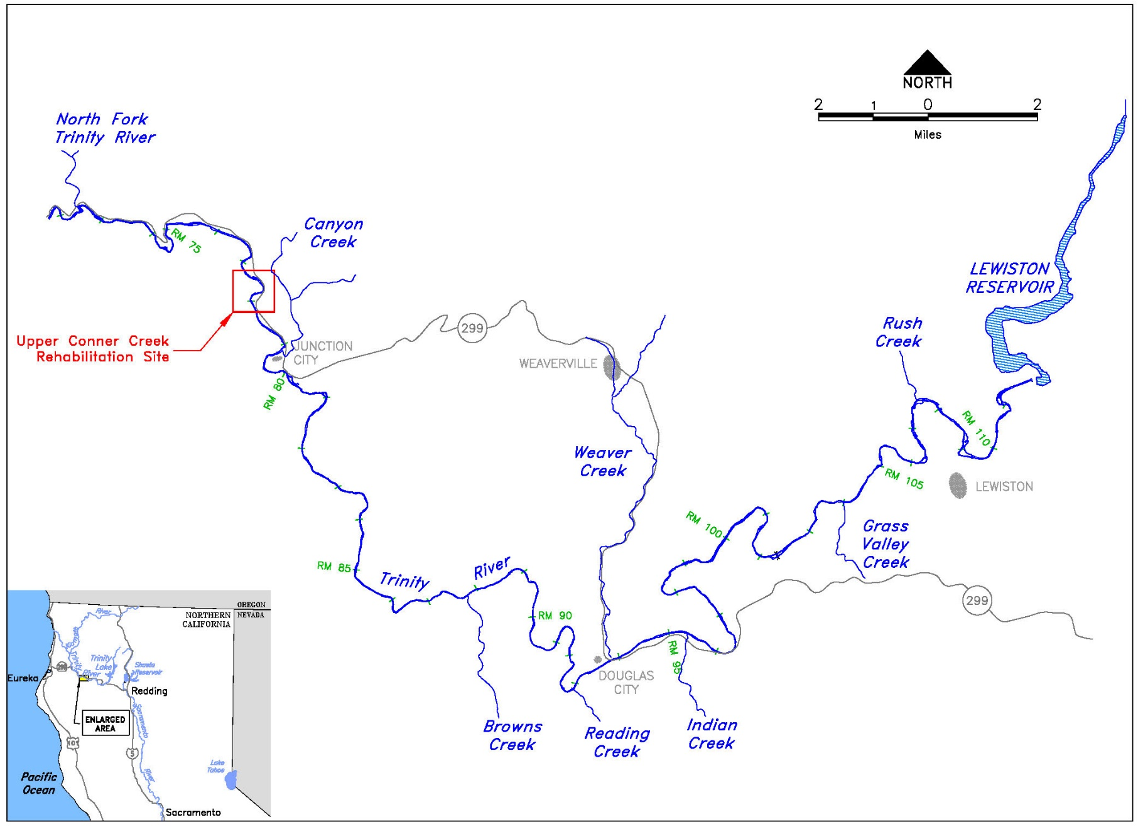
Site Location

Slide 4
Status Summary
Completed data collection to update topography at dynamic bars and mapped current large woody debris distribution.
Developed Existing Conditions Report for the project site.
Addressed and incorporated comments and edits from the Design Workgroup to existing conditions report.
Completed conceptual design ideas and narrative developed by the Hoopa Design Team.
Presented concepts and submitted to Design Workgroup for comment.
Developed three proposed alternatives using elements from conceptual designs.
Notes:
Site Location – Discuss location relative to Junction City, river mileage and other existing projects. Show both Large view map and aerial imagery of site
Current vs. Proposed ESL – Show team the existing 2007 existing UCC ESL and our new proposed ESL for the project. Use parcel map so it will lead into next slide
Land Ownership, Mining Claim, Recreation – Work from parcel map and mining claim map. BLM and private – provide percentages and acreage. Fade to parcel map with mining claim include, river mileage it covers, owners names. For recreation use public access figure. Discuss boat launch and need to retain access through the project
Existing infrastructure – CAD figure, photos of riprap, bank abutments, culverts, etc.
Geotechnical – Show proposed test pit location map
Geomorphic – substrate figures showing bedrock, bedrock photos, XS figures, Parameters (compare to CDG)
Hydrology – show updated FDCs rearing time. Discuss flows and potential design flows.
Existing Condition HM – Begin with Model development (terrain generation, data collection, etc.), brief talk on calibration (show figures and stats), results from hydraulic model
Veg – EC Veg Map, Save Tree/Sensitive communities, Non-native figure
Fisheries – Redd Map, Carry Capacity Figure , Holding Habitat analysis
Herp – FYLF figure, turtle observations
Next Steps – draft conceptual designs and development design alternatives, draft 30% design and design report

Slide 5
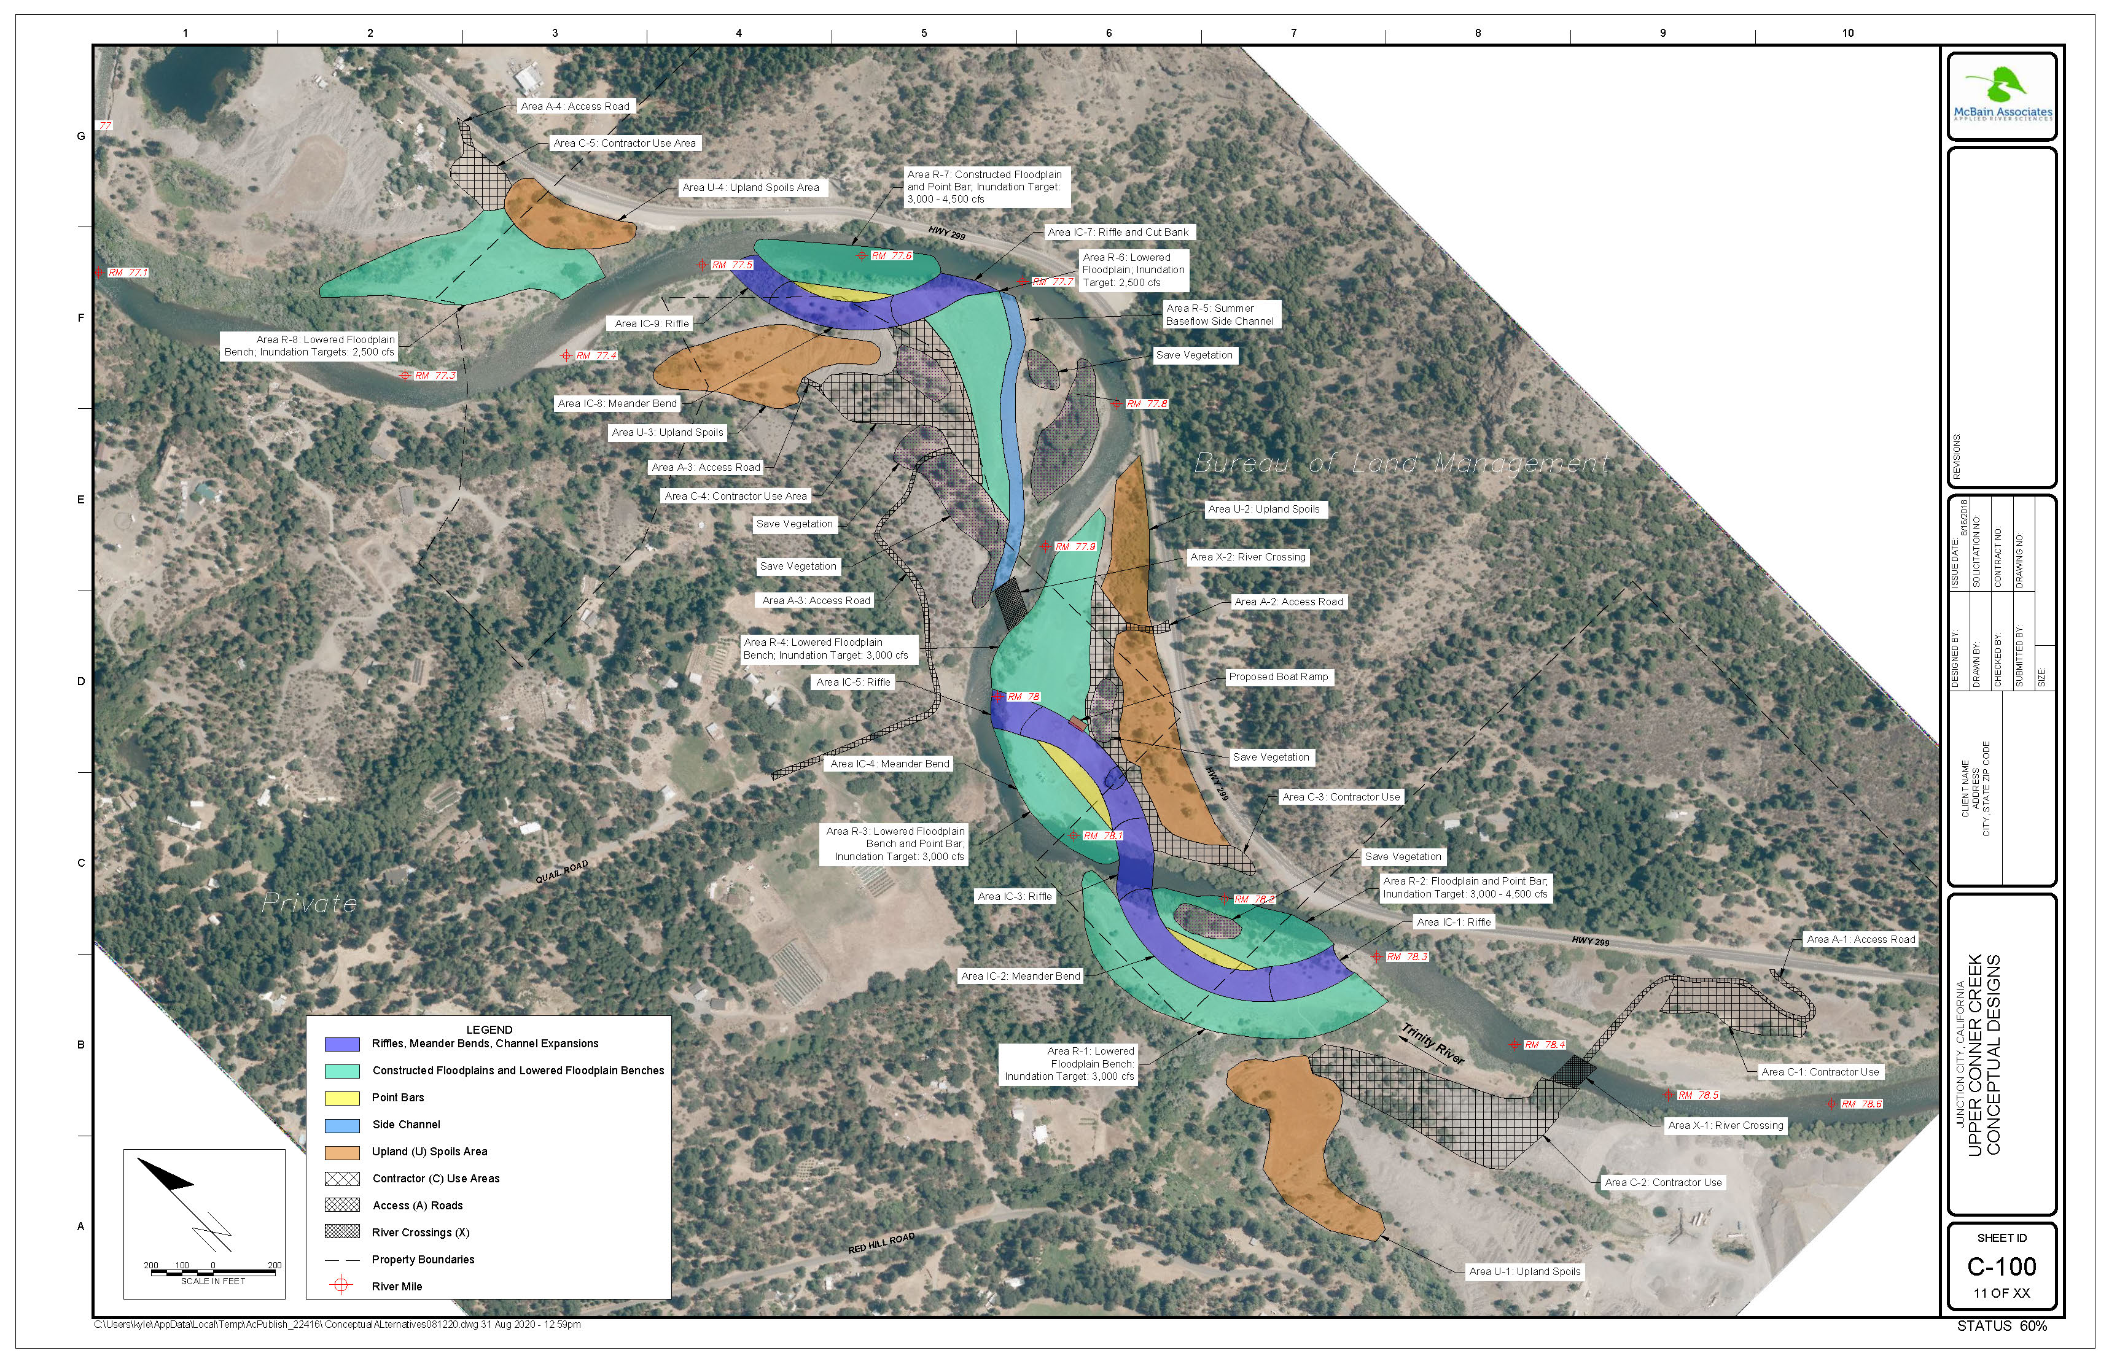
Meander Alternative
Notes:
Site Location – Discuss location relative to Junction City, river mileage and other existing projects. Show both Large view map and aerial imagery of site
Current vs. Proposed ESL – Show team the existing 2007 existing UCC ESL and our new proposed ESL for the project. Use parcel map so it will lead into next slide
Land Ownership, Mining Claim, Recreation – Work from parcel map and mining claim map. BLM and private – provide percentages and acreage. Fade to parcel map with mining claim include, river mileage it covers, owners names. For recreation use public access figure. Discuss boat launch and need to retain access through the project
Existing infrastructure – CAD figure, photos of riprap, bank abutments, culverts, etc.
Geotechnical – Show proposed test pit location map
Geomorphic – substrate figures showing bedrock, bedrock photos, XS figures, Parameters (compare to CDG)
Hydrology – show updated FDCs rearing time. Discuss flows and potential design flows.
Existing Condition HM – Begin with Model development (terrain generation, data collection, etc.), brief talk on calibration (show figures and stats), results from hydraulic model
Veg – EC Veg Map, Save Tree/Sensitive communities, Non-native figure
Fisheries – Redd Map, Carry Capacity Figure , Holding Habitat analysis
Herp – FYLF figure, turtle observations
Next Steps – draft conceptual designs and development design alternatives, draft 30% design and design report

Slide 6
Meander Alternative
The “Meander” Alternative applies concepts implemented as part of Chapman Ranch Phase A by creating a new meandering planform through the Upper Conner Creek project.
The legacy mainstem channel would be filled to create floodplains with point bars along the new mainstem. The old mainstem would become low flow side channel habitat.
The floodplain on river left between RM77.9 and RM 77.7 would be lowered. A side channel that conveys approximately 15% of the summer baseflow would be constructed through this lowered floodplain.
Constructed floodplains will have inundation targets of 2,500 cfs to 3,500 cfs to better meet riparian objectives.
Mining tailings will be used for upland spoil areas.

Slide 7
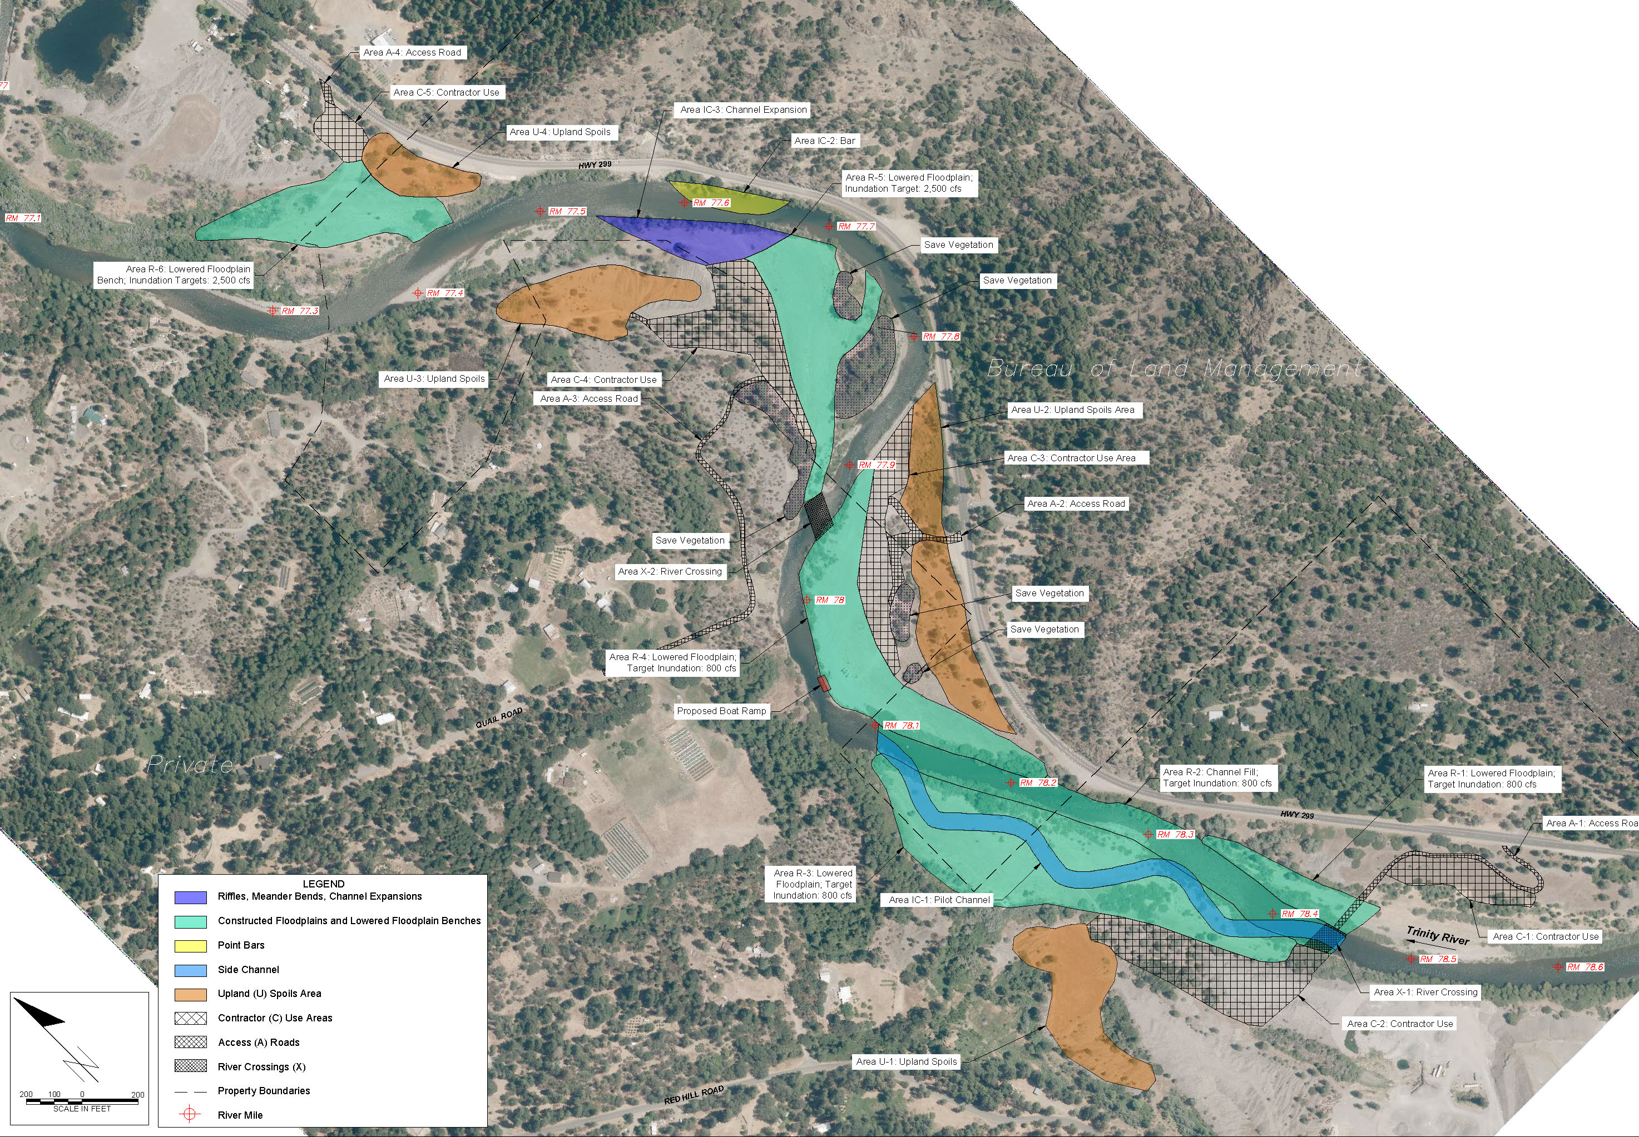
Stage-0 Alternative

Slide 8
Stage-0 Alternative
The “Stage-0” Alternative applies the Stage-0 restoration methodology in the upstream portion of the Upper Conner Creek project site (including the downstream left bank of the original Hocker Flat ESL).
The upstream floodplain on river left and right would be lowered while the mainstem channel is filled so that the mainstem channel and floodplain inundate at the same flow. A pilot channel will be excavated to maintain navigation.
Minor topographical variations and large wood features and plantings would be included in this area to encourage complex flow pathways.
In the downstream portion of the project site, a point bar and channel expansion would be constructed at RM 77.6 to promote river migration into the left bank floodplain.
Downstream constructed floodplains will have inundation targets of 2,500 cfs to 3,500 cfs to better meet riparian objectives.

Slide 9
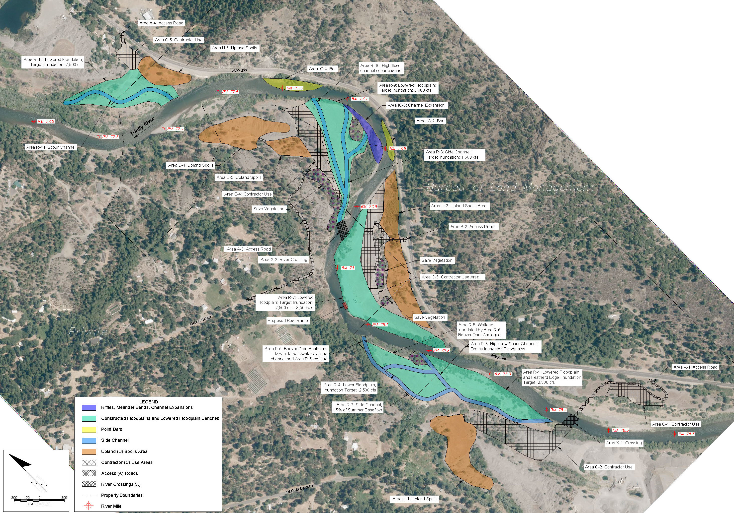
Off-channel Alternative

Slide 10
Off-channel Alternative
The Off-channel Alternative looks at potential design features that do not require changing the planform of the mainstem river. The design includes lowered floodplains, constructed side channels and scour channels, and a Beaver Dam Analogue (BDA) to backwater an existing drainage.
A side channel would be excavated through the abandoned floodplain on river left between RM 78.4 and RM 78.1. The rest of the floodplain will be lowered to inundate at 2,500 cfs. Scour channels will be constructed to help with drainage of the floodplain into the side channel and mainstem.
A BDA would be added at the downstream end of the side channel to backwater an existing drainage and maintain a constructed wetland feature at the downstream end of the abandoned floodplain.
Side channels and scour channels would be included in the downstream lowered floodplains to create hydraulic complexity and juvenile habitat.
Point bars would be constructed at RM77.8 and RM 77.6 to move mainstem away from Highway 299 and encourage migration towards the left bank.

Slide 11
Next Steps
Complete conceptual design report (in progress).
  Conduct metrics analysis on three conceptual alternatives and select an alternative.
Send out Design Workgroup for review.
Receive comments from the Design Workgroup.
Finalize Conceptual Design Report and selection of one alternative based on comments.
Based on alternative selected, develop 30% design, Supporting analyses and report.

