Slide 1
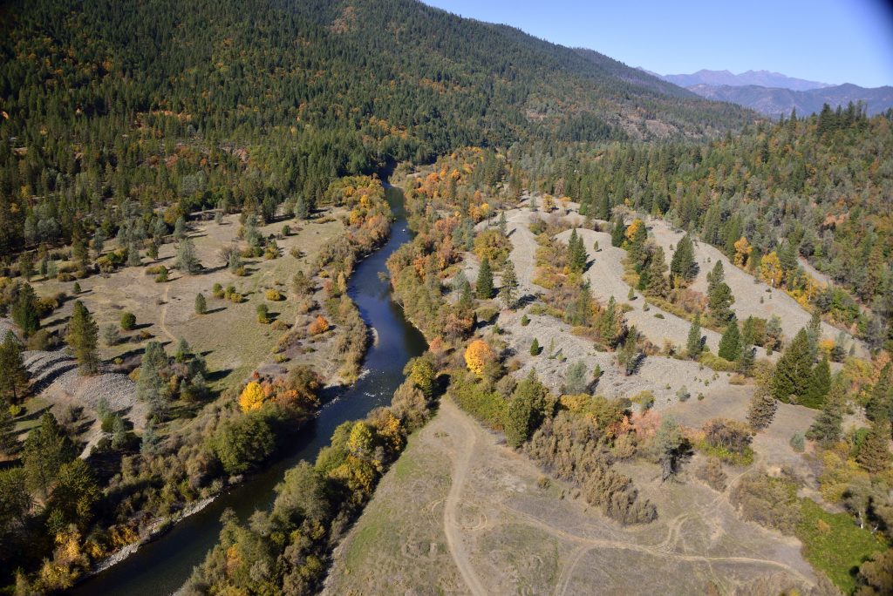
Biological Opinion for the Trinity River Restoration Program’s Mechanical Channel Rehabilitation, Sediment Management, Watershed Restoration, and Monitoring Actions in Trinity County, California
Presented By: Roman Pittman
NMFS

Slide 2
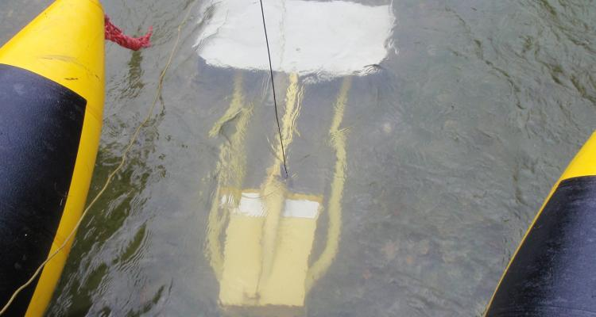
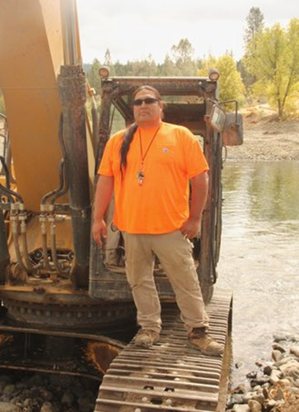
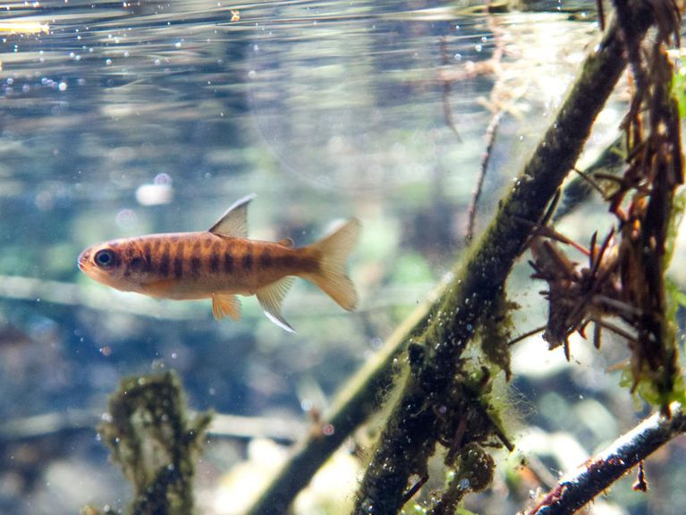
Overview…
Why new consultation was needed
Participating Agencies
Description of covered activities
Process for inclusion of restoration projects
Sideboards
Benefits of Programmatic Consultation
Questions

Slide 3
Why consultation was reinitiated:
NMFS’ original Biological Opinion (2000) provided ESA coverage for restoration activities and techniques which were in use at the time.
Techniques and project design have evolved. Adoption of new techniques constitutes a modification to the original action and the need for re-initiation of consultation.

Slide 4
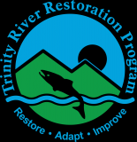
Agencies covered by the TRRP BiOp:
The Bureau of Reclamation (Reclamation) is the lead federal agency and proposes to fund, implement, or facilitate restoration activities in the Trinity River watershed and monitoring and research activities in the Trinity and lower Klamath basins under the Trinity River Restoration Program (TRRP).
Participating agencies may also implement, fund, and/or permit restoration, monitoring, and/or research activities in the Trinity and lower Klamath basins.
Participating agencies include: USFWS, BLM, Corps, USFS (Shasta Trinity NF)

Slide 5
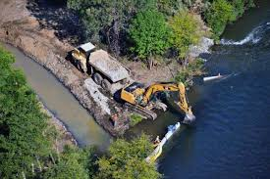
Restoration Activities
Channel Rehabilitation
Heavy equipment in the channel, channel excavation, and grading of floodplains.
Engineered log jams, side channels, alcoves, and hard points and boulders to direct scour.
Riparian vegetation may be removed to access sites or facilitate floodplain grading.
Low flow channel crossings

Slide 6
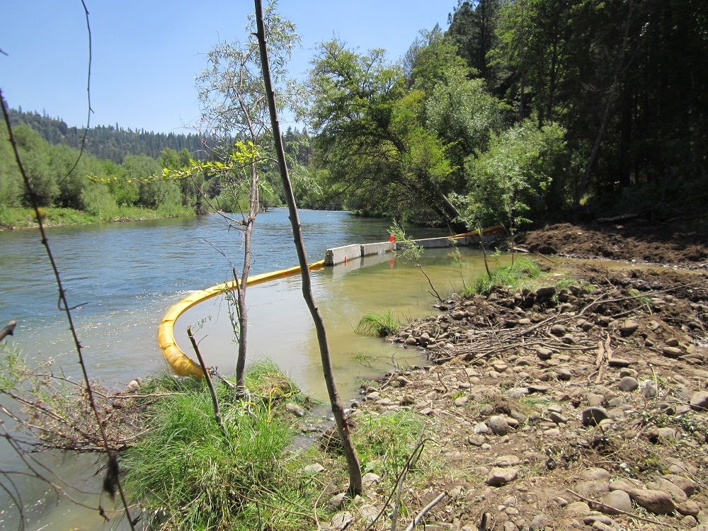
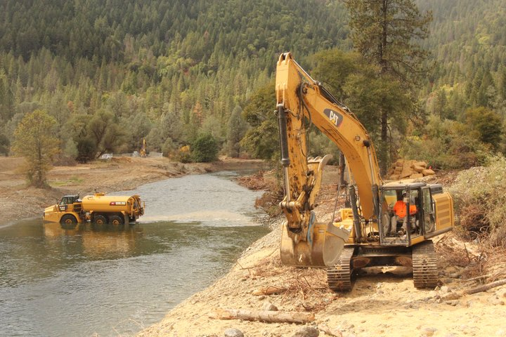
Channel Rehabilitation
Extended in-water work periods, pile-driving for structured log jams (SLJ) installation, alternate point bars, and beaver dam analogues.
Site restoration and revegetation post construction
Bedrock fracturing may involve use of jack hammers or expanding grout.
May require isolation from flowing water and/or dewatering with fish relocation

Slide 7
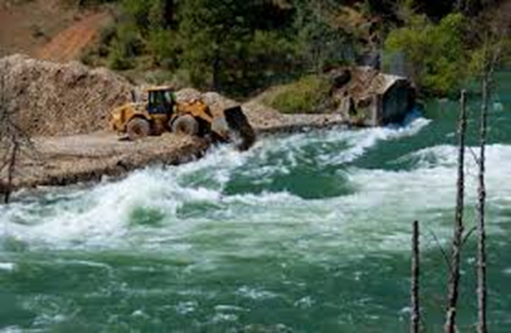
Fine and Coarse Sediment Management
Dredging of sediment retention ponds (Hamilton) and coarse/fine sediment augmentation
Bank stabilization measures including upslope erosion control activities to in-stream structures
Five locations for coarse sediment augmentation upstream of Indian Creek at (and additional sites under consideration).
Gravel injection may occur at low flow in shallow, backwater areas.

Slide 8
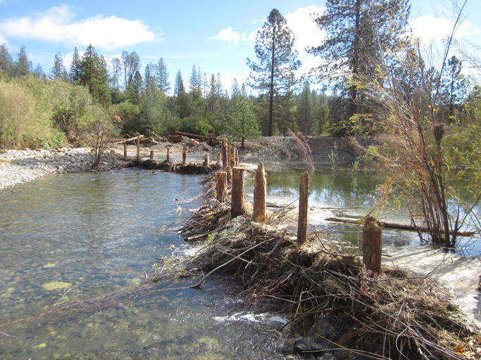
Watershed Restoration
Improving fish passage: culvert upgrades and small dam removal (Manzanita Creek Dam, East Weaver Creek Dam removal, Oregon Gulch Culvert)
Instream habitat restoration: LWD and boulder placement (including helicopter), channel and floodplain construction on tribs
In-stream flow restoration: water conservation education; monitoring to determine low flow thresholds; and designing and implementing efficient water conservation systems.
Road rehabilitation, culvert replacement, decom, and regrading
Beaver Dam Analogues
Stage Zero
Revegetation projects

Slide 9
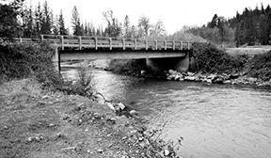
Infrastructure Modification
Bridge replacement and the Well Grant Program to mitigate for adverse effects of restoration flows on private riverside landowner’s water supplies.

Slide 10
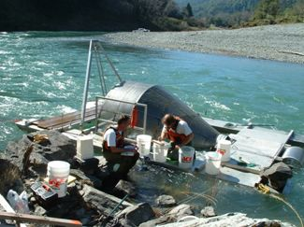
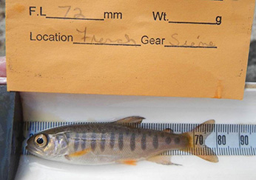
Fish monitoring and research
There are currently five studies to monitor restoration effectiveness:
Trinity River, Willow Creek and Pear Tree Trapping Sites.
Restoration site surveys (snorkel/dive).
Annual redd and carcass surveys in the mainstem Trinity River and tribs
PIT study to determine the overwintering strategy of Trinity River coho and extent of juvenile coho salmon site use.
Snorkel surveys and trapping (fyke, minnow, and seine nets) in the Trinity River and tribs to determine presence/ abundance (may include electrofishing).

Slide 11
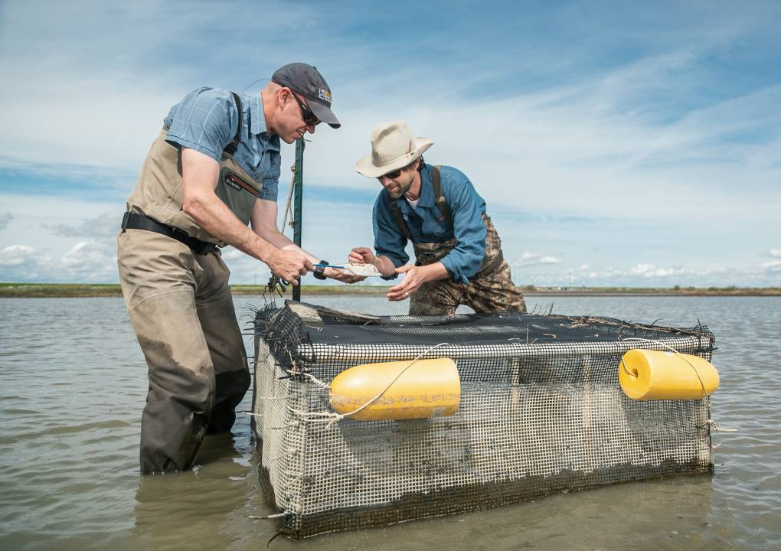
Fish monitoring and research
Additional Studies:
Mark-recapture projects to determine the relationship between flow release and outmigration timing by juvenile salmonids and to establish a causal link between outmigration timing and juvenile survival (PIT tagging at screw traps)
Effects of engineered side channel habitat on growth rate of juvenile salmonids. Juvenile Chinook salmon will be paced in paired cages in the mainstem and side channels and later collected via netting or electrofishing (Ken Lindke CDFW)

Slide 12
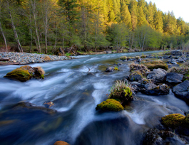
Sideboards
Annual project limits are expected to prevent cumulative impacts to water quality (sediment, turbidity, and water temperatures) and fish in the watershed.
Max of 4 mainstem channel restoration projects per year
Up to 6 locations per year for coarse gravel augmentation. Up to 8,000 cy mobile gravel may be added in a single year.
Dredging Hamilton ponds once every 5 years.
Six restoration monitoring and effectiveness studies/ year.
One bridge replacement annually.

Slide 13
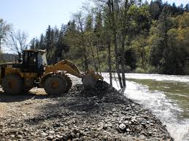
Sideboards (annual limits)
2 Fish Passage/Dam removal projects
8 Channel/floodplain rehabilitation projects (4 mainstem and 4 tributary)
2 In-stream habitat enhancement projects
3 Streambank stabilization projects
4 Road related projects per year with in-water activities (i.e. de-commissioning with culvert removal).

Slide 14
Instream Bank Stabilization
Industry-accepted bio-engineering design guidance: (CDFW 2010) or Washington State Aquatic Habitat Guidelines Program: Integrated Streambank Protection Guidelines (Cramer et al. 2003).
The maximum linear length shall not exceed 3X the active channel width at the site.
Retain natural vegetation, large wood, and permeable soils, limit compaction, and minimize the extent and duration of earthwork
Projects constructed during the same field season must be separated longitudinally (i.e., upstream and downstream) by at least 350 m.

Slide 15
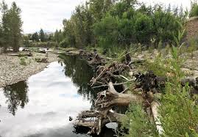
Instream Bank Stabilization
The following activities are not covered under this programmatic opinion:
Constriction of existing channel capacity.
Riprap that extends rock above the streambank toe.
Riprap that extends laterally into an area that was not previously revetted, if working on a previously hardened streambank stabilization site.
Riprap that does not include adequate vegetation and LWD.
Displacement of riparian or aquatic habitats (including submerged aquatic vegetation)
Wing deflectors, stream barbs, or channel-spanning structures including weirs.

Slide 16
Adoption of Restoration Projects
TRRP may adopt restoration actions that are not funded or implemented by TRRP or the participating federal agencies as long as they are consistent with the TRRP BA and Programmatic BO, including project limits and the amount or extent of incidental take.
Remaining project allocation and incidental take exemption may be used by participating federal agencies
Coordination among participating agencies is required to ensure that the prospective projects are consistent with the BO, and that project limits and amount or take are not exceeded.
The TRRP will be the lead in presenting to NMFS which projects are being proposed for inclusion into the TRRP Programmatic BO.

Slide 17
Process for Inclusion of Restoration Projects
Notification:
“No effect” and NLAA do not require notification to NMFS prior to implementation but NLAA will require tracking and reporting.
LAA projects will require notification prior to construction. Reported projects would include:
Fish handling or potential for harm (e.g., displacement, etc.)
Significant sediment delivery or turbidity, temporary change in flow, or species disturbance, if the changes to habitat or disturbance to species cannot be discounted (i.e., determined to be at the likely to adversely affect level) and the project results in a long term benefit to aquatic ecosystems.

Slide 18
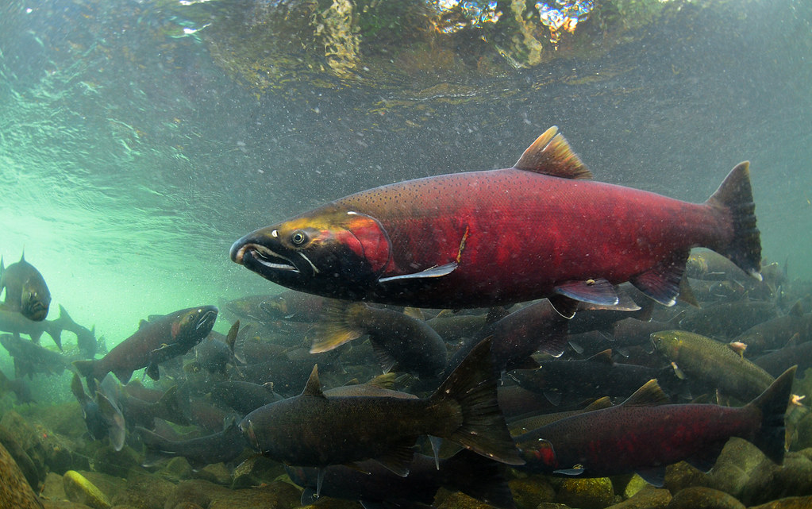
Process for Inclusion of Restoration Projects
Reported projects (continued):
Full spanning structures or engineered projects in habitat occupied by listed species.
Any projects proposing extensions to the work window.
Projects that involve streambank stabilization or in-channel excavation.

Slide 19
Process for Inclusion of Restoration Projects
Projects that result in a solely negative effect (without long term benefit to species or habitat) are not included in the BO and will require separate consultation.
Provide Project Notification Form (found in BiOp)
Projects not requiring notification can proceed so long as all federal, state, and local permit conditions are met.
NMFS will confirm that projects requiring notification are consistent with the TRRP Programmatic BO.

Slide 20

Monitoring and Reporting
The TRRP and participating federal agencies are responsible for reporting to NMFS
As the federal lead agency, the TRRP will be responsible for collating monitoring and reporting to NMFS.

Slide 21
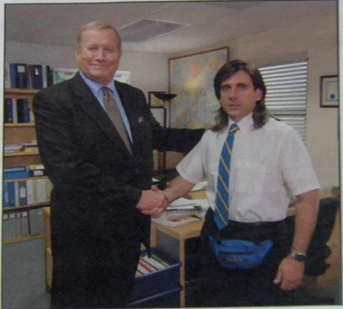
Benefits of Programmatic Consultation
Provides ESA coverage for multiple restoration actions in the Basin (not just a single action)
Participating federal agencies don’t have to do much to get ESA coverage (no BA or BO needed)
TRRP can include non-TRRP funded (regardless of source of funding) activities while prioritizing TRRP projects.

Slide 22
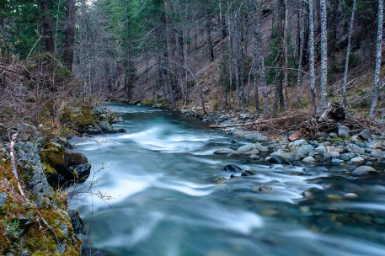
Questions?

