Slide 1
Valley Wetted Area, W_{a}
Dimensionless flow to wetted area curve
integrated over discharges up to the maximum fisheries flow
Wetted area scaled by valley area

Slide 2
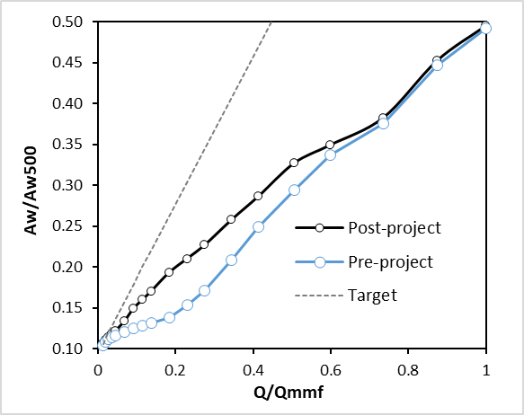
Example: Sheridan/Deep Gulch
Pre-project = 0.285, Post-project = 0.309
Target = 0.548

Slide 3
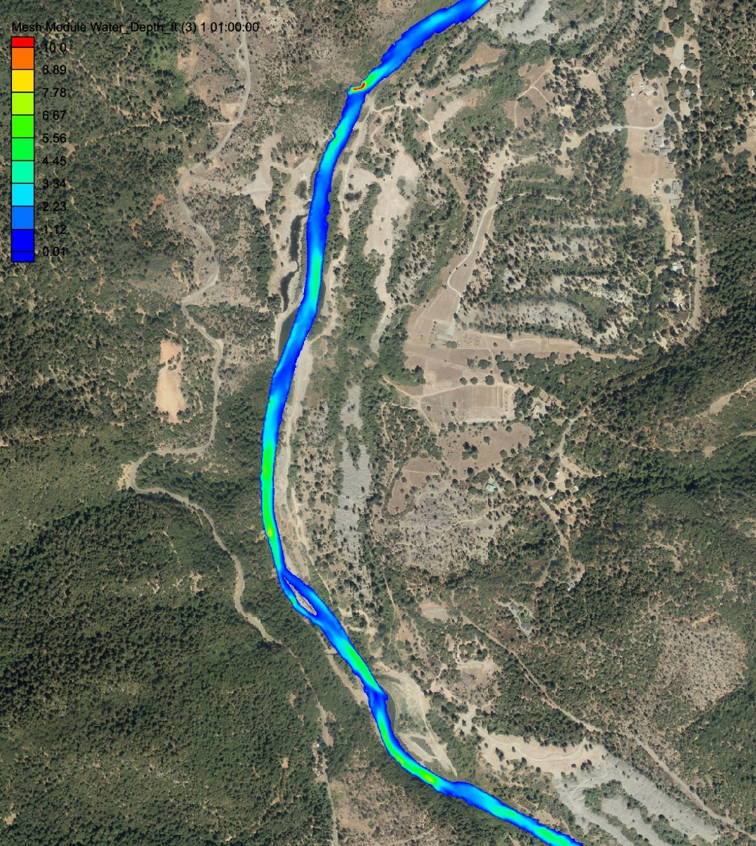
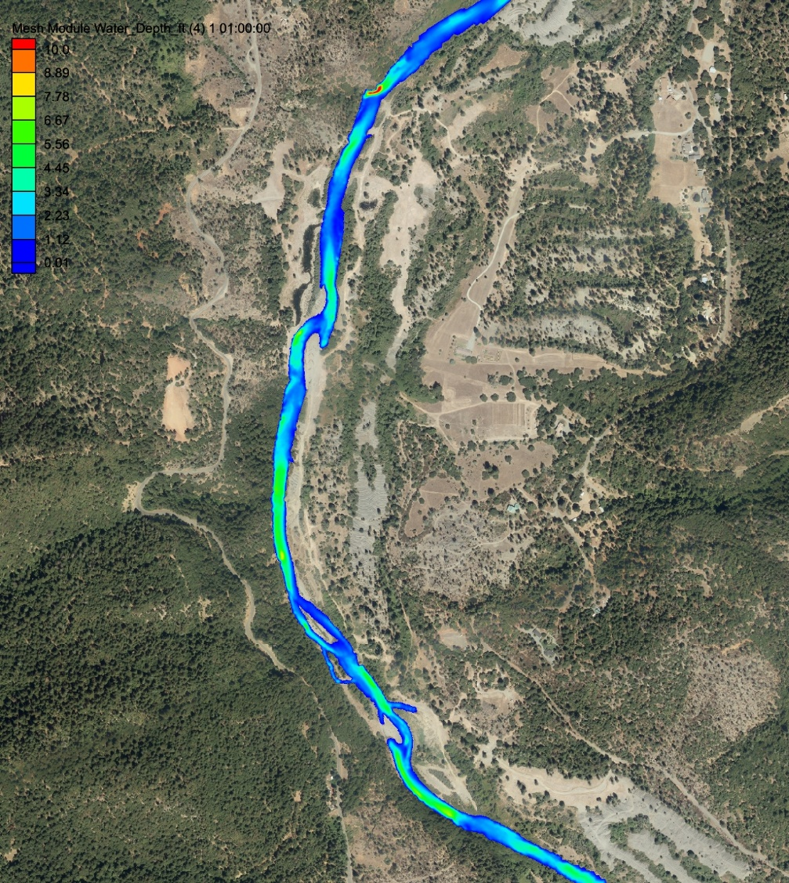
Sheridan/Deep Gulch, pre- and post-project, 300 cfs

Slide 4
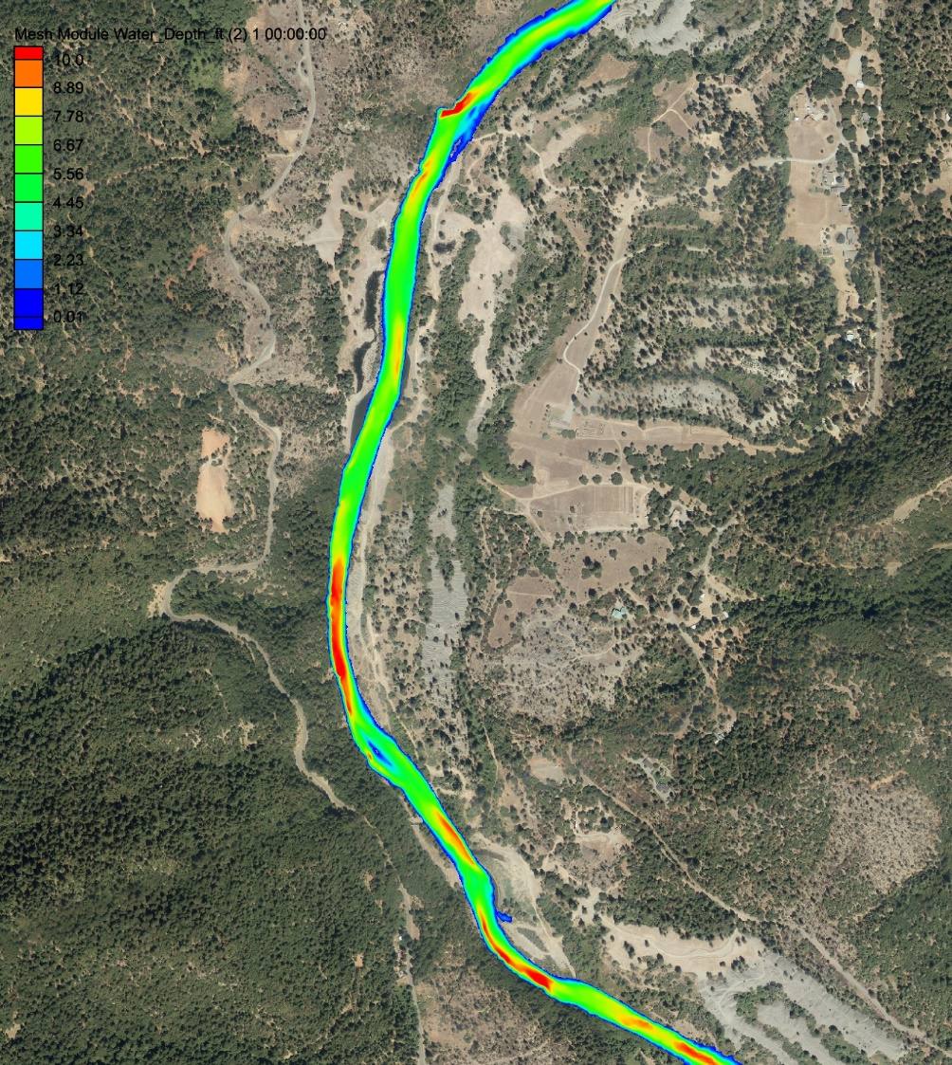
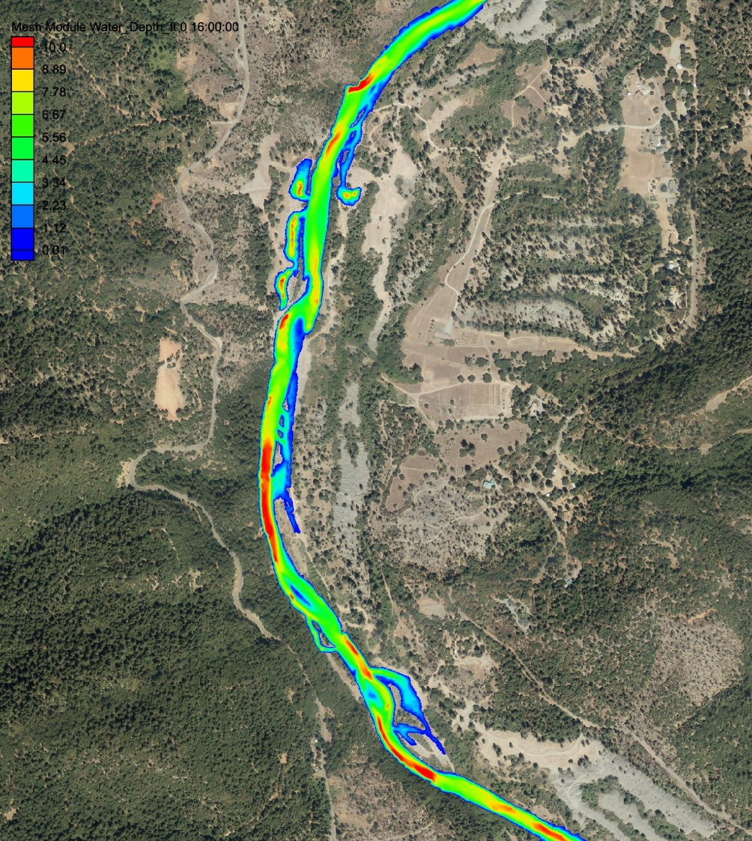
Sheridan/Deep Gulch, pre- and post-project, 4000 cfs

Slide 5
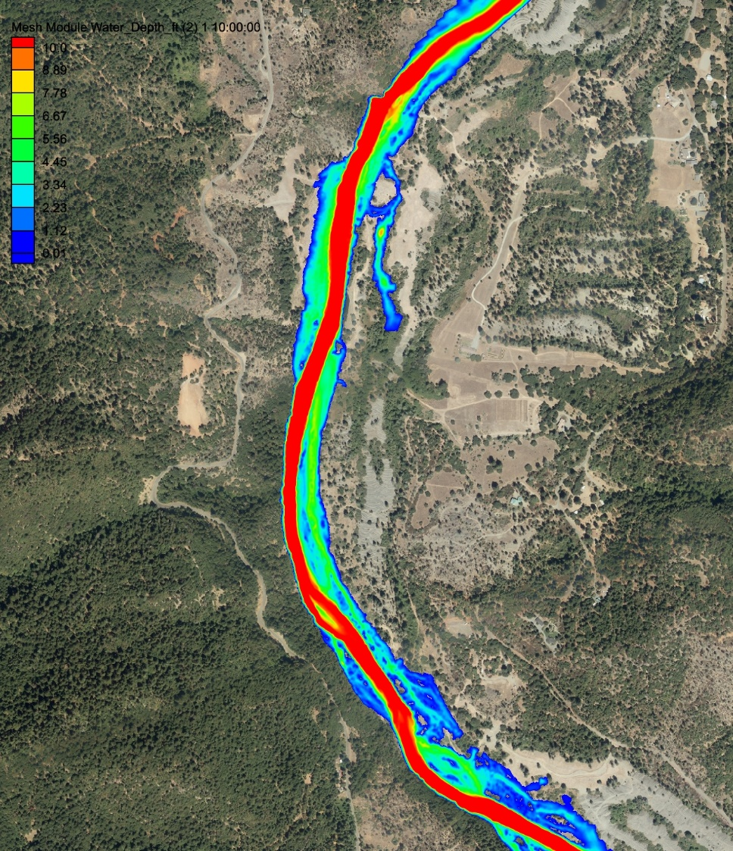
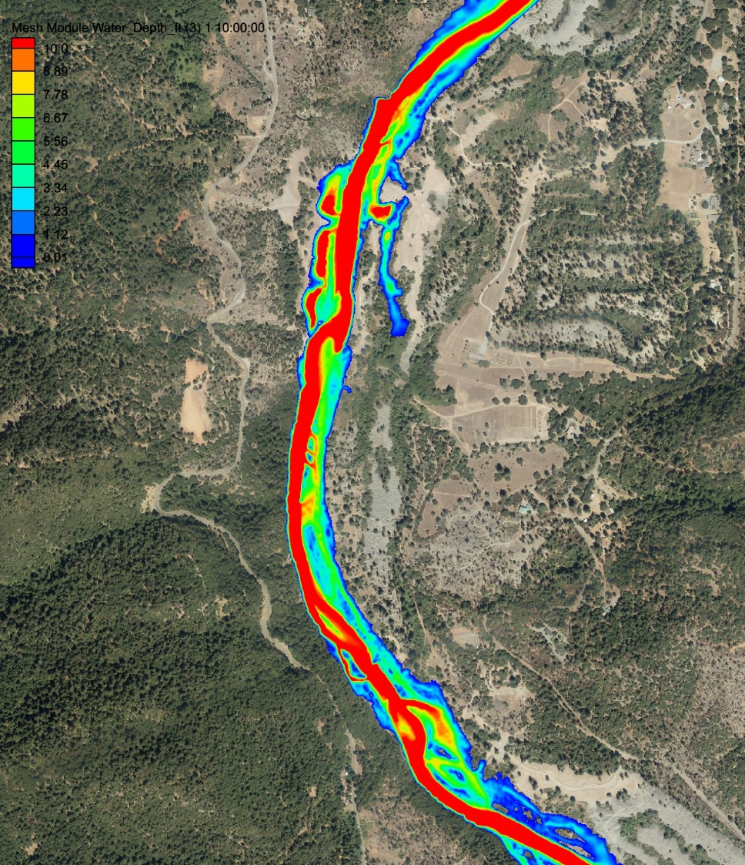
Sheridan/Deep Gulch, pre- and post-project, 13000 cfs

Slide 6
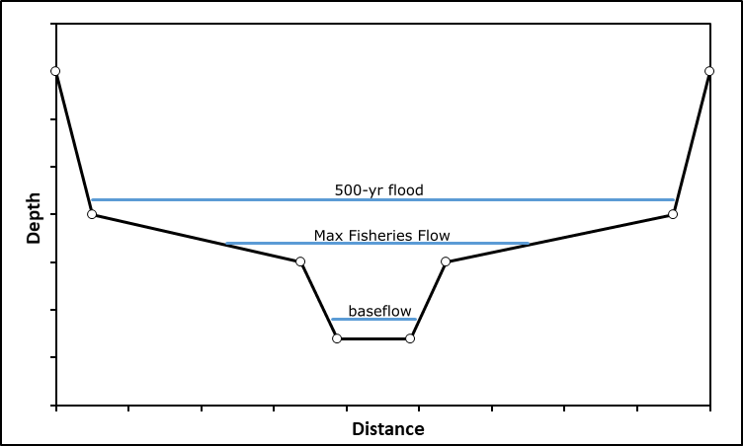
Valley Wetted Area, W_{a}
Physical Meaning

Slide 7
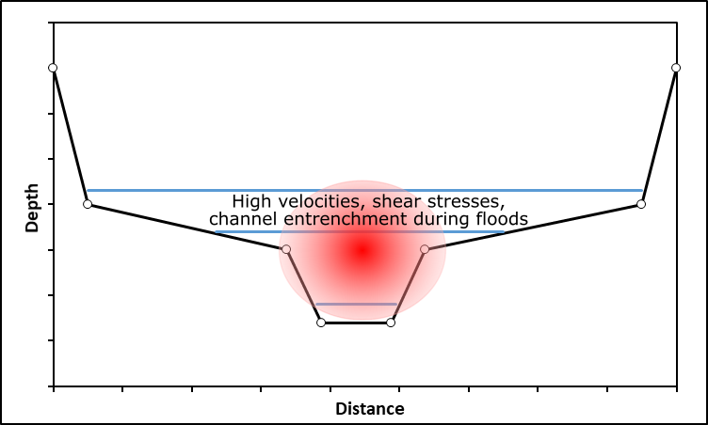
Valley Wetted Area, W_{a}
Physical Meaning

Slide 8
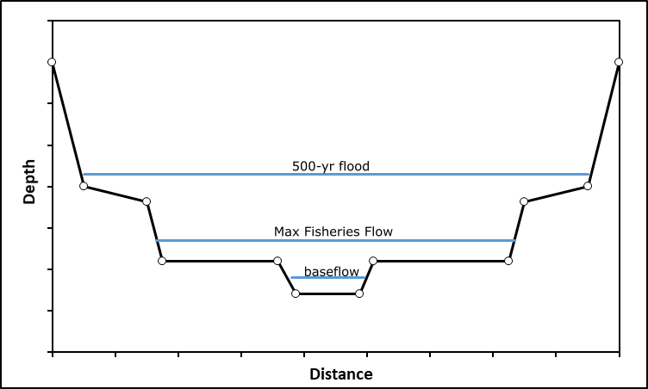
Valley Wetted Area, W_{a}
Physical Meaning

Slide 9
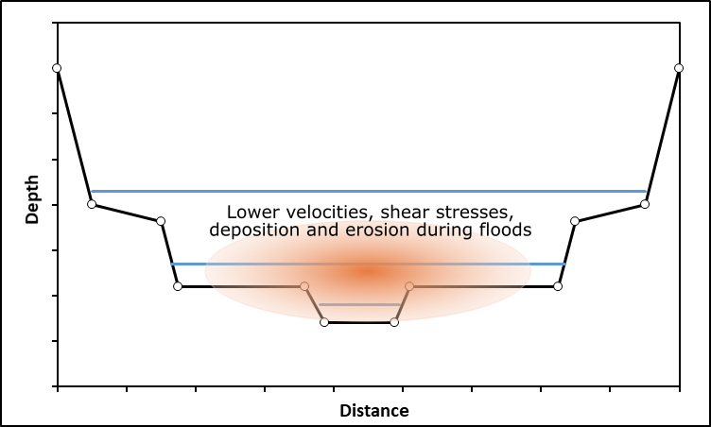
Valley Wetted Area, W_{a}
Physical Meaning

Slide 10
Active Channel Topographic Relief, R*
Dimensionless interdecile range of depths within active channel
Extent of active channel objectively defined by connected areas with at least 2 ft of water depth at 4000 cfs

Slide 11
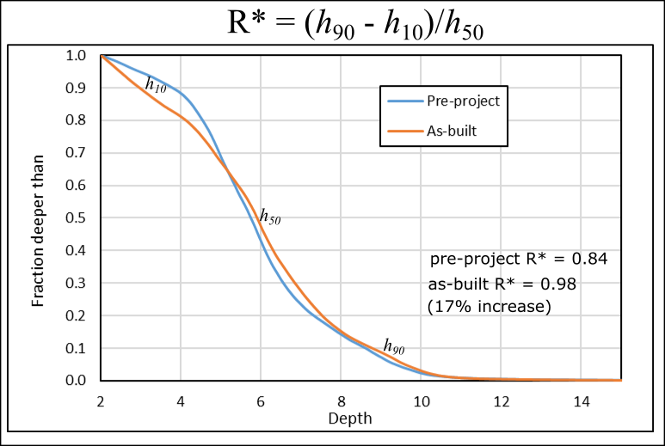
Example: Sheridan/Deep Gulch
Pre-project = 0.84, Post-project = 0.98

Slide 12
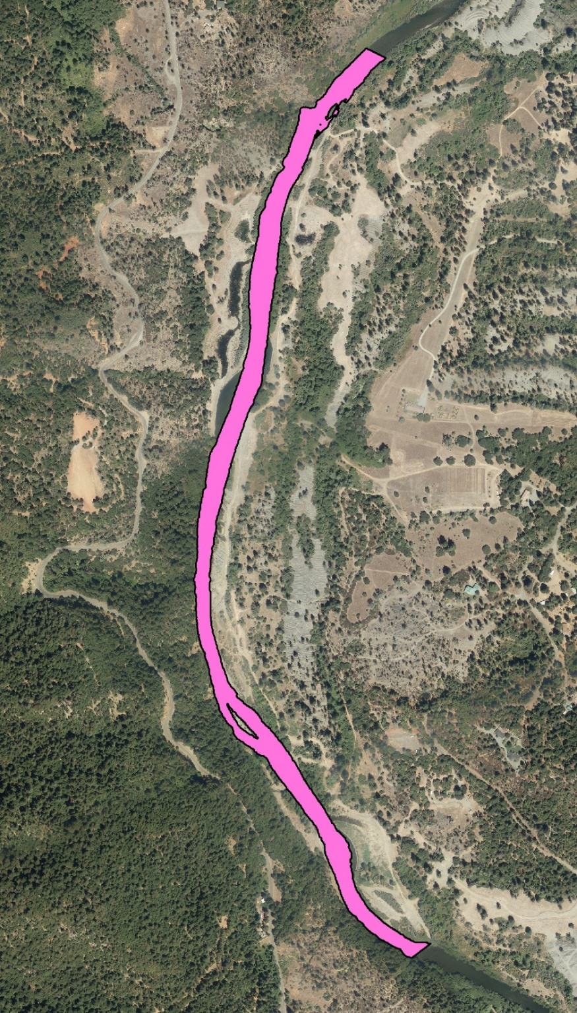
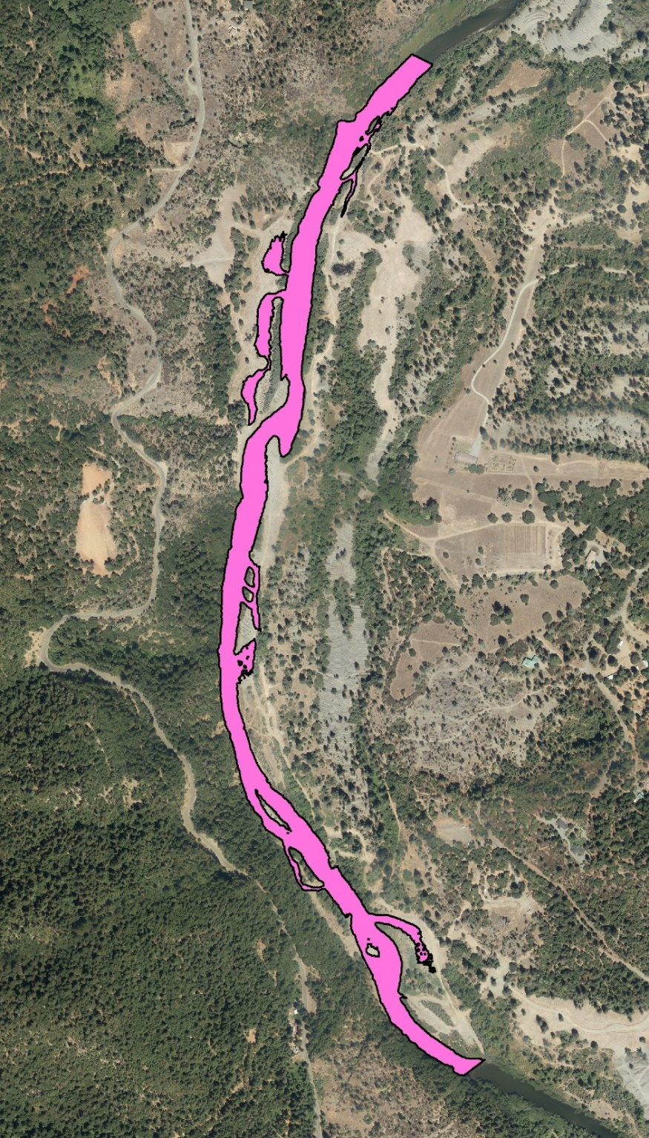
Example: Sheridan/Deep Gulch

Slide 13
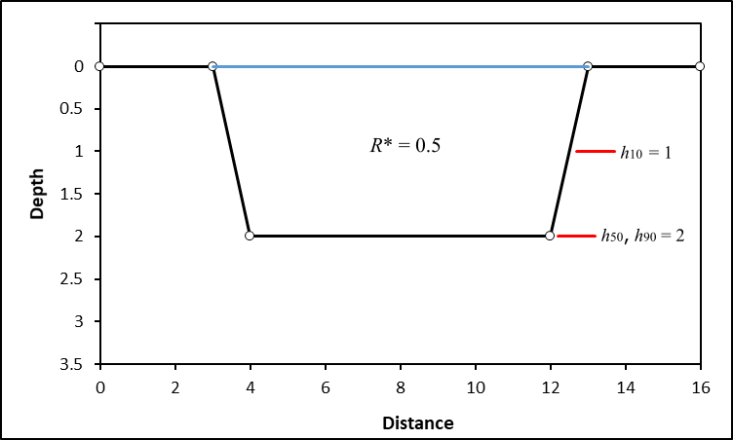
Active Channel Topographic Relief, R*
Physical Meaning

Slide 14
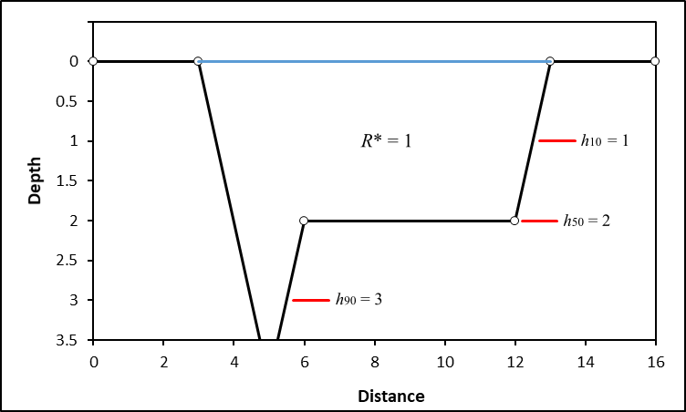
Active Channel Topographic Relief, R*
Physical Meaning

Slide 15
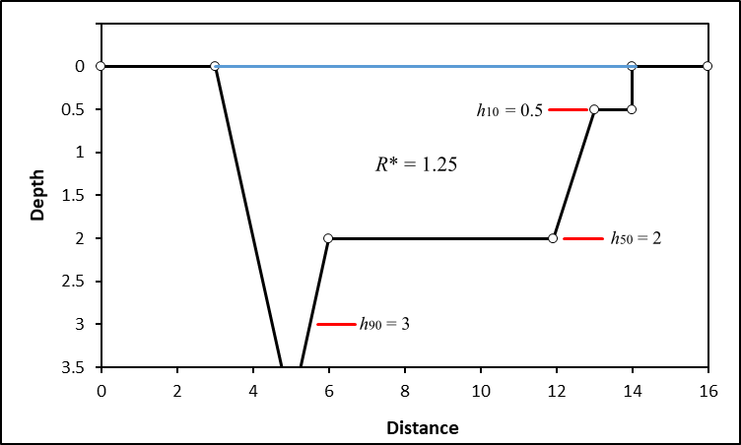
Active Channel Topographic Relief, R*
Physical Meaning

