Slide 1
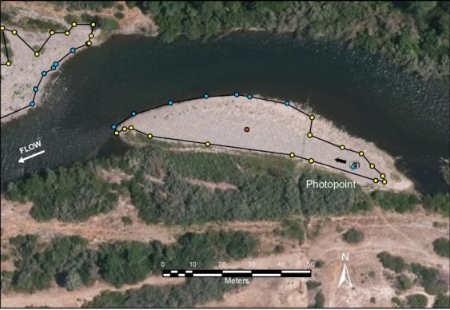
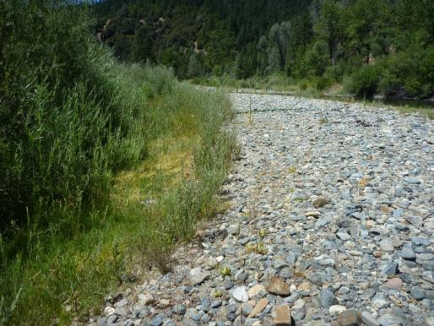
Physical Metrics: Active Bar Area
Need: coarse sediment storage (should a better relationship between physical process and geomorphic/fish habitat objectives)
Underlying assumption: more active bar area (per length of Trinity River) indicates more gravel storage
Why Active Bar Area? ➔ We can consistently measure it in the field
How is it measured? ➔ lower boundary is defined by 450 cfs summer water surface elevation, upper boundary is defined by 1) edge of vegetation, 2) imbrication of gravels (recent movement), 3) transition of gravel to sands, and/or 4) edge of post-ROD deposition

Slide 2
What does it mean?
In 1989 when we were looking for post-dam active/exposed gravel bars for geomorphic study sites, there were virtually none.
Flow Study, ROD, and 2007 Coarse Sediment Management Plan objective was to increase coarse sediment storage (short-term transfusion), then maintain that increased storage with long-term coarse sediment augmentation.
Unfortunately, none of those documents provided a coarse sediment storage target (how much coarse sediment storage do we need?)
Potential considerations for a storage target:
  More gravel bars➔ more fry rearing habitat and spawning habitat (eliminate dip in flow-habitat curve)
  More gravel bars➔ achieving a scaled-down, dynamic alluvial river
  More gravel bars➔ more channel complexity, and more hydraulic complexity over a range of flows
  More gravel bars➔ more lateral channel dynamics (expansion, migration, complexity)

Slide 3
Trends
No field mapping performed in 1989, but very few active gravel bars
Field mapping performed in summer 2014, none since, so no trends
1989-2014 qualitative trend is that there are many more active gravel bars on the Trinity River now than 1989
Would be a relatively easy metric to monitor (every 5 years).
Would take a trained 2-person field crew approximately 2-3 weeks to complete mapping over upper 40 miles using RTK GPS

Slide 4
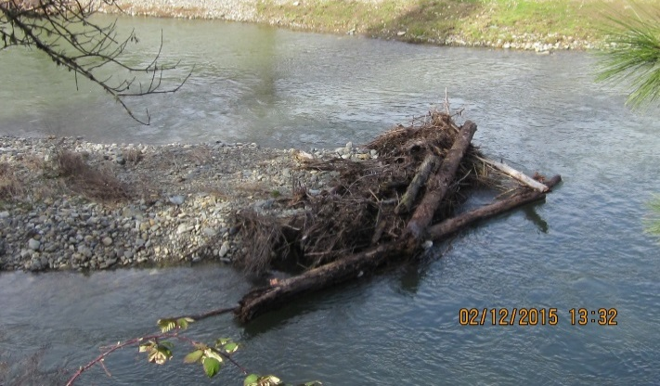
How would we use the metric in management?
If we are able to develop Active Bar Area targets (e.g., 360 m²/m) for key geomorphic reaches, we can use that metric to inform annual coarse sediment augmentation: which sites, where to place at sites, how much in each reach, how much at each site.
We can also look at other restoration mechanisms to create Active Bar Area that may not require coarse sediment augmentation, such as large wood placement, large boulder placement, and other forms of obstructions that induce coarse sediment deposition and higher residency time

Slide 5
Potential Metric
Active Bar Area density in Reach 5 exceeds 6.5 ft²/linear ft of channel
Assess using targets based on Active Bar Area density recommendations in soon-to-be released draft report.
Monitoring - Conduct Active Bar Area mapping every 5 years (approximately 2-3 weeks of field work by a 2-person crew)

