Slide 1
Functional River Analysis
Eric Peterson (TRRP/USBR) and Seth Naman (NMFS)
Plus: Justin Alvarez (HVT), Kyle De Juilio (YT), Chris Laskodi (TRRP/YT), Ken Lindke (CDFW), Dave Gaeuman (YT geomorphology), Smokey Pitman (ARS/HVT geomorphology), Todd Buxton (TRRP/USBR geomorphology)

Slide 2
Draft Supplemental Environmental Impact Statement, Trinity River Division, Long-Term Operation
Updates NEPA coverage for river flows and reservoir management
Joint-Leads: HVT and YT participated in development (plus CDFW, USFWS, TC)
Collaborating agency review completed
Public draft pending
No Action (2000 ROD) plus 6 Alternatives
  one analyzed with two models to span Adaptive Management
CalSim3 modeling incorporated Reservoir Management Release
  AKA “Safety of Dams” releases (SOD)
  Analysis presented here covers both with and without

Slide 3

Alternatives Cheat-Sheet
1 7
No Action Alt (NAA): the classic ROD 2000
Water Quality: 340 TAF / no min pool
Multiagency: A: Decision Tree, B: Realtime / min pool 1200-900-750 TAF
Modified Natural (Oscillation): WY shifted / min pool 1200-900-750 TAF
Risk informed: Alt 2 with 15% cut multi-year drought / min pool 750
*Removed*
Trinity County: ROD 2000+holdover / min pool 1500-1300-1100-1000-900-825-750 TAF
Maximum Flow: 70% of inflow released / min pool 750 / low baseflows
Reference Flow: Salmon River at Somes Bar, climate adjusted hydrology (SRaSBadj)

Slide 4
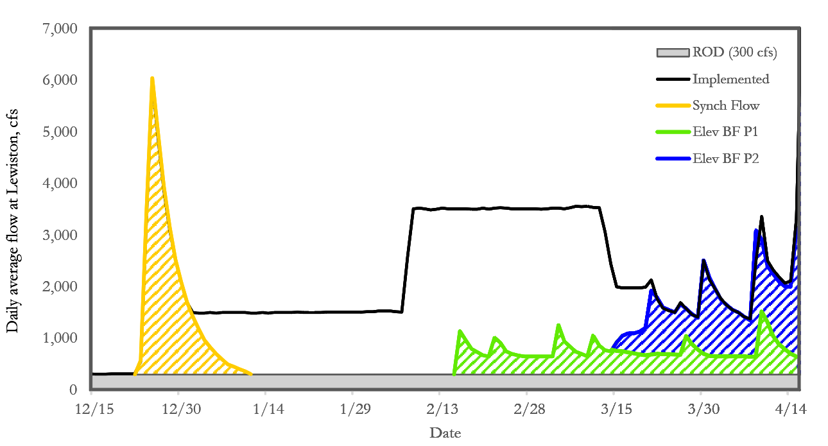
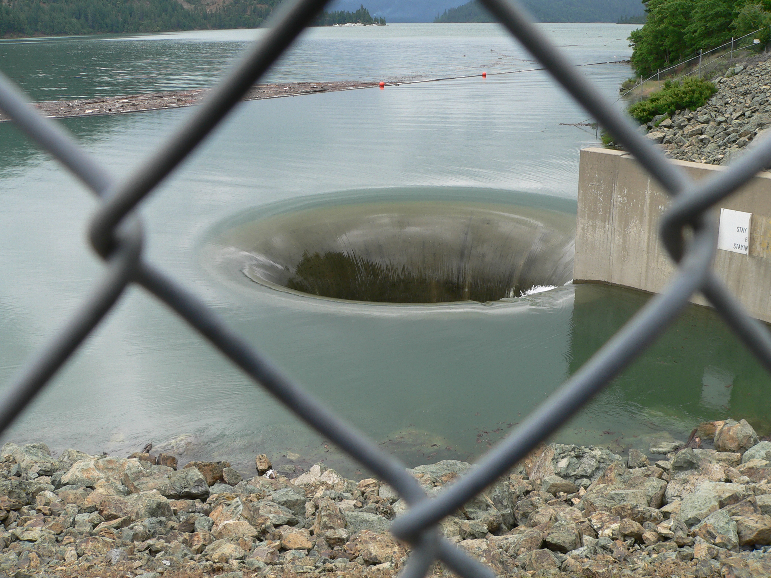
Safety of Dams Releases… are they relevant?
SOD rate since the ROD: 15%
(proactive actions)
CalSim3: 33%
Water Year 2025
Usually before this!

Slide 5
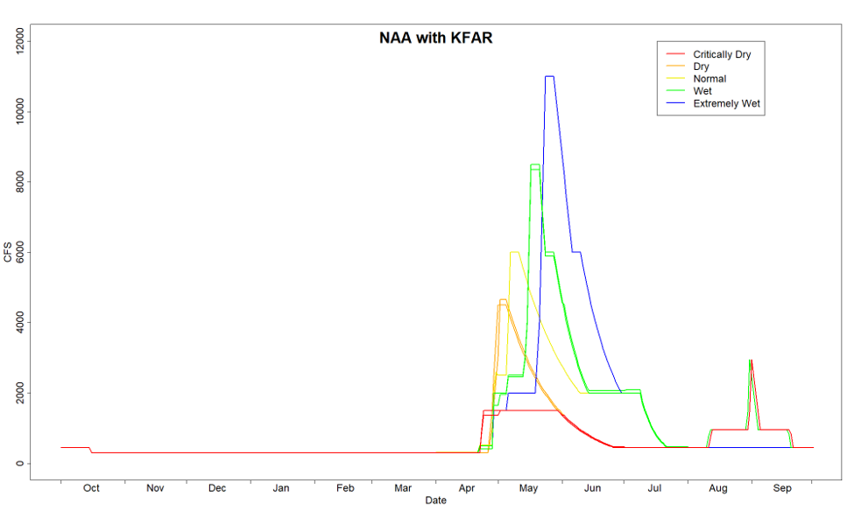
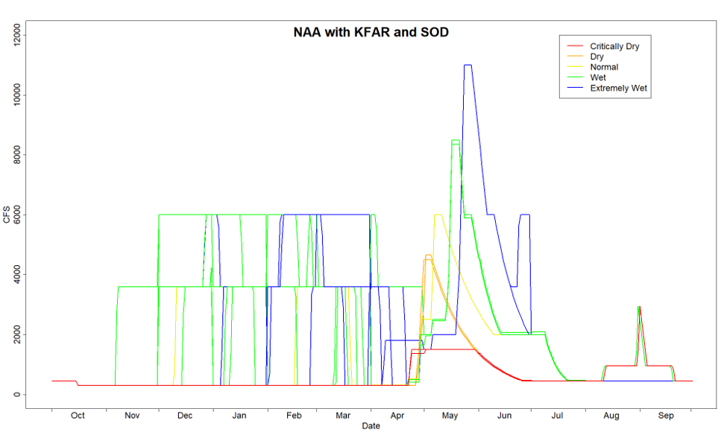
SEIS No Action Alt
ROD 2000
ROD water volumes
600 TAF planning minimum pool
300/450 baseflows
Restoration flows start Apr 15
FAR retained (all except Alt 1)
Ramping rates, 11k cfs max retained for all alternatives
CalSim3: SOD 33% of years,
7.4 MAF over 40 years

Slide 6
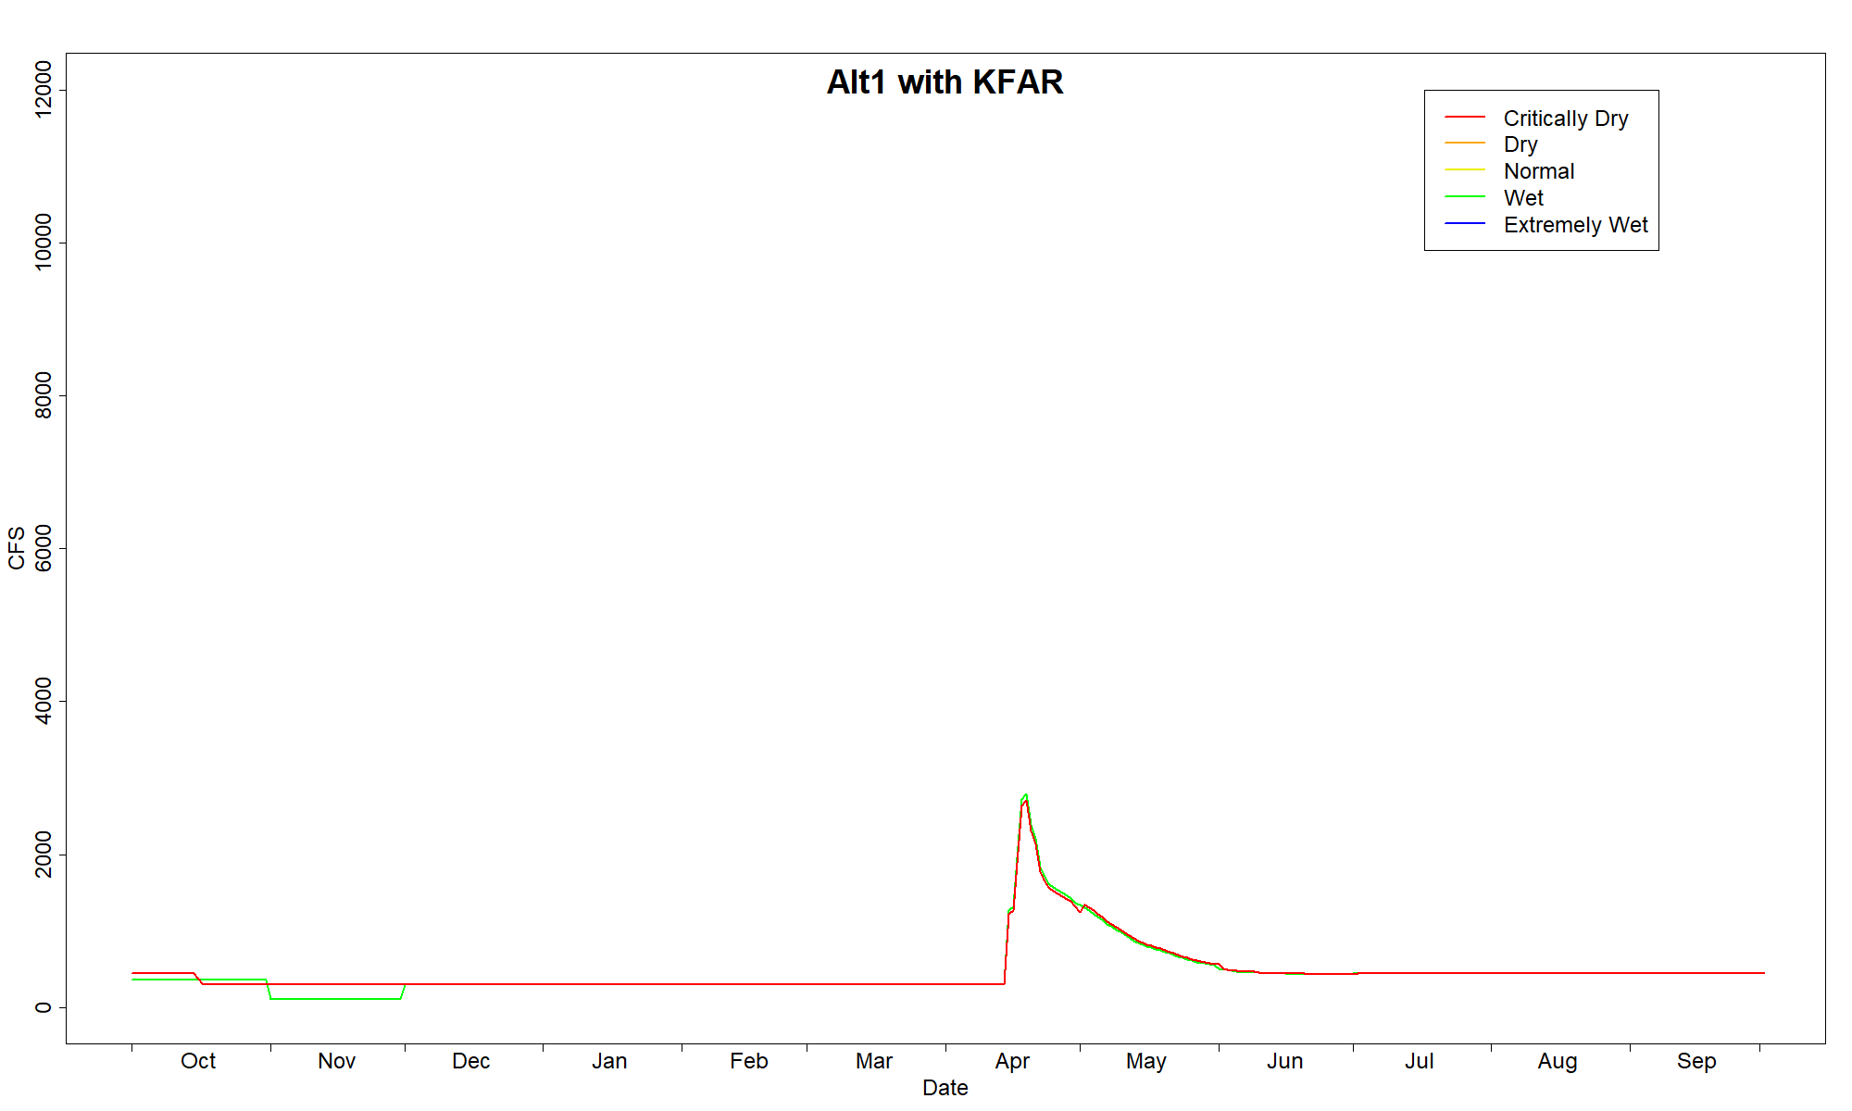
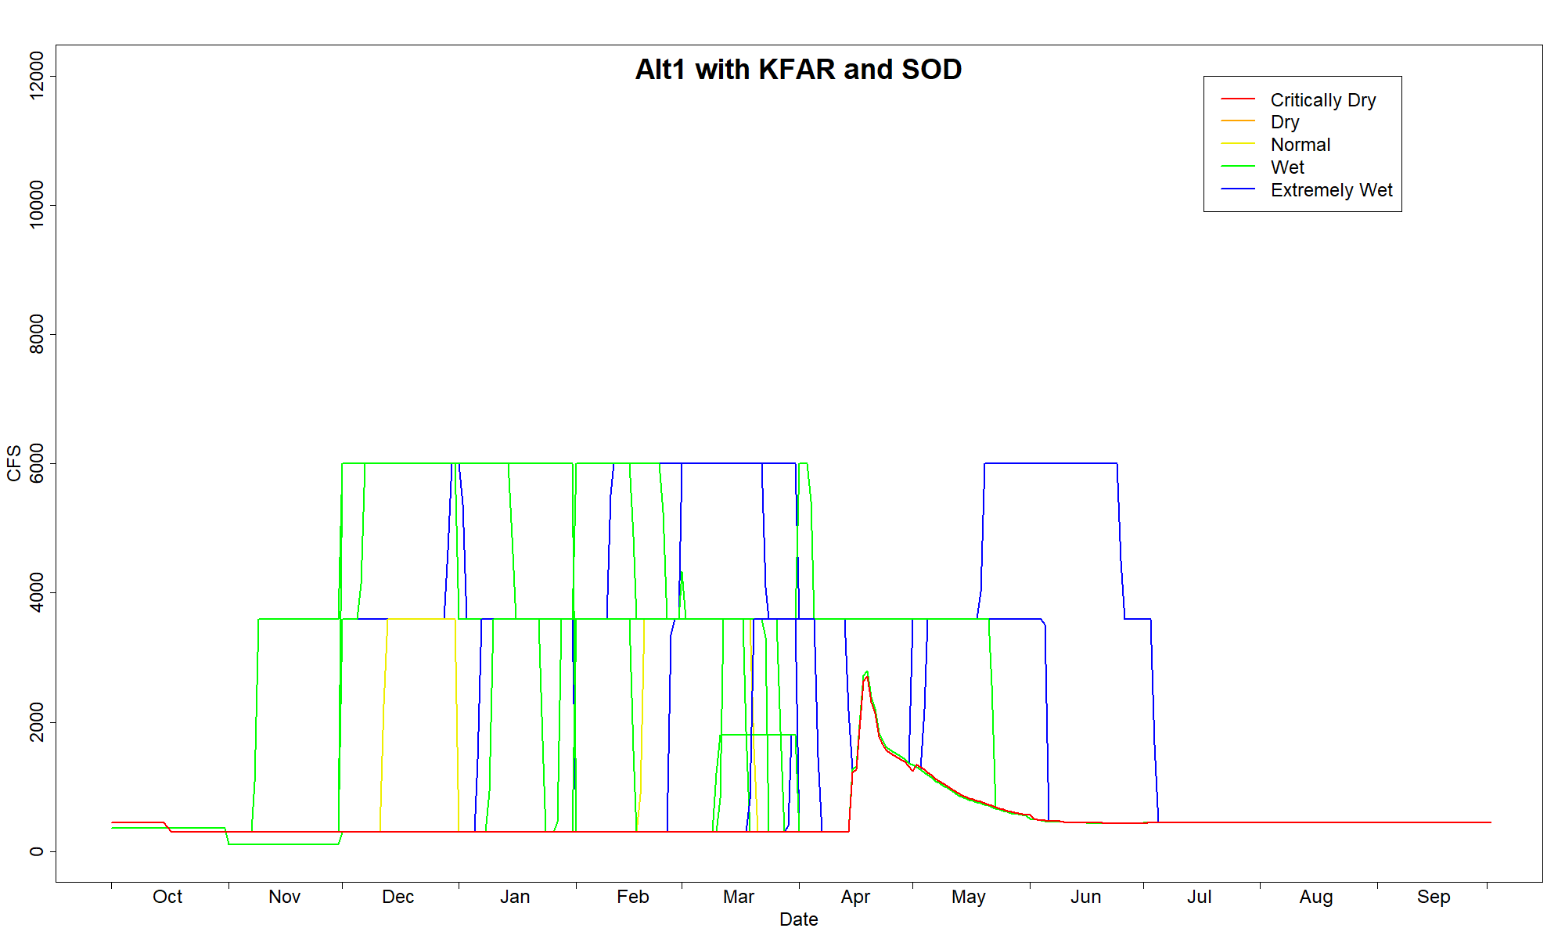
SEIS Alternative 1
Water Quality Control Plan
Legal minimums and WO 90-5
340,000 AF
NO planning minimum pool
300/450 baseflows (249,000 AF)
  Violated twice due to deadpool
Restoration flows start Apr 15
  (subject to AM)
No FAR
Ramping rates, 11k cfs max retained for all alternatives
CalSim3: SOD 30% of years,
6.7 MAF over 40 years

Slide 7
SEIS Alternative 2
Multi-Agency Deliberation
Multi-Agency Deliberation
  HVD, YT, NMFS, CDFW, USFWS, USBR
Objectives:
  Shift flows earlier in the season
  Align dam releases with surrounding hydrology specific to each water year
Broad Adaptive Management to achieve, represented by two methods (A and B)

Slide 8
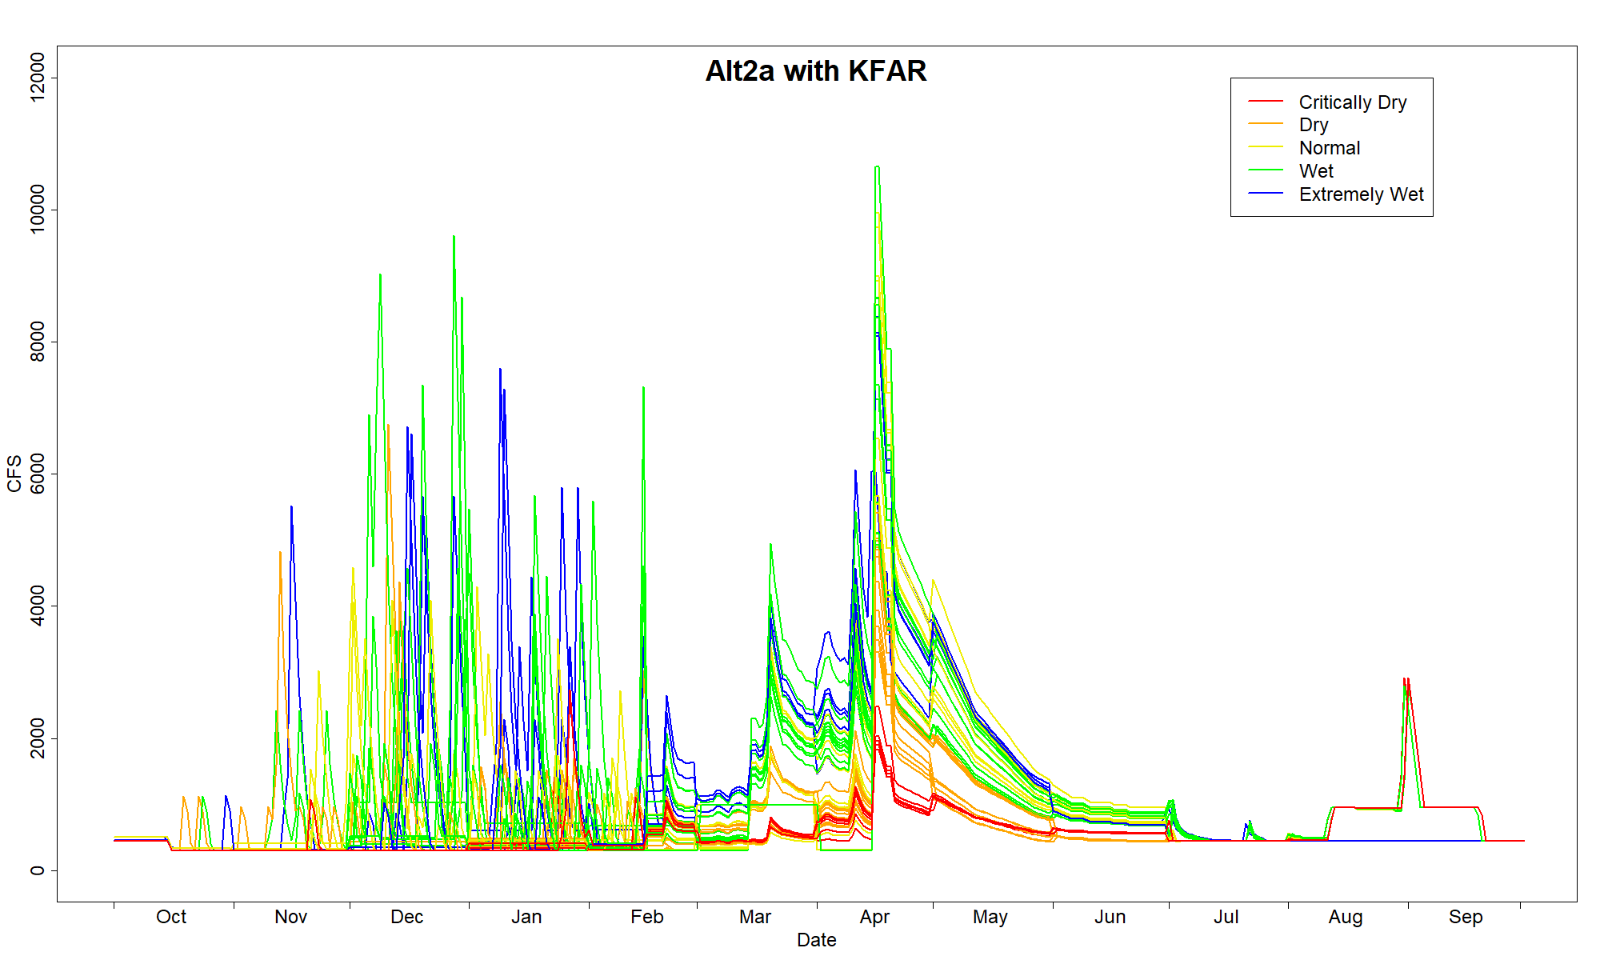
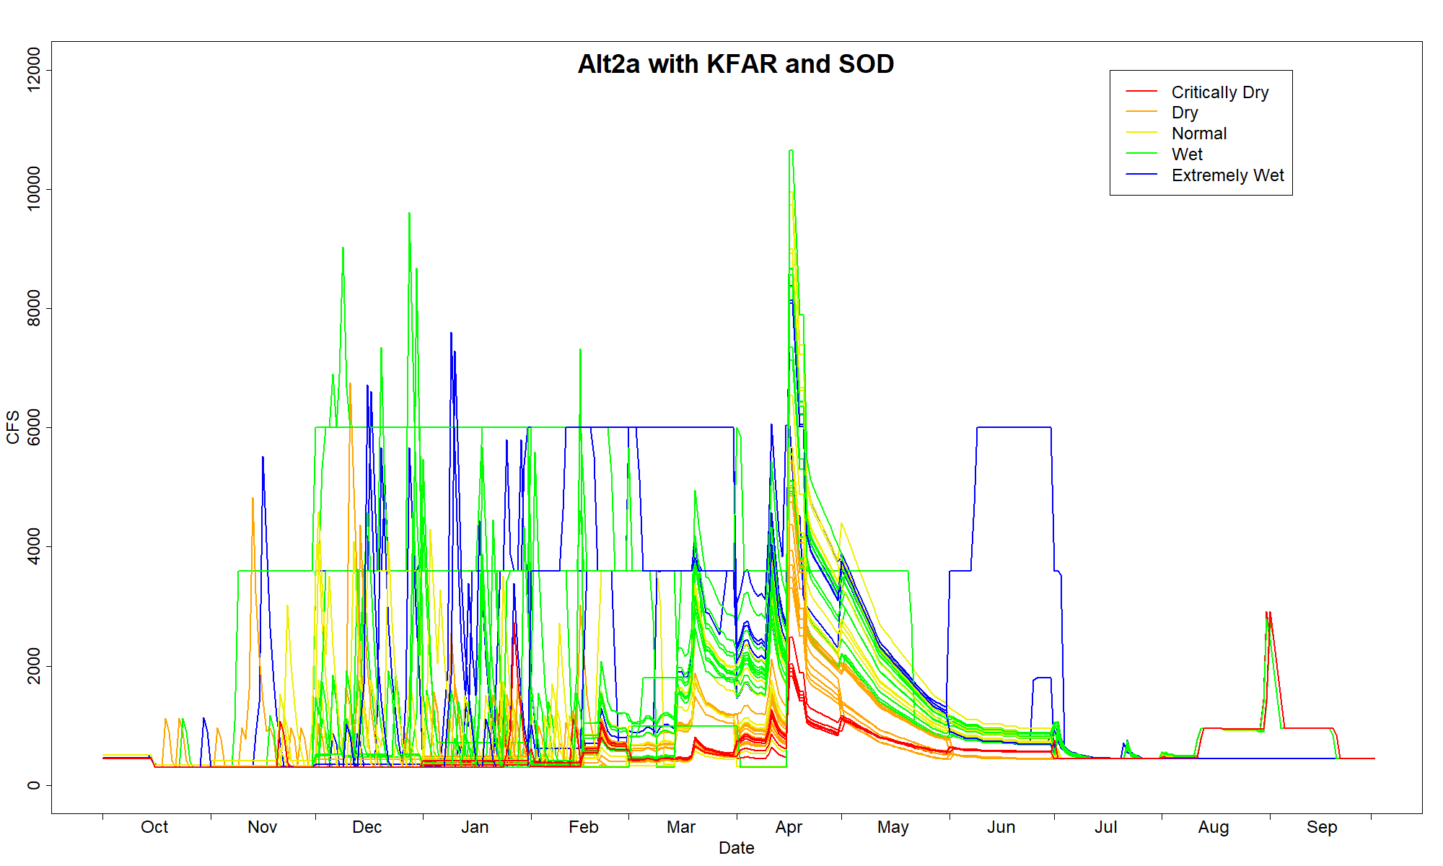
SEIS Alternative 2 (a)
Multi-Agency Deliberation
ROD water volumes
1200-900-750 TAF planning minimum pools
300/450 baseflows
  (subject to AM)
Restoration flows start October,
  trigger based
CalSim3: SOD 33% of years,
5.3 MAF over 40 years

Slide 9
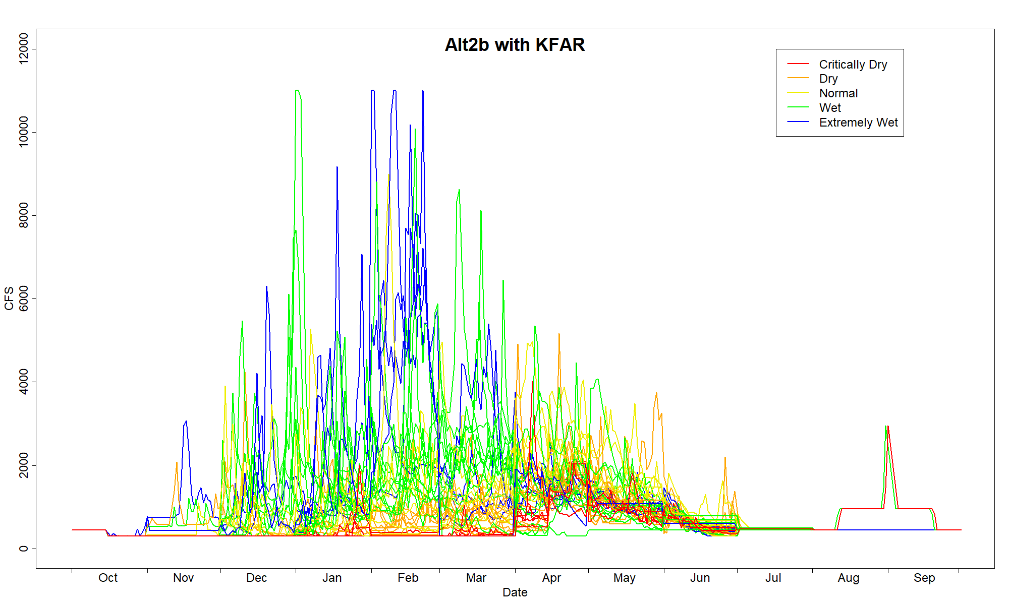
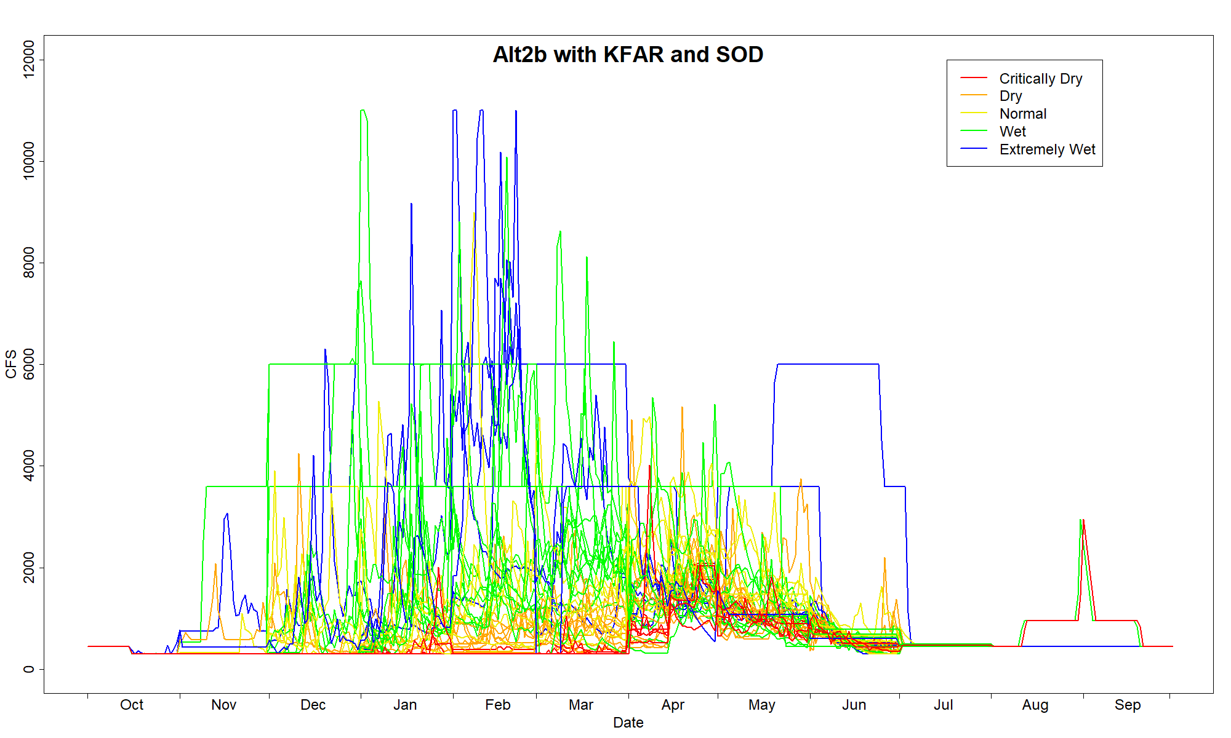
SEIS Alternative 2 (b)
Multi-Agency Deliberation
ROD water volumes
1200-900-750 TAF planning minimum pools
300/450 baseflows
  (subject to AM)
Restoration flows start October
  real-time from unimpaired streamgage
CalSim3: SOD 30% of years,
4.0 MAF over 40 years

Slide 10
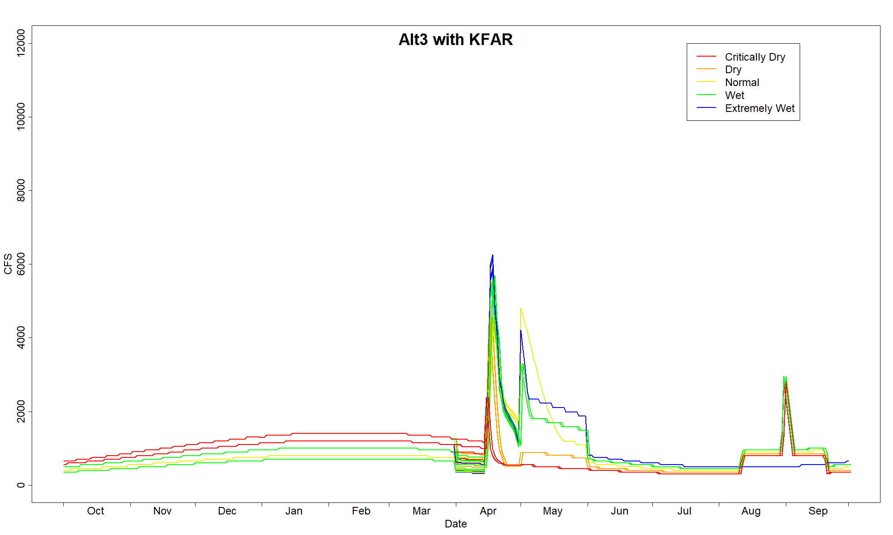
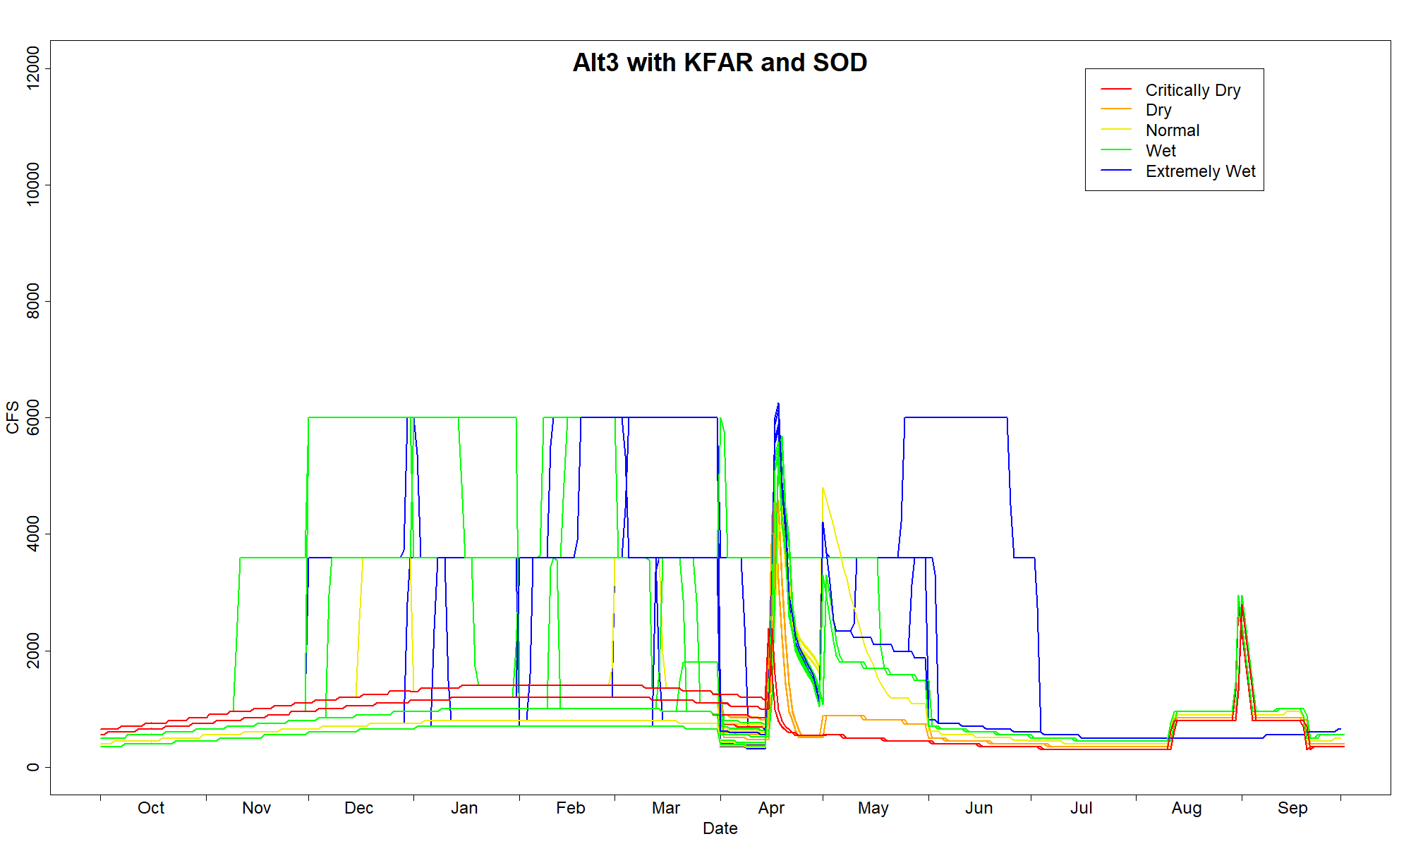
SEIS Alternative 3
Modified Natural Hydrology
ROD water volumes REDISTRIBUTED April to April
1200-900-750 TAF planning minimum pools
Oscillating summer baseflows
  300-500 in summer
Restoration flows start Apr 15
  (subject to AM)
CalSim3: SOD 33% of years,
5.3 MAF over 40 years

Slide 11

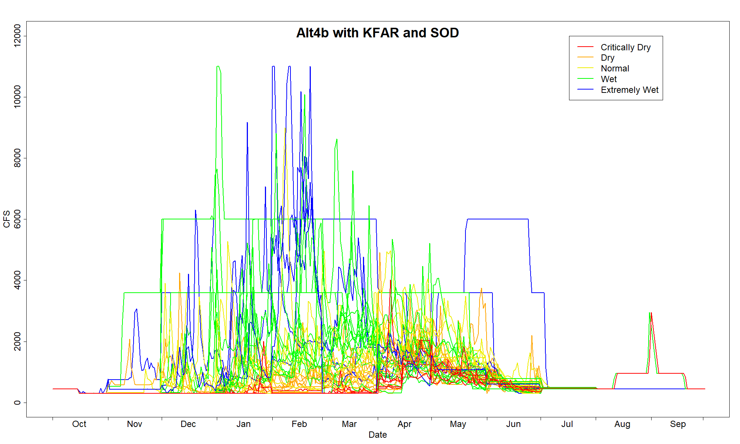
SEIS Alternative 4 (b)
Risk-Informed Operations
ROD water volumes, REDUCED 15% during ongoing drought years and in the first normal or wetter year
750 TAF planning minimum pool
Otherwise identical to Alt 2 (a and b)
300/450 baseflows
  (subject to AM)
Restoration flows start October
CalSim3: SOD 28% of years,
4.1 MAF over 40 years

Slide 12
SEIS Alternative 5 name
REMOVED

Slide 13
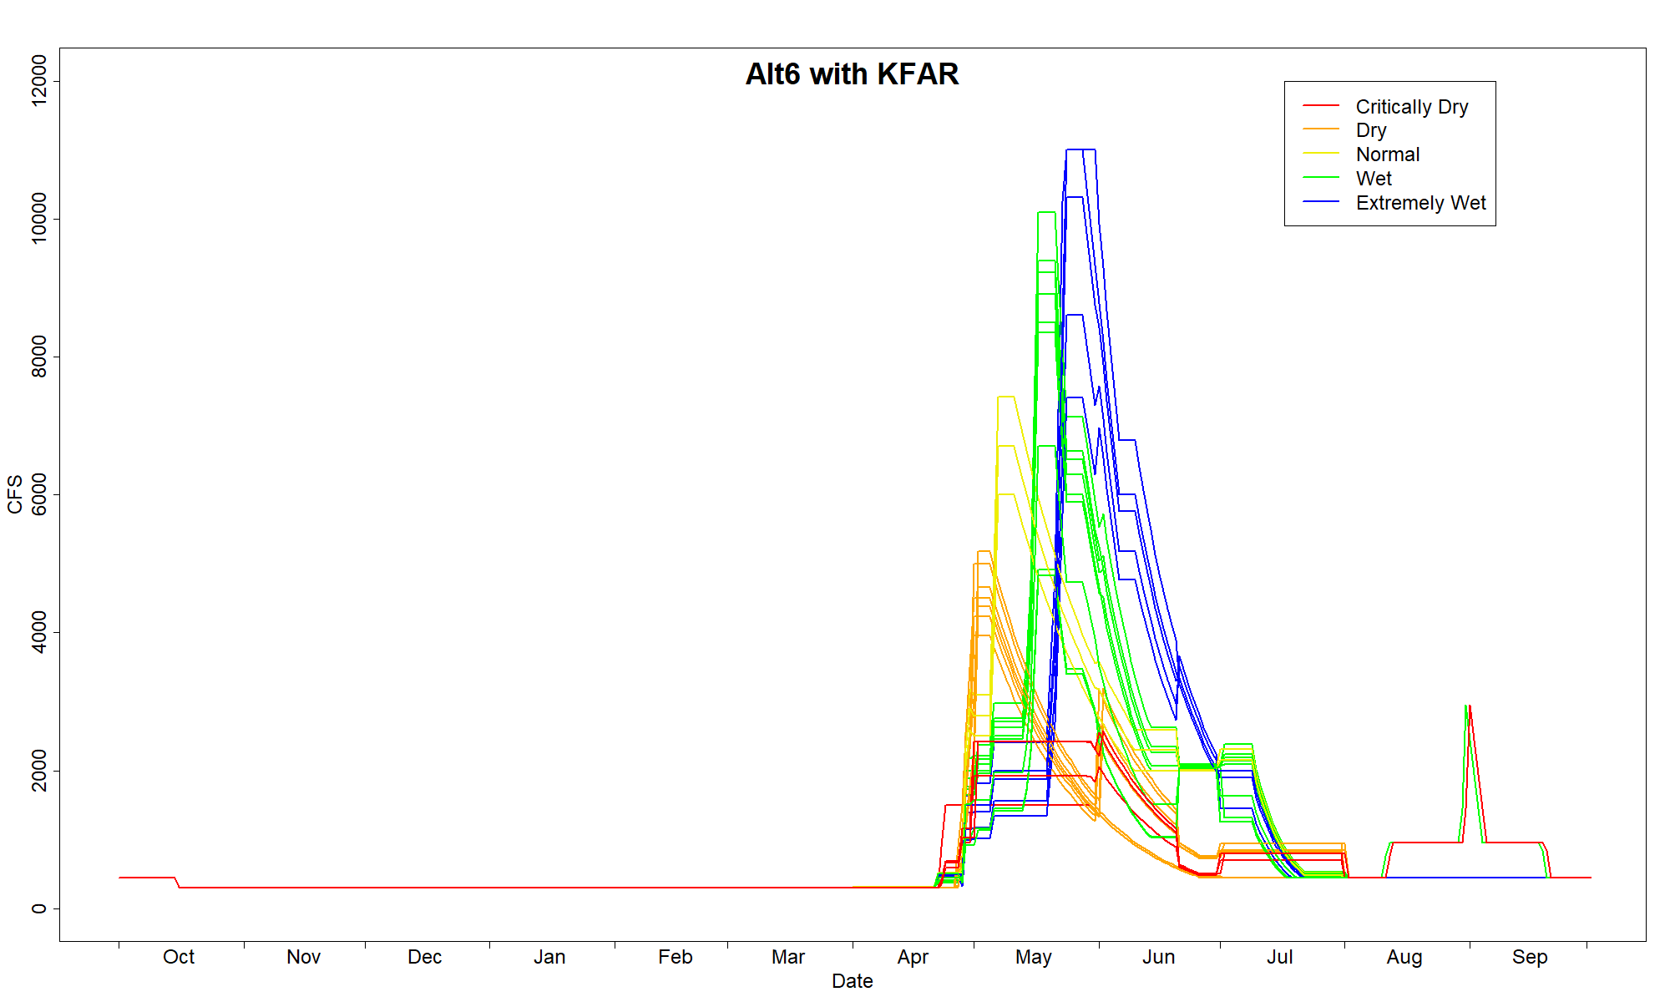
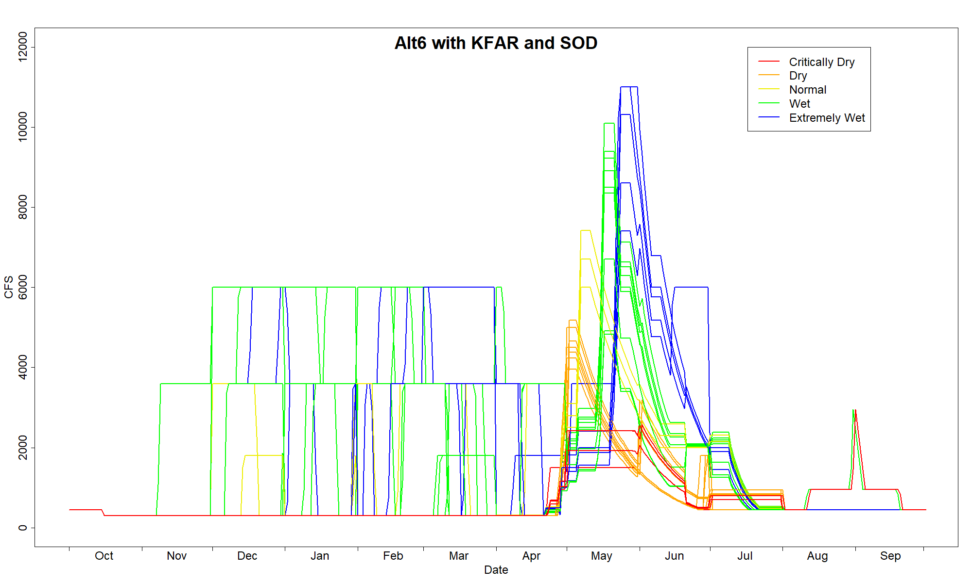
SEIS Alternative 6
Trinity County
ROD water volumes except 200 TAF when a Wet or Extremely Wet year follows a missed end-of-September storage, released over subsequent 3 years
1500-1300-1100-1000-900-825-750 TAF planning minimum pool
300/450 baseflows
Restoration flows start April 15
CalSim3: SOD 60% of years,
8.9 MAF over 40 years

Slide 14
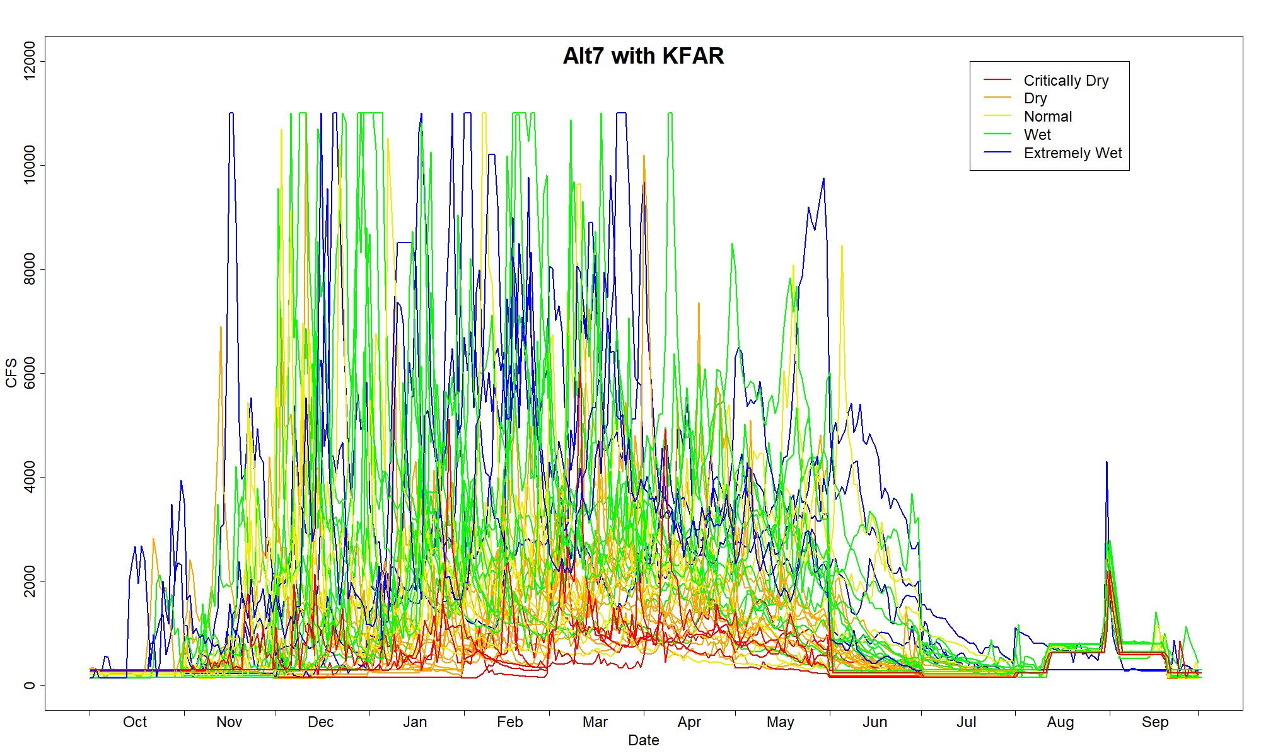
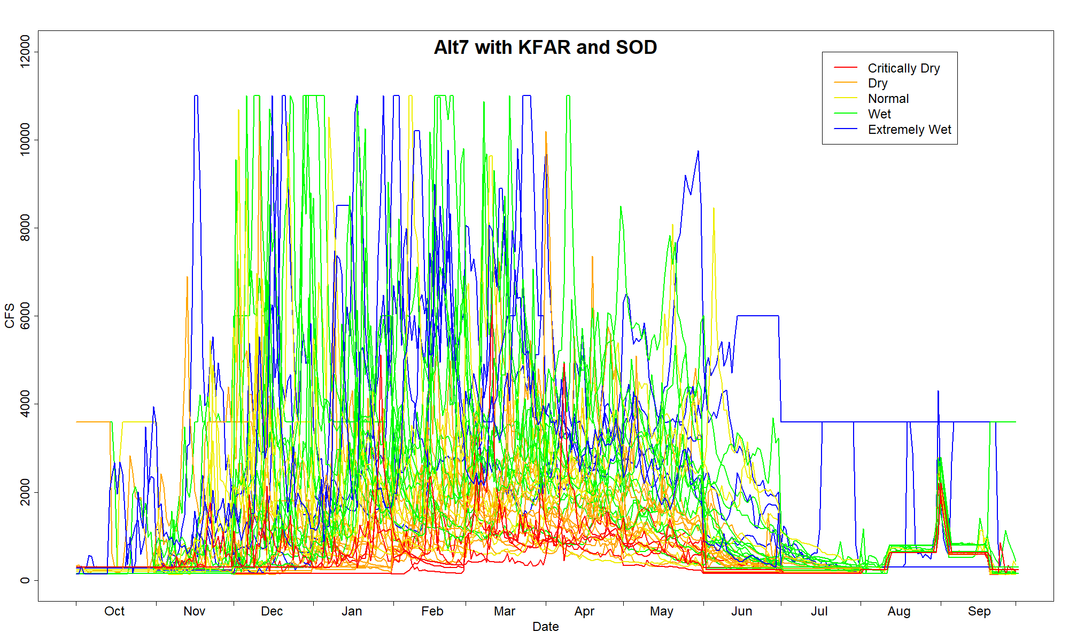
SEIS Alternative 7
Maximum Flow
~70% of inflows released
750 TAF planning minimum pool
300/450 baseflows reducing as low as 100 cfs at 750 TAF
Restoration flows start October
  real-time from unimpaired streamgage
CalSim3: SOD 18% of years,
1.5 MAF over 40 years

Slide 15
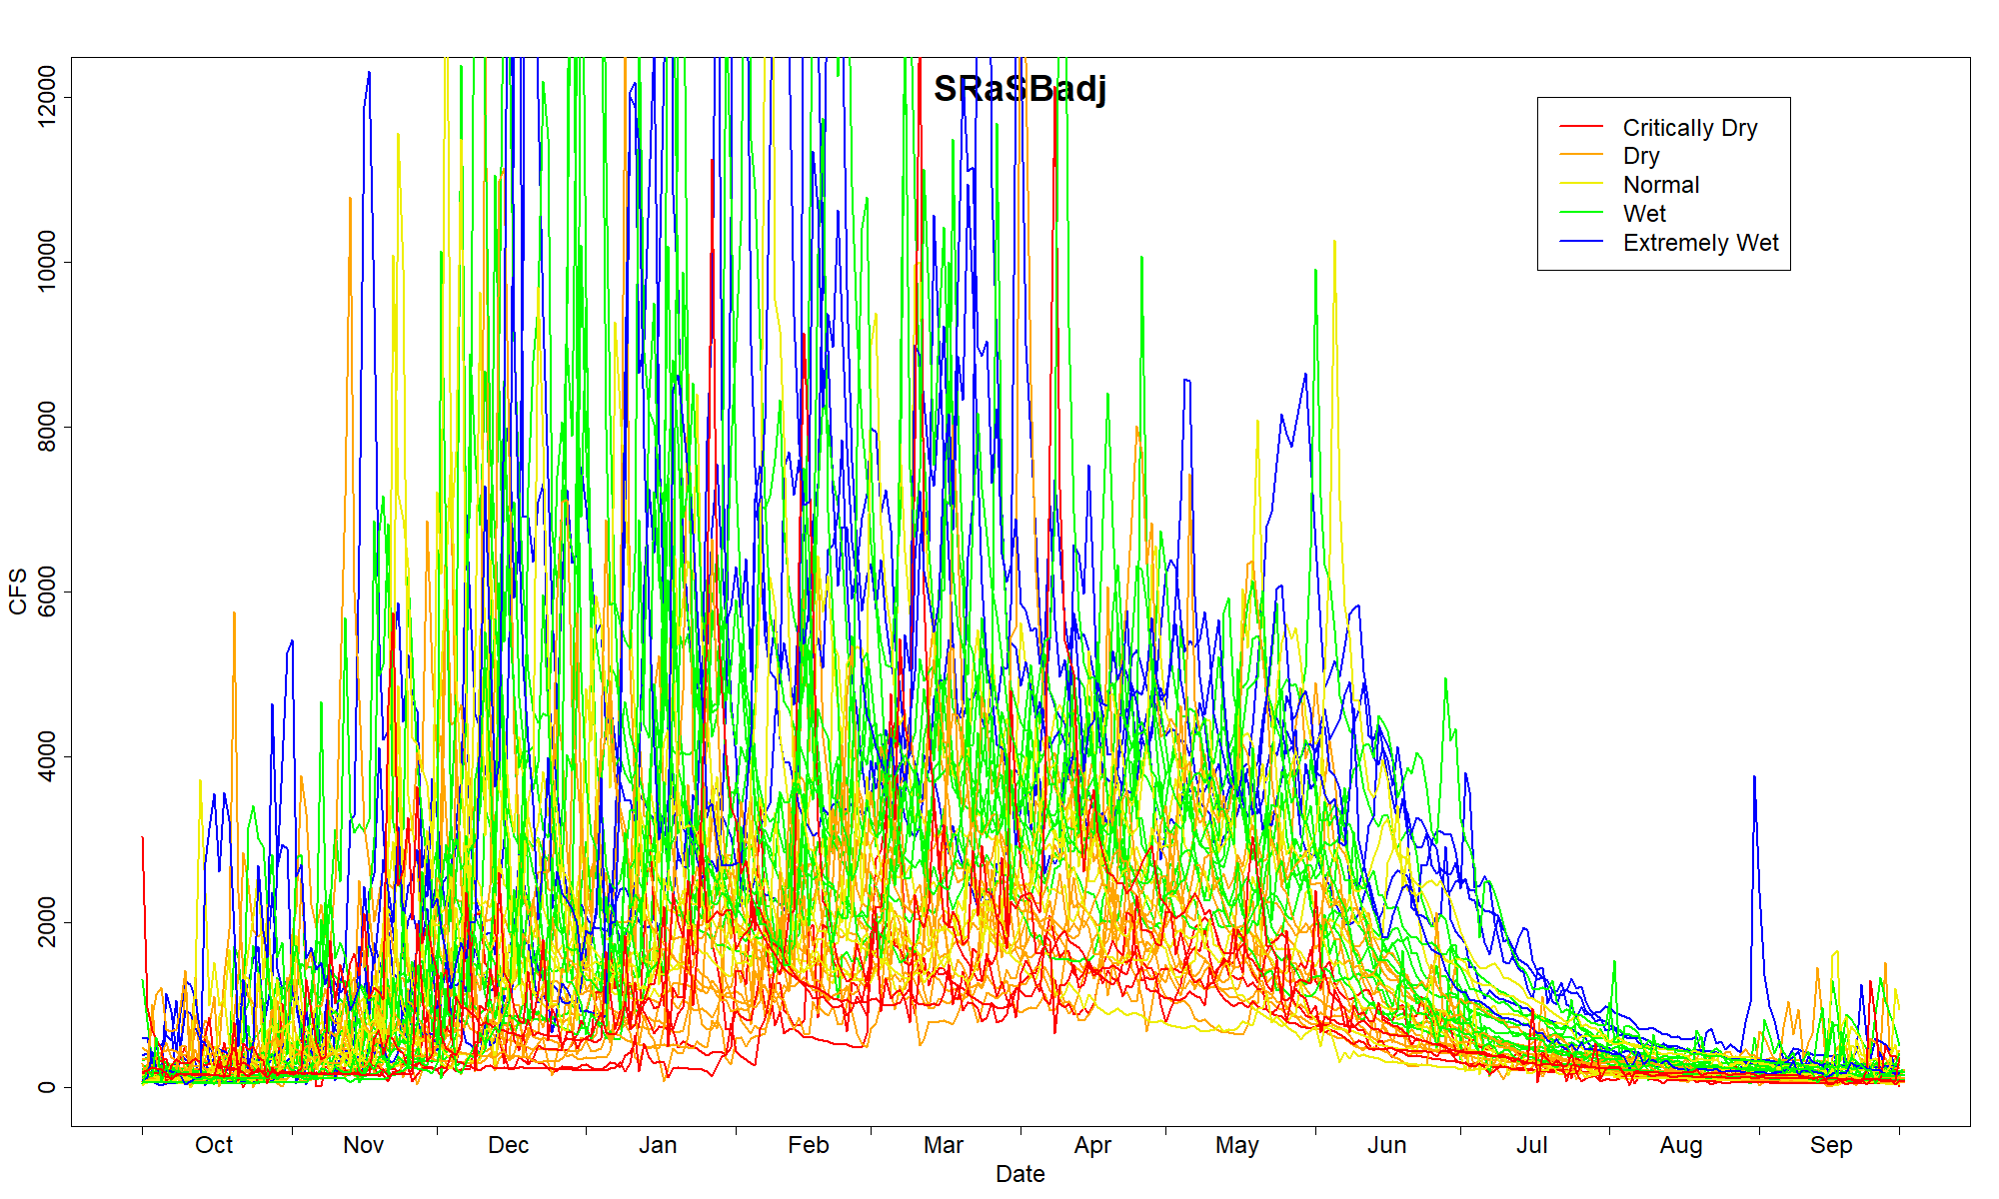
Reference Natural Flow
Salmon River at Somes Bar
  Climate adjusted to 2022 +/- 15
  conditions
  [as are hydrographs for all
  alternatives]
Not CalSim3 / No SOD models

Slide 16
How to analyze the effects of these Alternatives?
Many, many modeling and analysis exercises in the DSEIS!
Toward our interest in restoring the river for salmonids…
  Water temperature models
  Flow-based Coho population model
  Flow-based Chinook (S3) used, largely for analyzing effects on Orcas.
These models all have an inherent assumption:
a static river channel
Thus, the importance of analyzing…
Attributes of a Healthy Functional River

Slide 17
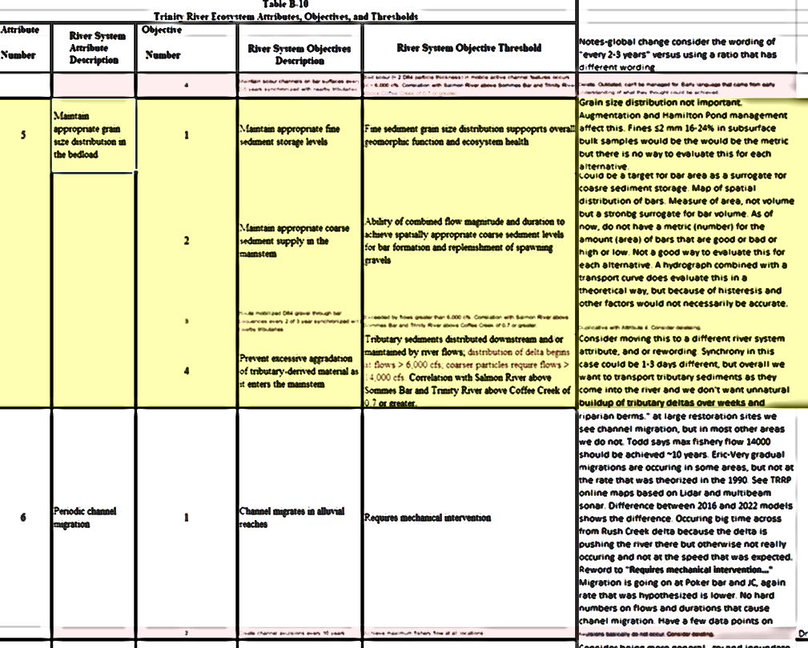
Joint-Leads team
Justin Alvarez (HVT)
Kyle De Juilio (YT)
Seth Naman (NMFS)
Eric Peterson (TRRP/USBR)
Chris Laskodi (TRRP/YT)
Ken Lindke (CDFW)
Dave Gaeuman (YT geomorphology)
Smokey Pitman (ARS/HVT geomorphology)
Todd Buxton (TRRP/USBR geomorphology)
9 Attributes

Slide 18
Attributes of a Functional River
Spatially complex channel geomorphology
  5 objectives… emergent properties of subsequent attributes
Flows are variable and synchronized with tributaries
  5 objectives… largely correlations to SRaSB and variation metrics
Frequently mobilized channelbed surface at appropriate time synchronized with tributaries to support geomorphic function and ecosystem health (winter months)
  2 objectives… threshold based
Periodic channelbed scour and fill at appropriate time synchronized with tributaries to support species and ecosystem health (winter months)
  3 objectives… threshold based
Maintain appropriate grain size distribution in the bedload
  3 objectives… CV, correlations, and thresholds
Periodic channel migration
  1 objective… threshold based
Functional floodplain
  4 objectives… inundation model, threshold, and correlation
Self-sustaining diverse riparian plant communities
  5 objectives… correlations and thresholds
Water temperature and microhabitat
  3 objectives… existing TRRP temperature targets
Σ = 31 Objectives
Don’t worry… I’ll just cover a select few.

Slide 19
Annual Thresholds (for geomorphic change)
Threshold (cfs) | Metric | NAA | Alt 1 | Alt 2a | Alt 2b | Alt 3 | Alt 4b | Alt 6 | Alt 7 | SRaSBadj
<4000 | Frequency | 13% (13%) | 100% (80%) | 15% (15%) | 38% (35%) | 13% (13%) | 40% (38%) | 15% (15%) | 8% (8%) | 5% (5%)
4000-5499 | Frequency | 28% (28%) | 0% (3%) | 28% (25%) | 25% (23%) | 65% (63%) | 23% (20%) | 35% (35%) | 15% (15%) | 3% (3%)
5500-7999 | Frequency | 18% (18%) | 0% (18%) | 18% (20%) | 13% (18%) | 23% (25%) | 15% (20%) | 23% (23%) | 18% (18%) | 15% (15%)
8000-10499 | Frequency | 30% (30%) | 0% (0%) | 38% (38%) | 15% (15%) | 0% (0%) | 13% (13%) | 23% (23%) | 15% (15%) | 13% (13%)
>= 10,500 | Frequency | 13% (13%) | 0% (0%) | 3% (3%) | 10% (10%) | 0% (0%) | 10% (10%) | 5% (5%) | 45% (45%) | 65% (65%)
Values given as: no-SOD (SOD)

Slide 20
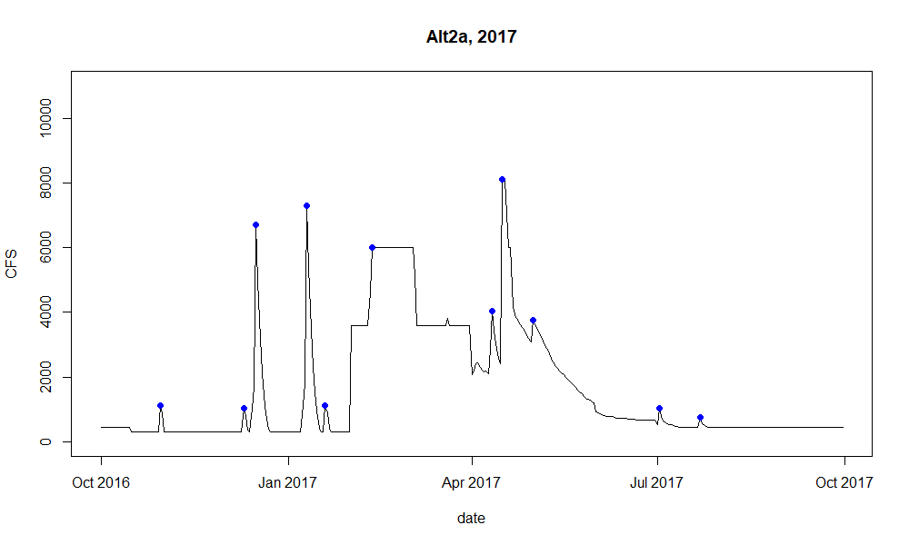
Peak Frequencies
(within years)
 | NAA | Alt1 | Alt2a | Alt2b | Alt3 | Alt4b | Alt6 | Alt7 | SRaSBadj
Average Peaks per Year of any flow rate | 1.875 (2.4) | 1 (1.425) | 8.575 (8.2) | 11.075 (10.225) | 2.475 (2.975) | 10.825 (9.9) | 2.25 (3.15) | 17.425 (17.4) | 23.25
Average Peaks per Year >= 8000 cfs | 0.425 (0.425) | 0 (0) | 0.4 (0.4) | 0.3 (0.3) | 0 (0) | 0.275 (0.275) | 0.275 (0.275) | 1.575 (1.575) | 2.475

Slide 21
Correlations to SRaSBadj (similarity to natural)
Correlation Time Period | NAA | Alt 1 | Alt 2a | Alt 2b | Alt 3 | Alt 4b | Alt 6 | Alt 7
Year-Round (Attr. 5.3, 7.1, 8.1, 8.2, 8.3) | 0.09 (0.35) | 0.07 (0.39) | 0.36 (0.51) | 0.72 (0.69) | 0.26 (0.47) | 0.72 (0.67) | 0.07 (0.38) | 0.89 (0.86)
Fall to Spring (October through March) (Attr. 2.3) | -0.21 (0.43) | -0.19 (0.38) | 0.47 (0.55) | 0.81 (0.74) | 0.31 (0.48) | 0.81 (0.72) | -0.21 (0.48) | 0.89 (0.88)
Snowmelt Peak (April through May) (Attr. 2.4, 7.2) | 0.05 (0.1) | 0 (0.22) | 0.27 (0.29) | 0.36 (0.48) | 0.19 (0.26) | 0.35 (0.46) | 0.03 (0.12) | 0.87 (0.87)
Mobilization Period (December through February) (Attr. 3.1, 3.2, 4.1, 4.2, 4.3) | NA (0.4) | NA (0.35) | 0.45 (0.51) | 0.84 (0.73) | 0.09 (0.41) | 0.84 (0.71) | NA (0.44) | 0.87 (0.86)
Winter (January through March) (Attr. 7.2) | NA (0.4) | NA (0.32) | 0.28 (0.45) | 0.79 (0.74) | 0.04 (0.4) | 0.80 (0.71) | NA (0.43) | 0.85 (0.84)

Slide 22
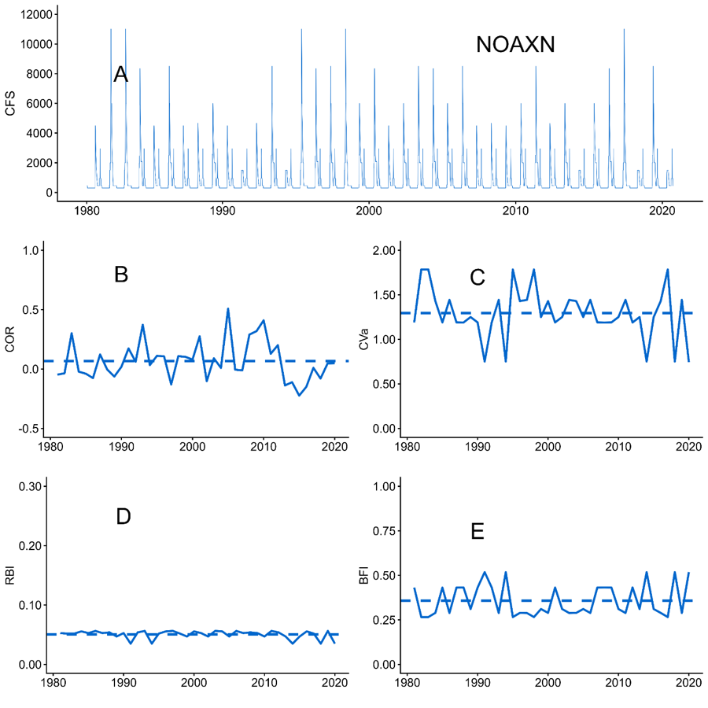
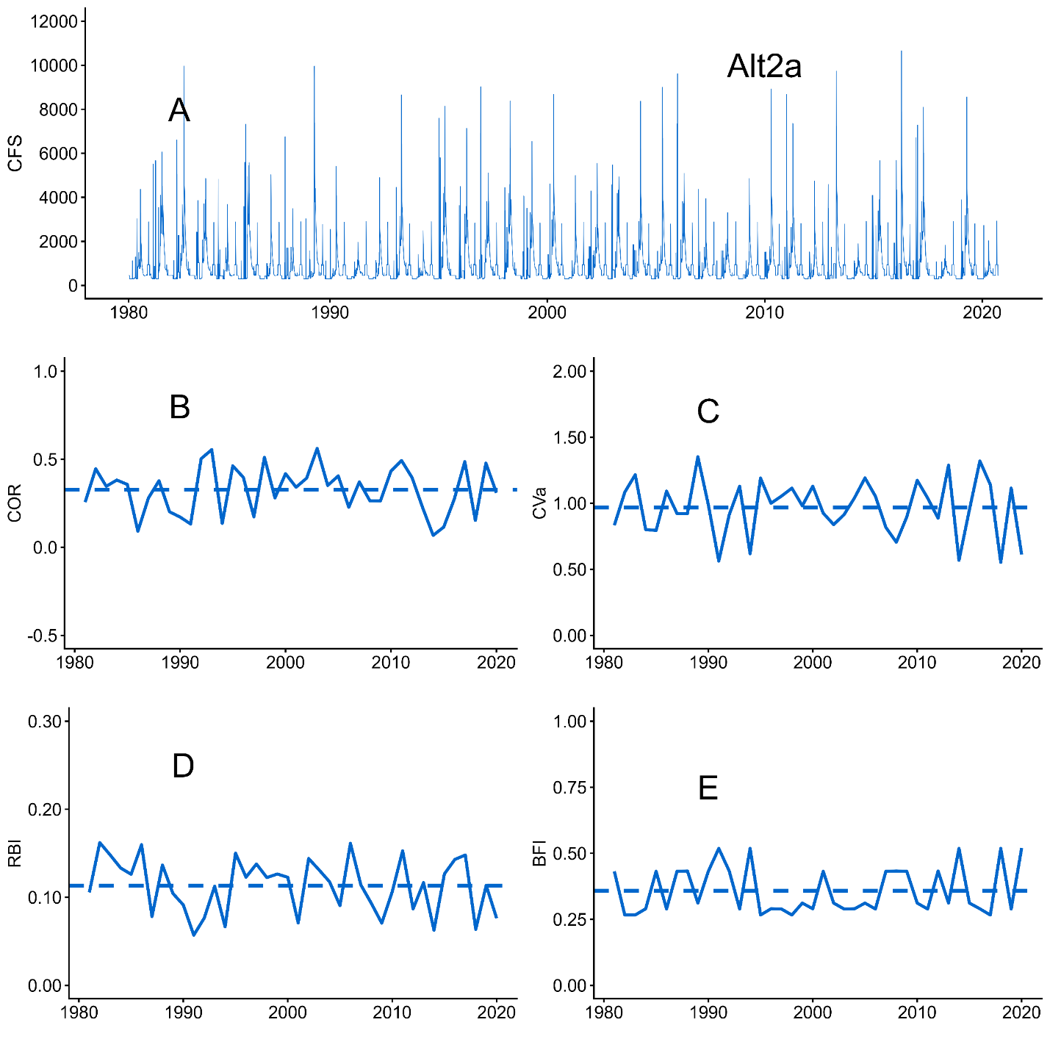
Graphical representations can capture interannual variation

Slide 23
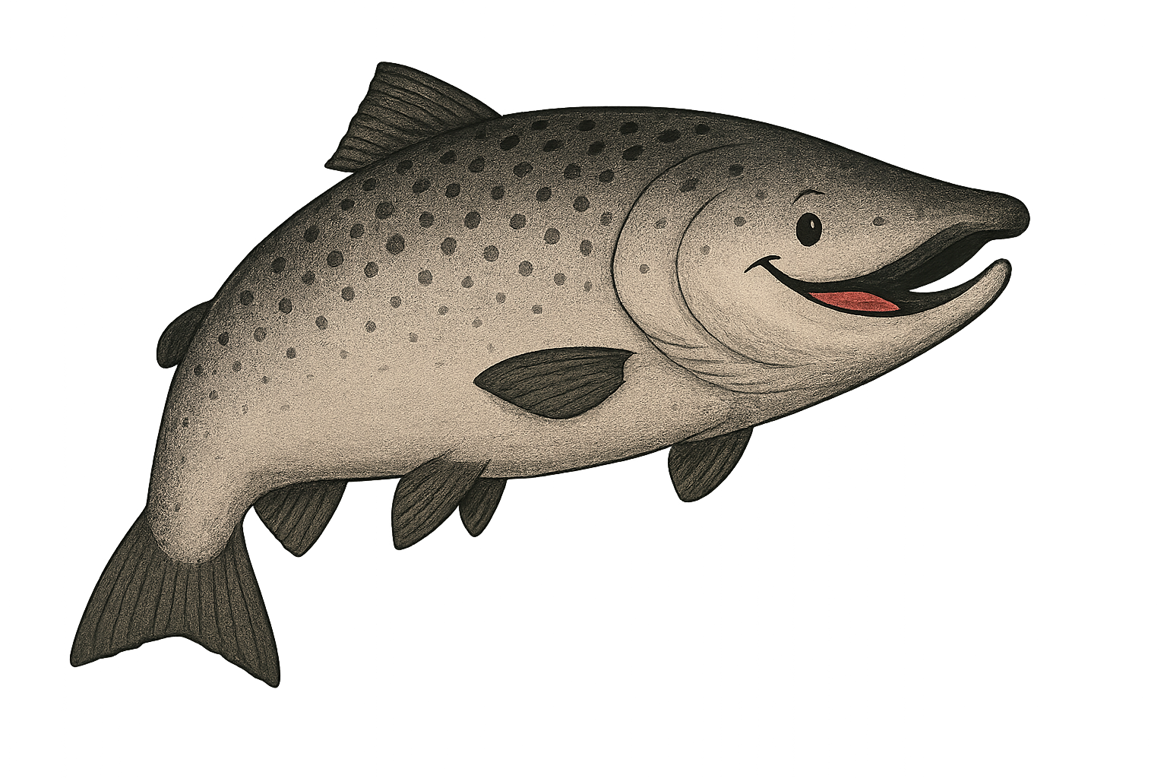
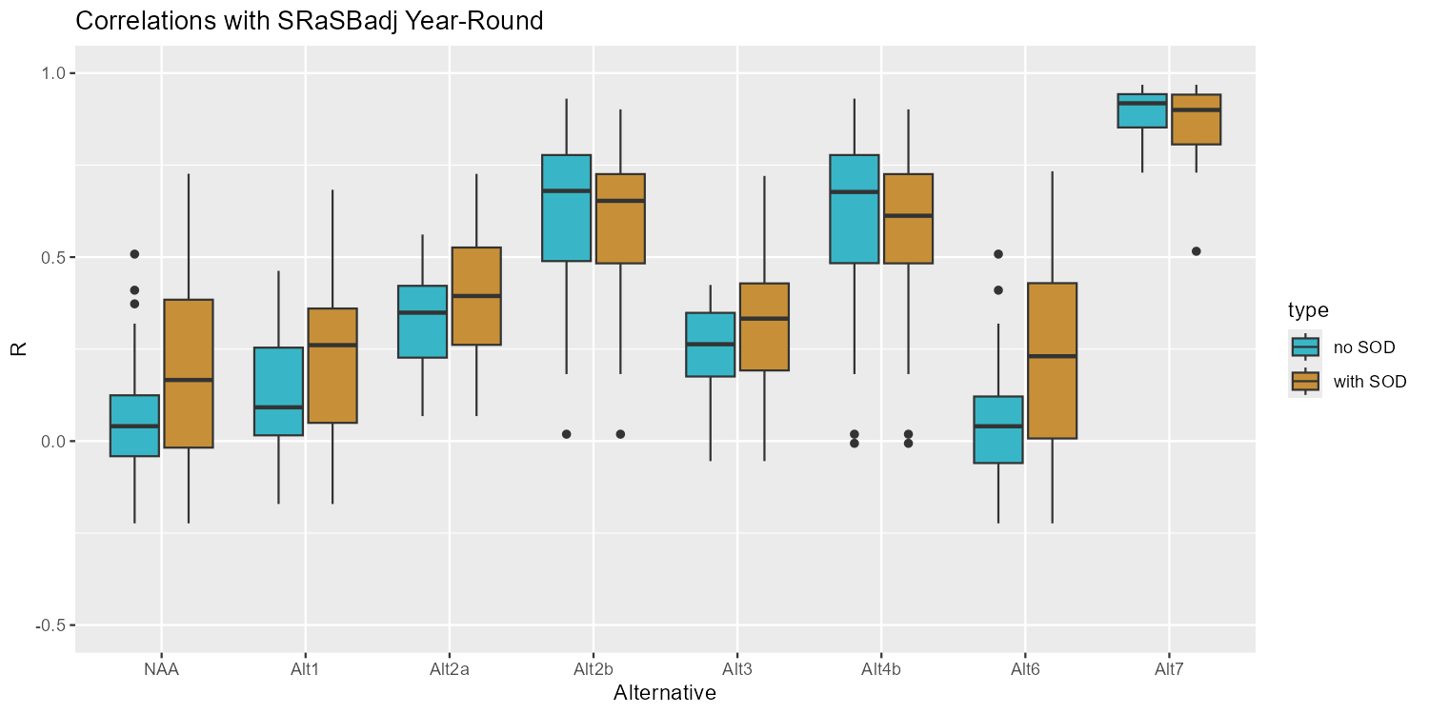
Correlations to SRaSBadj (graphical)
median, first quartile (25th percentile), third quartile (75th percentile), and outliers
Outlier
75th percentile
25th percentile
Median

Slide 24
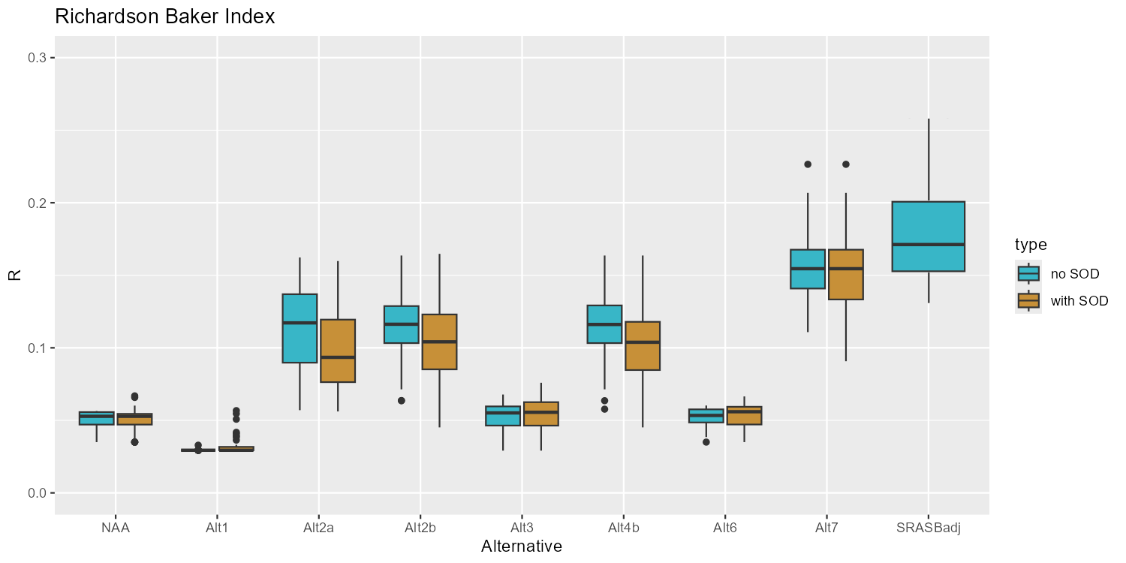
Richardson Baker Index (flashiness)

Slide 25
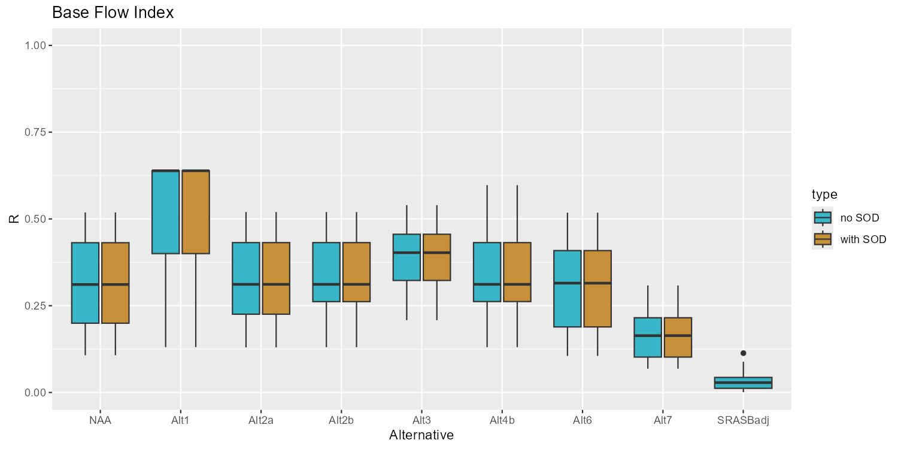
Baseflow Index (lowest flows compared to highest)

Slide 26
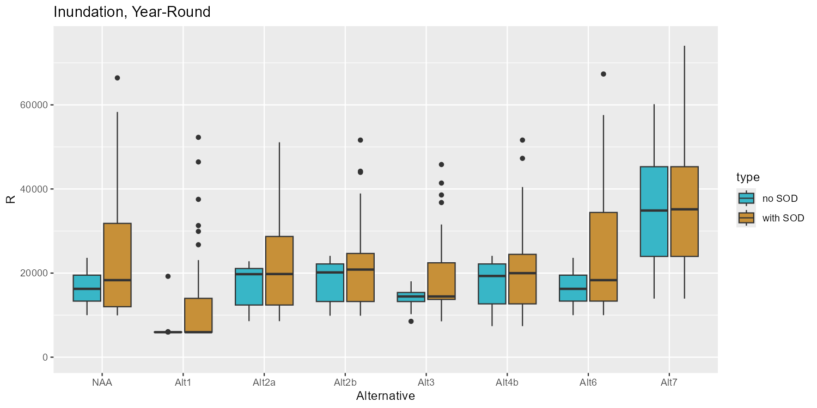
Inundation Duration
(7.1 inundate floodplains)

Slide 27
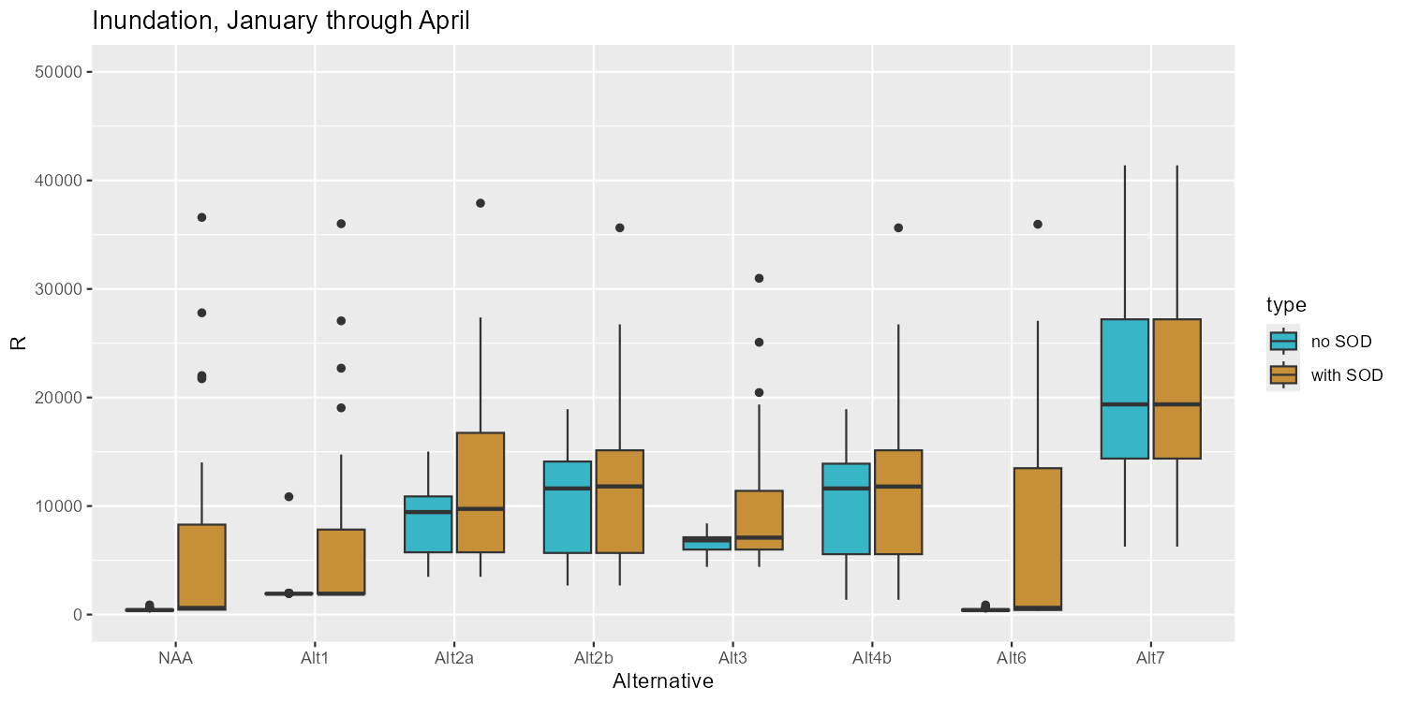
Inundation Duration
(7.3 Inc Habitat, minimize density limits)

Slide 28
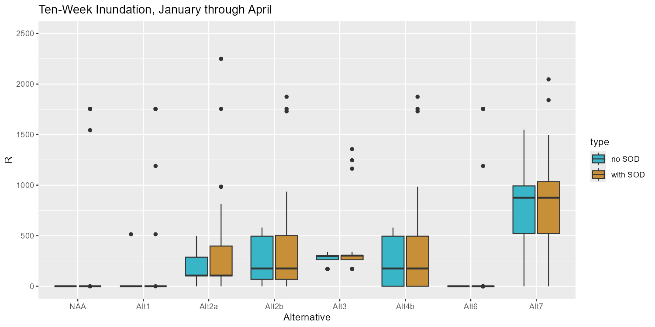
Inundation Duration
(7.4 Establish Foodwebs)

Slide 29
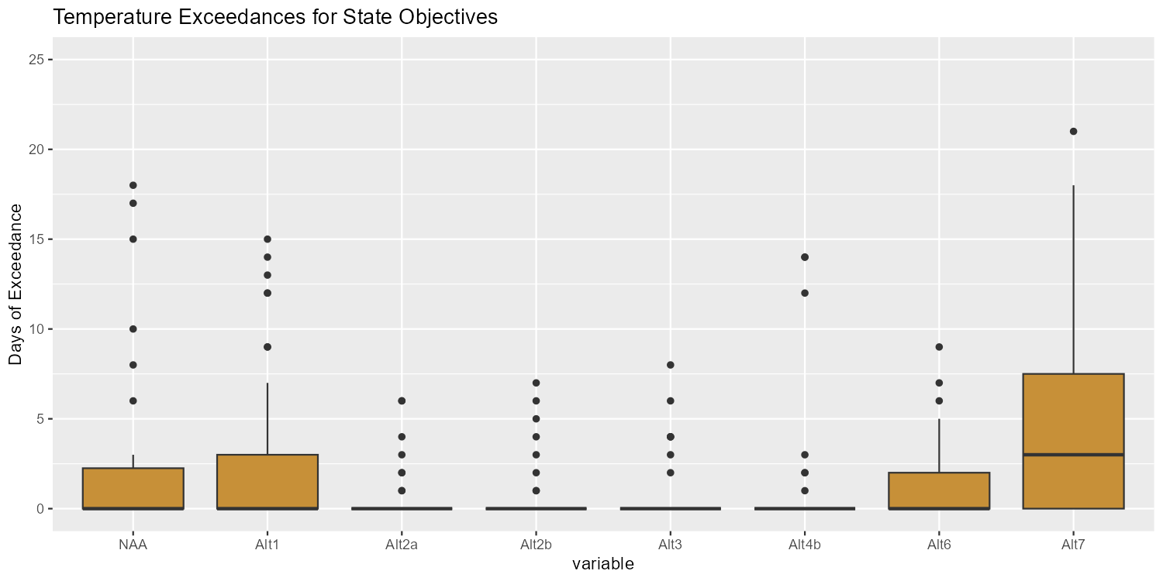
Water Temperatures
(WO 90-5 violations)
Temperature modeling without SOD not available.

Slide 30
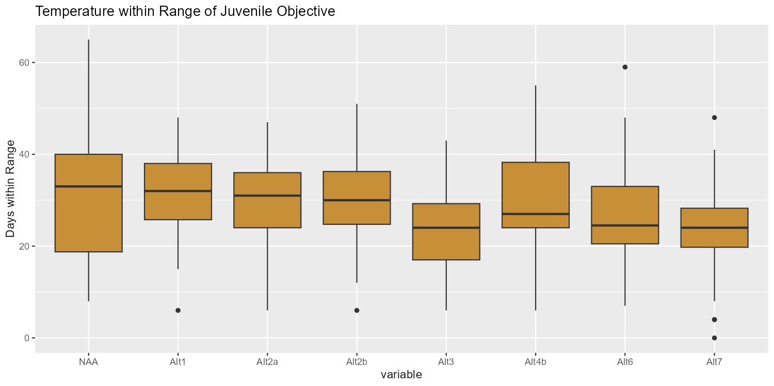
Water Temperatures
(days within 7DADA)
Temperature modeling without SOD not available.

Slide 31
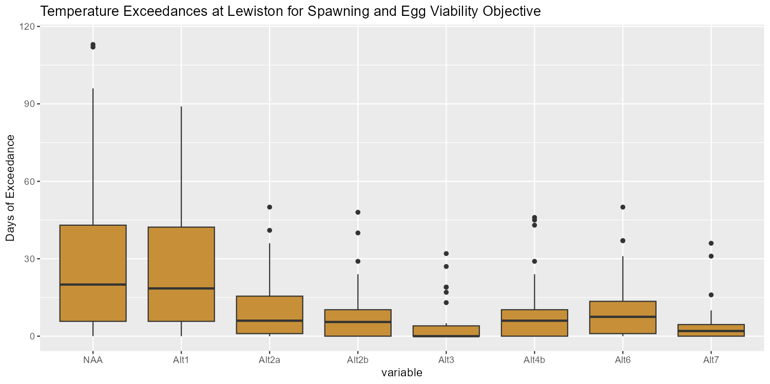
Water Temperatures
(TRRP TRAL target exceedance)
Temperature modeling without SOD not available.

Slide 32
Effects of the No Action Alternative
Achieves minimal geomorphic function for channel maintenance
Misses timing for synchronizing with watershed hydraulics
Misses timing for inundation to benefit salmonid habitat and food webs
Decent for juvenile temperatures in many years (but not all)

Slide 33
Summary Relative to NAA
Degradation from NAA,
or just little improvement
Strong improvement over NAA
Alt 1 – almost universally the lowest ranked
Alt 6 – minimal temperature improvement, otherwise poor performance
Alt 3 – generally poor, but intriguingly reliable inundation
  Something to think about for AM
Alt 2 (a and b) best overall performance
  a versus b? Each has benefits. AM hybrid?
Alt 4 not quite as good as Alt 2
Alt 7 great geomorph, great inundation, weak for some temperature metrics.

Slide 34
Extra

Slide 35
Daily Coefficient of Variation (CVd)
Correlation to SRaSBadj
 | NAA | Alt1 | Alt2a | Alt2b | Alt3 | Alt4b | Alt6 | Alt7
r-value for July-September (Attr 2.1) | 0.14 (0.14) | 0 (0.04) | 0.27 (0.21) | 0.29 (0.21) | 0.56 (0.23) | 0.29 (0.21) | 0.04 (0.04) | 0.09 (-0.14)
r-value for January-March (Attr 2.2) | NA (0.58) | NA (0.56) | 0.43 (0.35) | 0.87 (0.83) | 0.11 (0.11) | 0.87 (0.84) | NA (0.39) | 0.83 (0.83)
r-value for May-September (Attr 8.5) | -0.06 (-0.05) | -0.26 (-0.1) | -0.08 (0.01) | -0.09 (-0.04) | -0.18 (-0.04) | -0.1 (-0.04) | -0.15 (-0.13) | -0.07 (0.05)

Slide 36
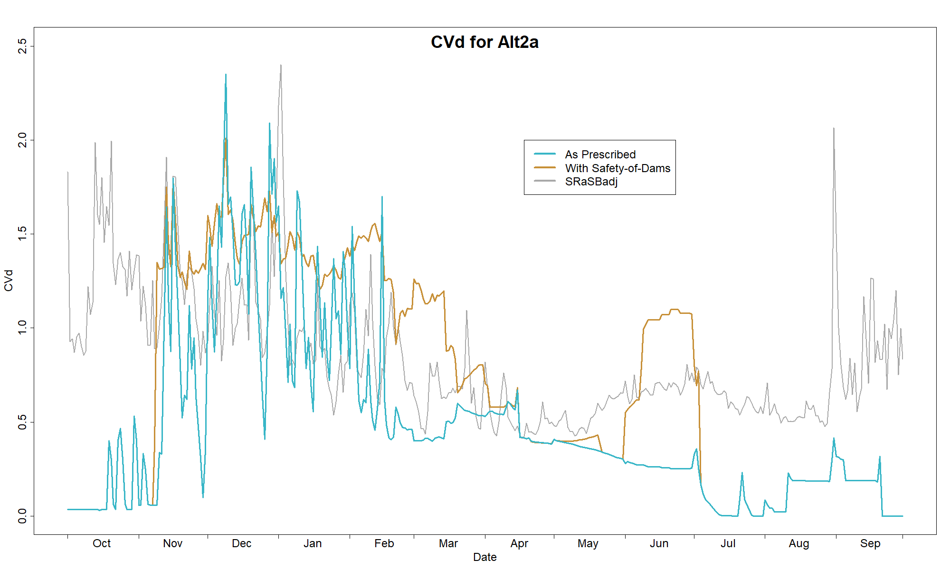
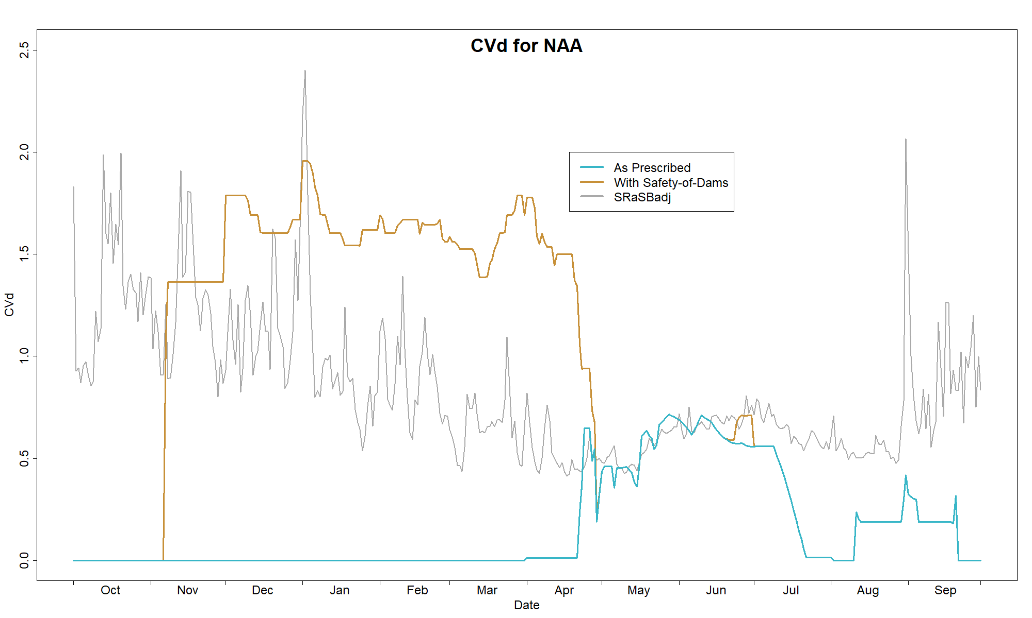
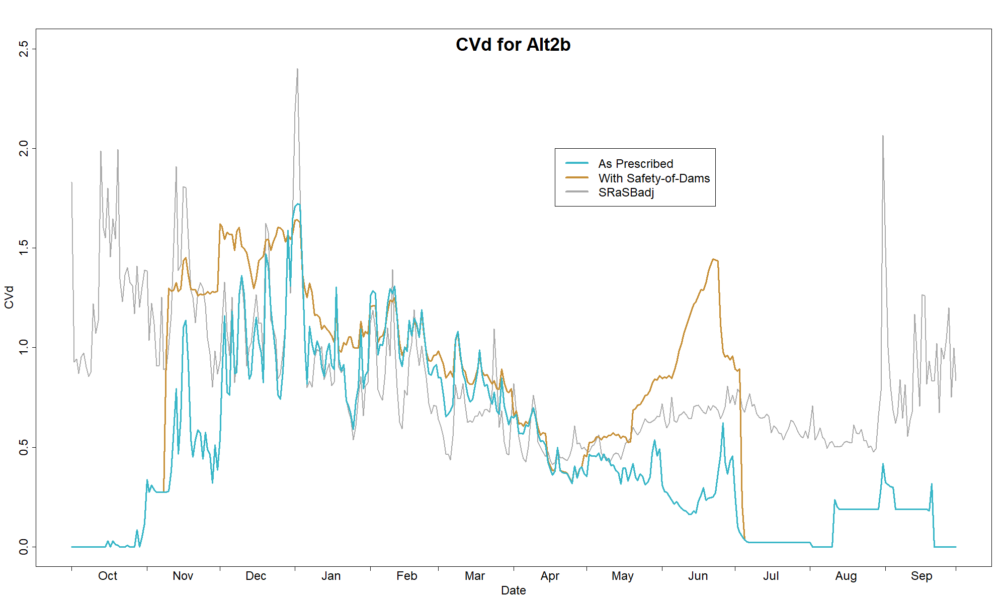
Daily Coefficient of
Variation (CVd)

Slide 37
Effects of Hydrology: Alt 1
Fails to provide geomorphic function to maintain channel
Misses timing for synchronizing with watershed hydraulics
Misses timing for inundation to benefit salmonid habitat and food webs

Slide 38
Effects of Hydrology: Alt 2a
Substantial improvement over NAA in geomorphic function for maintaining channel
Flows better synchronized with watershed hydraulics
Beneficial inundation timing for salmonid habitat and food webs

Slide 39
Effects of Hydrology: Alt 2b
Substantial improvement over NAA in geomorphic function for maintaining channel
Flows highly synchronized with watershed hydraulics
Beneficial inundation timing for salmonid habitat and food webs

Slide 40
Effects of Hydrology: Alt 3
Fails to provide geomorphic function to maintain channel
Misses timing for synchronizing with watershed hydraulics
Oscillating baseflows provide reliable inundation to benefit salmonid habitat and food webs

Slide 41
Effects of Hydrology: Alt 4b
Parallel to 2b, main difference is slightly less inundation.
Assume if 4a were analyzed, it would show similar parallel.

Slide 42
Effects of Hydrology: Alt 6
Achieves meager geomorphic function for channel maintenance (less than NAA, more than Alt 1)
Misses timing for synchronizing with watershed hydraulics
Misses timing for inundation to benefit salmonid habitat and food webs
Note: water temperatures at higher end among alternatives for adult holding; only moderate for juveniles, spawning, and egg incubation.

Slide 43
Effects of Hydrology: Alt 7
Achieves greatest geomorphic function for channel maintenance, perhaps with too many 11,000 cfs.
Strong synchronization with watershed hydraulics
Outstanding inundation to benefit salmonid habitat and food webs
Note: poor temperature performance for adult holding and juvenile objectives.

