Slide 1

Safety of Dams and TRRP Flows
Trinity Management Council 2026-06-17
Patrick Flynn – Flow WG Coordinator
Notes:
Coordinator since early June
TRRP/county role funded partially by TRRP

Slide 2
Table of Contents
Safety of Dams overview/history
Recent Safety of Dams releases
Impacts to fishery
Operational Realities of SODs
What is already being done
Potential TMC/TRRP actions
Notes:
Memo provided to IDT and TMC yesterday 9/10

Slide 3
Safety of Dams Overview/History
SOD releases
  Implemented when Trinity Lake levels could become unsafe due to lake levels and inflow
  Not counted as restoration flow volume
  Focus is safety of the dam infrastructure
SOD releases have happened in five water years since 2001
  2004, 84kaf, Wet
  2006, 408kaf, Ex. Wet
  2017, 36kaf, Ex. Wet
  2025, approx. 66kaf, Wet
  2026, 80kaf, Normal
Notes:
Memo provided to IDT and TMC yesterday 9/10

Slide 4
Recent SOD Releases
SODs releases happened in WY25 and WY26
First SOD releases since the Winter Flow project began
  These releases now impact restoration flows
Notes:
Memo provided to IDT and TMC yesterday 9/10

Slide 5
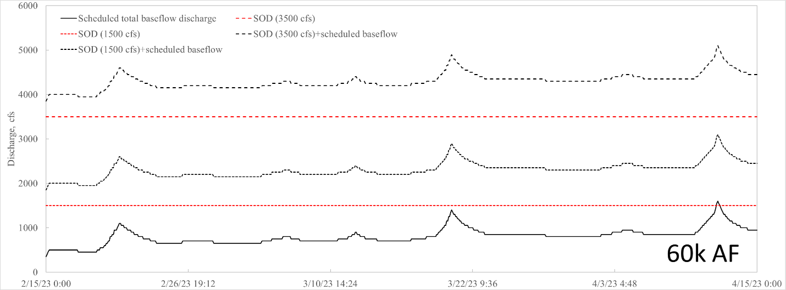
Recent SOD Releases
Notes:
This hydrograph shows the different options that we considered when deliberating how to approach SODs.
Black line on the bottom is the actual elevated baseflow schedule that was approved by TMC for WY2023. Red line above the bottom black line is 1500cfs. Other red line is 3500 cfs.
We also considered, but did not choose, to implement the elevated baseflows on top of the SODs. These are the other black lines.

Slide 6
SOD Impacts to Fishery
SOD flows can encourage spawning in areas that may become dewatered when the SOD flows are cut
Encourages primary production in areas that will not persist (i.e. higher elevation on the floodplains) if the flows are returned to baseflow
Push fish on to higher elevation floodplains and depending on the recession timing, can potentially strand fish.
SOD flows impact the 3-year WFV study
Notes:
Memo provided to IDT and TMC yesterday 9/10

Slide 7
Operational Realities
SOD releases are unavoidable and driven by storage encroachment, not TMC decisions
Management Actions
SOD flow effects are being fully evaluated in the ongoing long term operation EIS reconsultation
Analysis includes 40 years of modeled hydrographs, some containing SOD like events
ROD flows have always been accounted for “underneath” SOD releases, even when those releases have been 300 cfs (pre-WFV).
Notes:
Memo provided to IDT and TMC yesterday 9/10

Slide 8
Potential TMC/TRRP Actions
Continue to encourage coordination between CVO and TRRP
Others…discussion?
Notes:
Memo provided to IDT and TMC yesterday 9/10

Slide 9
Flow Workgroup WY2026 Spring Flow Recommendation:
Based on DSS results, workgroup recommends Set A for implementation in WY2026.
One hydrograph would be implemented for each scenario that could occur depending the April B120 forecast (shown previously).

Slide 10
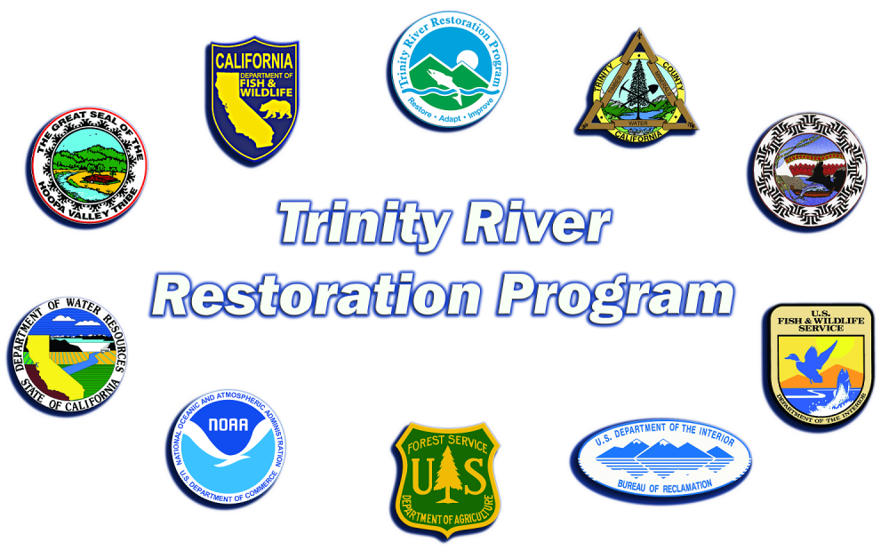
Recap and Questions
Safety of Dams overview/history
Recent Safety of Dams releases
Impacts to fishery
Operational Realities of SODs
What is already being done
Potential TMC/TRRP actions
Questions/Discussion?
Notes:
Recap:
Talked about how we got here
Talked about the planning process and meetings we had
Worked through DSS results
Made a recommendation
Questions?

