Slide 1
Fiscal Year 2027 Science Proposal from the
TRRP Interdisciplinary Team (IDT)
Eric Peterson, USBR/TRRP
Science Coordinator
Ken Lindke, CDFW
IDT Environmental Flows Subcommittee Coordinator

Slide 2
Three Presentations for the Price of One!
FY27 IDT Science Proposal, composed of:
  Environmental Flow Study Projects
  Monitoring and DSS Review Recommendations

Slide 3
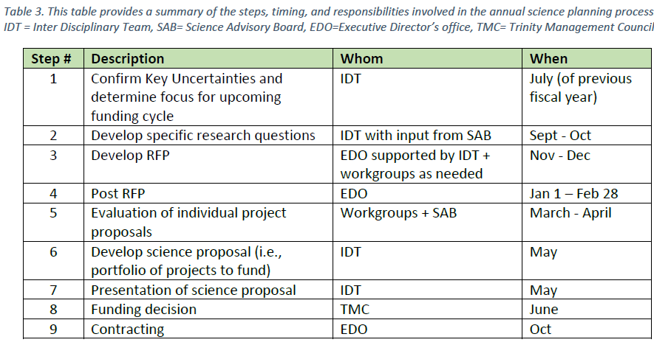
IDT Planning for FY27
TRRP Science Plan:
IDT meeting July 2025:
  Recognized that Environmental Flow Study and Monitoring/DSS Reviews would have plenty work to propose
  Canceled RFP process

Slide 4
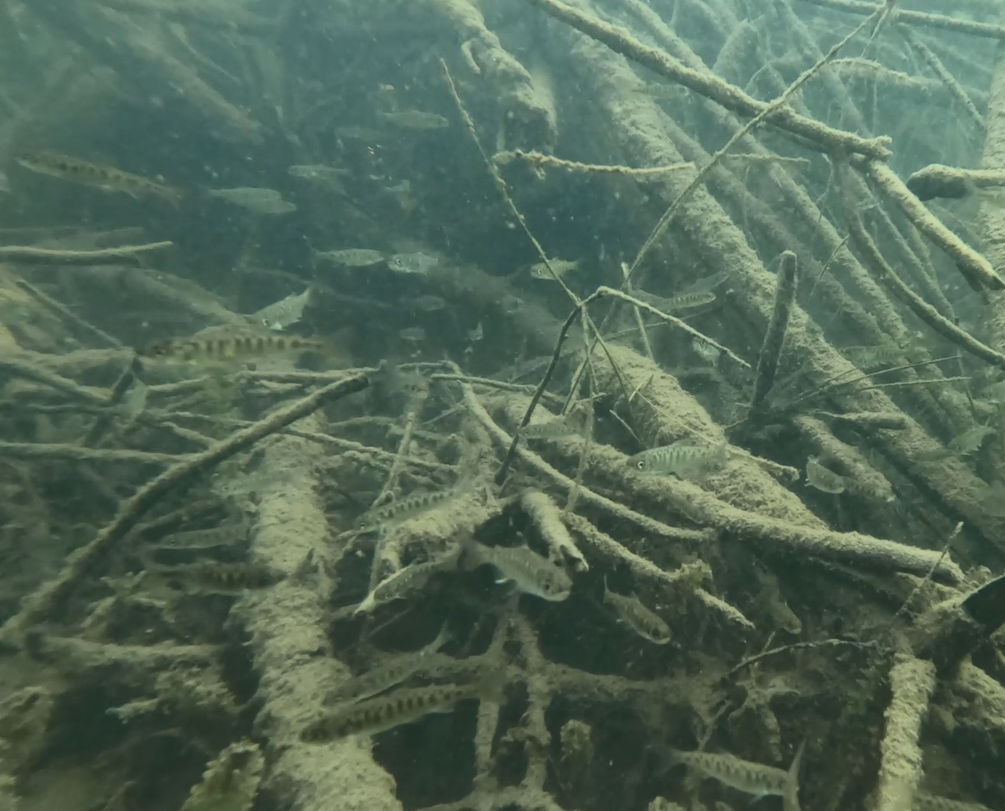

Environmental Flow Management Study Plan development
Ken Lindke, CDFW
Eric Peterson, USBR/TRRP

Slide 5
EFM Study Plan: Authorship and representation
Yurok Tribe
Chris Laskodi
Dave Gaeuman
Kyle De Juilio
Hoopa Valley Tribe
Justin Alvarez
USBR
James Lee
Eric Peterson
USFWS
Taylor Daley
Brad Nissen
Trinity County
Patrick Flynn
NOAA Fisheries
Seth Naman
Applied River Sciences
Scott McBain
John Bair
Smokey Pittman
CDFW
Ken Lindke
Representation from all TRRP agencies/entities except USFS
Representation from every main scientific discipline of interest to the Program
Notes:
list of co-authors
note all disciplines an all agencies except USFS

Slide 6
EFM Study Plan:
two phase structured decision-making process
Phase I
Information and hypothesis gathering
SMART hypotheses
Refinement and distillation
Phase II
Scoring
Prioritization
Identification of funding needs for FY27

Slide 7
EFM Study Plan: Phase I
Overview of process
Compiled hypotheses from foundational documents and brainstormed novel hypotheses
Organized by subject
Interrogated each hypotheses based on a series of questions to refine and distill to a smaller and relevant set to advance to scoring and prioritizing:
  Is the hypothesis SMART or can it be refined to a SMART hypothesis?
  Is it multiple hypotheses, if so, separate into specific testable hypotheses
  Direct relevance to EFM?
  Has the hypothesis already been adequately addressed with prior analyses?
Started with 91 hypotheses, expanded to 109, finished with 44

Slide 8
EFM Study Plan: Phase I
Subjects considered
Hydrology and geomorphology (11)
Water quality/temperature (9)
Reservoir management, lake levels, and hydropower (2)
Riparian plants (22)
Wildlife (18)
Fish (22)
Foodscape (5)
Periphyton and algae (6)
Human environment – angling and recreation (14)
Foundational Documents consulted
Flow study and ROD
Winter variable flow final report and EA
Integrated Assessment Plan (IAP)
Science Plan
Objectives and Targets document
Conceptual models report (2009)
*Novel hypotheses

Slide 9
EFM Study Plan: Phase I
Refinement phase started with 109 hypotheses
Hydrology and geomorphology (11)
Water quality/temperature (9)
Reservoir management, lake levels, and hydropower (2)
Riparian plants (22)
Wildlife (18)
Fish (22)
Foodscape (5)
Periphyton and algae (6)
Human environment – angling and recreation (14)
Finished with 44

Slide 10
EFM Study Plan: Phase II
Scoring criteria
Is the expected response sensitive enough to the EFM experiment and sufficiently free from confounding factors to be measurable?
Can the hypothesized response be measured within the experimental timeframe (3 years)?
Do we have existing data and/or analytical tools to evaluate the hypothesis?
Does the hypothesis address a significant programmatic uncertainty or disagreement, e.g., Science Plan key uncertainties, 2000 ROD objectives, etc.?
Is the hypothesis a core hypothesis of anticipated effects of the EFM to the Trinity River?
Scoring process
Scored by subject matter experts
Reviewed and discussed by entire group
All hypotheses sorted by score
Group discussion and professional judgement to agree upon final recommended list
Identified new data collection efforts needed to address selected hypotheses

Slide 11
EFM Study Plan: Phase II
Hypotheses forwarded to scoring/prioritization (44)
Hydrology and geomorphology (9)
Water quality/temperature (2)
Reservoir management, lake levels, and hydropower (2)
Riparian plants (2)
Wildlife (5)
Fish (13)
Foodscape (2)
Periphyton and algae (2)
Human environment – angling and recreation (7)
Scoring process
Scored by subject matter experts
Reviewed and discussed by entire group
All hypotheses sorted by score
Group discussion and professional judgement to agree upon final recommended list
Identified new data collection efforts needed to address selected hypotheses

Slide 12
EFM Study Plan: finalizing hypotheses
Memo describing process to date that includes hypotheses
SAB review
Programmatic review
Proposal development for FY27

Slide 13
EFM Study Plan: finalizing hypotheses
Among 44 hypotheses scored and prioritized, 30 are recommended by the EFM Study Plan subcommittee
Many hypotheses can be grouped into single efforts, likely ~12 efforts overall to address 30 hypotheses.
Most hypotheses can be addressed with existing long-term monitoring or modelling data
7 hypotheses require additional data collection in FY27 to be addressed
Proposal development for FY27

Slide 14
EFM Study Plan: FY27 funding
Funding requested for the following projects:
Evaluating the timing of tributary peak flows relative to EFM
Evaluating EFM effectiveness for increasing sediment transport capacity above tributary junctions
Evaluating EFM effectiveness for mobilizing coarse fine sediment from the mainstem Trinity River near tributary junctions
Evaluating Changes to Late Spring and Summer Near-Channel Groundwater Dynamics in Response to EFM
Benthic Macroinvertebrate Monitoring - Streambed Disturbance and Seasonal Inundation (addresses two hypotheses)
** Pilot study on shifts in Merganser predation due to EFM

Slide 15
EFM Study Plan: next steps
Draft memo describing process and includes hypotheses - Done
SAB review - Done
Programmatic review - Done
Proposal development for FY27 - Done
Following SAB and Programmatic review, finalize list of hypotheses
Study plan development for selected hypotheses
Complete draft report for SAB and Programmatic review
Response to comments, final report

Slide 16
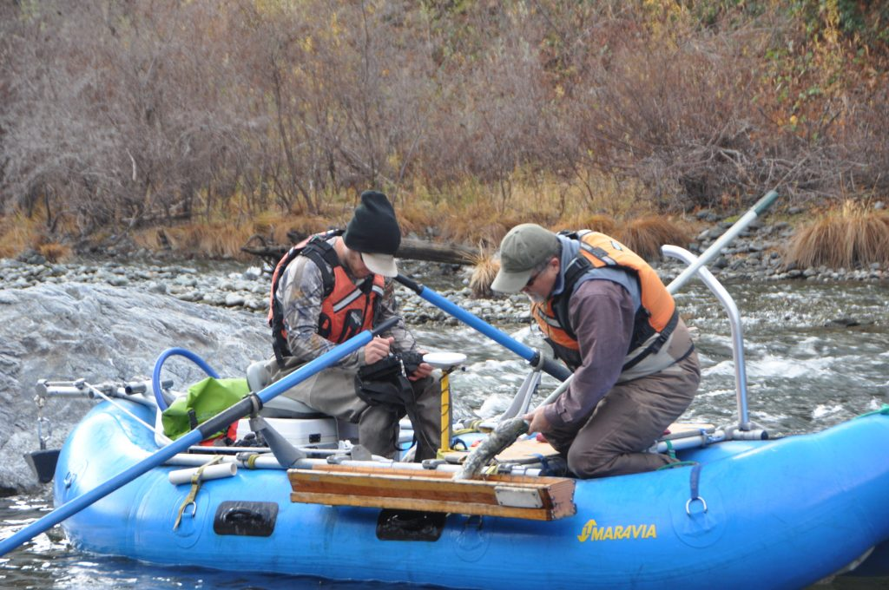
Monitoring and DSS Reviews

Slide 17
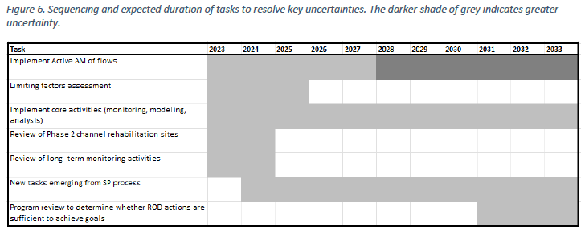
Monitoring and DSS Reviews
TRRP Science Plan:

Slide 18
IDT Monitoring and DSS Review
Strategy
Start with internal review
  option to identify need for contracting deeper review
Added DSS due to concerns from Flow Workgroup
IDT meeting, Sept. 2024
  Identified ca. 30 review topics
  Assigned topics to Workgroups
    Option for workgroups to identify unmet needs
    Workgroups generally used subcommittees
    Reviewers could not be funded for the topic, but could reach out to topic participants
Completed reviews January 2026
Drafted memo with implementation plan

Slide 19
IDT Monitoring and DSS Review
Implementation Plan
Spring 2026 draft summary:
  Final set of 27 reviews
  IDT’s Implementation Plan
Reviewed by SAB
  Final report pending
Most common recommendation:
  Catch up on report and data deliveries
Many small changes not requiring funding adjustments
  To be implemented through workgroups
Funding adjustments:
  Test grain-size mapping with multibeam sonar
  Add turbidity at 3 gages
  Add temperature at 3 gages
  Cut funding for Burnt Ranch gage
  Contract assistance for Fish WG on outmigrant and run-size monitoring strategies
  Budget for Physical WG on
  sed. aug. monitoring
  Develop TARGETS documentation
  Enhancements to S3 model
  Assess need for Spawning Surveys from North Fork to Willow Creek Weir

Slide 20
Recommended Funding Adjustments
Add turbidity at 3 gages ($139k)
  Limekiln (Steelbridge), Junction City, Above North Fork
  Realtime telemetry
  Applied River Sciences
Add temperature at 3 gages ($39k)
  Coffee Creek, Junction City, Hyampom
  Realtime telemetry
  USGS
Cut funding for Burnt Ranch gage ($-35k)
  Not used in any TRRP analyses
Budget for Physical WG on sed. aug. monitoring ($50k)
  Topography, pebble counts, etc.
  Annual application to be managed by WG
Develop TARGETS 1D documentation ($32k)
  We have a manual, nothing on model mechanics
  Proposal will include validation

Slide 21
Putting both topics together…
IDT met on May 4th to prioritize the list across
  Environmental Flow Study
  Monitoring and DSS Recommendations
  Consensus prioritization
Affirmed at the IDT meeting June 3rd

Slide 22
IDT FY27 Science Proposal
Priority | Category | Item | Cost Est | Running Total | Recurrence
1 | Mon&DSS | Drop Burnt Ranch Gage (EST) USGS | $ -29,600.00 | $ -29,600.00 | annual
2 | Mon&DSS | Sediment Augmentation Monitoring WG Budget | $ 50,000.00 | $ 20,400.00 | annual
3 | EFS | Tributary Synchronization | $ 14,558.00* | $ 34,958.00 | one time
4 | EFS | BMI | $ 124,129.00 | $ 159,087.00 | covers 2 years
5 | EFS | Sed Above Tribuary Junctions | $ 34,315.00 * | $ 193,402.00 | one time
6 | EFS | Coarse Fine Sed at Deltas | $ 28,851.00 * | $ 222,253.00 | one time
7 | Mon&DSS | Turbidity (Limekiln, JC, aboveNF) ARS | $ 138,700.00 | $ 360,953.00 | one time, then ~12k
8 | Mon&DSS | TARGETS 1D documentation | $ 32,191.00 | $ 393,144.00 | one time
9 | EFS | Groundwater Dynamics | $ 121,256.00* | $ 514,400.00 | one time
10 | EFS | Mergansers** | $ - | $ 514,400.00 | one time
11 | Mon&DSS | Temp (abCC, JC, Hyampom) USGS | $ 39,000.00 | $ 553,400.00 | one time, then ~half
* Costs likely to change with SAB recommendations (<10%, <25%, <20%, ca .-10%, respectively). At maximums, that is +15,801 and -12,126.
** Prioritized low, but with no funding requested, we will move forward anyway.

