Slide 1
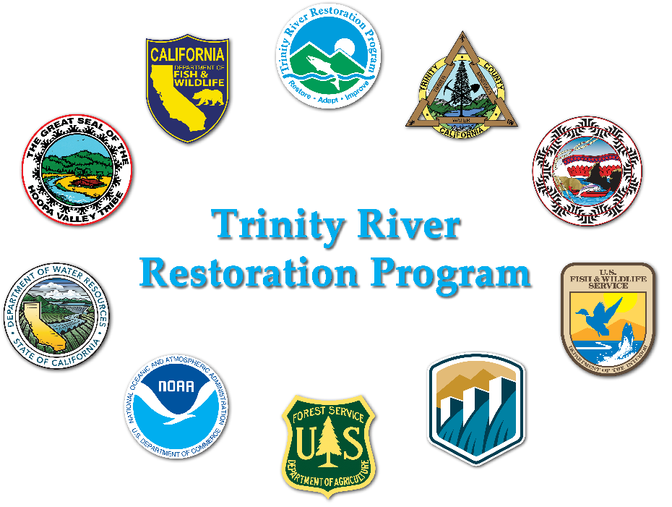
The long-term goals of this Program are to restore the form and function of the Trinity River; restore and sustain natural production of anadromous fish populations in the Trinity River to pre-dam levels; and to facilitate full participation by dependent tribal, commercial, and sport fisheries through enhanced harvest opportunities.
Notes:
This goal statement was adopted by the TMC in December 2019 to highlight that we are using process based-restoration to bring back fish for people

Slide 2
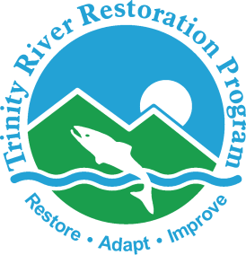
Priorities for Fiscal Year 2027
Budget Proposal
Mike Dixon
Executive Director

Slide 3
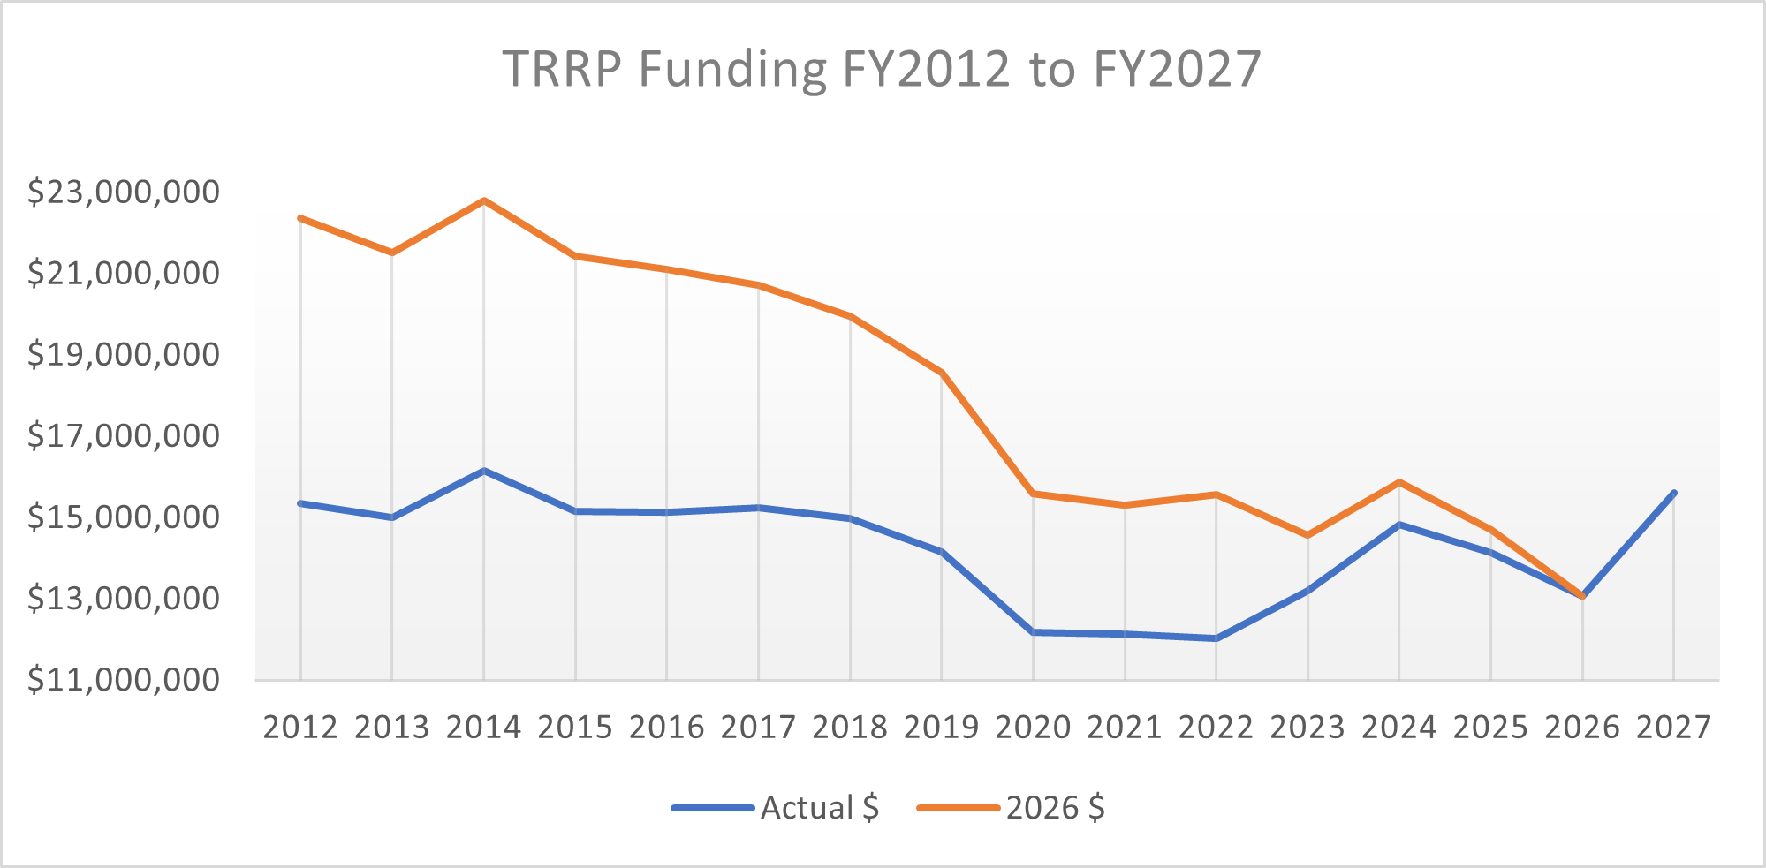

Slide 4
What is planned in 2027?
40-mile topographic survey
Evans Bar Channel Rehabilitation Project
Environmental Flow Study ongoing

Slide 5
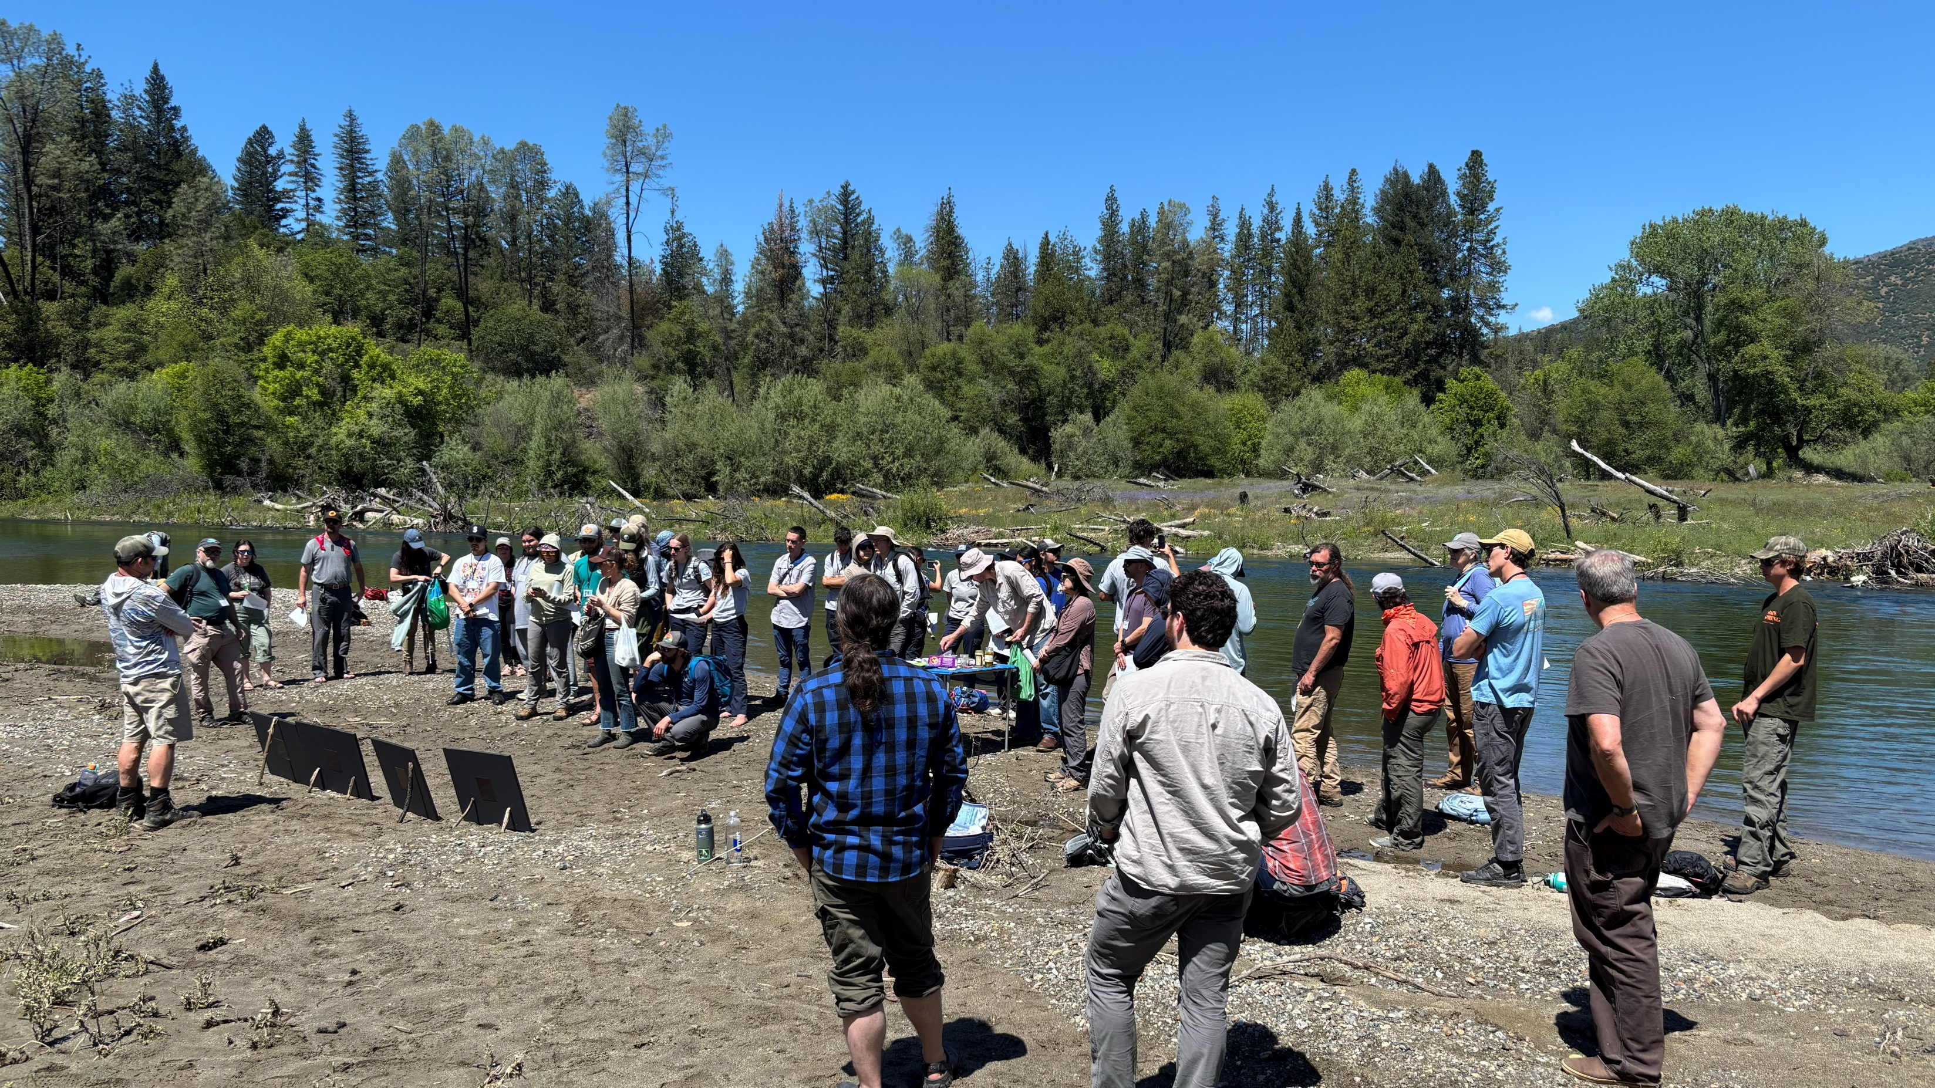
Maintain support for program partner engagement
Photo credit: Mike Dixon, Reclamation

Slide 6
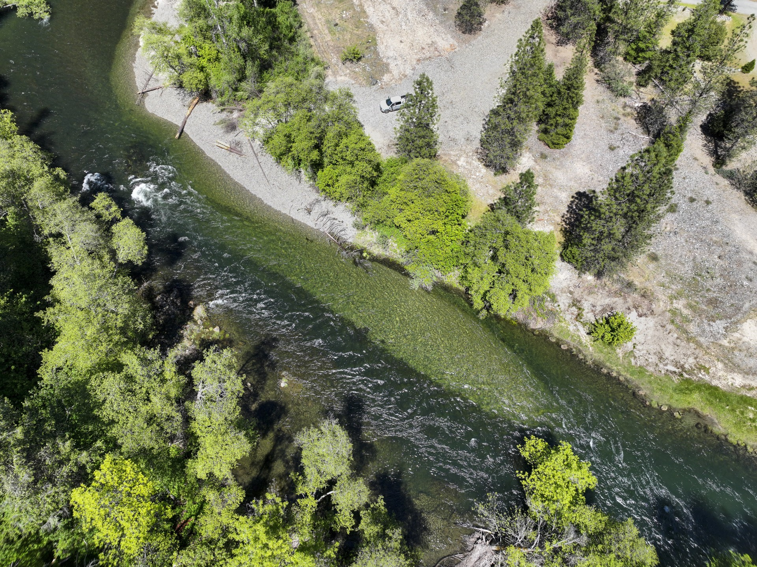
Continue to implement effective restoration actions
  Initiate Evans Bar Channel Rehabilitation Project
  Advance designs for remaining projects
  Continue pause on watershed grant funding
  Place sediment, if recommended
Photo credit: Eric Wiseman, YTCC

Slide 7
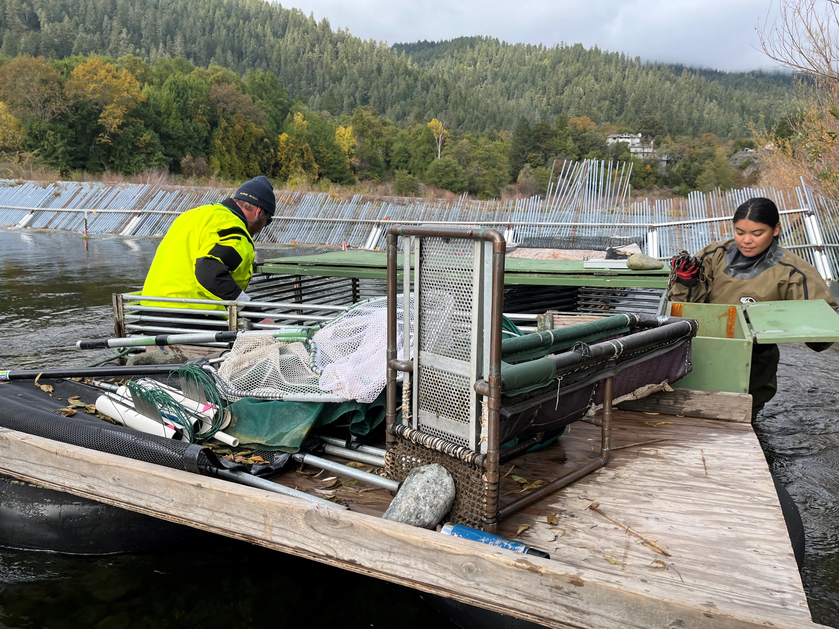
Implement our tools through adaptive management
Continue long term monitoring
Fund key EFS projects
Photo credit: Mike Dixon, Reclamation

Slide 8
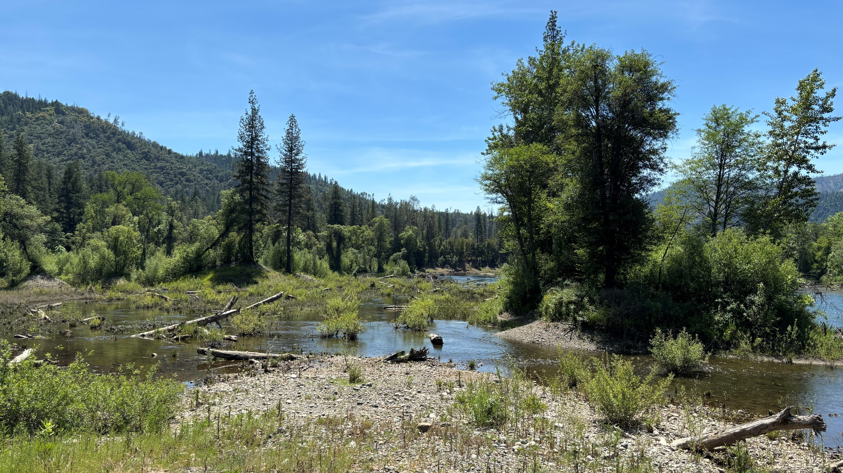
Discussion

