Slide 1
2026 Ocean and Freshwater Fishery Planning Overview Klamath/Trinity Focus
Brett kormos – CDFW
Coastal Fisheries Program Manager

Slide 2
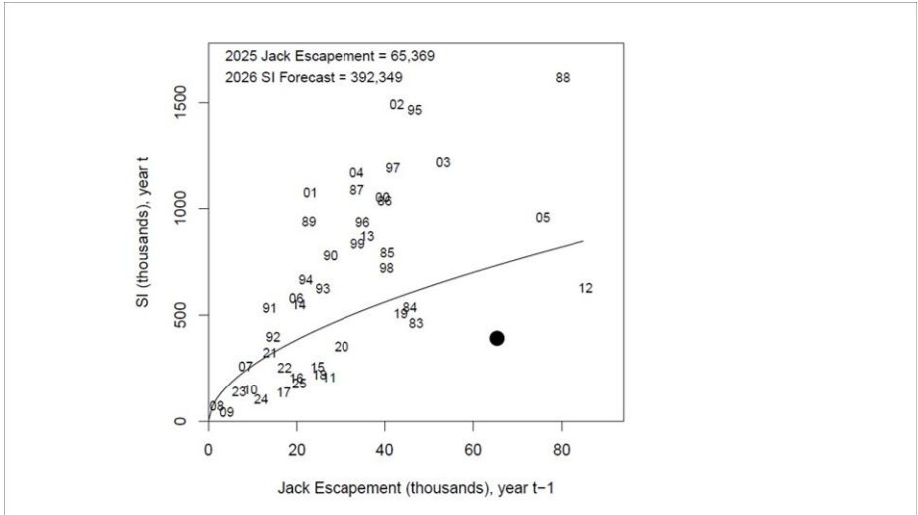

SRFC Forecast

Slide 3
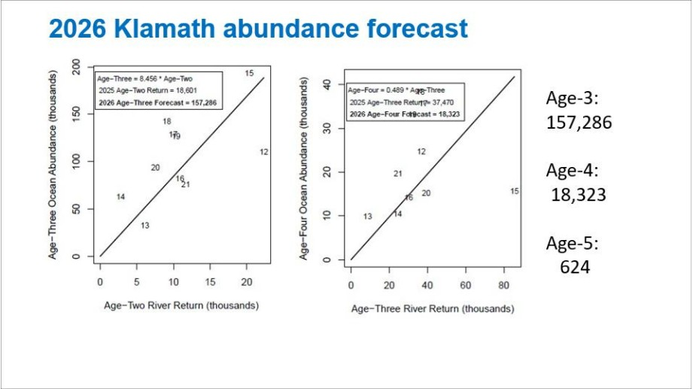




KRFC Forecast

Slide 4
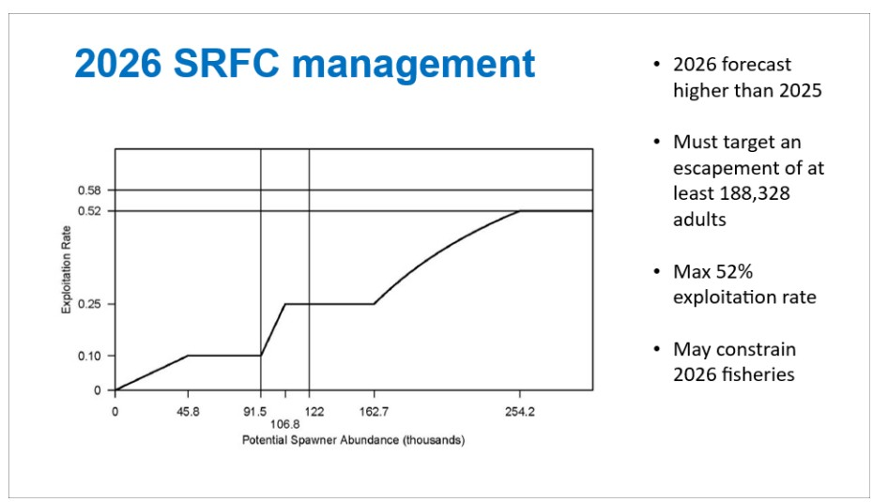
SRFC Harvest Control Rule

Slide 5
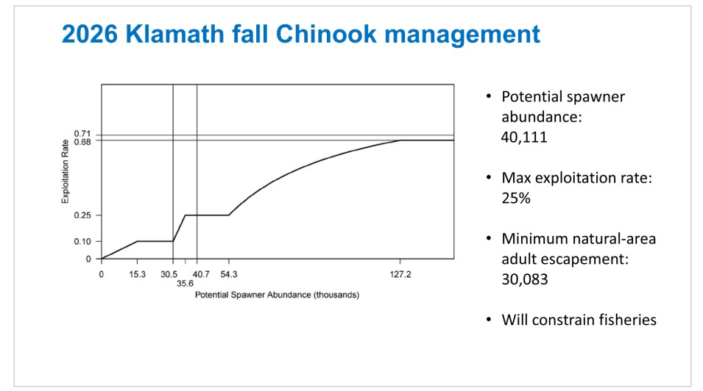
KRFC Harvest Control Rule

Slide 6
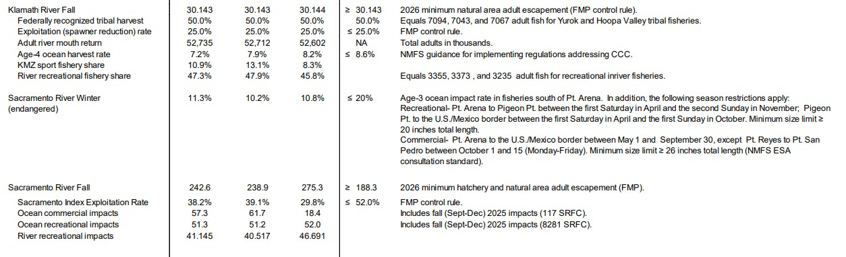
















KRFC and SRFC Harvest Projections

Slide 7
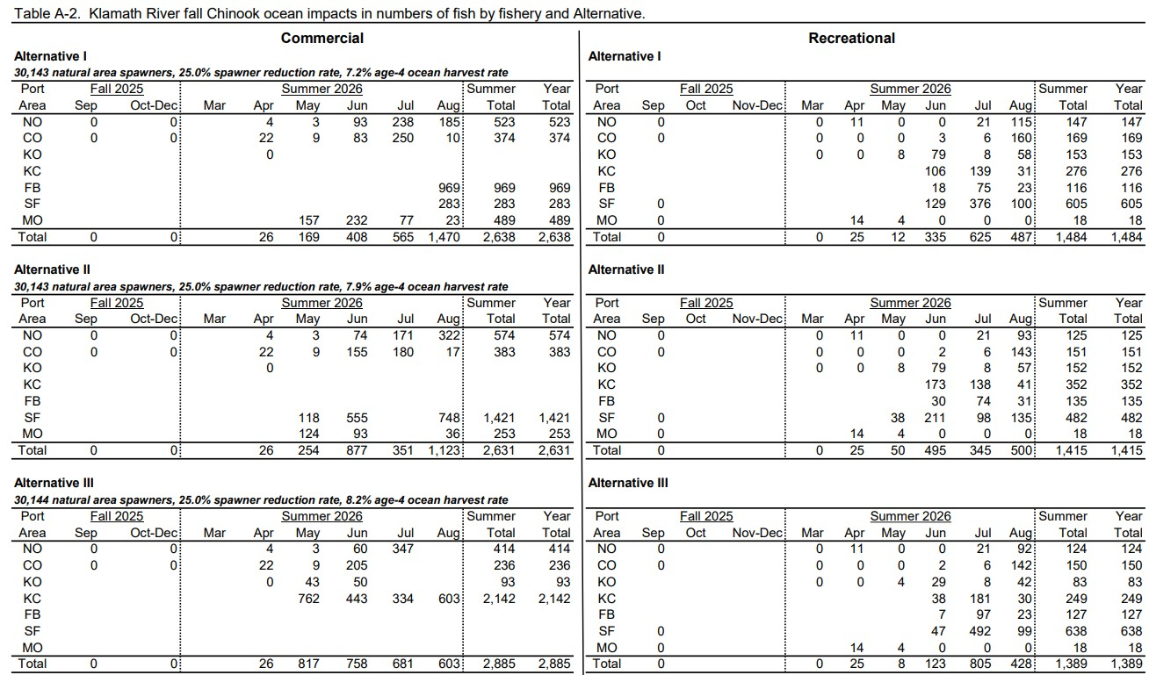












Zooming In: KRFC Harvest Projections

Slide 8
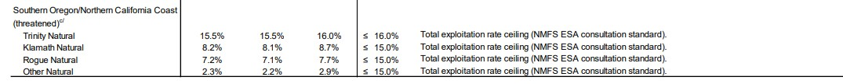




SONCC Coho Projections

Slide 9
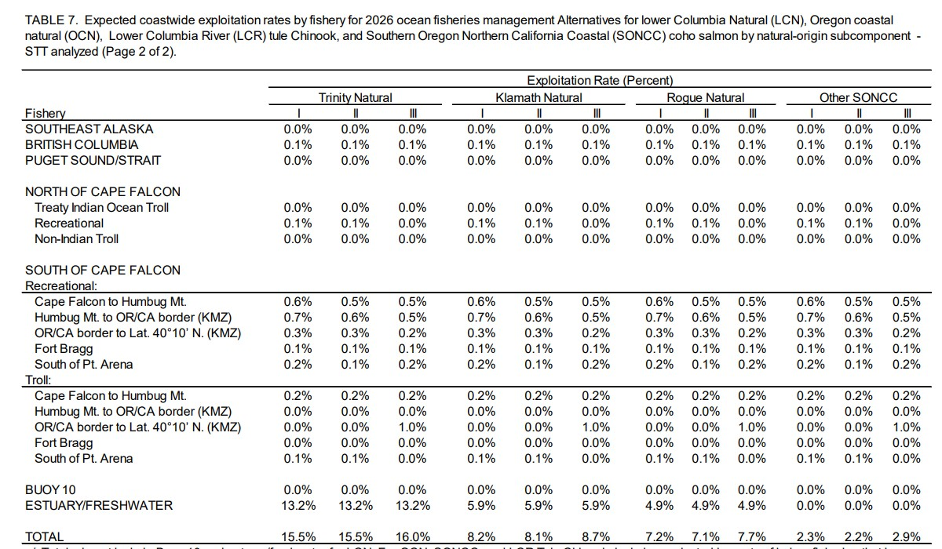






Zooming In: SONCC Coho Projections

Slide 10
Next Steps
April 7-12, PFMC Meeting, Portland Oregon
  Final ocean season will be determined
  Final freshwater escapement projection and tribal/state KRFC harvest guidelines provided
California Fish and Game Commission April 15-16
  CDFW will present range of options for freshwater seasons for discussion
California Fish and Game Commission May 5-6
  Final freshwater sportfishing seasons will be determined

Slide 11
QUESTIONS?

