Slide 1
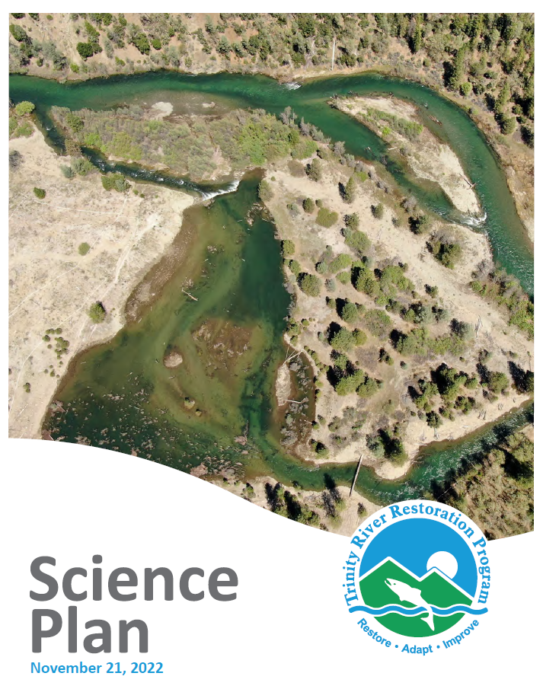
FY 2026
Science Proposals
(Take 2 – TMC March 2027)
TRRP Interdisciplinary Team (IDT)
Represented by Eric Peterson, Science Coordinator

Slide 2
Overview
Last June…
FY26 Request approval of 2 project proposals
  Addition of variable food intake to S3
    Funding request: $336,266
  Biological response to thermal heterogeneity via turtles
    Funding request: $126,614
Total: $462,880
TMC deferred decision due to high uncertainty with TRRP budget at that time.

Slide 3
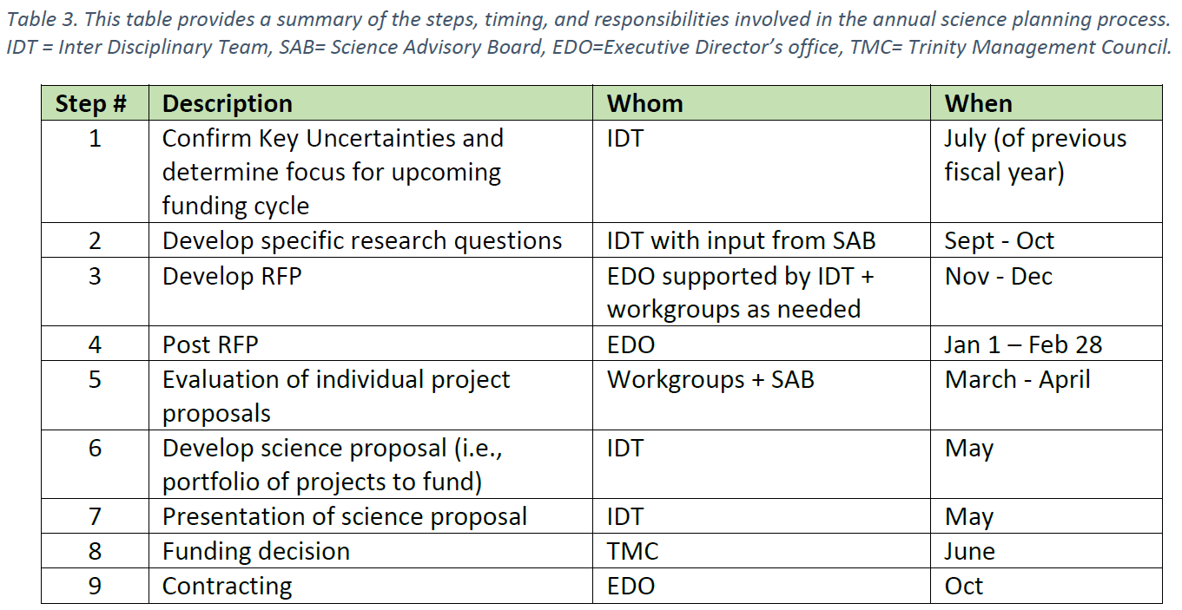
Science Plan
Key Uncertainties
Wetted Width
  Goal 1: Form
Nutrient Flux
  Goal 1: Function
Temperature Regime
  Goal 1: Function
Fish Production
  Goals 2 & 3: Fish
ROD Effectiveness
  Goals: all

Slide 4
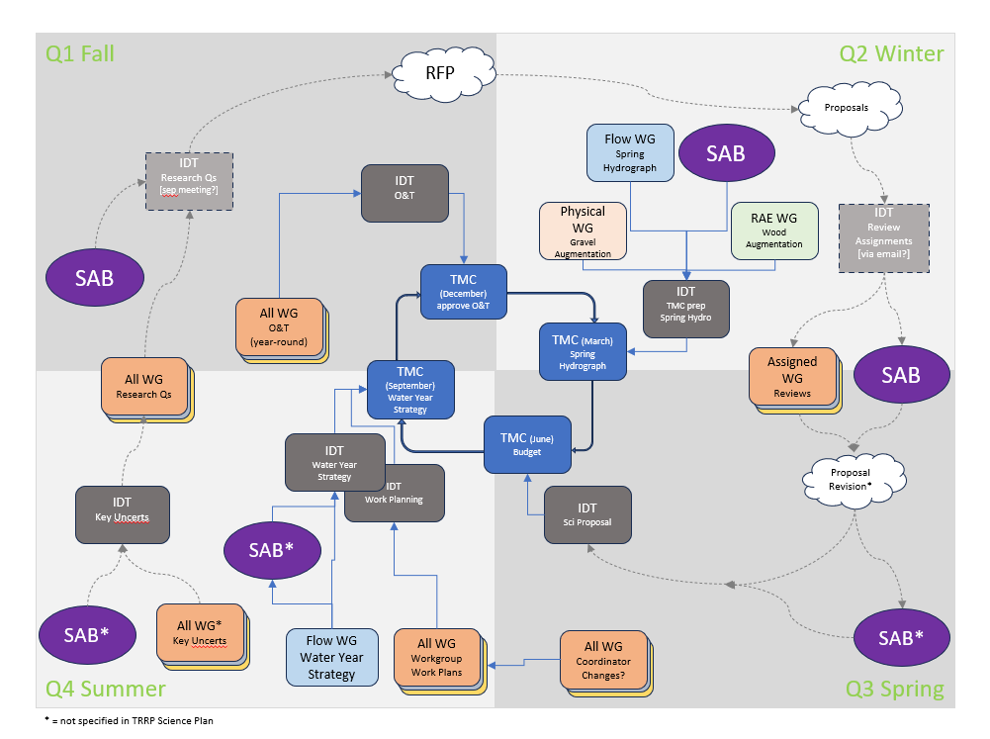

Slide 5
FY 26 Science Plan Request from IDT
Q: Development of a foodscape model for incorporation into the Stream Salmonid Simulator
Q: Can rehabilitation site design provide adequate thermal diversity for Northwestern pond turtle (Actinemys marmorata) growth?

Slide 6
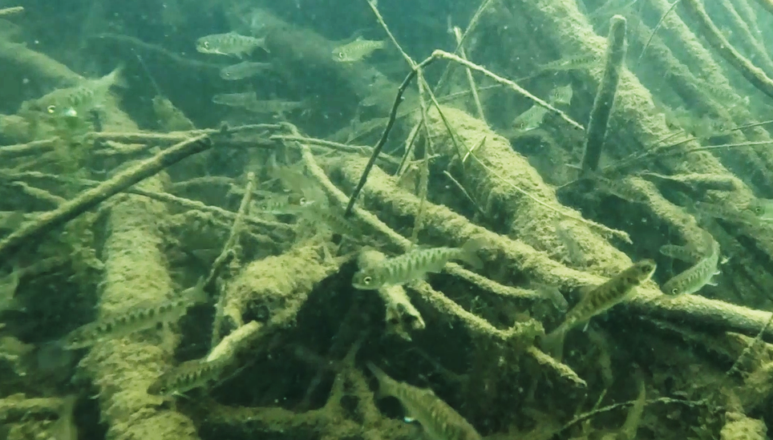
Q: Development of a foodscape model for incorporation into the Stream Salmonid Simulator
Title: Linking fish foraging with population dynamics: Incorporating variable consumption into the Stream Salmonid Simulator [S3]
Partnership: M. Dodrill (USGS), R. Perry (USGS), K. Lindke (CDFW), C. Laskodi (YTFP), S. Naman (NMFS), and N. Som (USGS).
Funding Request: $336,266 (to USGS)
Background:
  S3 currently accounts for consumption at a uniform rate across river length and time.
Project (2-fold):
  Enable variation
    consumption rate
    Drift foraging model*
  Calibration
    Available drift data
    Otolith collection (250 juvenile Chinook)
  Report by end of September 2027 (now 2028?)
  * more complex than it sounds
    numerous variables per SRH2D mesh cell, per flow,
    to compute lookup tables for efficient running of S3
    may require USGS High Performance Computing Center
Image: Aaron Martin

Slide 7
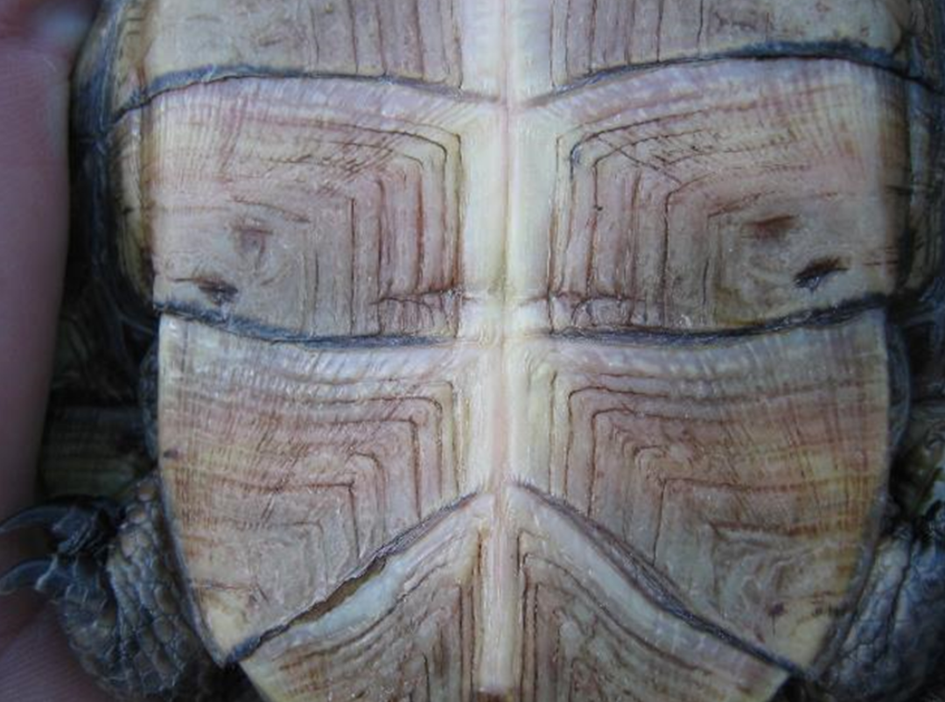
Q: Can rehabilitation site design provide adequate thermal diversity for Northwestern Pond Turtle (Actinemys marmorata) growth?
Title: Thermal Assessment of Turtle Growth and Habitats at
Rehabilitation Sites
Partnership: J. Alvarez (HVT), D. Ashton (ARS), B. Nissen (USFWS)
Funding request: $126,614 (to HVT and ARS)
Background:
  A prior study shows reduced growth in focal-reach turtles versus
  South Fork TR (Ashton et al. 2015)
Project:
  1 summer fieldwork
  3 sites selected by occupancy - younger turtles (better to measure growth)
  2 weeks of site visits to capture and measure growth annuli
  Temperature sampling at used features, mainstem, and site in general
  Analysis: Growth (annuli) versus temperature; can also compare existing data from other thermal regimes
  Potential comparison to SRH2D temperature model (Yurok collaboration)
  Report drafted by December 2026

Slide 8
SAB Evaluation and Ranking
Did not evaluate cost
Overall, the SAB agrees each project can provide important learnings to the Trinity River and are worthy of funding, but with consideration to noted concerns
  assumptions needed to develop a drift foraging module in the S3 model may overshadow its predictive capacity
  study design for Turtles using multiple methods to collect temperature data in rehabilitation and mainstem sites may not produce defensible results [particularly the general site sampling]
Ranked the Dodrill et al. (drift foraging) proposal somewhat higher as it addresses the primary purpose of the TRRP–fish production

Slide 9
IDT request to TMC
Fund both completed proposals:
  Linking fish foraging with population dynamics: incorporating variable consumption into the Stream Salmonid Simulator
    Authors: M. Dodrill (USGS), R. Perry (USGS), K. Lindke (CDFW), C. Laskodi (YTFP), S. Naman (NMFS), and N. Som (USGS).
    Funding request: $336,266 (to USGS)
  Thermal assessment of turtle growth and habitats at rehabilitation sites
    Authors: J. Alvarez (HVT), D. Ashton (ARS), B. Nissen (USFWS)
    Funding request: $126,614 (to HVT and ARS)
Total: $462,880

