Slide 1
Trinity Management Council LTO/Trinity Update
September 17, 2025
Notes:
My name is Kristen Hiatt, I’m with the Bay Delta Office.​

Slide 2

Agenda
Action 5
Trinity Alternatives
Trinity Update
Next Steps
Notes:
Today’s presentation will cover
Operations Plan – Action 5
Trinity Alternatives
Trinity Update
Next Steps

Slide 3
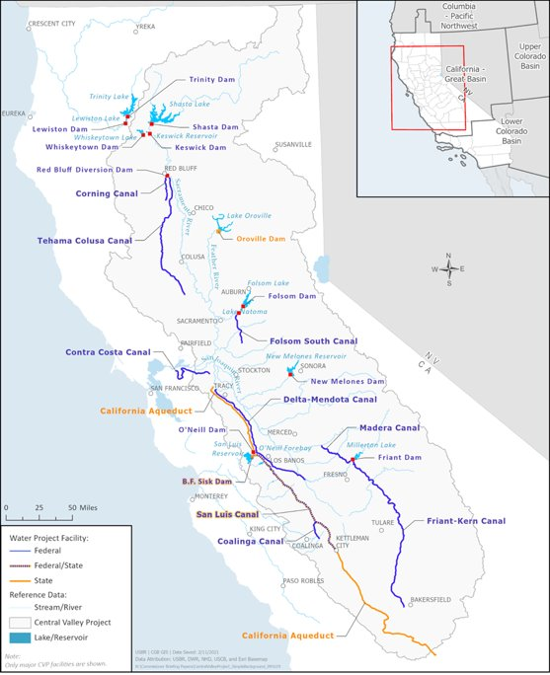
Operation Plan - Action 5
Remove Fall X2
Remove Early Implementation of Delta export reduction
Revise Entrainment Management
Revise Governance
Simplify Descriptions
Adaptive Management - NEPA
Notes:
As discussed last time I presented to you all, Executive order 14181 was signed by President Trump on January 24, 2025, which directs agencies to provide more water resources in terms of deliveries and additional hydropower in relation to the 2024 LTO.
The goal of Operation Plan - Action 5 is to respond to EO 14181 by seeing immediate water supply benefits, while recognizing the 2024 ROD and needing to stay within the bounds of the ROD, which includes 2 Biological Opinions and an EIS
Action 5 is codifying the actions we’ve taken this year. We’ll go into more detail on each of these, but at a high level:
- There’s rationale for removing fall x2 action and the early implementation of export reduction
- Action 5 revises parts of entrainment management
- Revises aspects of governance. One of the challenges we observed is balancing collaboration while respecting each agency’s decision authority, so looked at governance through that lens.
- We simplified some of the proposed action descriptions
And then adaptive management was copied over from the Proposed Action consulted upon and moved into the NEPA-only realm
So lets dive in

Slide 4
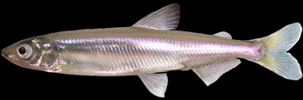
Fall X2
Originally proposed as an experiment in 2008 FWS Biological Opinion
2019 Adjusted to reduce impacts to Shasta cold water pool
2024 Proposed Action included Fall X2
2024 FWS Biological Opinion:
  "Contemporary life cycle modeling supports the hypothesis that high summer outflow can contribute to beneficial effects but does not support the hypothesis that variation in fall outflow does."
  "The Fall X2 action is not anticipated to have observable effects on delta smelt survival"
Notes:
-Action 5 includes removal of the Delta Smelt Summer and Fall Habitat Action known as “Fall X2” which was initially proposed as an experiment under the 2008 Biological Opinion
- In 2019, the action was adjusted to reduce impacts to Shata Reservoir coldwater pool (moving X2 from 74km to 81km Nov and Dec?)
- Fall X2 action was in 2024 Proposed Action: "To increase the amount of low salinity zone habitat for Delta Smelt, in Wet and Above Normal year, Reclamation and DWR will maintain a 30-day average X2 ≤ 80km for September through October."
- However, 2024 Biological Opinion concluded that while lifecycle modeling supports the hypothesis that high summer outflow can be beneficial, it does not support the fall hypothesis. And stated, “The Fall X2 action is not anticipated to have observable effects on Delta smelt survival.”
The conclusion of the Fall X2 experiment will provide 40 TAF to the CVP and, if adopted, 60 TAF to the SWP over the long-term.

Slide 5
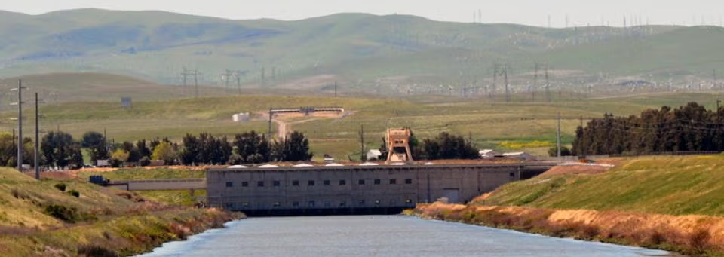
Early Implementation
Proposed as two-year stop-gap measure
Intended to develop data and assist decisions on HRL
SWP did not include Early Implementation in ITP
Notes:
Action 5 includes removal of the Healthy Rivers and Landscapes Early Implementation measure.
The action was originally designed to bridge the period between adoption of the Healthy Rivers and Landscapes Program with implementation – it was a CVP-only measure.
delays have resulted in Early Implementation Component of the Spring Delta Outflow lacking the physical and scientific infrastructure necessary to develop data that could assist in decisions regarding whether and how to implement the HRL
The early implementation action costs the CVP 62.5 TAF in dry and below normal years and 87.5 TAF in above normal water year (40 TAF average).
Action 5 includes the Healthy Rivers and Landscapes Program as agreed to by HRL parties in the February 2022 MOA upon adoption by the State Water Board.

Slide 6
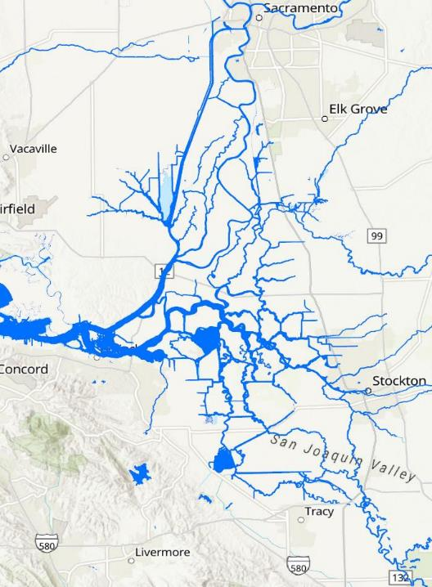

Entrainment Management
Fremont
Weir
Yolo Bypass
Delta Cross Channel
Start of Entrainment Management (OMR ≥ -5,000)
  First Flush
  Detection in Salvage
Real-Time Assessment Thresholds (Weekly)
  Smelts: expands Jersey Point Flow Criteria
  Salmonids: Change to Annual Trajectory and Survival
Stormflex Criteria for OMR ≥ -6,500 cfs
End of Entrainment Management (No Change)
Georgianna Slough
Chipps Island
Old and Middle Rivers
Banks and Jones Pumping Plants
Head of Old River
Long-Term Operation of the Central Valley Project and State Water Project
6
Notes:
The goal of Action 5 updates to Delta criteria is that when actions are taken that restrict water supply, there is a material benefit to species.
Onset of OMR management follows first flush conditions or detection of species in salvage
The First Flush conditions are the same but can occur in December, January or February
Once OMR has started, it will be maintained at no more negative than -5000 unless assessments show need for modification
For real-time assessments
The flow at Jersey Point (JPF) provides a surrogate for high flows that reduce the risk of entrainment regardless of OMRI. Reclamation and DWR would compute JPF based on San Joaquin River Inflow at Vernalis, Consumnes River Inflow, Mokelumne River Inflow, Calaveras River Inflow, Flow from Sacramento River through DCC, Flow from Sacramento River through Georgiana Slough, 65% of in-Delta precipitation, -65% of in-Delta diversions, and -Export Pumping at (Banks + Jones).
for salmonids, if an assessment indicates annual salvage loss is on a trajectory to exceed 1% of the Juvenile Production Estimate (JPE) entering the Delta and a reduction in pumping would materially increase through-Delta survival, pumping will be reduced to -3,500 cfs for at least 7 days
Stormflex is included in Action 5 – increasing from -6250 to -6500
No change to the end of OMR season
Estimated 50 to 100 TAF savings for the CVP and, if adopted, 60 to 165 TAF savings to the SWP
________________________________________________________________________________________________________________________________________________
A stand-in for the population model for Larval and Juvenile longfin was used that used the Alt2 assumptions but had an additional offramp when the Midwater Trawl index was > 500
Winter-Run triggers when crossing 50% of the salvage limit and then again every week there is additional salvage after that. Doesn't make a whole of difference
Turbidity Bridge (Adult Delta Smelt action) has an off-ramp on JPF rather than QWest. Just note that the Larval/Juvenile action is now represented in CalSim as effectively extending the ability to trigger Turbidity Bridge through the entire OMR Management Season as a stand-in for real-time PTM modeling.

Slide 7
Governance & Simplified Descriptions
Roles and Responsibilities
  Action Agency
  Consultation and Incidental Take
  Reinitiation Triggers
Forums for Input (Tributary Groups)
  Notifications
  Seasonal Actions
  Annual Report
Scientific Standards
Reclamation and DWR Directors
Agency Directors
and the Public
Fish and Water Operations Group
Annual Report Team
Tributary Groups
Sacramento (SRG)
Clear Creek (CCT)
American (ARG)
Stanislaus (SWT)
Delta (DAT)
Drought Response Year (DRY)
Notes:
[Tim]
For Governance
Real time groups often struggle with tradeoff analyses, there are different stakes in different decisions
And it’s not really fair to ask a fish biologist if it’s okay to kill a fish. We’ve seen the group be very risk-averse in a way that has little species benefit at a large water cost.
This governance is reflective of having action agencies lead in their role of operating the projects
Having the Services lead in their role of consultation and incidental take; and if and when a reinitation trigger is crossed
Action 5 governance is revised to conform to statutory roles and remove the real-time minimization of effects that is not required to avoid jeopardy or stay within the incidental take statement
Forums for input identify where we need collaboration and input which is focused in the tributary groups
We all should be collaborating on determining best available tools, science, and analytical methods.
As for a simplified descriptions - there was a lot of extra information in the 2024 PA, for example assumptions for analyses or where data was going to be pulled from to conduct analyses. Information is better placed in the actual analyses than in a PA description.

Slide 8
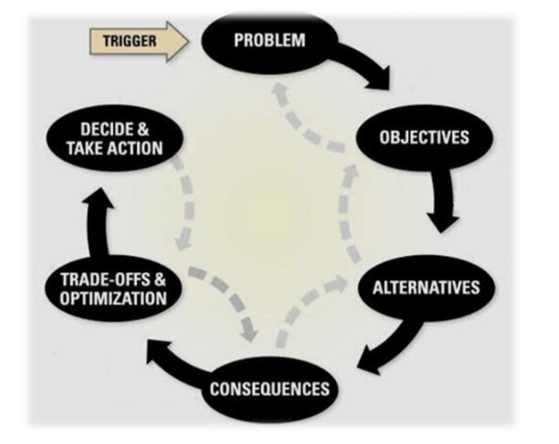

Adaptive Management (NEPA)
Retain the “Bin”, now called “Group”, Framework
Interested Party Governance
No Special Studies Identified (No Effects/Permitting Need)
Retain Relationship to ESA Section 7 Consultation
Notes:
[Tim]
Relocated and revised adaptive management away from an ESA-focused process because the adaptive management program doesn’t require incidental take. Revisions to the adaptive management program aim to focus it to be more community driven rather than regulatory driven.
The list of actions prioritized under adaptive management were retained; previously organized by “Bins” (1, 2, 3), now called “Groups”
A governance section was added for adaptive management, which includes Interested Parties (water users, NGOs, tribes, as well as agencies)
No Special Studies were Identified in Action 5
Adaptive management now includes a section on retaining the relationship to ESA Section 7 Consultation --- In the event that a change is required to the Incidental Take Statement (ITS), and the change is fully consistent with the analysis in the biological opinion, the Services could amend the ITS without reinitiating the consultation.

Slide 9
Action 5 Milestones
Action 5 Milestones - 2025 | Jan | Feb | Mar | Apr | May | Jun | Jul | Aug | Sep | Oct | Nov | Dec
Drafting Project Description
Calsim (Water Operations) Modeling
Final Project Description
NMFS and USFWS Coordination
Temperature and Hydrodynamics Modeling
Biological Effects Modeling
Supporting Effects Analyses
Responses from NMFS and USFWS
NEPA Sufficiency Review
Record of Decision
For Discussion Purposes – Subject to Change
Notes:
For Action 5, we are targeting a new Record of Decision in December
Used the first part of the year to focus on modeling and project description development
In June we began engaging with NMFS and FWS. We’ve been coordinating on which lines of evidence should be analyzed to determine if Action 5 is within effects analyzed in the Bos
We’re moving through temp, hydrodynamics and biological modeling for the next few months
We’re also working on determining if Action 5 is within NEPA impacts disclosed in 2024 EIS, working towards a NEPA sufficiency review
Targeting December
I will pause for any questions…
And now we will turn our attention to Trinity starting with the Trinity alternatives. I will give a high level overview of the alternatives and then Mike will dig into some of the technical details of the them.

Slide 10
TRD Preliminary Alternatives
No Action Alternative – 2000 ROD / 2017 ROD / 2020 ROD
Alternative 1 – Water Quality Control Plan
Alternative 2 – Multi-Agency Deliberation
Alternative 4 – Risk-Informed Operations
Alternative 5 – Low Emissions with Flexible Management
Alternative 6 – Trinity County Local
Alternative 7 – Maximum Flow
Alternative 3 – Modified Natural Hydrograph
Notes:
For the purposes of todays discussion, I want start by saying that **Reclamation and the joint leads are currently in discussions regarding the range of alternatives and may be elevated in the near future, particularly as it pertains to Alternative 1.**
Current range of alternatives that we are considering are shown here.
No Action Alternative for Trinity sticks to the 2000 Record of Decision; for the remaining CVP tribs and Delta, the no action sticks to the 2020 Record of Decision and DWR’s Incidental Take Permit
Alt 1-Water Quality Control Plan - Operation to water right terms and conditions implementing the state water quality control plan objectives for the San Francisco Bay/Sacramento–San Joaquin Delta (Bay-Delta), CVP tributaries, and other agreements. This alternative also serves as a bookend for the analysis.
For Alternative 2 – Alternative 2 (Multi-Agency Deliberation) represents actions made to reach consensus with Reclamation, the Hoopa Valley Tribe, the Yurok Tribe, California Department of Fish and Wildlife (CDFW), NMFS, and USFWS. This alternative's objective is to shift flows earlier in the season for fisheries benefit as compared to the No Action Alternative.
Alt 3- uses an oscillating hydrograph to meet the biological and physical objectives of the TRRP.
Alt 4-Risk Informed Operations provides alternative criteria for Trinity River releases that prioritizes water deliveries over drought protection. Similar to Alt 2 but has different prioritization.
For Alternative 5, based on our screening criteria, this alternative was absorbed into other alternatives as it has compatible components including the storage component (Trinity County Alternative) and the long-term diversion pattern (No Action Alternative)
Alt 6 –prioritizes carryover storage and provides for meeting temperature objectives during drought.
Alt 7 – provides for maximum flow that prioritizes ecosystem restoration; maximum flow alternative is a modification from the Maximum Flow alternative included in the 2000 Trinity EIS. This alternative also serves as a bookend for the analysis.

Slide 11
Key Operations of NAA and Alt2-4
 | NAA | Alt 1 | Alt2a&b | Alt3 | Alt4 | Alt 6 | Alt 7
Lewiston Release | WYT based volume from 2000 ROD | 340,000 acre-feet consistent with Section 3406(b)(23) of CVPIA prior to the completion of the 1999 flow study. | 2000 ROD volumes shifted earlier with winter releases | Seasonally oscillating hydrograph and adaptive peak release | Same as Alt2, but reduce total ROD volume by 15% in case of drought and low storage | Same as NAA, except allow for carryover of ROD flows to subsequent water year(s). No summer flow reductions. | Alternative, 70% of inflow to Trinity Reservoir
Storage Target | 600 TAF | N/A | For Multi-year drought • First Year 1.2 MAF • Second Year 900 TAF • Third Year750 TAF 750 TAF minimum for end of Dec | Same as Alt2 | 750 TAF | Temp objectives from Kamman memo: • First Year 1.5 MAF • Second Year 1.3 MAF • Third Year 1.1 MAF • Fourth Year 1 MAF • Fifth Year 900 TAF • Sixth Year 825 TAF • Seventh Year 750 TAF Carryover of ROD flows from one water year to subsequent water year(s) | 750 TAF
Diversion | Lower in spring/summer and higher in fall/winter for temperature benefits | Water diverted as needed, not seasonally, to supply CVP needs. | Prioritize Trinity flow and temp from Fall-Summer, diversions for CVP after Jun/Jul 1st | Same as Alt2 | Same as NAA | Same as NAA | No exports to Central Valley except to maintain Lewiston release temperature from late June – late October
*Alts 1, 6, 7 are in progress

Slide 12

Trinity River Division (TRD) Reconsultation Update
Targeting a cooperating agency draft Supplemental Environmental Impact Statement in September 2025
Cooperating agencies will have a 30-day review
Study area is Trinity River Region
Interim Update - Contents Subject to Change
Notes:
Lets head up north for a Trinity update.
Currently working on a cooperating agency draft supplemental environmental impact statement with the Trinity Joint Leads, the Hoopa Valley Tribe and the Yurok Tribe
We are targeting the end of September to distribute this draft document
Cooperating agencies will have 30-days to review and provide comments
Reclamation will use these cooperating agencies comments to help inform the next draft of this document, which would be the Public Draft Supplemental Environmental Impact Statement
Study area for this draft is the Trinity River Region, which is Trinity Dam, Lewiston Dam, Trinity River to the confluence with the Klamath, the lower Klamath river and the nearshore Pacific Ocean.
Resource areas that will likely be ready to go in this cooperating agency draft include:
Water Quality
Water Supply
Air quality/GHG
Visual
Terrestrial
Economics
Recreation
Power
Geology
Still working on Aquatics and results are not yet available.
question’s:
We continue to discuss the range of alternatives included in the supplemental EIS with our Joint Leads, but the current range does include alternatives with increased deliveries. Theres a range of water available for restoration purposes so for alts that have less water for restoration, there would be more water available for diversion. Similarly there are alternatives that contemplate increased restoration releases, which would impact diversions, so theres a range.
We anticipate taking a deeper dive in the December WIIN Act meeting, and can share additional results
Central Valley Analysis – We are coordinating with upper management to establish the overall strategy for evaluating impacts to the Central Valley. This includes determining the sequencing of actions and defining the appropriate scope and extent of analysis. While the approach has not yet been finalized, we will continue to provide updates as decisions are made.
Range of alternatives question – Working closely with the joint leads on determining the range of alternatives. We anticipate taking a deeper dive in the December WIIN Act meeting, and can share additional results
A cooperating agency under NEPA is any Federal, State, Tribal, or local government agency that has jurisdiction by law or special expertise regarding an environmental issue associated with a proposed action.

Slide 13


Trinity River Division (TRD) Reconsultation Update (continued)
Upcoming Deliverables:
  Biological Assessment – targeting fall/winter 2025
  Public Draft SEIS – targeting winter 2025
  Final Draft SEIS – targeting spring 2026
  NEPA Decision – targeting spring 2026
Interim Update - Contents Subject to Change
Notes:
Current schedule for upcoming deliverables is as follows:
__________________
Once a new Trinity operation or Proposed Action is identified, Reclamation intends to perform an analysis that shows the effects and tradeoffs for all of the Central Valley Project which includes the Trinity River. At that time, Reclamation will reassess the appropriate mechanism to disclose any potential impacts.
That may include a supplemental NEPA document for the operation of the CVP and may require a revised, amended, or supplemental Record of Decision to incorporate Trinity operational elements.

Slide 14

Upcoming
Trinity Cooperating Agency Draft
Trinity Biological Assessment
E.O. 14181 - Action 5 Environmental Compliance Sufficiency Review
Next WIIN Act Quarterly Meeting in December
Notes:
We will plan our next meeting in December where we will likely talk a bit more about Executive Order implementation, Trinity analysis, and Trinity BA.

Slide 15
Thank You
Notes:
[Luke]
That ends our WIIN Act meeting. Thank you all for attending and we will post these slides on our Bay Delta Office webpage.

