Slide 1

WY2025 Spring Flow Recommendation
Trinity River Restoration Program Flow Work Group
Patrick Flynn – Coordinator
TMC 03/19/2025

Slide 2
Table of Contents
Flow Planning Process
  Unique circumstances of WY2025
    Winter Flow project implementation
    Safety of Dams releases (SODs)
  Water Year scenarios
Selected Hydrographs
  Why they were selected
Recommendation from Flow WG to IDT/TMC

Slide 3
Recent events:
Trinity Management Council Motion - 9/18/2024
  Motion: Radley Ott motions to Approve Flow WG WY2025 recommendation as presented in the September 2024 IDT memo items 1&2
  Item 1 was to implement winter flow as proposed by Trinity County
  Item 2 was to implement spring flows after April 15
Hoopa Valley Tribe signed the FONSI for the Winter Flow EA on December 11, 2024
  This action (along with signature of the Yurok Tribe) allowed the Winter Flow project to go forward in its full and complete form, as intended
Notes:
Of course the Hoopa Valley Tribe also signed the FONSI for the Winter Flow project in December, which created a new flow planning regime for the Trinity River.

Slide 4
Flow Planning Process
WY2025 was/is unique
Full implementation of the whole and complete Winter Flow Variability project for the first time
  Hoopa Valley Tribe signed Winter Flow EA December 11, 2024
Safety of Dams (SOD) releases
  Began January 1 at 1,500 cfs
  Increased to 3,500 cfs around February 7. Reduced back down to 2,000 cfs by 3/15. Currently at 2,000 cfs
Four meetings total: 2/6, 2/13, 2/19, 3/3
Notes:
Signature of the HVT on the FONSI for the Winter Flow EA established a new paradigm for flow planning for the TRRP
We will need to plan for not only the April B120 forecast, but also the February and March B120 forecasts

Slide 5
Implementation of Winter Flows in WY2025
Quick WFV recap
Three periods:
  Synchronized storm pulse period from December 15 – February 14
  Elevated baseflow period from February 15 – April 14
  Second elevated baseflow period from March 16 – April 14
    Two “check-ins”
      One using the February 90% Bulletin 120 (B120) forecast
      One using the March 90% B120 forecast

Slide 6
Implementation of Winter Flows in WY2025
WY2025
Synchronized flow event on December 23, 2024
  Used 60,000 acre-feet (af) of ROD water
February B120 was just barely for a Normal water year
  Used 60,000 af of ROD water per WFV ruleset
March B120 was solidly for a Wet year
  Used an additional 60,000 af of ROD water per WFV ruleset
In total, 180,000 af of ROD water was released in the “winter period”

Slide 7
Safety of Dams releases
  Began January 1 at 1,500 cfs
  Increased to 3,500 cfs around February 7. Reduced back to 2,000 cfs by 3/15
Flow WG met on 2/6/25 to deliberate the most appropriate way to implement elevated baseflows during the winter period given the safety of dams (SOD) releases
Chose to “implement” the elevated baseflow hydrographs that were approved by TMC in 2022 for implementation in WY2023
Chose to model safety of dams releases for decision-making, but the safety of dams release volumes were not accounted for as winter flow volumes
Notes:
Will show how the SODs were modeled when I review the hydrographs that were developed.

Slide 8
Water Year Scenarios
Two remaining scenarios possible (out of the three that are mentioned in the memo to IDT)
The most likely is Scenario #1. Unlikely that we will see an Extremely Wet year
Scenario | Sync | Feb B120 | Mar B120 | Apr B120 | Total released from Dec 16-Apr 15
1 | 60k | Norm-60k | Wet-60k | Wet | 180kaf
2 | 60k | Norm-60k | Wet-60k | Ex. Wet | 180kaf
Notes:
The FWG envisioned two scenarios that release 180,000 af during the period from December 15 to April 14 (the “winter period”) and one scenario which releases 120,000 af during the same period, based on the WFV ruleset. These volumes result from the implementation of the synchronization peak flow in late December (60,000 af released), the Normal February B120 90% forecast (60,000 af released from February 15 to April 14), and a Wet March B120 90% forecast (which would allocate an additional 60,000 af from March 15 to April 14). This would result in 180,000 af released above baseflow prior to April 15. A Normal March B120 90% forecast would not allocate additional water and would result in 120,000 af released above baseflow during the same period. The uncertainty surrounding the March B120 dictates the need to plan for two scenarios depending on volume released in the winter period. The FWG also planned for the chance of both a Wet and Extremely Wet water year type based on the April B120. In total, hydrographs were developed and modeled for three scenarios (Table 1).

Slide 9
Hydrograph Development
Elected to develop one hydrograph that focused on riparian objectives, and one that focused on geomorphic/fish objectives per likely water year scenario
Reviewed Decision Support System (DSS) results
Chose most appropriate set of hydrographs for implementation by a consensus decision
Geomorphic/Fish Hydrographs were selected for recommendation
Notes:
Stream Salmonid Simulator (S3)
River Basin Model 10 (RBM10)
Temperature Modeling
TARGETS
Foothill yellow-legged frog Assessment Model (FYFAM)
Bedload modeling
Geomorphic/fish hydrographs showed greater benefit to the river from all model results, except for the FYFAM model. Some adjustments were made to the final hydrograph that maintained benefit to fish and achieved geomorphic objectives, while reducing impacts to FYLFs.

Slide 10
Considered Hydrographs
Notes:
Developed three sets of hydrographs (2 per likely scenario)

Slide 11
Hydrograph A
Broad Swell of Water

Slide 12
Hydrograph B Normal–Wet–Wet w/ Geomorphic Peak
Geomorphic peak (7800 cfs)
Riparian recession
Spring Chinook migration pulses
Notes:
Key points:
The peak is less than 8k due to 180kaf being released in the winter
SOD releases were modeled on actuals, then presumed to recede to 1500 cfs beginning March 1, then down to scheduled elevated baseflows beginning March 15
Actual situation looks like it will be recede to 1500 cfs beginning March 15. Unknown at this time when the elevated baseflows hydrograph will be visible.
Pulses for spring chinook migration in July
These are actually swapped in position to improve conditions for FYLFs
Spring releases extend until August 28 or so

Slide 13
Hydrograph C
Broad Swell of Water

Slide 14
Hydrograph D Normal-Wet-Extremely Wet w/ Geomorphic Peak
Geomorphic peak (~10,100 cfs)
Riparian recession
Spring Chinook migration pulses
Notes:
Keys for ExWet:
Again peak is lower than 11,000 cfs due to 180kaf being released in the winter period
Otherwise the hydrograph is similar to the Wet hydrograph, just scaled up to release more water.

Slide 15
DSS Results

Slide 16
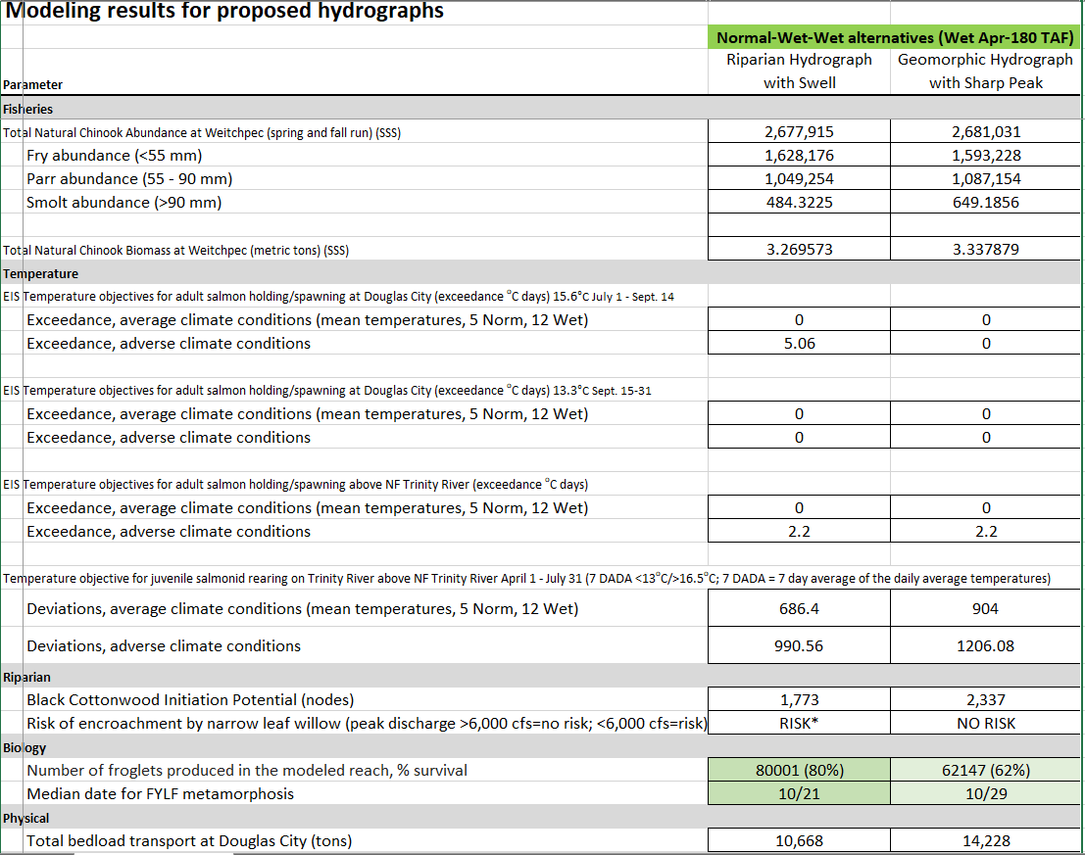
Hydrograph A
Hydrograph B
Notes:
More production of smolts
More Chinook biomass
Greater mile-days of temperatures meeting juvenile rearing targets
Greater Black Cottonwood potential (more nodes)
More bedload transport in tons
Less froglets produced and later median metamorphosis date
We swapped the peaks in July to help the frogs. 13% less egg scour by this change.

Slide 17
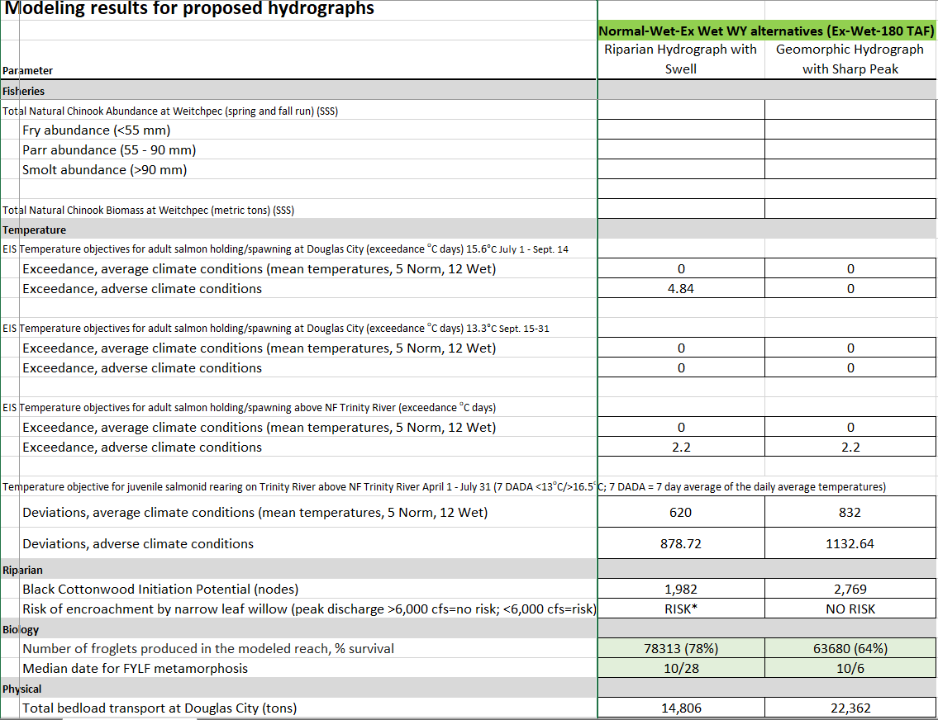
Hydrograph C
Hydrograph D
Notes:
S3 was not run for the Extremely wet hydrographs
Greater mile-days of temperatures meeting juvenile rearing targets
Greater Black Cottonwood potential (more nodes)
More bedload transport in tons
Less froglets produced but earlier median metamorphosis date
We swapped the peaks around in the month of July to help the frogs. 21% less egg scour by this change.

Slide 18
Recommendation
Implement hydrographs B and D
  If the April 50% B120 is Wet, implement Hydrograph B
  If the April 50% B120 is Extremely Wet, implement Hydrograph D
Forward to Regional Directors

Slide 19
Potential Concern:
Concerns:
Additional 300 cfs coming from Lewiston could pose safety risk to innertubers/other rec users of the river
Pros:
Additional 300 cfs may increase recreational value for whitewater rafting
Options:
Move peak to (perhaps) July 8
  No biological harm from this change
Leave as is
  Potential benefit to whitewater rafting
Spring Chinook Migration Pulses
Peak rises from 700 cfs to 1000 cfs on July 4 (a Friday)

Slide 20

Recap
Flow Planning Process
  Unique circumstances of WY2025
    Winter Flow project implementation
    Safety of Dams releases (SODs)
  Water Year scenarios
Selected Hydrographs
  Why they were selected
Recommendation from Flow WG to IDT/TMC
Notes:
Recap:
Talked about how we got here
Talked about the planning process and meetings we had
Worked through DSS results
Made a recommendation
Questions?

Slide 21
Questions?
Thanks to modelers
Todd Buxton (Reclamation)
  Bedload transport modeling
Ken Lindke (CDFW)
  Temperature analysis
Don Ashton (McBain Associates/Applied River Sciences)
  FYFAM modeling
John Bair (McBain Associates/Applied River Sciences)
  Riparian advice/TARGETS modeling
Simone Groves (Hoopa Valley Tribe)
  TARGETS modeling
Chris Laskodi (Yurok Tribe)
  RBM10 modeling and S3 modeling
Russ Perry (USGS)
  RBM10 modeling
All Flow WG members and hydrograph developers
Notes:
Recap:
Talked about how we got here
Talked about the planning process and meetings we had
Worked through DSS results
Made a recommendation
Questions?

Slide 22
Potential Concern:
Concerns:
Additional 300 cfs coming from Lewiston could pose safety risk to innertubers/other rec users of the river
Pros:
Additional 300 cfs may increase recreational value for whitewater rafting
Options:
Move peak to (perhaps) July 8
  No biological harm from this change
Leave as is
  Potential benefit to whitewater rafting
Spring Chinook Migration Pulses
Peak rises from 700 cfs to 1000 cfs on July 4 (a Friday)

Slide 23
Normal Feb 90% B120 –Wet March 90% B120 – Wet April 50% B120
Synchronized storm pulse
SOD releases
Geomorphic peak (7800 cfs)
Elevated baseflows
Riparian recession
Spring Chinook migration pulses
Notes:
Key points:
The peak is less than 8k due to 180kaf being released in the winter
SOD releases were modeled on actuals, then presumed to recede to 1500 cfs beginning March 1, then down to scheduled elevated baseflows beginning March 15
Actual situation looks like it will be recede to 1500 cfs beginning March 15. Unknown at this time when the elevated baseflows hydrograph will be visible.
Pulses for spring chinook migration in July
These are actually swapped in position to improve conditions for FYLFs
Spring releases extend until August 28 or so

Slide 24
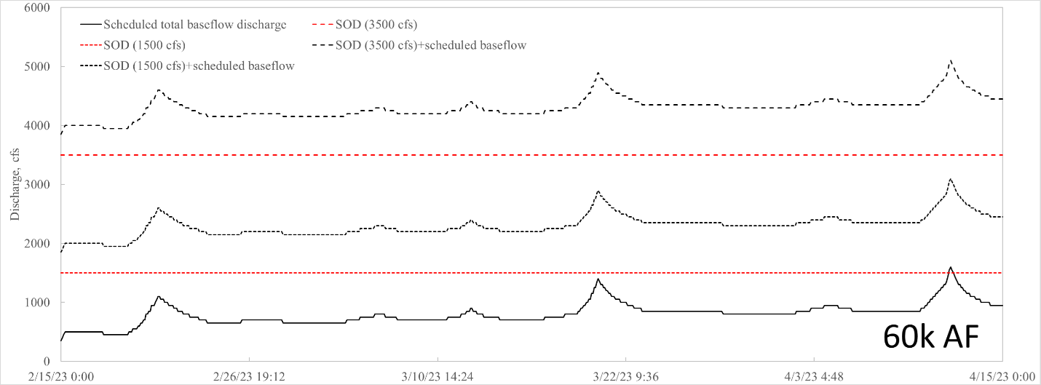
Notes:
This hydrograph shows the different options that we considered when deliberating how to approach SODs.
Black line on the bottom is the actual elevated baseflow schedule that was approved by TMC for WY2023. Red line above the bottom black line is 1500cfs. Other red line is 3500 cfs.
We also considered, but did not choose, to implement the elevated baseflows on top of the SODs. These are the other black lines.

