Slide 1
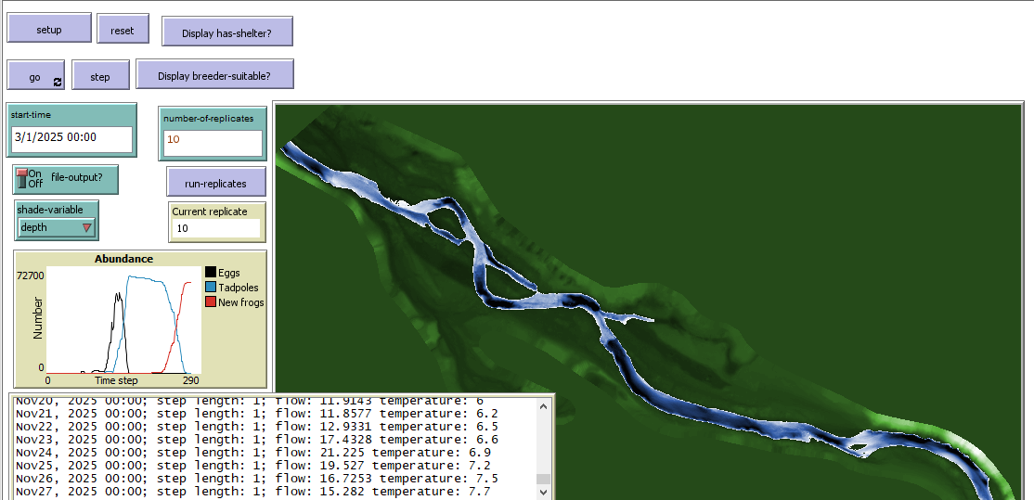
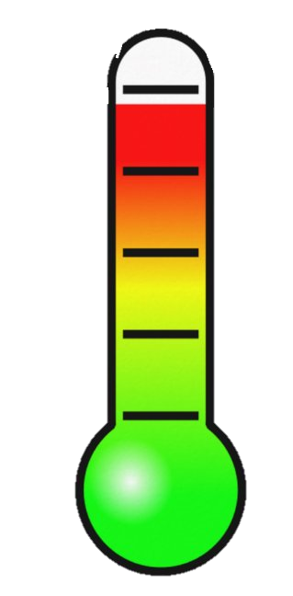
FYFAM Evaluations for TRRP
Proposed Hydrographs for WY 2025
Don Ashton
NNW 2011
NWW 2011
NWEW 2017
Chapman Ranch
“as-built”
topography
3/3/2025

Slide 2
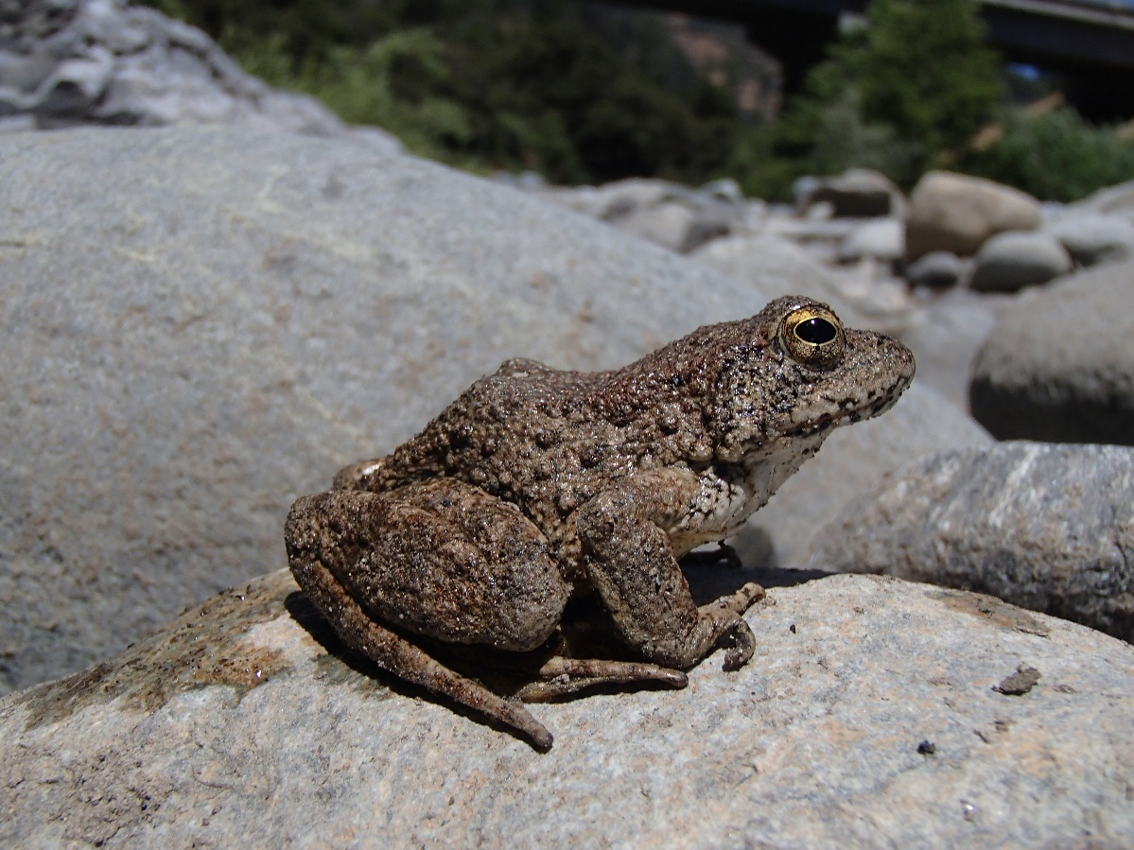
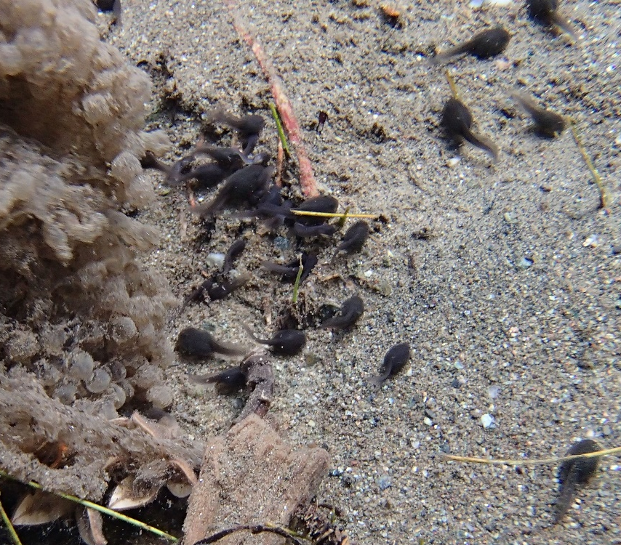
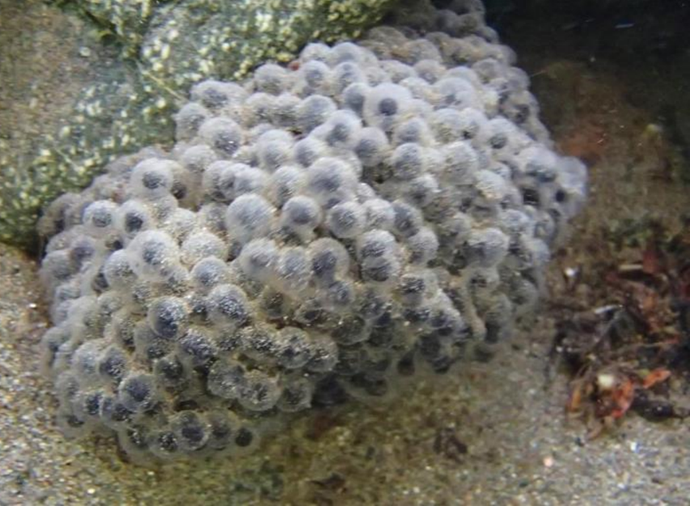
Foothill Yellow-legged Frog (Rana boylii)
Tadpole
Adult
Egg mass

Slide 3
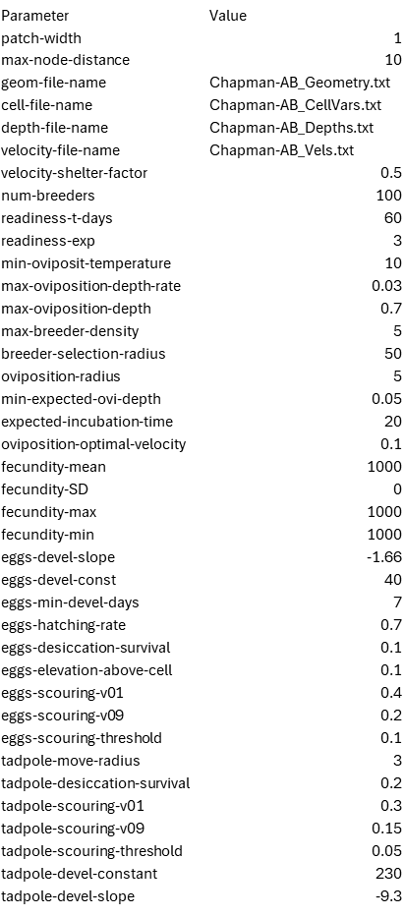
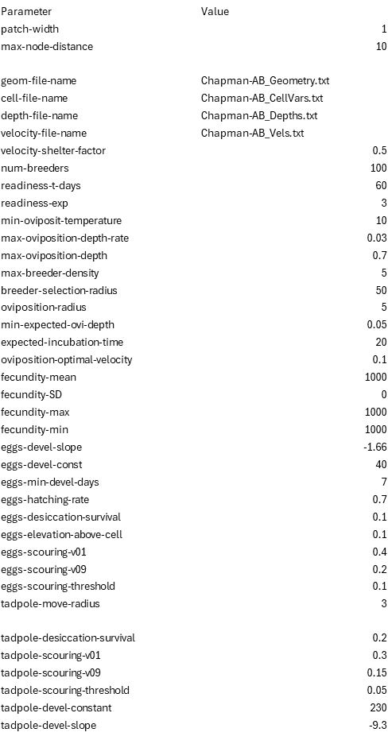
Parameters

Slide 4
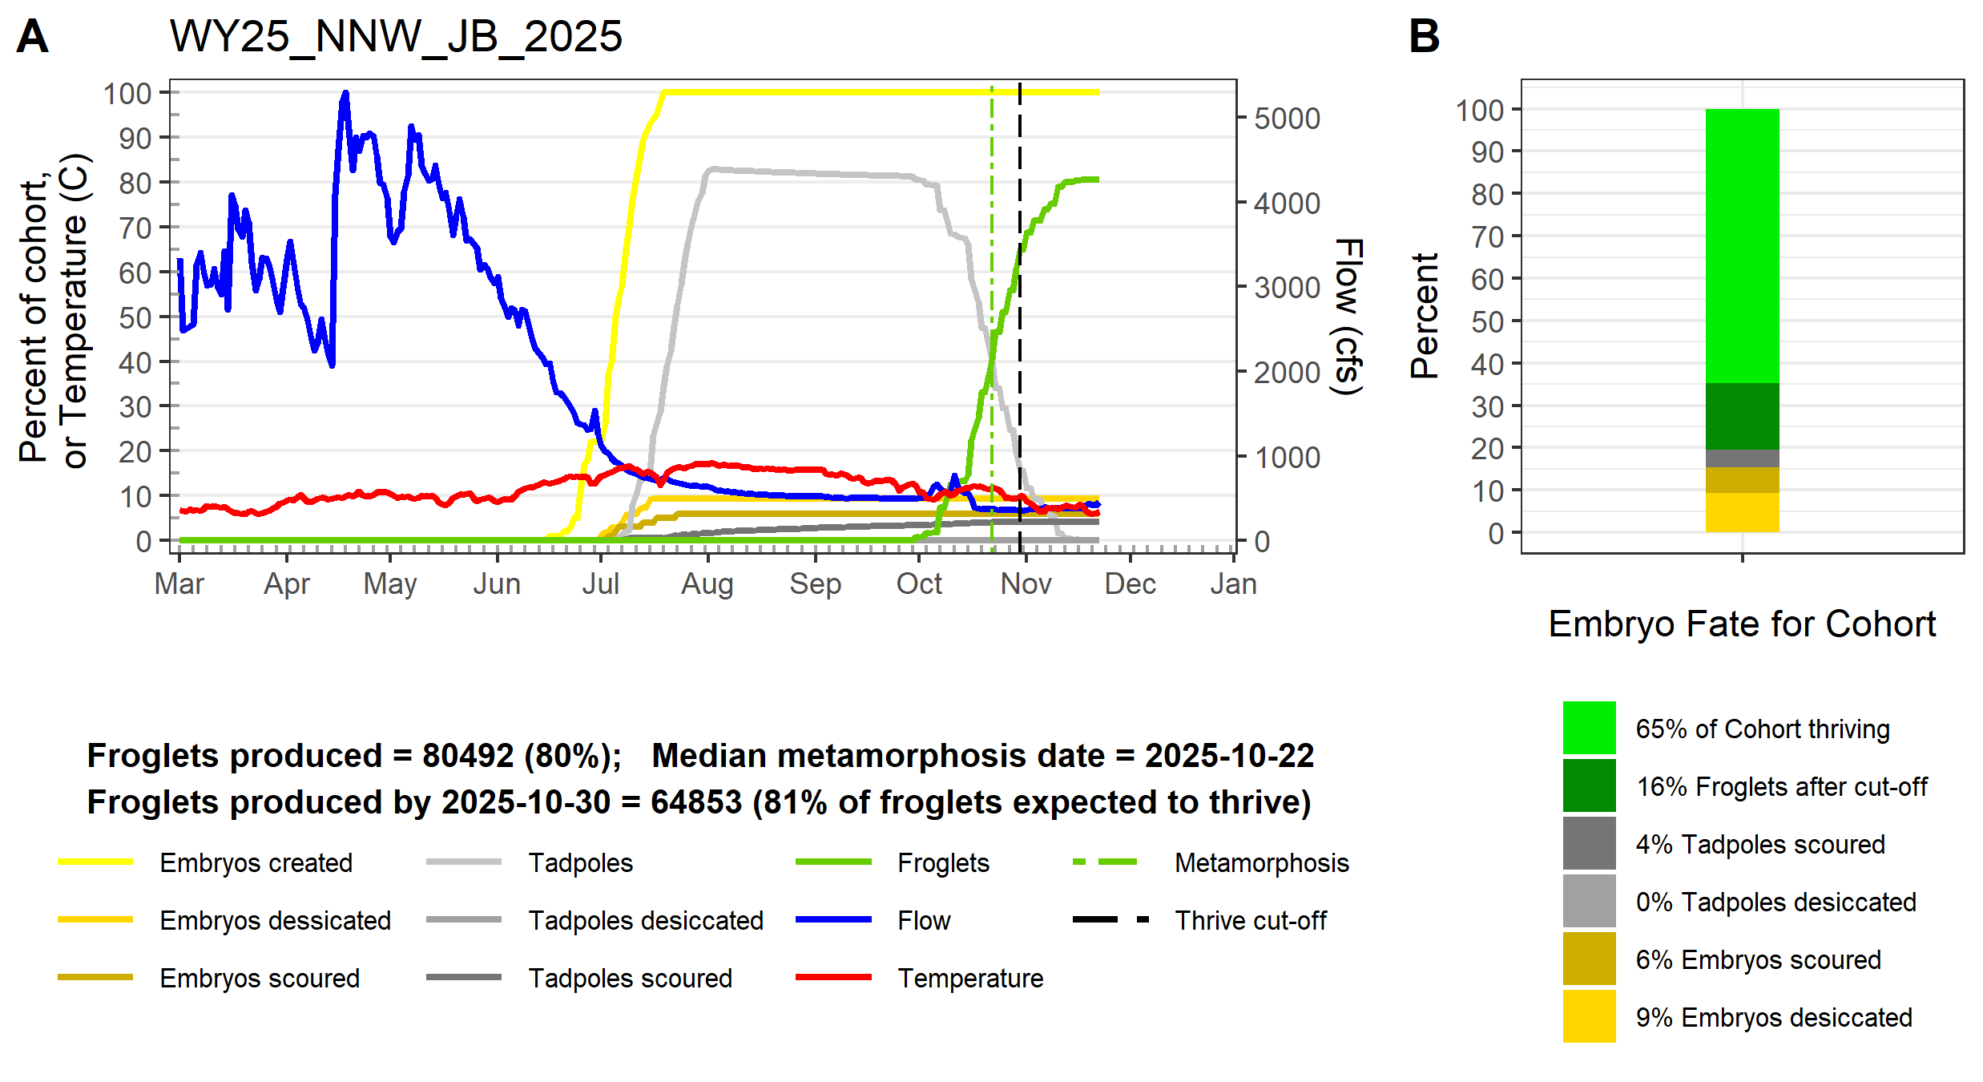
NNW JB

Slide 5
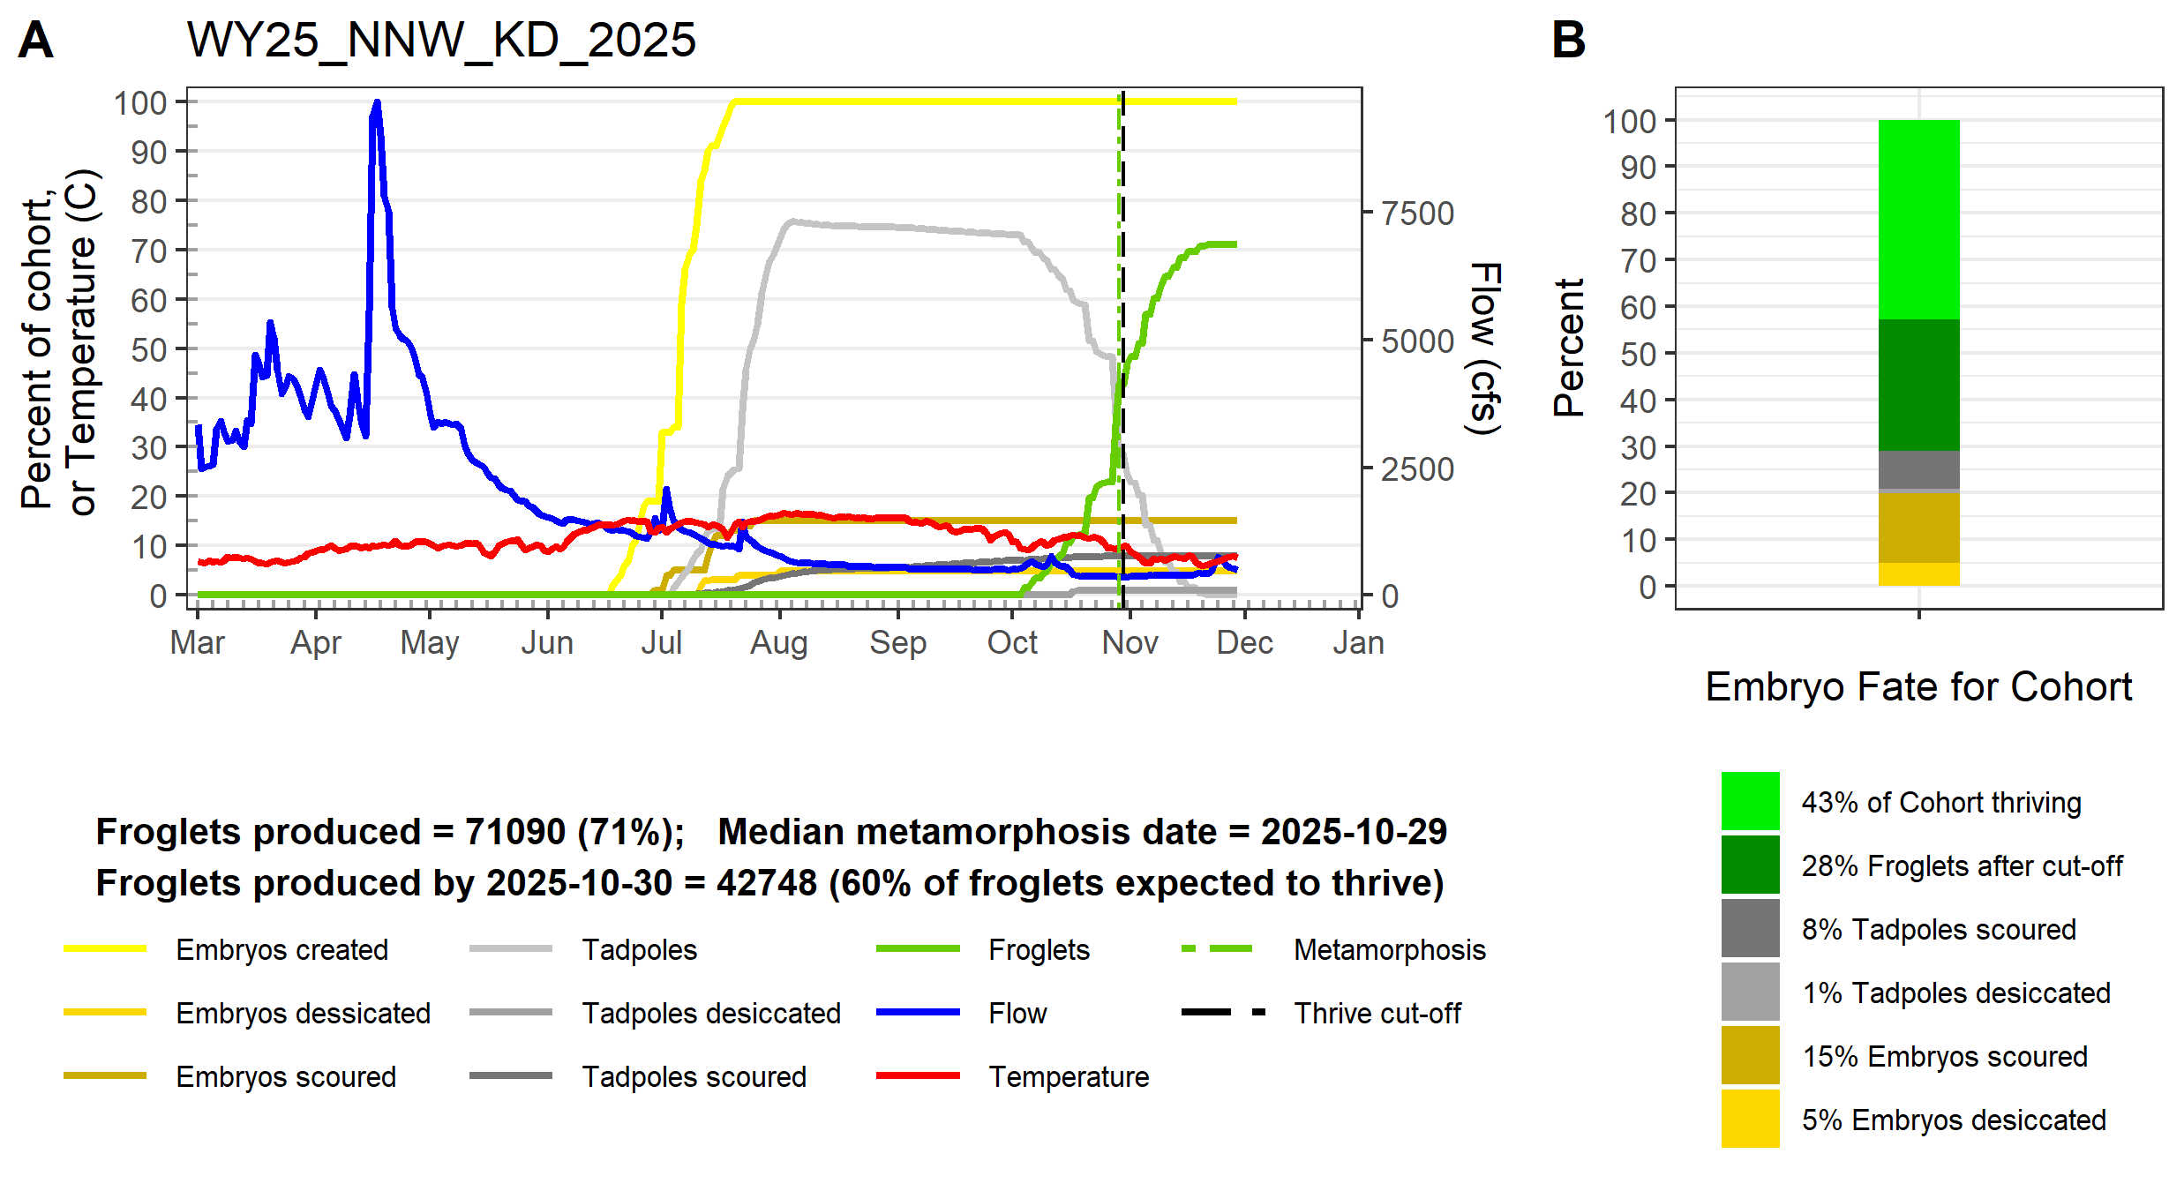
NNW KD

Slide 6
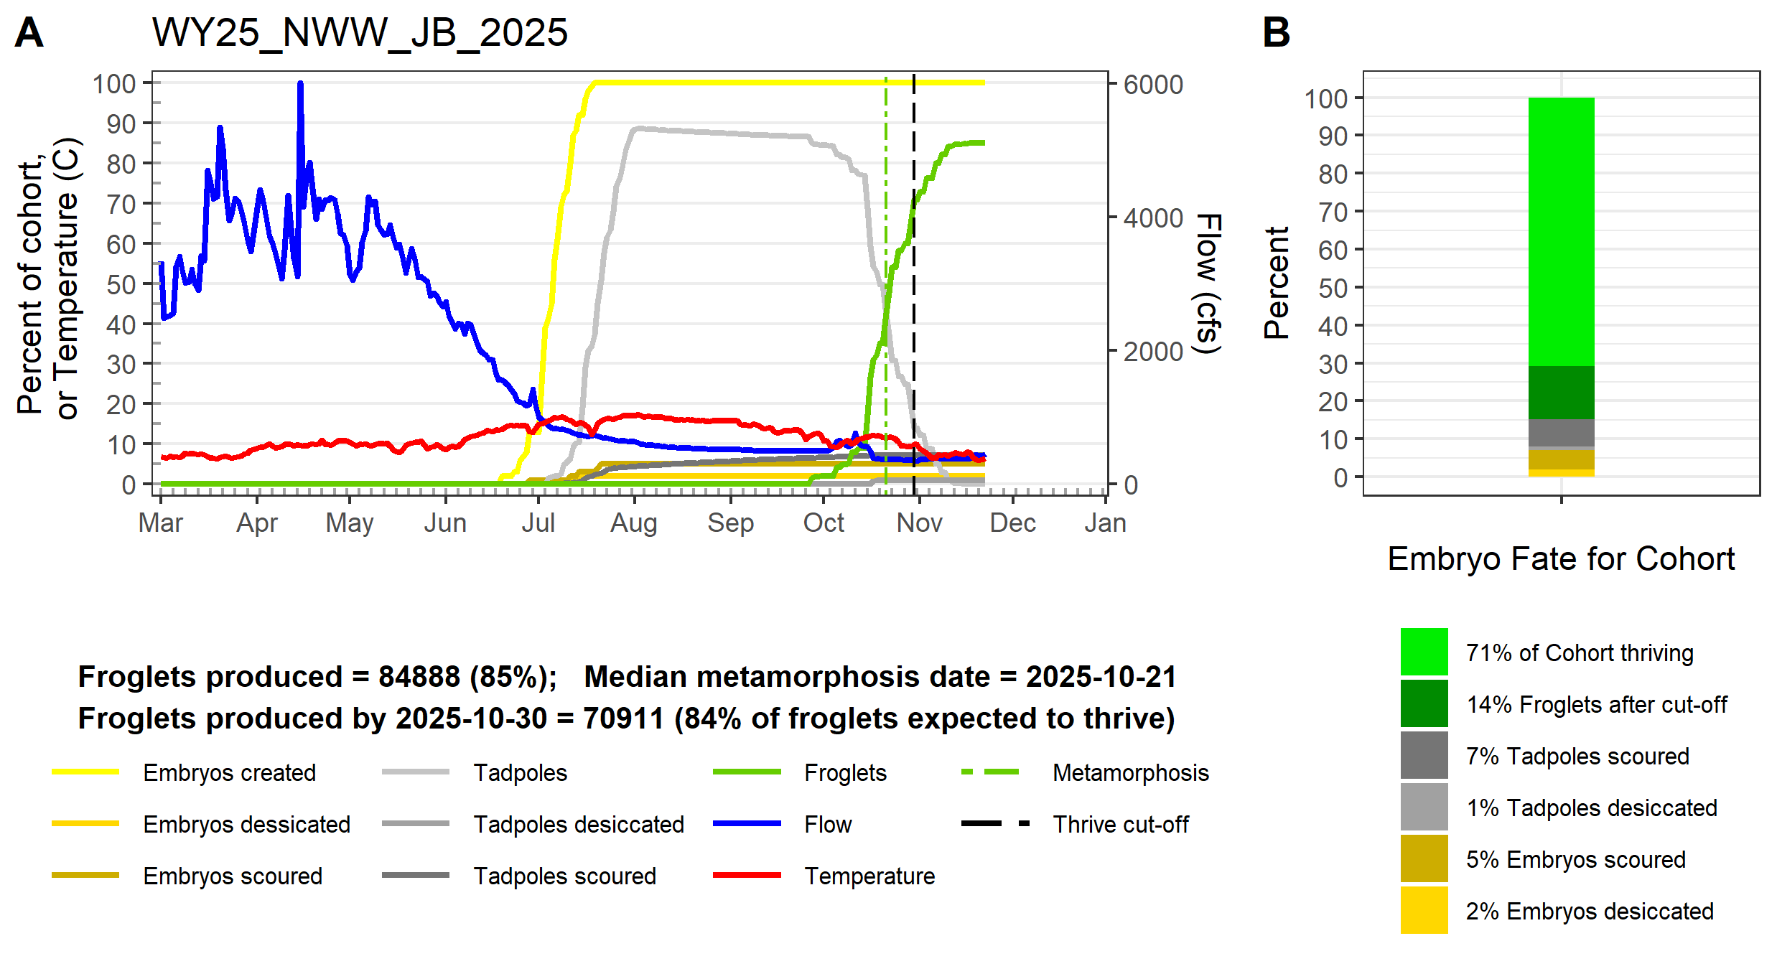
NWW JB

Slide 7
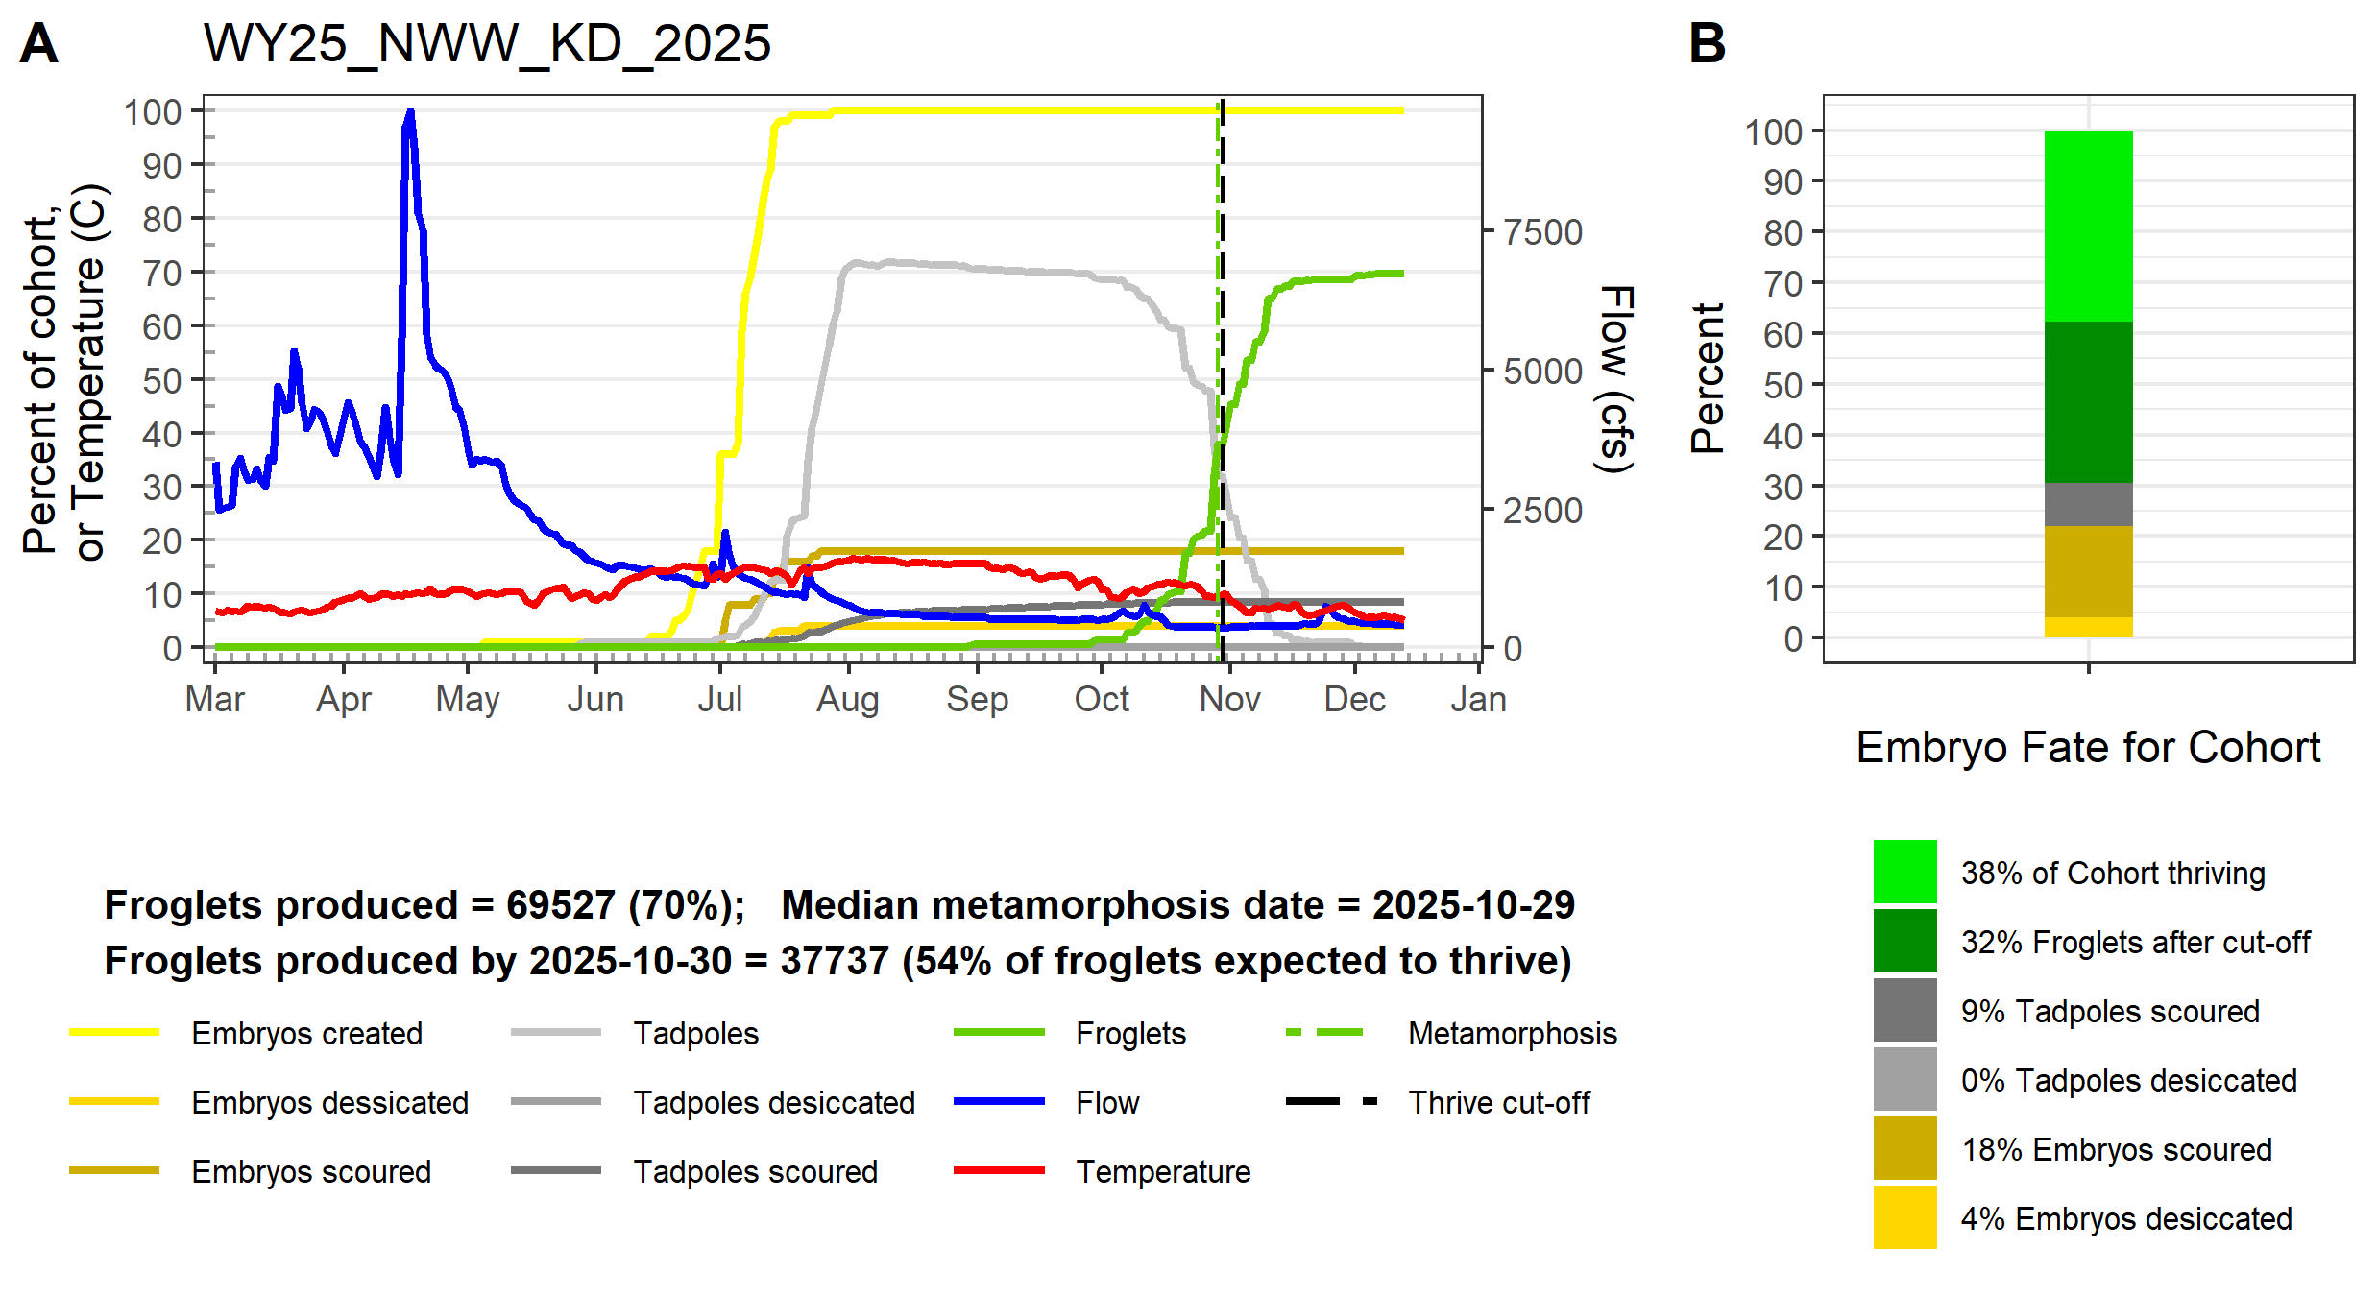
NWW KD

Slide 8
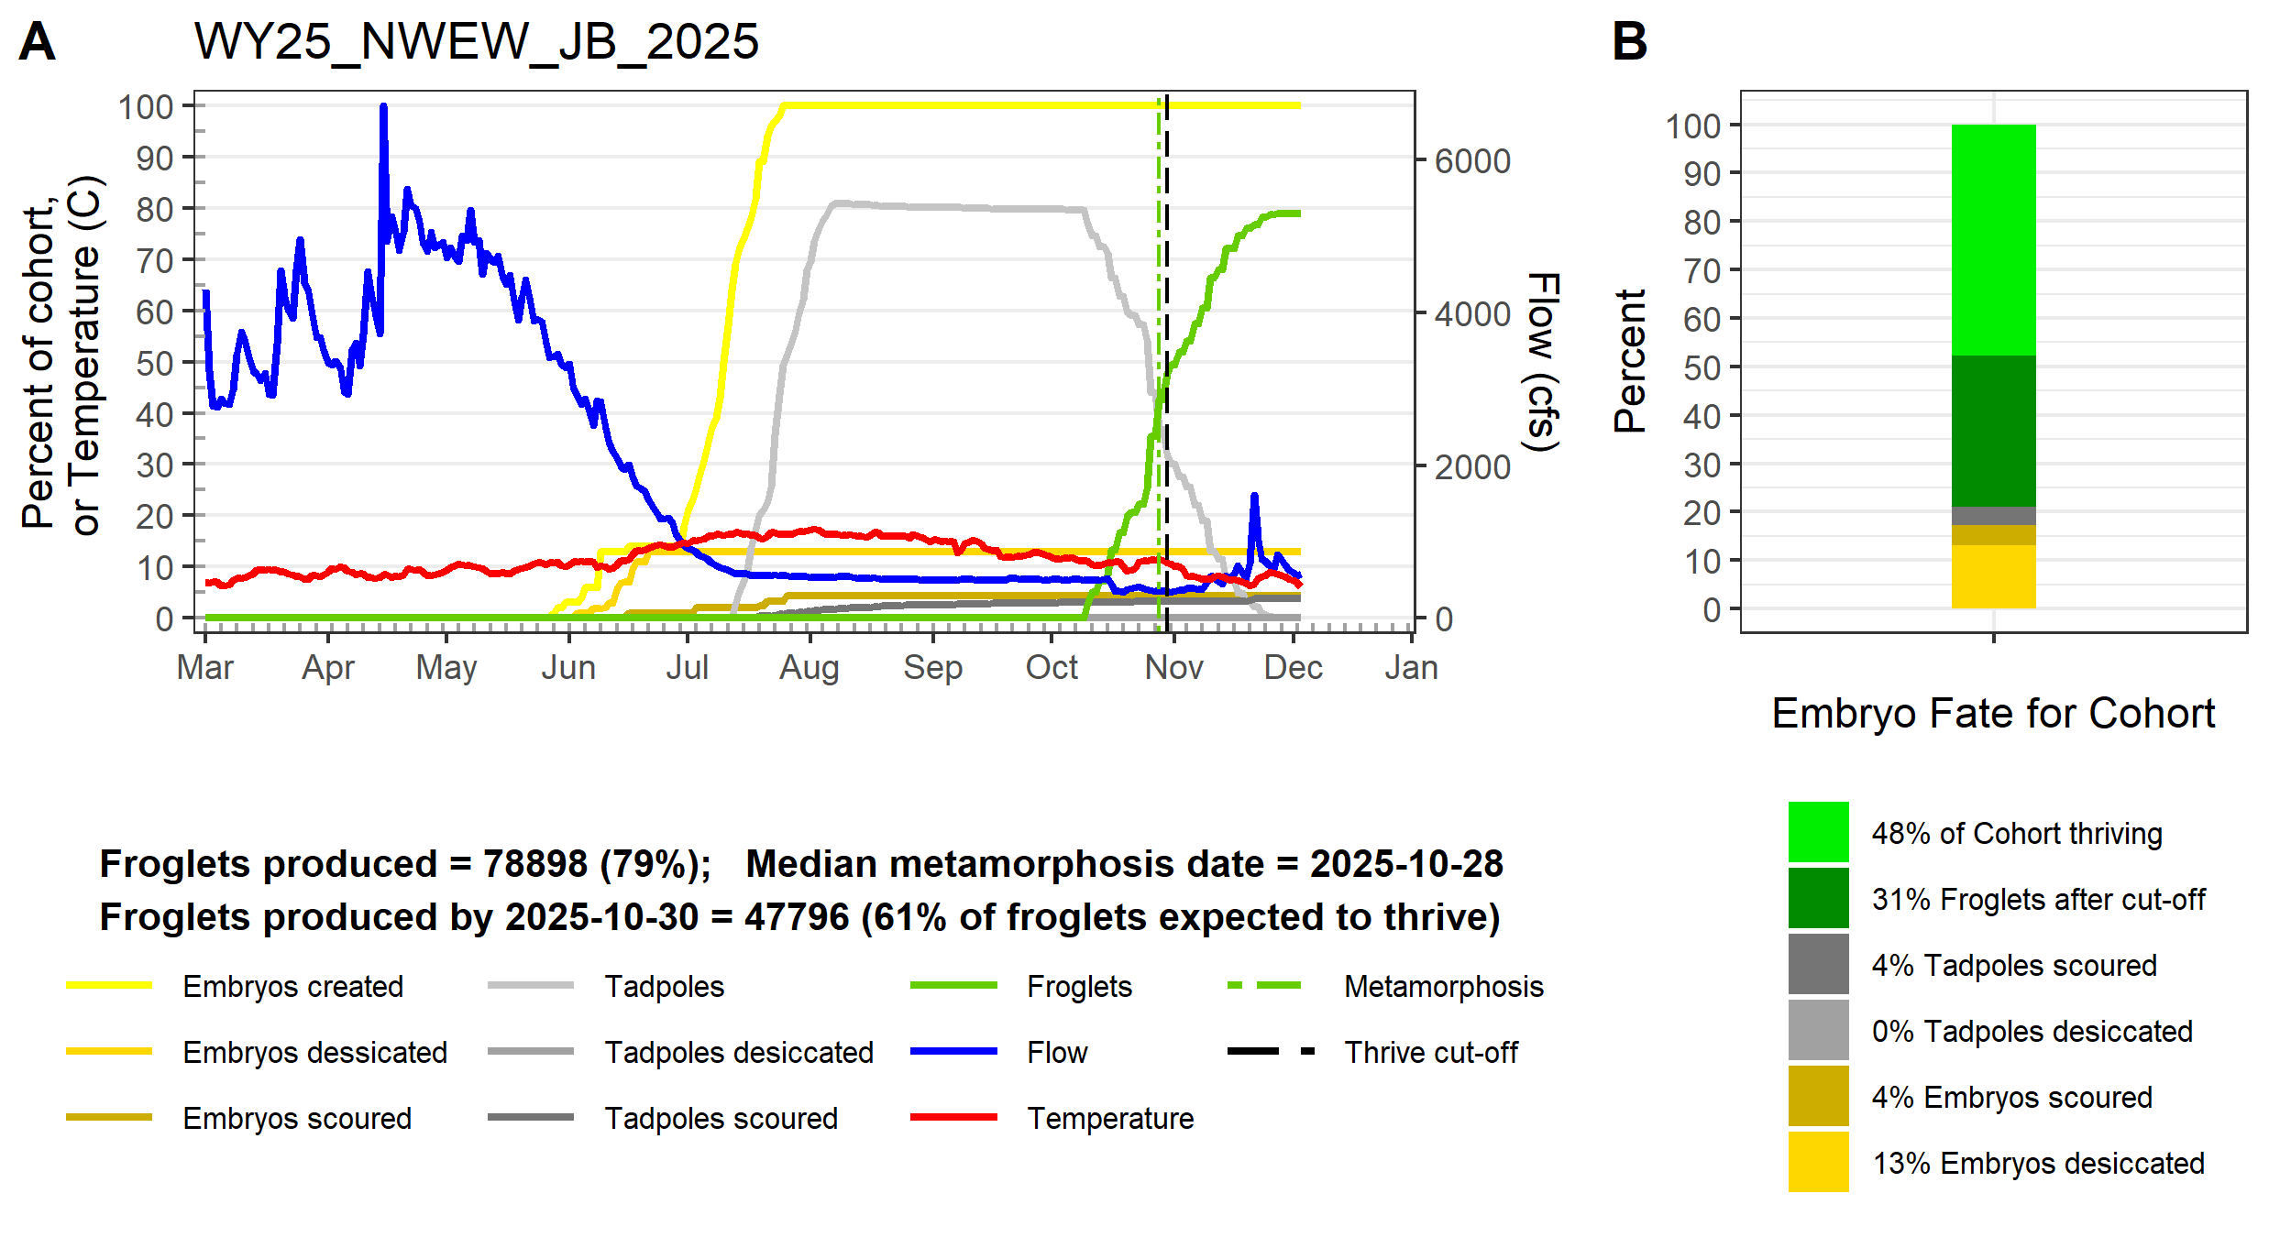
NWEW JB

Slide 9
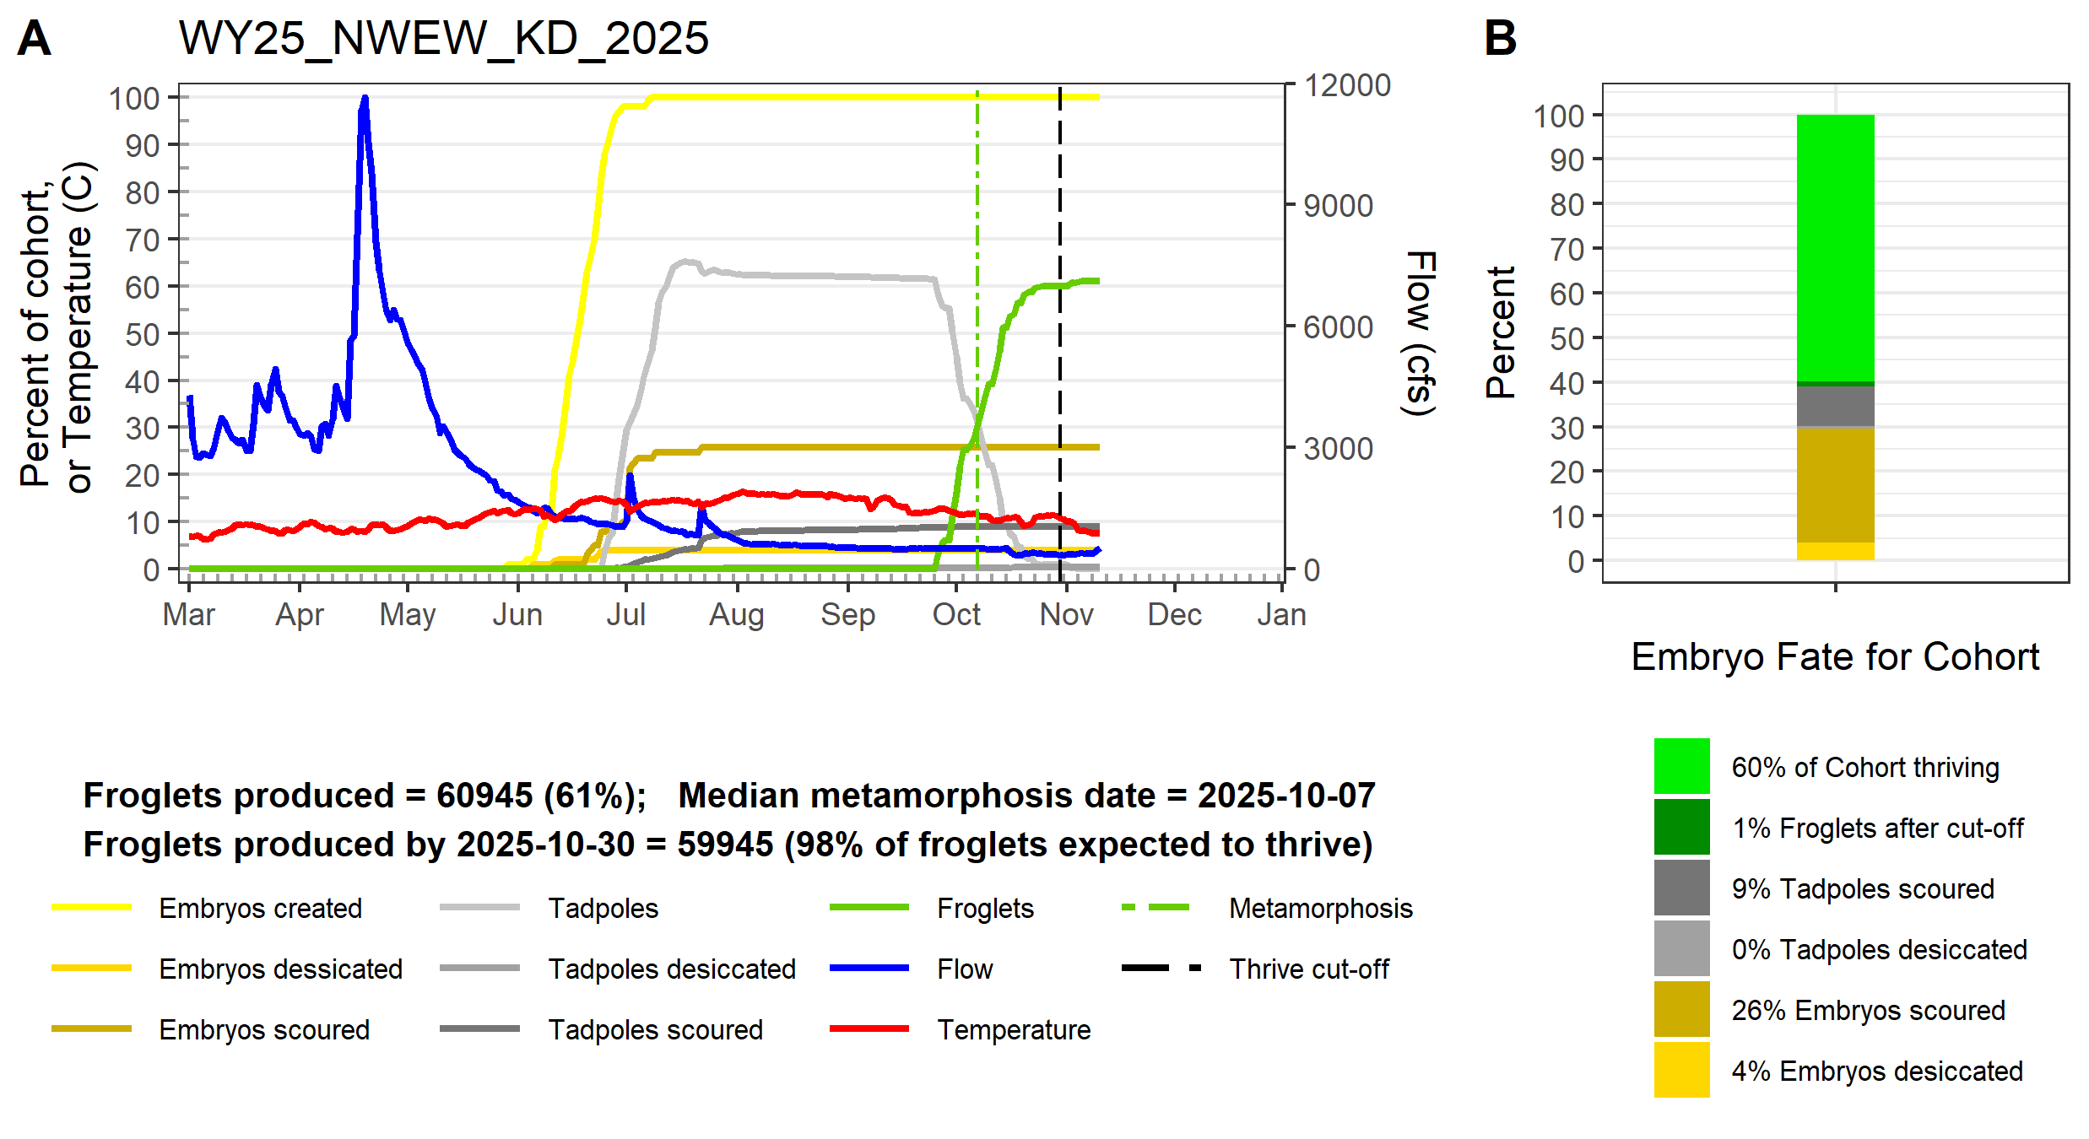
NWEW KB

Slide 10
Select “Most Typical” replicate
NNW JB
ScenarioReplicate | MedianMeta | MeanMeta | DiffMeta | RankMeta | Froglets | MeanFroglets | DiffFroglets | RankFroglets | TypicalRun | Cohort | EggDesic | EggScour | TadDesic | TadScour | Frogs
WY25_NNW_JB_1 | 10/22/2025 | 10/22/2025 | 0.2 | 2.5 | 74667 | 80491.6 | 5824.6 | 9 | 5.5 | 1 | 0.11025 | 0.05002 | 0 | 0.09306 | 0.74667
WY25_NNW_JB_2 | 10/22/2025 | 10/22/2025 | 0.2 | 2.5 | 80492 | 80491.6 | 0.4 | 1 | 1 | 1 | 0.09359 | 0.06 | 0 | 0.04149 | 0.80492
WY25_NNW_JB_3 | 10/22/2025 | 10/22/2025 | 0.2 | 2.5 | 83869 | 80491.6 | 3377.4 | 8 | 4 | 1 | 0.08312 | 0.02027 | 0 | 0.05792 | 0.83869
WY25_NNW_JB_4 | 10/21/2025 | 10/22/2025 | 1.2 | 8 | 89800 | 80491.6 | 9308.4 | 10 | 10 | 1 | 0.03272 | 0.0309 | 0 | 0.03838 | 0.898
WY25_NNW_JB_5 | 10/25/2025 | 10/22/2025 | 2.8 | 10 | 80802 | 80491.6 | 310.4 | 2 | 7 | 1 | 0.08265 | 0.043 | 0 | 0.06633 | 0.80802
WY25_NNW_JB_6 | 10/23/2025 | 10/22/2025 | 0.8 | 5.5 | 77577 | 80491.6 | 2914.6 | 6 | 5.5 | 1 | 0.12052 | 0.05 | 0 | 0.05371 | 0.77577
WY25_NNW_JB_7 | 10/23/2025 | 10/22/2025 | 0.8 | 5.5 | 80086 | 80491.6 | 405.6 | 3 | 3 | 1 | 0.10857 | 0.04 | 0 | 0.05057 | 0.80086
WY25_NNW_JB_8 | 10/21/2025 | 10/22/2025 | 1.2 | 8 | 78690 | 80491.6 | 1801.6 | 5 | 8 | 1 | 0.08995 | 0.06002 | 0 | 0.06313 | 0.7869
WY25_NNW_JB_9 | 10/22/2025 | 10/22/2025 | 0.2 | 2.5 | 81646 | 80491.6 | 1154.4 | 4 | 2 | 1 | 0.10068 | 0.033 | 0 | 0.04986 | 0.81646
WY25_NNW_JB_10 | 10/21/2025 | 10/22/2025 | 1.2 | 8 | 77287 | 80491.6 | 3204.6 | 7 | 9 | 1 | 0.11387 | 0.07 | 0 | 0.04326 | 0.77287
NNW KD

Slide 11
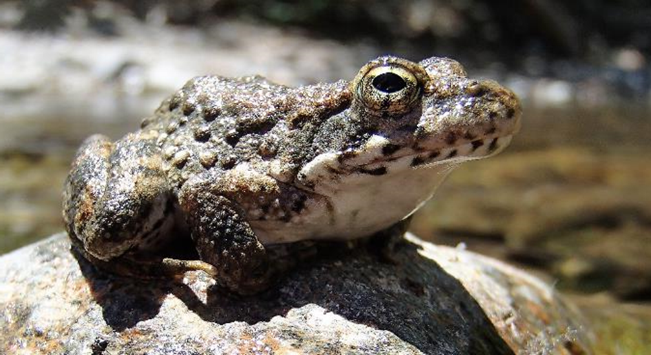
Foothill Yellow-legged Frog (Rana boylii)
Don Ashton don@mcbainassociates.com

