Slide 1
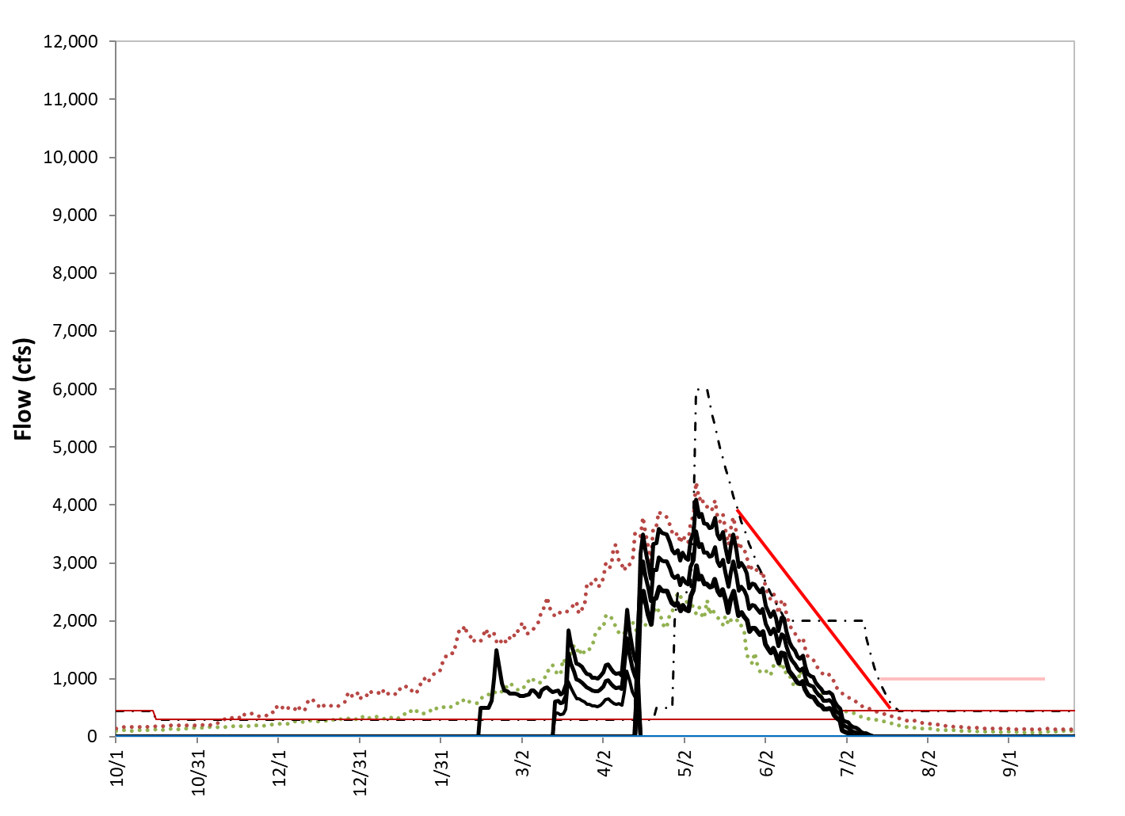
Scaled Q50

Slide 2
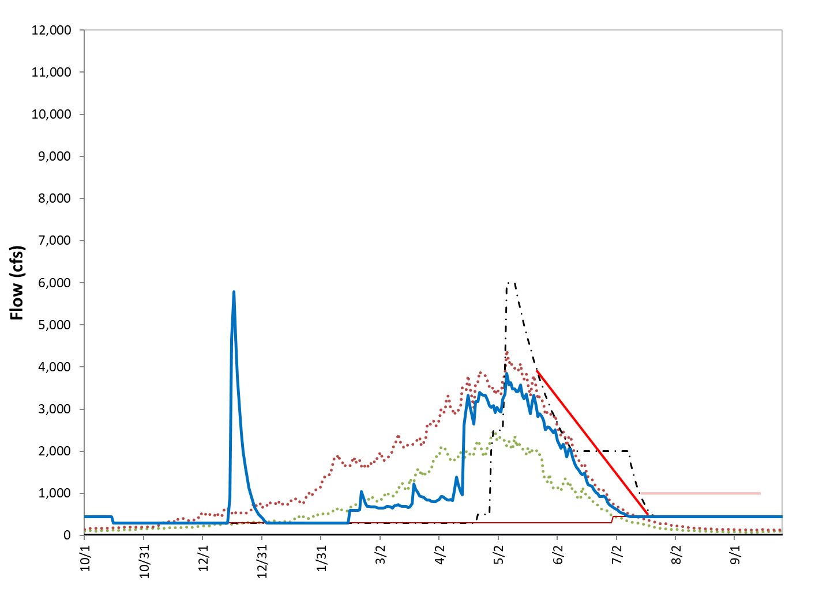
Scaled Q50 N-N-W

Slide 3
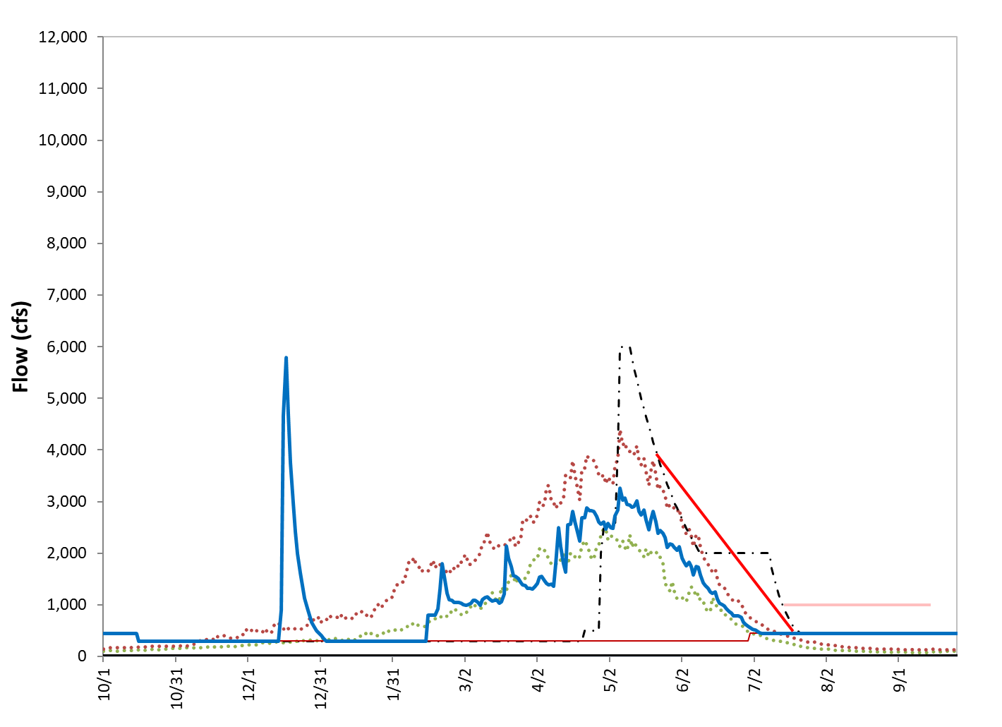
Scaled Q50 N-W-W

Slide 4
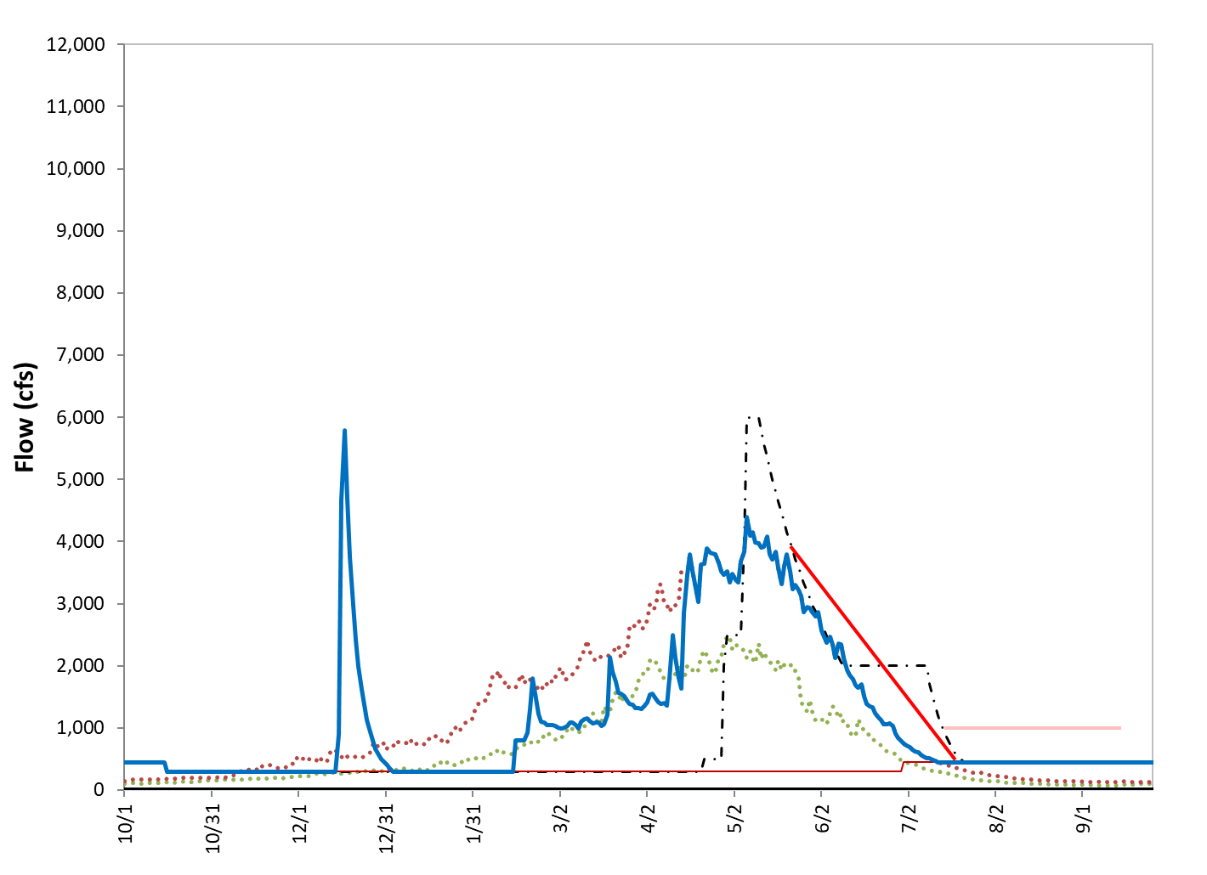
Scaled Q50 N-W-E

