Slide 1
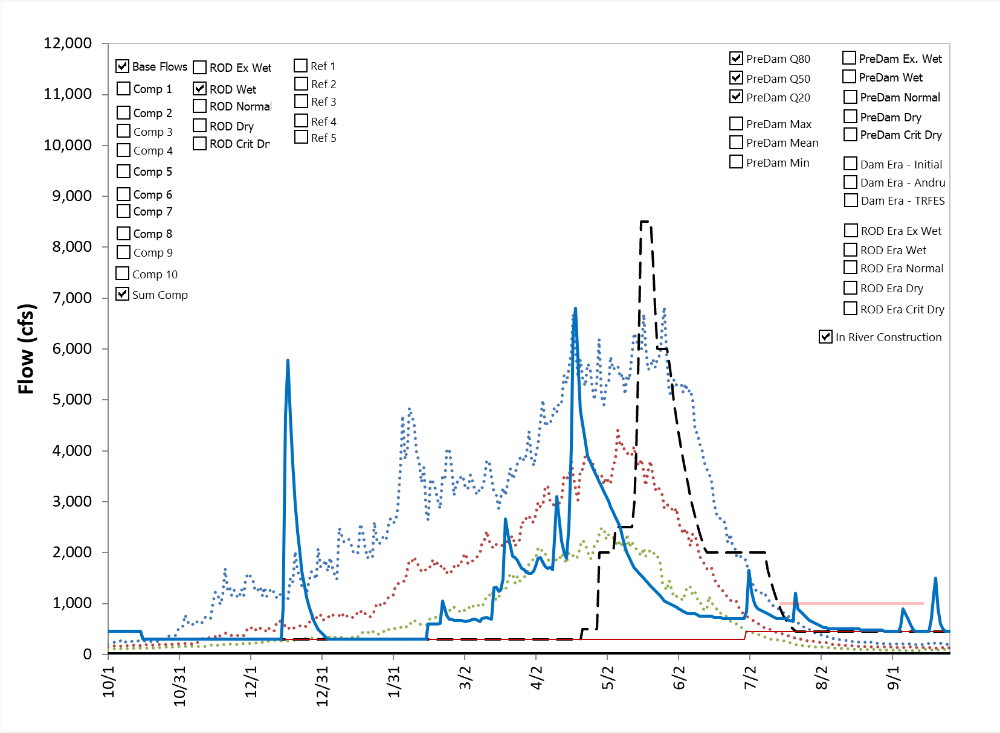
Normal – Wet - Wet

Slide 2
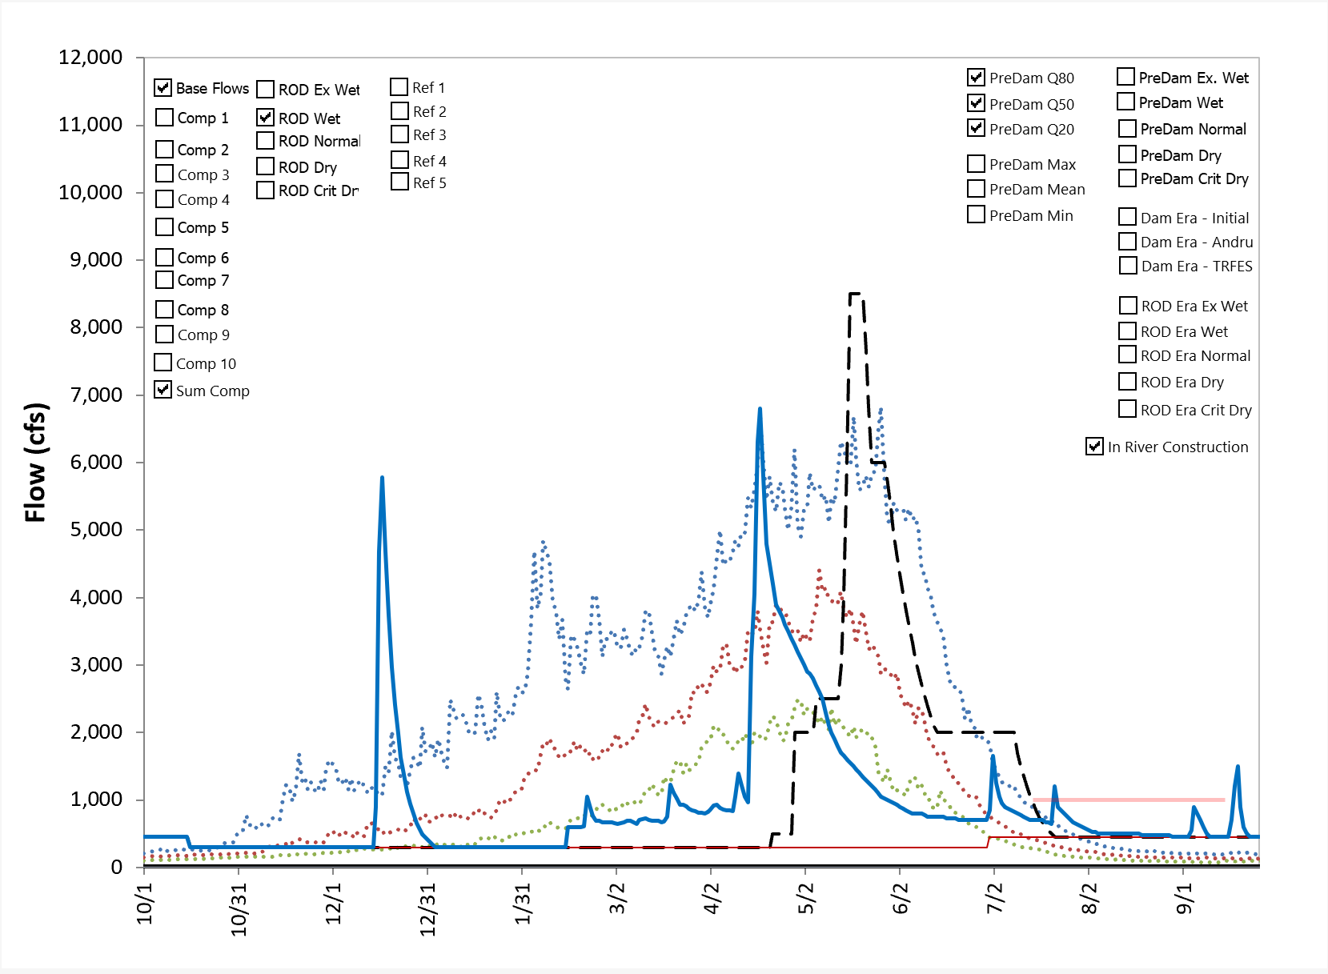
Normal – Normal - Normal

Slide 3
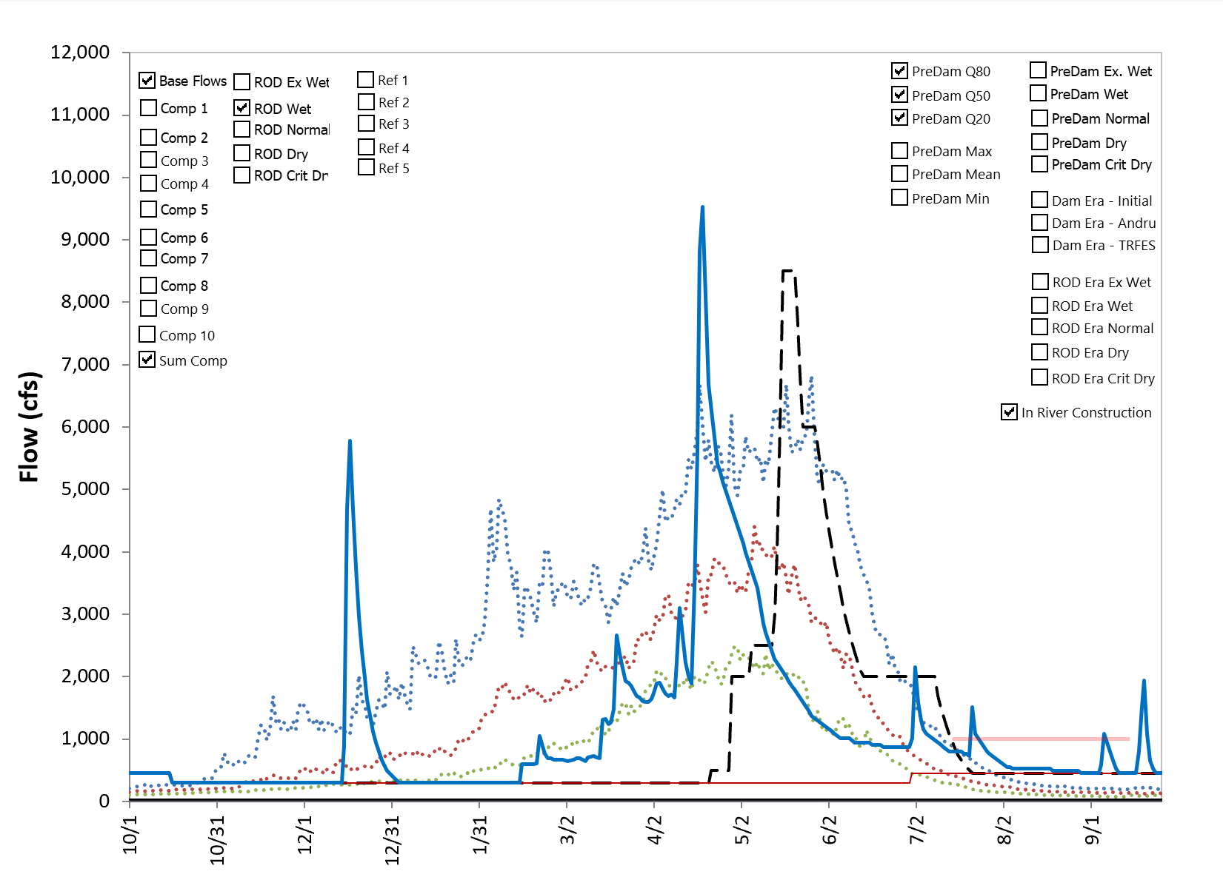
Normal – Wet – Ex Wet

