Slide 1
Flow WG 2025-02-19
Spring Flow Planning 2
Review of Proposed Hydrographs
Assignment of Modelers

Slide 2
Agenda
Introductions (if needed)
Review last week’s meeting (02/13/25)
Review current hydrologic conditions
Presentation of proposed hydrographs/discussion
Identification of models to run and modelers to run them
Adjourn

Slide 3
02/13/25 outcomes
The group pivoted from the scenarios agreed upon 2/6 given that the February B120 was a normal year:
    See below for scenarios to be developed for
The group agreed to model two hydrographs per scenario:
    One (1) with a focus on riparian objectives
    One (1) with a focus on geomorphic/fish objectives
Kyle DeJuilio and YTF committed to developing one or more hydrographs
Justin Alvarez and HVTF committed to developing one or more hydrographs
Scenario | Sync | Feb B120 | Mar B120 | Apr B120 | Total released from Dec 16-Apr 15
1 | 60k | Norm-60k | Wet-60k | Wet | 180kaf
2 | 60k | Norm-60k | Norm-0k | Wet | 120kaf
3 | 60k | Norm-60k | Wet-60k | Ex. Wet | 180kaf
Ideally we will end up with a maximum of 6 hydrographs to model.

Slide 4
Hydrologic Conditions Update

Slide 5
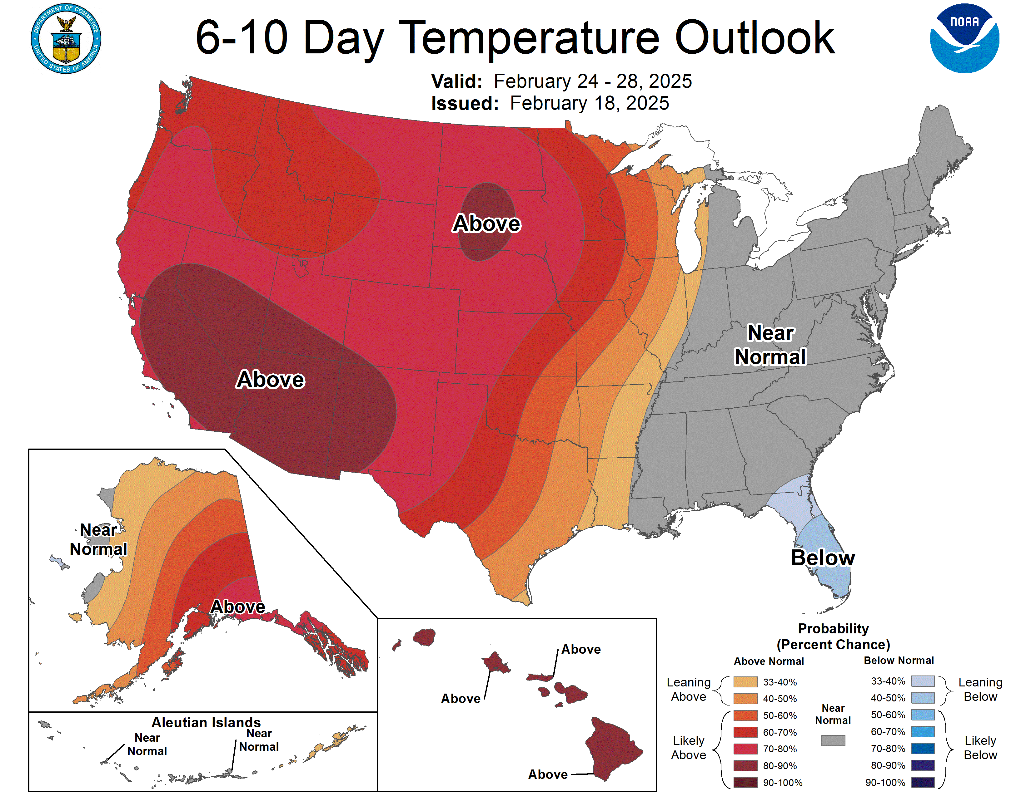

Slide 6
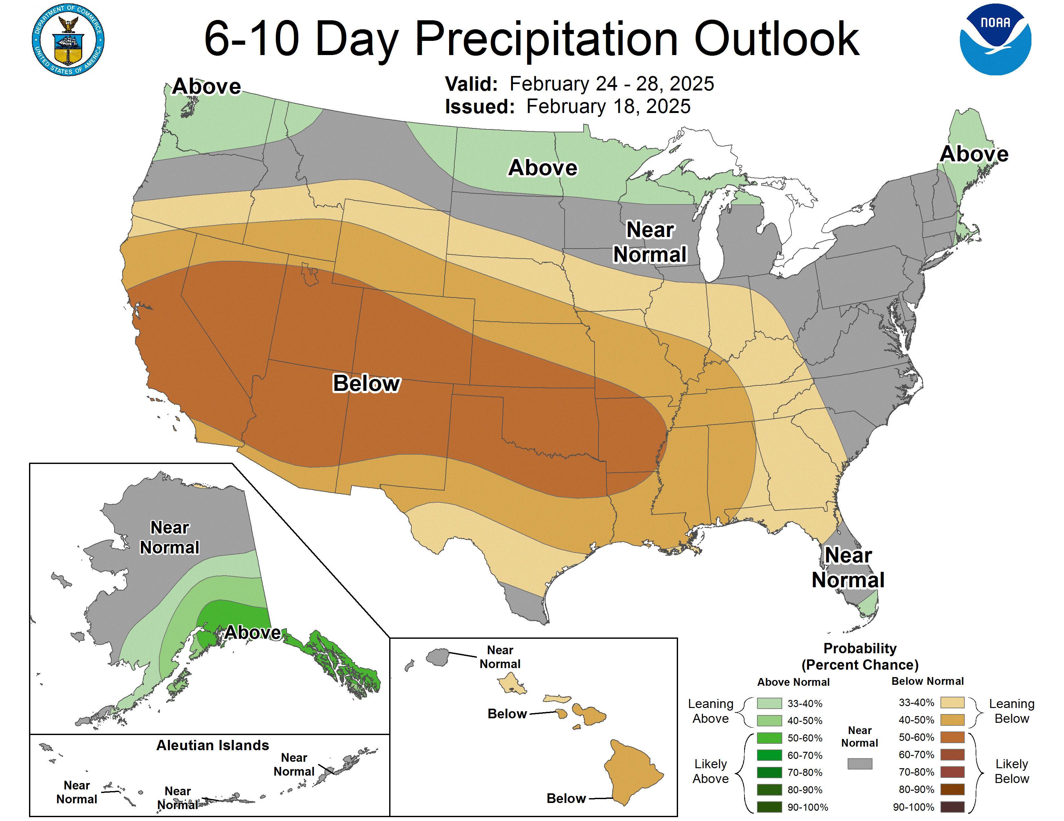

Slide 7
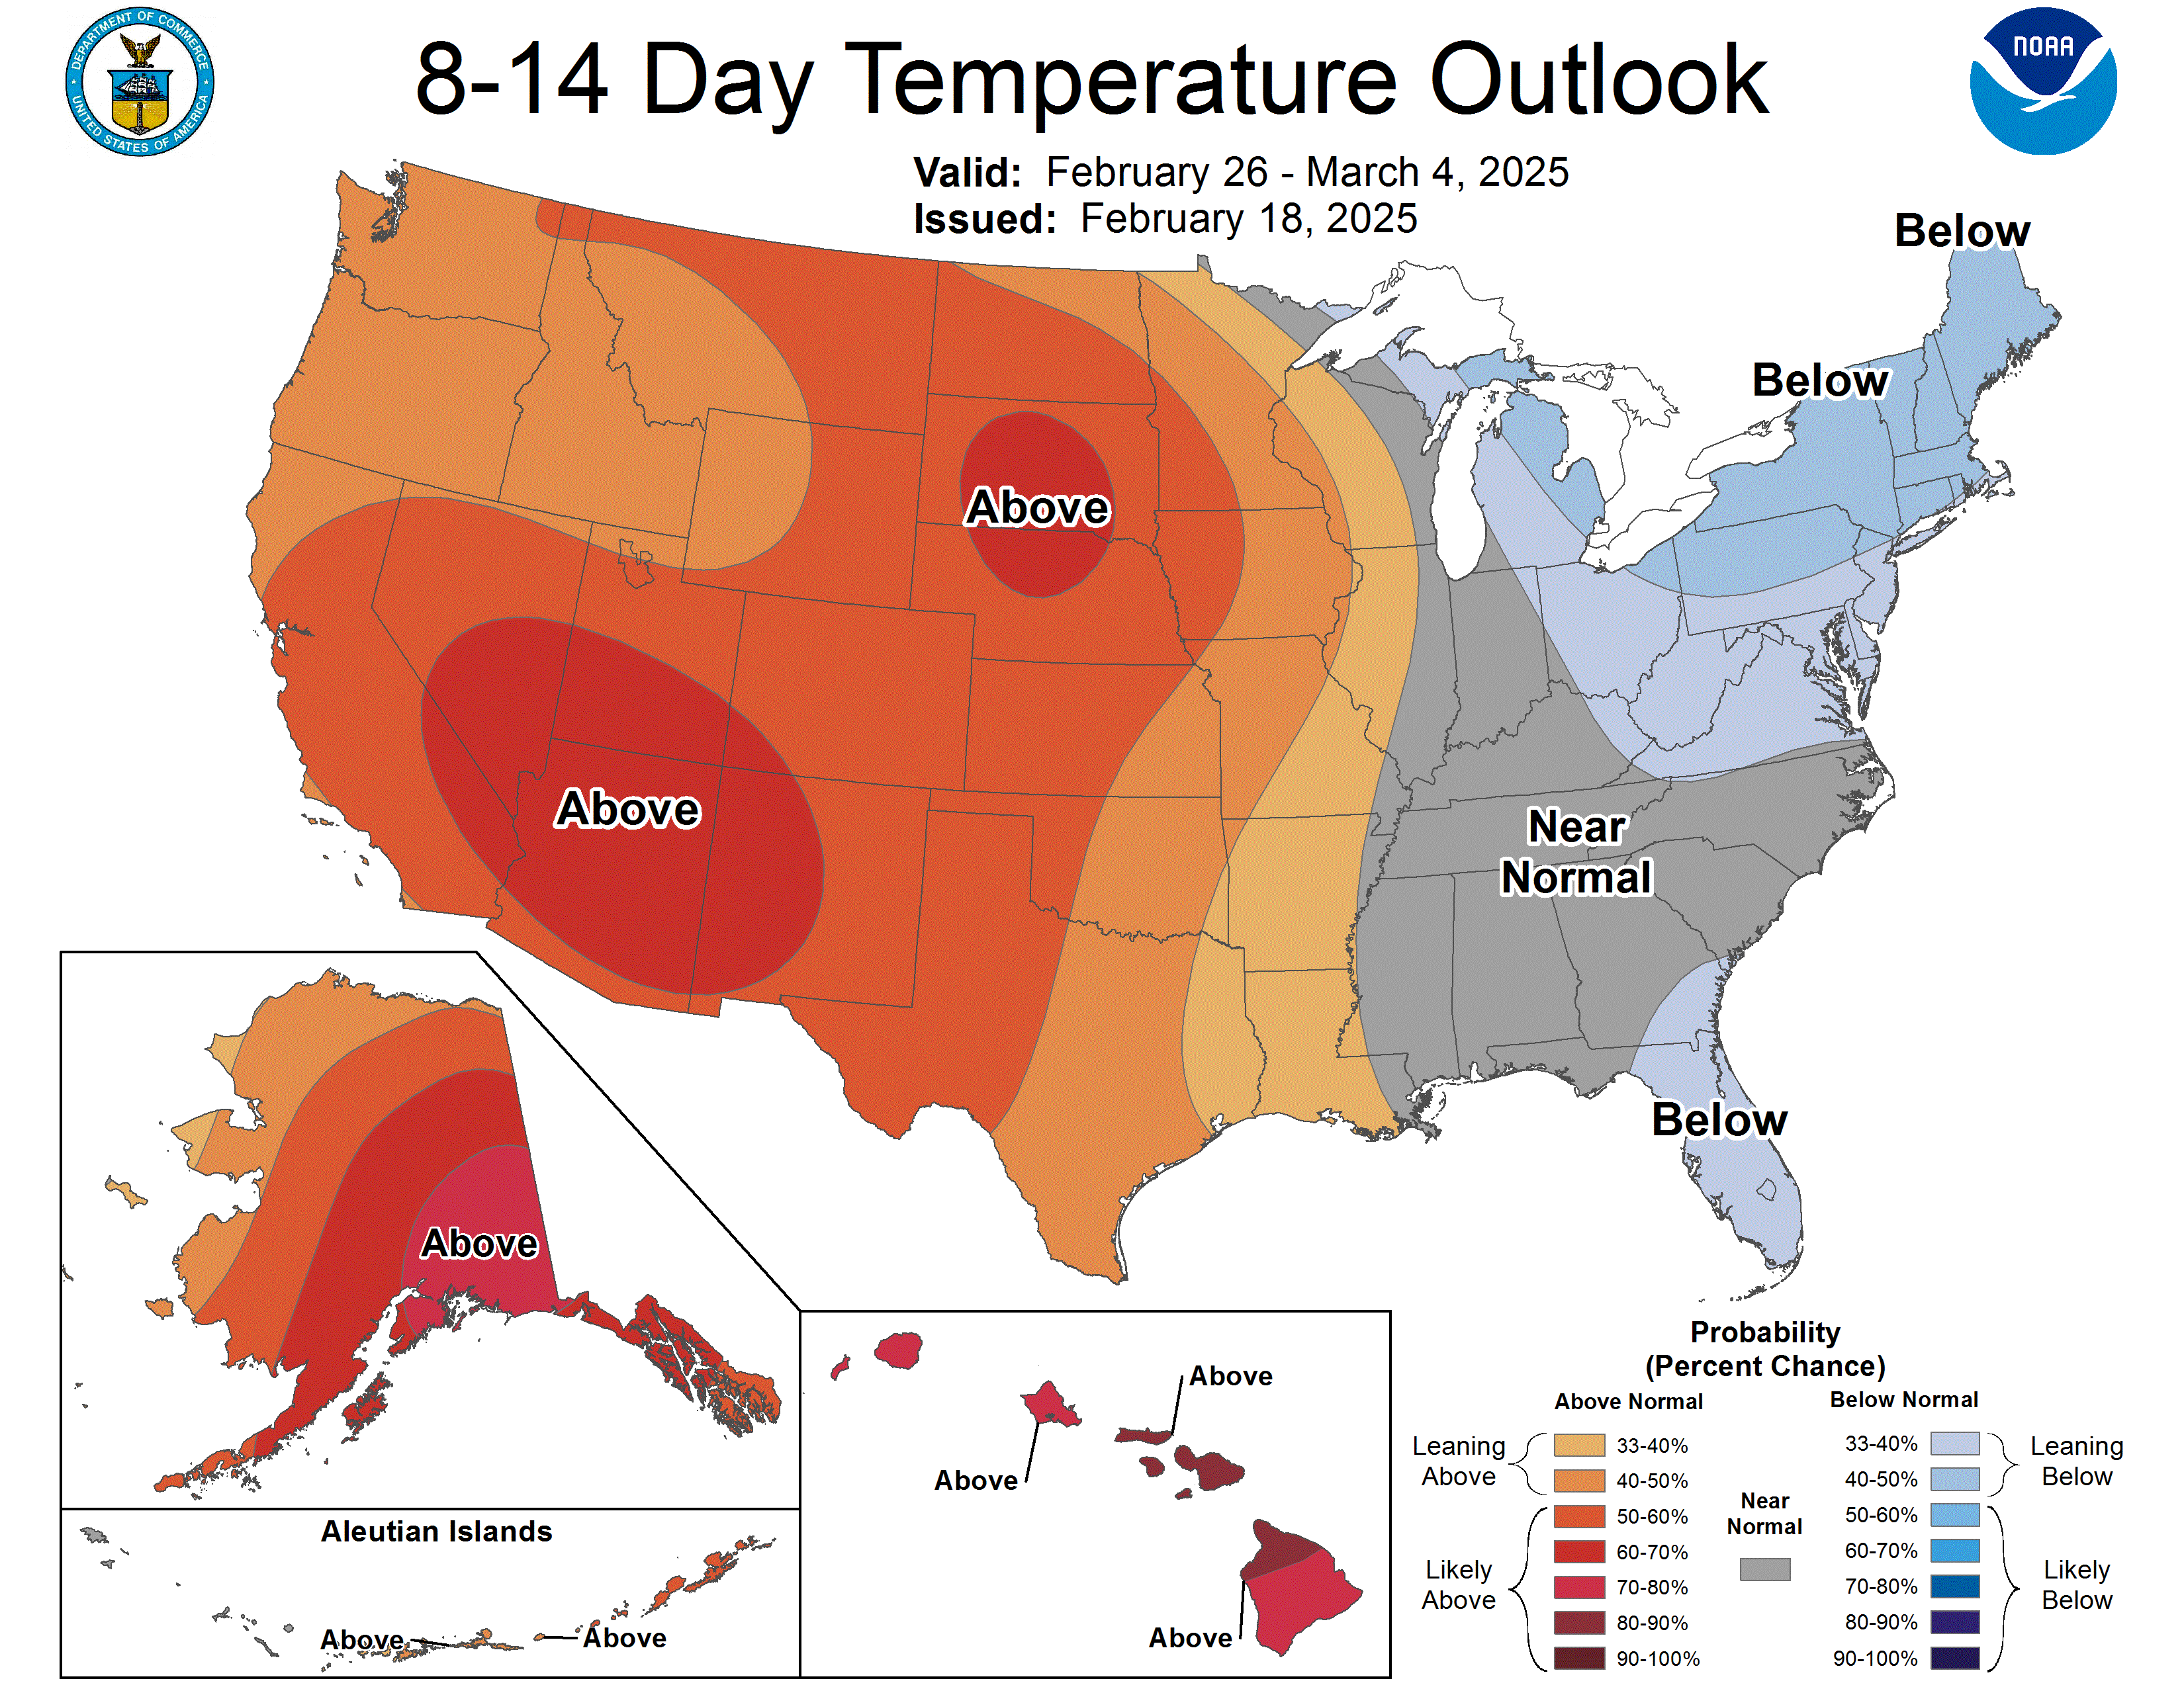

Slide 8
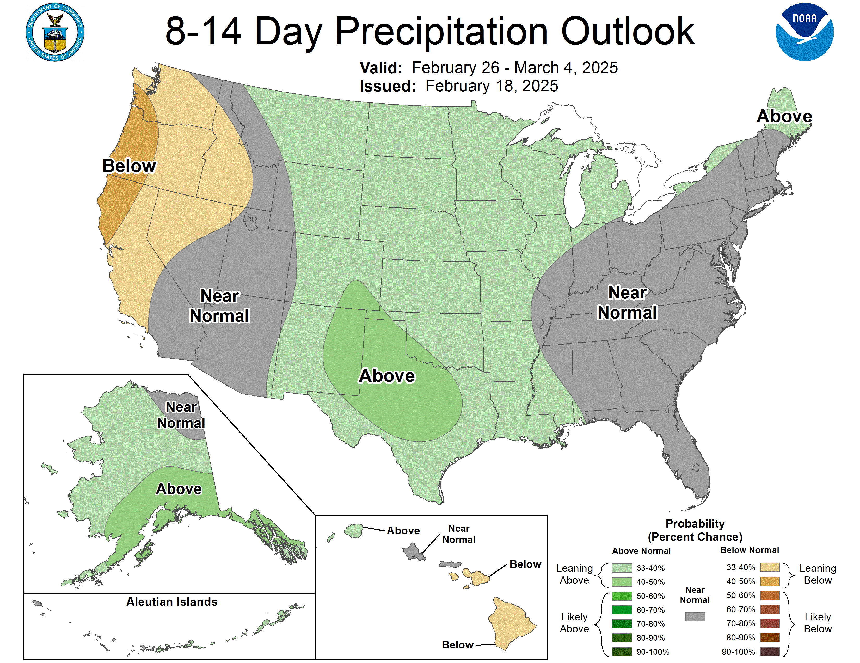

Slide 9
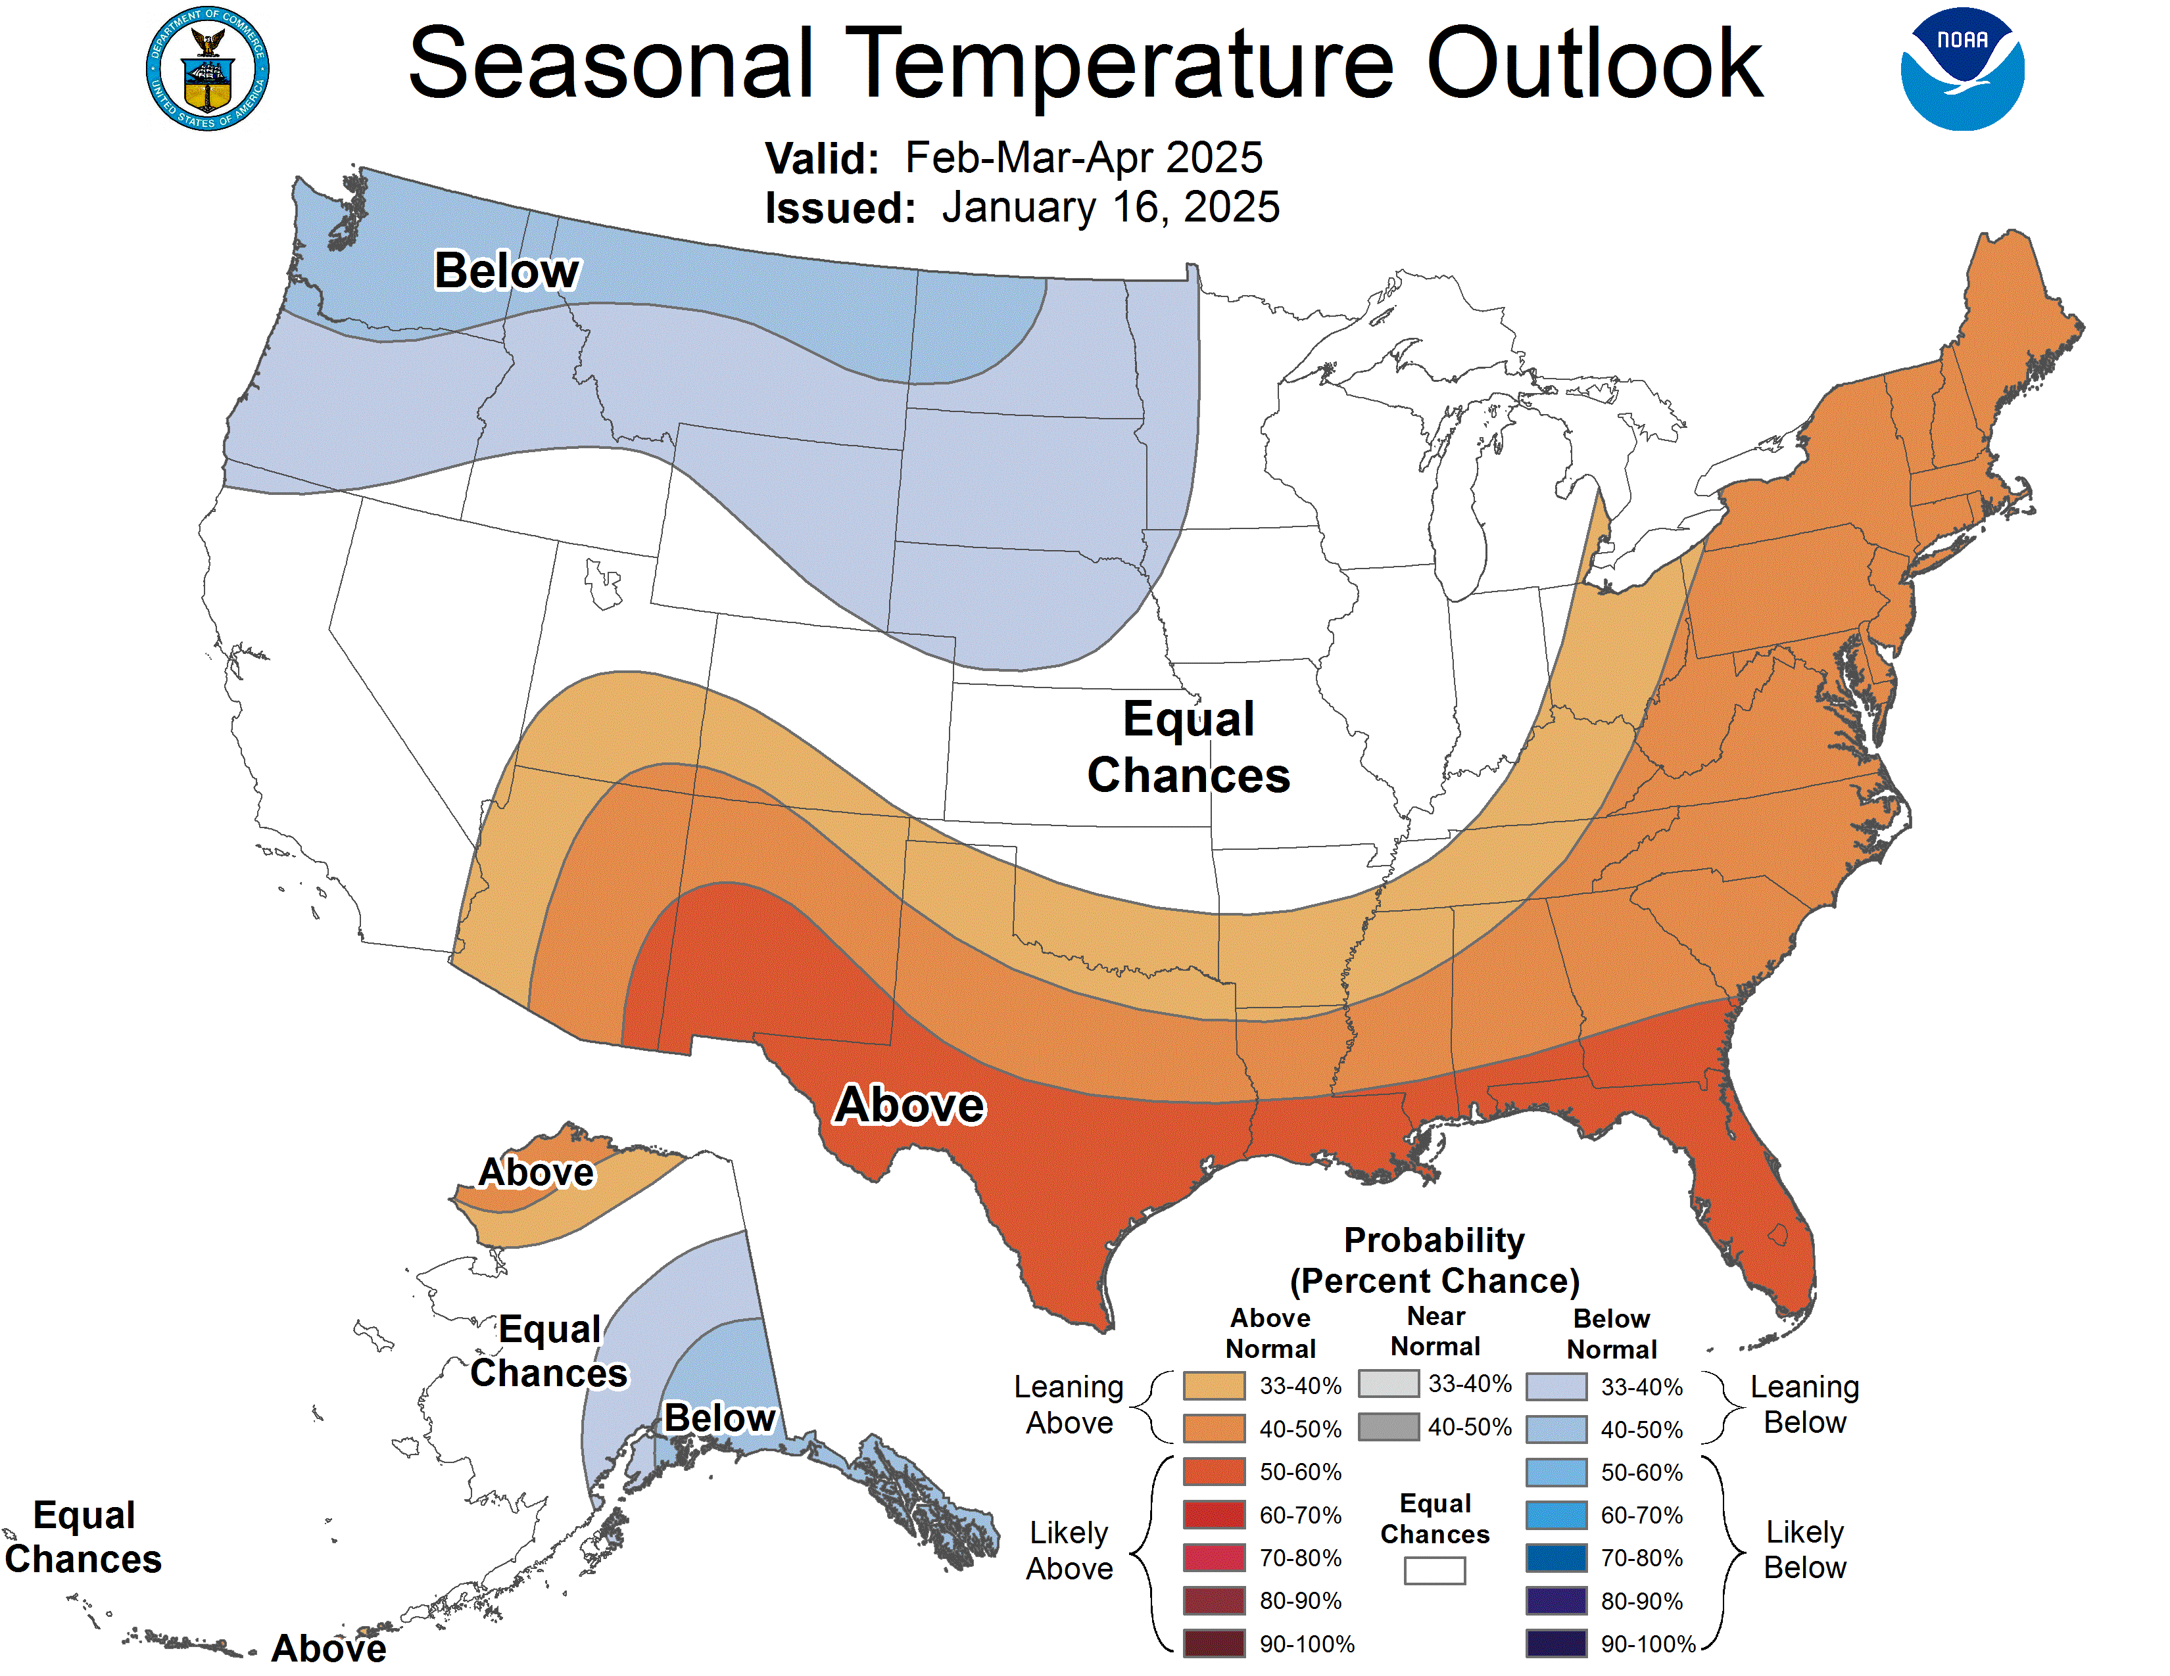

Slide 10
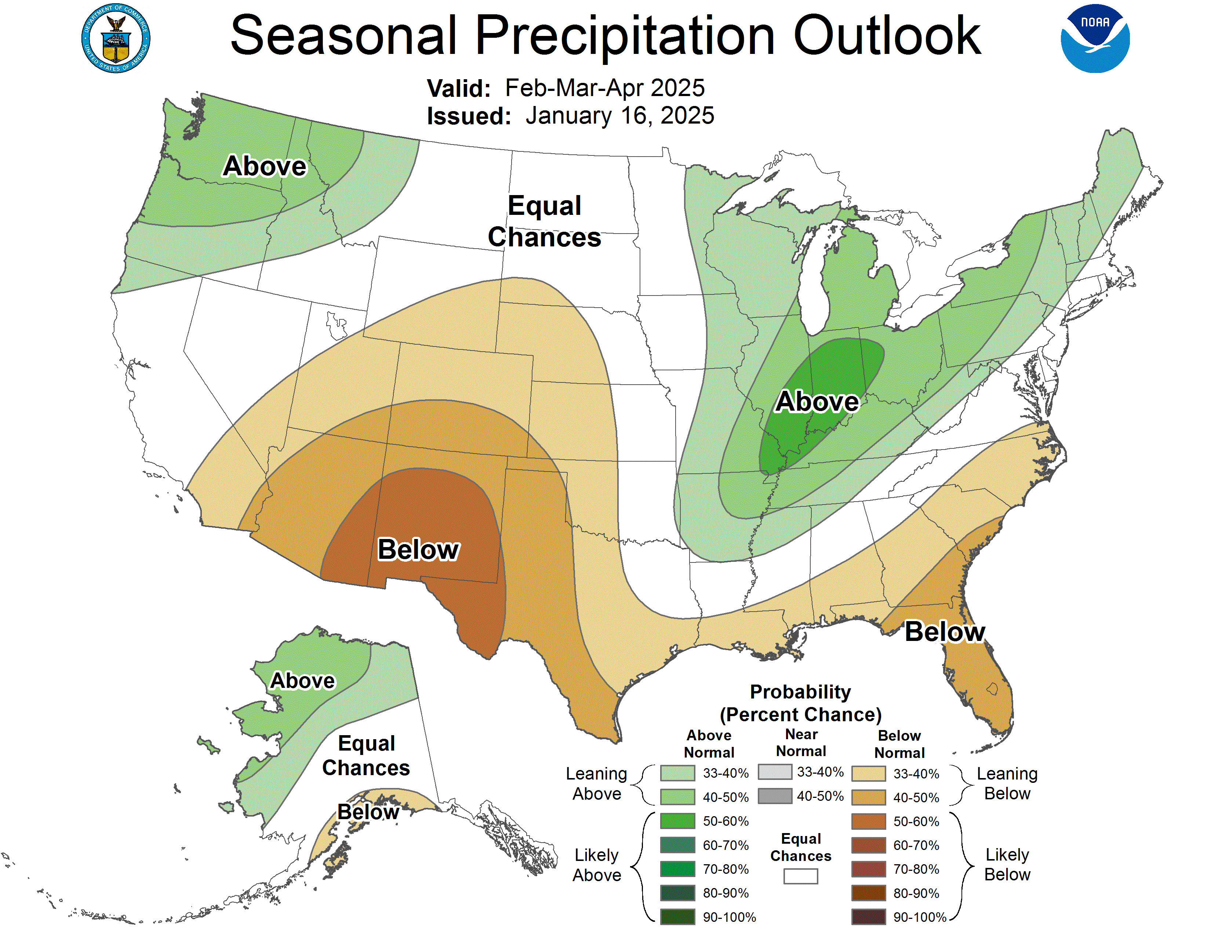

Slide 11
Other resources
CNRFC - Hydrology - River Guidance - Graphical RVF - TRNC1
CNRFC - Ensemble Products - CEGC1
Major Water Supply Reservoirs

Slide 12
Presentation of Proposed Hydrographs and discussion

Slide 13
Identification of Models and Modelers
  RBM10 – Laskodi / Perry?
  Temps – Lindke
  S3 – Laskodi
  FYFAM – Ashton
  TARGETS – Bair/Groves
  Bedload (if desired by Physical WG) – Buxton
  Facies mapping - Buxton

Slide 14
Recap
Reviewed 02/13 meeting outcomes
Reviewed hydrologic conditions
Presentations of proposed hydrographs and discussion
ID of models and modelers/discussion
Anything else before we adjourn?

Slide 15
Thanks!
Next meeting 3/3 9am-2pm
  DSS results will be reviewed and hydrographs will be selected for recommendation to IDT/TMC

