Slide 1
Flow WG 2025-02-13
Spring Flow Planning
Review of Hydrologic Conditions
Hydrograph Assignments

Slide 2
Agenda
Introductions (if needed)
Review current hydrologic information
Review of hydrograph objectives and considerations
Hydrograph development and modeling schedules

Slide 3
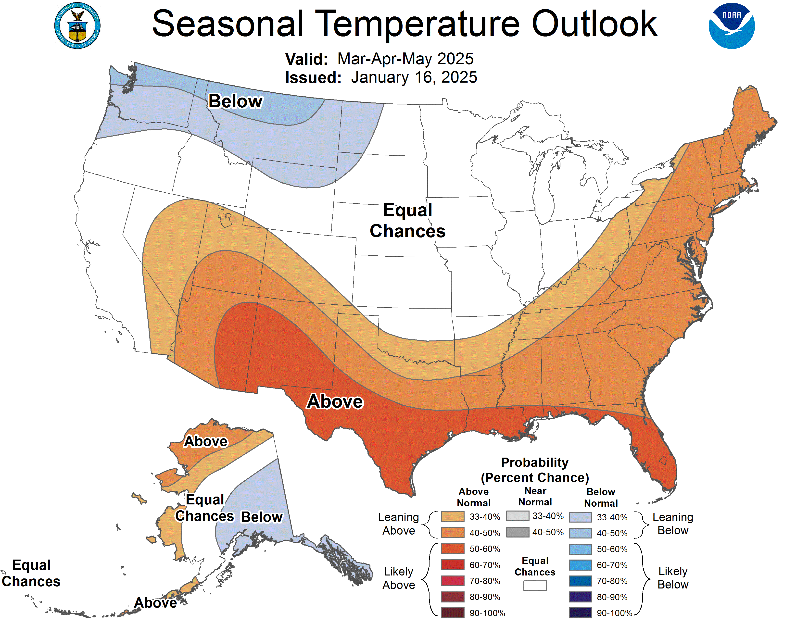

Slide 4
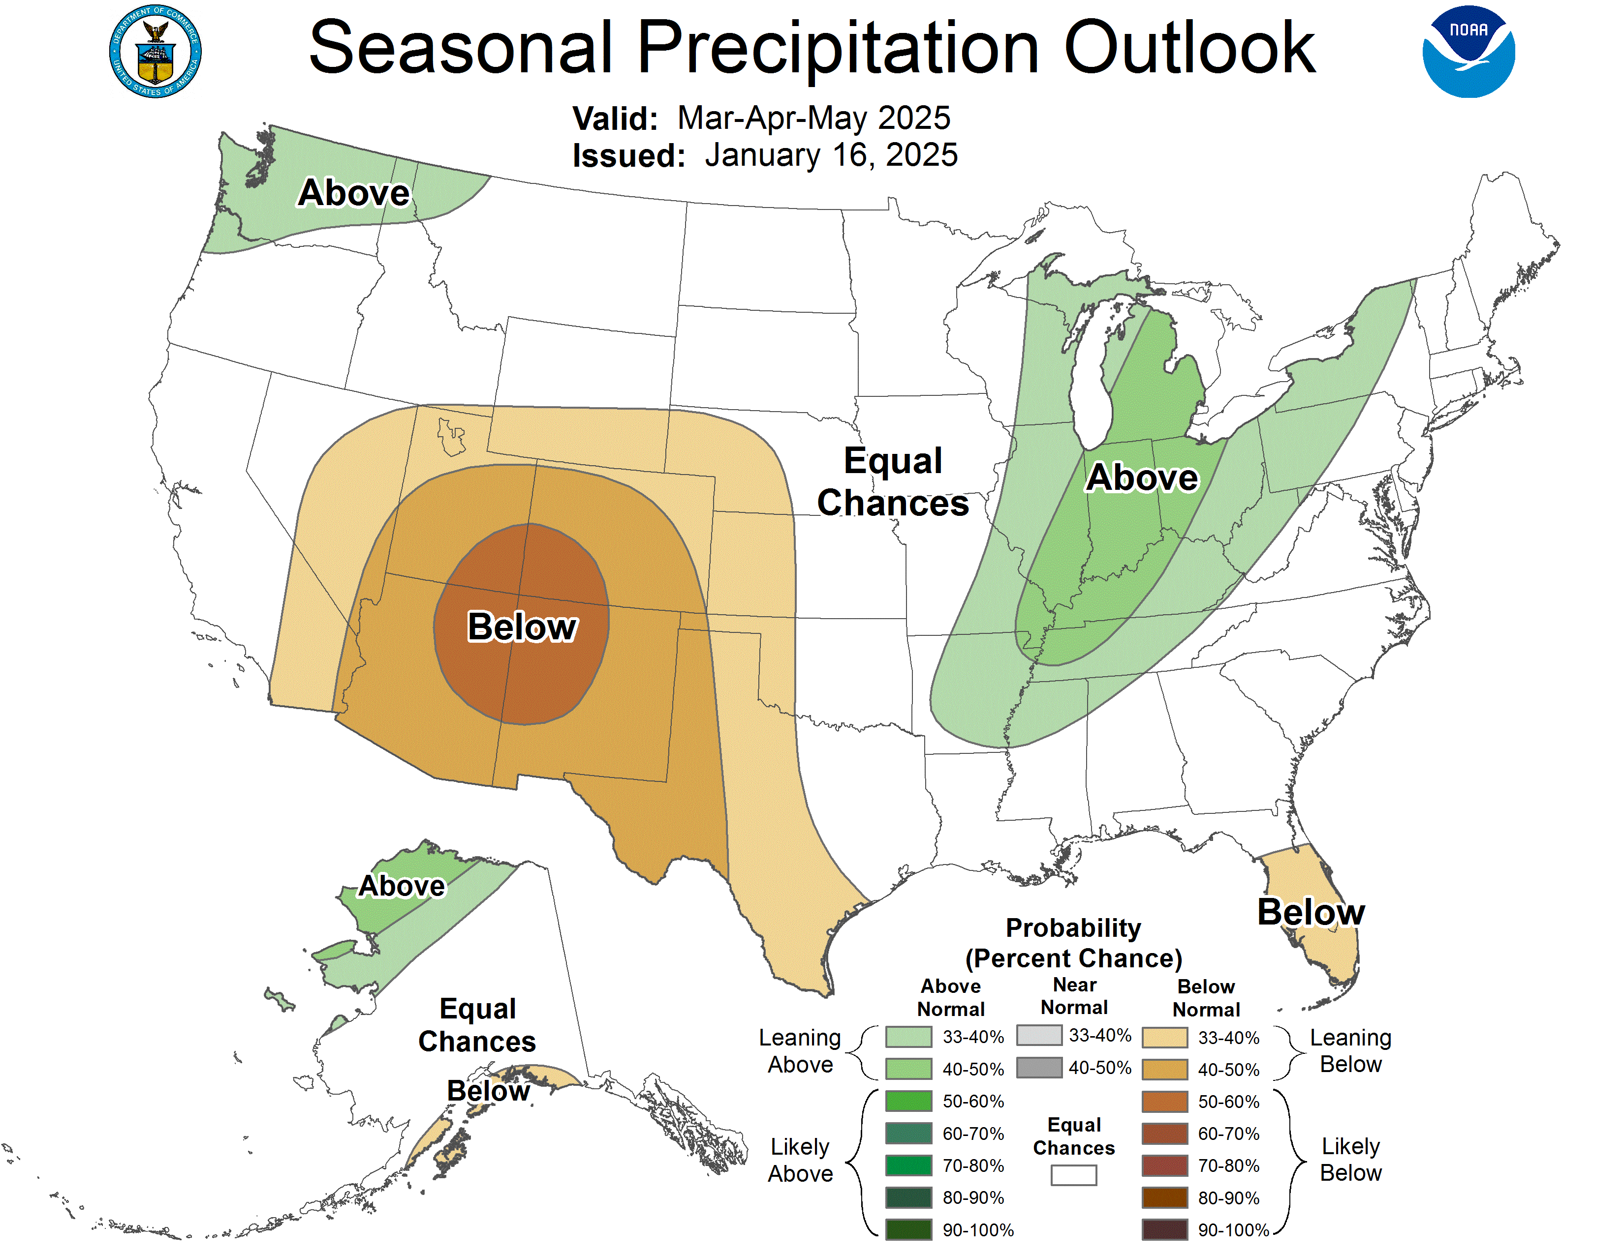

Slide 5
Other resources
CNRFC - Hydrology - River Guidance - Graphical RVF - TRNC1
CNRFC - Ensemble Products - CEGC1
Major Water Supply Reservoirs

Slide 6
Hydrograph Objectives and Considerations
Normal Water Year: Achieve a peak release of 6,000 cfs for sediment mobilization, fine sediment deposition on floodplains, encourage riparian establishment on floodplains, and scour 1 year old woody riparian vegetation on channel margins (Flow Study Table 8.7).
Wet Water Year Achieve a peak release of 8,500 cfs for sediment mobilization and channel migration at rehab sites, create floodplains, encourage riparian establishment on floodplains, and scour up to 2 year old woody riparian vegetation on channel margins (Flow Study Table 8.7).

