Slide 1
Q1 Fall
Q2 Winter
RFP
Proposals
Flow WG
Spring Hydrograph
SAB
IDT
Research Qs
[sep meeting?]
IDT
O&T
Physical WG
Gravel Augmentation
RAE WG
Wood Augmentation
IDT
Proposal Assignments
[via email?]
SAB
TMC (December)
approve O&T
IDT
TMC prep
Spring Hydro
All WG
O&T
(year-round)
All WG
All WG
TMC (March)
Spring Hydrograph
Assigned WG
Reviews
SAB
All WG
All WG
Research Qs
TMC (September)
Water Year Strategy
All WG
All WG
All WG
Q4 Summer
Q3 Spring
TMC (June)
Budget
IDT
Water Year Strategy
IDT
Work Planning
Reviews
IDT
Key Uncerts
IDT
Sci Proposal
SAB*
IDT
Proposal Completion
(via email?)
Proposal Revision*
Science Request
SAB*
All WG*
Key Uncerts
All WG
SAB*
All WG
Flow WG
Water Year Strategy
All WG
Workgroup Work Plans
All WG
Coordinator Changes?
All WG
All WG
All WG
All WG
* = not specified in TRRP Science Plan

Slide 2
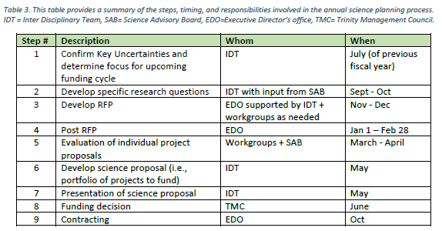
References / Notes
TRRP Science Plan section 3.3.3
Motion approved by TMC (7:1), June 2024:
Any recommendations or conditions for WY 2025 flows between 01 Oct and 15 April are to be submitted to the Flow Workgroup by 19 July and any specific hydrographs are to be submitted to the Flow Workgroup by 9 August.

