Slide 1

TRRP Trinity Management Council
March 20, 2024
WY 2024 Water Year Update and Hydrograph Options

Slide 2
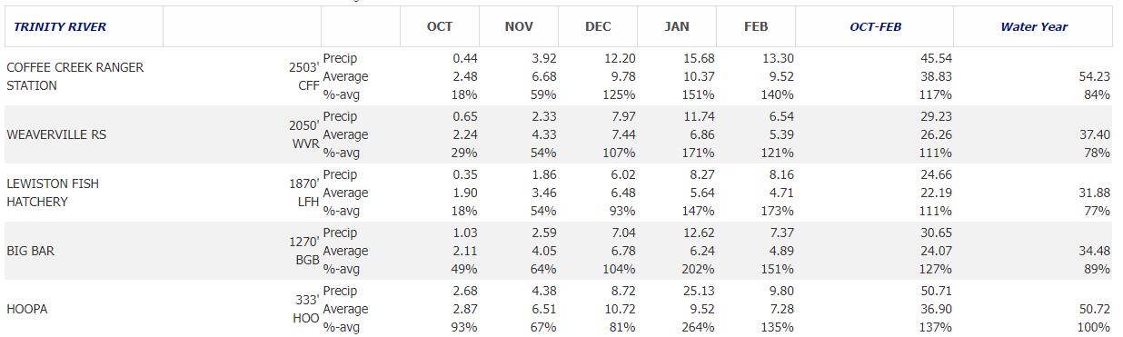
WY 2024 Precipitation Summary
Report generated 03/19/2024 https://cdec.water.ca.gov/reportapp/javareports?name=PRECIPOUT

Slide 3
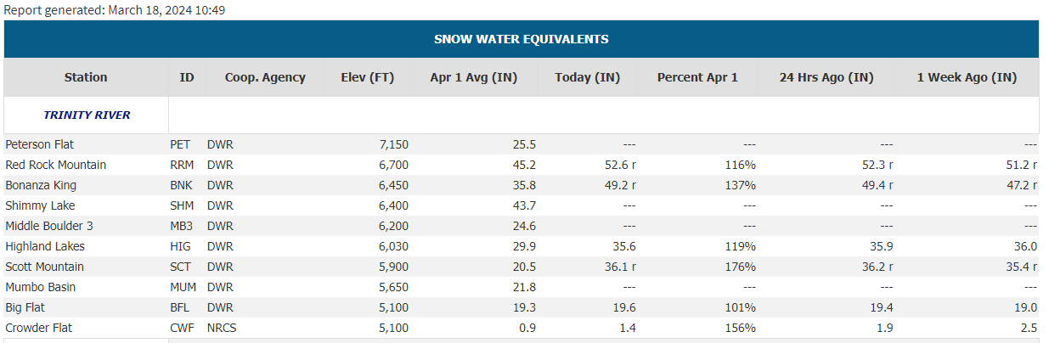
Snowpack in the Trinity R. Basin

Slide 4
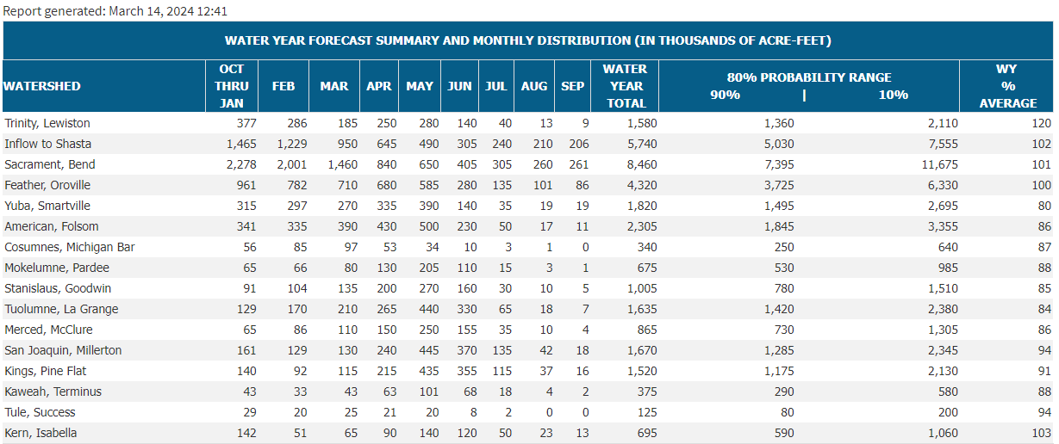
DWR March B120

Slide 5
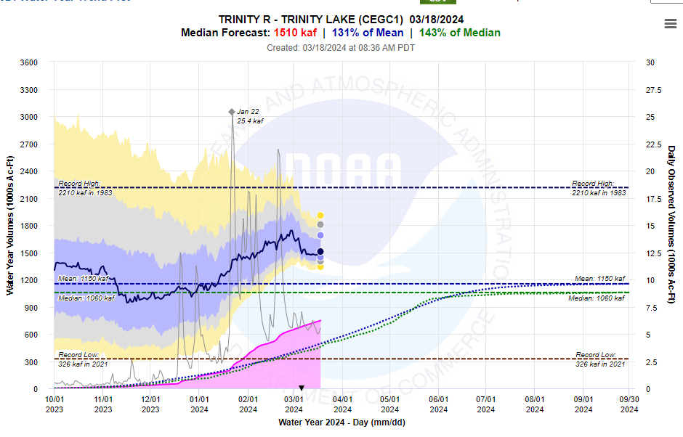
50% inflow prediction currently 1,510 kaf
(Wet: 1,350-1,999 kaf Ex. Wet: ≥2,000 kaf)
80% PI 1,360 – 2,110
Min/max prediction: 1,340 – 1,910

Slide 6
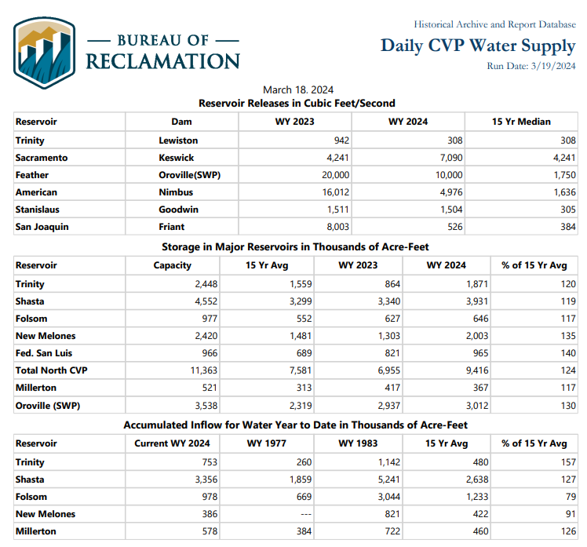

Slide 7
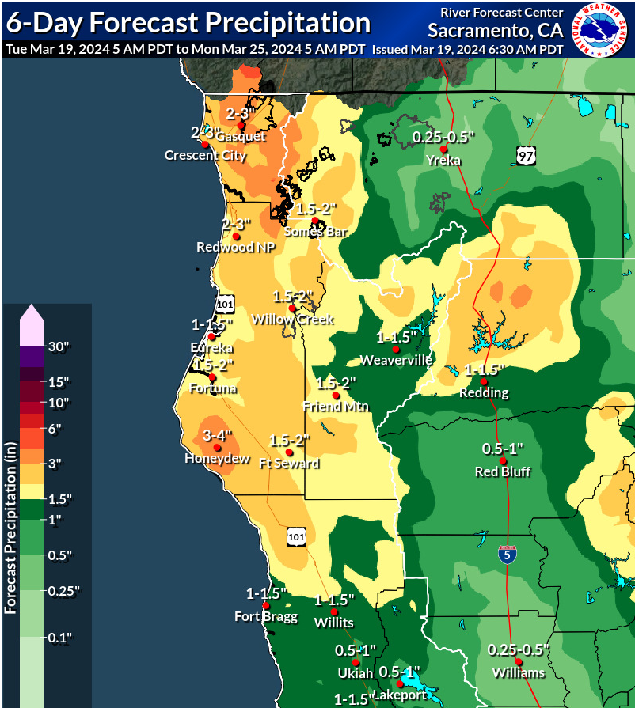

Slide 8
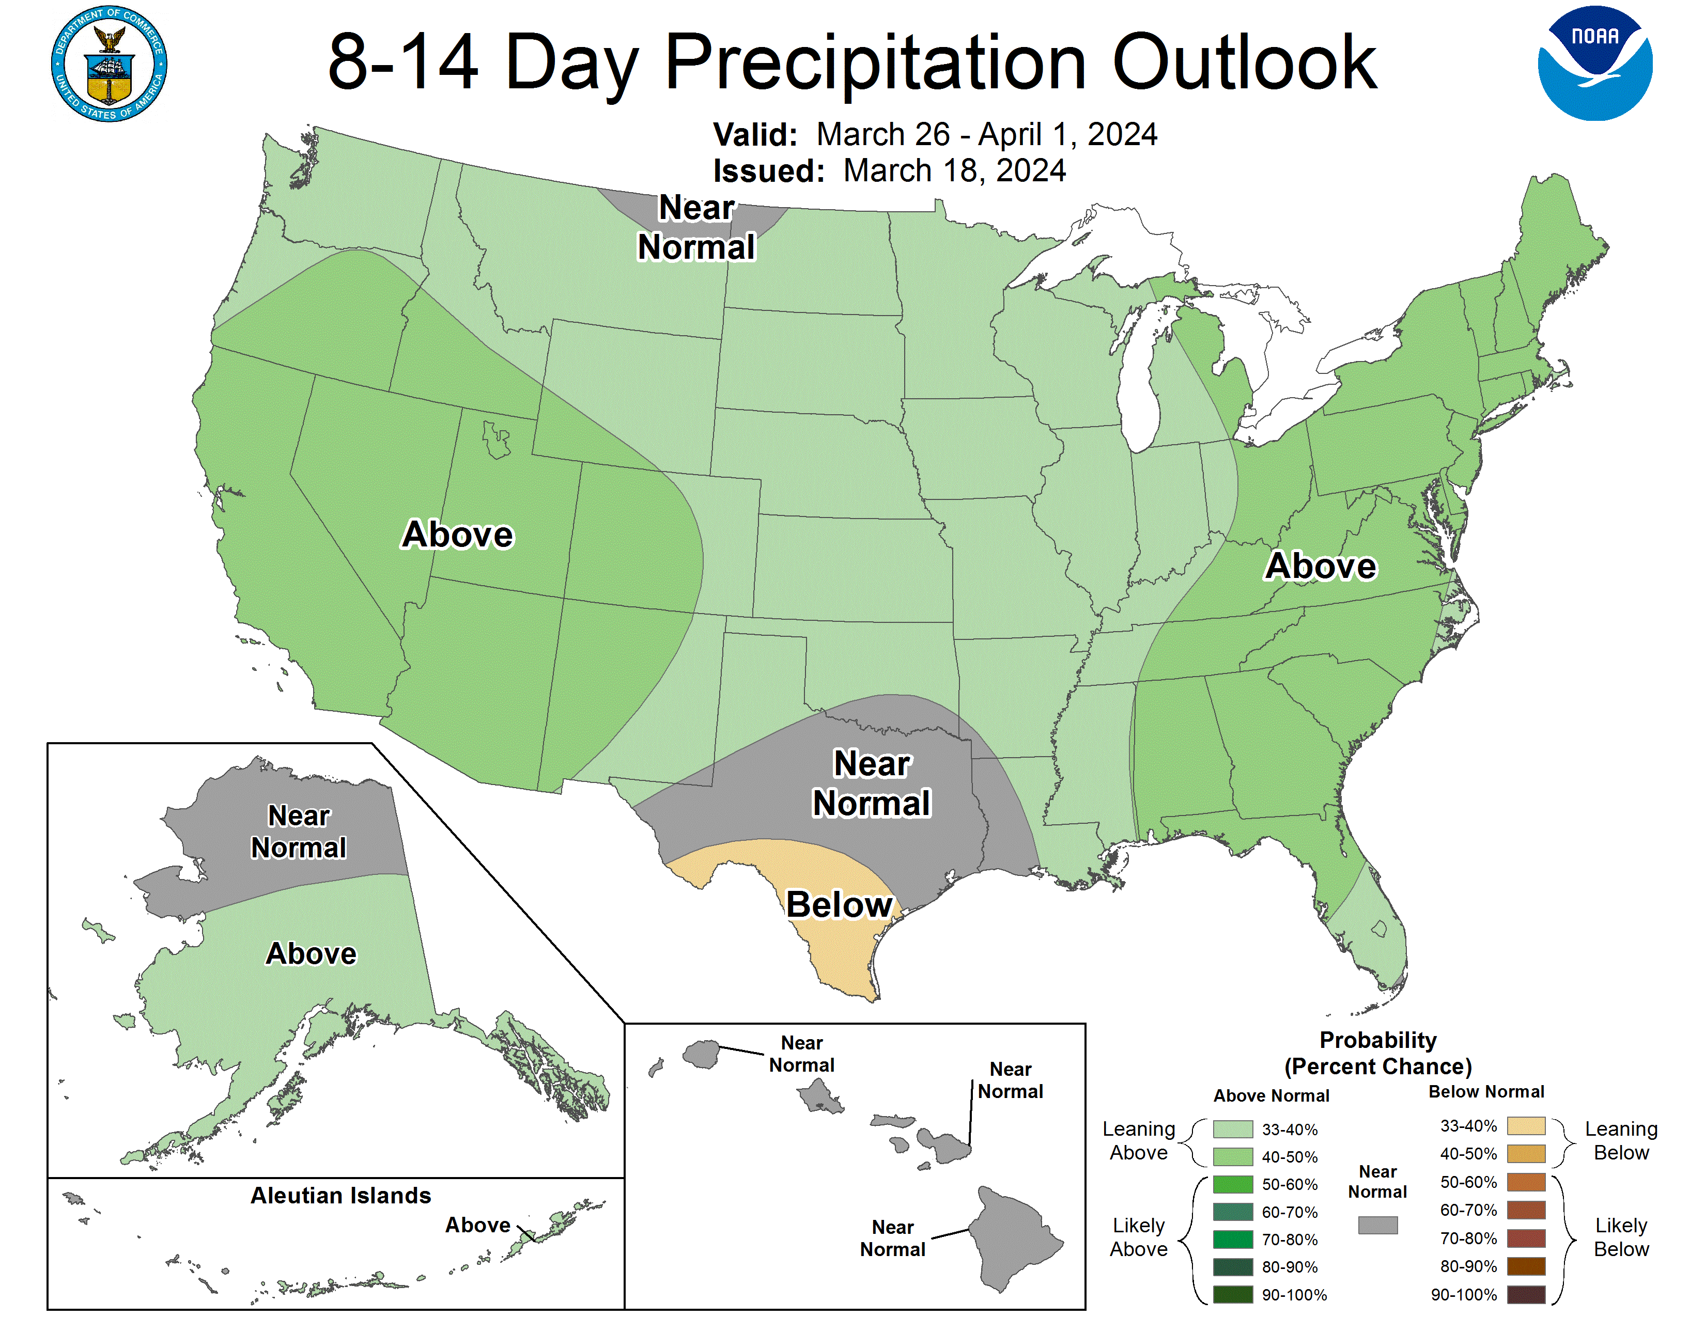
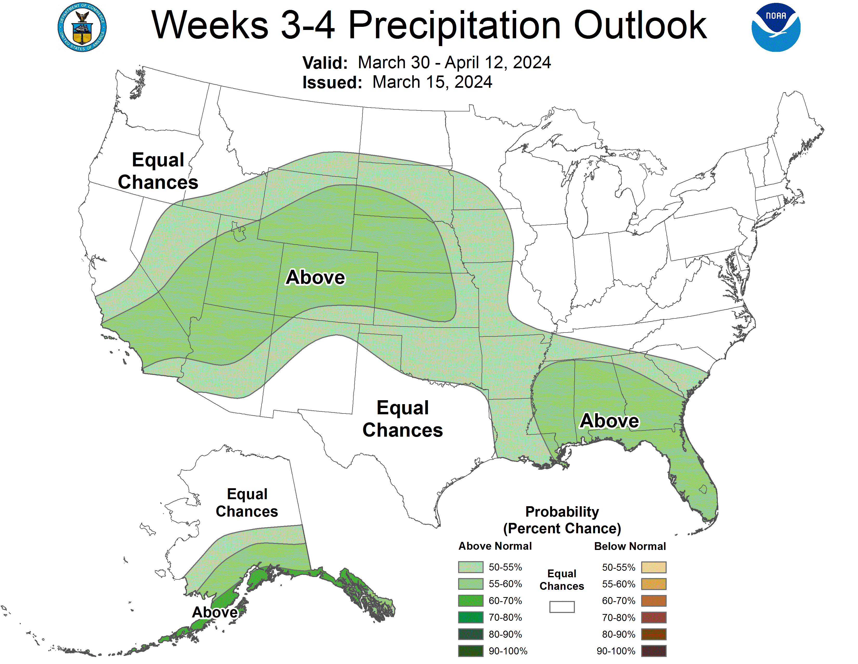

Slide 9
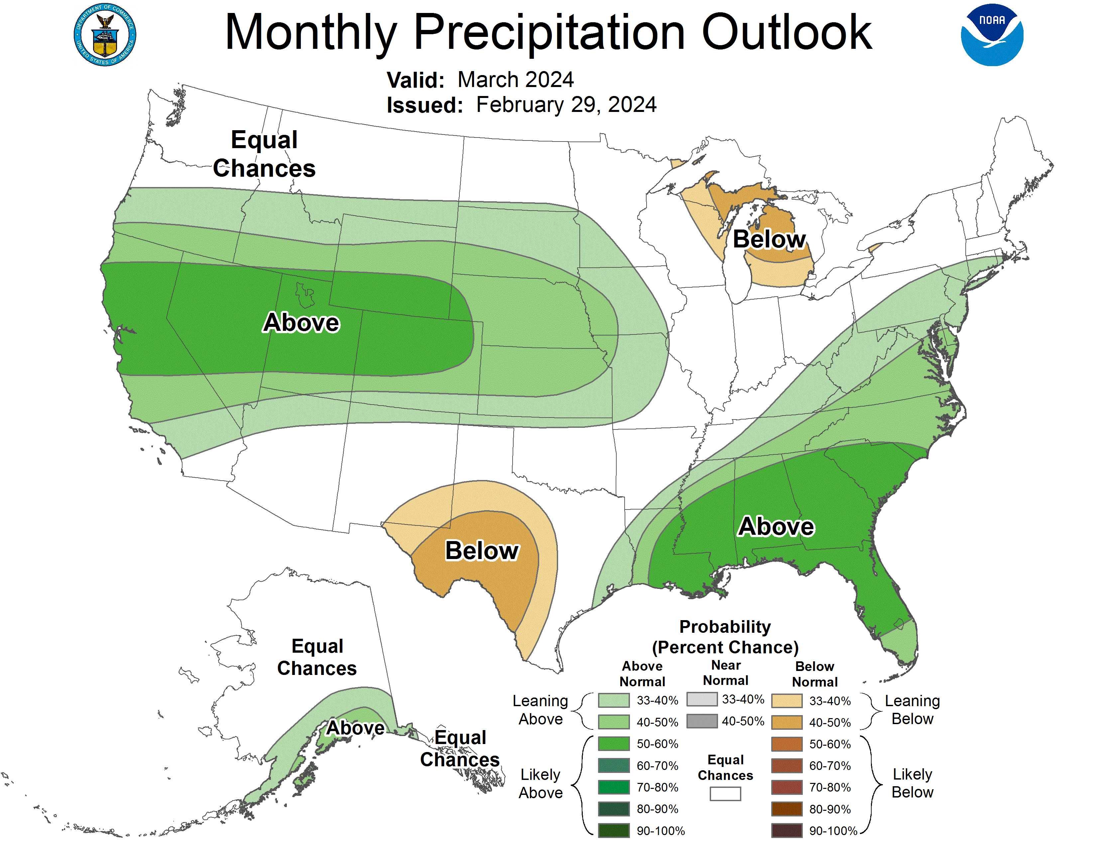
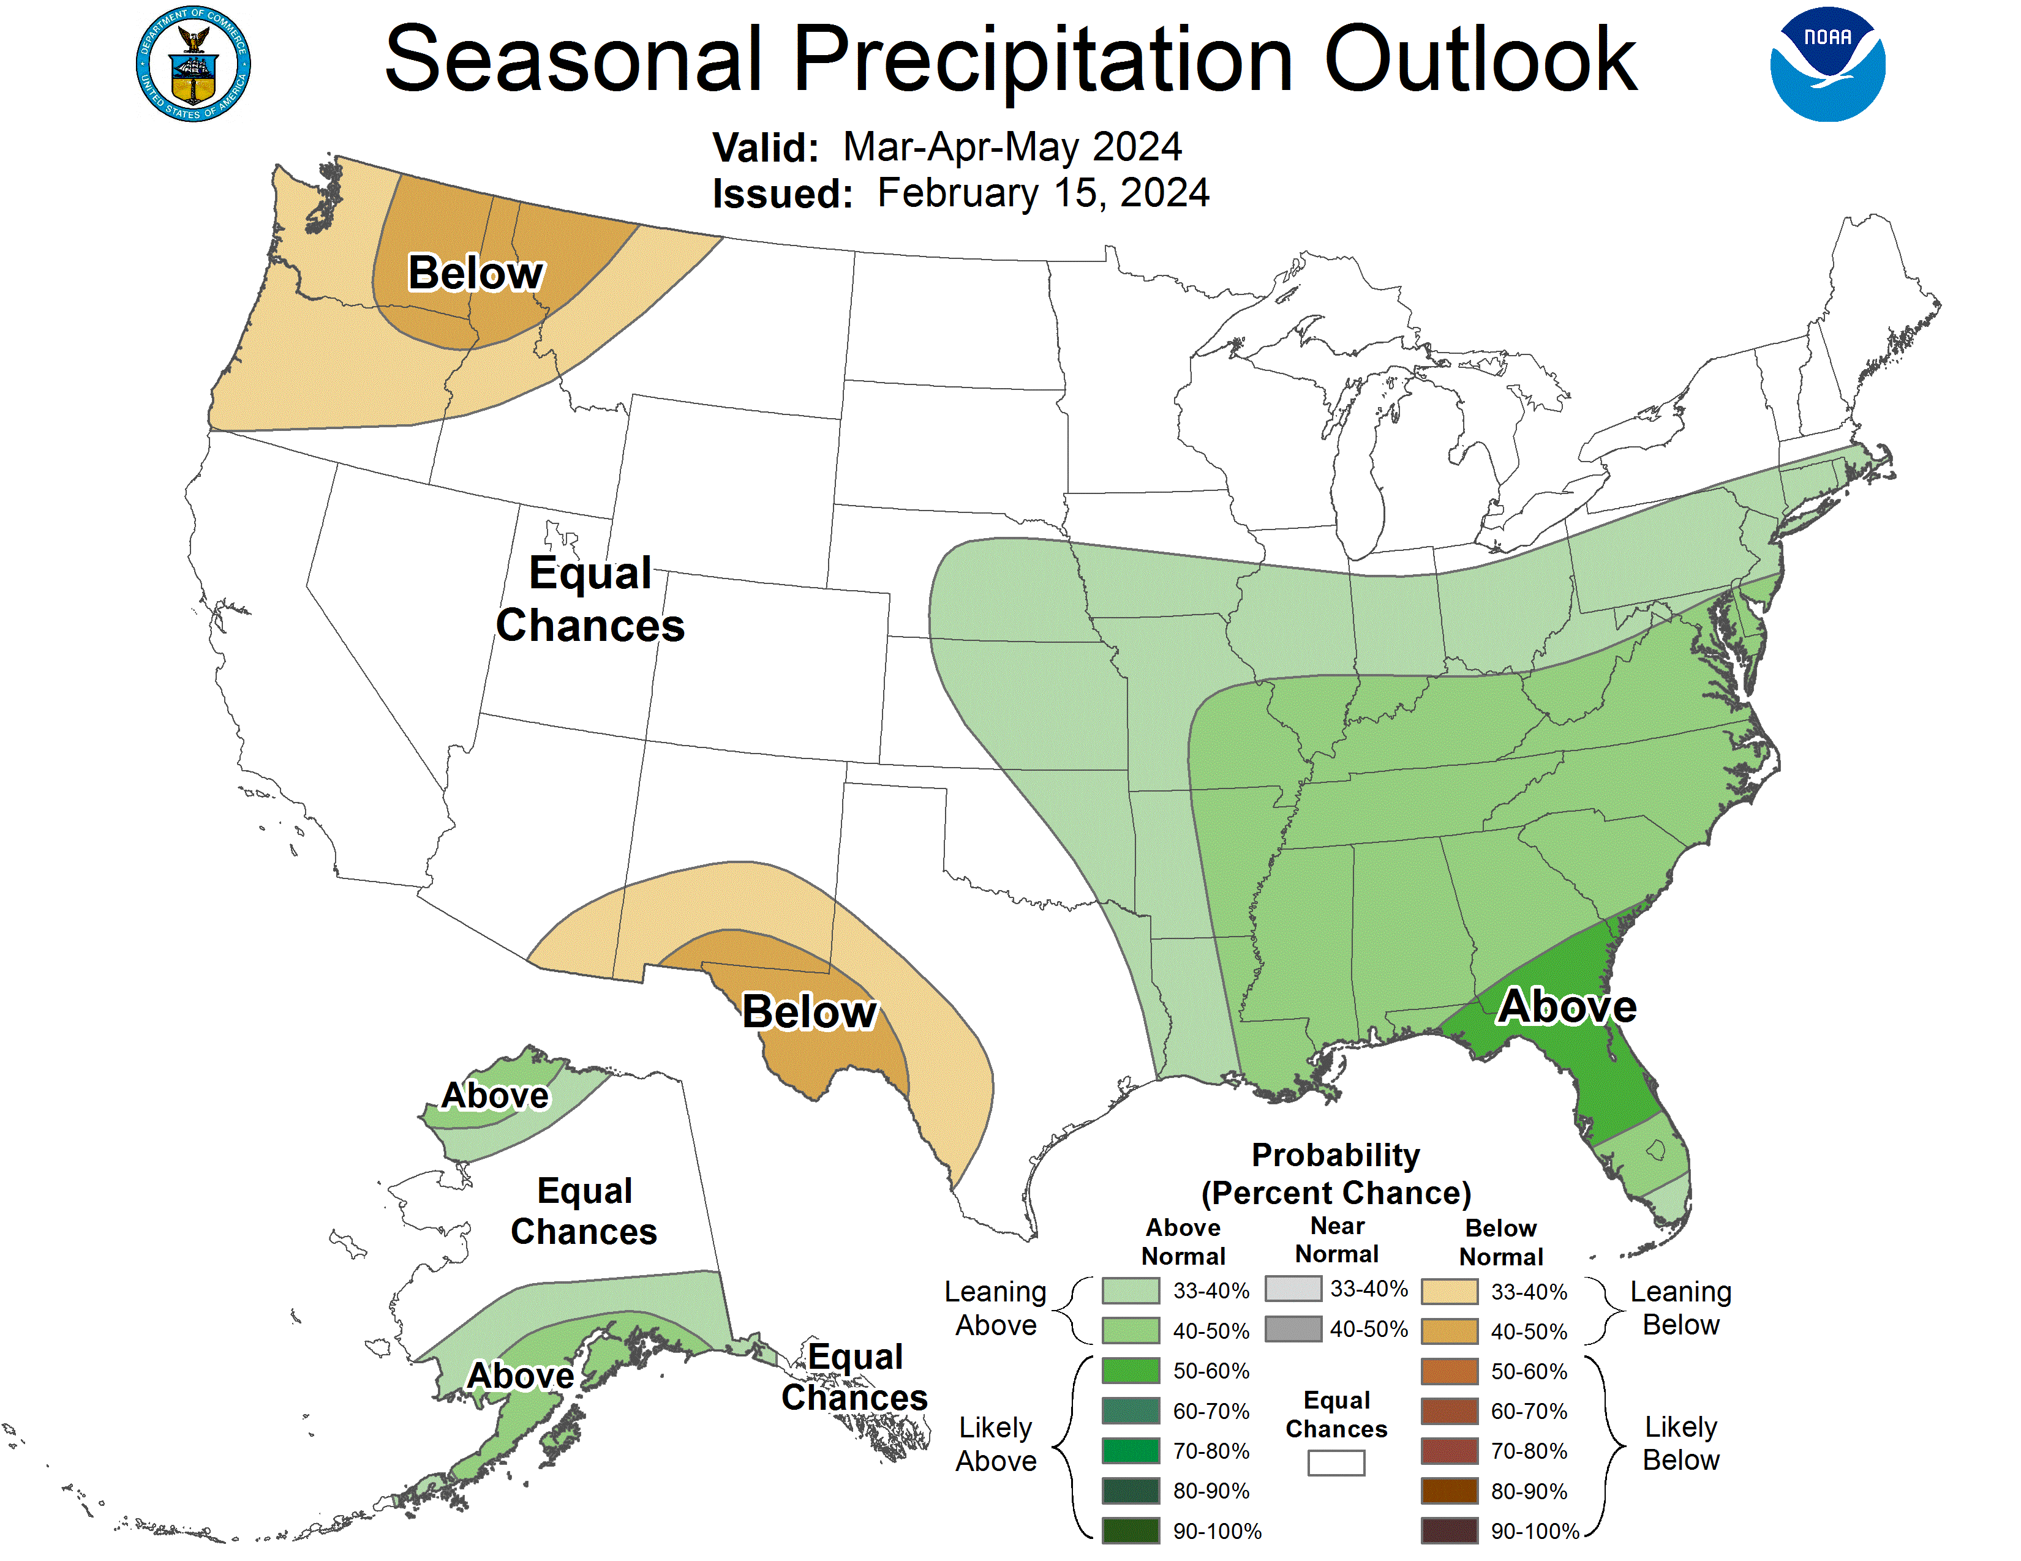

Slide 10
Summary
Current forecast is virtually certain for a Wet WY
Precipitation forecasts are mixed with 1”-3” precipitation forecasted 1-6 days, above average precipitation for the month of March, and neutral through remainder of spring.
April B120 Forecast expected from CDWR April 10, 2024 and this will determine the water year classification

Slide 11
March 7 Flow WG summary
FWG did not reach consensus on flow recommendation
Four agencies did not support recommendations for full ROD releases in spring, regardless of the shape of the hydrograph
  Technical recommendations based on best available science were made in September and January
  Full ROD releases in Wet/ExWet years in spring are detrimental to fish growth and other ecosystem components
  Position statement on full spring ROD releases was written by USFS, NOAA, CDFW, and Yurok Tribe technical representatives
Remaining agencies supported Normal, Wet and Ex. Wet hydrographs alternatives presented here
No DSS- (DSS shows little to no difference among alternative hydrographs that begin after 4/15, so DSS is being re-evaluated)

Slide 12
Targets and considerations
Adult holding targets: 60F July 1 – Sept. 14 @ DGS
EIS ramp rates
Delay start of spring releases to support egg survival study? Start April 16
Revegetation at OR gulch: discourage mass colonization by narrow-leaf willow
Monthly average of 1,000 cfs (Wet) or 1,500 cfs (Ex. Wet) in May (temp. synthesis)
Flow WG questioned whether >8,500 cfs release is necessary this year due to high releases last year

Slide 13
Extremely Wet WY TRFES objectives
Mobilization of matrix particles (D₈₄) on alternate bar surfaces (11k cfs)
Channelbed scour greater than 2 D₈₄’s depth and redeposition of gravels on face of alternate bars (11k cfs)
Transport sand out of the reach at a volume greater than input from tributaries to reduce instream sand storage (11k cfs and bench)
Transport coarse bed material at a rate near equal to input from tributaries to route coarse sediment, create alluvial deposits, and eliminate tributary aggradation (11k cfs)
Periodic channel migration (11k cfs)
Floodplain creation, inundation, and scour (11k cfs and bench)
Channel avulsion (11k cfs)
Woody riparian mortality on lower alternate bar surfaces and woody riparian regeneration on upper alternate bar surfaces and floodplains (11k cfs)
Maintain variable water table for off-channel wetlands and side channels (descending limb and bench)

Slide 14
Stated Obj. for 2017ExWet
Increase hydrologic variability
Delay frog breeding
Provide suitable temperatures for salmonids
Deposit fine sediment on floodplains
Transport sediment
Bar and floodplain development
Scour riparian vegetation
Wet floodplains
Maintain pools (scour)
Increase thermal diversity
Separate geomorphic and snowmelt runoff peaks
Germinate cottonwood seeds and other trees
Temperatures and habitat for salmonids
Reduce pre-spawn mortality
Increase egg viability
Suitable for frog breeding
Temperatures and habitat for salmonids
Habitat monitoring benches
Notes:
Where did these come from?

Slide 15
HVT Extremely Wet
Modification of 2017ExWET
Starts April 16th
Recession limb modified to be better for plants
600 cfs bench through mid-August
  prevent riparian establishment at 450 cfs elevation, encouraging recruitment at higher elevations and widening riparian area
  potentially cause mortality of established narrow-leaf willow through inundation rather than scour
  elevated flows at this time of year is presumed to have minimal temperature effects
  moves water out of the peak
450 cfs summer baseflow starts August 15th

Slide 16
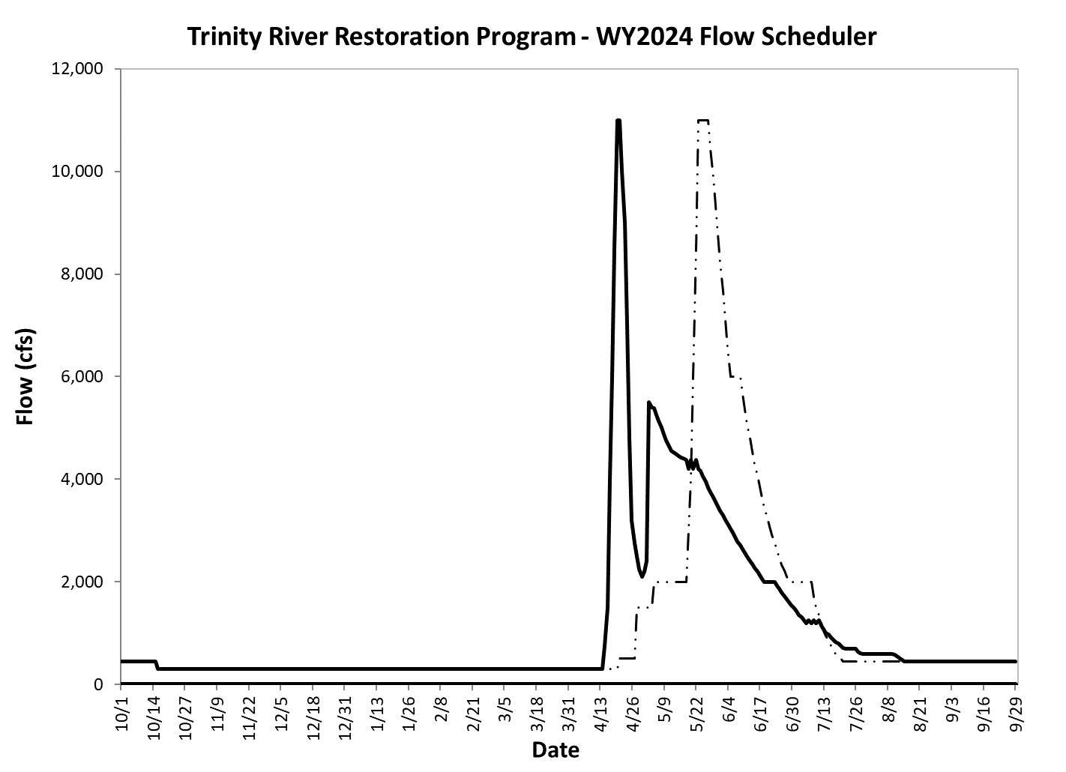
HVT Extremely Wet (modified 2017 ExWet)

Slide 18
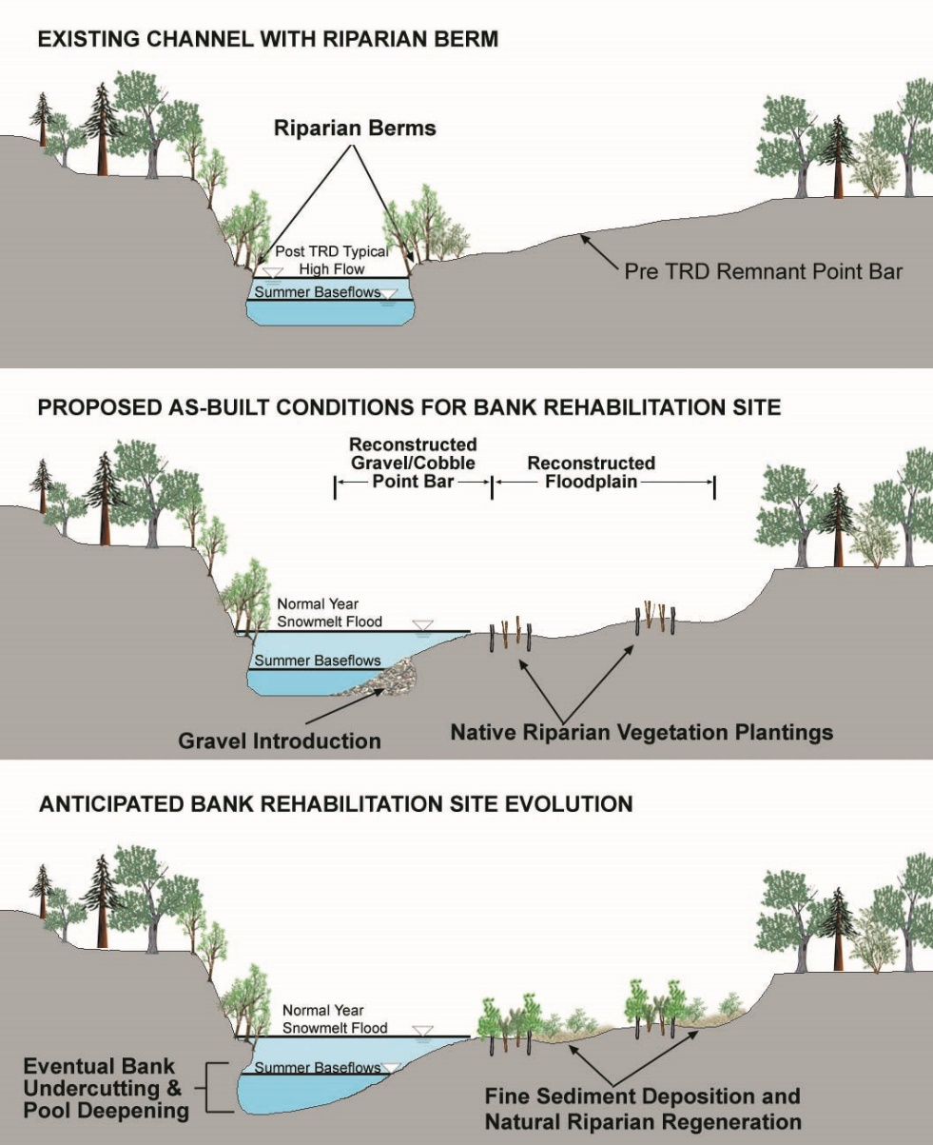
Post-TRD flow regulation led to narrow bands of vegetation along the post-TRD channel margins. Desired future conditions include less abundant vegetation along the channel margins, and more abundant vegetation from floodplains to the surrounding upland forests.

Slide 19
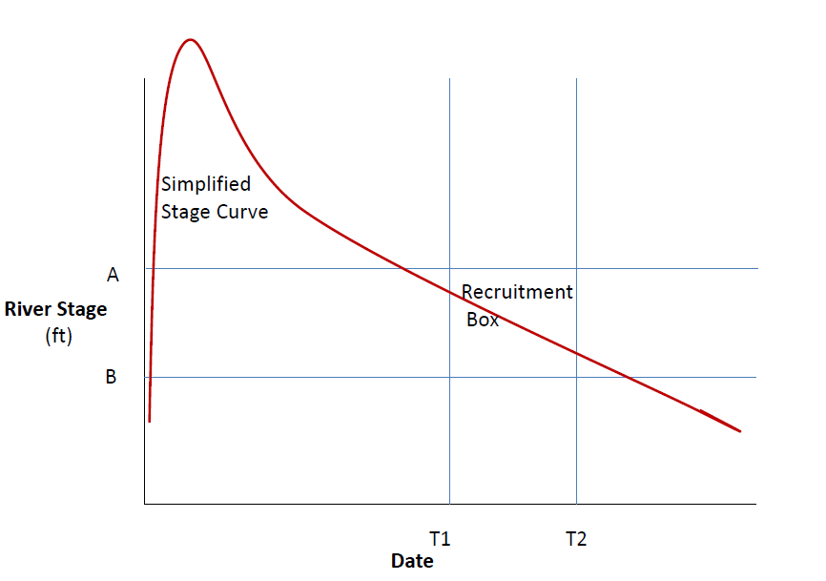
Recruitment Box Model (Mahoney and Rood 1998)

Slide 20
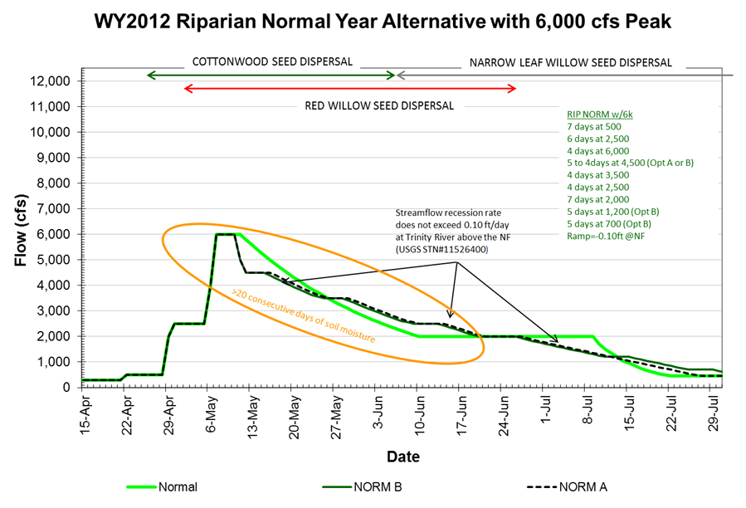

Slide 21
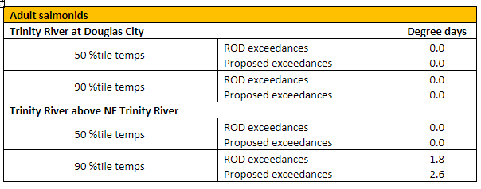
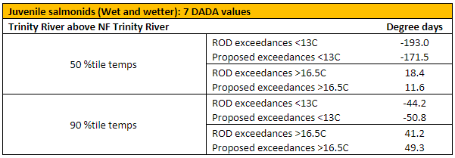
HVT Extremely Wet RBM-10

Slide 22
Wet WY TRFES objectives
Mobilization of matrix particles (D₈₄) on alternate bar surfaces (8.5k cfs)
Channelbed scour greater than 1 D₈₄’s depth and redeposition of gravels (8.5k cfs)
Transport sand out of the reach at a volume greater than input from tributaries to reduce instream sand storage (8.5k cfs and bench)
Transport coarse bed material at a rate near equal to input from tributaries to route coarse sediment, create alluvial deposits, and eliminate tributary aggradation (8.5k cfs)
Periodic channel migration (8.5k cfs)
Floodplain creation, inundation, and occasional scour (8.5k cfs and bench)
Woody riparian mortality on lower alternate bar surfaces and woody riparian regeneration on upper alternate bar surfaces and floodplains (8.5k cfs)
Maintain fluctuating water table for off-channel wetlands and side channels (descending limb and bench)

Slide 23
Stated Obj. for 2011Wet8.5
Encourage establishment and growth of riparian vegetation on floodplains
Scour up to 3 yr old woody riparian vegetation along low flow channel margins and scour younger plants higher on bar flank
Increase species and age diversity of riparian vegetation
Create moist ground surfaces on constructed and natural floodplains between 2,500 and 6,000 cfs to provide sufficient time for a riparian hardwood seed to germinate and begin to grow
Descend at a rate equal to or less than 0.10 ft a day at the Trinity River above the North Fork
Establishes riparian vegetation on constructed surfaces where channel rehabilitation project objectives specifically target riparian vegetation regeneration as the reason for lowering terraces and excavation.
Potentially a more cost effective method of establishing a diverse assemblage of riparian plant species on constructed floodplains
If successful will meet, or exceed riparian natural regeneration regulatory compliance requirements (TRRP 2008)
Addresses riparian related TRFES objectives for WET and NORMAL water classes
Builds on knowledge gained from the WY2006 adaptive management experiment that focused on riparian initiation on constructed floodplains (McBain and Trush 2007)
Notes:
Taken from meeting summary 3/17/2011. Best I can tell from notes, these objectives are the same for both hydrographs, odd as it sounds.

Slide 24
HVT Wet
Modification of 2011WET8.5
Starts April 16th*
Recession limb modified to be better for plants
450 cfs summer baseflow starts July 30

Slide 25
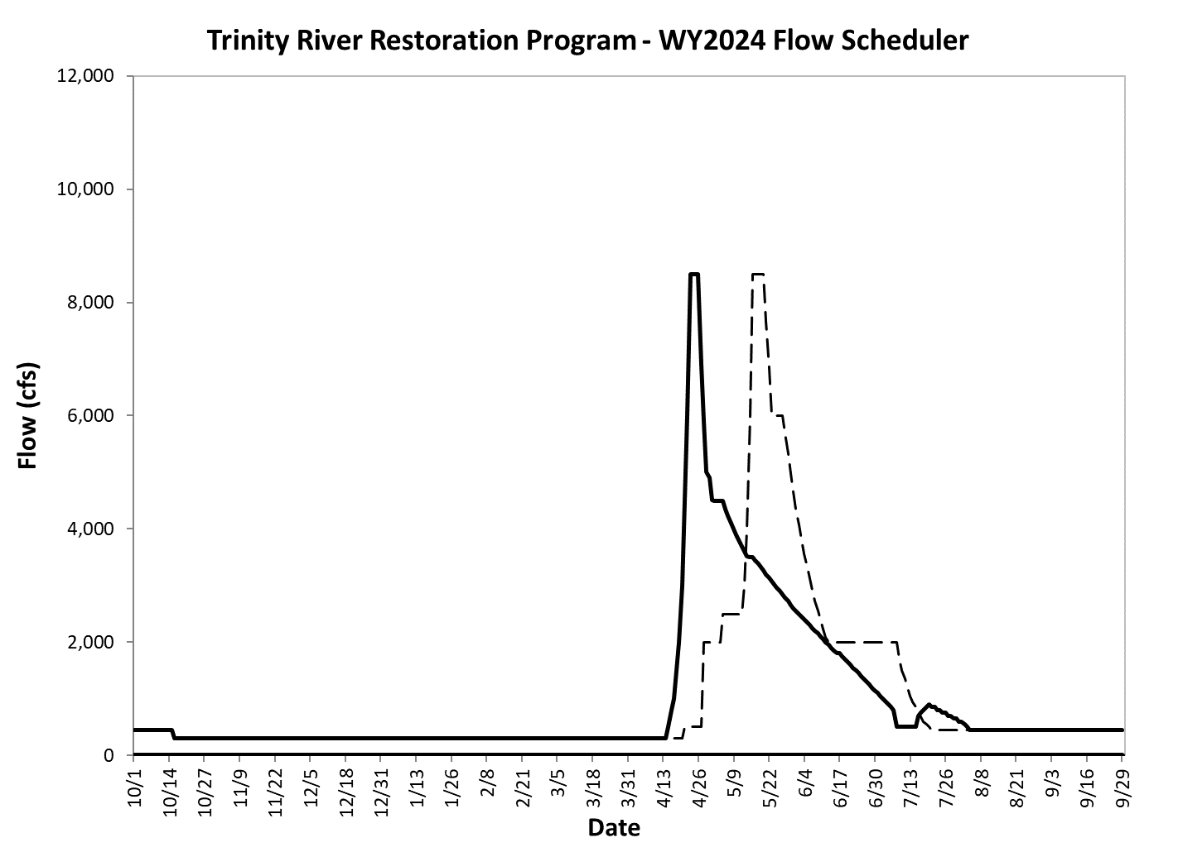
HVT Wet (modified 2011Wet8.5)

Slide 26
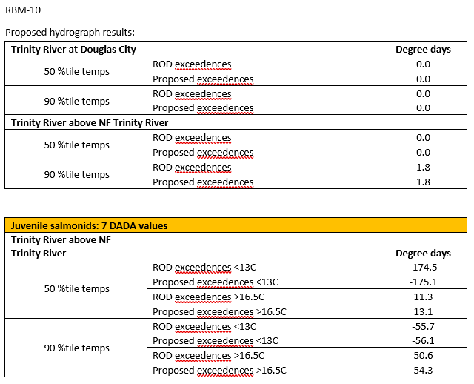
HVT Wet RBM-10

Slide 27
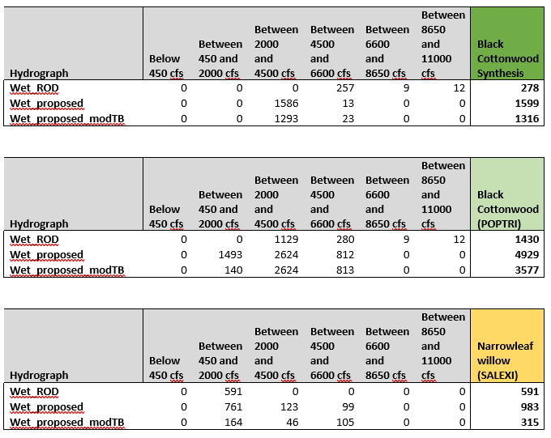
HVT Wet TARGETS
Notes:
The modifications requested on behalf of the hyporheic flow study decreased riparian recruitment of black cottonwood seedlings, but not by much. It also decreased the establishment of narrowleaf willow. Both the proposed HVTF hydrograph and the modified version of the HVTF hydrograph had better performance for black cottonwood recruitment, but the former had an increased threat of narrowleaf willow encroachment. The “Black Cottonwood Synthesis” model utilizes a 2 week seed dispersal window during peak median seed dispersal, while the “Black Cottonwood (POPTRI)” model considers the full range of seed dispersal (6.5 weeks).

Slide 28
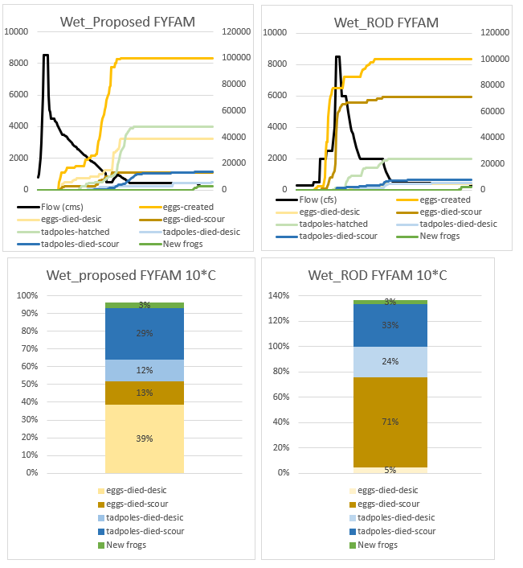
HVT Wet FYFAM
Notes:
Compared with the ROD, the proposed hydrograph has a reduced mortality of both eggs and tadpoles due to desiccation and scour. While both models suggest a similar output of “new frogs”, the proposed hydrograph created almost twice as many tadpoles. This indicates that the proposed hydrograph has a relatively high success rate of growing eggs into tadpoles compared with the ROD. The “speedbump” at the base of the recession limb for the proposed hydrograph was the source of significant egg desiccation. The metamorphosis of frogs occurred approximately 10 days earlier in the proposed hydrograph than in the ROD hydrograph.

Slide 29
Normal WY TRFES Objectives
Encourage establishment and growth of riparian vegetation on floodplains
Scour 3-yr old riparian vegetation at low-flow elevation and younger veg at higher elevations
Increase species and age diversity of rip. veg.
Riparian hardwood recruitment at 2,500-6,000 cfs elevations
Mobilize D₈₄ grain size on most alluvial features
Transport coarse sediment
Reduce fine sediment storage*
Evaluate pool depth dynamics (deepening/filling) due to 6,000 cfs release

Slide 30
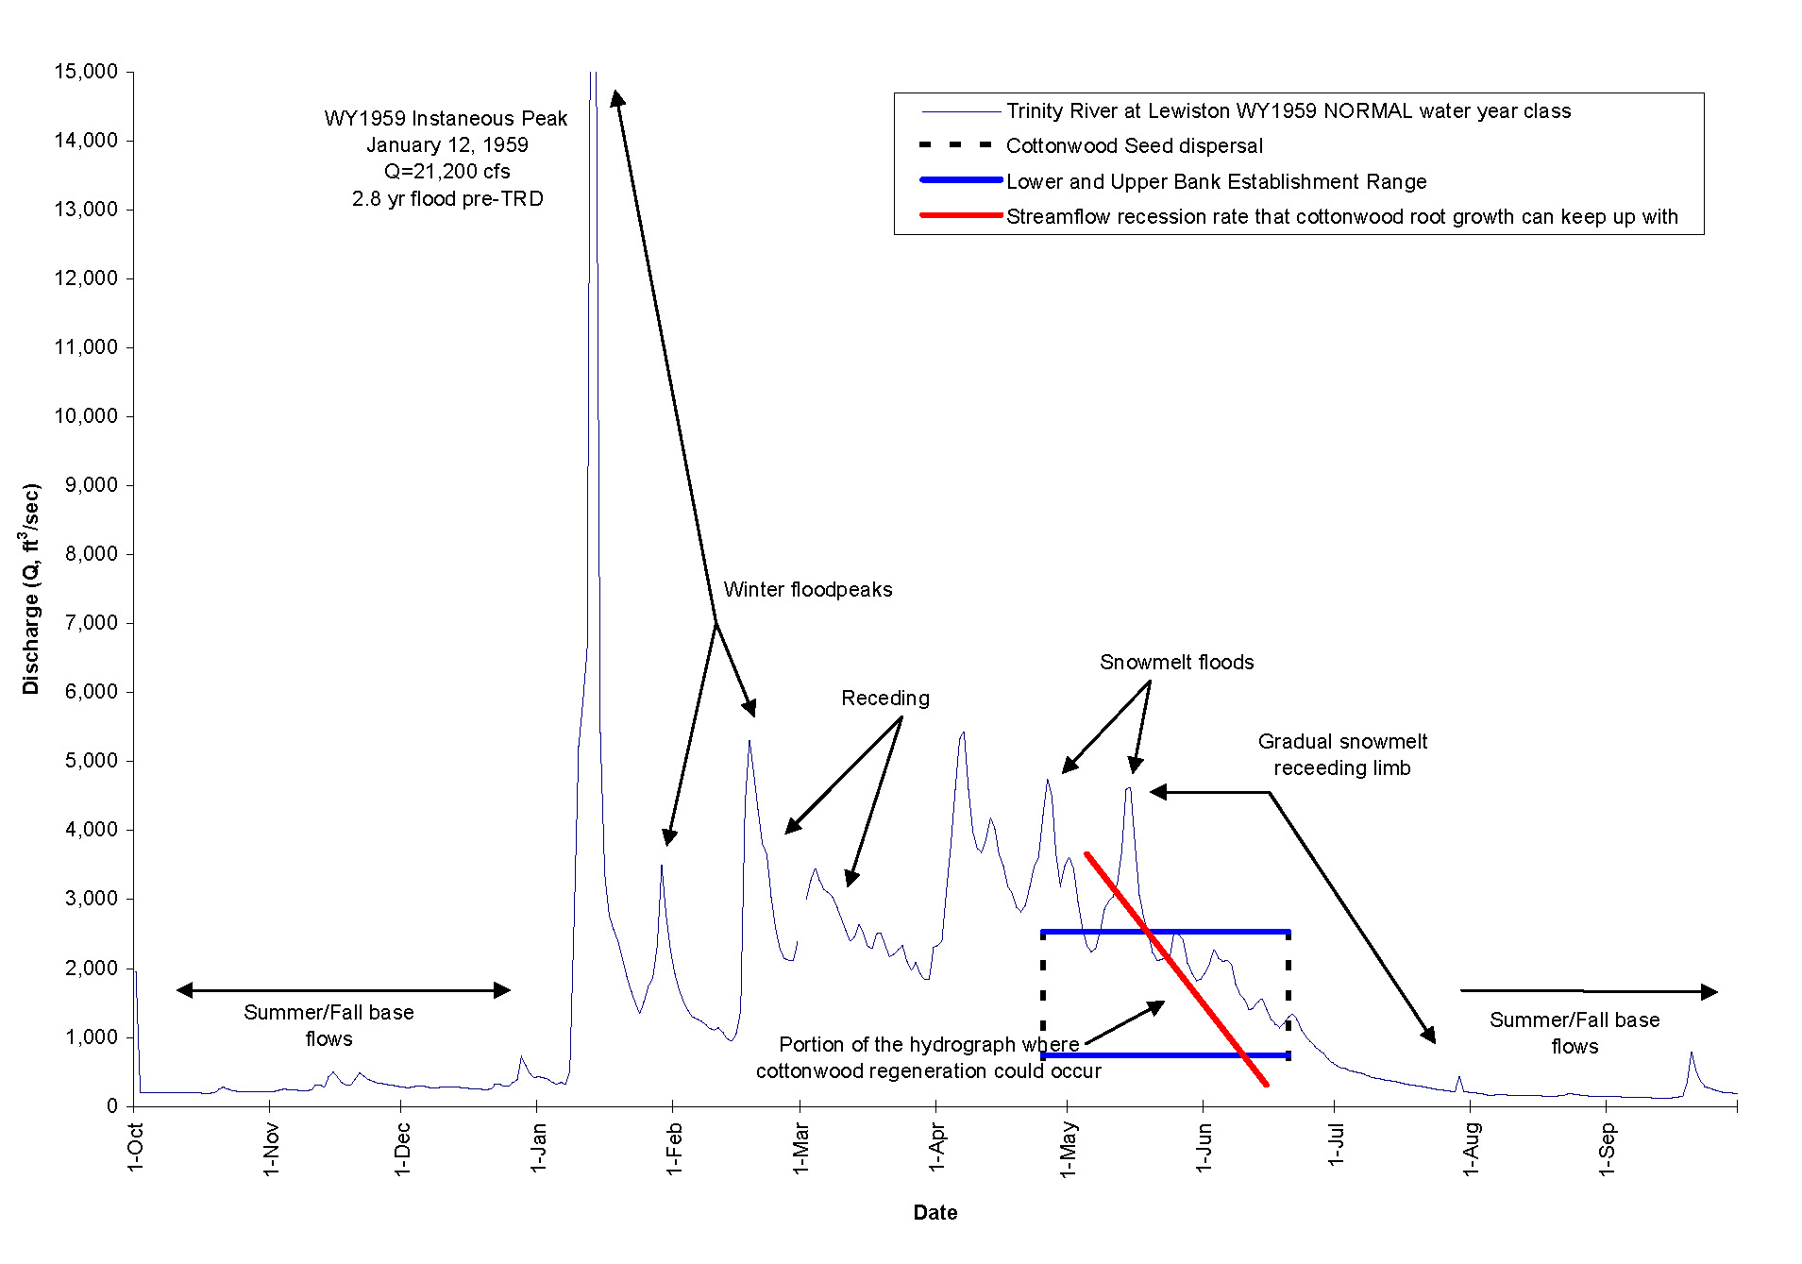
Representative Unimpaired WY1959 NORMAL Hydrograph

Slide 31
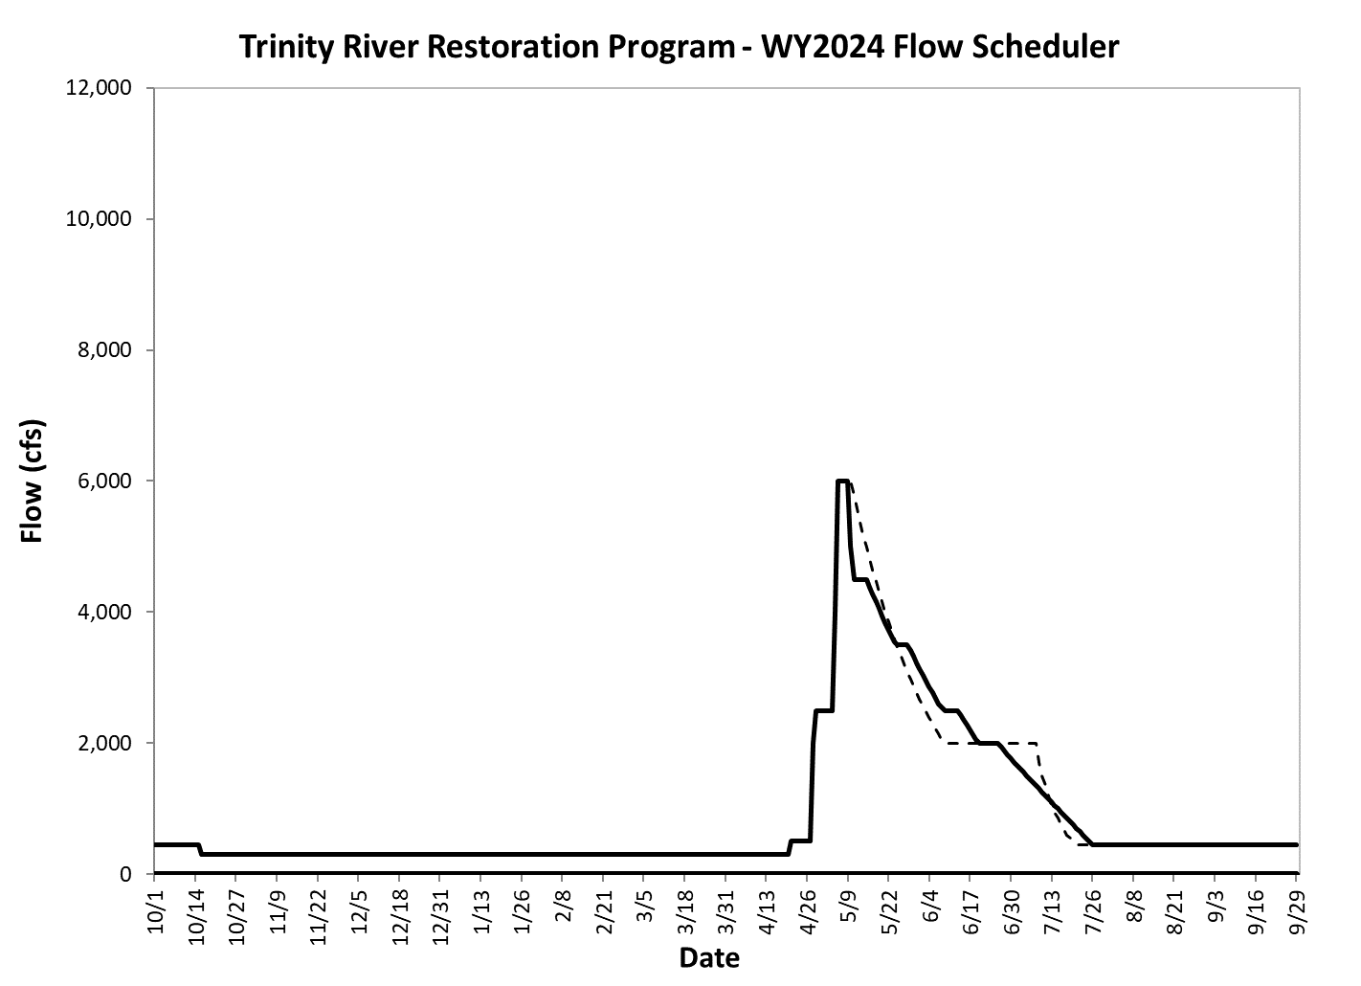
2012Norm

Slide 32
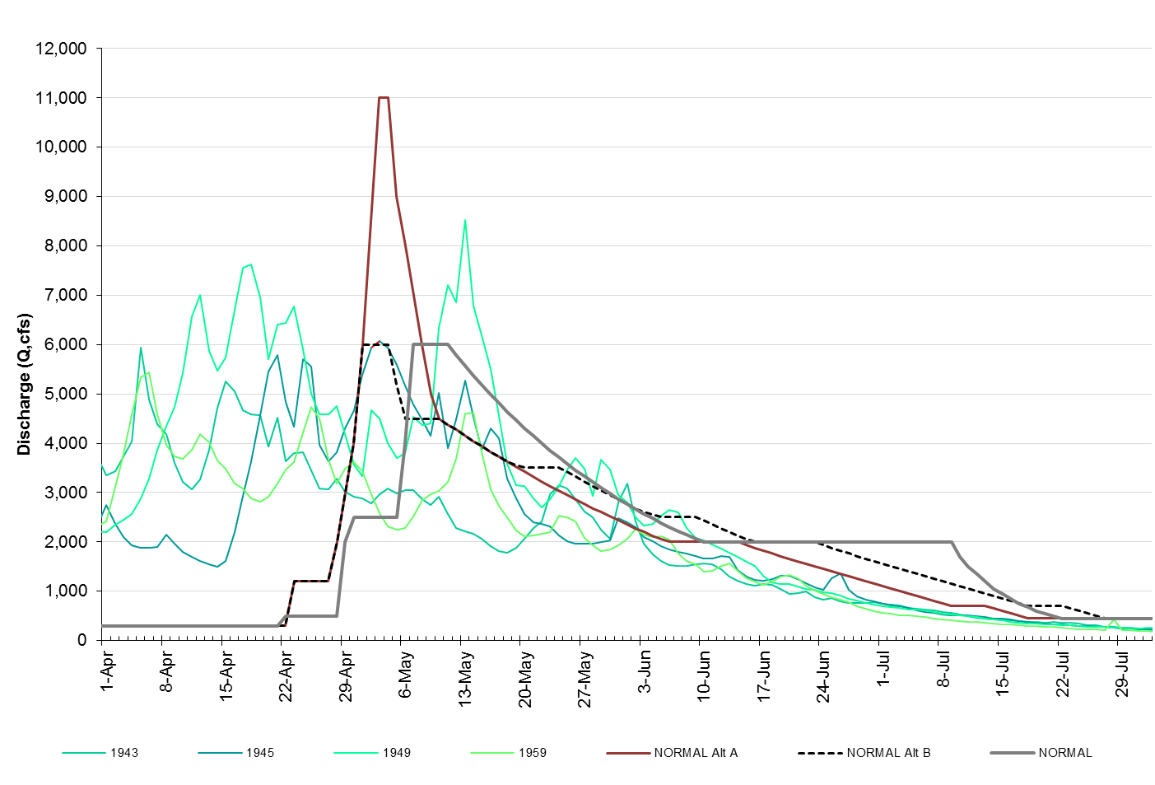
WY2012 NORMAL RIPARIAN ALTERNATIVES OVERLAID ON UNIMPAIRED NORMAL YEARS

Slide 33
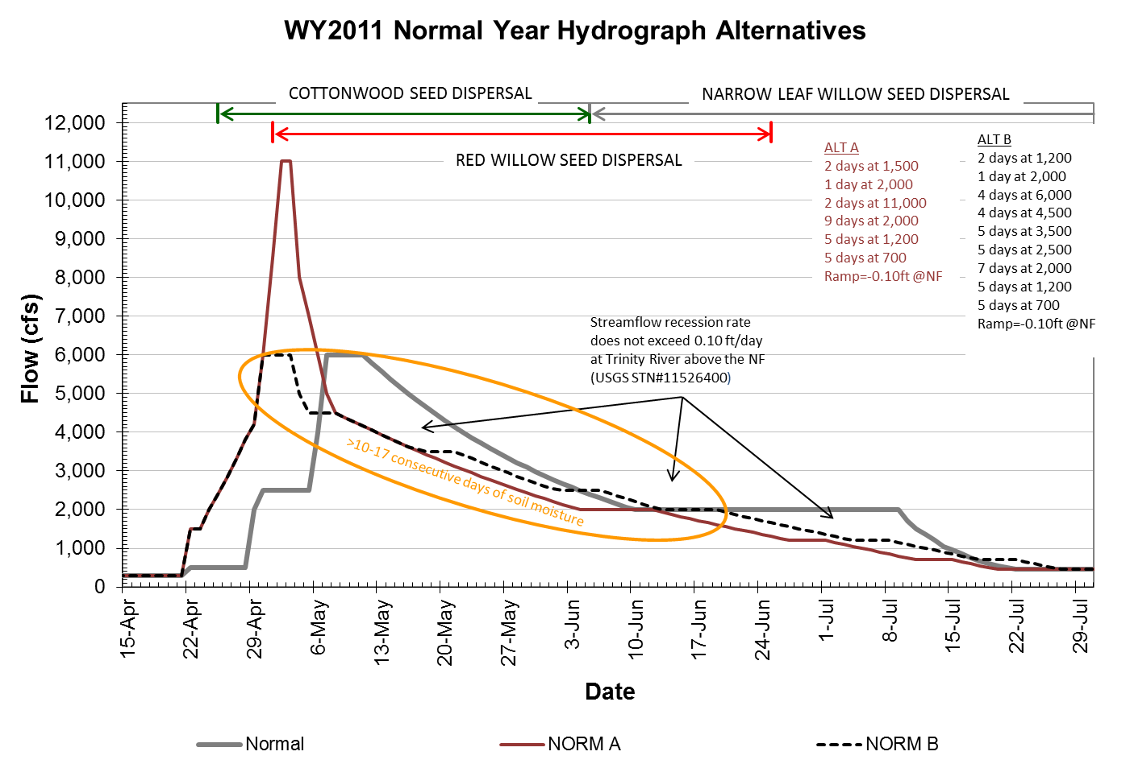

Slide 34
Conclusion
Three potential water years, but Wet is almost a certainty
Options are ROD hydrographs vs alternatives that were forwarded through the Flow Workgroup
All alternatives are more effective than ROD for meeting riparian objectives and arguably slightly better for FYLF production
Effectiveness essentially equal for other objectives

Slide 35
Extra slides

Slide 36
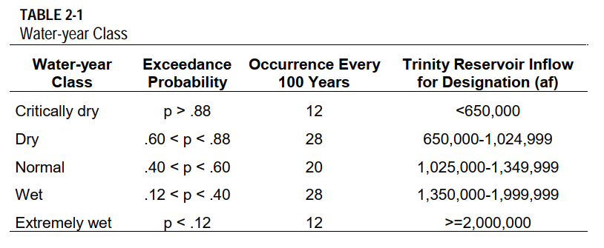
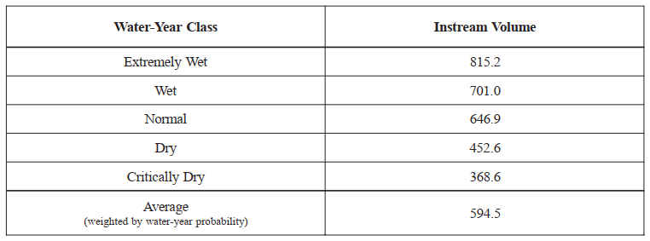

Slide 37
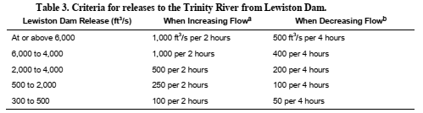
EIS/Implementation Plan ramp rates

Slide 38
WRO 90-5 and NCRWQCB’s basin plan
Douglas City daily temp not to exceed 60° F (15.5 ° C) between July 1 and Sept 15
Douglas City daily temp not to exceed 56 ° F (13.3 ° C) between Sept 15 and Oct 1
North Fork Confluence not to exceed 56 ° F (13.3 ° C) between Oct 1 and Dec 31

Slide 39
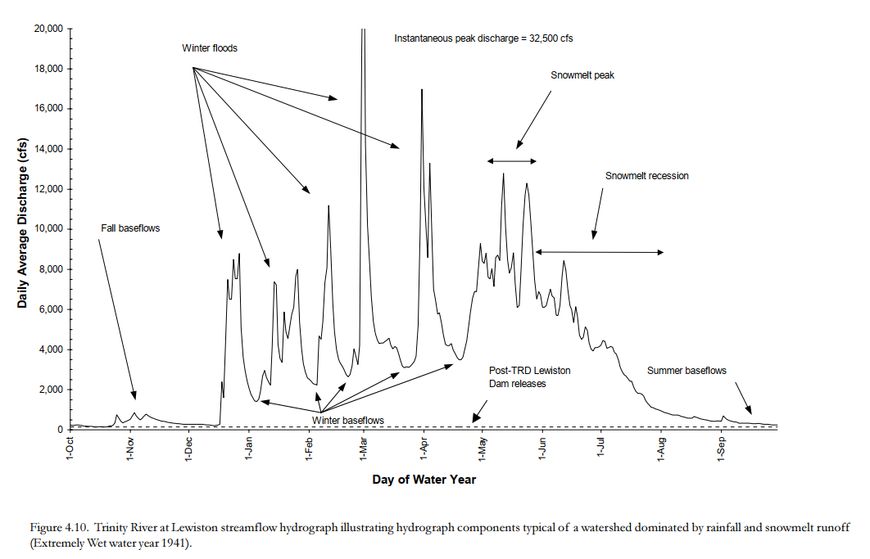
“Collectively, annual hydrograph components were responsible for alternate bars, riparian communities, and salmon populations. Big, infrequent floods were better at accomplishing some tasks such as mobilizing alternate bars, whereas smaller, more frequent floods produced smaller-scale benefits such as the scouring of seedlings. These variable flows created the spatial complexity underpinning salmon habitat and the riparian community in the pre-TRD mainstem.” TRFES (USFWS and HVT, 1999)

