Slide 1
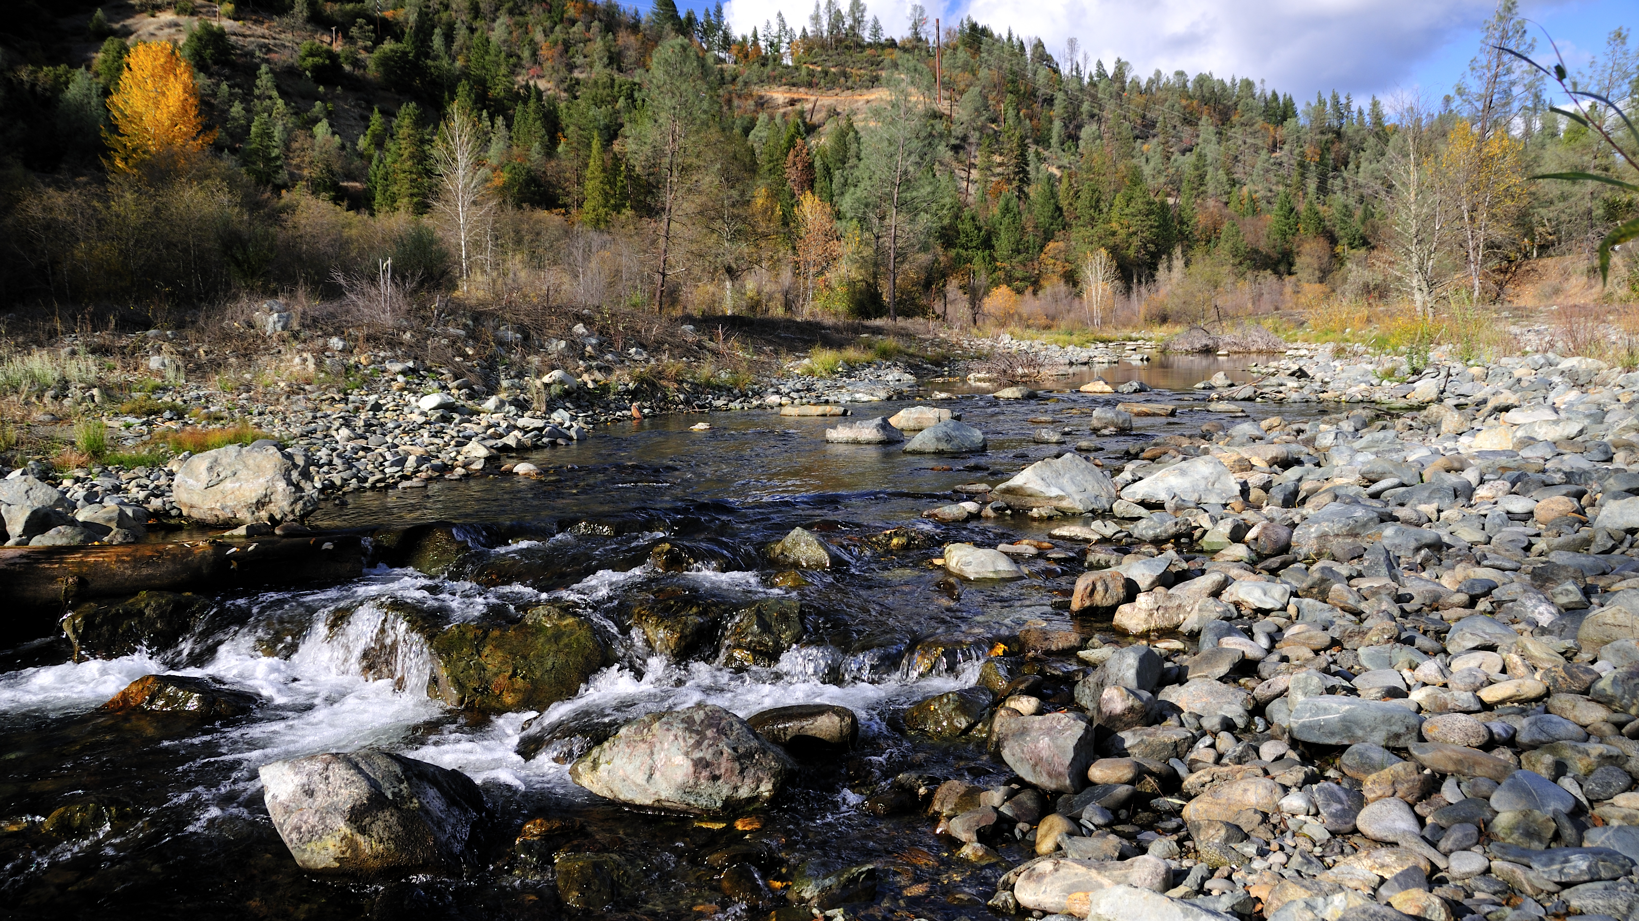
Trinity River Watershed Restoration Programmatic Environmental Assessment

Slide 2
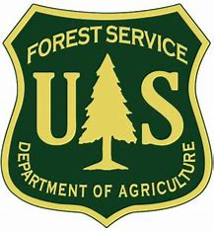
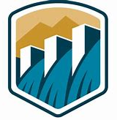
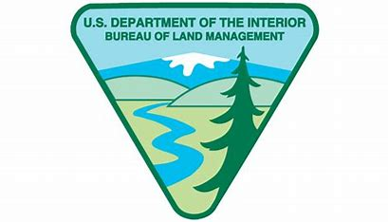
Cooperating Agencies
Other potential agencies: US Army Corps of Engineers (USACE) & Natural Resources Conservation Service (NRCS)

Slide 3
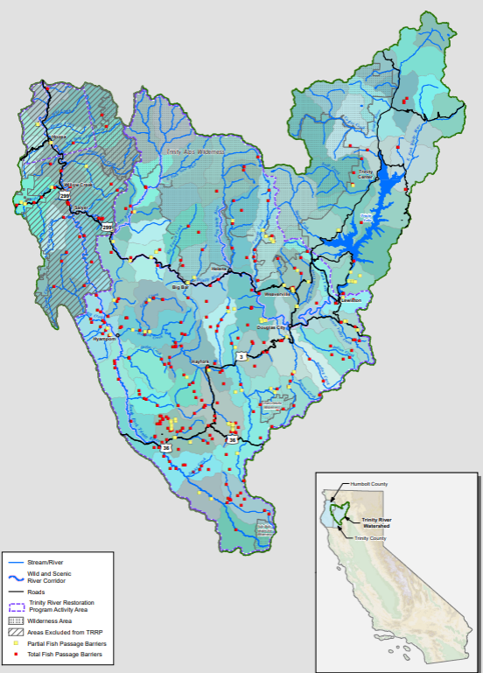
Project Area
HUC 12
Excluded area overlaps with Six Rivers NF Aquatic Restoration PEA & HVT Reservation
Yellow dots: partial fish passage barrier
Red dots: total fish passage barrier

Slide 4

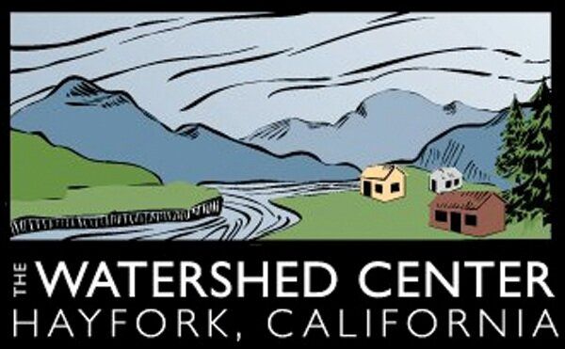


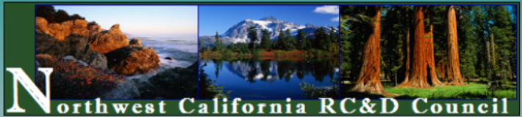
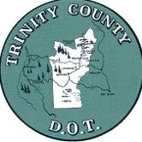
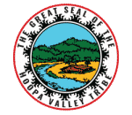

Who, Why, How
Expedite watershed restoration
Federal nexus
Implementers

Slide 5
Project Activity Categories
Restoration and Enhancement of Off-Channel and Side-Channel Habitat
Floodplain Restoration
Removal or Retrofitting of Fish Passage Barriers, Small Dams, Flood Gates, Pilings
Water Conservation
Salmon Carcass Placement & Remote Site Incubation
Bioengineered Bank Stabilization
Aquatic, Wetland, Riparian, and Upslope Habitat Enhancement
Road Decommissioning, Maintenance, and Rehabilitation

Slide 6
Endangered
Species
Act
2020 NMFS BO
  Reinitiating consultation to include:
    Increase project capacity
    Fish Screens
    Impact pile driving using metal piles
    Explosives?
    Other suggestions?
2022 FWS Statewide BO
  Late arriving agencies
  Northwestern Pond Turtle – proposed threatened

Slide 7
Restoration and Enhancement of Off-Channel and Side-Channel Habitat
Habitat Elements:
Vegetation
Loose large wood w/ and w/o rootwads
Structured log jams
In-stream boulders
Beaver dam analogues
Spawning gravel
Other:
Channel and streambank excavation
Floodplain lowering, grading, and revegetation
Construction of gravel and skeletal bars
*Additional treatments listed on activity cards

Slide 8
Floodplain Restoration
Setback, breaching, modification, and removal of:
Levees
Berms
Dikes
Floodplain grading in support of hydraulic reconnection of floodplain
Rock placement as engineered
Stream material
Riffle ramps
Weirs
Filling or reshaping of in- and off-channel gravel pits
*Additional treatments listed on activity cards

Slide 9
Removal or Retrofitting of Fish Passage Barriers, Small Dams, Flood Gates, Pilings
Removal or retrofitting (for fish passage) of:
small dams
Diversions
flood gates
legacy structures
Separation of streams from artificial impoundments (e.g., ponds or lakes)
By realigning or rerouting channels or
Through vertical concrete sheet piles or sheet-pile walls
*Additional treatments listed on activity cards

Slide 10
Water Conservation
Water conservation and efficiency outreach
Instream Flow Dedication (Water Code 1707)
Storage and forbearance programs
Flow monitoring
Designing, permitting, and implementing individual water conservation systems
*Additional treatments listed on activity cards

Slide 11
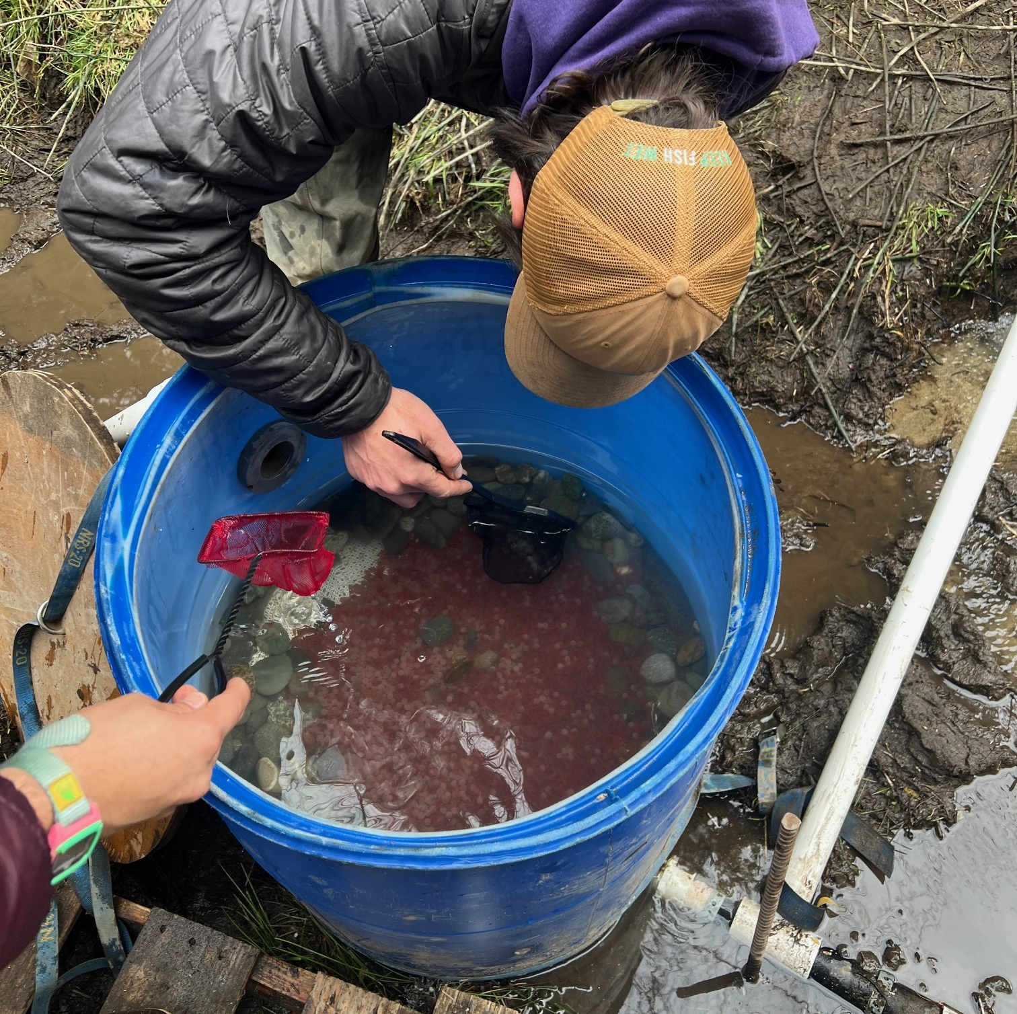
Salmon Carcass Placement & Remote Site Incubators
Obtain excess carcasses from Trinity River Hatchery
Distribute carcasses throughout watershed as needed
Hatch salmonid eggs streamside

Slide 12
Bioengineered Bank Stabilization
Bank reshaping
Slope grading
Coir log installation
Deformable soil reinforcement using biodegradable material
Revetment consisting of trees, native plants, or willow walls
Brush mattresses
Brush check dams
*Additional treatments listed on activity cards

Slide 13
Aquatic, Wetland, Riparian, and Upslope Habitat Enhancement
Removing nonnative terrestrial and aquatic invasive plant species (no herbicide use)
Tree removal and salvage for instream placement when possible
Revegetation with native plants, shrubs, and trees
Temporary irrigation
Installation of livestock fencing around sensitive habitat
*Additional treatments listed on activity cards

Slide 14
Road Decommissioning, Maintenance, and Rehabilitation
Maintenance
Grading
Rocking
Clearing of drainage structures
Rehabilitation
Out-sloping
Addition of water energy dissipaters
New drainage structures
Culvert and bridge replacement
Decommissioning
Removing stream crossing structures, culverts, and “Humboldt Crossings”
Reshaping, ripping, seeding, and mulching roadway surfaces
*Additional treatments listed on activity cards

Slide 15
Questions?
Thank you for your time ☺

