Slide 1
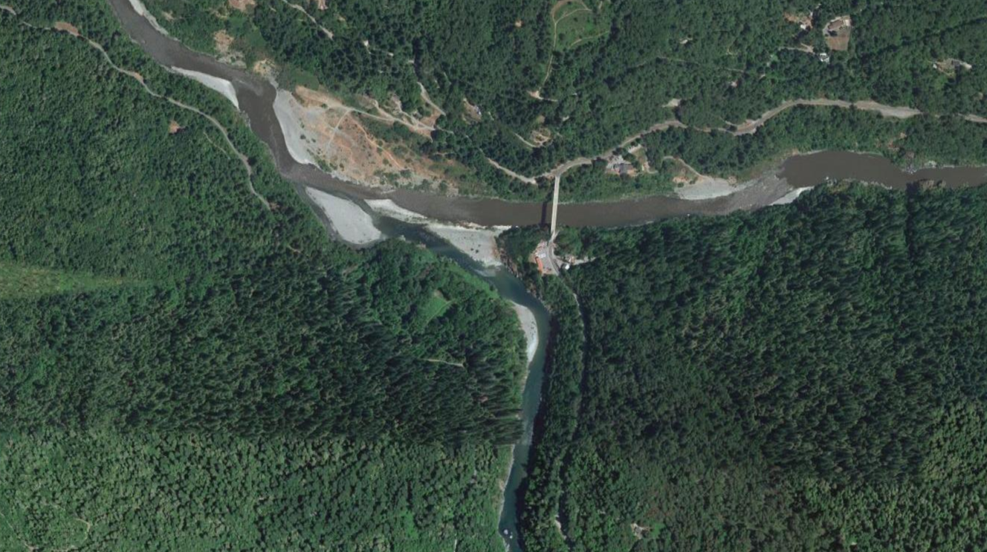


Trinity River LFA Phase 1
Overview of draft LFA Study Plan options for
Trinity Management Council
3/21/2024
Jason Hall and Joe Merz, Cramer Fish Sciences

Slide 2
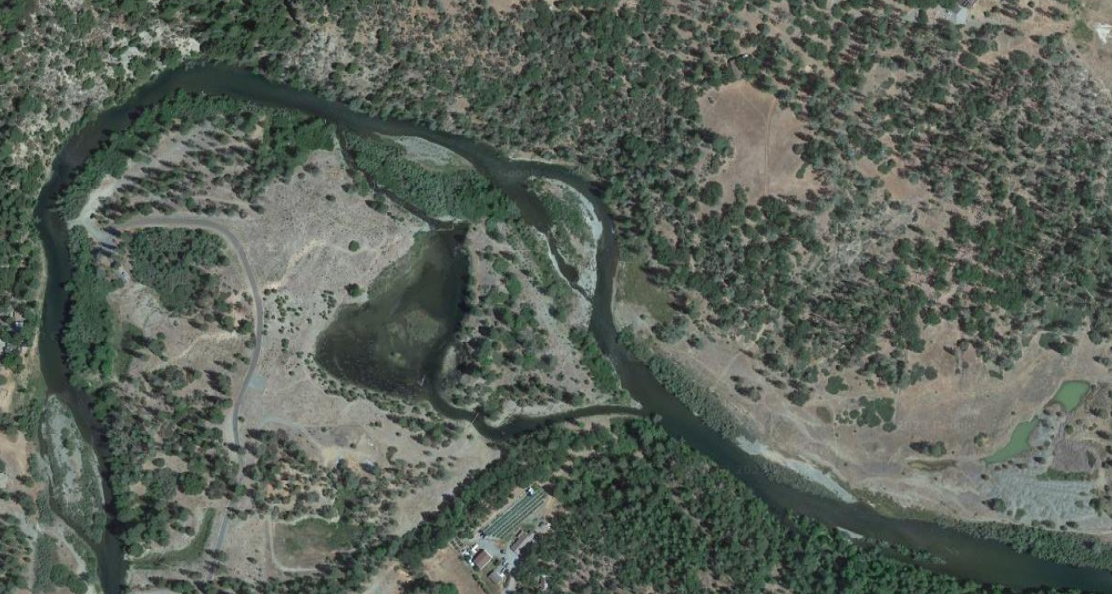
Meeting outline and agenda
Background and rational for Trinity LFA study
Overall project goals and objectives
Phase 1 goals and objectives
Revised conceptual life cycle diagram and drivers/causes
LFA Study Plan approach and considerations
LFA Study Plan options and recommendations

Slide 3
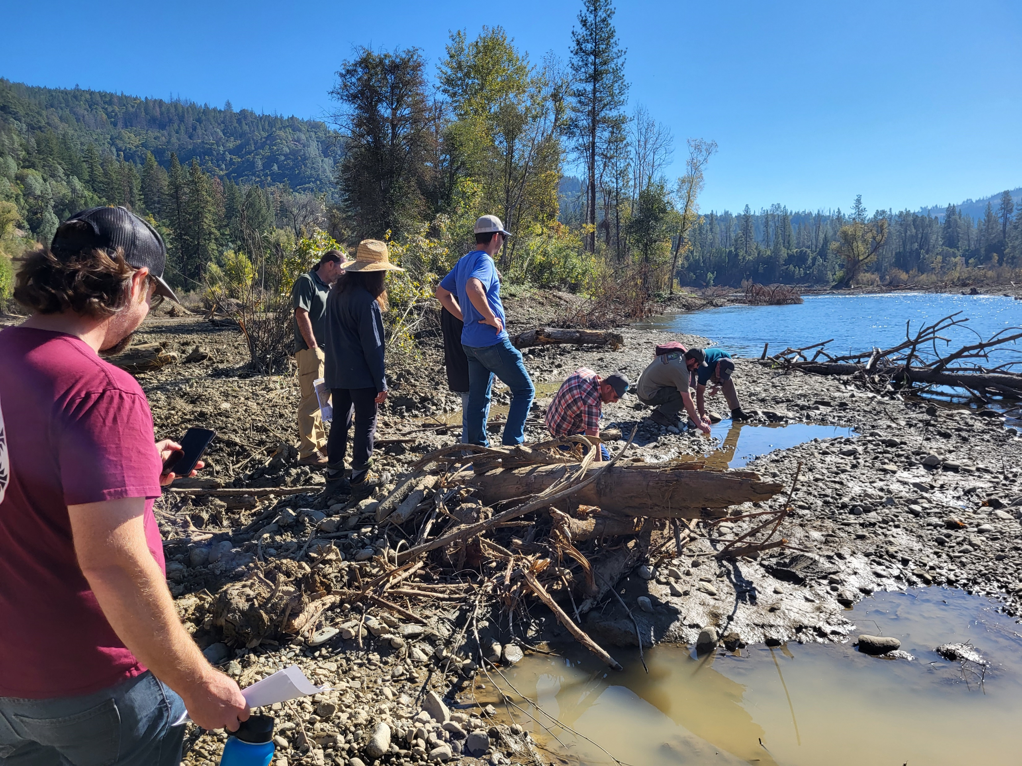
Background and rational for LFA
TRRP has invested in restoring the Trinity River for 20+ years
Long-term TRRP goals:
  Restore the form and function of river
  Restore/sustain natural production of anadromous fish to pre-dam levels
  Facilitate full participation by comanagers and stakeholders
Restoration has been linked to increases in juvenile Chinook production
No commensurate increase in adult returns detected
TRRP identified need to conduct an LFA to identify potential causes for observed discrepancies or lack of return responses
Restoration site visit after
Trinity River LFA kickoff meeting

Slide 4
Trinity LFA Project Goals and Objectives
Better understanding of what is limiting adult returns
Provide information to support fishery and production goals
Ability to identify and rank multiple limiting factors
Identify data gaps and uncertainties
Support identification of restoration or management scenarios to address limiting factors
Support evaluation of current, planned, or potential actions to address limiting factors
Provide material and tools for public facing outreach materials or tools

Slide 5
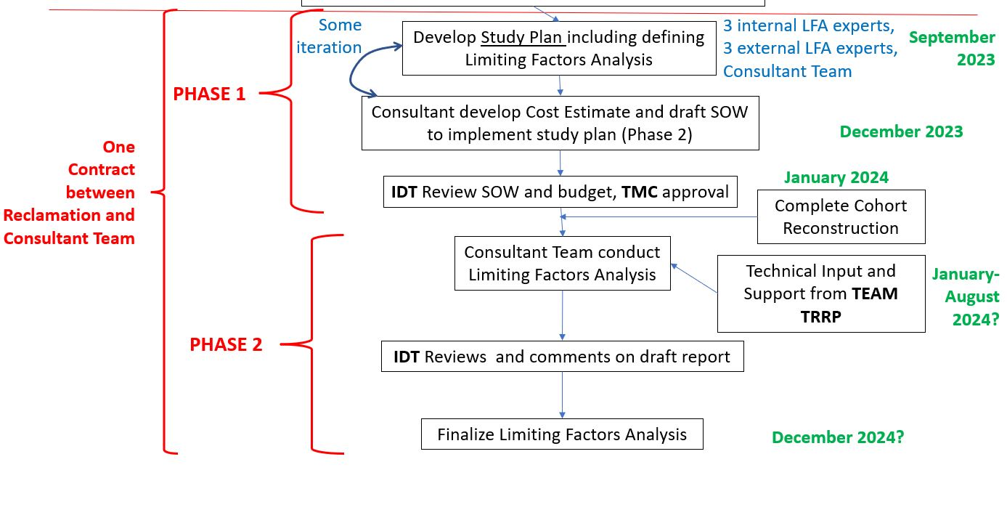
Trinity LFA Project Goals and Objectives
Trinity LFA Strategy includes two Phases
CFS
Team

Slide 6
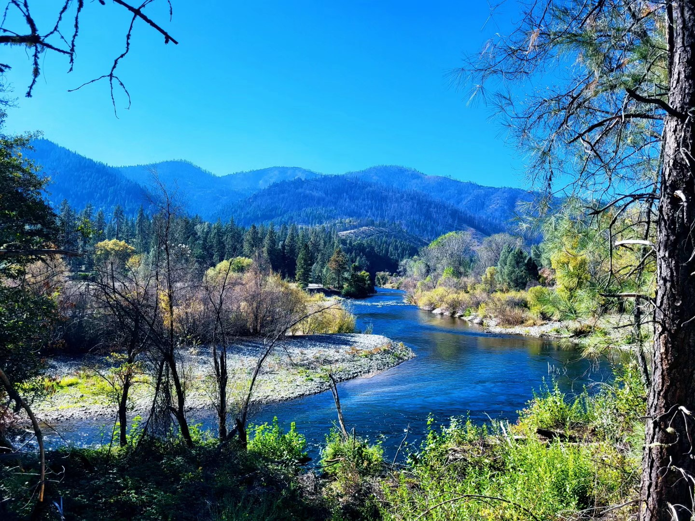
Phase 1 goals and objectives
Host kickoff meeting with TRRP and partners
Review and update conceptual life cycle diagram
Develop 3+ level of effort LFA Study Plan options
Provide sufficient information to:
  Selection option/strategy
  Prepare an RFP for Phase 2

Slide 7
Revised Life Cycle Diagram

Slide 8
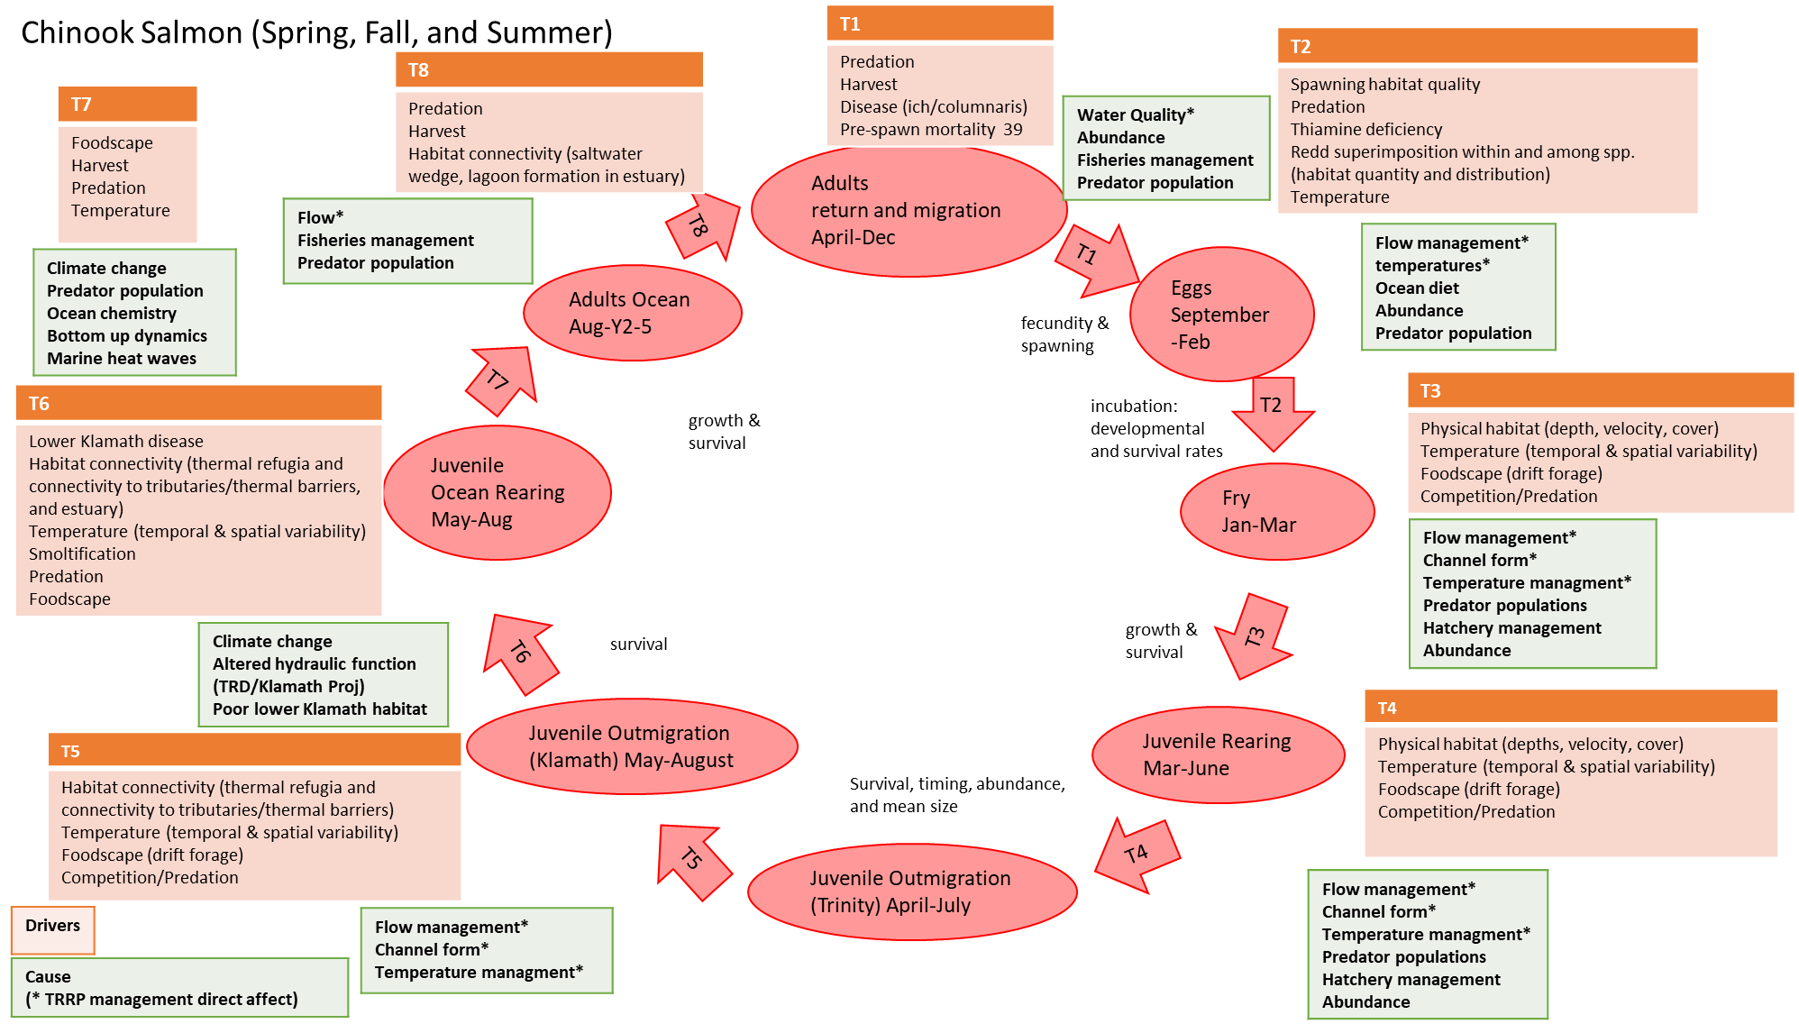
Life cycle diagram and the LFA
Reviewed TRRP provided LCD
Identified refinements to address spatial and life history complexities
In coordination with TRRP and Trinity LFA TAG
The LCD provides a conceptual framework for the LFA
Identify life stage transitions and the factors that influence transition rates
Original conceptual LCD

Slide 9
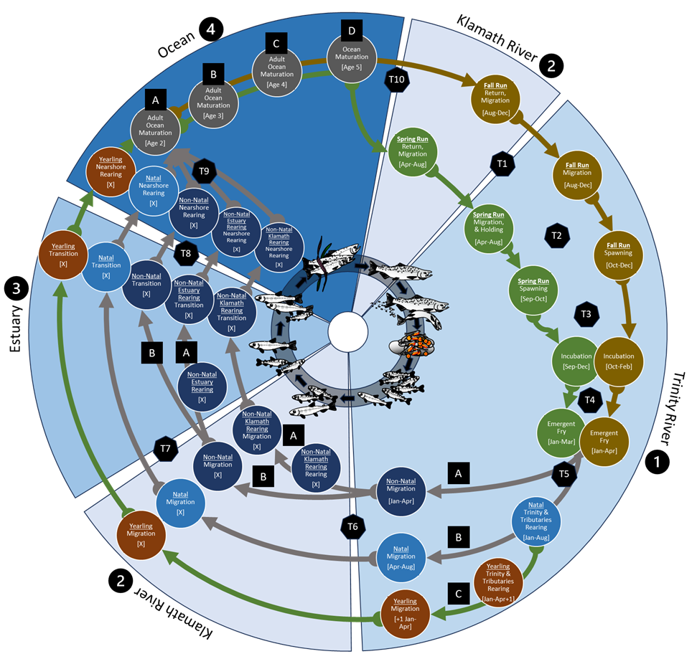
Revised LCD for Trinity River Chinook
Key Updates:
Increased spatial structure:
  Estuary outmigration
  Klamath/Trinity adult migration
Broke out Fall and Spring Run
Added juvenile life history pathways
Increase in complexity can always be scaled back later…
Supports Trinity LFA and Study Plan options
LCD Revised in coordination with TAG

Slide 10
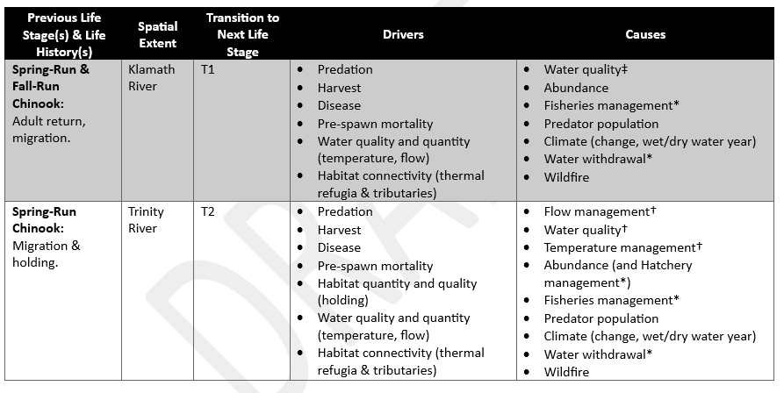
Updated drivers/causes linked to LCD
Example of *potential* drivers and causes**
linked to life stage transitions
* Potential → LFA to evaluate
** Includes factors TRRP can influence

Slide 11
Trinity River Chinook LFA Study Plan Options

Slide 12
Considerations for the LFA Study Plan Options
The system, population, factors, and LFA questions are complex, dynamic, and interconnected
Need to consider multiple life stages, spatial and temporal extents, and multiple factors and actions
Approach should consider the full life cycle
Approach should also be scalable and level of effort options can build on each other (Options ≈ Phases)
Ability to identify and prioritize limiting factors, adaptively manage to address emerging issues, and evaluate actions/scenarios

Slide 13
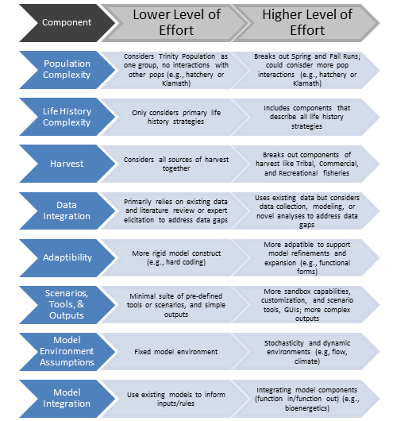
Life cycle modeling approach
Example of scalability and increasing complexity for LCM
LCMs can include full life cycle
Model transition rates between life stage
Complexity is scalable and adaptable
Can make use of existing data and support simulations/scenarios
Identify what life stages/factors are limiting and data gaps
Phase 1 memo includes decision support information:
  Choosing appropriate complexity
  Building new vs adapting existing
  models (e.g., S3)
  General LCM framework and approach

Slide 14
LFA Study Plan Options
Outlined 3 level of effort options
Increasing level of effort and complexity/functionality
Build on each other so they can be sequenced
Option 1: High-level focused on key life stages – identify areas of focus
Option 2: Full LCM and GUI to support LFA
Option 3: Full LCM and GUI with scenarios to inform management

Slide 15
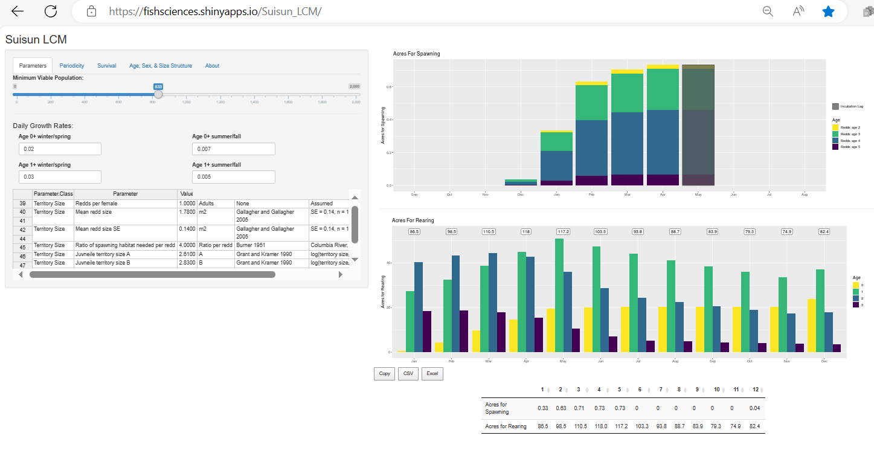
LFA Study Plan Options - Examples
Example of an RShiny GUI for a simple spreadsheet LCM model for Suisun Creek Steelhead
Focus on key life stages and less data requirements
Determine population goals and habitat needed
Compare to available habitat
Support identification of limiting life stages for more in depth focus in future
Support simple “gaming” to support management

Slide 16
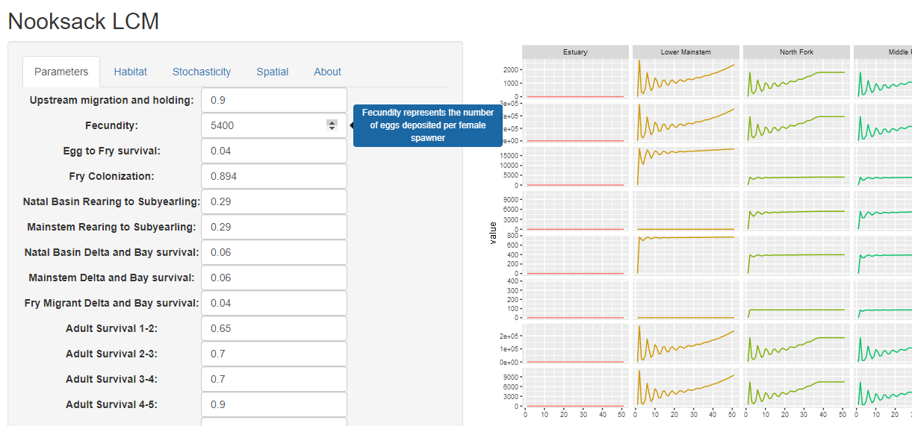
LFA Study Plan Options - Examples
Example of an RShiny GUI for a more complex full life cycle LCM for Nooksack River early Chinook
Full LCM accounts for more life cycle complexity
Spatial and temporal complexity
Requires more data
Ability to test more hypotheses
And dive deeper into life stages and life histories to determine LFs
Supports more “gaming” and evaluation of management actions

Slide 17
LFA Study Plan Options
Key Steps
Determine goals and formulate hypotheses
Evaluate data needed/available to test hypotheses and build LCM
Parameterize and evaluate
Identify and prioritize LFs
Identify and evaluate actions/strategies to address
Share tools/information, make accessible/transparent

Slide 18
LFA Study Plan Options
 | Option 1 | Option 2 | Option 3
Timelines | 6-9 months | 12-18 months | 18-24 months
Data Required | Lowest | High | Highest
Experience Required | Lowest | High | High
Key Deliverables | Spreadsheet style LCM High-level improvement goals and strategies | Full LCM with GUI Identified and prioritized limiting factors | Full LCM with GUI and Scenarios Identified and prioritized limiting factors Scenario based evaluations
Pros | Lowest level of effort Easiest to fit data Can inform where to focus (sets the stage) | LCM supports full life cycle based LFA Identify and prioritize LF | Same as Option 2 Ability to evaluate scenarios and support adaptive management
Cons | Does not directly identify LFs Limited resolution | Higher level of effort, data, and staffing Increased complexity and sensitivity | Additional time and data requirements

Slide 19
Recommendations
Could start with Option 1 for a lower initial level of effort
  Results could help refine approaches to the next level of effort
But we recommend starting with Option 2
Option 2 provides a good balance of:
  Complexity
  Level of effort
  Ability to meet project goals/objectives
  Support identification and prioritization of LFs and data gaps
Then plan to expand to Option 3 in the future
Plan for developing public facing or open source GUIs and tools to support program objectives and usability

Slide 20
Supplemental/Extra slides

Slide 21
Considerations for the LFA Study Plan Options
The system, population, factors, and LFA questions are complex, dynamic, and interconnected
Need to consider multiple life stages or spatial and temporal extents as well as multiple factors and actions
Approach should consider the full life cycle
Approach should also be scalable and level of effort options can build on each other
You have a lot of data and previously developed tools/analyses to build on…
Approach determines what kind/quality of data are needed
Focus on life stage transitions
Need estimates of abundance at previous and next life stage
Monitoring methods with sufficient accuracy to detect change

Slide 22
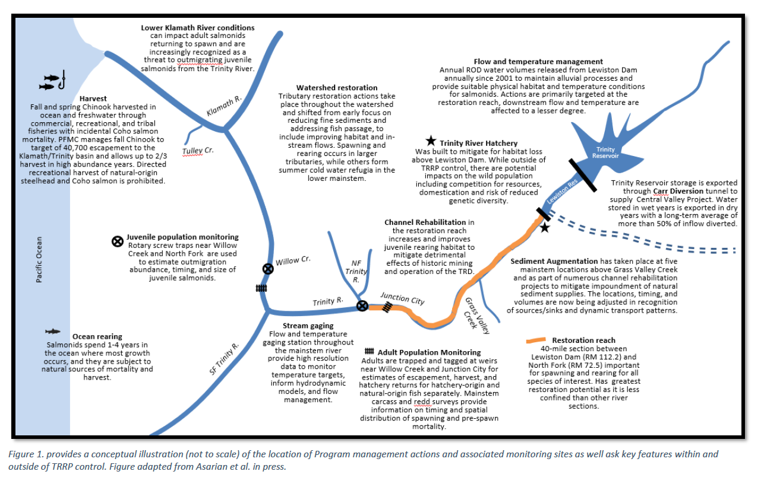
Data Inventory and Monitoring Components
You have a lot of data!
Identifying where we have data will be key
Aligning data with life stages and transitions
Data outside Trinity will also be key

Slide 23
Data considerations and discussion
Data for Klamath/downstream life stages will be key for LFA…
Juvenile survival and production monitoring:
  When will analysis of Trinity to Klamath survival data be available?
  RSTs in Klamath?
  Mark recapture studies in place?
  RST calibrations for yearlings, and age/size specific calibrations?
Genetic mark recapture and monitoring:
  Carcasses and RST monitoring (GMR and run type)
Broodyear reconstructions:
  Will be available in Phase 2 and key to LFA
  To include harvest, ocean maturation and survival
Bony structures, microchemistry, etc…
  Life history reconstructions, estuary rearing, etc…
Estuary monitoring:
  Did we track down estuary monitoring data?

Slide 24
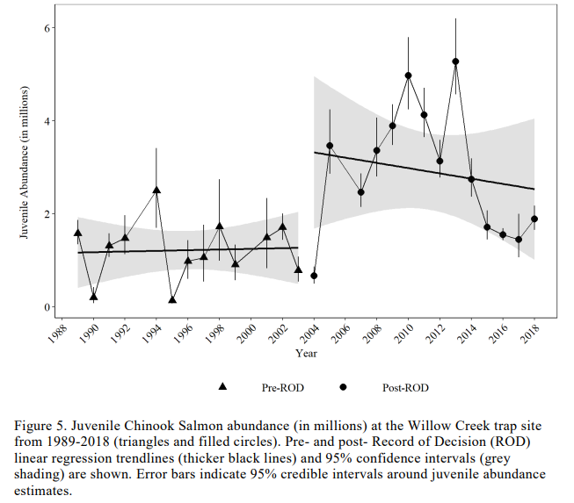
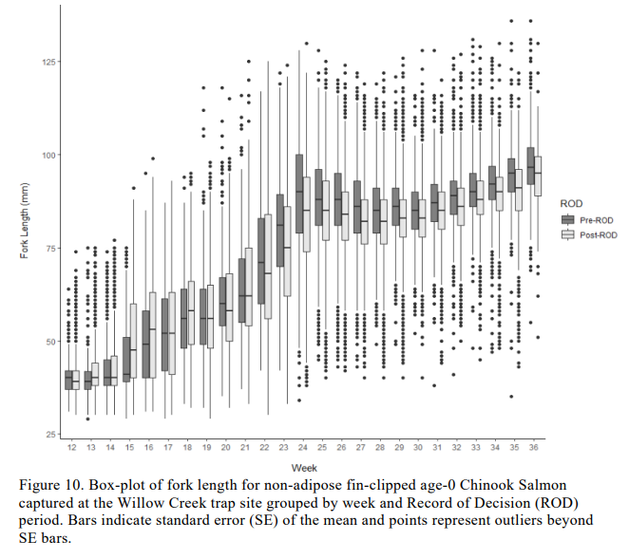
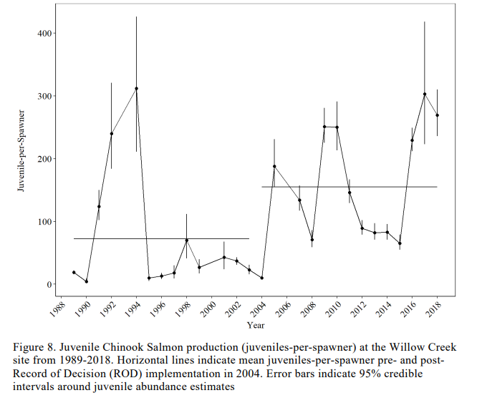
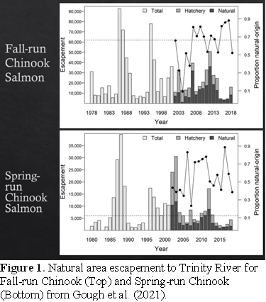
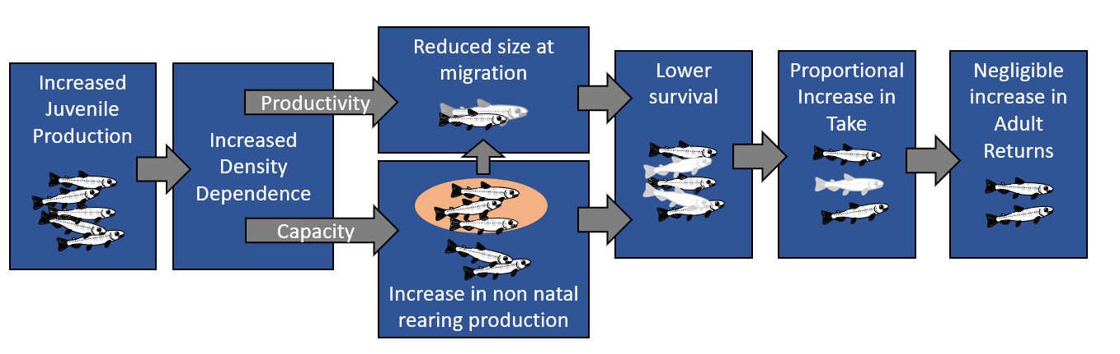
Data considerations and discussion
How was conclusion that increased juvenile production has not increased adult returns determined?
Notes:
How can you see increased juvenile production and not an increase in adults?
Increased production of non-natal rearing fry
Smaller size at outmigration = reduced survival to adult return
Increased production can compensate for reduced survival
But increased harvest and/or ocean conditions can mute signal..
Broodyear reconstructions will help address these questions
Life cycle model approach is a good way to get at these kinds of questions…

Slide 25
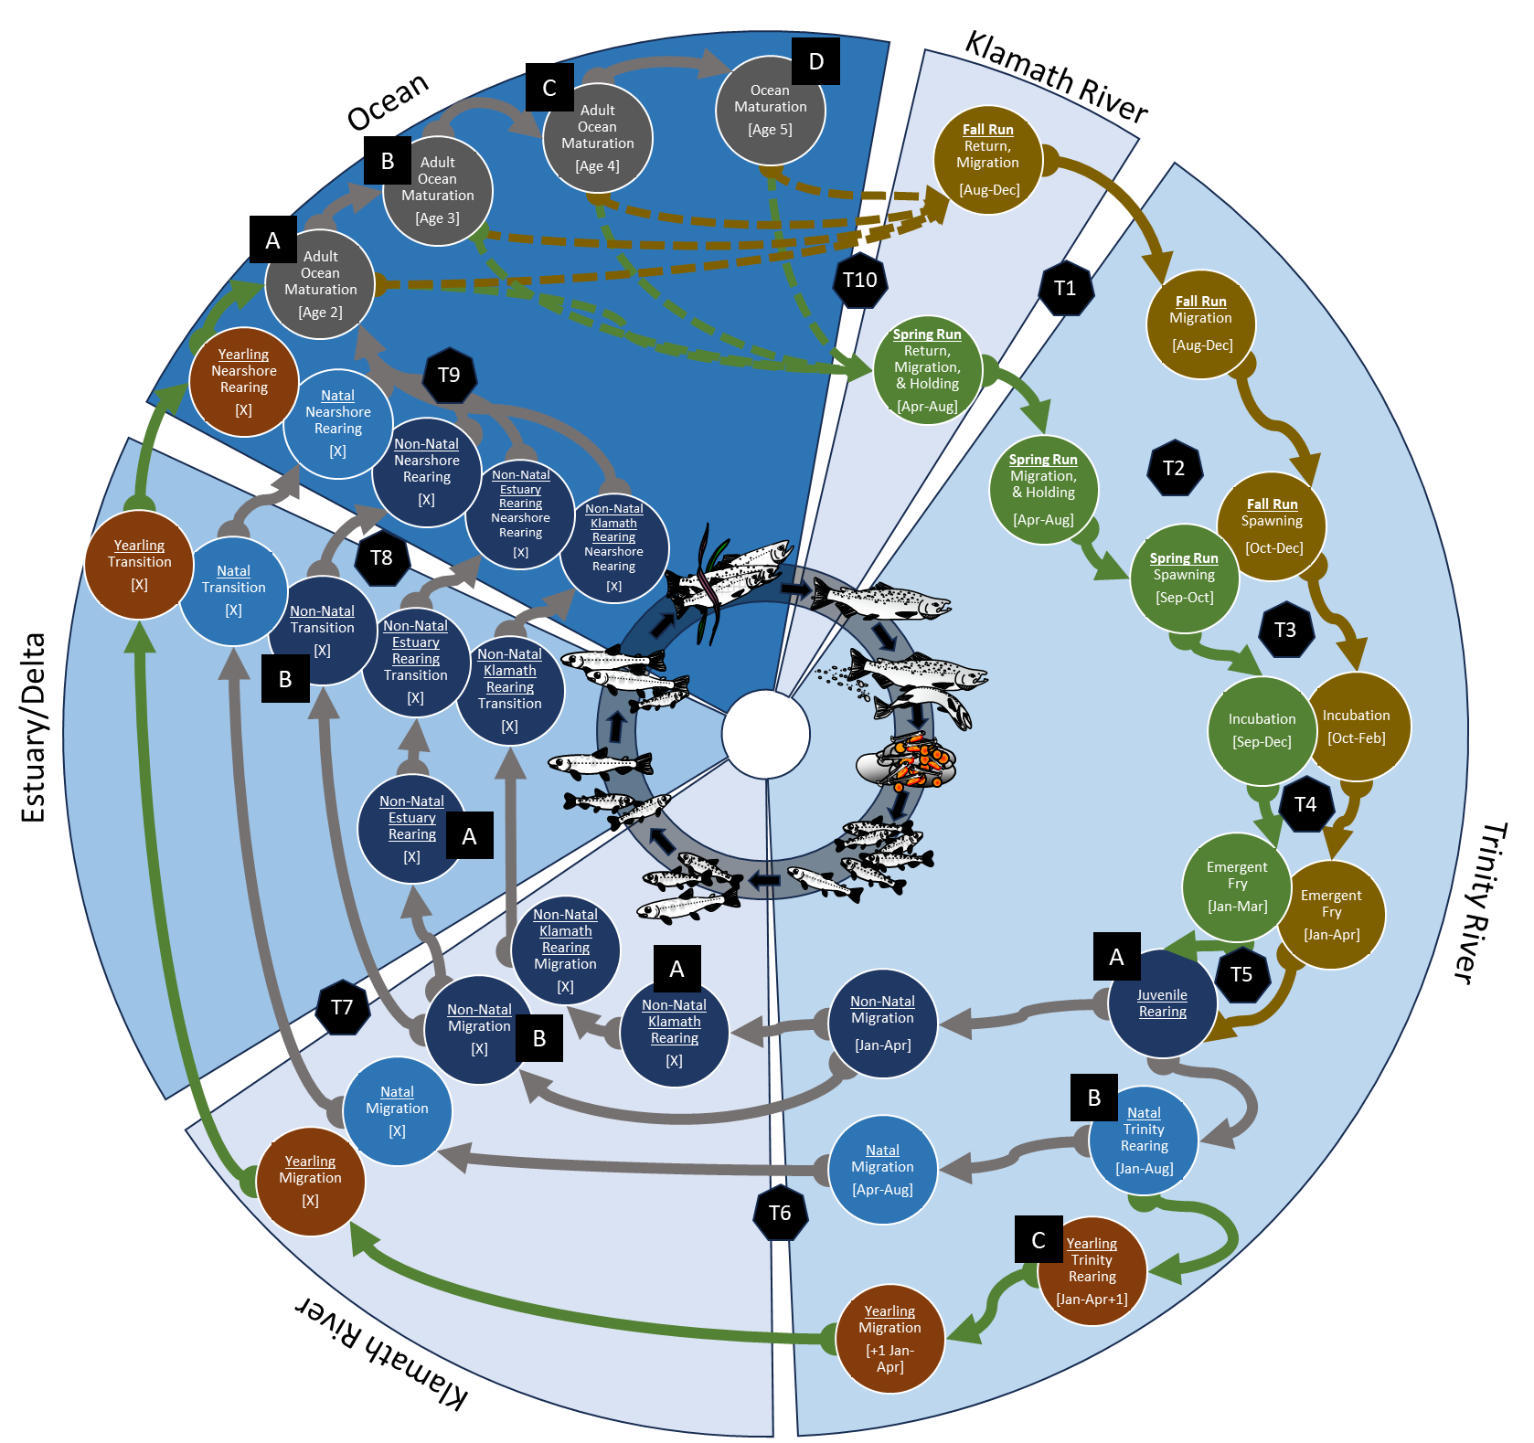
Considerations for LFA approach
To achieve goals of LFA, we need an approach that…
  Considers complexity and interconnectedness of life cycle
  Is complex but scalable
  Considers spatial structure and out of basin factors (e.g., Klamath, estuary, ocean)
  Includes temporal structure and periodicity
  Consider monitoring data as well as other modeling efforts (e.g., bioenergetics, habitat, flow, habitat suitability)
LCMs can address all of these considerations…

Slide 26
Conceptual Ecological Model for LFA
Phase 1
Phase 2
Quantifiable TRRP goals
Meeting
TRRP goals?
Refine conceptual life cycle diagram:
Reflect key life stages and how they interact with TRRP Goals
Develop 3+ Level of Effort LFA Study Plans
Translate conceptual model into quantitative Mechanistic Model
Develop rules to identify Limiting Factors (LF)
Determine LF data needs and level of error to support LFA
Refine Mechanistic Model
Use Model output to prioritize limiting factors
Refine life cycle diagram
Address Data Gaps and Uncertainties:
Monitoring
Analogy
Elicitation
No
Yes
Identify management actions that can address limiting factors
Monitor and Reevaluate
Meeting
TRRP goals?
Prioritize actions:
What can be done?
What has most potential for effect?
How many dials can we turn at once?
Yes
No
Monitor and Evaluate Effectiveness/Responses:
Did action have intended effect?
Application and Adaptive Management

Slide 27
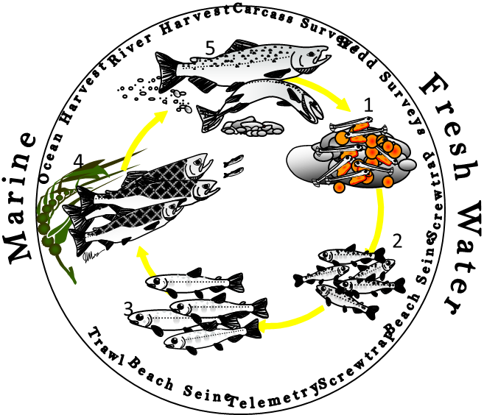
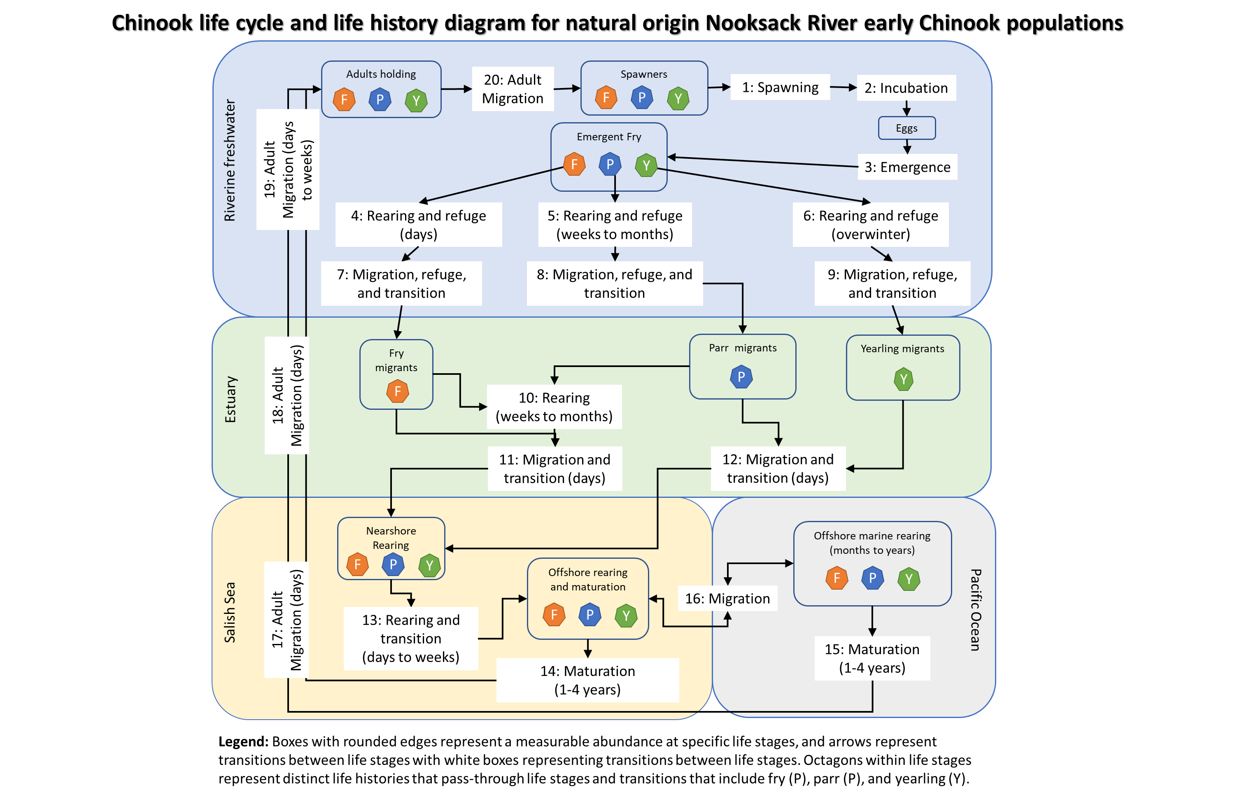
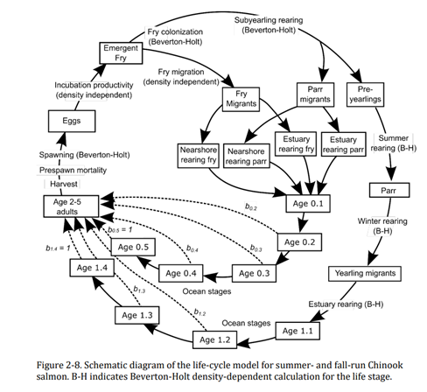
Approaches, tools, and applications
General stage class model diagram from
Merz et al. 2013
NOAA HARP Model LCM diagram

Slide 28
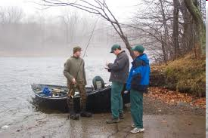
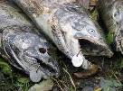
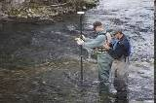

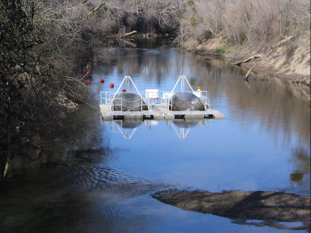
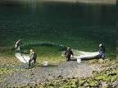
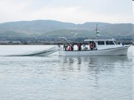
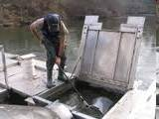

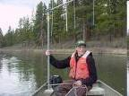
Generalized life-cycle, timing and associated monitoring
1: Hyporheic development of embryo and pre-emergent fry;
2: fry and parr rearing;
3: smolt rearing and emigration;
4: ocean development and return immigration to natal streams;
5: adult stream maturation and spawning

