Slide 1




Working DRAFT:
Third Revision with TAG Feedback
D
Klamath River
Ocean
C
Ocean Maturation
[Age 5]
B
Adult Ocean Maturation
[Age 4]
T10
A
Adult Ocean Maturation
[Age 3]
Fall Run
Return, Migration
[Aug-Dec]
Adult Ocean Maturation
[Age 2]
Spring Run
Return, Migration
[Apr-Aug]
Yearling
Nearshore Rearing
[X]
T9
T1
Fall Run
Migration
[Aug-Dec]
Natal
Nearshore Rearing
[X]
Non-Natal
Nearshore Rearing
[X]
Non-Natal
Estuary Rearing Nearshore Rearing
[X]
Spring Run
Migration, & Holding
[Apr-Aug]
T2
Yearling
Transition
[X]
T8
Non-Natal
Klamath Rearing Nearshore Rearing
[X]
Fall Run
Spawning
[Oct-Dec]
Natal
Transition
[X]
Non-Natal
Transition
[X]
Spring Run
Spawning
[Sep-Oct]
Non-Natal
Estuary Rearing Transition
[X]
Non-Natal
Klamath Rearing Transition
[X]
T3
Estuary
B
A
Incubation
[Sep-Dec]
Incubation
[Oct-Feb]
Non-Natal
Estuary Rearing
[X]
T4
Trinity River
Non-Natal
Klamath Rearing Migration
[X]
A
Emergent Fry
[Jan-Mar]
Emergent Fry
[Jan-Apr]
T7
Non-Natal
Migration
[X]
Non-Natal
Klamath Rearing
Rearing
[X]
A
T5
B
Non-Natal
Migration
[Jan-Apr]
Natal Migration
[X]
T6
Natal Trinity & Tributaries Rearing
[Jan-Aug]
Yearling Migration
[X]
B
Natal Migration
[Apr-Aug]
Yearling Trinity & Tributaries Rearing
[Jan-Apr+1]
C
Klamath River
Yearling Migration
[+1 Jan-Apr]

Slide 2
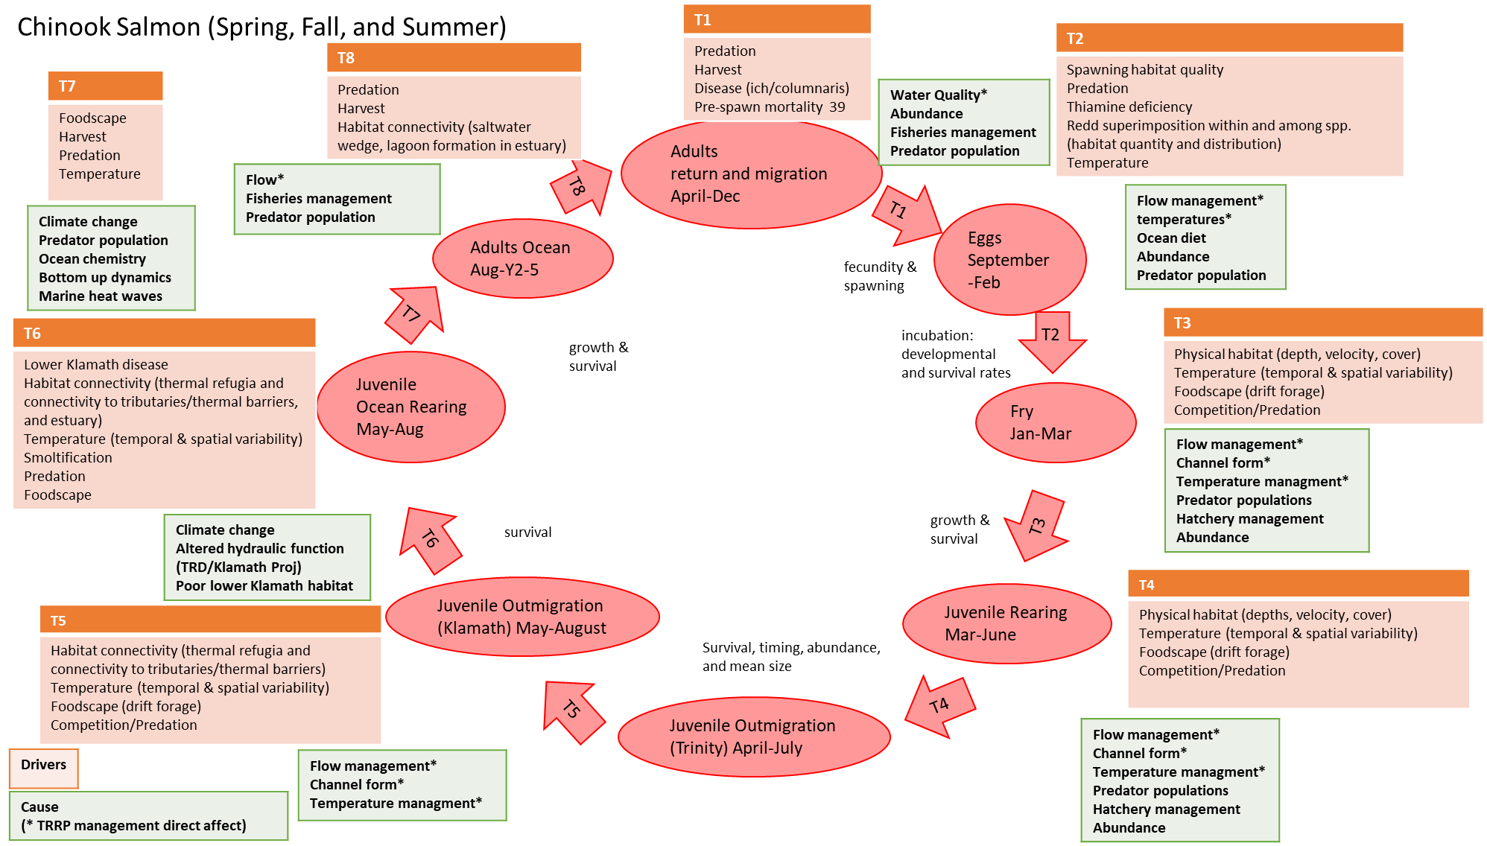
Original LCD for Trinity River Chinook provided by TRRP
(for reference during review)

