Slide 1

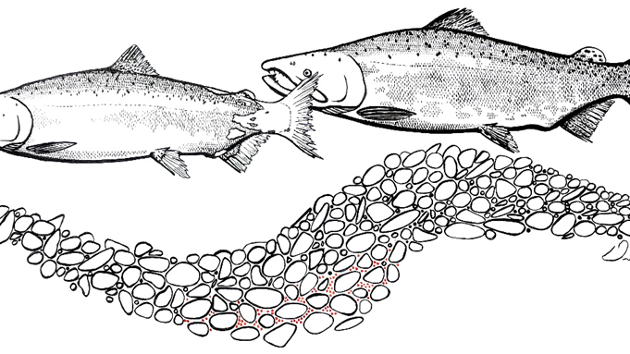
Assessment of Adult Salmonid Spawning in the Trinity River

Slide 2




Assessment of Adult Salmonid Spawning in the Trinity River
Principal Investigators
USFWS
  Steve Gough
  Reuben Smit
  Nick Som
YTFP
  Kyle DeJuilio
  Chris Laskodi
CDFW
  Ken Lindke
HVT
  George Kautsky
  Billy Matilton

Slide 3
Report Structure
Introduction
Adult Salmon Monitoring and Escapement
Spawning Ground Surveys
Syntheses and New Analyses
Discussion and Next Steps

Slide 4
2. Adult Salmon Monitoring and Escapement (CDFW, HVT)
2.1 Data Sources and Methods
2.2 Annual Escapement Estimates
2.3 Natural Area Escapement
2.4 Hatchery Return Composition of Natural- and Hatchery-Produced Fish
Fall-run Chinook Salmon
Spring-run Chinook Salmon
Coho Salmon
Steelhead

Slide 5
Natural Area Escapement
Fall-run Chinook Salmon
Coho Salmon
Spring-run Chinook Salmon
Steelhead

Slide 6
Hatchery Return Composition of Natural- and Hatchery-Produced Fish
Fall-run Chinook Salmon
Coho Salmon
Spring-run Chinook Salmon
Steelhead

Slide 7
3. Spawning Ground Surveys (USFWS, YTFP)
3.1 Data Sources and Methods
3.1.1 Mainstem Spawning Ground Surveys
3.1.2 Tributary Spawning Ground Surveys
3.2 Carcass Data and Analyses
3.2.1 Distribution and Proportion of Natural and Hatchery Spawners
3.2.2 Pre-spawn Mortality
3.2.3 Escapement Estimates
3.3 Redd Data and Analyses
3.3.1 Redd Identification
3.3.2 Trends in Redd Abundance and Distribution
3.3.3 Tributary Spawning

Slide 8
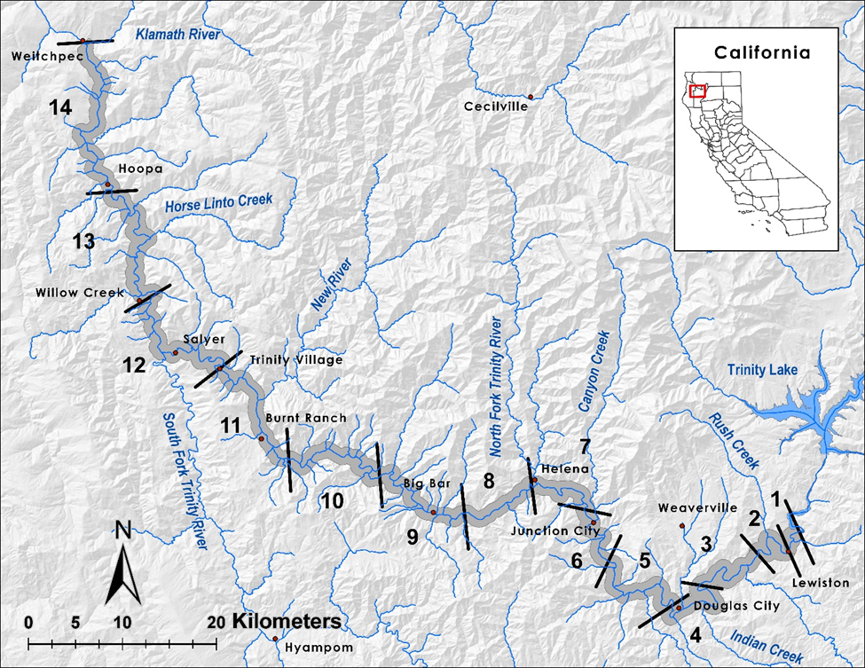

Spawning Ground Surveys - Objectives
Assess the spatial distribution of Chinook Salmon redds, particularly in relation to TRRP management actions,
Quantify Chinook Salmon spawning in the mainstem Trinity River,
Quantify pre-spawn mortality of female Chinook Salmon,
Quantify and describe temporal and spatial distribution of natural- and hatchery-origin Chinook Salmon spawning, and
Collect biological data ancillary to escapement (fork lengths for estimating size distribution and jack proportion, scales for age composition, sex ratio, etc.).

Slide 9
Pre-spawn Mortality
Temporal distribution of pre-spawn mortality fresh female Chinook Salmon carcasses, Trinity River surveys 2009–2017

Slide 10
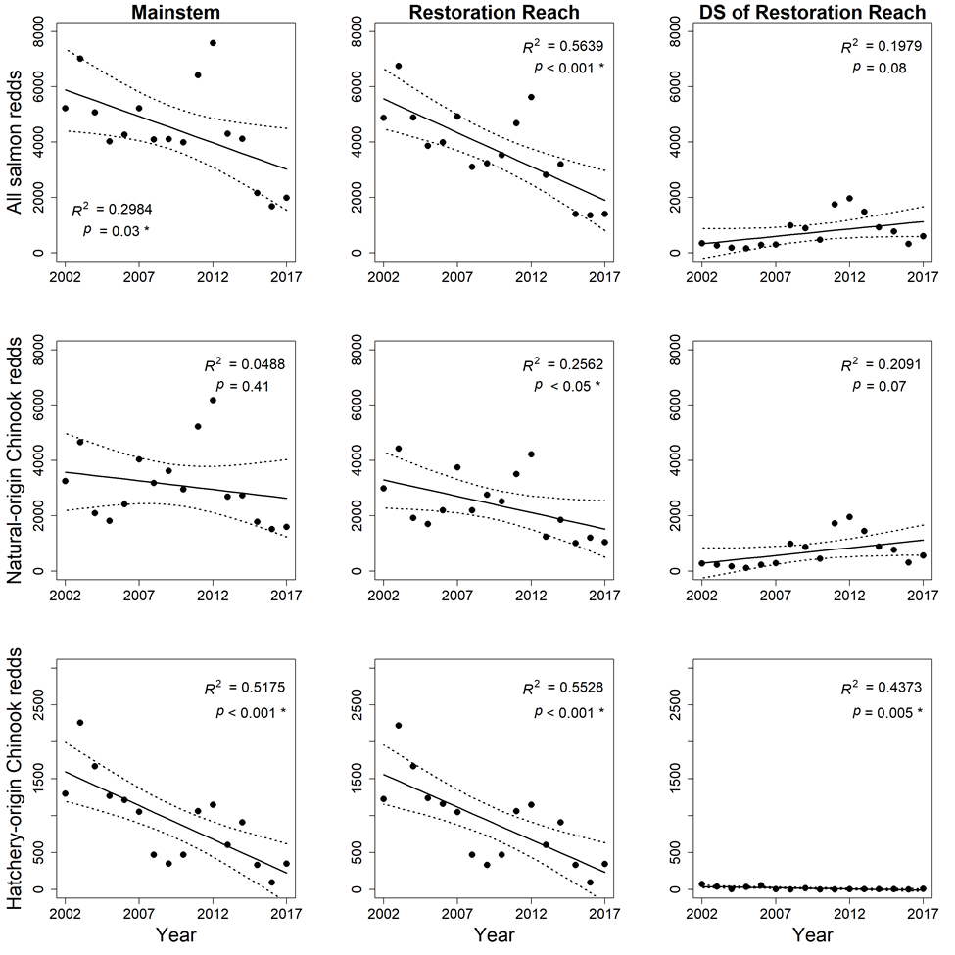
Redd Abundance: System Scale

Slide 11
Redd Distribution: System Scale

Slide 12
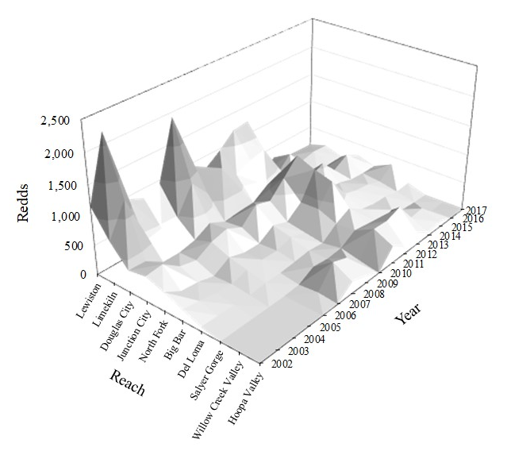
Redd Abundance and Distribution: Reach Scale
Spatiotemporal distribution of natural-origin Chinook Salmon redds in the mainstem Trinity River reach-scale sections, 2002–2017

Slide 13
Redd Abundance and Distribution: Site Scale
Spatiotemporal distribution of the annual abundance of natural-origin Chinook Salmon redds in the mainstem Trinity River TRRP restoration reach site-scale sections, 2002–2017

Slide 14
Redd Abundance and Distribution: Site Scale
Spatiotemporal distribution of the annual proportions of natural-origin Chinook Salmon redds in the mainstem Trinity River TRRP restoration reach site-scale sections, 2002–2017

Slide 15
4. Syntheses and New Analyses
4.1 Species Composition of Salmonid Escapement
4.2 Pre- and Post-ROD Escapement Comparison
4.3 Causal Effects of Pre-Spawn Mortality
4.4 Redd Superimposition
4.5 Redd Dewatering
4.6 Distribution of redds in channel rehabilitation areas compared to unrestored areas within the restoration reach

Slide 16
Causal Effects of Pre-spawn Mortality
Pre -spawn mortality rates for Chinook Salmon in the Trinity River during the pre-ROD (1955–1999) and full implementation (2005–present) time periods.

Slide 17
Causal Effects of Pre-spawn Mortality
Spatial distribution of pre-spawn mortality fresh female Chinook Salmon carcasses, Trinity River surveys 2009–2017

Slide 18
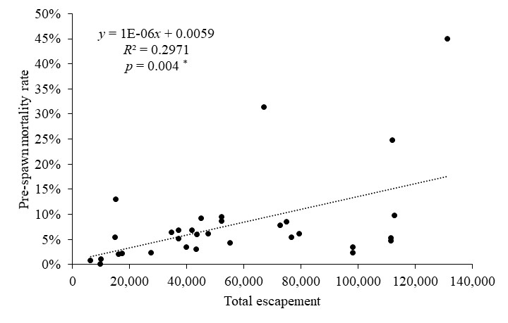
Causal Effects of Pre-spawn Mortality
Pre-spawn mortality rates from female Chinook Salmon carcasses relative to the total escapement of Chinook Salmon in the Trinity River from 1988 to 2017

Slide 19
Redd Superimposition
Distance between redds and their nearest neighboring redd in the mainstem Trinity River, 2009–2016. The blue dotted line represents a distance of 3.4 m between redds, which is the estimated distance at which redds begin to overlap. The red dotted line represents a distance of 1.7 m between redds, which is the estimated distance at which egg pockets become superimposed.

Slide 20
Redd Superimposition
Relationships between redd numbers and undisturbed redds and undisturbed pits
Reach 1
Restoration Reach downstream of Reach 1
Downstream of the Restoration Reach
from 2009 to 2016.

Slide 21
Redd Dewatering
Spatial and temporal distribution of dewatered redds in the Trinity River, 2013–2016
67 dewatered redds (0.3%-1.1% of total redds annually)
  32 after flows dropped following emergency high flow releases from Lewiston Dam
  35 following annual flow reduction from summer (450 cfs) to winter base flows (300 cfs)
  46 with partially exposed mound
  19 with fully exposed mound
  2 with fully exposed pit

Slide 22
Distribution of redds in channel rehabilitation areas compared to unrestored areas within the restoration reach
Reach scale: Proportion of redds in rehab sites compared to unrestored areas
  No change: Lewiston, Limekiln, Junction City, North Fork
  Increase: Douglas City
Site scale
  Redd proportions increased at 5 of 20 sites between pre- and post-construction periods (Sven Olbertson, Indian Creek, Lorenz, Upper Junction City, Wheel Gulch)
Annual percentage of Chinook Salmon redds in rehab areas within the restoration reach of the Trinity River from 2002 to 2017

Slide 23
5. Discussion and Next Steps
5.1 Escapement
5.2 Spawning
5.3 Revisiting IAP Objectives and Progress
5.4 Recommendations

Slide 24
Recommendations
Natural-origin escapement targets for adult salmonids should be re-evaluated
Clarification of the intent of hatchery escapement targets
Determine effect of ocean conditions on adult returns
Evaluate holding habitat
Increase the quality and availability of spawning habitat area
Achieve temperature objectives for adult salmonids and further evaluation of temperature targets
Internal and external review to identify efficiencies in the adult salmon monitoring and redd and carcass survey design

Slide 25
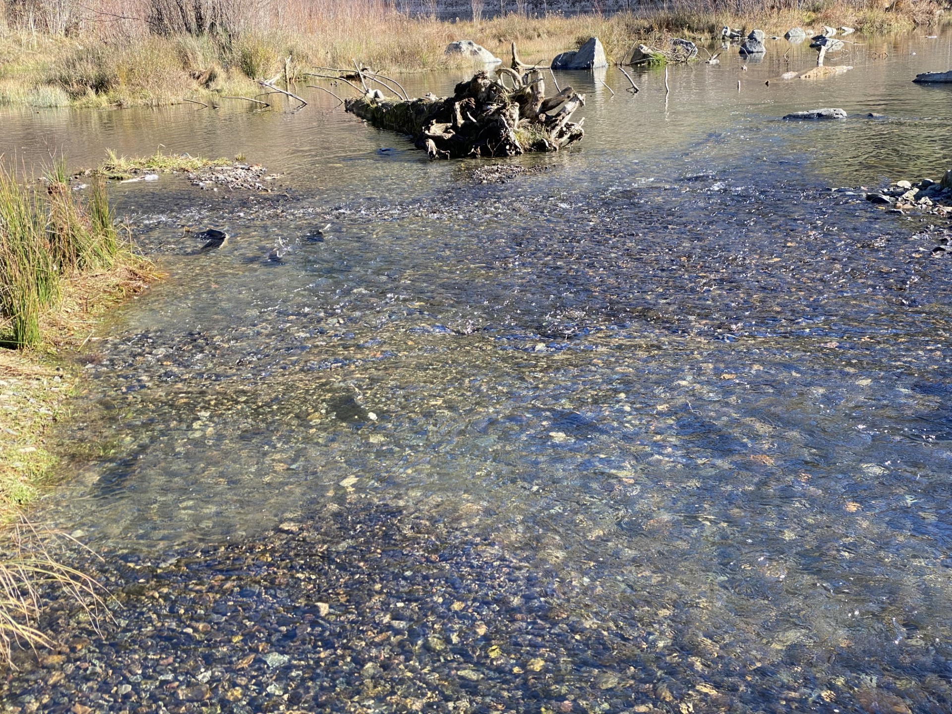
Photo by M. Bradford, CDFW

