Slide 1

TRRP Refinements – Science Plan Approval
Trinity Management Council (TMC) Quarterly Meeting
March 29, 2023
Weaverville, CA
Refinements Team:
Chadwin Smith, Ph.D. (Headwaters Corporation) – Refinements Coordinator
Darcy Pickard (ESSA, Pickard Environmental Consulting) – Co-Facilitator

Slide 2
TRRP Refinements Phase 1
Timing – June 2017 through September 2019; initiated after Tribes ask for review, idea of “Joint Directorate”
Purpose – review goals and mandates of the Trinity River Flow Evaluation Study (TRFE) and Record of Decision (ROD), identify refinements to TRRP management and functions that will better serve those goals and mandates, and assist the Department of the Interior (DOI) in implementing the refinements.
Process – TRRP document(18) review; electronic (56) & in-person interviews (31); application of Adaptive Management Program Evaluation Framework (AMPEF)
Recommendations:
  Cooperative Agreement – high-level support to negotiate a new way forward (structure & function)
  Program Document – single foundational document; purpose, goals, decision-making, budgeting, etc.
  Adaptive Management Plan – negotiated, agreed-upon plan for Program science (became Science Plan)

Slide 3
TRRP Refinements Phase 2
Timing – May 2020 through May 2023
Purpose – facilitate work with the TMC to develop a Program Document (PD) that addresses key attributes of TRRP organizational structure and function, and a Science Plan (SP) that provides a focused roadmap for adaptive management (AM) and other TRRP science learning activities.
Collaboration/Trust Building – small TMC-appointed work groups (the Program Document Drafting Committee and the Science Plan Drafting Committee) with regular check-ins with the full TMC and the public; dozens of meetings (virtual).
Consensus – intent was to get TMC consensus on the PD and SP then present those documents to the Regional Directors for Reclamation and the Service for review, discussion, and concurrence.
Implement – TMC begin implementation of the PD and SP in 2023 as a new way forward.

Slide 4
TRRP Refinements Phase 2 – Program Document
Boundaries:
ROD is the “box” the Program can play in – limited options for management actions and change
Keep overall major structural components
Warned that TRRP/TMC “cannot refine itself”
Outcomes = PROGRESS!
Program Purpose and Goals – form, function, fish, harvest; agreed to by TMC in late 2019/early 2020
Implementation Priorities – ROD management actions
Science Priorities – Key Uncertainties, Core Activities, Path Forward (synced with Science Plan)
Organizational Structure and Process Guidance – slightly revised org. chart, TMC bylaws, IDT charter, SAB charter, TSAC charter
Budgeting Guidance – “Conflict of Interest”

Slide 5
TRRP Refinements Phase 2 – Key Outstanding Issues
SP provides strong forward direction, but:
A few outstanding issues related to the PD and overall function of the TRRP/TMC, which directly relate to the Program’s ability to successfully implement the SP:
  Role of the TMC
  TMC bylaw changes – on tomorrow’s agenda!
  Conflict of Interest
  TRRP Stakeholder Advisory Committee (TSAC)
  Science Advisory Board (SAB)

Slide 6
TRRP Refinements Phase 2 – Science Plan
Accomplishments – Process / Outcomes:
Concise and plain language summary
Builds on and leverages existing efforts
Collaboratively developed
Consensus within the Science Plan Drafting Committee (SPDC) – Justin Alvarez, Kyle DeJuilio, Liam Gogan, James Lee, Ken Lindke, Seth Naman, Nick Som
Support from TMC members who provided a review:
  ‘…an honest reflection of what has happened…’
  ‘…really nice work…’
  ‘…delivers a far more streamlined and therefore implementable approach…’
  ‘how impressed I am with the SP… It should go a long ways towards improving AM within the TRRP…’

Slide 7
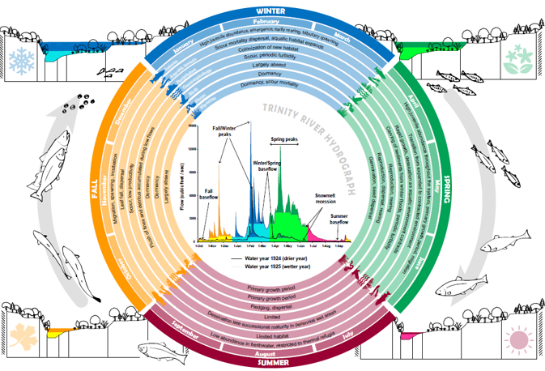
TRRP Refinements Phase 2 – Science Plan
Accomplishments – Looking back:
Explicit documentation of learning to date
Evaluation of central TRFE (1999) central hypotheses
What has worked/not worked
Where perspectives differ → captured as uncertainties
Updated more holistic conceptual model provides focus

Slide 8
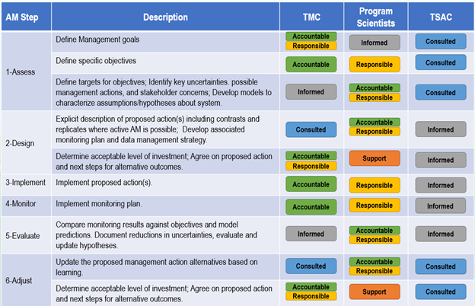
TRRP Refinements Phase 2 – Science Plan
Accomplishments – The Plan:
Trinity specific AM plan
  Improved clarity on roles (RASCI)
  Flows identified as top AM opportunity
Science Priorities – improved focus
  5 Key uncertainties – linked to PD goals
  Core activities - short list of critical monitoring & modeling activities
  Path forward - Six actionable next steps to address Priorities
Information Road Map
  Annual science planning process represents big step forward
  Addresses conflict of interest concerns and role of SAB
  Clarifies roles of scientists and managers, was vetted w/ PDDC

Slide 9
TRRP Refinements Phase 2 – Science Plan
Science Priorities – Key Uncertainties:
Wetted width – Can adjusting site rehabilitation and flow management strategies result in increased rates of wetted width expansion over a range of discharges? [GOAL 1: Form]
Nutrient flux – Can changing management actions result in greater transfer of energy through trophic levels? [GOAL 1: Function]
Temperature regime – Can we manage temperatures to benefit multiple life stages of salmonids while meeting other species needs? [GOAL 1: Function]
Fish production – At what life stage and/or what habitat resource do bottlenecks to production occur? [GOALS 2 & 3: Fish]
ROD effectiveness - Can we achieve the Program goals with the tools and decision space provided by the ROD? [GOAL 1 Form and function; GOALS 2 & 3: Fish]

Slide 10
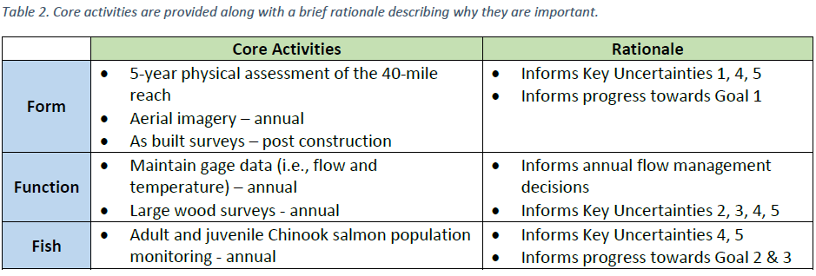
TRRP Refinements Phase 2 – Science Plan
Science Priorities – Core Activities:

Slide 11
TRRP Refinements Phase 2 – Science Plan
Science Priorities – Path Forward:
  Implement active AM of flows
  Complete a limiting factors assessment
  Implement the Core Activities
  Complete a review of Phase 2 Channel Rehab sites
  Review of long-term monitoring activities
  Complete a Phase 3 review to determine whether ROD actions are sufficient to achieve goals

Slide 12
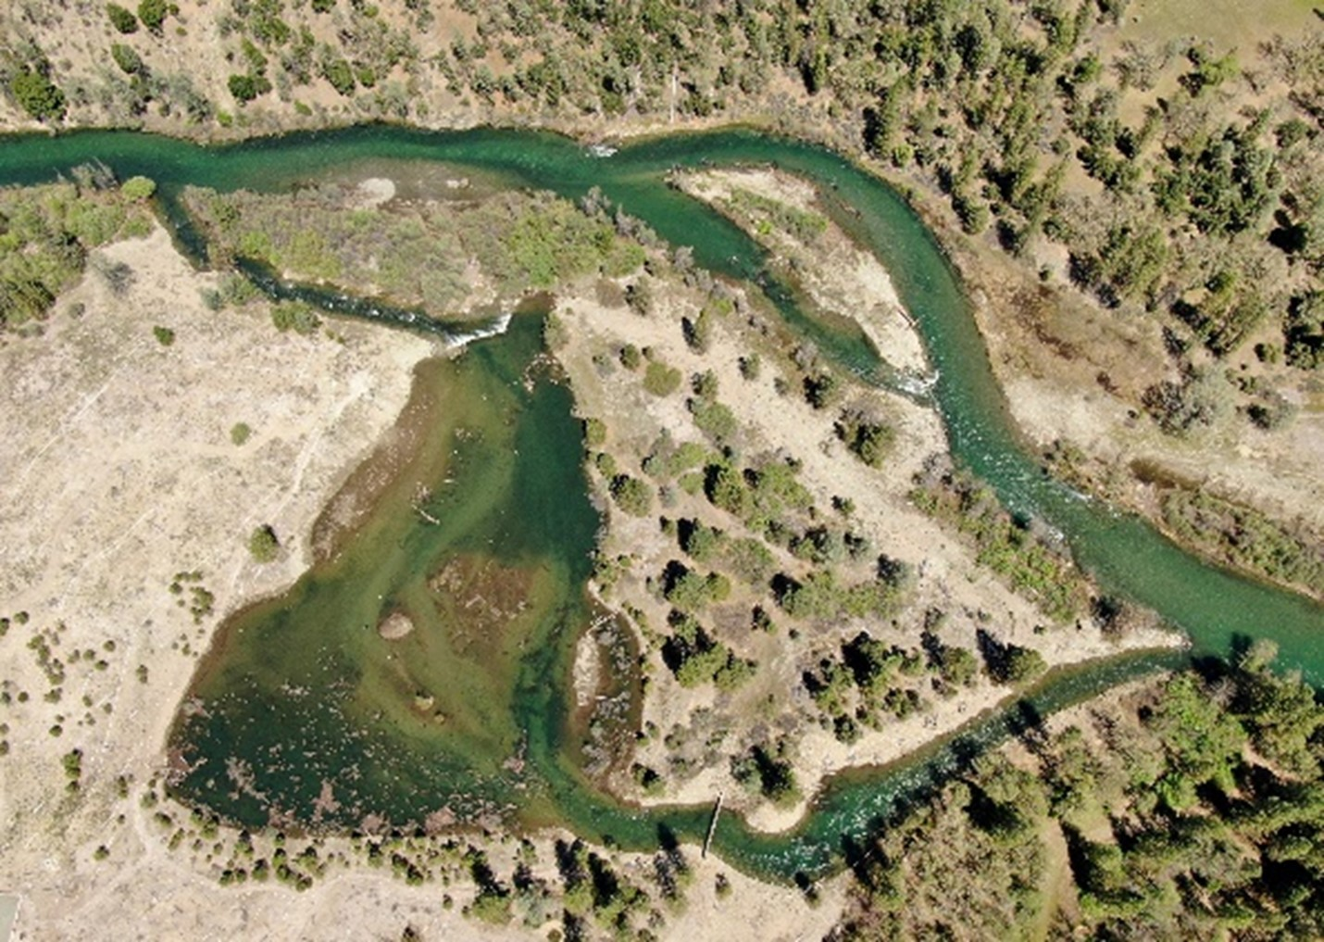

TRRP Refinements Phase 2 – Science Plan
Comments from Science Plan Drafting Committee (SPDC) members
Recommendation from IDT

Slide 13

IDT/Science Coordinator Recommendation
James Lee, Science Coordinator
27 March 2023

Slide 14
TMC approval of science plan is critical to its implementation
IDT has found it useful and draft plan was used for FY 2022 and FY 2023 science planning
IDT conversations focused on how to update the science plan

Slide 15
Recommendation: The Science Coordinator and Interdisciplinary Team recommend that the TMC adopts the Science Plan portion of the Program Document, and uses it to guide our science process

