Slide 1

FY 2023 Science Update
James Lee- Science Coordinator
Trinity Management Council
Winter Quarterly Meeting
December 7-8, 2022

Slide 2
FY 2023 Science topics
Summer 2022- IDT members generated a list of topics that were based on uncertainties discussed in Science Plan
Topics were ranked by the IDT, and Investigation Plans solicited based on these topics with the intent to fund IPs based on the corresponding topic’s rank
TMC-approved science budget was $500,000

Slide 3
Key Uncertainties
1) Wetted width – Can adjusting site rehabilitation and flow management strategies result in increased rates of wetted width expansion over a range of discharges?
2) Nutrient flux – Can changing management actions result in greater transfer of energy through trophic levels?
3) Temperature regime – Can we manage temperatures to benefit multiple life stages of salmonids while meeting other species needs?
4) Fish production – At what life stage and/or what habitat resource do bottlenecks to production occur?
5) ROD effectiveness - Can we achieve the Program Goals with the tools and decision space provided by the ROD?

Slide 4
Topics derived from uncertainties
How does hydrology, especially as it influences scour and inundation, affect the foodscape for juvenile salmonids? (IDT Rank = 3 of 6)
What is Chinook salmon survival from egg to smolt, and/or from smolt to age-2 in ocean? (IDT Rank = 4 of 6)
What life stage of Chinook salmon limits population recovery? (IDT Rank = 1 of 6)
What are the lateral and vertical extents of a restored Trinity River valley? (IDT Rank = 5 of 6)
Can selective thermal withdrawals from Lewiston reservoir provide water temperatures prescribed for the Trinity River? Alternatively, if existing infrastructure is insufficient, can an adjustable temperature curtain at the reservoir spillway and/or relocation of the upstream curtain provide the additional control for targets to be met? (IDT Rank = 2 of 6)
What is the trajectory of evolution of channel rehabilitation sites relative to the physical processes that form and maintain a dynamic alluvial channel? (IDT Rank = 6 of 6)

Slide 5
Four Investigation Plans Received
“Fall Chinook Redd Environmental Condition and Egg Survival to Emergence in Reach 1 of the Trinity River” HVT, YT, CDFW
“Empirical and modeling investigation of water management in Lewiston Reservoir for providing temperatures targeted for release to the Trinity River and hatchery” USBR, YT
“Evolution of stream morphology and physical habitat at Trinity River rehabilitation sites, 2016 through 2022” YT
“Modeling hyporheic flows and linking them to macroinvertebrate populations to estimate the foodscape for rearing juvenile salmonids in the Trinity River” USBR, USFWS, YT

Slide 6
SAB reviewed IPs
Investigation Plan | SAB Recommendation | SC Recommendation | Cost
Egg survival | Fund with major revisions | Return reviews to authors, SC to ref review, will recommend to ED for funding after comments are sufficiently addressed | $172,292
Hyporheic flow | Fund with minor revisions | Recommend funding* | $182,778
Lewiston Reservoir temperature study | Fund with minor revisions | Recommend funding* | $87,287
Morphologic change | Fund with minor revisions | Recommend funding* | $45,191
*SC will referee responses to SAB reviews and authorize studies to commence after IPs are revised

Slide 7
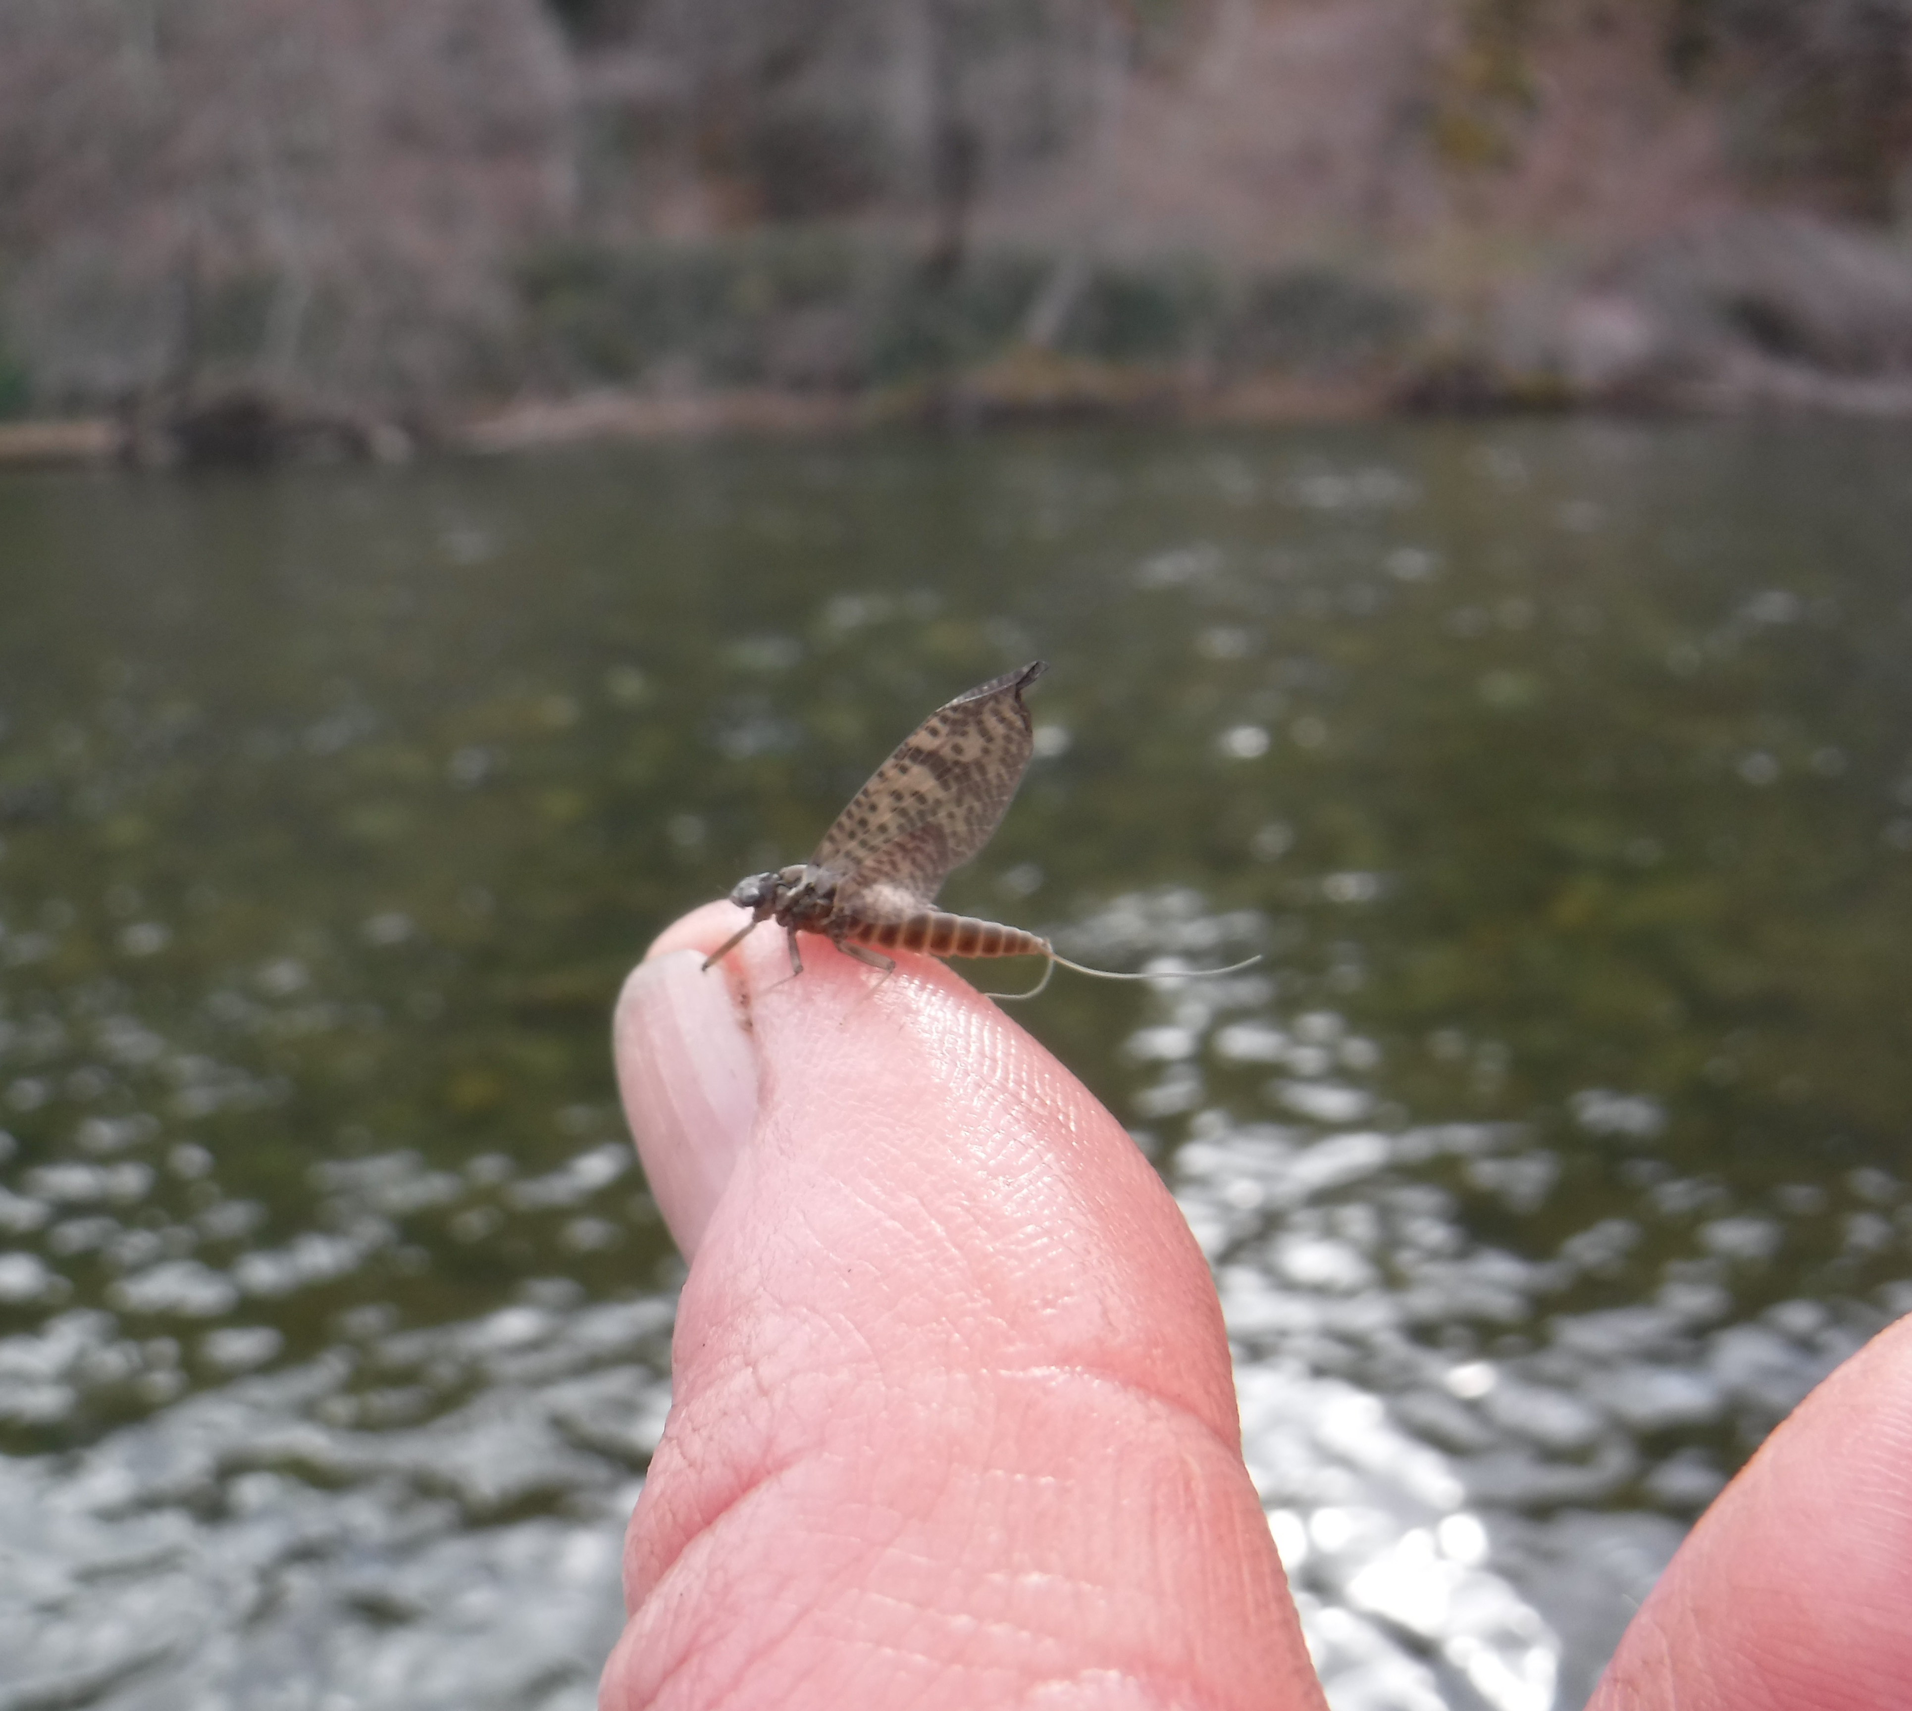
Questions?

Slide 8
Topic | USFWS | BOR | HVT | YT | CA | NOAA | TC | USFS | Average
How does hydrology, especially as it influences scour and inundation, affect the foodscape for juvenile salmonids? | 6 | 3 | 5 | 1 | 1 | 4 |  | 1 | 3.33333
What is Chinook salmon survival from egg to smolt, and/or from smolt to age-2 in ocean? | 3 | 5 | 3 | 3 | 6 | 3 |  | 3 | 3.83333
What life stage of Chinook salmon limits population recovery? | 1 | 2 | 1 | 5 | 2 | 2 |  | 5 | 2.16667
What are the lateral and vertical extents of a restored Trinity River valley? Product: Develop a next step towards a river corridor management strategy that delineates the lateral and vertical extents of the potentially restored river valley. Follow the blueprint outlined in Paul Powers’ paper that uses the geomorphic grade line design method. Will incorporate anthropogenic constraints such as private property and floodplain developments. Will help guide future restoration efforts as well as evaluate progress towards objectives. | 5 | 6 | 2 | 2 | 4 | 5 |  | 2 | 4
Can selective thermal withdrawals from Lewiston reservoir provide water temperatures prescribed for the Trinity River? Alternatively, if existing infrastructure is insufficient, can an adjustable temperature curtain at the reservoir spillway and/or relocation of the upstream curtain provide the additional control for targets to be met? | 4 | 1 | 4 | 4 | 5 | 1 |  | 4 | 3.16667
What is the trajectory of evolution of channel rehabilitation sites relative to the physical processes that form and maintain a dynamic alluvial channel? | 2 | 4 | 6 | 6 | 3 | 6 |  | 6 | 4.5

