Slide 1

Staffing the Science Advisory Board
James Lee- Science Coordinator
Trinity Management Council
Winter Quarterly Meeting
December 7-8, 2022

Slide 2
What is the SAB and what role do they play in TRRP?
From Program Document:
Science Advisory Board (SAB). The TMC will establish a Science Advisory Board (SAB) comprised of up to five (5) independent scientists representing areas of expertise of significance to the TRRP. All SAB members will be appointed by the TMC. The SAB is advisory to the TMC but will work closely with the Executive Director, Program staff, and the IDT to evaluate implementation of the Science Plan and develop recommendations to and advice for the TMC. SAB composition, selection, and activities will be implemented according to the SAB charter (Appendix C). The selection process for SAB members and day-to-day management of the SAB will be facilitated by the Program’s Science Coordinator or by an independent science review coordinator selected by the TMC.

Slide 3
Current SAB membership
John Buffington (fluvial geomorphology)
Andrew Paul (fish biology)

Slide 4
Who?
Fish biology
Aquatic ecology
Riparian/watershed ecology
Fluvial geomorphology
Hydraulic engineering/hydrology

Slide 5
How?
Appointment procedure (Section II.1 in SAB charter)
  Members will be appointed by the TMC
  Basis- candidates submitted by a Selection Panel selected by the TMC and convened by Science Coordinator
  SC recommends using Core IDT members (agency reps)
  Selection Panel should convene in January to begin a recruitment plan

Slide 6
Recruiting
“Nominations shall be solicited from the TMC, IDT, ED, Program staff, TSAC, and other TRRP entities, as well as other agencies, groups, professional societies, academia, private entities, the National Research Council, and the public.”

Slide 7
Contracting
Federal employees- Interagency agreements (fastest)
Non-federal and non-profit- NOFO (can be done through CGB)
Outside USA or for-profit- contract (longer process with a sole-source justification needed)

Slide 8
Next steps
With TMC concurrence, schedule an IDT meeting in January to:
  Finalize position descriptions
  Produce and distribute postings
  Finalize timeline for recommending new membership to TMC

Slide 9
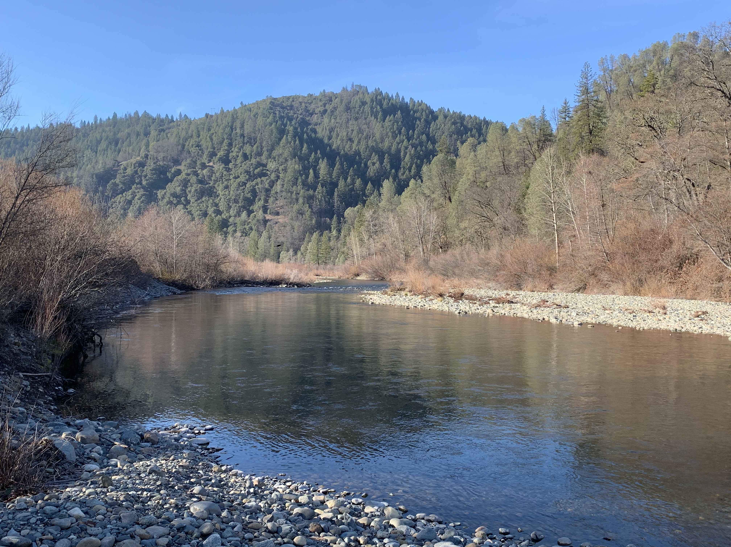
Questions?

