Slide 1

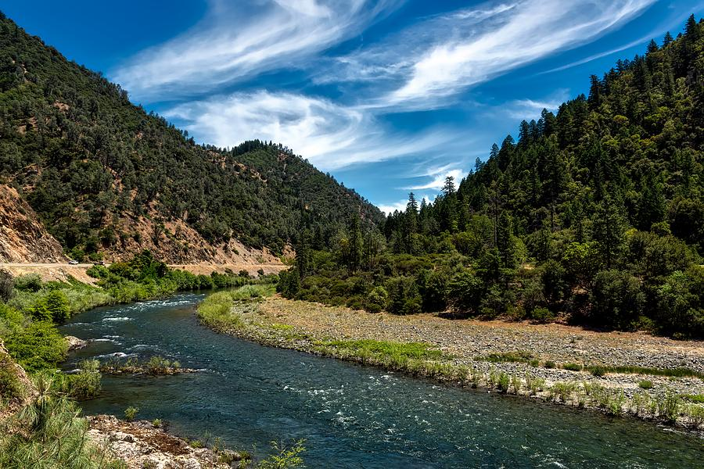

Klamath Basin Salmon Restoration Grantmaking Program – Year One
Femke Freiberg – Program Director, Western Water
July 27, 2022
Orcas in Puget Sound
Trinity River, California

Slide 2
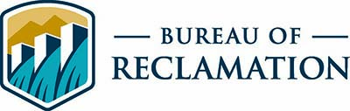
Joint Request for Proposals Overview
Klamath River Coho Program:
Reclamation Klamath Basin Area Office
On-the-ground activities that improve degraded habitat and assist in enhancing natural populations of SONCC coho salmon.
Mainstem Klamath River and tributaries between Iron Gate Dam (IGD) to the Klamath River mouth excluding the Trinity River.
Required by NMFS 2019 BiOp.
Up to $1,409,500 available in 2022.
Trinity River Restoration Program:
Reclamation Northern California Area Office
Actions that reduce fine sediment delivery in degraded watersheds or improve habitat connectivity.
Tributary watersheds of the Trinity River between Lewiston Dam and Weitchpec, including the South Fork Trinity River and its tributaries.
Required by DOI 2000 Record of Decision.
Up to $972,500 available in 2022.
Grant size range: $10,000 - $500,000.
Match encouraged.

Slide 3
FY22 Program Timeline
RFP Launch: February 28th
Applicant Webinar: March 10th
Pre-Proposal Due Date: March 28th (5 pre-proposals received)
Pre-Proposal Review Meeting: April 25th (4 projects invited to full)
Full Proposal Due Date: May 23rd
Full Proposal Review Meeting: June 13th (3 projects recommended for funding)
NFWF BOD Recommendation Submitted: June 22nd
Congressional Notification Submitted: June 27th
Planned Award Announcements: August 1st

Slide 4
Review Committee
Western Water Program Director, NFWF
Science Director, Aquatic Conservation, NFWF
Executive Director, Trinity River Restoration Program, Bureau of Reclamation
Implementation Branch Chief, Trinity River Restoration Program, Bureau of Reclamation
Hydrologist, U.S. Forest Service
Fish and Wildlife Biologist, U.S. Fish and Wildlife Service
Engineer, California Natural Resources Agency, Department of Water Resources
Fisheries Biologist, Yurok Tribe
Habitat Division Lead, Hoopa Tribal Fisheries
Trinity County Supervisor, District 3

Slide 5
Recommended Trinity River Grant Slate
1. Resiliency in the Greater Trinity River Watershed (CA)
Watershed Research and Training Center
Easygrants No. 75213
NFWF Coop. Federal Funds (BOR): | $439,542.39
NFWF Subtotal (Indirect): | $439,542.39 (18.8%)
Matching Funds: | $156,960.00
Total Project: | $596,502.39
Plan and implement four storage tank arrays and establish long-term forbearance agreements to reduce annual water withdrawals from key tributaries to the Trinity River during the summer low-flow period. Project will increase the quality and quantity of natural temporal habitats crucial to the survival of anadromous fishes and aquatic organisms in the Trinity River Watershed.

Slide 6
Recommended Trinity River Grant Slate
2. Oregon Gulch Culvert Replacement Planning Project (CA)
Yurok Tribe
Easygrants No. 75429
NFWF Coop. Federal Funds (BOR): | $104,182.67
NFWF Subtotal (Indirect): | $104,182.67 (16.8%)
Matching Funds: | $0
Total Project: | $104,182.67
The Yurok Tribe will complete 100% design plans and obtain environmental approvals to replace the Oregon Gulch culvert under Sky Ranch Road in Junction City. The Project will open over five miles of suitable salmonid spawning and rearing habitat. The grantee will collect existing conditions data, complete technical modeling and draft design, and complete a design report. The grantee will coordinate with other regulatory and conservation agencies and organizations in the Trinity River Basin including the Trinity County Department of Transportation (TCDOT).

Slide 7
Recommended Trinity River Grant Slate
3. East Branch East Weaver Creek Migration Barrier Removal (CA)
Northwest California Resource Conservation & Development Council
Easygrants No. 75458
NFWF Coop. Federal Funds (BOR): | $265,582.08
NFWF Subtotal (Indirect): | $265,582.08 (5.8%)
Matching Funds: | $107,910.00
Total Project: | $373,492.08
Replace a road crossing with an arch culvert at a USFS campground and community trail system in order to open a migration pathway for anadromous fish. Project will restore access to 1.2 miles of good quality habitat to all life stages of salmonid species.

Slide 8
Total FY22 Investment
Total recommended TRRP funding: $809,307
Total match: $264,870
Total conservation impact: $1,074,177

Slide 9
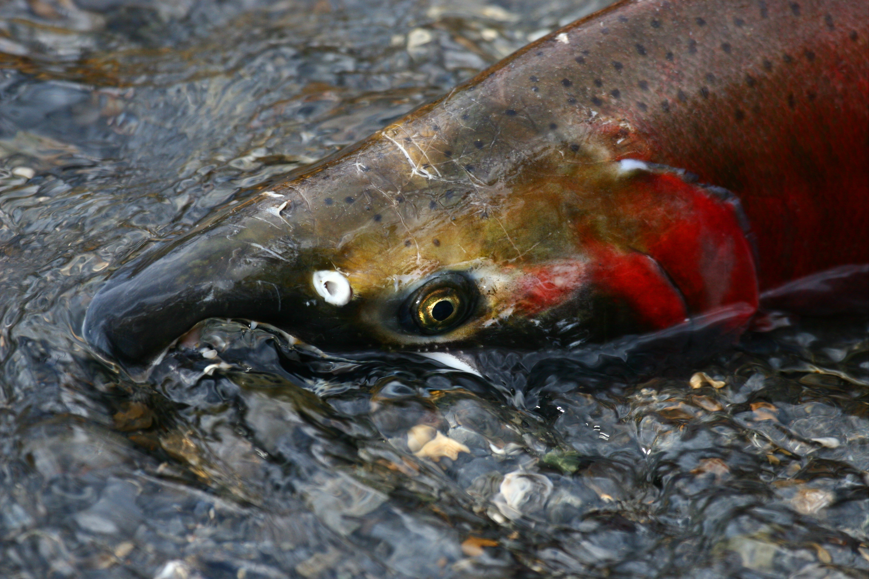
Next Steps
Announce awards week of August 1st
Onboard Hamer Environmental for compliance support
Hold kick-off meetings with grantees
Begin planning next RFP – potential for late Fall launch
Coho salmon

