Slide 1

FY 2023 Science Plan Update
James Lee, Science Coordinator, Trinity River Restoration Program
June 15, 2022

Slide 2

“to restore and maintain the Trinity River's
anadromous fishery resources“
[by]
“rehabilitating the river itself, restoring the attributes that produce a healthy, functioning alluvial river system”

Slide 3
Background-Elements
Science-related activities that will occur, or be funded, in FY 2023
Elements include:
Core Monitoring
  Status and Trend Monitoring
  Other Core
Model updates
Uncertainty-driven Investigations (Flex funding)
Workgroup Activities

Slide 4
Background- Science Plan
A Science Planning Document is currently in final stages and will be completed as part of the refinements project (in FY 2022).
Overlap between Science Plan Drafting Committee and Interdisciplinary Team
Components of Science Plan will be used for FY 2023 planning

Slide 5
Status and Trend Monitoring
Same as FY 2021 and FY 2022 (budgets adjusted for inflation)
  Chinook run-size estimation
  Fall Chinook CWT
  Fall Chinook Scale Ageing
  Outmigrant Monitoring
  Yurok Tribal Harvest Monitoring (Lower Klamath)
  Hoopa Valley Tribal Harvest Monitoring (Lower Trinity)
  Redd and carcass monitoring
Science Plan is expected to recommend a review of these projects

Slide 6
Other Core Monitoring
Aerial imagery collection (in implementation budget)
Stream gaging

Slide 7
Model updates
Hydraulic Model (SRH-2D)
  Funded in FY 2022
Bed surface grain-size map
  Roughness layer for hydraulic model
  Can be used in conjunction with hydraulic model to predict bed entrainment
  SAB comments still need to be incorporated into final investigation plan
RBM-10
  Funded in FY 2022

Slide 8
Uncertainty-driven activities
Projects funded this fiscal year include:
  NREI vs Physical Habitat
  Effects of scour and inundation on aquatic communities
  SRH-2D temperature module validation
2023 RFP for research or modeling needs
  $500k budgeted
  Interim project selection to come from IDT, informed by draft Science Plan priorities and SAB input, and will be a recommendation to TMC at next quarterly meeting

Slide 9
Workgroup Highlights
Design
Watershed
Fish
  Potentially developing SOWs/RFPs for:
    Status and trend project review
    Limiting Factors Analysis
Flow Workgroup
  Hydrograph planning and analysis
  Winter flow variability

Slide 10
Workgroup Highlights (cont)
Physical
  Corridor delineation
  Gravel augmentation
Riparian and Aquatic Ecology
  TBD- likely RFP/SOW development for riparian/aquatic ecology and temperature studies

Slide 11
Workgroup Highlights (cont)
IDT/all
  Objectives and Targets- still need to reduce overlap across disciplines
  Prioritizing uncertainties and developing problem statements
  Implement annual science planning process for FY 2024

Slide 12
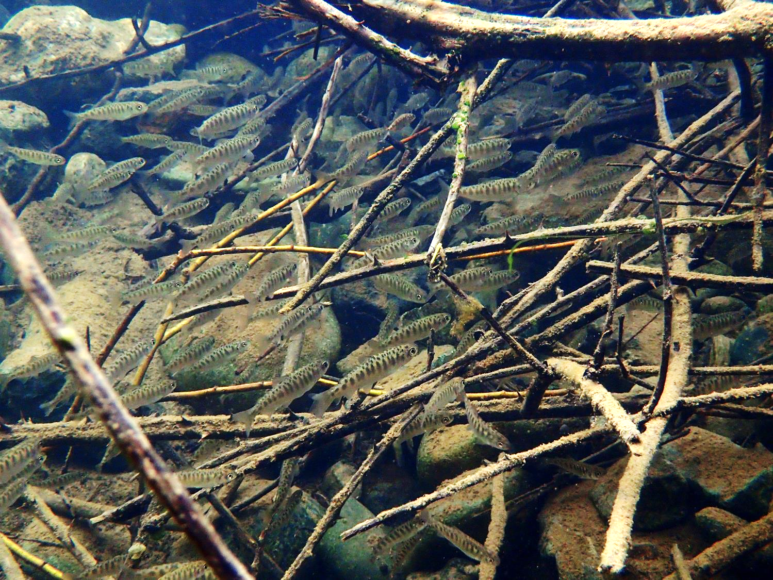
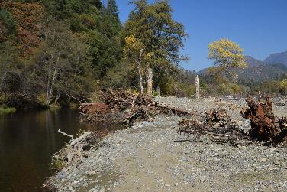
Questions?
Young Chinook
Deep Gulch
(2017 channel restoration project)
Photo by Aaron Martin, Yurok Tribe

Slide 13
Goals:
-Fund science projects as early as possible in the fiscal year
-Minimize conflicts-of-interest
-Maximize efficiency (information gained/cost)
-Utilize external reviewers (SAB) to ensure that both specified IDT priorities can be addressed, and study objectives can be met, by the investigation plans.
-Maintain TRRP partners’ responsibility for setting research priorities and funding projects that address these priorities (i.e., not asking an external entity to make science funding decisions for us).

Slide 14
Roles:
IDT ranks topics/research questions
TMC considers funding the final project list at September quarterly meeting
SAB ensures that specified IDT priorities can be addressed and study objectives can be met by the proposed investigation plans

Slide 15
Each core IDT member proposes 1 research question or topic (May/June)
  Should be based on the key uncertainties identified in the Science Plan
  Number of research questions submitted per IDT member can vary annually depending on anticipated funding
  Example from FY 2018 solicitation: “Determine flow rates on river and tributaries. Data to be used for assessments on flow accretion, flood frequency, sediment transport, temperature, habitat, modeling, climate change, watershed impacts, and others”
IDT refines and prioritizes these topics in a ranked list (June)
  Topics will be scored according to their benefit to adaptive management decision-making, including relevance to key uncertainties and decision support.
  Core members provide rankings to IDT coordinators who then compile them into a composite ranking.
TRRP Science Coordinator creates a solicitation package based on these questions. (June)
  Format would be similar to FY 2018 Solicitation Package
  Includes specific instructions to authors for the content and submittal of proposed investigation plans.
(step 4 from pathway 1 is omitted) Solicitation package is sent out to partners (June)
Proposed investigation plans are received by IDT in August and reviewed for completeness.
  This also provides an opportunity for TRRP Science Coordinator and Executive Director to work with PIs to maximize the use of anticipated funds
Proposed Investigation Plans are submitted to SAB for review. SAB recommends: fund, fund with revisions, or do not fund. In the unlikely situation where multiple proposed investigation plans are submitted for the same research topic, the SAB would recommend the best fit.
A request to fund projects is submitted to TMC at the September TMC meeting based on the initial IDT ranking of topics and the SAB reviews
  Projects are funded according to their ranks until allocated funds are used
  Projects that are conditionally approved by SAB are not funded until they are revised and SAB concurs with revisions

