Slide 1
Klamath basin Sport fishing regulations for 2022
Fall Chinook –process and outcomes
Spring Chinook-Limited fishery
Steelhead/ Brown trout- no changes
Coho- New “harvest control rule”

Slide 2
Fall Chinook- Recreational
Fishing allocation and regulations
Fall Chinook adult harvest allocations to tribal and non-tribal fisheries are decided annually by the Pacific Fishery Management Council (PFMC) and are based on projected abundance, conservation goals and Klamath River fall Chinook stock harvest control rules
2021 fall Chinook returns, by age, are used to forecast ocean abundance for 2022. Estimates are derived from “sibling regressions” i.e. age 2 in-river returns used to predict age 3 ocean abundance, in-river 3 predict ocean age 4, etc.
PFMC models data, applies constraints (ESA, conservation standards, sharing agreements, etc), determines harvestable surplus, models ocean fishery alternatives using the Klamath Ocean Harvest Model (KOHM) and ultimately selects a preferred alternative that results in a) ocean fishing seasons and in-river allocations (tribal and non-tribal).

Slide 3
Age Composition of the 2021 Klamath Basin fall Chinook Salmon run
Source: 2022 KRTT
Notes:
More detailed look at numbers behind the pictures we just looked at. Age-structured escapement, harvest, and hatchery returns separate adults into ages 3-5.
Table represents a transition from This year’s returns to next year’s projections.
These data are used to predict ocean abundance by age and provides the starting point for modeling regulatory prescriptions and harvest allocations to the various user groups.
Explain percentages in two right-most columns.
Note natural area spawners. As mentioned, this is the sector that determines conservation status for the stock.
Note the age-specific total river run values at bottom. These are used to predict ocean abundance.

Slide 4
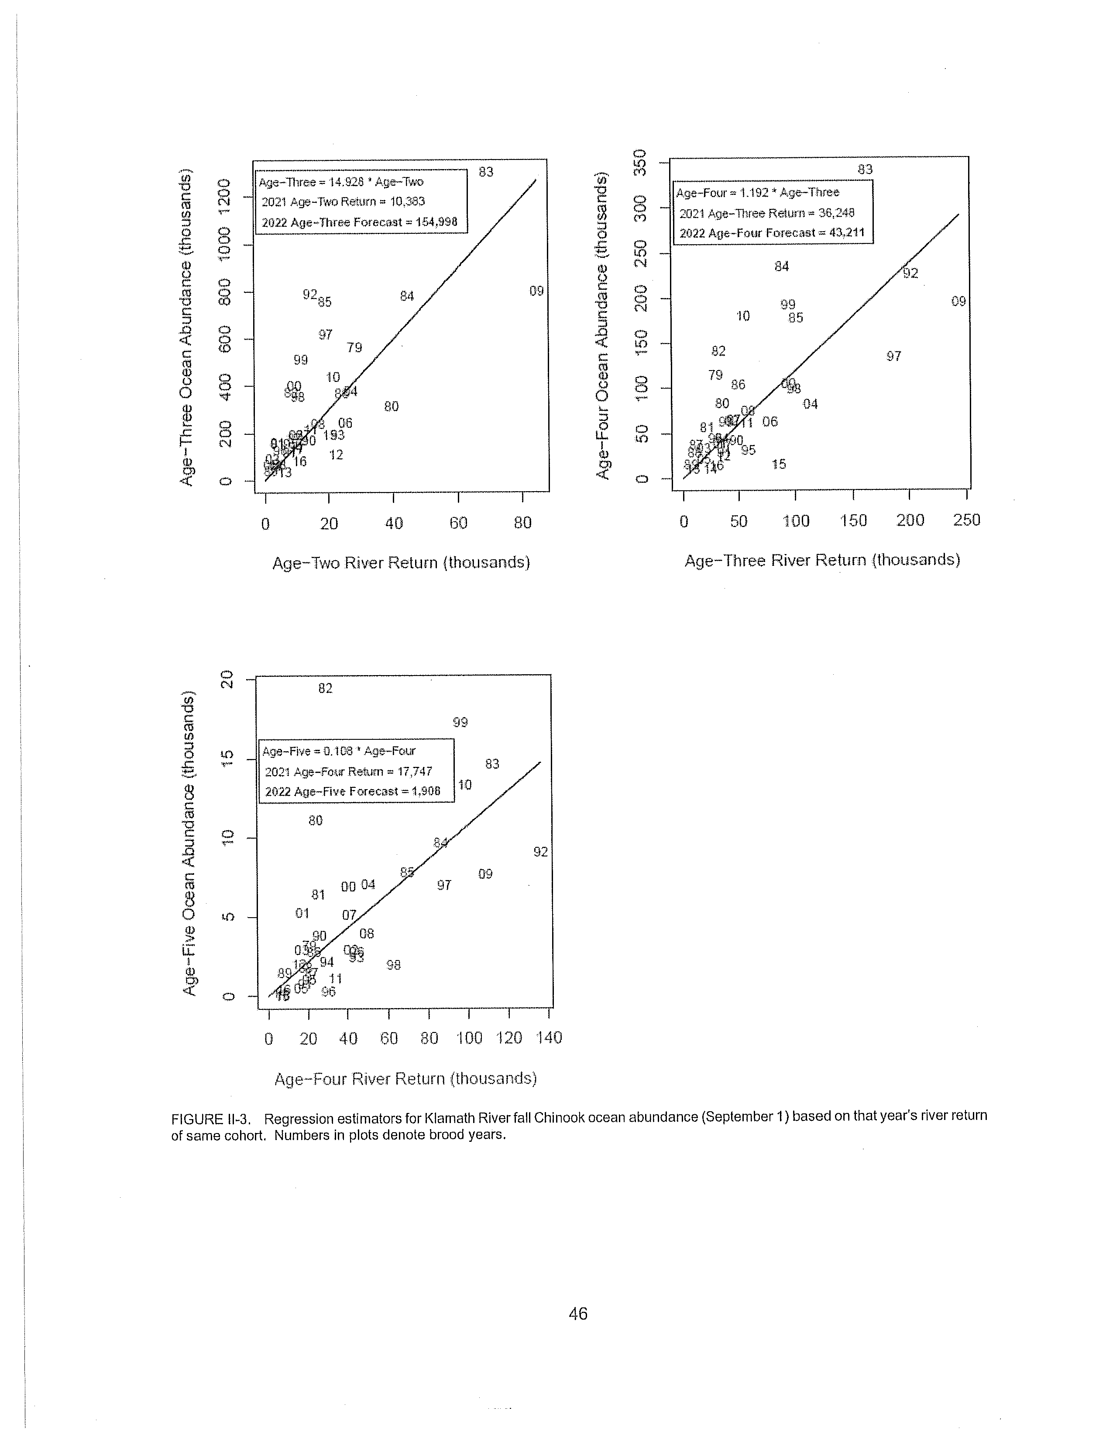
2021 In-River returns and ocean stock projection (Sept. 1 2021)
in-river ocean abundance
Age 2 - 10,384 Age 3 - 154,998
Age 3 - 36,248 Age 4 - 43,211
Age 4 – 17,747 Age 5 – 1,908
Total age 3-5 Ocean abundance 200,117
Actual river returns are dependent on maturation rates, natural mortality rates (fixed in the models), out-of basin stray rates, ocean harvest rates.
Based on the above, the forecast of natural area spawning adults, absent fisheries, is 50,906. Appling the harvest control rule for Klamath stocks results in a 25% max exploitation rate and a predicted natural area escapement of 38,180 adults after fisheries.

Slide 5
Fall Chinook- Recreational
Fishing allocation and regulations
2022 Fall Chinook Salmon management and regulations
Ocean fishery - CA Klamath Management Zone (CAKMZ)
Open May 1 -31 and Aug 1 – September 5, 2 fish per day> 20 inches. No commercial fishery in the KMZ this year.
Klamath Basin In-river Adult Allocations (Quotas)
Tribal allocation – 9,434 adults (50% of harvestable surplus)
Recreational allocation – 2,119 Adults
Allocation split between 4 sub-quota areas; lower and Upper Klamath river, lower and upper Trinity River. Trinity River receives 33% (699) of the total allocation of adult (>23 inches) fall Chinook, split between the two sub-quota areas.
Daily bag limit of 2 fish, no more than 1 adult, Possession limit of 6 fish no more than 3 adults

Slide 6
Spring Chinook- Recreational Fishing Regulations
Upper Klamath-Trinity River (UKTR) Spring Chinook salmon were listed as threatened under CESA by the Fish and Game Commission in June of 2021. Commission has authority to allow limited sportfishing on listed species (F&G code 2084).
Commission approved the following season, bag and possession limits for Spring Chinook Salmon:
Trinity River- Season of July 1 through August 31, upstream of the confluence of the South Fork Trinity River to Old Lewiston Bridge. Daily bag of 1 fish any size, Possession limit of 2 fish any size.
Klamath River- Season of July 1 though August 14, downstream of Weitchpec. Daily bag of 1 fish any size, possession limit of 2 fish any size.
No Chinook sport fisheries in the basin from Jan. 1 through June 30.

Slide 7
Steelhead/
brown trout Recreational Fishing Regulations
Regulations have remained consistent from the recent past.
Steelhead- Open all year on the main stem Trinity and Klamath Rivers with some tributary opportunities (Bogus Creek, New River, South Fork Trinity River, Scott, Salmon and Shasta rivers) during prescribed time periods.
Steelhead bag and possession limit- 2 hatchery fish per day (ad-clpped), 4 in possession.
Brown trout- Open all year on the Trinity River.
Brown trout bag and possession limit- 10 brown trout per day, 20 in possession.

Slide 8
Coho Salmon are both state and federally listed as threatened under CESA and ESA. No current directed take (harvest) is currently allowed in California sport or commercial fisheries.
The Pacific Fisheries Management Council (PFMC) convened an ad hoc committee of state, federal and tribal entities to review the current “harvest control rule” and perform a risk assessment to guide future management of marine and in-river fisheries.
The ad hoc team produced a report with their findings and recommendations entitled:
Pacific Fishery Management Council
Southern Oregon/Northern California Coast
Coho Salmon:
Fishery Harvest Control Rule
Risk Assessment
October 2021
Coho Salmon Recreational Fishing Regulations

Slide 9
Coho Salmon Recreational Fishing Regulations
The results/recommendations from the report were incorporated into a new SONCC coho salmon harvest control rule (HCR) promulgated by the PFMC. NMFS shortly thereafter wrote a biological opinion for the new rule.
Key facts
The old HCR was applied to marine fisheries only for incidental impacts and directed harvest (Oregon only) and was set at max exploitation rate of 13%.
The new rule applies to both marine and in-river fisheries and the max exploitation rate is set at 15% for all SONCC coho populations, with the exception of the Trinity River population, which has a cap of 16%.
The new HCR will result in further constraints to ocean Chinook fisheries in some years, particularly in the Klamath Management Zone.

