Slide 1
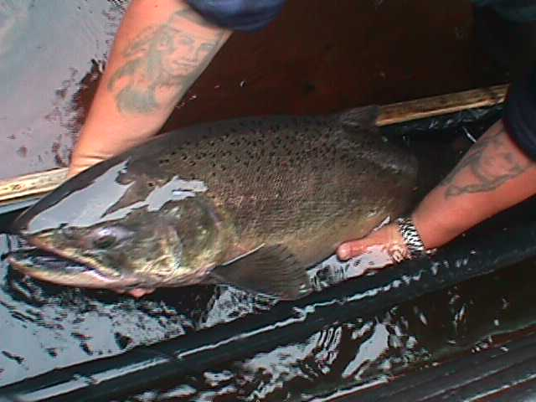
UKTR Spring Chinook Salmon Listing/Management Update
Presenter- Wade Sinnen, CDFW
6/15/2022 TMC Meeting

Slide 2
UKTR Spring Chinook Salmon Listing
Listing process and timeline
July, 2018 – Petition submitted by Karuk Tribe and Salmon River Restoration Council (triggered CDFW review for petition evaluation, found to have merit).
Feb, 2019 – Commission determined listing may be warranted (Spring Chinook candidacy conferred). Finding by commission triggered status review by CDFW.
March 2021 – CDFW submitted status review. Recommended not to list as separate species under ESU definition. Report cited declining spring populations, however Chinook complex relatively robust. Defined spring population as an “ecotype”, that has declined due to loss of habitat (mostly above dams) and other factors.
June 16, 2021 – Commission voted to list UKTR spring Chinook Salmon as threatened under ESA. Ruling cited that Commission does not have to recognize federal ESU designations and can list population segments as warranted. Listed “spring genetic ecotype” (homozygous spring genes).
Dec, 2021 – Jan. 2022 – Commission adopted formal findings, filed rulemaking with Office Of Administrative Law, regulation went into effect January 24, 2022.

Slide 3
UKTR Spring Chinook Salmon Listing
Fisheries management and regulations
Feb 2019 – Candidacy conferred full CESA protection for the species while in status review which triggered emergency regulations and resulted in full closures of all areas where adult Spring Chinook might be encountered.
Jan 2020 - Commission directed the CDFW to conduct constituent out-reach regarding compromise on complete fishing closures on Spring Chinook since the closures would also affect fall Chinook fishing opportunities.
Spring 2020 - New emergency regulations (cert of compliance) were adopted by the Commission as a result of public outreach. Fishing for spring Chinook allowed July 1 – August 14 below Weitchpec on the Klamath and July 1 – Aug 31 above the South Fork Trinity River on the mainstem Trinity River. Fall Chinook regulations start immediately following Spring Chinook Closures.

Slide 4
UKTR Spring Chinook Salmon Listing
Regulatory management- permitting
Beginning January 24, 2022, projects within UKTR Chinook Salmon habitat may need a California Endangered Species ACT (CESA) Incidental Take Permit (ITP) coverage (Fish & G. Code § 2081, subd. (b); Cal. Code Regs., tit. 14, §§ 783.2-783.8).
An Incidental Take Permit (ITP) requires species-specific avoidance, minimization, and full mitigation consistent with CESA for project related impacts.
The Department has implemented a “Cutting The Green Tape” initiative for restoration projects that significantly reduces cost, time and permitting requirements. @https://wildlife.ca.gov/Conservation/Watersheds/Cutting-Green-Tape
CDFW is crafting an internal regulatory document that focuses on geographical extent, time and area avoidance and minimization/mitigation measures to comply with CESA.
CDFW also will need to consider research projects and how to permit. Currently, research is permitted through our Scientific Collection Permitting process. May require an additional CESA MOU for the take of UKTR Spring Chinook.

Slide 5
Draft Staff Considerations for Conservation of the Upper Klamath Trinity Chinook Spring Chinook
(Oncorhynchus tshawystscha)
Avoidance and Minimization Considerations
Avoidance considerations
Is there UKTR Spring Chinook Salmon habitat within or adjacent to the project site?
Have UKTR Spring Chinook Salmon been documented within or adjacent to the project site?
Are there UKTR Spring Chinook Salmon present at the project site, in any life stage?
Can the project proponent use seasonal work windows to avoid take?
Minimization Considerations
Can seasonal restrictions be used to minimize impacts?
Can UKTR Spring Chinook Salmon be excluded from the project area? (needs take coverage)
Can UKTR Spring Chinook Salmon be relocated outside of the project area? (needs take coverage)
​
​

