Slide 1

Trinity River Winter Flow Variability
DOI – Bureau of Reclamation
Trinity River Restoration Program
Presented by:
Chad Abel, USBR
Seth Naman, NMFS
Kyle de Juilio, Yurok Tribe
Ken Lindke, CDFW
Notes:
Ask audience to please note slide numbers for follow-up questions.
Ask audience to get a copy of the decision tree from the EA handy if they want to follow along during examples later.

Slide 2
The Flow Study and ROD explicitly recommended investigating winter variable flows through adaptive management
“No high-flow releases are planned, but synchronization of peak releases with stormflows should be evaluated through the adaptive management program to assess opportunities to maximize benefits of high-flow releases while conserving water” (TRFES 1999)
“Based on subsequent monitoring and studies guided by the TMC, the schedule for releasing water on a daily basis, according to that year’s hydrology, may be adjusted but the annual flow volumes established in Table 1 may not be changed” (2000 ROD)

Slide 3

TRRP DSS Exercise-Chinook salmon production
 | Natural | ROD | Difference (Natural – ROD) | Difference (%)
N - tot (millions) | 5.0 | 5.0 | 0.0 | 0.8
N - Fry (millions) | 3.8 | 4.2 | -0.4 | -8.0
N - Parr (millions) | 1.2 | 0.8 | 0.4 | 46.6
Fry - FL (mm) | 34.0 | 33.0 | 1.0 | 3.0
Parr - FL (mm) | 83.0 | 76.0 | 7.0 | 9.2
Fry - Mass (g) | 0.4 | 0.4 | 0.0 | 0.0
Parr - Mass (g) | 5.9 | 4.6 | 1.3 | 28.3
Fry - BioMass (Metric ton) | 2.5 | 2.2 | 0.3 | 12.3
Parr - BioMass (Metric ton) | 4.9 | 3.3 | 1.6 | 48.1
Source: Perry et al 2016
Notes:
Note the third row where the NUMBER of parr was estimated to increase 46.6%
In addition to greater abundance, estimated 28% increase in estimated mass of individual parr
Both of these result in substantial increases in estimated total biomass of emigrating juvenile Chinook

Slide 4
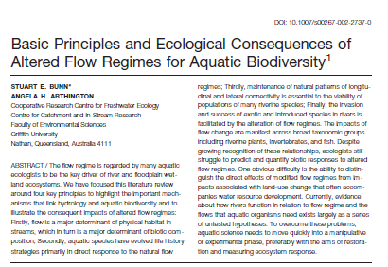
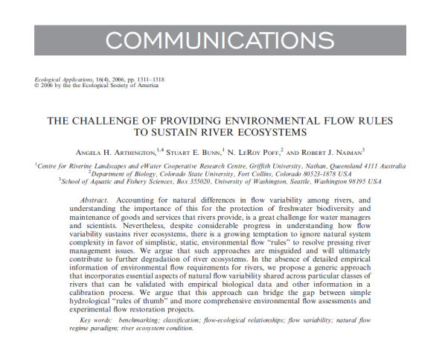
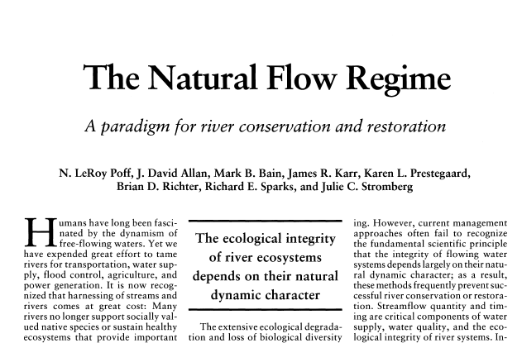
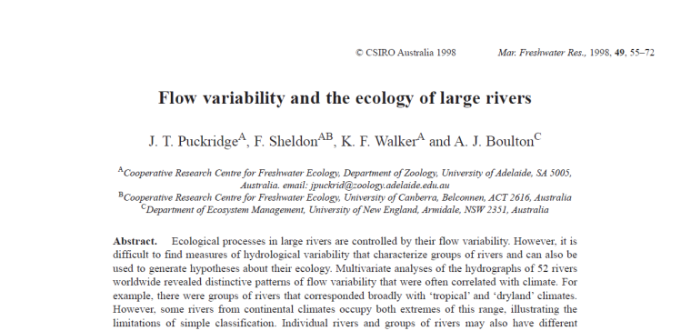
“Simplistic, static, environmental flow rules are misguided and will ultimately contribute to further degradation of river ecosystems”-Arthington et al 2006
Notes:
The main point here is that there have been numerous studies published in peer-reviewed scientific journals since 2000 that support moving toward a more natural flow regime

Slide 6
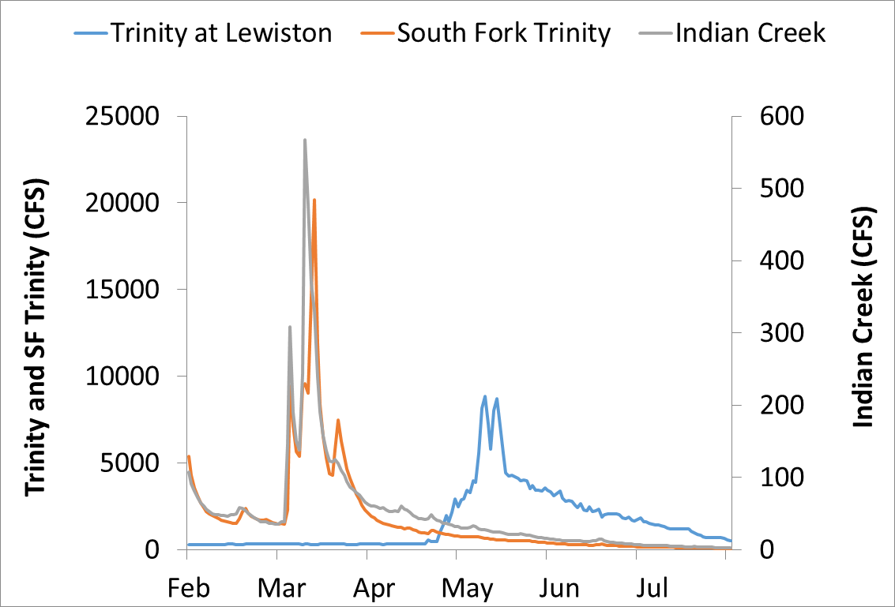
Too flat in winter, and too cold in spring
Discharge (cfs) | Change in Predicted 40-Mile Habitat Capacity | Habitat Units with Predicted Capacity Increases
300 | 0 | 0
500 | 3% | 58%
700 | 7% | 61%
900 | 10% | 66%
1100 | 14% | 72%
1300 | 19% | 78%
1500 | 25% | 81%

Slide 7
The Flow Problem
What we can’t change
Annual water volume
Release temp
What we can change
Timing of release
Magnitude of release

Slide 8
Objectives
Increase growth of salmon fry and parr
Synchronize flows of the regulated mainstem with its free-flowing tributaries
Provide thermal cues for smoltification and downstream migration earlier in the year
Increase nursery habitat availability for juvenile salmon
Provide seasonally appropriate disturbance of the macroinvertebrate prey species for rearing salmonids
Reduce effects of temperature suppression on growth of rearing salmonids

Slide 9
FAQs
How can we guarantee that we will not overspend ROD volumes if we release water prior to the water year determination?
Will summer or winter baseflows be affected, and what affect will there be on adult temperature targets under water order 90-5?
How can we accomplish ROD objectives with less water after April?
  more efficient use of water with shorter peaks and shorter recessions supported by science (e.g., hysteresis and cottonwood root growth), consistent with AM mandated by ROD
How will the summer cold-water pool in Trinity reservoir be affected?
Why do geomorphic work in CD/D years?
  these happen in historic record, so is consistent with natural conditions.
Notes:
- Water order 90-5 does not include 60F DG target
- Why geomorphic in CD/D? There are two ways to increase BMI food availability for juvenile salmonids: 1) increase duration of inundation of additional habitat (e.g., floodplains), or 2) bed disturbance events that make food available in the drift and reset succession to provide more vulnerable food resources. Sustained inundation is infeasible in CD/D water years because of less water. Bed disturbance is feasible and is observed in the historic record even in CD and D years.

Slide 10
Proposed Action
Flow Synchronization Period (Dec 15 – Feb 15)
Synchronize a 60,000 af, high magnitude dam release with a winter flow event
6,500 cfs maximum flow from Lewiston Dam
Forecasting tools from CNRFC at USGS mainstem gage above North Fork predicts 4,500-12,000 cfs event
72-hour notice to USBR
Elevated Baseflow Period (Feb 15 – April 15)
Two possible releases in Feb and March based on B120 90% exceedance forecast to predict water year type
Volume released based on Decision Tree and winter period allocation of water year type
Notes:
Alternative language for baseflow period:
Elevated releases above 300 cfs starting in mid-February with volumes determined in February and March
Volumes are determined based on the decision tree and B120 90% exceedance forecasts of water year type in February and March

Slide 11
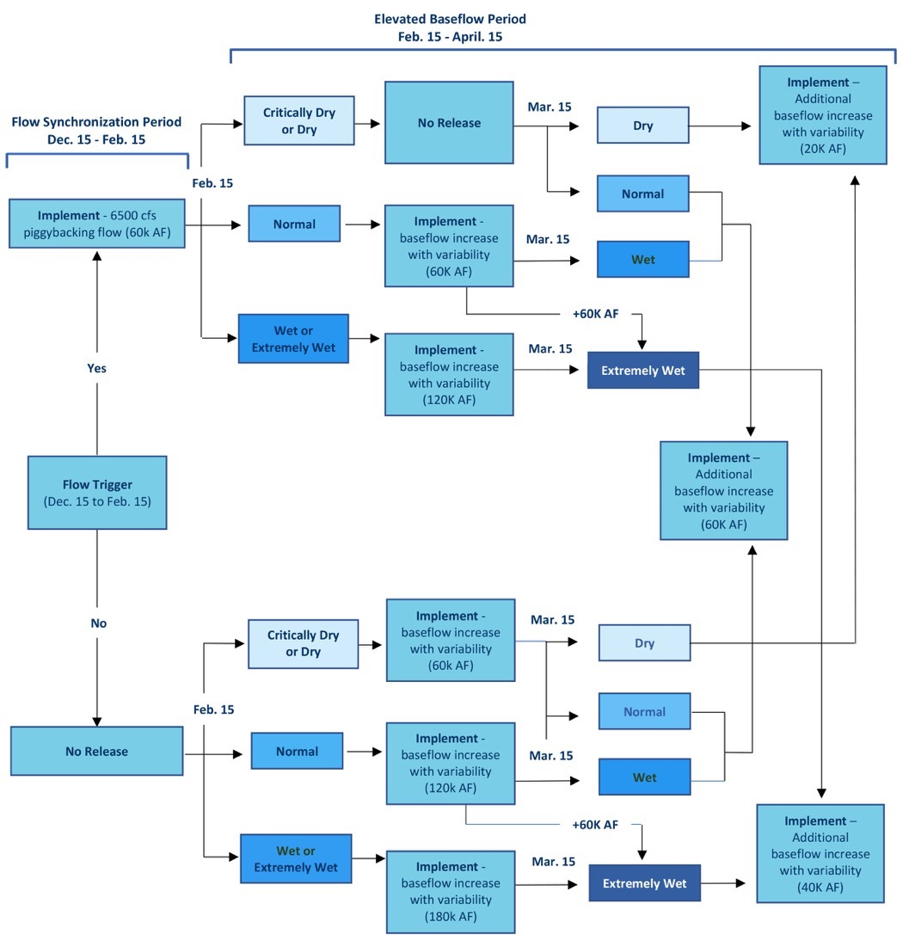

Slide 12
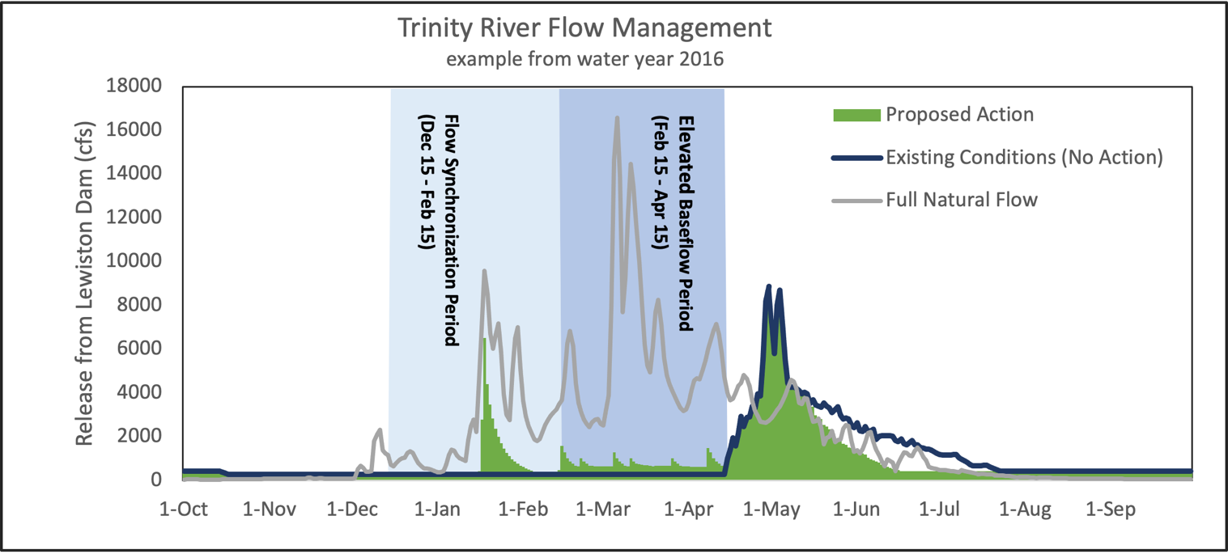
Notes:
Hypothetical example from the EA using data from 2016
Explain components and tell them to remember the theme. Same theme (e.g., solid green proposed, two winter flow periods, blue observed hydrograph) will be used in next few examples
Solid blue line was the actual hydrograph implemented in 2016
Grey line is full natural flow if Lewiston Dam didn’t exist
Two winter variable flow periods: flow synchronization and elevated baseflow
solid green area is a hypothetical example of what flows could have looked like in 2016 if the proposed action was implemented
NOTE:
there was a synchronized flow event in late January. The trigger is not met every year, so this doesn’t occur every year
elevated baseflow begins 15 February and continues until spring restoration flows. Note that the shape is not prescribed in the EA, only volumes. In fact the proposed flow for WY22 is a bit different
water moved to winter was taken out of the spring ramp-down. Geomorphic peaks were kept. In a real-world scenario, actual flows after 15 April would be recommended using the same protocols as now with the remaining ROD volume.

Slide 13
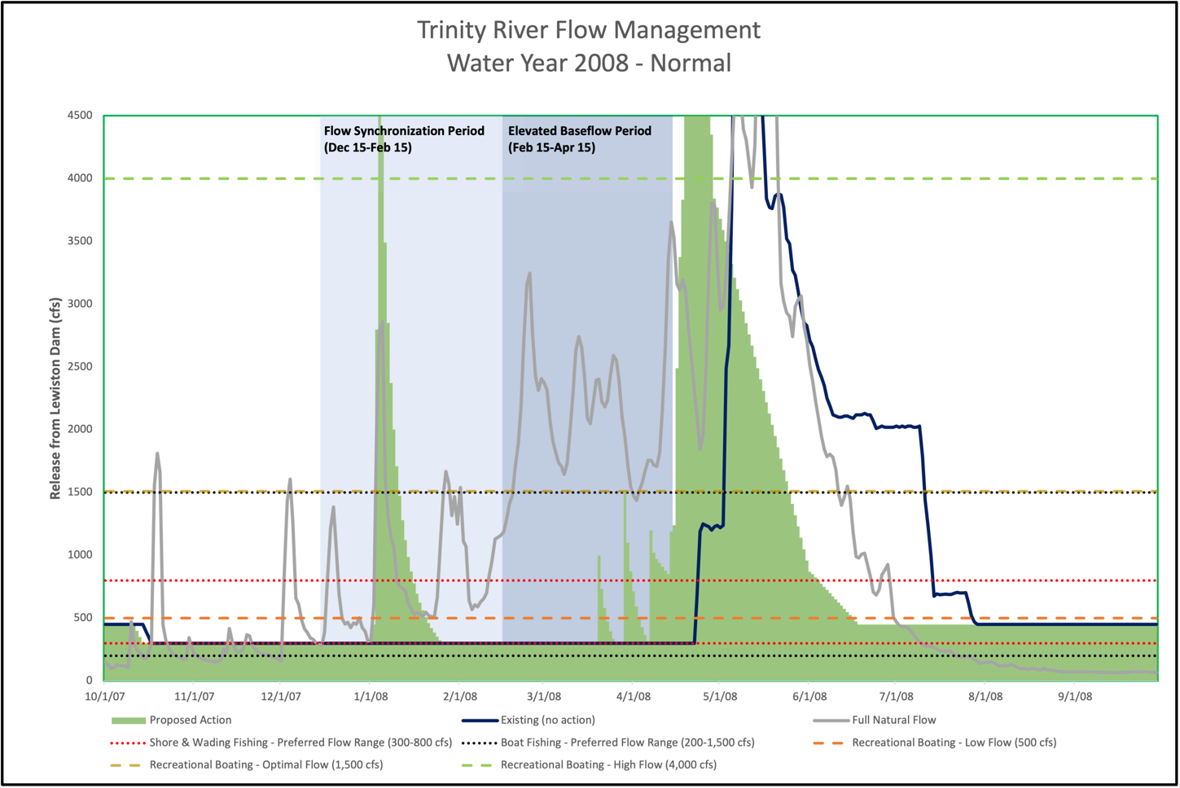
Notes:
The next three slides show hypothetical implementation of the proposed action using real flow data from three Normal water years, each highlighting different aspects of the flow action, and the three combined showing how actual flow schedules for the same water year type can differ depending on synchronizing flow triggers and projected water year types. Encourage everyone to follow along on the decision tree if they have it in front of them.
WY 2008
There was a synchronized flow release, which reduced the amount of water available Feb-Mar by 60k af
The February B120 forecasted a Dry water year and because there was a synchronized release, no additional release above 300 cfs started in Feb.
The March B120 also forecasted a Dry water year, so the decision tree indicates we release 20K af 15 March – 15 April above 300 cfs.
Because 80k af was moved before 15 April, X af remain to be released following our normal procedures after 15 April.

Slide 14
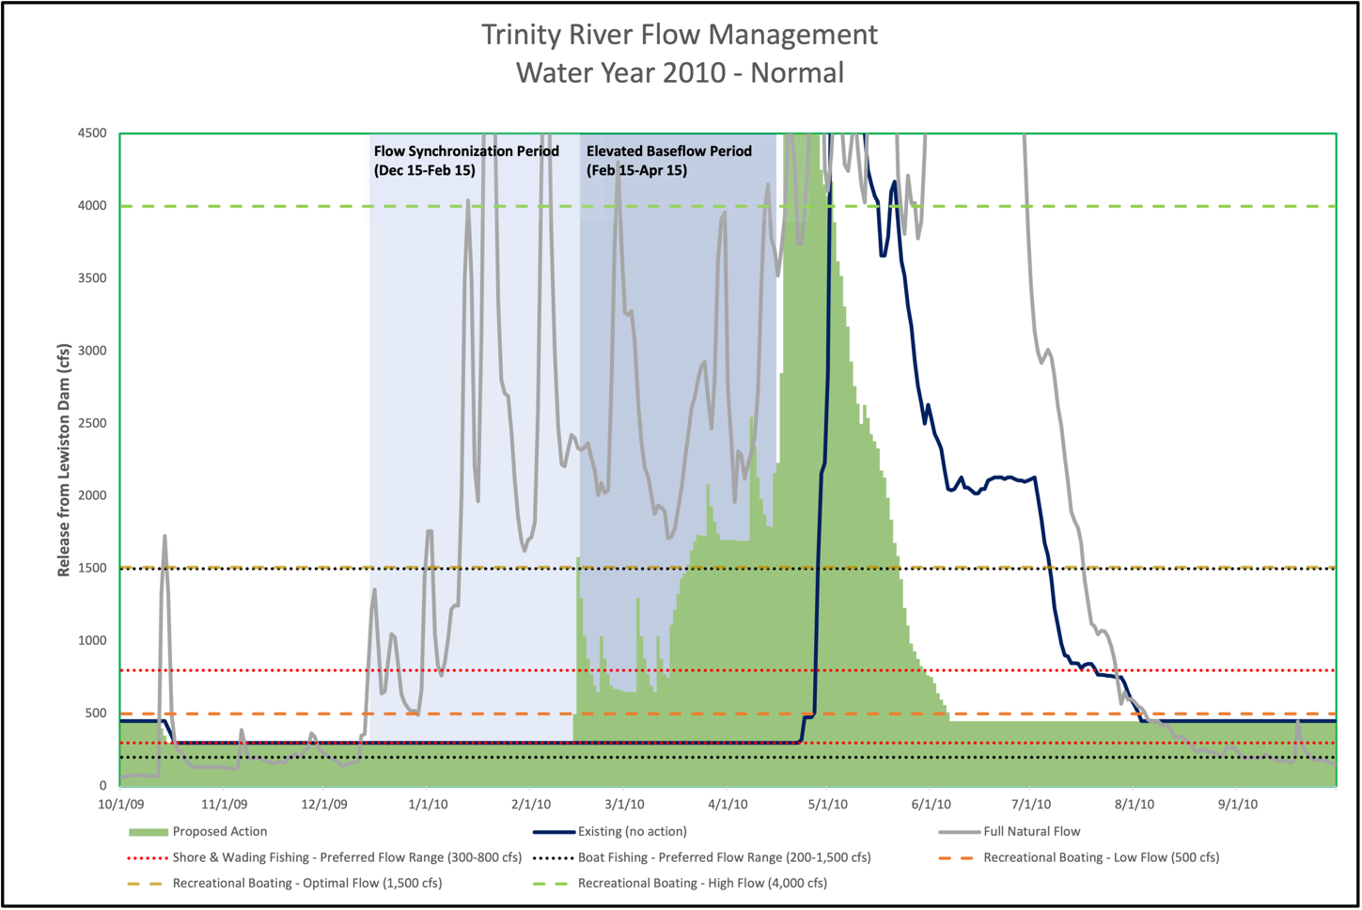
Notes:
WY 2010
There was NO synchronized flow release, so that 60k af is available for release Feb-Mar
The February B120 forecasted a CD water year and because there was NO synchronized release, that 60k af is available for Feb-Mar. No additional volume is available because of the CD forecast
The March B120 forecasted a Normal water year, so the decision tree indicates an additional 60K af 15 March – 15 April. NOTE that the elevated baseflow increases mid March because the additional 60k af was added.
Because 120k af was moved before 15 April, X af remain to be released following our normal procedures after 15 April.

Slide 15
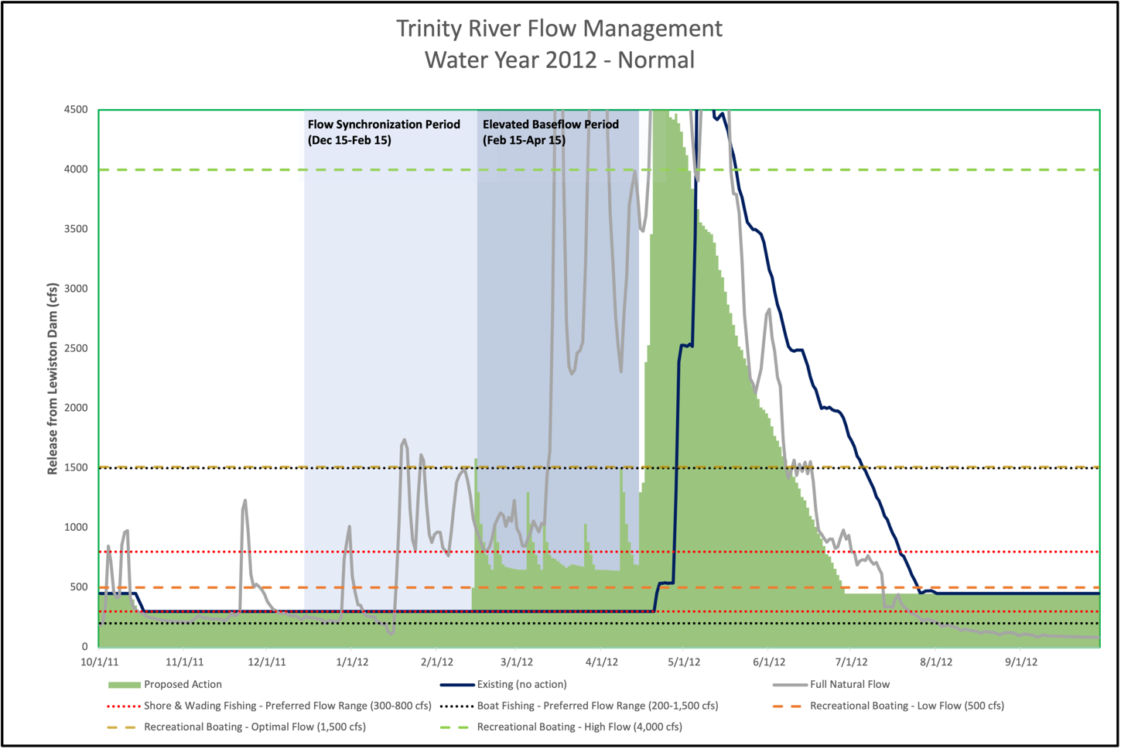
Notes:
WY 2012
There was NO synchronized flow release, so that 60k af is available for release Feb-Mar
The February B120 forecasted a CD water year and because there was NO synchronized release, that 60k af is available for Feb-Mar. No additional volume is available because of the CD forecast
The March B120 also forecasted a CD water year, so the decision tree indicates no additional releases 15 March – 15 April. NOTE that the elevated baseflow Mar-Apr looks essentially the same as Feb-Mar because no additional volume was added based on the March B120, in contrast to 2010.
Because 60k af was moved before 15 April, X af remain to be released following our normal procedures after 15 April.
ALSO SHOWS ITS IMPOSSIBLE TO MODEL EVERY FLOW OUTCOME, EVEN WITHIN THE SAME WATER YEAR TYPE

Slide 16
Estimated benefits
Increase access to rearing habitat for juvenile salmonids
  fish Capacity increased ~9% on average across the 40-mile restoration reach
increase the size of juvenile salmonids emigrating downstream
  ~5-19% increase in mass of juveniles at the end of June
Increase in cottonwood recruitment in Normal and wetter water years at the 2,000 – 4,500 cfs elevation
Seasonally appropriate high-flow events
  provide seasonally appropriate disturbance of BMI community to increase food availability
  perform geomorphic work more efficiently with the same amount of water
  essentially no increased risk of redd scour (<1%)
Notes:
Instead of modeling every possible outcome, the proposed action was modeled using hydrology from the 2004-2019 time period.
Analysis is presented either for all years or as an average across years.
In some instances an analysis is presented by WY type, but in practice this would have to be assessed retrospectively because WY type is not known when the action is preformed.
Notably, all these analyses could be performed retrospectively to quantify effects of winter variable flow actions if they are implemented.

Slide 17
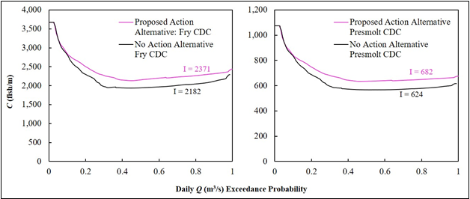
Capacity of fry (left) and presmolt (right) Chinook Salmon as it relates to flow duration for a ‘No Alternative’ (bottom curve) and ‘Alternative’ (top curve) winter flow regime over the entire Trinity River restoration reach.
Using an integrated area under the curve metric (Cooper et al. 2021 in review), there is a respective 8.7% and 9.3% increase in fry and presmolt capacity over the entire restoration reach from the flow regime with ‘the no Action alternative to that with the Proposed Action alternative.
Notes:
Increased access to juvenile rearing habitat

Slide 18
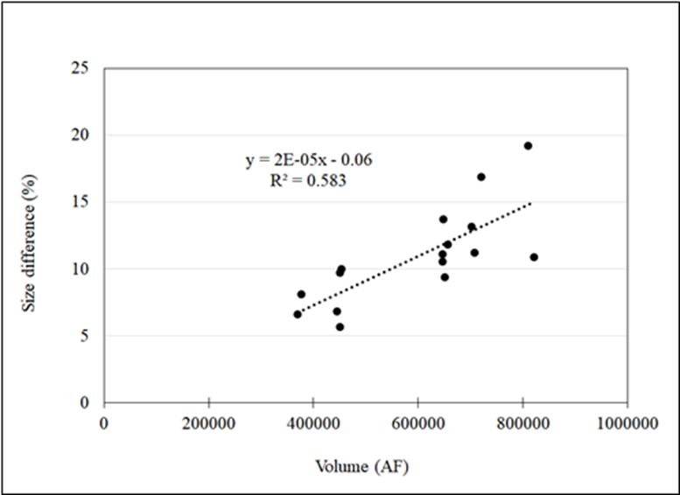
Relationship between end-of-June size difference (%) between the action and No Action alternatives (action minus no action), and annual Lewiston Dam restoration release water volumes for water years 2004 to 2019.

Slide 19
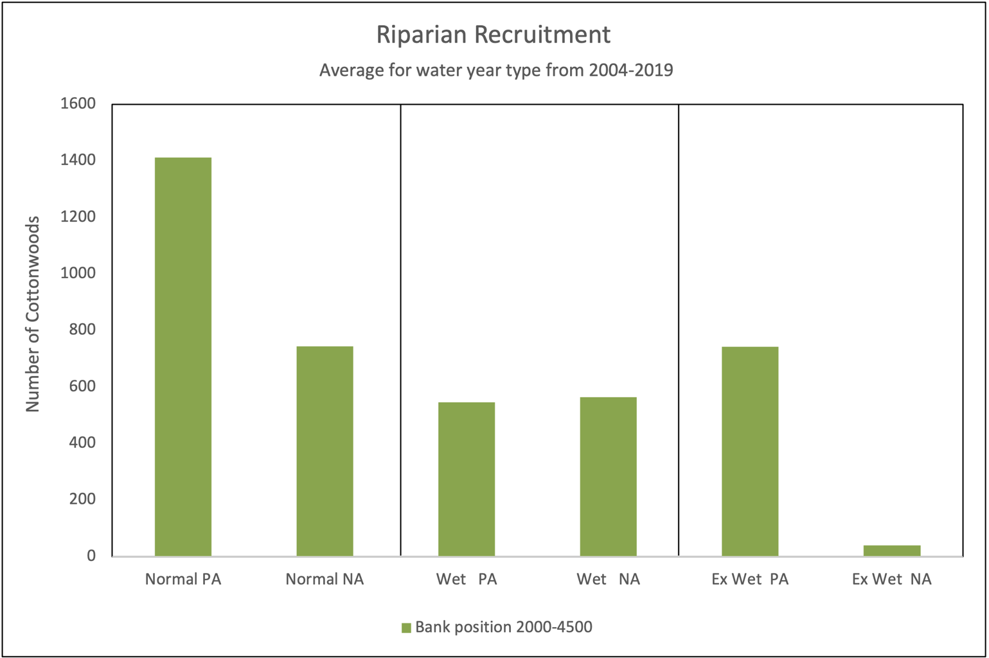
TARGETS model results from 2004 - 2019 for average Black Cottonwood recruitment at 2,000 to 4,500 cfs within the Restoration Reach.
This flow range has the most opportunity for successful recruitment
riparian recruitment is not a primary objective in Dry and Critically Dry WYs

Slide 20
Increases in proportion of spawned streambed area with Shields numbers >0.06 in the Proposed Action from the No Action alternative for each MFF reach for each year where a peak flow event would have occurred during the incubation period under the Proposed Action from WY 2004-2019.
Proposed Action | 2019 | 2017 | 2016 | 2015 | 2008 | 2006 | Avg increase in redd locations with Shields >0.06 | Avg Risk of Redd Scour
Lewiston | 9.6% | 9.6% | 9.6% | 9.6% | 9.6% | 9.6% | 9.6% | 0.7%
MFF Reach 2 | 8.4% | 8.6% | 8.7% | 8.6% | 8.3% | 8.5% | 8.5% | 0.6%
Limekiln | 7.8% | 7.8% | 8.1% | 7.7% | 7.4% | 1.9% | 6.8% | 0.5%
MFF Reach 4 | 6.8% | 6.5% | 7.0% | 6.5% | 6.0% | 1.1% | 5.6% | 0.4%
Douglas City | 7.6% | 4.5% | 1.4% | 2.2% | 7.7% | -0.4% | 3.8% | 0.3%
Junction City | 2.2% | 0.7% | -0.8% | -0.1% | 2.2% | 0.0% | 0.7% | 0.0%
Abv North Fork | 3.6% | -5.4% | 1.5% | 0.1% | 3.7% | 0.0% | 0.6% | 0.0%
Avg | 6.6% | 4.6% | 5.1% | 4.9% | 6.4% | 3.0% | 5.1% | 0.4%
Note: At the bottom of the table, is the average area of increase for all reaches and on the right is the average for all years within each reach. The column on the far right uses 7% value for the risk of redd scour from May et al. 2009 for bin of Shields numbers >0.06 to assess the risk to the entire population of redds.
Notes:
The take-away message is that estimated increase in redd scour risk is less than 1% IF a synchronized flow occurs.
Emphasize that the long-term or average risk is even lower because synchronized flows would not occur every year.

Slide 21
Year | Water Year Type | Trinity Power Plant Generation Market Value ($ million)
 |  | No action (Existing Conditions) | Proposed Action | Market Value Difference | Percent Difference
2010 | Normal | 10.64 | 10.94 | 0.30 | 2.8
2011 | Wet | 12.46 | 12.98 | 0.52 | 4.0
2012 | Normal | 11.52 | 11.33 | (0.19) | -1.7
2013 | Dry | 16.86 | 17.37 | 0.51 | 3.0
2014 | Critically Dry | 16.86 | 16.78 | (0.08) | -0.1
2015 | Dry | 10.72 | 10.60 | (0.12) | -1.3
2016 | Wet | 8.79 | 8.52 | (0.27) | -3.1
2017 | Extremely Wet | 13.31 | 13.48 | 0.17 | 1.3
2018 | Critically Dry | 10.11 | 10.15 | 0.04 | 0.4
2019 | Wet | 10.05 | 11.72 | 1.67 | 15.3
Total | All Water Year Types | 121.28 | 123.86 | 2.58 | 2.1
Notes:
- Note that this analysis came directly from CVO

Slide 23
Proposal to meet the need
Flow Workgroup WY2022 recommendations
A single peak flow event of 6,500 CFS (daily average) for the flow synchronization period (December 15 to February 15)
One hydrograph covering the February 15 to April 15 time period scaled to three different flow volumes
One hydrograph covering the March 15 to April 15 time period scaled to three different flow volumes

Slide 24
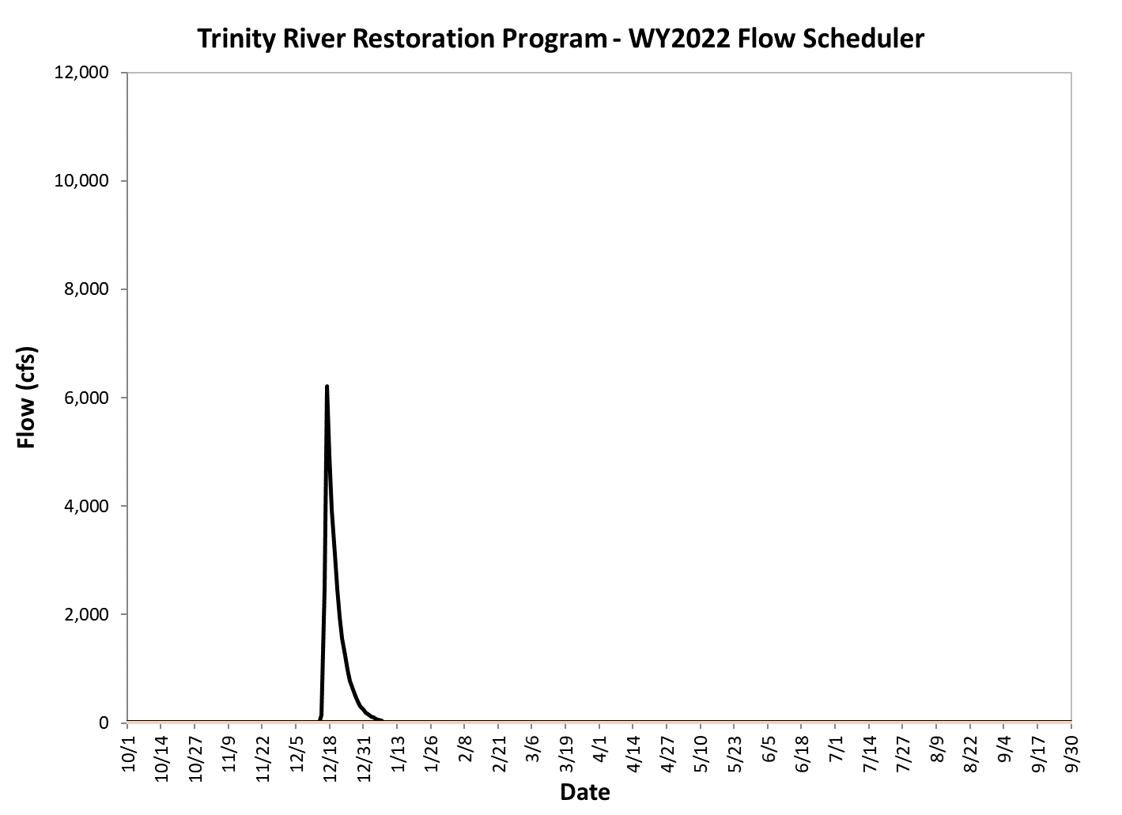
Recommended flow components
Synchronization flow period

Slide 25
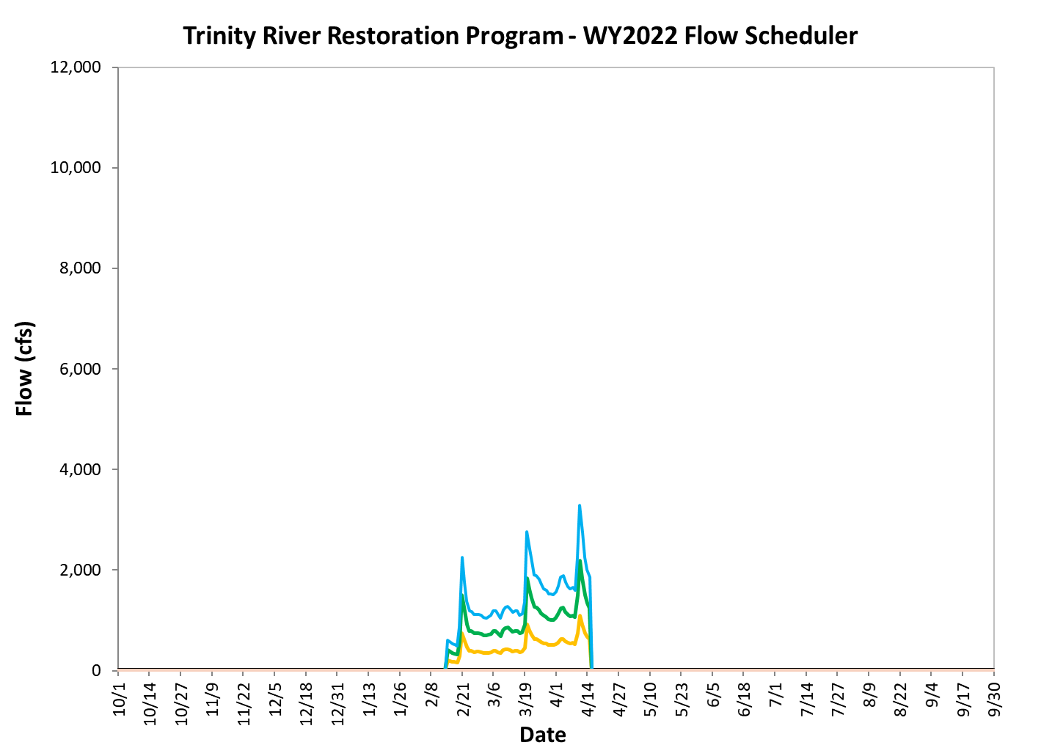
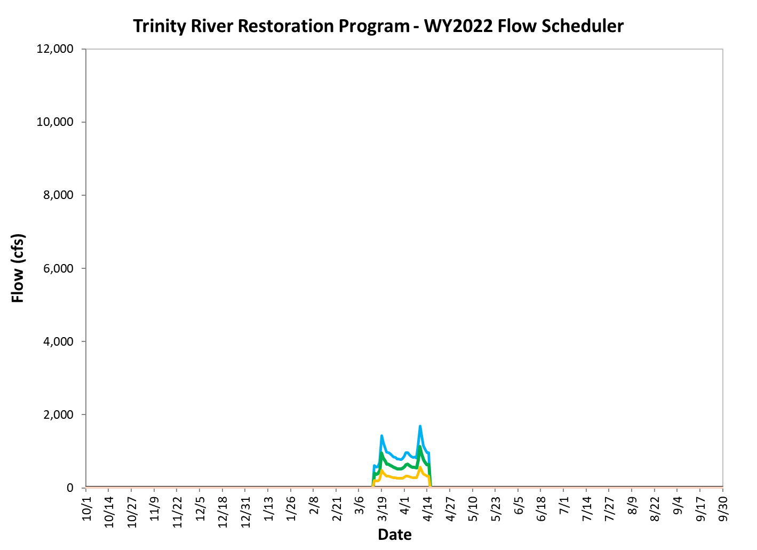
Recommended flow components
Elevated baseflow period

Slide 26
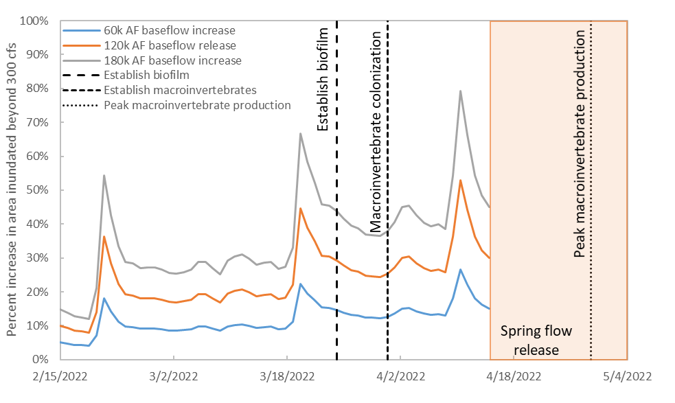
Wetted channel area and macroinvertebrate colonization and production
Primary production, macroinvertebrates: Prior to June 15, inundate surfaces for 28d for establishment of biofilm, 35d for macroinvertebrate establishment, and 63d for peak macroinvertebrate production.
Notes:
point out that this analysis was not included in the EA.
It was developed based on the proposed flow components to make this point more clear.

Slide 27
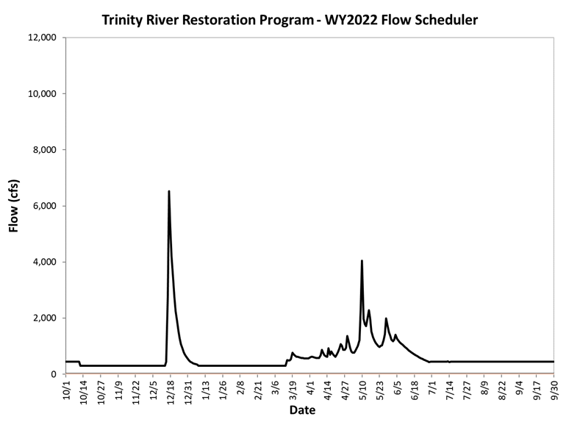
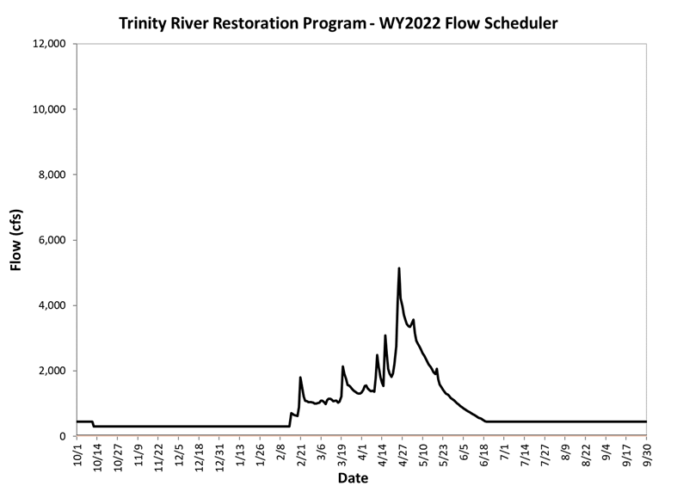
Example hydrographs
Dry and Normal
Notes:
Point out that these are hypothetical. Seems obvious, but TMC members are used to seeing spring hydrographs that are NOT hypothetical.

Slide 28
Effectiveness monitoring
Rotary screw traps – date of outmigration and fish size
Water temperature monitoring-temperature compliance
Flow magnitude and stage height-inundation and recession, riparian recruitment and riparian scour
Geomorphic monitoring – delta monitoring (aerial photo), planform change (bathymetry and lidar 5-yr)
Benthic Macroinvertebrate study (proposed)
If implemented, Program scientists will observe and propose additional hypotheses not yet developed.
Notes:
The proposed BMI study addresses sustained inundation but not drift food availability.
If the proposed action is implemented this year, it will be a pilot year in which we make observations to propose additional hypotheses/questions that are not yet developed.

Slide 29
Questions?
Thank you!
The technical team:
  Seth Naman, NOAA
  Justin Alvarez, Hoopa Valley Tribe
  Kyle De Juilio, Yurok Tribe
  Ken Lindke, CDFW
  Chad Abel, USBR-TRRP
  Brandt Gutermuth
  Ironwood Consultants

