Slide 1

TRRP Refinements:
Progress & Schedule
TMC Meeting
December 9, 2021
Chadwin Smith, Ph.D. – Headwaters
Trinity River Refinements Coordinator & Co-Facilitator
Darcy Pickard, M.Sc., P. Stat. – ESSA
Co-Facilitator

Slide 2


Task 3 – Program Document (PD)

Slide 3
PD progress to date
TRRP Purpose:
TRRP Goal:
Phases:
Phase I: 2000-2010
Phase II: 2011-2021
Phase III: 2022-2032 (implement PD and SP)
Phase IV: 2033-2043
The purpose of this Program is to mitigate impacts of the Trinity River Division of the Central Valley Project on anadromous fish populations in the Trinity River by successfully implementing the 2000 Trinity River Record of Decision and achieving Congressionally mandated restoration goals.
The long-term goals of the Program are to: 1) restore the form and function of the Trinity River; 2) restore and sustain natural production of anadromous fish populations in the Trinity River to pre-dam levels; and 3) to facilitate full participation by dependent tribal, commercial, and sport fisheries through enhanced harvest opportunities.

Slide 4
PD progress to date
Phase III Milestones:
Provide water to the Trinity River via annual flow releases from Lewiston Dam consistent with the ROD, the overall Program goal, and science of the Program.
Implement and maintain as necessary priority channel rehabilitation projects based on the best available science and availability of Program funds.
Annual sediment augmentation in the Trinity River based on prioritized recommendations contained in the Science Plan and the best available science.
Prioritize and implement watershed restoration in Trinity River tributaries consistent with the ROD and will address limiting factors that will contribute to salmonid production.

Slide 5
Secretary of the Interior
(USBR & USFWS co-lead agencies)
Independent Science Review
Trinity Management Council
(TMC)
TRRP Stakeholder Advisory Committee
(TSAC)
Science Advisory Board
(SAB)
Peer Review
TRRP Executive Director (includes BOR Program Staff and partner staff)
DRAFT – for discussion with PDDC in December 2021
Interdisciplinary Team
(IDT)
Technical Workgroups
Physical
Flow/Temperature
Fish
Riparian/Aquatic Ecology
Watershed

Slide 6
Issues the PDDC is wrestling with:
Language of Milestones #1 and #2
“Law of the Trinity”
TRRP organizational structure
TMC by-laws
TRRP Stakeholder Advisory Committee (TSAC)
Independent science (SAB and peer review)
“Conflict of interest”
Phase III budget
Adaptive management (AM)
Upcoming PDDC meetings:
December 14, 2021
January 12, 2022
February in-person?

Slide 7
Issues the SPDC is wrestling with:
Prioritization of key science activities for Phase III
Adaptive management (AM)
  What, where, and when it is applicable in the context of the TRRP
Key questions, hypotheses
Management Actions
  Documenting the current understanding and evolution of thinking behind management actions
Role of independent science
Linkages to PD, especially through the milestones / management actions
Next steps
January 20-21, 2022

Slide 8
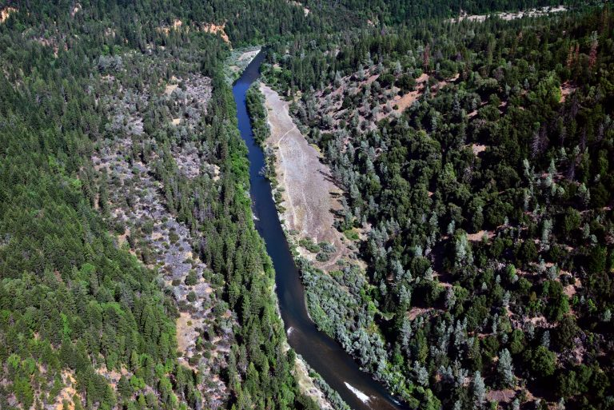
TRRP Refinements:
Progress & Schedule
Comments from PDDC and SPDC members
Q & A
THANKS!

