Slide 1
Inclusiveness & approaches in program outreach
Trrp fy22 outreach plan
TMC Meeting - September 15, 2021

Slide 2
The receptivity continuum
Out and Out Support; Advocate
  “Go, TRRP, go!”
Luke Warm; But Won’t Support Us
  “That’s okay with me.”
Neutral; Don’t Care
  “Eh, whatever.”
Don’t Like It; But Won’t Stop You
  “If you have to.”
Out and Out Opposition; Try to Veto Us
  “No way – never!”
Who are we trying to reach, who do we spend the most time on, and where do we devote resources?
Adapted from, Systematic Development of Informed Consent (SDIC). The Institute of Participatory Management and Planning

Slide 3
2021 gravel augmentation @ hatchery reach
TRRP has been wasting $16 million a YEAR of taxpayer money on “restoration” which has proven to be a complete failure.
“The restoration project should be ashamed of themselves for what they are doing.”
“In my opinion the restoration project is not working. I wish they would let nature do its thing.”
“It’s a mess when you put in dams and divert water the valley you screw up the river…add the draught and obvious global warming it really gets bad. You can’t expect to fix it by just dumping gravel in it, even if it might possibly help a bit you are fighting a losing battle.”
“It might be helpful for you to do a bit more research [in reference to a naysayer’s post]. When I began reading this and realized that you’re offering misinformation in your post I stopped reading.”
“Can anyone tell me who TRRP is? And who hired them? How long this contract is for??? I’m sorry I’m not knowledgeable on the subject but I’d like to know more. It seems unnecessary to disturb nature in this way.”
“They can’t control nature. Can’t they see that yet?”
“Time to abolish the restoration project? My vote would be yes!”
“Our knowledge is OWT, on the water training, something a classroom setting can’t achieve. You can read all the books you want, but mother nature can’t be learned from a book. We’ve tried for so many years to work with TRRP and give them our comments and concerns, only to be shut down by their, ‘we have an education and you don’t’ mentality.”
“Educate yourselves. The River died with the dam. Mitigation efforts can’t fix that but might one day restore the fishery. Ignorance and hysteria won’t help.”
“TRRP work is shitty at best.”
Out and Out Support; Advocate
  “Go, TRRP, go!”
Luke Warm; But Won’t Support Us
  “That’s okay with me.”
Neutral; Don’t Care
  “Eh, whatever.”
Don’t Like It; But Won’t Stop You
  “If you have to.”
Out and Out Opposition; Try to Veto Us
  “No way – never!”

Slide 4
Underlying issues
Termination of TAMWG and the prolonged delay in establishing a new stakeholder advisory group
Years of poor adult salmon returns
Undervaluing of steelhead and their prestige with sport anglers
Belief that TRRP conducts business in a deliberatively clandestine manner to circumvent oversight and meaningful participation (i.e. distrust)
Philosophical differences on what restoration of the Trinity River means, including where resources should be targeted
The “out and out opposition”

Slide 5

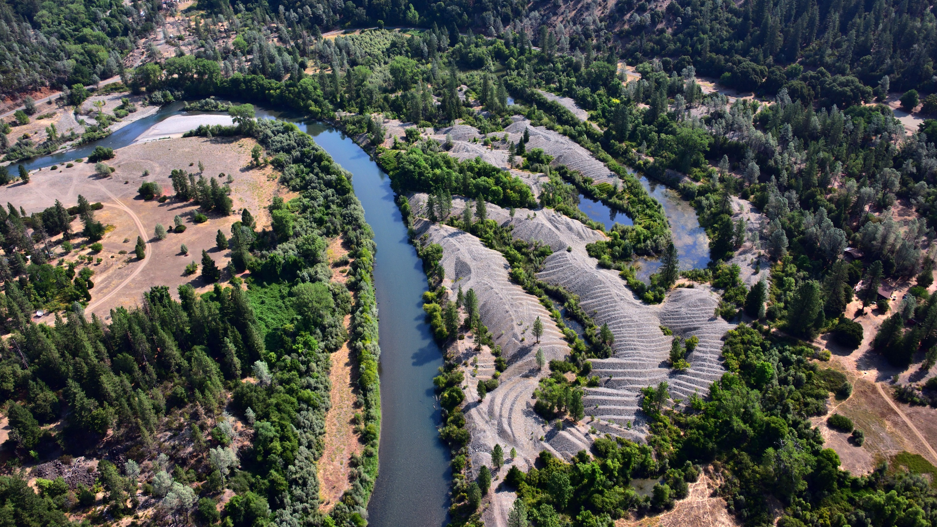

Slide 6
Trinity Journal Op-ED – July 14, 2021
From Andrew Harris – President, Trout Unlimited – Shasta Trinity Cascades Chapter
February-April Flow Variability: The Trinity River already experiences elevated and variable flows February-April due to tributary inflow downstream from Lewiston Dam. These tributary inflows are significant in the Junction City area and much greater below the confluence with the North Fork.
Mid-Winter Spike: We believe that the high spring flows dictated by the Record of Decision have been beneficial for the river and anadromous fish on the Trinity. These high flows are critically important to facilitate alluvial flow within the mainstream of the Trinity River, allowing for a dynamic river system below the dams.
Alternative Actions: TRRP seems intent on shifting some of the ROD allotment to the winter months. Our chapter would support an alternative mid-winter use of this water, which would be to maintain minimum instream flows (MIFs) of 450cfs throughout the winter.
We also have serious concerns due to lack of transparency at TRRP and the difficulty and inability for outside organization to peer-review supporting documents. We are fortunate to have contacts with the right connections and were third-party forwarded sample hydrographs from the past 17 years that illustrated the proposed changes. These hydrographs should be included in the scoping solicitation. These oversights by TRRP reflect a profound lack of transparency. We advocate for increased public accountability and independent technical peer review of TRRP’s proposals. Given the overall lack of transparency and accountability for the program and our lack of confidence in a positive outcome for the winter flow variability and mid-winter spike experiments, we do not support any major changes to release schedules that will negatively impact recreational fishing.
Trout Unlimited Website:
“Most major river systems, of course, now have dams and water diversion infrastructure on them and cannot replicate unimpaired flow conditions. However, the science of river ecology and hydrology affirms that, in the absence of unimpaired flow conditions, mimicking the natural variability in river flows is essential to support wildlife species such as salmon and steelhead that have evolved to those ecosystems and to take advantage of the natural variability of those systems.
Link: Functional streamflows key to recovering salmon and steelhead | Trout Unlimited

Slide 7
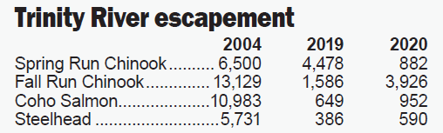
Underlying issues
Termination of TAMWG and the prolonged delay in establishing a new stakeholder advisory group
  “Since the dissolution of the Trinity River Adaptive Management Group in 2019, little information has been allowed to flow publicly.”.
Years of poor adult salmon returns
  “By any objective appraisal they have been a dismal failure.”.
Undervaluing of steelhead and their prestige with sport anglers
  “The TRRP has consistently focused on salmon to the exclusion of the other species of fish in the system, particularly steelhead.”
Belief that TRRP conducts business in a deliberatively clandestine manner to circumvent oversight and meaningful participation (i.e. distrust)
  “Absolutely nothing has been done since the Headwaters Corporation Organizational Assessment Report of the TRRP (Nov. 29, 2018) was published to correct the problems or administer the suggested solutions cited in that scathing report.”
  “A government-funded organization should operate transparently.”
  “TRRP has treated the public, and all interested parties like mushrooms. Essentially, keeping us in the dark and feeding us manure.”
Philosophical differences on what restoration of the Trinity River means, including where resources should be targeted
  “The Fly Shop’s concerns are based upon what we have witnessed in the past 40-plus years fishing and guiding on the Trinity River”
  “The TRRP Oregon Gulch project drastically remapped the river and eliminated prime adult salmon and steelhead holding water. These are runs we have fished in and caught steelhead for decades.”
The “out and out opposition”
Trinity Journal Op-Ed – July 14, 2021
Mike Michalak & Bryan Quick, The Fly Shop

Slide 8
The Fly Shop’s concerns are based upon what we have witnessed in the past 40-plus years fishing and guiding on the Trinity River.
“Our knowledge is OWT, on the water training, something a classroom setting can’t achieve. You can read all the books you want, but mother nature can’t be learned from a book. We’ve tried for so many years to work with TRRP and give them our comments and concerns, only to be shut down by their, ‘we have an education and you don’t’ mentality.”

Slide 9
Fy22 Outreach Activities

Slide 10
A More Personable Front
TRRP Website Bios
  Ideally, will include office staff, TMC, and TRRP Workgroup Participants
  Minimum of Name, Title & what your position entails
  Personalize based on individual comfort level
  Contact info…but need to be careful (SPAM!)
Highlight program individuals in annual report
Stay in your lane or go up the chain
  Don’t be afraid to communicate, but stick to your subject matter (but maybe not in an online forum)
FY22 Outreach Plan
Hi, my name is Chad. Part of my role with TRRP is to oversee the gravel augmentation project that you have concerns about. Please call me at the TRRP office and I’d be happy to discuss this with you.

Slide 11
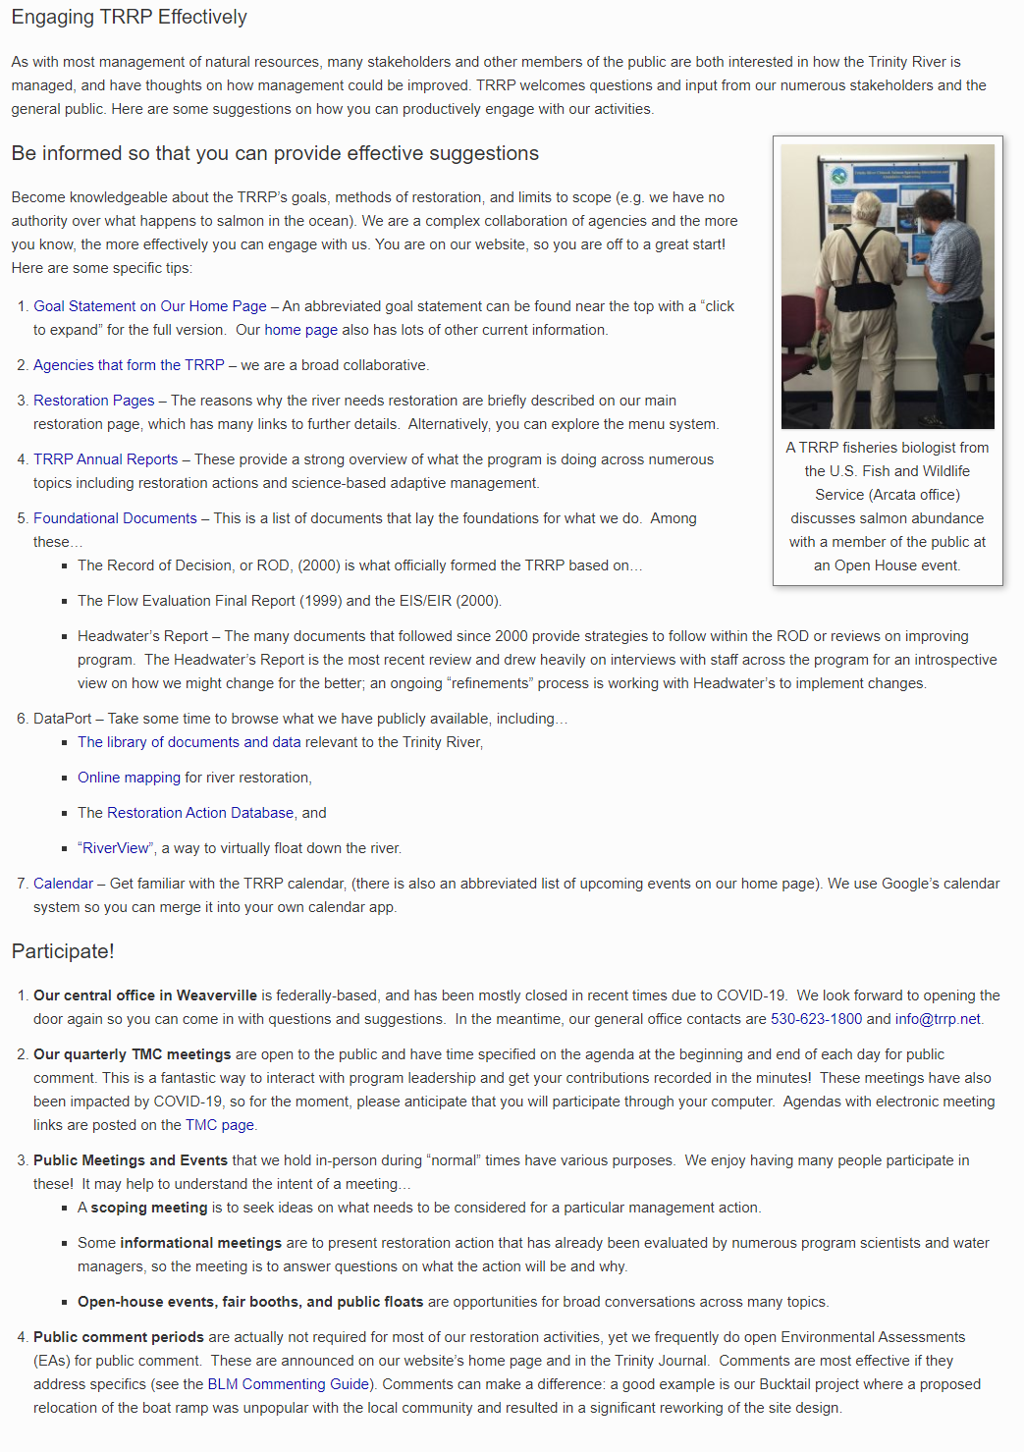
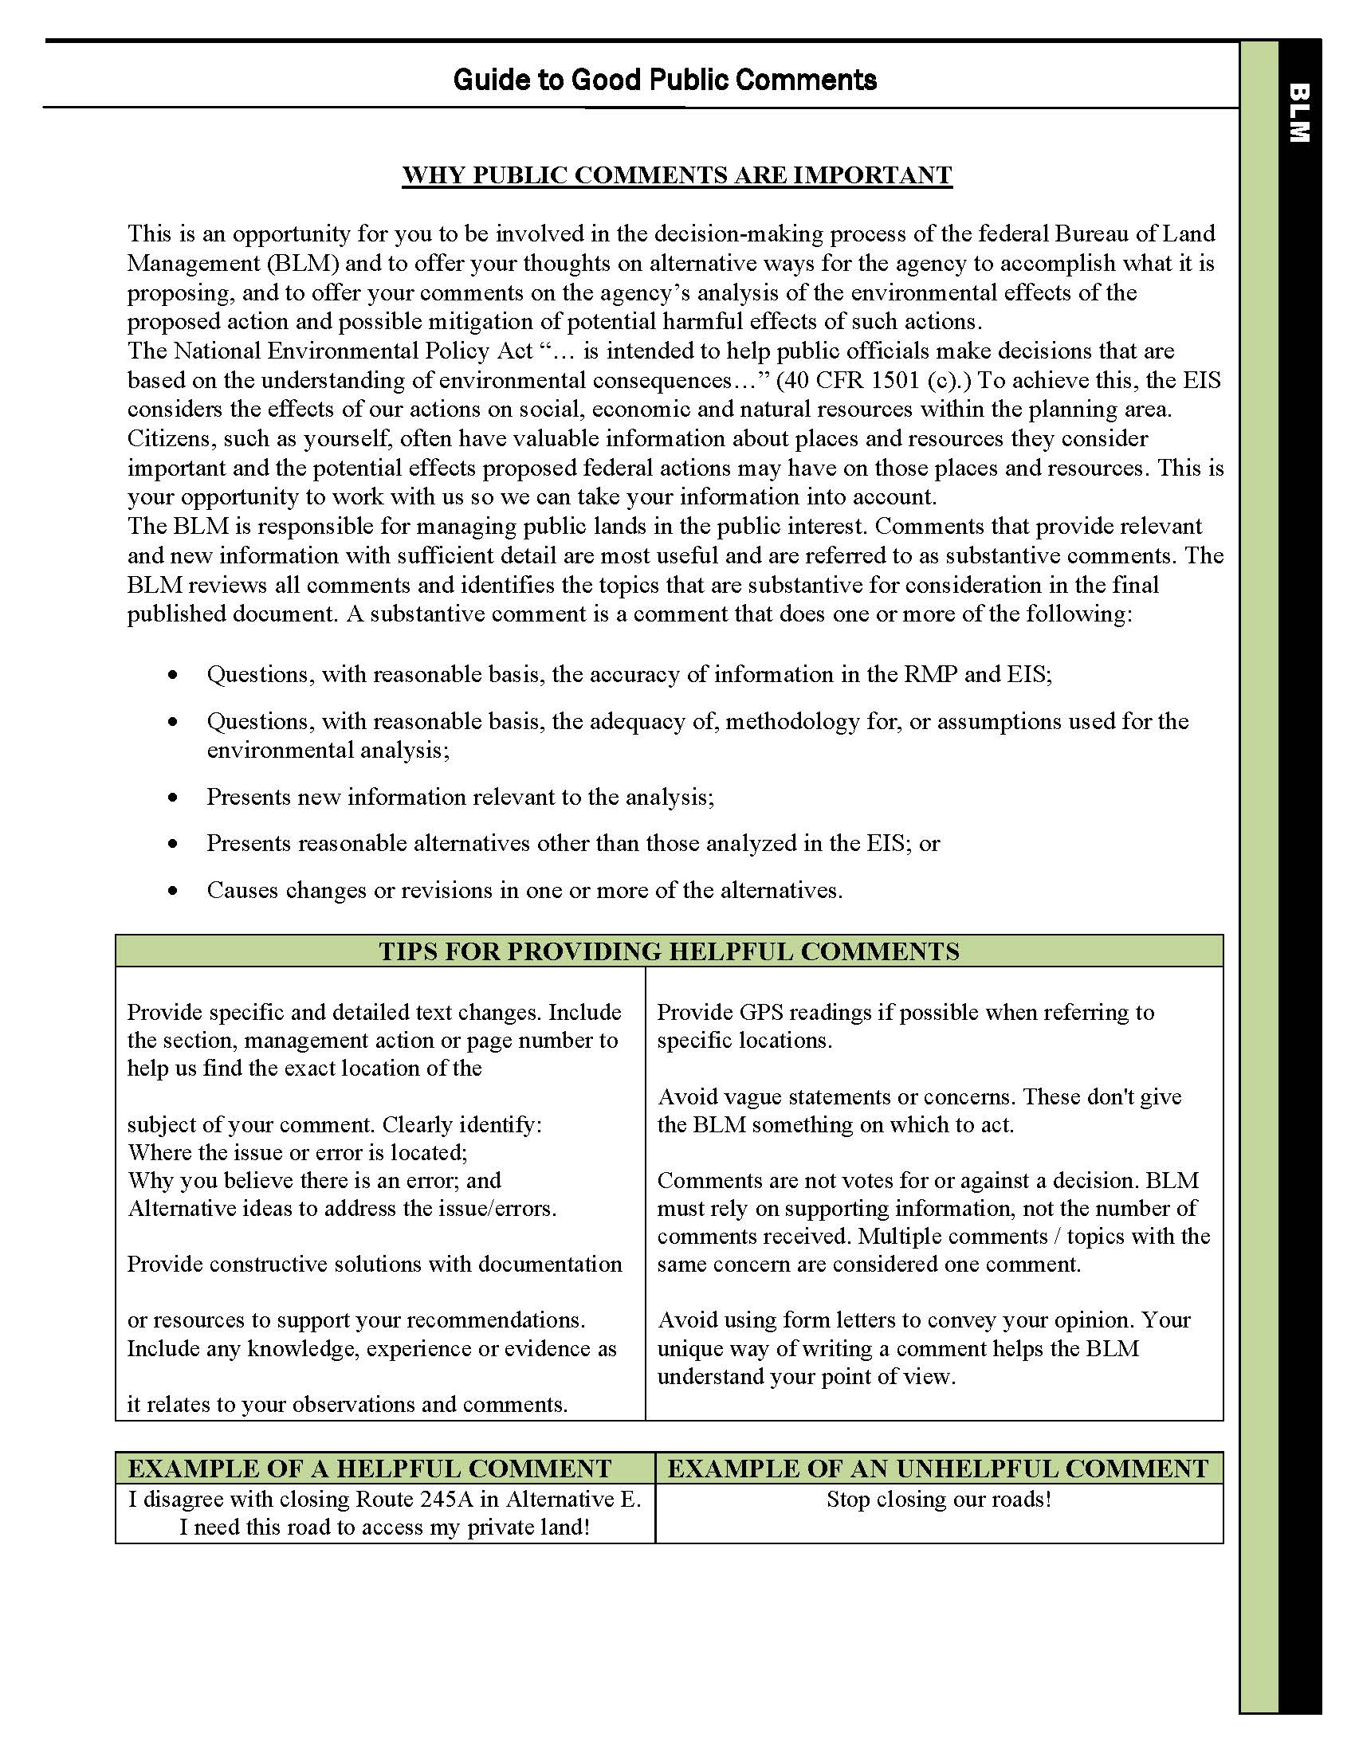
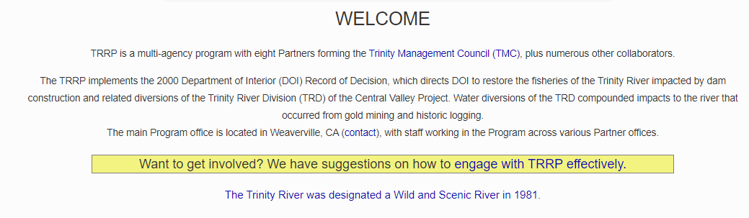
Decode Government
Don’t expect the public to know the nuances of government structure and authorities
Outside our purview? At least have a canned response
  Tribal harvest
  Hatchery operations
  Fishing quotas
How to effectively engage with TRRP
FY22 Outreach Plan

Slide 12
Take Our Message Downstream
Current outreach efforts are focused entirely on Trinity County
Downstream communities are affected by our program actions as well
Better representation of overall public opinion
Do better to engage tribal members in their community
Trout Unlimited as an organization AND the Shasta Trinity Chapter
FY22 Outreach Plan

Slide 13
Workgroup Transparency
Consistency across workgroups
  Posting agenda in advance
  Posting a meeting summary
FY22 Outreach Plan

Slide 14
The Proverbial Gut Check
Know good advice when we hear it
The weekday public float
Improving our watershed grant program
Trinity County-centric outreach
FY22 Outreach Plan

Slide 15
Continued Outreach with RCD
Goal 1: Build Community Support and Trust
  Strategic messaging through print, electronic, and social media
  Community meetings and events 3x/year (e.g., Salmon Festival)
Goal 2: Build Community Awareness of the Benefits of Restoration
  Two river trips/yr.
  Discover Trinity – field tours, led hikes
  Youth events – Day at the Wetlands, River Days, Weaverville Summer Camp
  Two volunteer opportunities / year
Goal 3: Build Program Identity
  6 articles in Trinity Journal/year
  Monthly postings on electronic media
  Two science events/year (e.g., Science Symposium)
  Quarterly contributions to Conservation Almanac
FY22 Outreach Plan

Slide 16

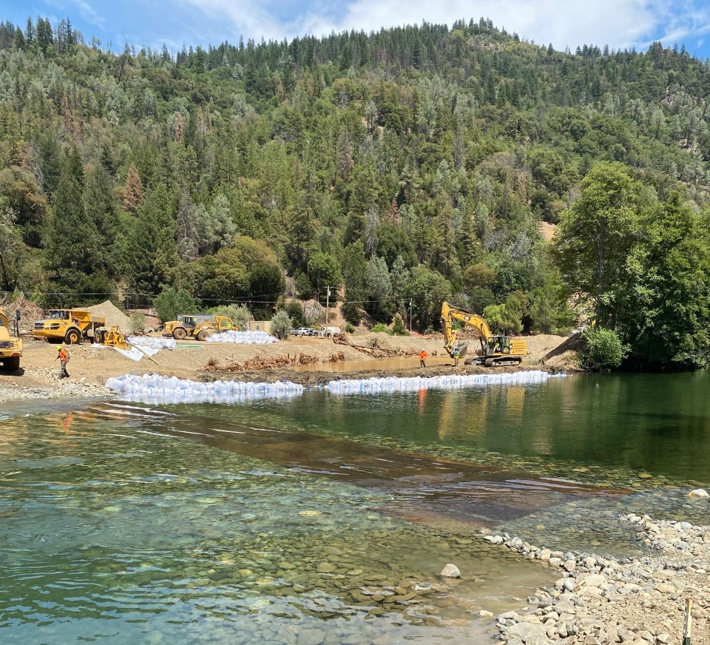
Questions???

