Slide 1
Trinity River Winter Flow Variability
Environmental Assessment
Project Proponent and Lead Agency
U.S. Department of the Interior
Bureau of Reclamation – Trinity River Restoration Program Office
Chad Abel, Implementation Branch Chief
TMC Quarterly Meeting – Sept 15, 2021

Slide 2
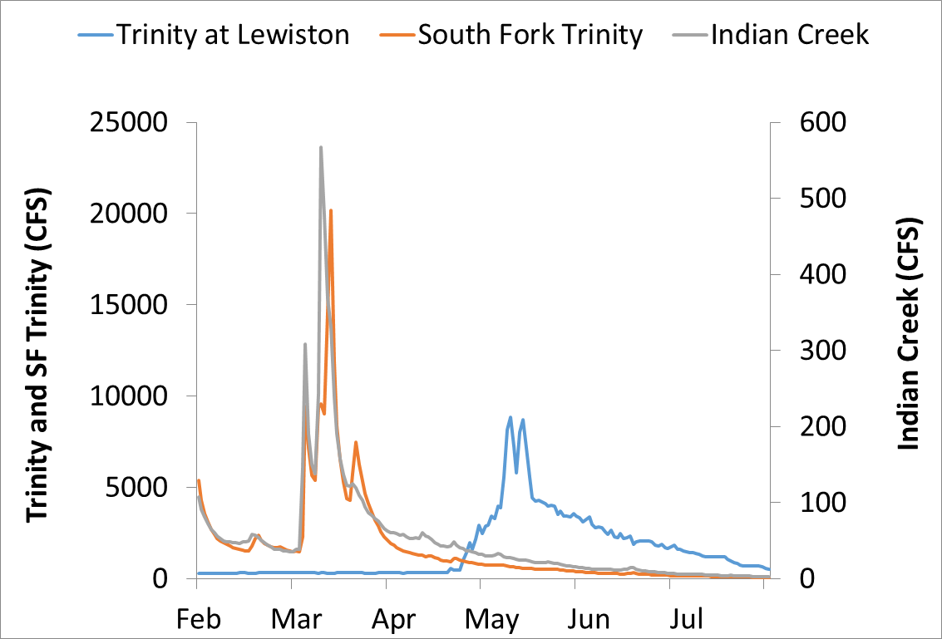
Too late and too cold
Discharge (cfs) | Change in Predicted 40-Mile Habitat Capacity | Habitat Units with Predicted Capacity Increases
300 | 0 | 0
500 | 3% | 58%
700 | 7% | 61%
900 | 10% | 66%
1100 | 14% | 72%
1300 | 19% | 78%
1500 | 25% | 81%

Slide 3
The Flow Problem
What we can’t change
Annual water volume
Release temp
What we can change
Timing of release
Magnitude of release

Slide 4
Objectives
Increase growth of salmon fry and parr
Synchronize flows of the regulated mainstem with its free-flowing tributaries
Provide thermal cues for smoltification and downstream migration earlier in the year
Increase nursery habitat availability for juvenile salmon
Provide seasonally appropriate disturbance of the macroinvertebrate prey species for rearing salmonids
Reduce effects of temperature suppression on growth of rearing salmonids

Slide 5
Proposed Action
Flow Synchronization Period (Dec 15 – Feb 15)
Synchronize a 60,000 af, high magnitude dam release with a winter flow event
6,500 cfs maximum flow from Lewiston Dam
Forecasting tools from CNRFC at USGS mainstem gage above North Fork predicts 4,500-12,000 cfs event
72-hour notice to USBR
Elevated Baseflow Period (Feb 15 – April 15)
Two possible releases in Feb and March based on B120 90% exceedance forecast to predict water year type
Volume released based on Decision Tree and winter period allocation of water year type

Slide 6
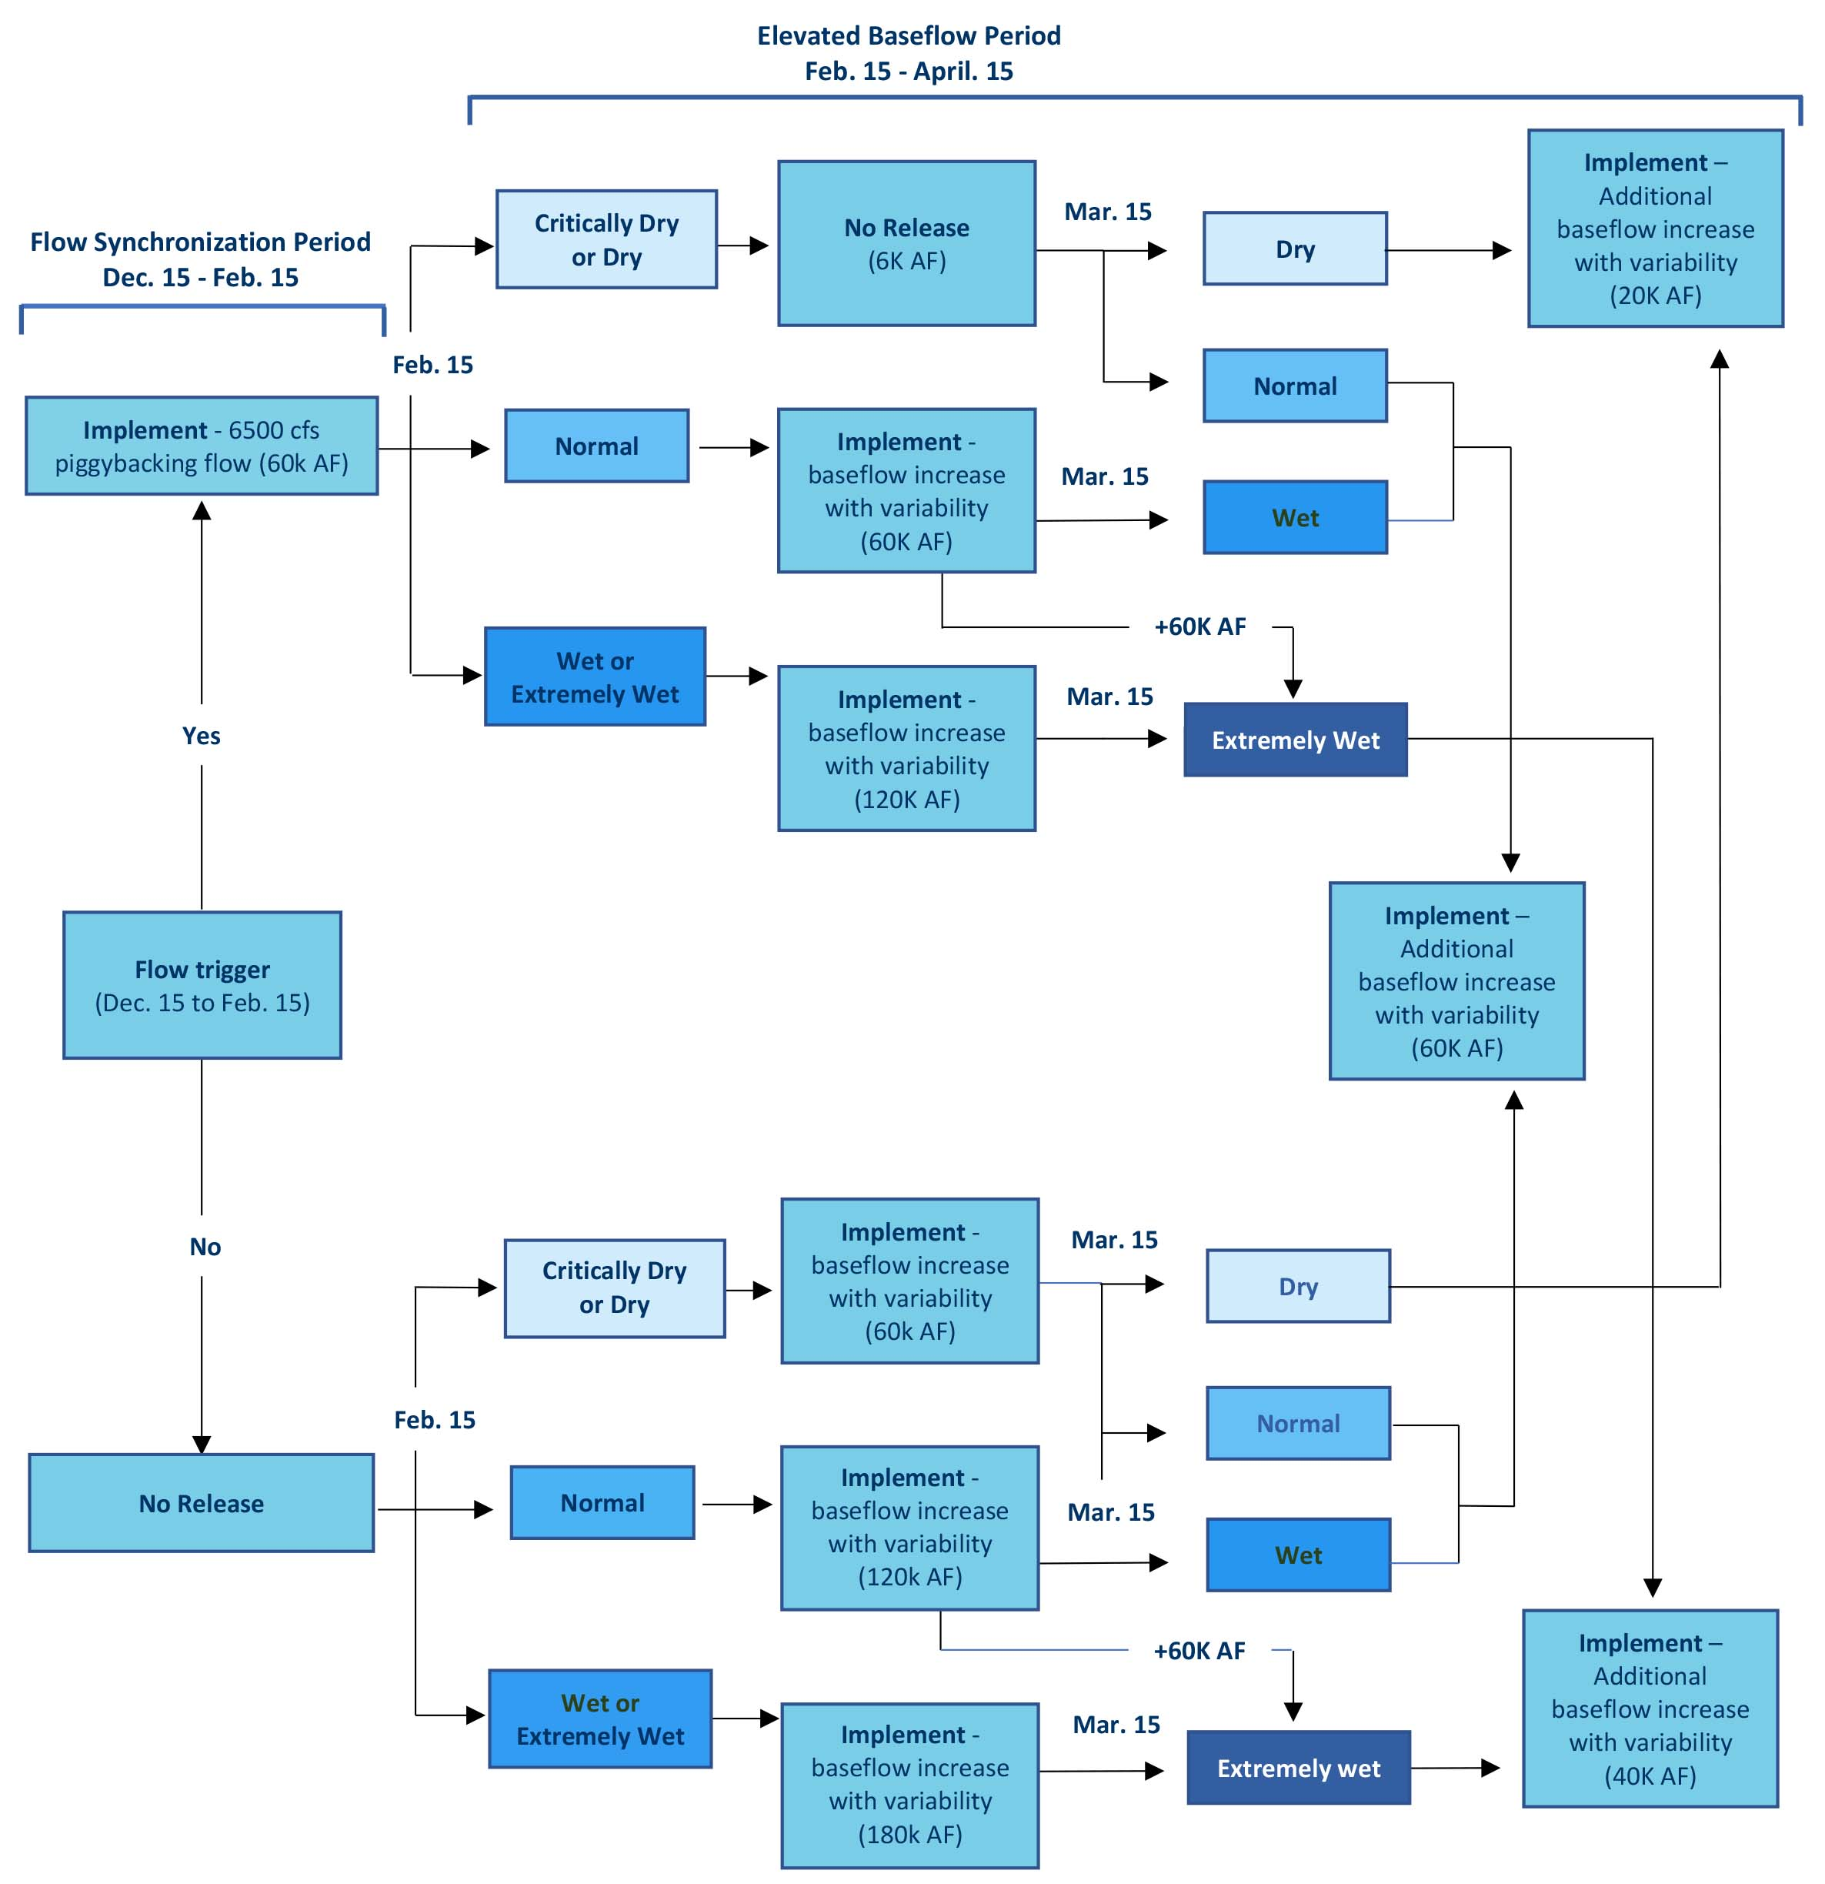

Slide 7
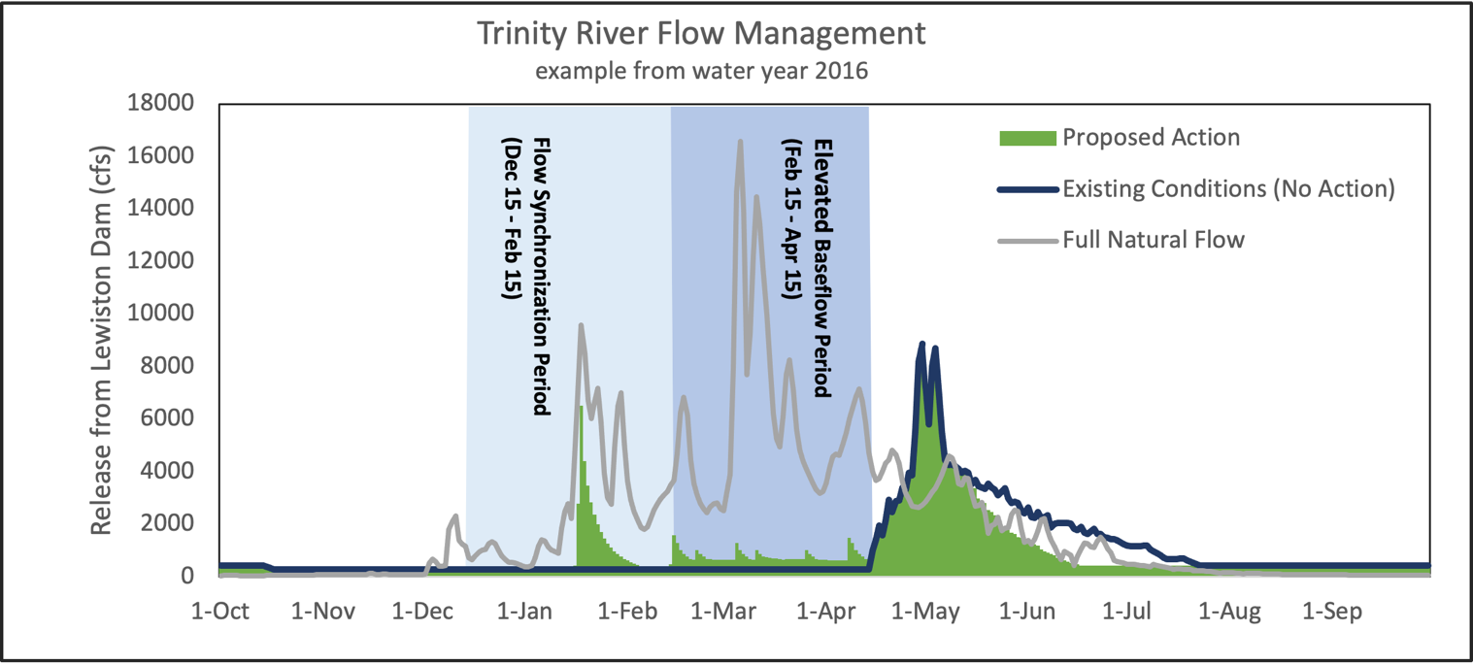

Slide 8
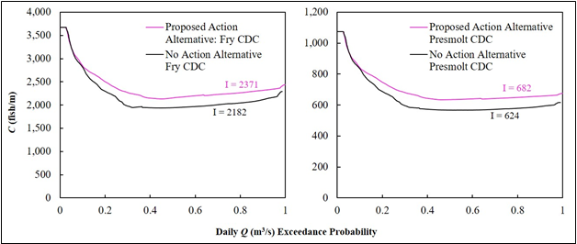
Capacity of fry (left) and presmolt (right) Chinook Salmon as it relates to flow duration for a ‘No Alternative’ (bottom curve) and ‘Alternative’ (top curve) winter flow regime over the entire Trinity River restoration reach.
Using an integrated area under the curve metric (Cooper et al. 2021 in review), there is a respective 8.7% and 9.3% increase in fry and presmolt capacity over the entire restoration reach from the flow regime with ‘the no Action alternative to that with the Proposed Action alternative.

Slide 9
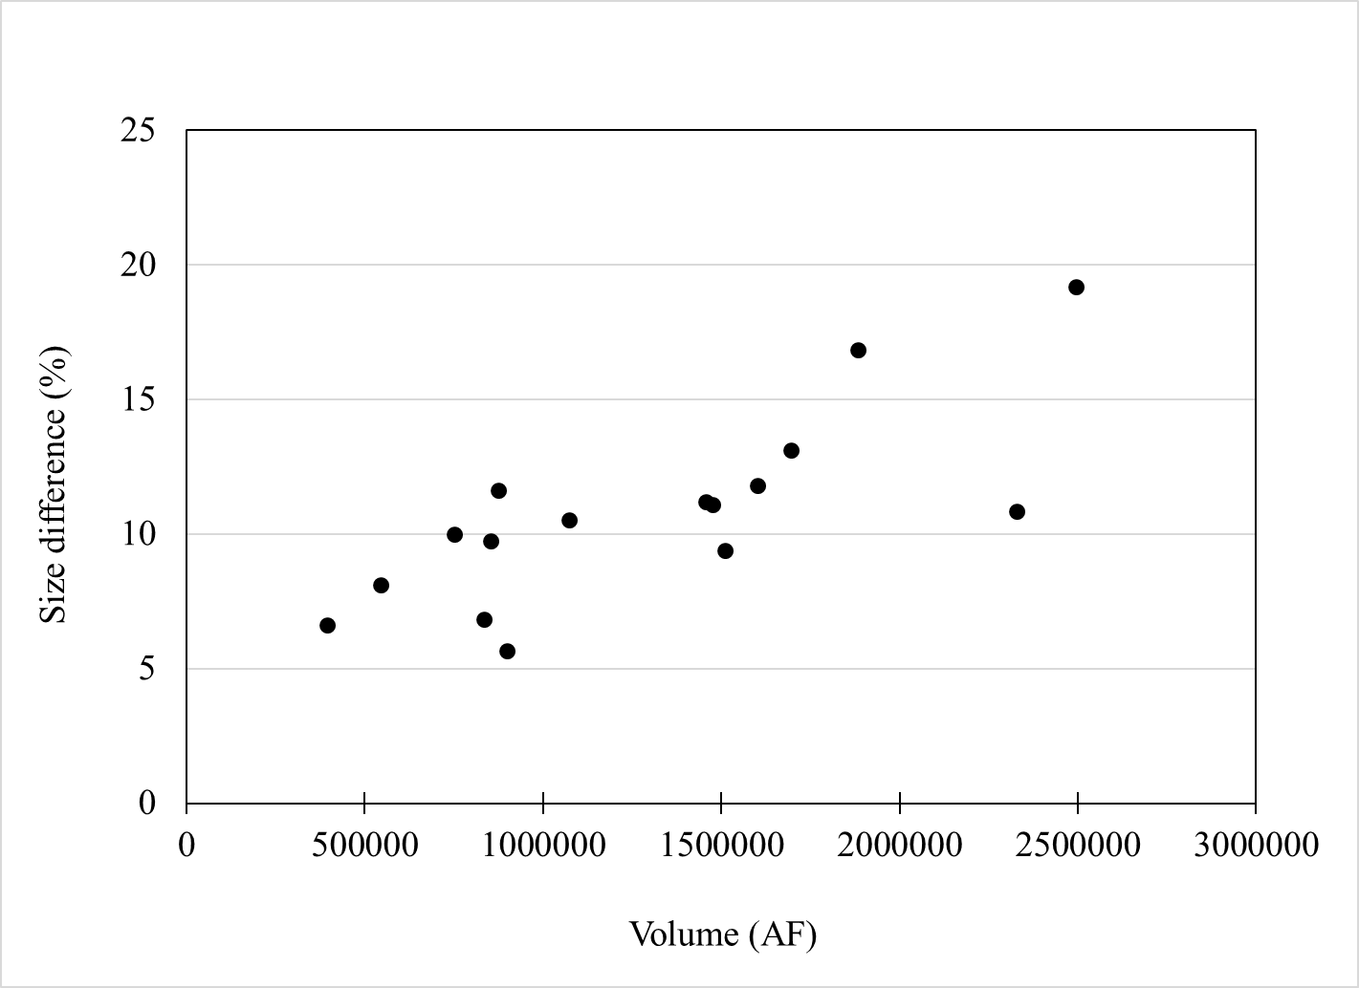
Relationship between end-of-June size difference (%) between the action and No Action alternatives (action minus no action), and annual water volumes for water years 2004 to 2019.
The modeled water temperatures and their effect on modeled Chinook salmon mass (g) showed that in all years (2004-2019), the action results in greater end-of-June mass than the No Action alternative. Differences in the end-of-June mass for the Proposed Action and No Action alternatives ranged from 1.1 g to 2.2 g. The resulting differences in mass as a percentage of end-of-June Chinook salmon size ranged from 5.7% to 19.2% over the study period. The relationship between total water year volume and the percentage difference in end-of-June mass between the alternatives was significant (R² = 0.594; P < 0.001), resulting from the warmer water temperatures that the Proposed Action alternative provides in the spring months relative to that of the No Action alternative. The effect is most pronounced in wetter water year types, as the Proposed Action moves a large volume of water from the spring juvenile Chinook salmon rearing period to the winter months.

Slide 10
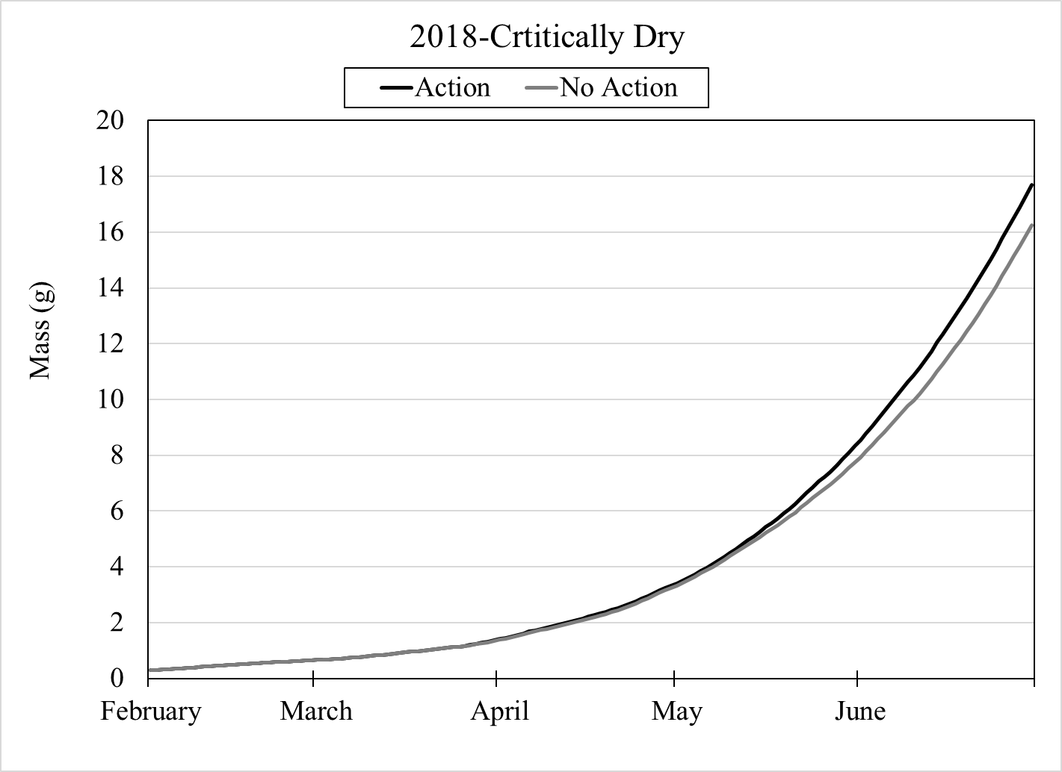
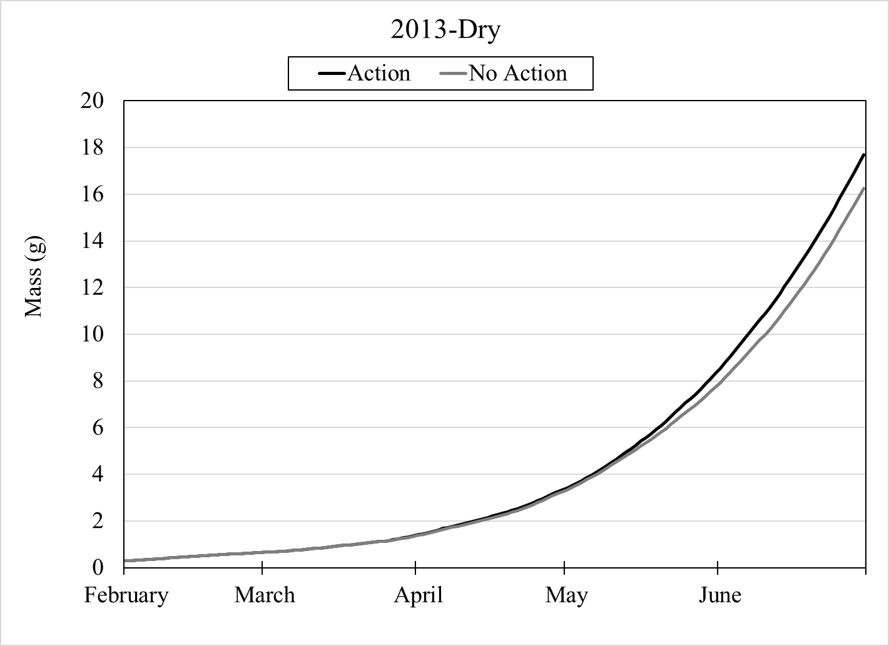
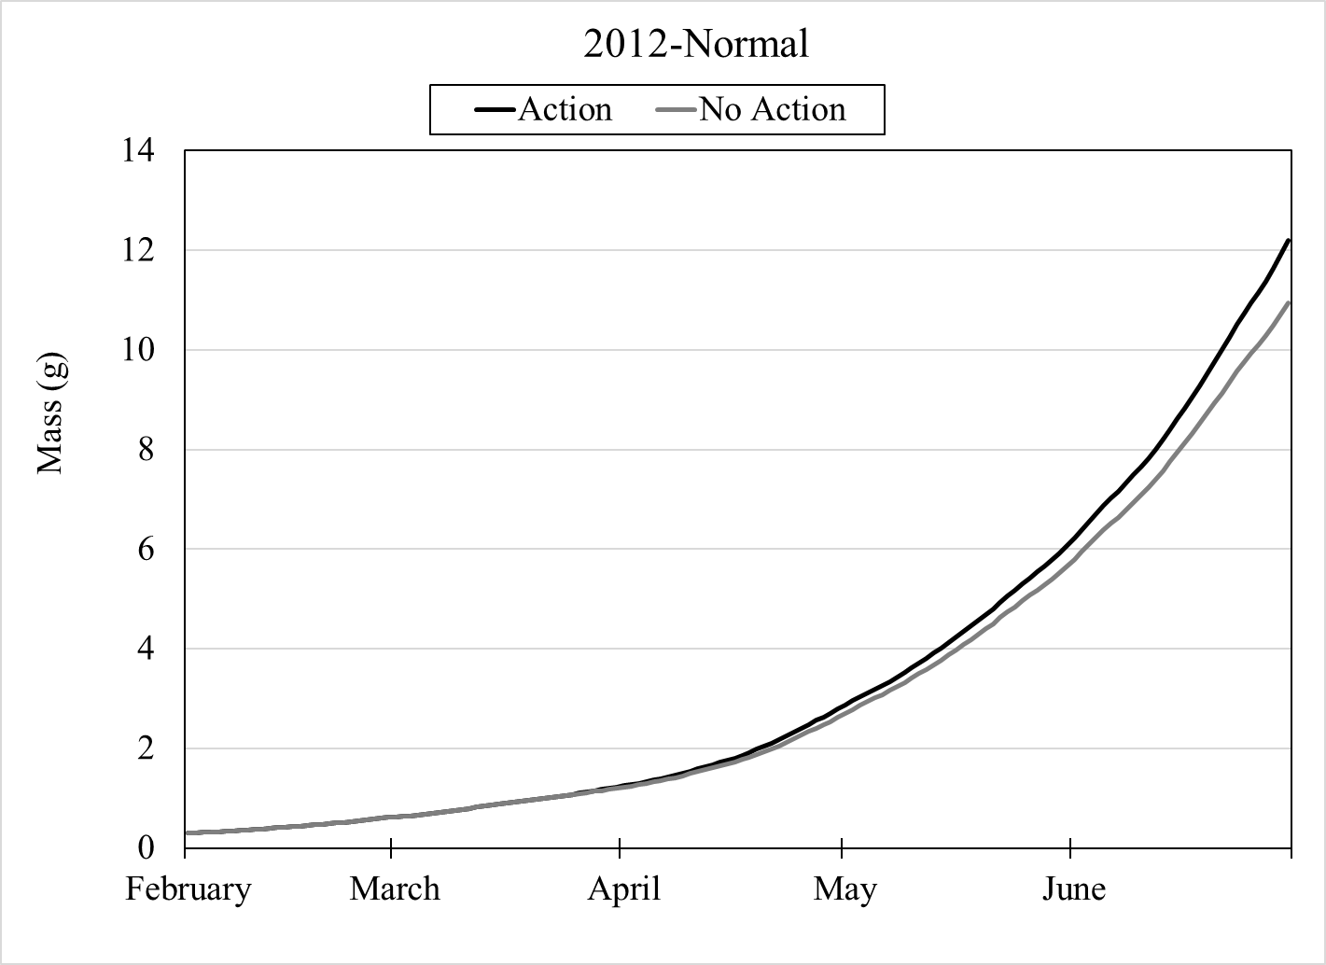
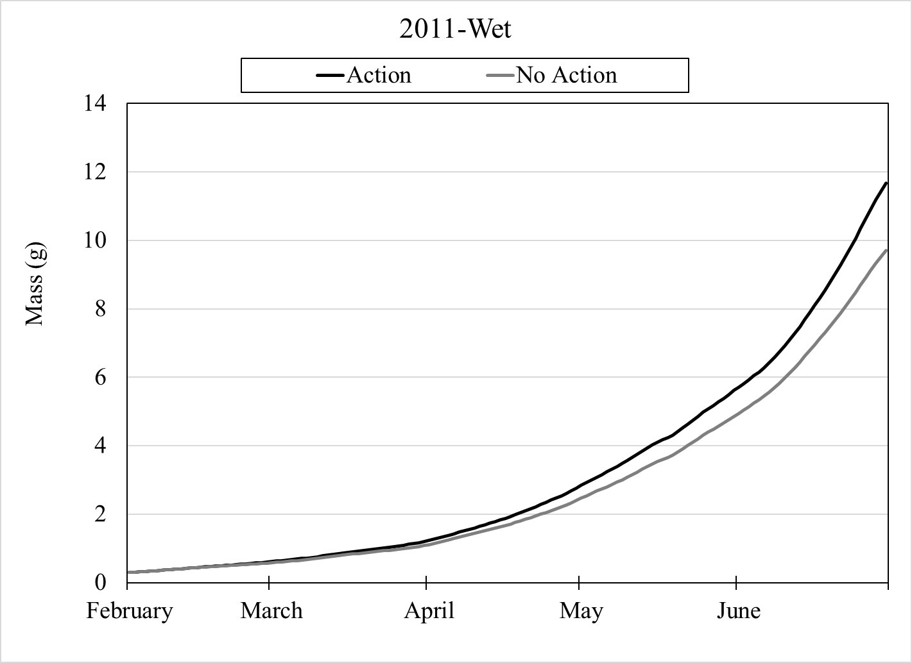
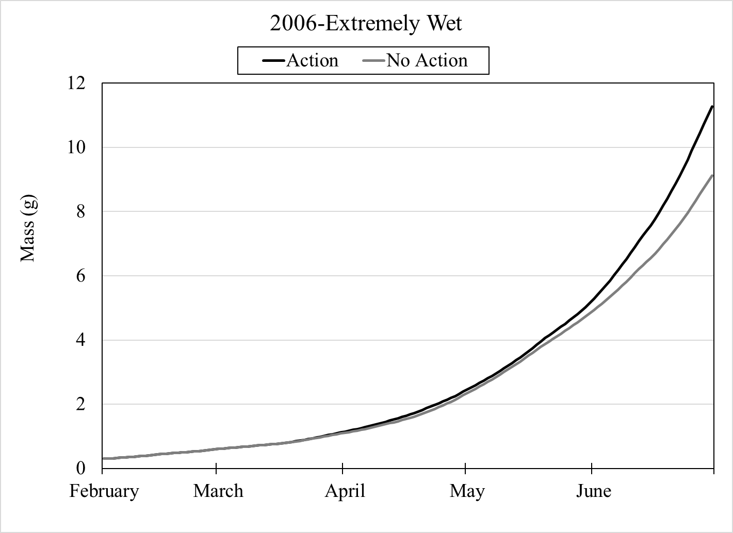

Slide 11
Increases in proportion of spawned streambed area with Shields numbers >0.06 in the Proposed Action from the No Action alternative for each MFF reach for each year where a peak flow event would have occurred during the incubation period under the Proposed Action from WY 2004-2019.
Proposed Action | 2019 | 2017 | 2016 | 2015 | 2008 | 2006 | Avg increase in redd locations with Shields >0.06 | Avg Risk of Redd Scour
Lewiston | 9.6% | 9.6% | 9.6% | 9.6% | 9.6% | 9.6% | 9.6% | 0.7%
MFF Reach 2 | 8.4% | 8.6% | 8.7% | 8.6% | 8.3% | 8.5% | 8.5% | 0.6%
Limekiln | 7.8% | 7.8% | 8.1% | 7.7% | 7.4% | 1.9% | 6.8% | 0.5%
MFF Reach 4 | 6.8% | 6.5% | 7.0% | 6.5% | 6.0% | 1.1% | 5.6% | 0.4%
Douglas City | 7.6% | 4.5% | 1.4% | 2.2% | 7.7% | -0.4% | 3.8% | 0.3%
Junction City | 2.2% | 0.7% | -0.8% | -0.1% | 2.2% | 0.0% | 0.7% | 0.0%
Abv North Fork | 3.6% | -5.4% | 1.5% | 0.1% | 3.7% | 0.0% | 0.6% | 0.0%
Avg | 6.6% | 4.6% | 5.1% | 4.9% | 6.4% | 3.0% | 5.1% | 0.4%
Note: At the bottom of the table, is the average area of increase for all reaches and on the right is the average for all years within each reach. The column on the far right uses 7% value for the risk of redd scour from May et al. 2009 for bin of Shields numbers >0.06 to assess the risk to the entire population of redds.

Slide 12
Year | Water Year Type | Trinity Power Plant Generation Market Value ($ million)
 |  | No action (Existing Conditions) | Proposed Action | Market Value Difference | Percent Difference
2010 | Normal | 10.64 | 10.94 | 0.30 | 2.8
2011 | Wet | 12.46 | 12.98 | 0.52 | 4.0
2012 | Normal | 11.52 | 11.33 | (0.19) | -1.7
2013 | Dry | 16.86 | 17.37 | 0.51 | 3.0
2014 | Critically Dry | 16.86 | 16.78 | (0.08) | -0.1
2015 | Dry | 10.72 | 10.60 | (0.12) | -1.3
2016 | Wet | 8.79 | 8.52 | (0.27) | -3.1
2017 | Extremely Wet | 13.31 | 13.48 | 0.17 | 1.3
2018 | Critically Dry | 10.11 | 10.15 | 0.04 | 0.4
2019 | Wet | 10.05 | 11.72 | 1.67 | 15.3
Total | All Water Year Types | 121.28 | 123.86 | 2.58 | 2.1

Slide 13

Timeline and Next Steps
18 May – 18 June
Public Scoping May 18 – June 18: 72 comments received
15 Sep. – 15 Oct.
Public Review Period Sept 15 – October 15
5 Oct.
Public Meeting (virtual) October 5 @ 6pm
18 Oct.
Beginning October 18: review and respond to comments, finalize EA
Early November
Final EA and (hopefully) FONSI

Slide 14
Questions?
Thank you!
The EA planning, modeling & analysis team
  Seth Naman, NOAA
  Justin Alvarez, Hoopa Valley Tribe
  Kyle De Juilio, Yurok Tribe
  Ken Lindke, CDFW
NEPA Coordination – Brandt Gutermuth
EA Drafting, Technical Editing, and 508 Compliance – Ironwood Consultants

