Slide 1

TRRP Refinements:
Progress & Schedule
TMC Meeting
September 16, 2021
Chadwin Smith, Ph.D. – Headwaters
Trinity River Refinements Coordinator & Co-Facilitator
Darcy Pickard, M.Sc., P. Stat. – ESSA
Co-Facilitator

Slide 2

Task 3 – Program Document (PD) schedule (estimated)

Slide 3
PD progress to date
PD architecture:
Main document – Purpose, Goal, Milestones, key procedures
Attachment #1 – Law of the Trinity
Attachment #2 – Milestones Document
Attachment #3 – Organizational Structure Document
Attachment #4 – Finance Document
Attachment #5 – Science Plan

Slide 4
PD progress to date
TRRP Purpose:
TRRP Goal:
Phases:
Phase I: 2000-2010
Phase II: 2011-2021
Phase III: 2022-2032 (implement PD and SP)
Phase IV: 2033-2043
The purpose of this Program is to mitigate impacts of the Trinity River Division of the Central Valley Project on anadromous fish populations in the Trinity River by successfully implementing the 2000 Trinity River Record of Decision and achieving Congressionally mandated restoration goals.
The long-term goals of the Program are to: 1) restore the form and function of the Trinity River; 2) restore and sustain natural production of anadromous fish populations in the Trinity River to pre-dam levels; and 3) to facilitate full participation by dependent tribal, commercial, and sport fisheries through enhanced harvest opportunities.

Slide 5
PD progress to date
Phase III Milestones:
Provide water to the Trinity River via annual flow releases from Lewiston Dam consistent with the ROD and the overall Program goal.
Implement and maintain as necessary priority channel rehabilitation projects based on TRRP science learning and depending on the availability of Program funds.
Annual sediment augmentation in the Trinity River based on prioritized recommendations contained in the Science Plan and the best available science.
Prioritize and implement watershed restoration in Trinity River tributaries consistent with the ROD and based on limiting factors that if addressed will contribute to salmonid production.
To Do:
Working on explanatory text for each Milestone – what does it mean for TRRP, how to measure, how does the TRRP track progress?
Organizing principles for the SP

Slide 6
Secretary of the Interior (w/ USBR/FWS co-lead)
TRRP “Oversight” Committee
Trinity Management Council
Stakeholder Advisory Committee
TRRP Operations
TRRP Executive Director
Independent Science Review
SAB
Peer Review
Technical Workgroups
(Ad Hoc)
Interdisciplinary Team

Slide 7
PD progress to date
Key “to-dos”:
Organizational Structure Document – FACA issues related to Stakeholder Advisory Committee; ways to streamline organizational structure; charters for all TRRP bodies/committees; use of independent science; look again at other restoration programs for ideas
Finance Document – “capacity” (base funding, TRRP partners, conflict of interest); how to build out multi-year budget based on PD milestones and related SP priorities
Upcoming PDDC meetings:
Schedule full Committee meeting in late September/early October
November 9, 2021; virtual full Committee meeting

Slide 8
Task 4 – Science Plan (SP) Schedule (estimated)
Task 4 Requirements | Estimated Completion Date:
Science Plan Drafting Committee member coordination | Throughout Task 4
SPDC: Meeting #1, 3-hour teleconference | May 5, 2021
SPDC: Meeting #2, one-day teleconference | May 26, 2021
SPDC: Meeting #3, one-day teleconference | June 30, 2021
SPDC: Meeting #4, 3-hour teleconference | July 22, 2021
SPDC: Meeting #5, one-day teleconference | Aug 19, 2021
TMC in-person meeting for Draft TRRP Science Plan (1-day meeting) | Sept 16, 2021
SPDC: Meeting #6, 3-hour teleconference #3 | Oct 7
SPDC: Meeting #7, in-person meeting* | Oct 7, 2021
SPDC: Meeting #8, one-day teleconference | Nov 18, 2021
TMC in-person meeting* for Draft TRRP Science Plan (1-day meeting) | Dec 9, 2021
SPDC: Meeting #9, 3-hour teleconference | Jan 25, 2022
Draft TRRP Science Plan | Feb 2022
TMC in-person meeting* for Draft TRRP Science Plan (1-day meeting) | March 2022
SPDC: Meeting #10, 3-hour teleconference | April?, 2022
TMC in-person meeting* for Final TRRP Science Plan (1-day meeting) | June 2022
*Propose to shift timing a bit to align better w PDDC and constraints of SPDC members

Slide 9
Where are we at? / Where are we headed?
SP architecture:
Vision is to have a very short readable document (20 pages ideally although that may be tough) with attachments or references as needed
Current science priorities will be clearly articulated up front (e.g., on the first ~2 pages) followed by technical content as necessary and guidance on the process / considerations to identifying priorities
The SP will leverage existing efforts and reference these (e.g., Objectives and Targets from the working groups as well as Synthesis reports)

Slide 10
Where are we at? / Where are we headed?
Wrestling with some key issues now:
Development of a simple conceptual model to frame the SP
Adaptive management (AM)
  What, where, and when it is applicable in the context of the TRRP
Hypothesis Testing
Management Actions
  Documenting the current understanding and evolution of thinking behind management actions
Role of independent science
Linkages to PD, especially through the milestones / management actions
Next steps
Guidance on synthesis reporting
Process for prioritization and applying this process for the initial SP
Upcoming meetings:
Wednesday, Oct 7; 9:00 AM to 4:00 PM Pacific Time; full SPDC meeting

Slide 11
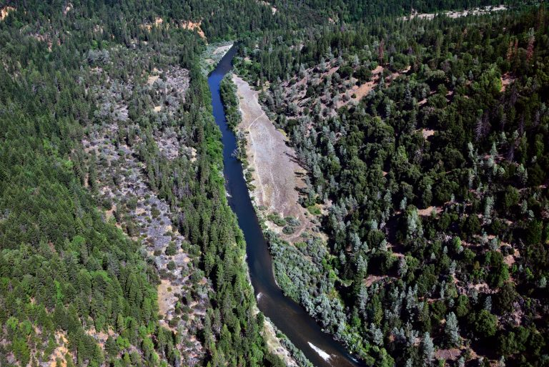
TRRP Refinements:
Progress & Schedule
Comments from PDDC and SPDC members
Q & A
THANKS!

