Slide 1
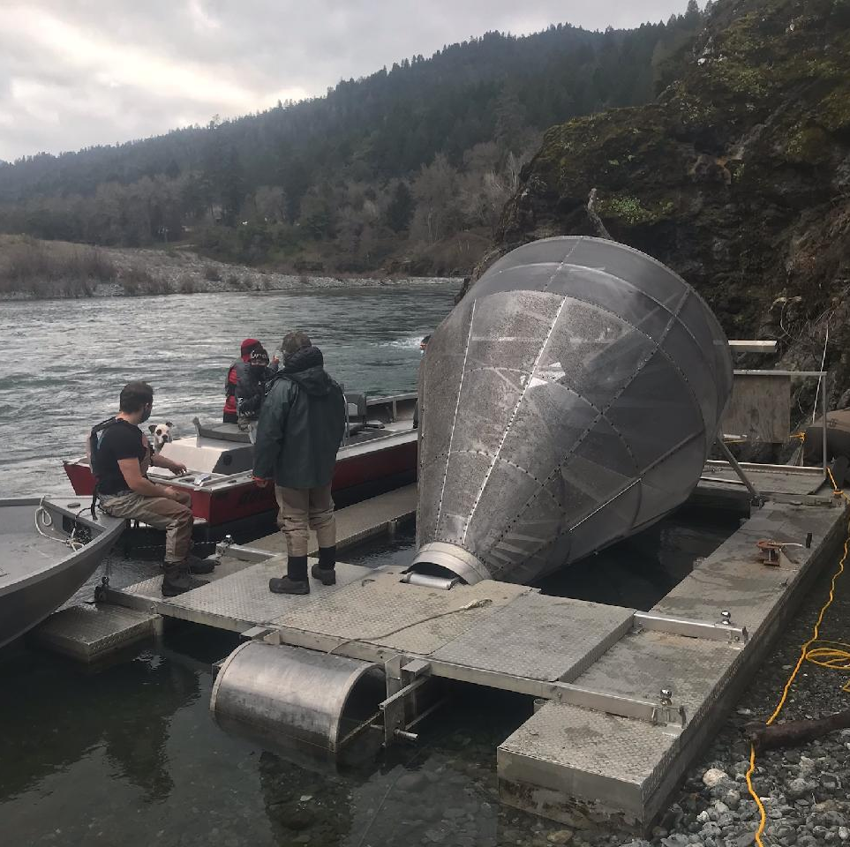
Analysis and Model Evaluation of Long-Term Data Collected at the Willow Creek Outmigrant Trap
Chris Laskodi, Yurok Tribe
Presentation to the TMC
June 17, 2021
Photo: Max Ramos

Slide 2
Background
Outmigrant traps first installed in the late 1980s
  Operated annually since 1989
  Used to assess population, outmigration timing and duration of salmonid species
Several models developed to enumerate population estimates and passage
  Flow-based → expands the count of fish caught in trap by proportion of river that was sampled
  Mark-recapture → expands the count of fish caught in the trap by the recapture of a known amount of marked individuals
  HDAT → relates smolt emigration timing with accumulated daily average water temperatures in Hoopa
In 2016, YTFP published a request for assistance to further develop existing statistical analyses and statistical models to synthesize long-term Trinity River data sets
In 2017, YTFP selected Thomas Gast & Associates Environmental Consultants to evaluate project objectives

Slide 3
Objectives
1) Evaluate influence of water temperature on the outmigration timing of Trinity River Chinook Salmon
2) Evaluate flow-based and mark-recapture population estimates as predictors of RT80 and RT50
3) Quantify the predictive ability of the HDAT model proposed by Hayden and Heacock
4) Evaluate the historical differences between Chinook salmon outmigrant abundance/population on the Trinity River pre and post implementation of the Record of Decision (ROD) flows

Slide 4
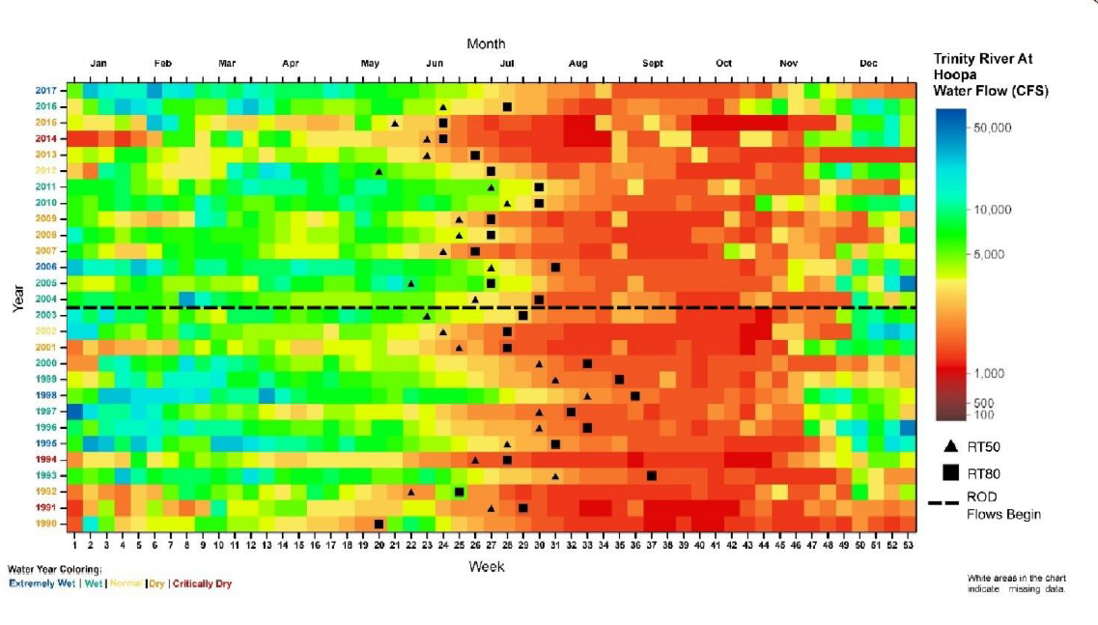
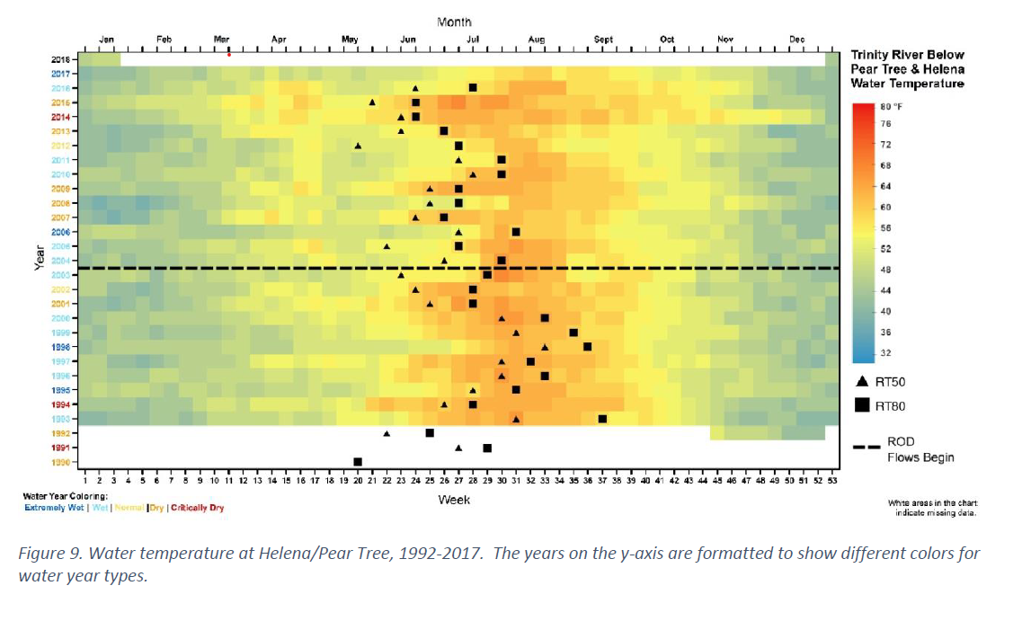
Objective 1 → Evaluate influence of water temperature on the outmigration timing of Trinity River Chinook Salmon

Slide 5
Objective 1 (cont.)

Slide 6
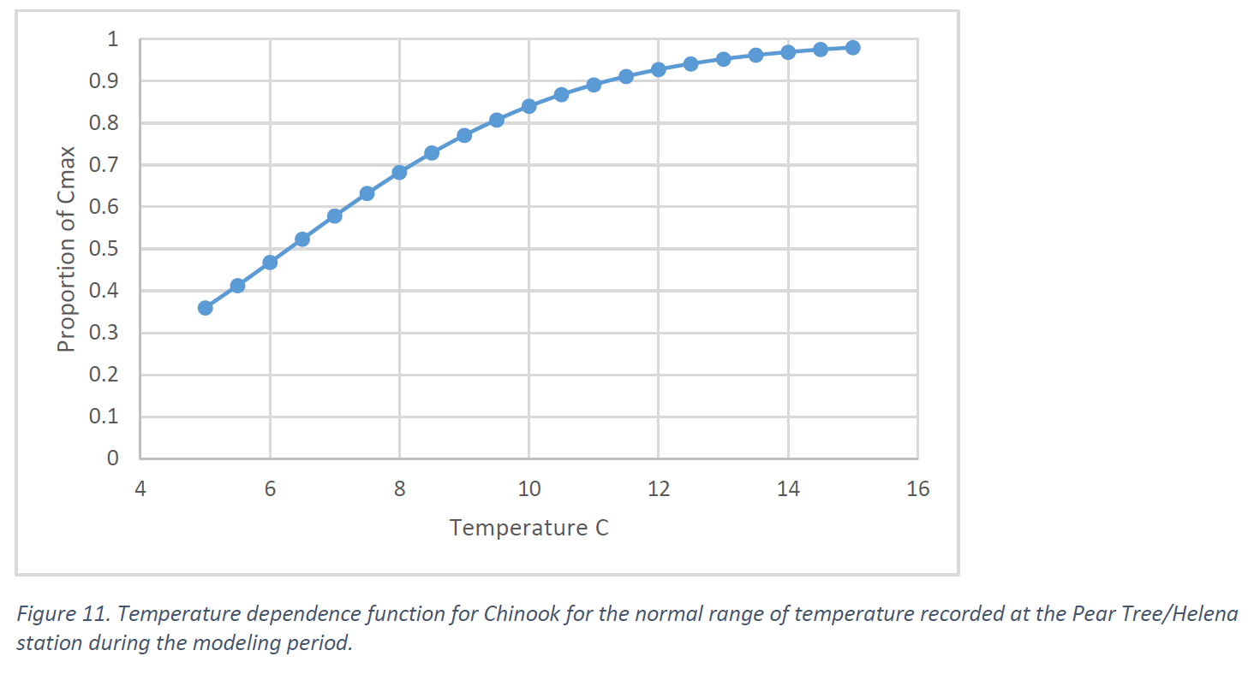
Objective 1 (cont.)
Used Wisconsin Bioenergetics Model 4.0 to simulate daily growth and consumption of Chinook juveniles
Consumption generally declined sharply in late April during the spring ROD flow releases
Model developed to link consumption with discharge and density
  Higher discharge Feb-April (+)
  # of redds and discharge in May (-)
Notes:
Also mention results of relative weights being unimportant

Slide 7
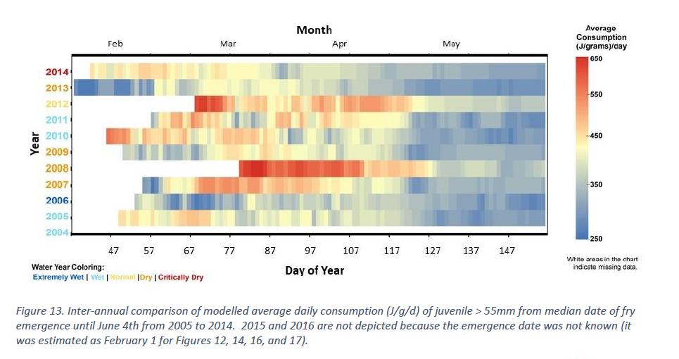

Slide 8
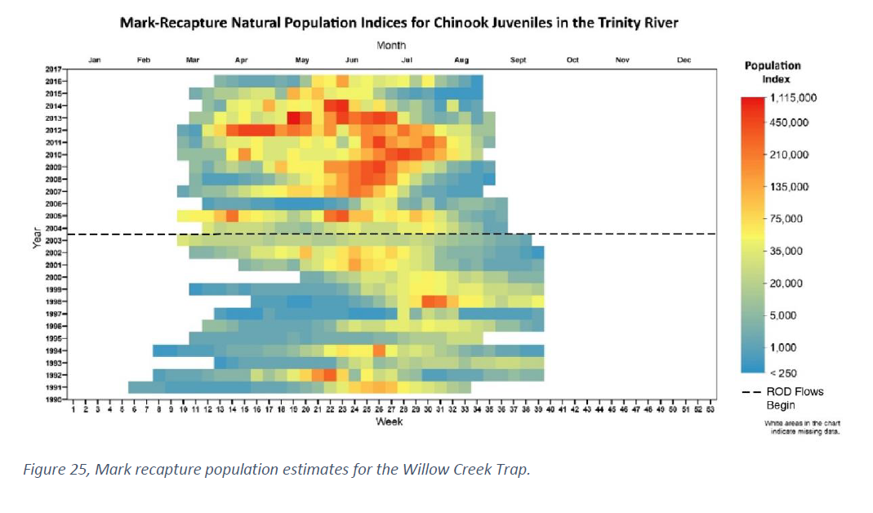
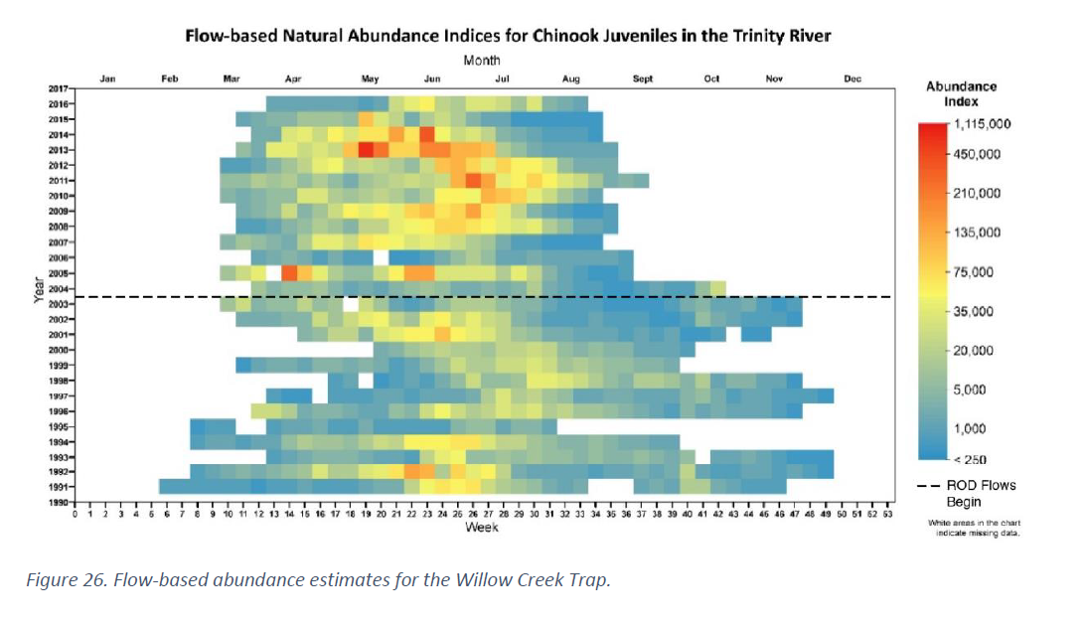
Objective 2 → Evaluate flow-based and mark-recapture population estimates as predictors of RT80 and RT50

Slide 9
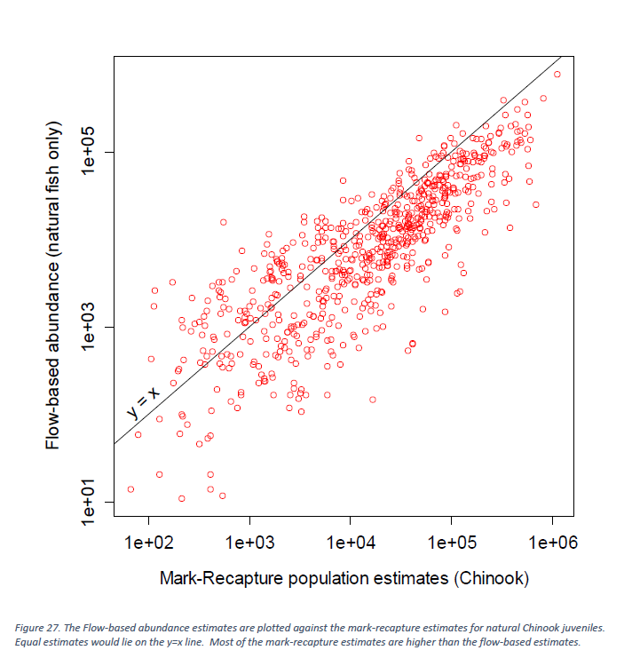

Slide 10
Objective 2 (cont.)
Mark-recapture consistently has higher estimates compared to flow-based
Both methods rely on sets of assumptions
Which is better?
Acoustic tracking or three-dimensional tracking could help address assumptions

Slide 11
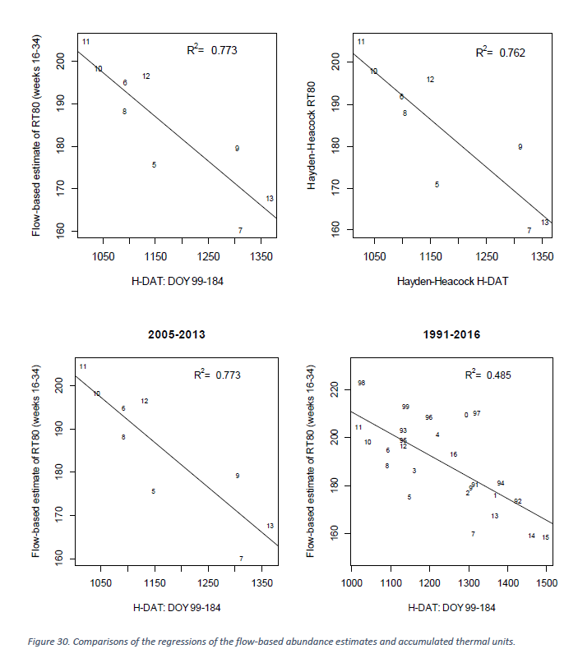
Objective 3 → Quantify the predictive ability of the HDAT model
2013 → Hayden and Heacock develop HDAT model
  Linear regression used to estimate outmigration timing based on water temperatures
HDAT model had large discrepancies when applied to longer time series
Better fit for flow-based estimates than mark-recapture

Slide 12
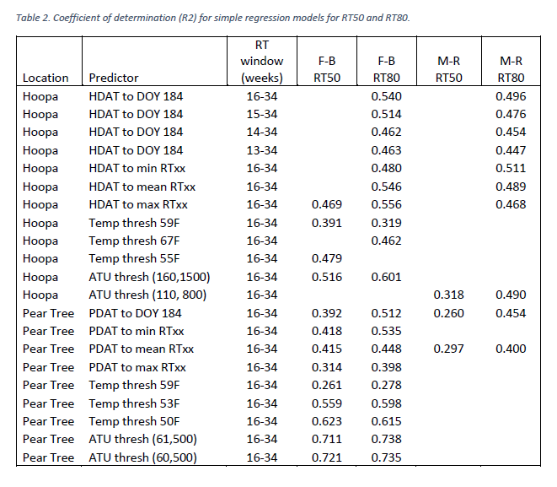
Objective 3 (cont.)
Explored several new models
  PDAT
  Temperature thresholds
  ATU thresholds
Models fit flow-based estimates better than mark- recapture

Slide 13

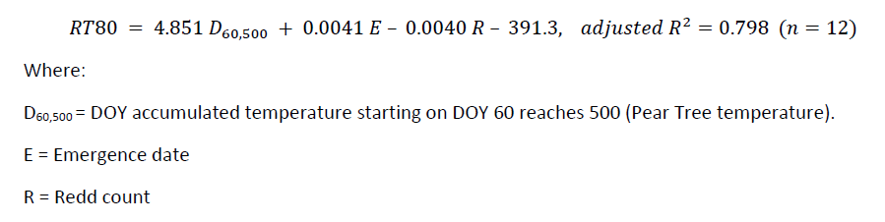
Objective 3 (cont.)
Photo: Max Ramos
Also explored multiple regression models
  Temperature
  Redd counts
  Median emergence date
One model stood out using 3 variables
  Lowest AIC and highest R^2
  Only based off 12 years of record
  Re-examine after more data points

Slide 14
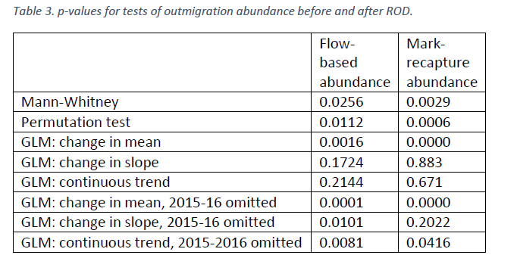
Objective 4 → Evaluate the historical differences between Chinook salmon outmigrant abundance/population pre and post ROD
Differences between pre-ROD and post-ROD were tested using non-parametric methods
Mark-recapture and flow-based highly significant (p < 0.01)
  Number of post-ROD juveniles more abundant
Other GLM also highly significant
Explored relationship between redd counts and outmigrants
  No significant relationships and low R^2

Slide 15
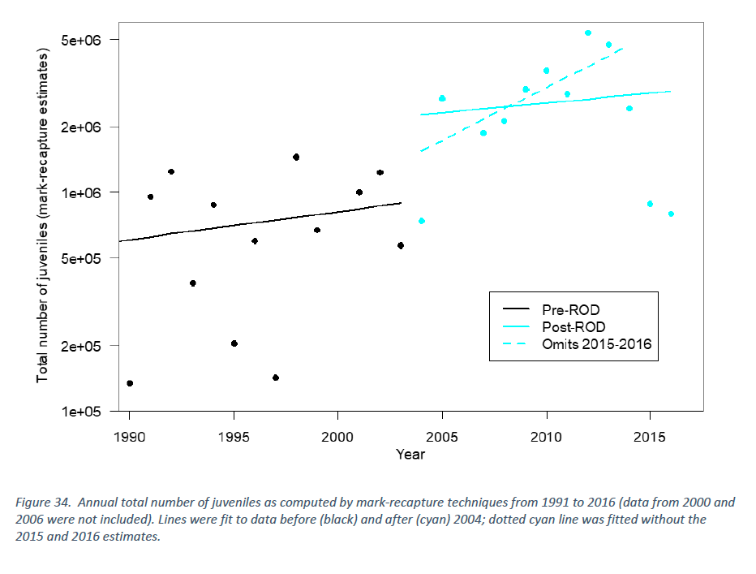
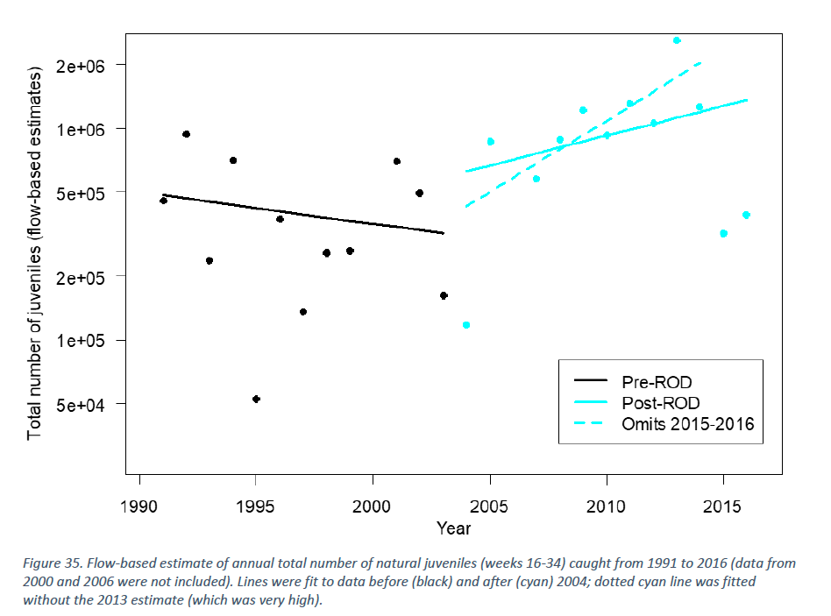

Slide 16
Conclusions
Juvenile Chinook abundance significantly increased post-ROD
Warmer water temperatures during the initial ROD flows could increase the potential for growth and could encourage earlier outmigration
Bioenergetics shows potential consumption rate variable from February-April then a lower consistent level during ROD flows.
HDAT performed worse with longer time-series
Best explanatory model to describe outmigration timing includes PT ATU and PT temperature thresholds
Multivariate models for outmigration also explored but not enough time series data for practical use
Flow-based estimates consistently lower than mark-recapture estimates

