Slide 1
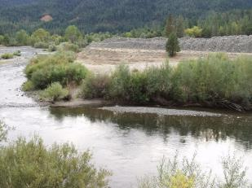
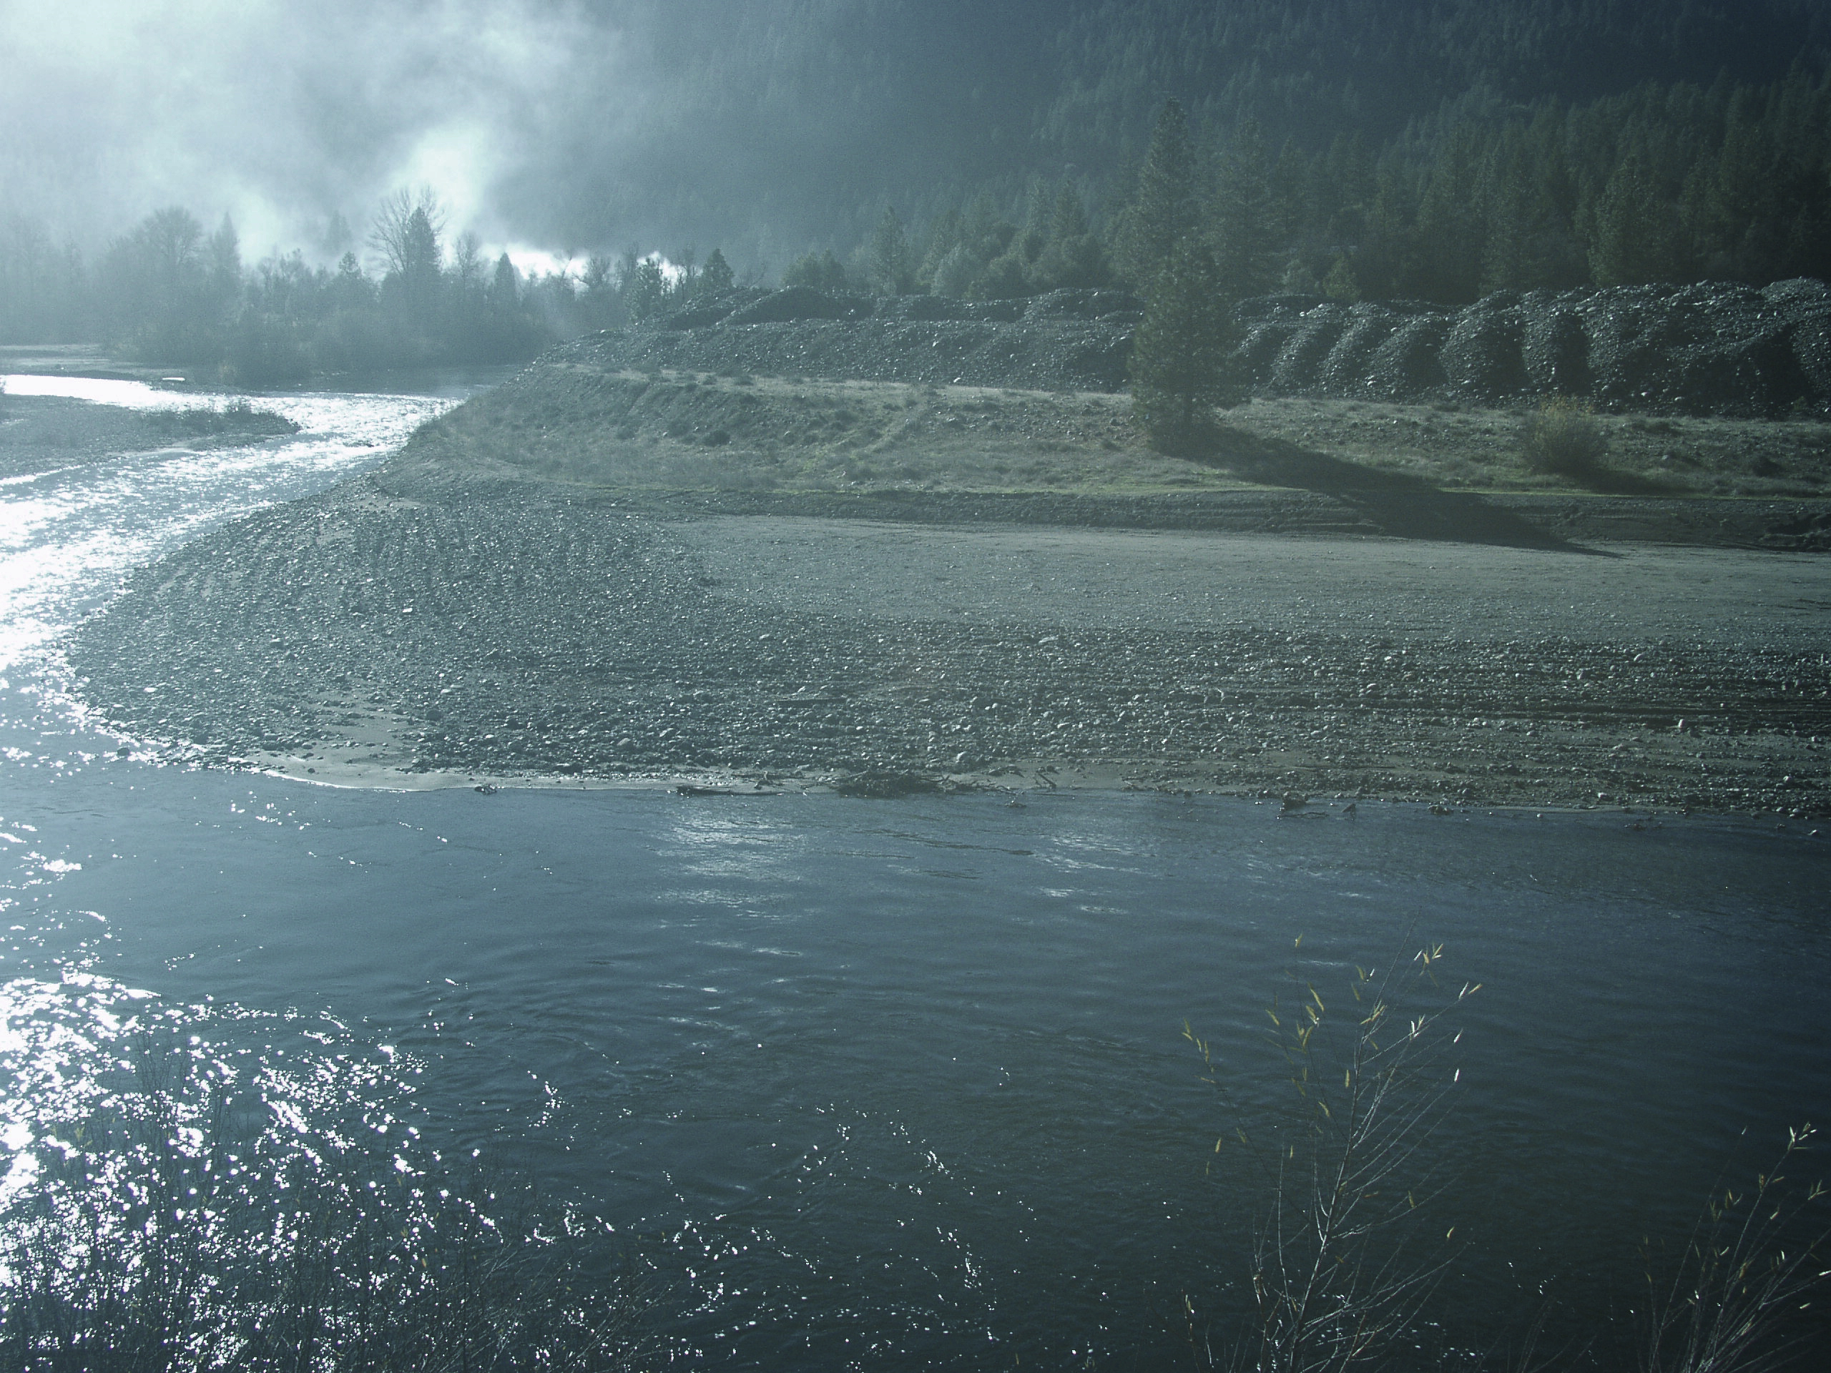
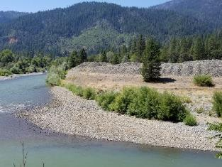
Riparian Encroachment Synthesis
Proposal Identification TRRP-2018-021
2004 2005 2019
John Bair,
Senior Riparian Ecologist,
McBain Associates 980 7th St, Arcata, CA, 95521
(707) 273-1046 john@mcbainassociates.com
May 27, 2021

Slide 2
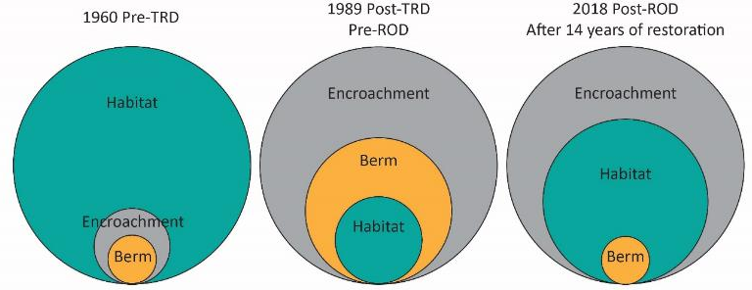
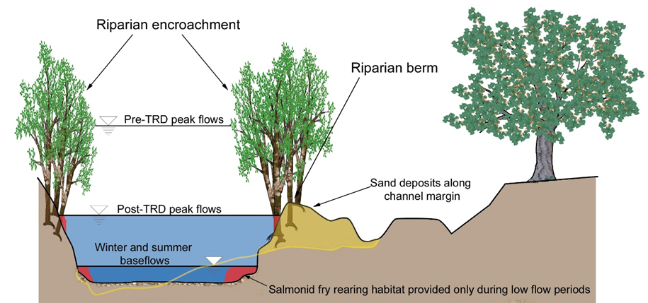
Conceptual model of the changing relationship between juvenile salmonid habitat, sediment berms, and riparian encroachment

Slide 3
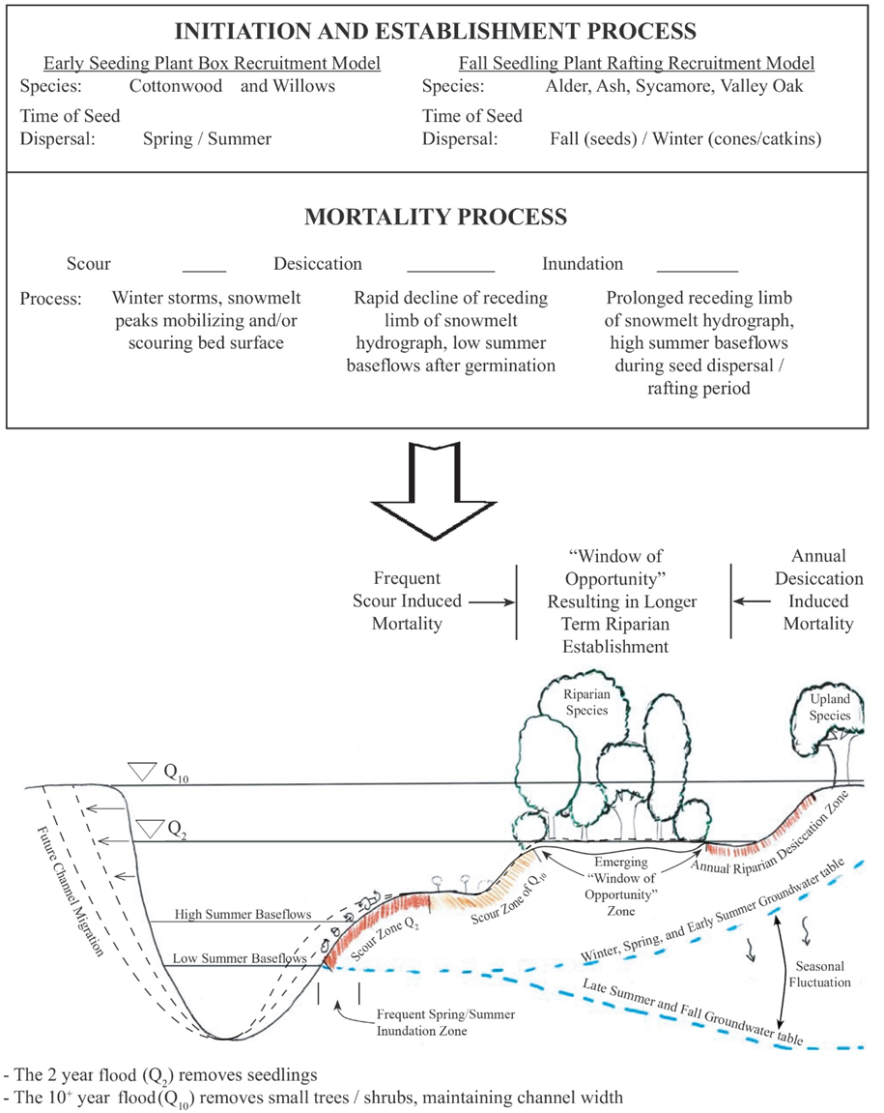
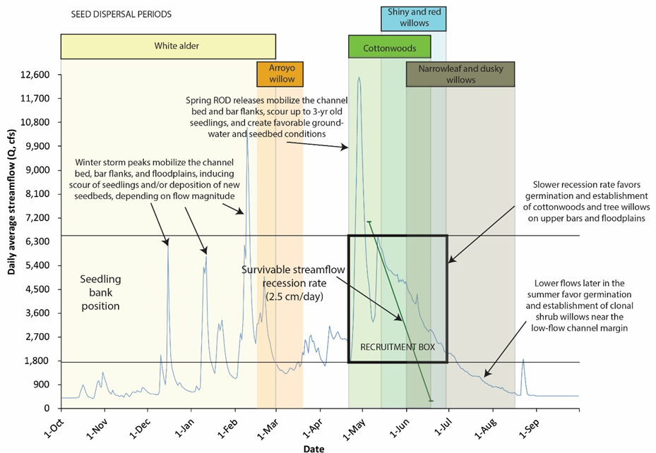
Window of Opportunity

Slide 4
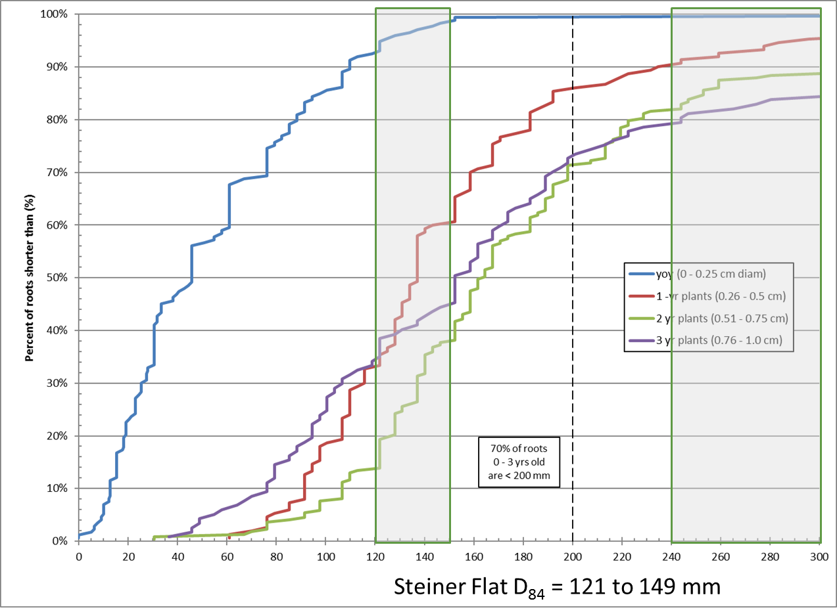
Cumulative rooting depths associated with each age class (n=790)

Slide 5
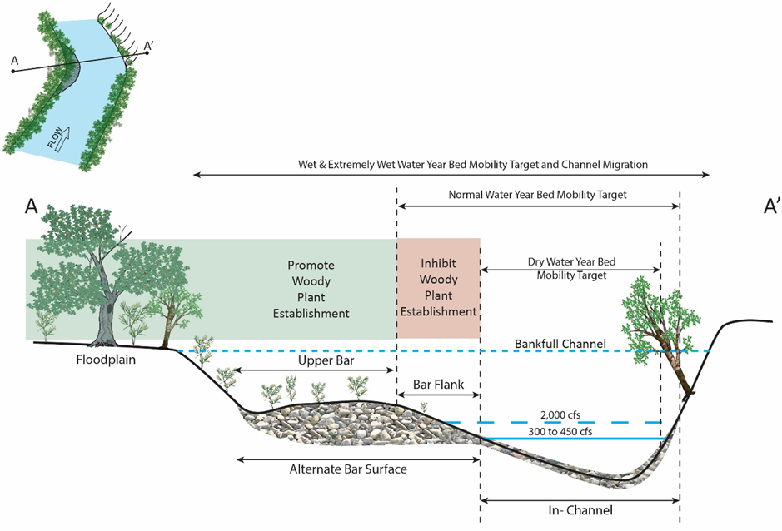
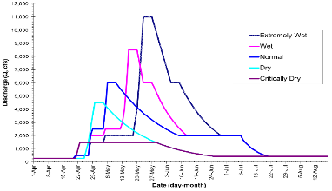
TRFES Riparian Rehabilitation Strategy
Objective | Critically Dry | Dry | Normal | Wet | Extremely Wet
 | (Q_{peak} = 1,500 cfs) | (Q_{peak} = 4,500 cfs) | (Q_{peak} = 6,000 cfs) | (Q_{peak} = 8,000 cfs) | (Q_{peak} = 11,000 cfs)
Bar Flank Bed Mobility | (None) | Mobilize the surface of in-channel alluvial features (e.g., spawning gravel deposits). | Mobilize D₈₄ particles on general channel bed surface and along flanks of alternate bar surfaces. | Mobilize D₈₄ particles on alternate bar surfaces. | Mobilize D₈₄ particles on flanks of alternate bar surfaces.
Bar Flank Bed Scour | (None) | (None) | Channel bed scour and redeposition of gravels. | Channel bed scour greater than 1× D₈₄ depth and redeposition of gravels. | Channel bed scour greater than 2× D₈₄ depth and redeposition of gravels on face of alternate bars.
Bar Flank Riparian Seedling Scour | Discourage germination of riparian plants on lower bar surfaces for the early portion of the seed release period. | Discourage germination of riparian plants on bar flank for the early portion of the seed release period. | Woody riparian vegetation mortality up to 1-yr old along bar flank of alternate bar surfaces. | Woody riparian vegetation mortality up to 2-yr old along bar flank of alternate bar surfaces. | Woody riparian vegetation mortality along low water edge of alternate bar surfaces; scour up to 3-yr old woody riparian vegetation along channel margins and scour younger plants higher on bar flanks.
Upper Bar and Floodplain Riparian Establishment | (None) | (None) | Woody riparian regeneration on upper bar surfaces. | Woody riparian regeneration on upper alternate bar surfaces and floodplains. | Woody riparian regeneration on upper alternate bar surfaces and floodplains.
Large Wood Storage | (None) | (None) | (None) | Increase riparian vegetation and future large wood recruitment. | Increase riparian vegetation and future large wood recruitment.
Promote Riparian Germination Lower in the Channel via Lower Summer Baseflows | Not adopted due to water quality (i.e., temperature) criteria | Not adopted due to water quality (i.e., temperature) criteria | Not adopted due to water quality (i.e., temperature) criteria | Not adopted due to water quality (i.e., temperature) criteria | Not adopted due to water quality (i.e., temperature) criteria
Notes:
5

Slide 6
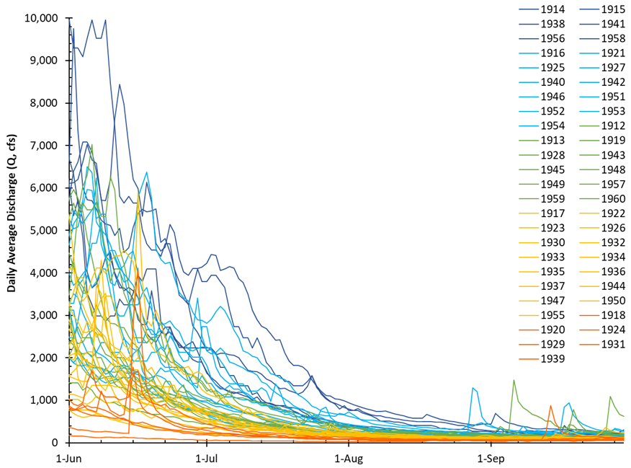
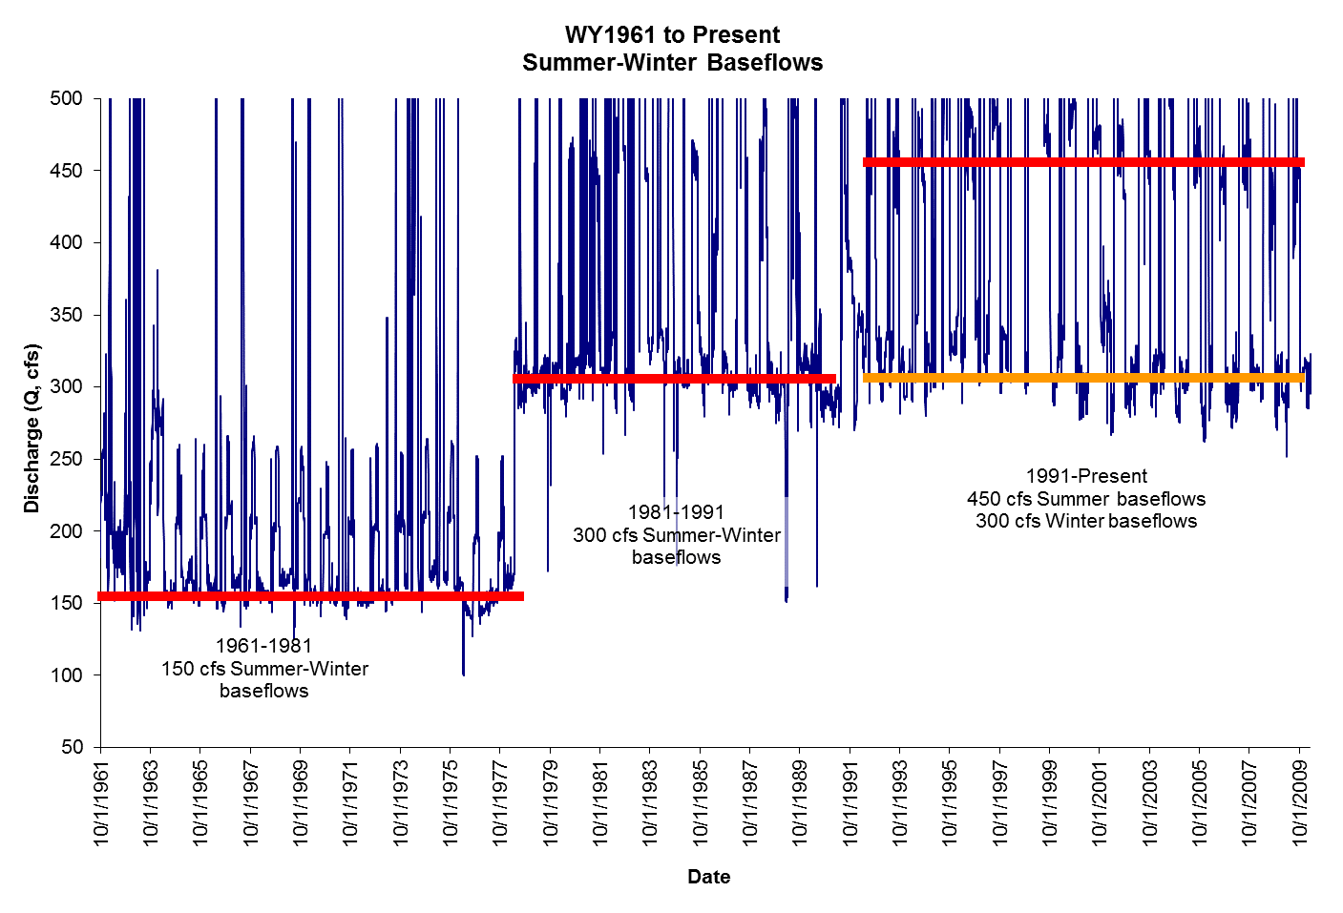
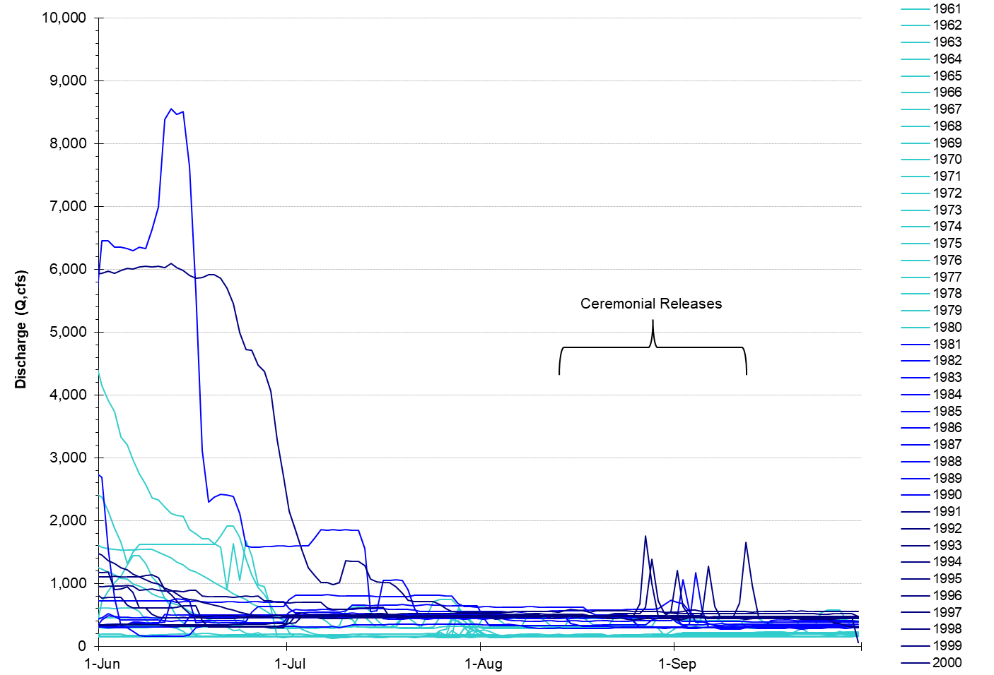
Daily average summer baseflows at Lewiston

Slide 7
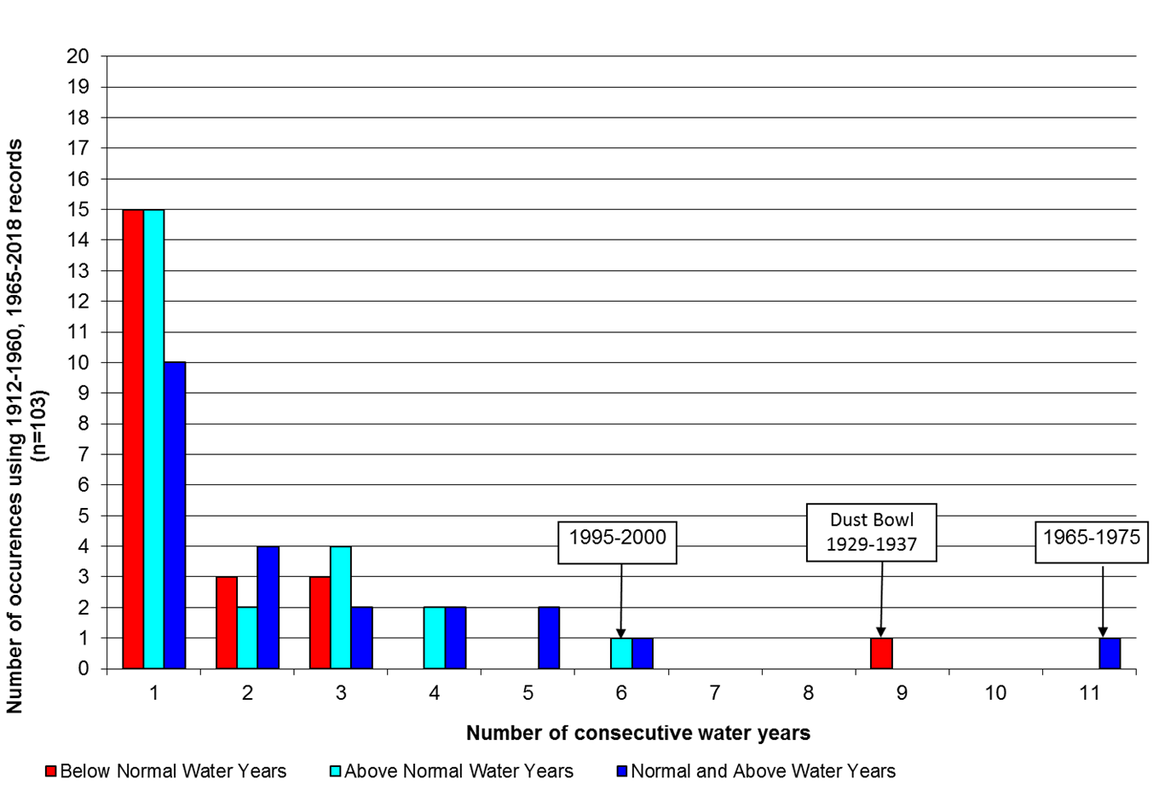
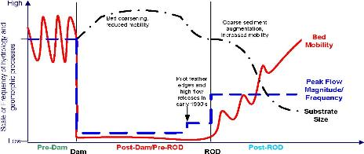
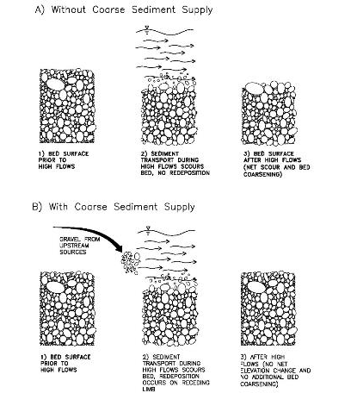
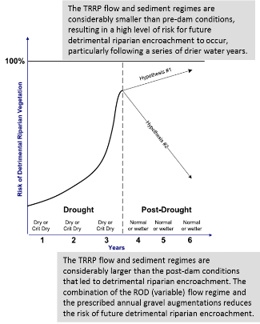
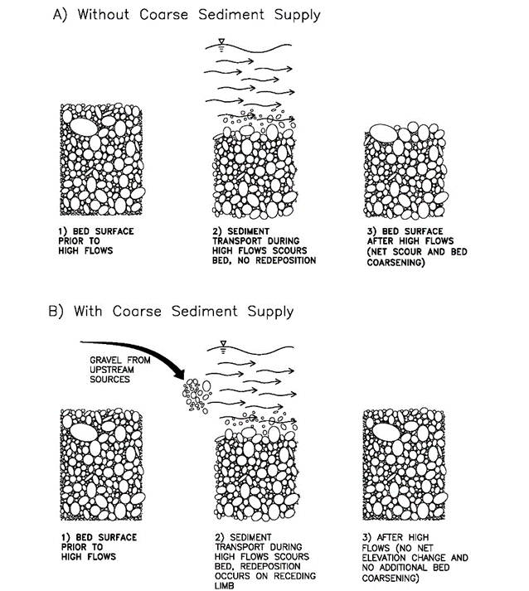
Competing detrimental encroachment hypotheses

Slide 8
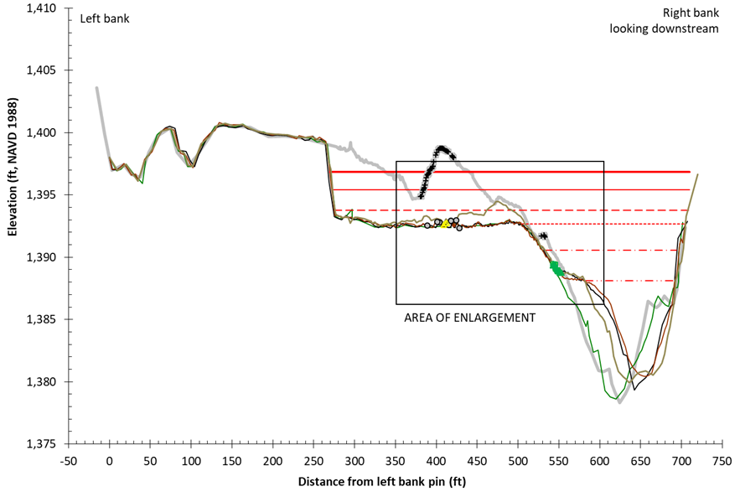
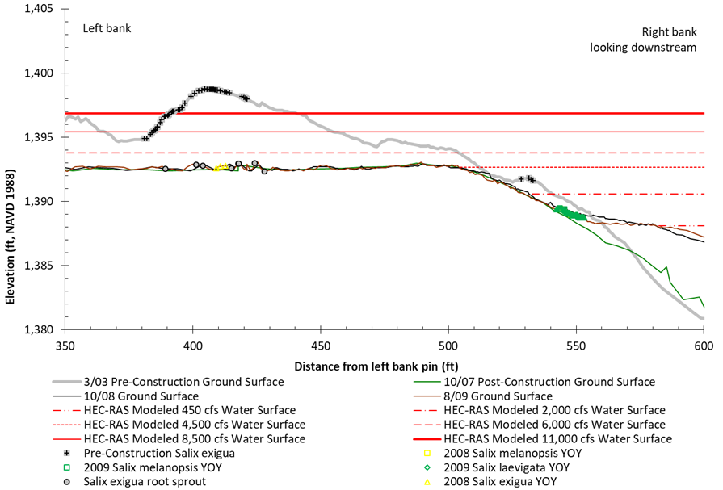
2005 - 2009 Period
Valdor Gulch
Site | Year Constructed | First Cohort that Could Colonize the Surface
Hocker Flat | 2005 | 2006 cohort
Lewiston Hatchery Coarse Sediment Augmentation | 2006 | 2007 cohort
Lower Conner Creek | 2006 | 2007 cohort
Elkhorn | 2006 | 2007 cohort
Pear Tree Gulch | 2006 | 2007 cohort
Valdor Gulch | 2006 | 2007 cohort
Indian Creek | 2007 | 2008 cohort
Dark Gulch/Bucktail | 2008 | 2009 cohort
Lewiston 4 (Sven Olbertson, Deadwood Creek, Cableway, and Hoadley Gulch) | 2008 | 2009 cohort
Sawmill | 2009 | 2010 cohort
Water Year | Instantaneous Maximum Lewiston Streamflow (cfs) | Cohorts Scoured | Surviving Cohorts | Persisting Cohorts
2005 | 7,640 | 2004 cohort | None | 1993, 1998, 2000 and 2002 cohort
2006 | 10,400 | 2003, 2004, and 2005 cohorts | None | 1993, 1998, 2000 and 2002 cohort
2007 | 4,810 | None | 2006 cohort | 1993, 1998, 2000, 2002 and 2006 cohort
2008 | 6,890 | 2007 cohort | 2006 cohort | 1993, 1998, 2000, 2002 and 2006 cohort
2009 | 4,630 | None | 2006 and 2008 cohort | 1993, 1998, 2000, 2002, 2006 and 2008 cohort

Slide 9
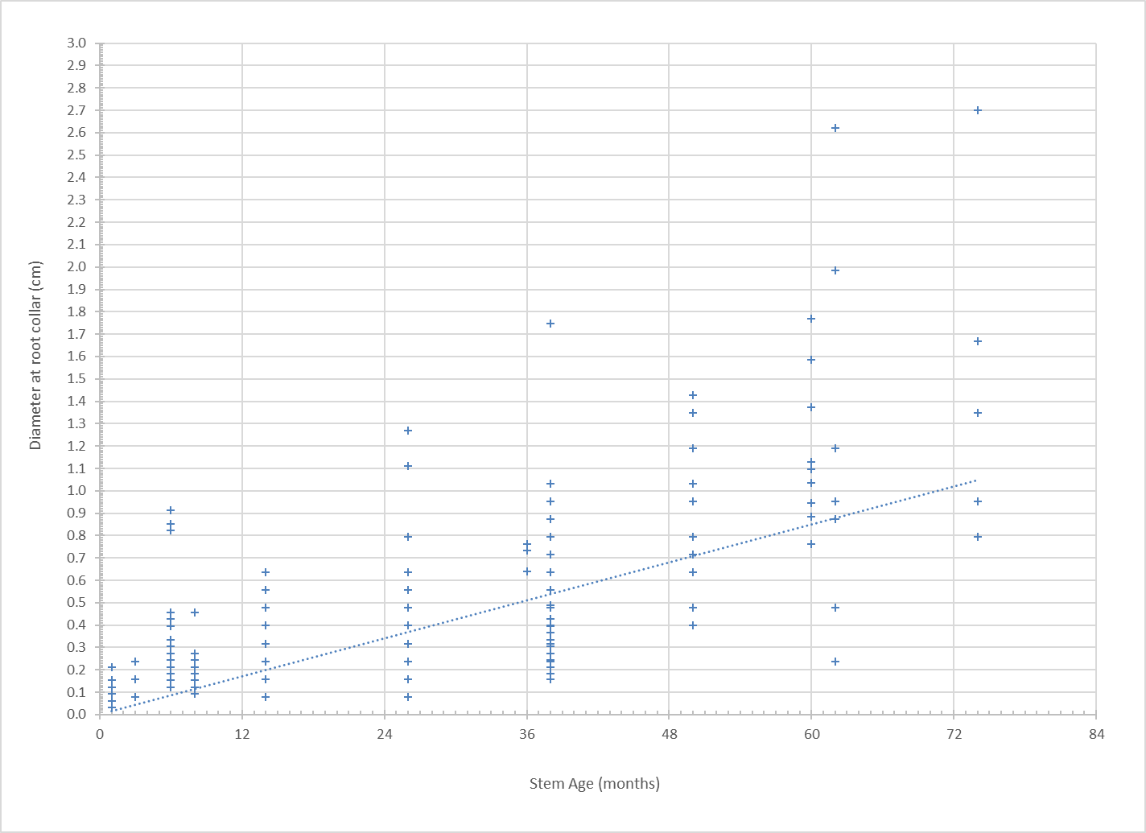
2010-2012 Period
GRTS Panel | Water Year
 | 2009 | 2010 | 2011 | 2012 | 2013 | 2014 | 2015 | 2016 | 2017 | 2018 | …
1 | X | X |  |  | X | X |  |  |  | X
2 |  | X | X |  |  | X | X
3 |  |  | X |  |  |  | X | X
4 |  |  | X | X |  |  |  | X | X
5 |  |  |  | X | X |  |  |  | X | X
…. |  |  |  |  |  |  |  |  |  |  | …
Site | Year Constructed | First Cohort that Could Colonize the Surface
Lowden Ranch | 2010 | 2011 cohort
Reading Creek | 2010 | 2011 cohort
Trinity House Gulch | 2010 | 2011 cohort
Wheel Gulch | 2011 | 2012 cohort
Lower Steiner Flat | 2012 | 2013 cohort
Upper Junction City | 2012 | 2013 cohort
Size Class (cm) | Dominant Plant Age | Q to Remove | WY Type to Remove | Risk Code | Risk Description
0.0–0.25 | Young-of-Year | 6,000 cfs | Normal and wetter | Green | Moderate risk, these hardwoods should be watched to evaluate if they get to the 2-yr old stage; no modification of the hydrograph needed
0.26–0.50 | 1-year-old | 6,000 cfs | Normal and wetter | Green | Moderate risk, these hardwoods should be watched to evaluate if they get to the 2-yr old stage; no modification of the hydrograph needed
0.51–0.75 | 2-year-old | 8,500 cfs | Wet and wetter | Yellow | High risk, 8,500 cfs suggested for that year; may recommend subtle adjustments to hydrograph release for that given water year
0.76–1.0 | 3-year-old | 11,000 cfs | Extremely Wet | Red | Extreme Risk, 11,000 cfs suggested that year; may need to modify hydrograph release for that given water year
1.01–1.50 | 4-year-old | Unlikely to remove with flows alone | N/A | Grey | Beyond what ROD streamflows are expected to remove
1.51–2.0 | 5-year-old | Unlikely to remove with flows alone | N/A | Grey | Beyond what ROD streamflows are expected to remove
Plant Size (DRC, cm) | Plant Age | Plant Density Encroachment Threshold (plants/ft²) | Plant Density Encroachment Threshold (plants/m²)
0–0.25 | Young-of-Year (YOY) | 16 | 172
0.26–0.50 | 1-year
0.51–0.75 | 2-year | 0.65 | 7
0.76–1.0 | 3-year | 0.15 | 2
> 1.0 | > 3-year | 0.11 | 1
Water Year | Instantaneous Maximum Lewiston Streamflow (cfs) | Cohorts Scoured | Surviving Cohorts | Persisting Cohorts
2010 | 7,480 | 2009 cohort | 2006 and 2008 cohort | 1993, 1998, 2000, 2002, 2006 and 2008 cohort
2011 | 12,300 | 2008, 2009, and 2010 cohorts | 2006 cohort | 1993, 1998, 2000, 2002 and 2006 cohort
2012 | 6,180 | 2011 cohort | 2006 cohort | 1993, 1998, 2000, 2002 and 2006 cohort

Slide 10
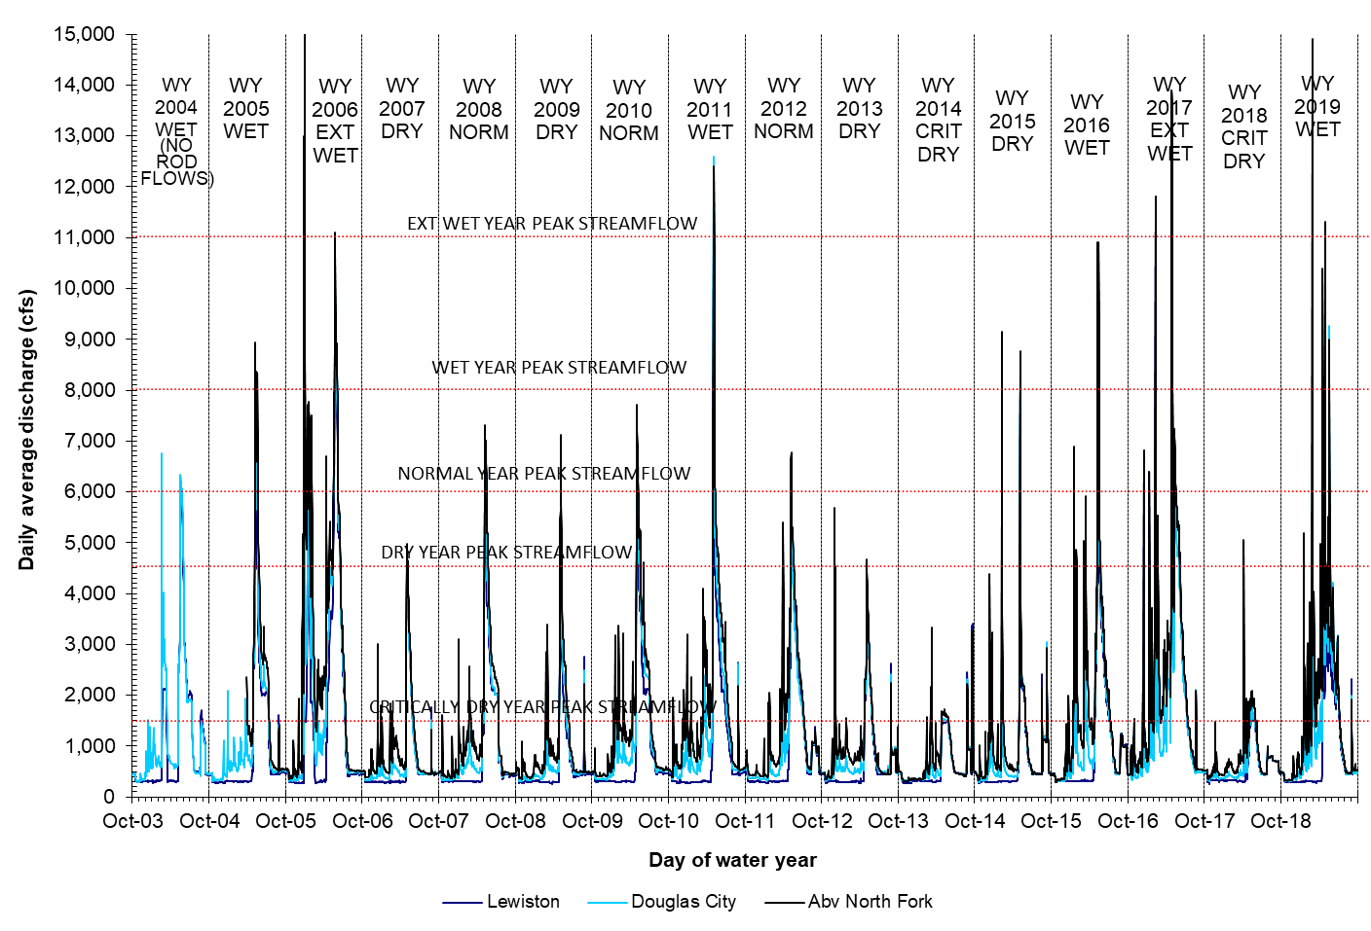
WY 2004 to WY 2019 hydrographs and water year sequencing (n= 16 yrs)
Cohort | Discharge that kills cohort
YOY | 6,000 cfs
1 yr | 6,000 cfs
2 yr | 8,500 cfs
3 yr | 11,000 cfs
>3 yr | > 11,000cfs
?
1
2
3
YOY

Slide 11
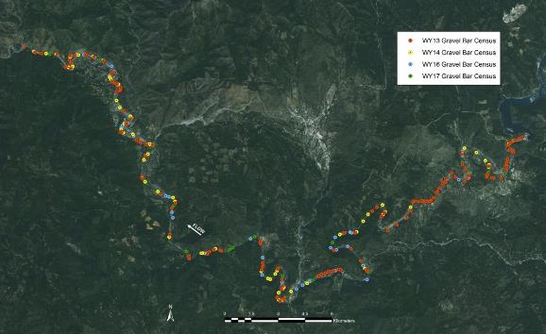
2013-2017 Period
Type of Bar | 2012 | 2013 | 2015 | 2016
Bars totally inundated at less than 2,000 cfs | 69 | 125 | 126 | 103
Bars totally inundated at more than 2,000 cfs | 69 | 68 | 68 | 88
Total | 138 | 193 | 194 | 191
Site | Constructed | First Cohort that Could Colonize the Surface
Douglas City 2013 | 2013 | 2014 cohort
Lorenz Gulch | 2013 | 2014 cohort
Lower Junction City | 2014 | 2015 cohort
Douglas City 2015 | 2015 | 2016 cohort
Limekiln Gulch | 2015 | 2016 cohort
Bucktail | 2016 | 2017 cohort
Water Year | Instantaneous Maximum Lewiston Streamflow (cfs) | Cohorts Scoured | Surviving Cohorts | Persisting Cohorts
2013 | 4,590 | None | 2006 and 2012 cohort | 1993, 1998, 2000, 2002, 2006 and 2012 cohort
2014 | 3,460* | None | 2006, 2012, and 2013 cohort | 1993, 1998, 2000, 2002, 2006, 2012, and 2013 cohort
2015 | 8,830 | 2013 and 2014 cohorts | 2006 and 2012 cohort | 1993, 1998, 2000, 2002, 2006 and 2012 cohort
2016 | 9,600 | 2012 and 2015 cohorts | 2006 cohort | 1993, 1998, 2000, 2002, and 2006 cohort
?
*The peak discharge of 2014 was not associated with spring ROD flows, rather it occurred on September 22, 2013, and was associated with Lower Klamath River water temperature and fish health flows.

Slide 12
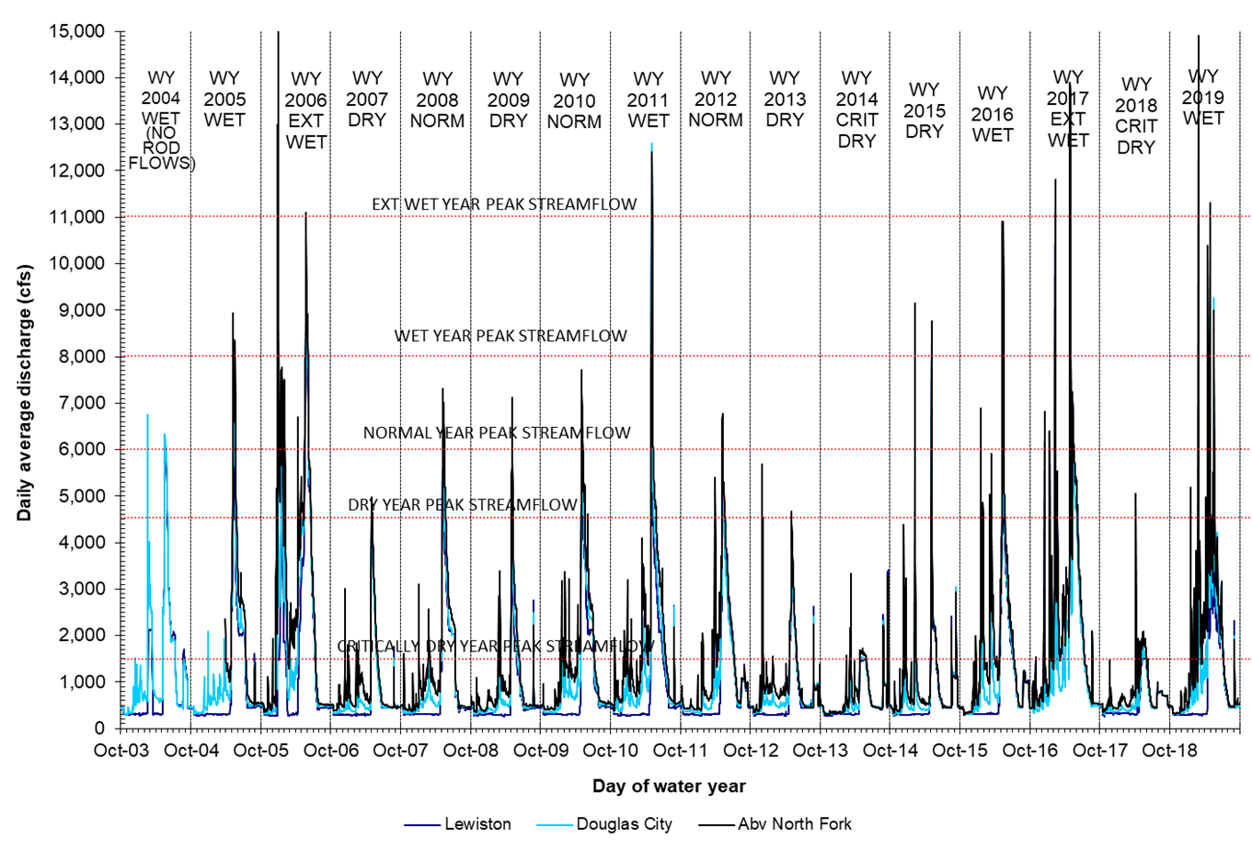
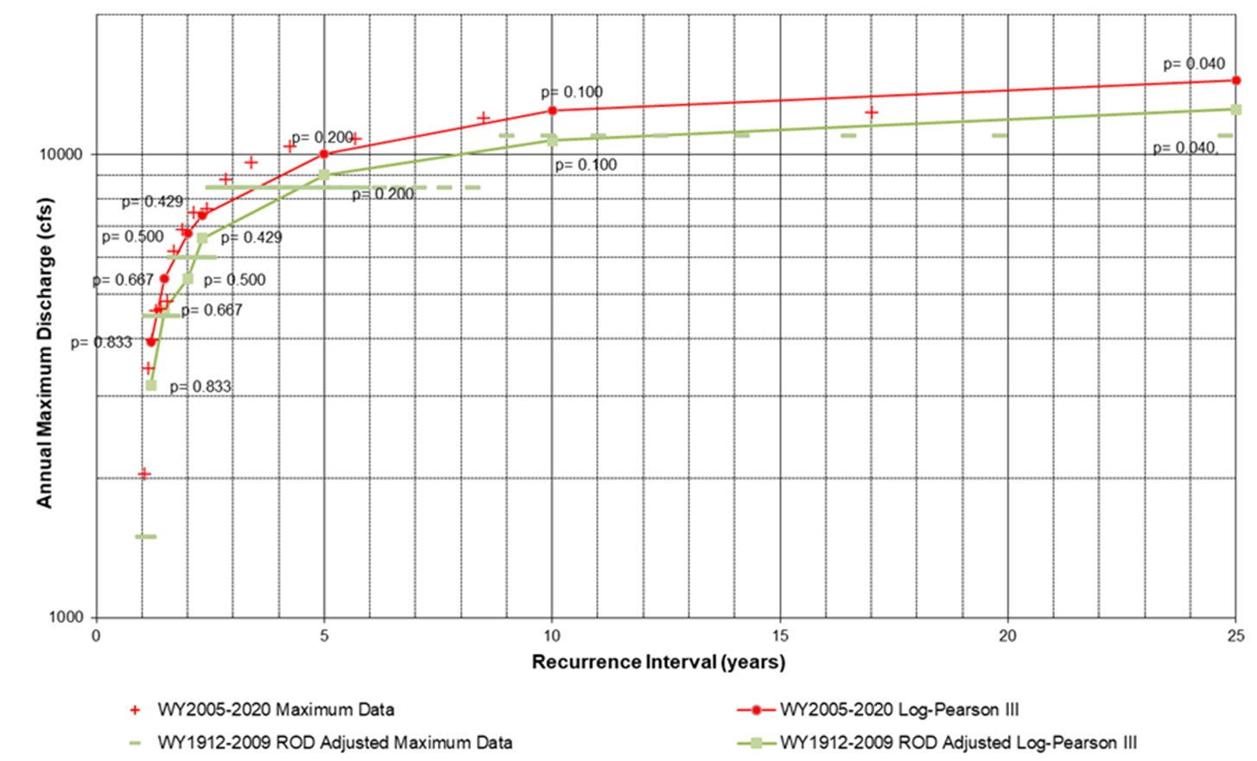
Reflections on Streamflow Management
The TRRP has utilized the flexibility in ROD hydrograph schedules to reach the maximum allowable peak streamflow release as frequently as possible in Normal and wetter years.
The purpose for increasing maximum flood peak frequency has maximized the amount of geomorphic work and sediment transport

Slide 13
Evaluation of detrimental encroachment hypotheses
x
Water Year | Water Year Class Based on April 1 Inflow Forecast | TRFE Minimum Recommendation (U.S. Tons) | Actual Total Augmentation (U.S. Tons) | Difference (U.S. Tons)
2000 | WET | 13,700 | 2,781 | –10,919
2001 | DRY | 206 | 0 | –206
2002 | NORMAL | 2,466 | 0 | –2,466
2003 | NORMAL | 13,700 | 2,740 | –10,960
2004 | WET | 13,700 | 0 | –13,700
2005 | WET | 13,700 | 0 | –13,700
2006 | EXT WET | 42,470 | 2,302 | –40,168
2007 | DRY | 206 | 6,138 | 5,932
2008 | NORMAL | 2,466 | 17,002 | 14,536
2009 | DRY | 206 | 11,179 | 10,974
2010 | NORMAL | 2,466 | 22,454 | 19,988
2011 | WET | 13,700 | 7,288 | –6,412
2012 | NORMAL | 2,466 | 0 | –2,466
2013 | DRY | 206 | 2,329 | 2,124
2014 | CRIT DRY | 0 | 0 | 0
2015 | DRY | 206 | 3,781 | 3,576
2016 | WET | 13,700 | 4,932 | –11,398
2017 | EXT WET | 42,470 | 7,672 | –34,798
2018 | CRIT DRY | 0 | 0 | 0
2019 | WET | 13,700 | 4,795 | –8,905
2020 | CRIT DRY | 0 | 0 | 0

Slide 14
Recommendations
Review, Revise, and Adopt a Reach-based Prediction of Achievable Channel Pattern
Develop and Adopt a Revised Vegetation Encroachment Hypothesis
  H01: The 6,000, 8,500, and 11,000 cfs flood events occurring at the frequency of Normal and wetter years cannot inhibit near channel woody seedling establishment and the formation of a dense band of vegetation after a period of three consecutive dry years.
  HA1: The 6,000, 8,500, and 11,000 cfs flood events occurring more frequently than Normal and wetter years and during dry periods can inhibit near channel woody seedling establishment and disrupt the formation of a dense band of vegetation even after a three-year dry period.
Evaluate Current Berm Condition
Evaluate and Revise the Conceptual Model for Coarse Sediment Augmentation and Update the Coarse Sediment Management Plan
Repeat the Exposed Gravel Bar Census in Normal and Wetter Years
Annually Estimate Detrimental Encroachment Risk to Inform Annual Flow Scheduling
Evaluate Variable Summer Baseflows and Conduct Flow Experiment

