Slide 1
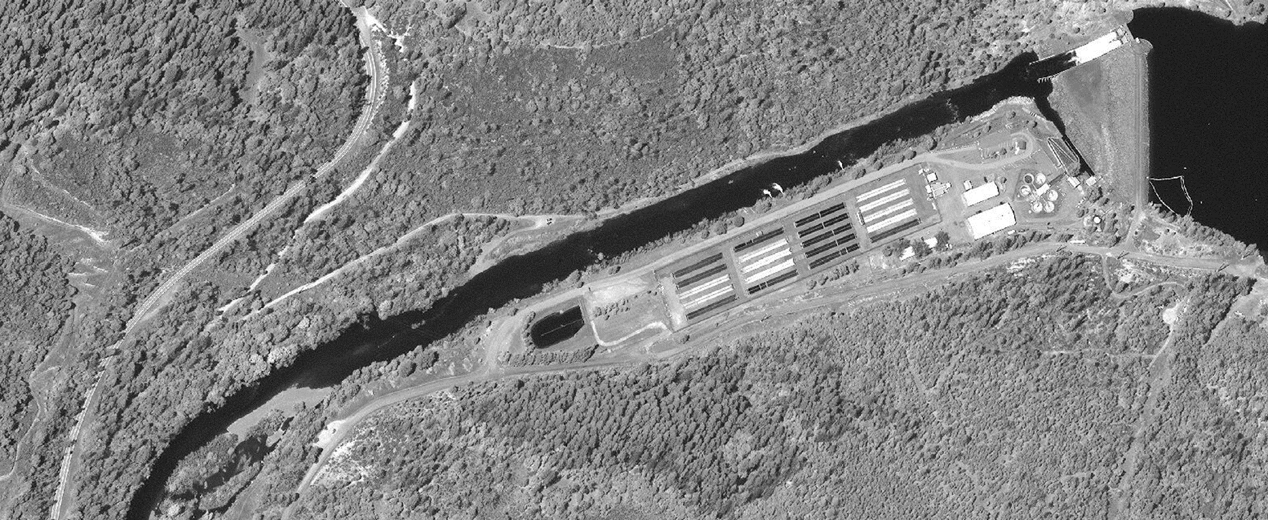
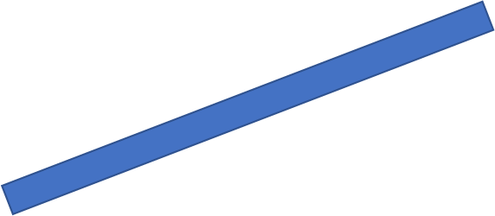
Gravel Augmentation Summer 2021
Location: Hatchery Reach

Slide 2

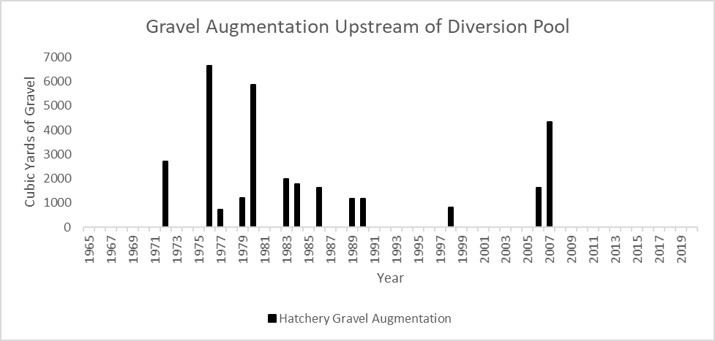
Gravel Augmentation Summer 2021
OBJECTIVES:
Reduce Gravel Deficit between Lewiston Dam and Weir Hole
Enhance Spawning Habitat
Enhance Hydraulic Diversity and Juvenile Rearing Habitat

Slide 3
Gravel Augmentation Summer 2021
PLAN DETAILS:
On-going: Stockpile Gravel (0.5 – 4” D₅₀)
July 15 – August 15: Gravel Placement
  Target 5,500 CY
  Average Depth 1 foot
  Placement from Right Bank
  Flow Diversion to Left Bank
Placement Assumes ROD Flows only

