Slide 1
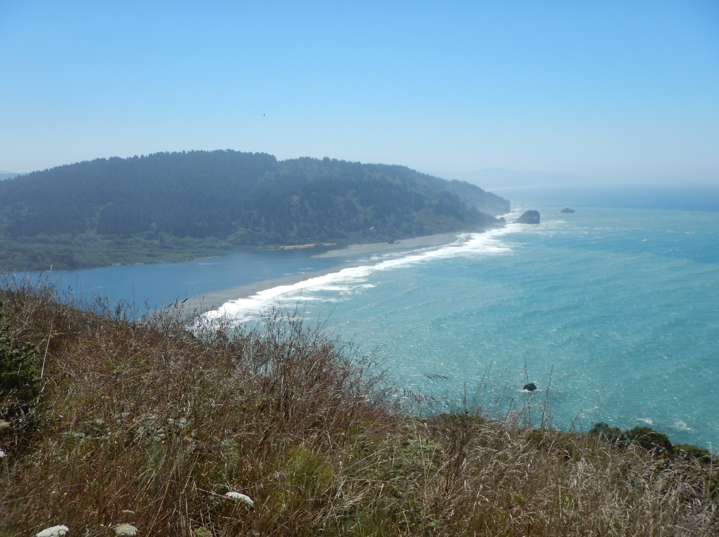

Klamath Basin
Fall Chinook Management
Determination of quotas and fishery regulations
Trinity Management Council presentation
June 16, 2021
Wade Sinnen, CDFW
Notes:
1. Introduce self, title, project 2. describe what you will be presenting (age structured in-river harvest and escapement data) 3. Describe its importance ( Data is used to forecast ocean abundance of Klamath stock, which is then modeled for fishery impacts and 2021 escapement, which is the basis for ocean season structure and in-river quota allocation)

Slide 2
Presentation Overview
In-river monitoring and age structure estimation
Forecasting ocean abundance and projected river return
Escapement objectives and de minimus provisions
Pacific Management Fishery Council harvest allocations
State regulatory process
Adopted 2021 regulations

Slide 3














In-river fall Chinook monitoring
and landowners
Notes:
All the agencies, tribes and NGO’s that participate. Stress the importance of the team effort and cooperation

Slide 4
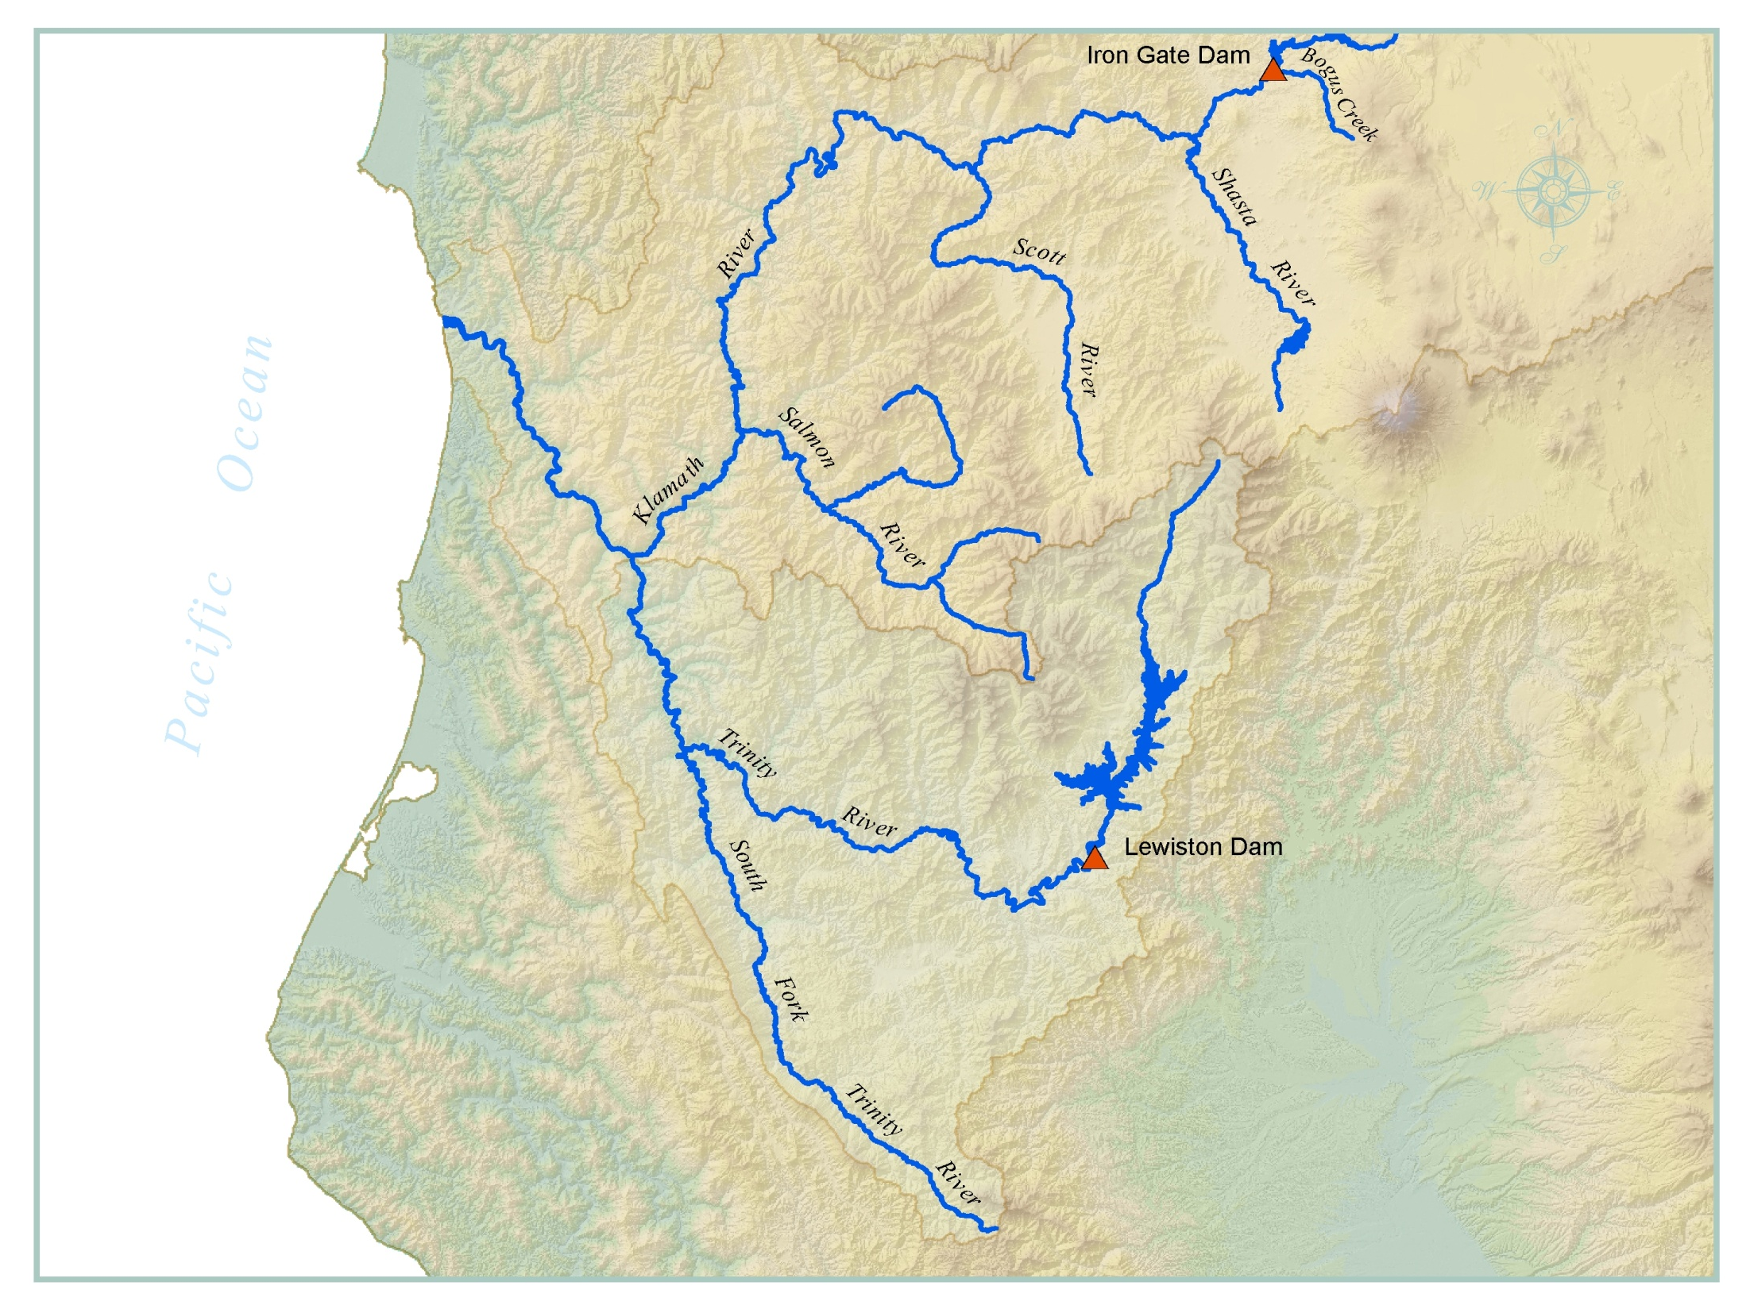




Klamath River Basin
Iron Gate Hatchery
Crescent City
Eureka
Trinity River Hatchery
Carcass/redd surveys
CDFW Weirs
Creel survey
Notes:
Monitoring locations- Monitor harvest, natural and harvest escapement.

Slide 5
Age Composition of the 2020 Klamath Basin fall Chinook Salmon run
Source: 2021 KRTT
Notes:
This table depicts age information which is mostly based on scale analyses, some areas use surrogates from other nearby areas. This data is used to estimate ocean stock abundance by age and is the starting point for regulatory prescriptions and harvest modeling and allocation to the various user groups. I like to review parts of this table such as pointing out adult natural spawners.

Slide 6
The is the start of the Pacific Fisheries Management Council Process

Slide 7

2021 Ocean abundance projection for Klamath fall Chinook adults (age 3-5)
Age 3 – 135,569
Age 4 – 45,124
Age 5 -739
Total = 181,432
However, natural mortality, age-based maturation rates and stray rates reduce the expected number that will return to the mouth of the Klamath river mouth in any given year. Additionally, an annual proportion of the return will escape to basin hatcheries. These fish are not counted toward natural escapement goals.
In 2021, the forecast for natural-area escapement, absent fisheries is 42,098.

Slide 8

2021 Klamath basin escapement object under de minimus fisheries
The standard Klamath basin natural area adult spawner escapement objective is 40,700 fall Chinook. Escapement above this level is termed the “harvestable surplus”.
However, when the stock projection does not allow for prosecuting minimal tribal and non-tribal fisheries, de minimumus, rules can be applied. The de minimus rule allows for targeting lower escapement.
The 2021 forecast for escapement, under de minimus rules, is 31,574 natural area adults

Slide 9
2021 Klamath basin allocations
The harvestable surplus of adult Klamath River fall Chinook salmon is split between Federally recognized tribal and non-tribal fisheries 50:50.
The non-tribal share is split between CA and OR ocean fisheries (commercial and recreational) and in-river fisheries. The in-river recreational fishery typically receives a minimum of 15%.
2021 Klamath River adult fall Chinook Salmon allocations
Tribal – 8,135
In-river recreational – 1,221

Slide 10
Fish and Game Commission Regulatory Process
Annual process
Involves three meetings (Notice, Discussion and Adoption)
PFMC allocations influence regs directly (auto conformance in ocean fisheries) or indirectly by size of allocation (in-river regulations)
CDFW or Public can make recommendations on annual regs
Typically, CDFW proposes initial regs for Notice meeting that contain a range for quota, seasons and bag and possession limits.
CDFW also makes recommendations for final regs that are consistent with quota size and other factors.
Based on the small quota this year of 1,221 adult fall Chinook, CDFW recommended a daily bag of 2 fish, no more than 1 adult (>23 inches) and possession of 6 fish, no more than 3 adults

Slide 11
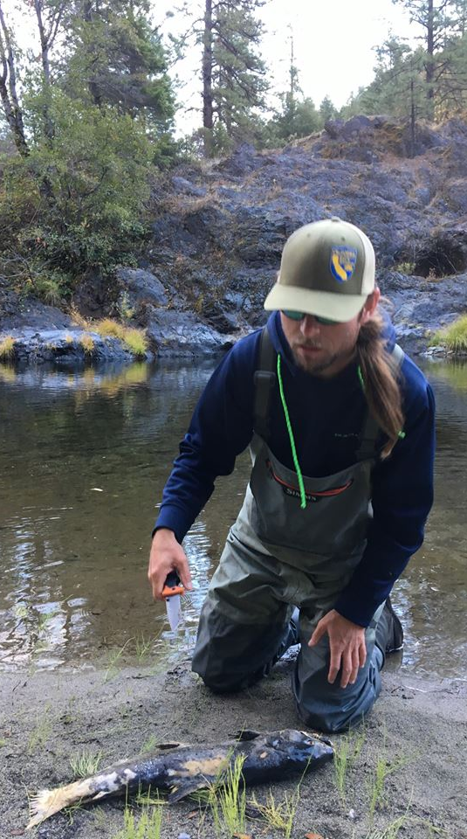
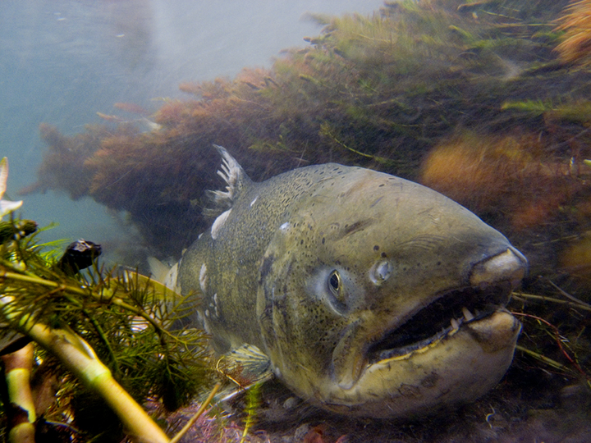
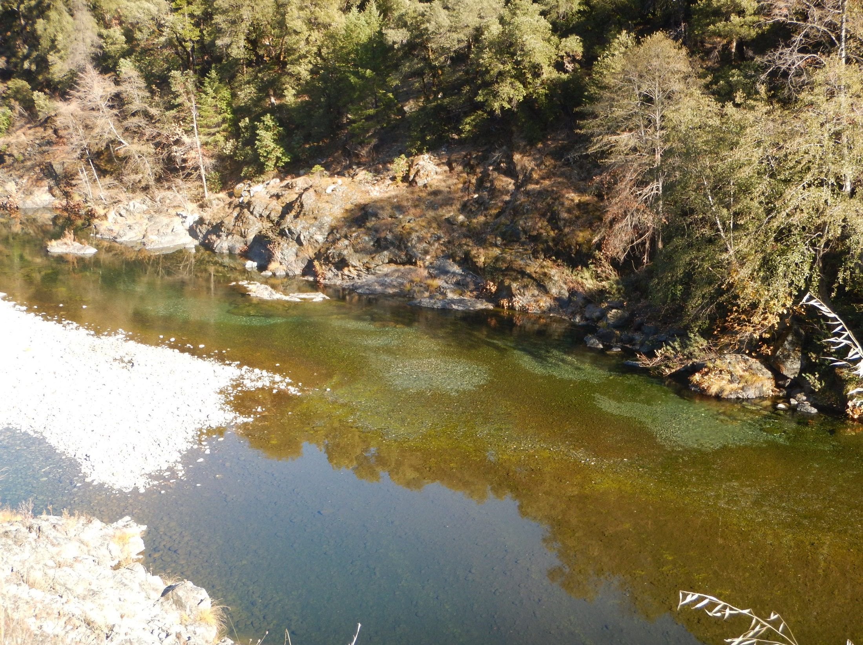
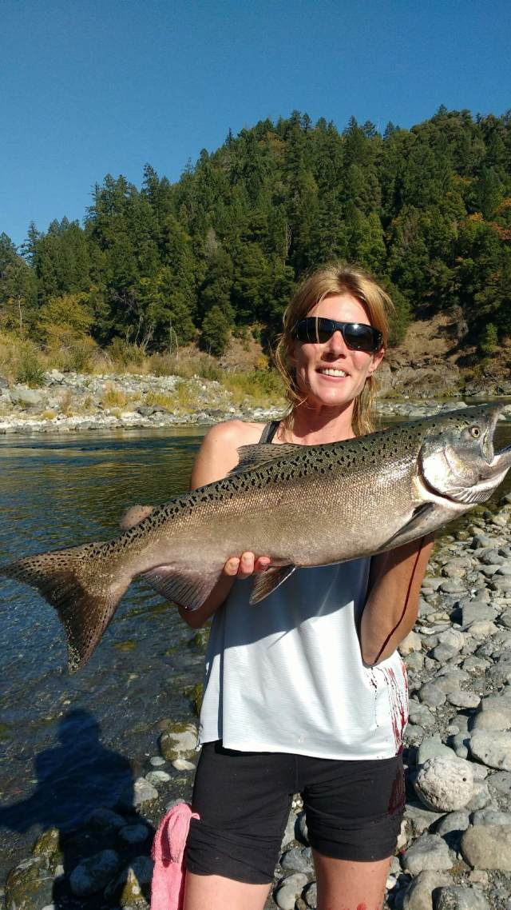
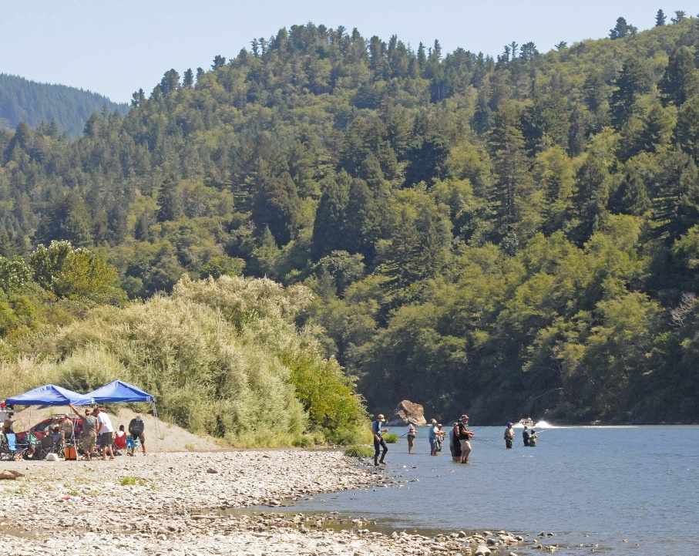
Questions?
Notes:
Ask the audience if they have any questions or comments. If the answer is not easily attainable ask the individual to see you afterwards.

