Slide 1

TRRP Refinements:
Progress & Schedule
TMC Meeting
June 16, 2021
Chad Smith, Ph.D. – Headwaters
Trinity River Refinements Coordinator & Co-Facilitator
Darcy Pickard, M.Sc., P. Stat. – ESSA
Co-Facilitator

Slide 2



Schedule
Period of Performance = June 1, 2020, through May 31, 2023
Tasks and Deliverables | Estimated Months (June 1, 2020, start; meetings and most work begin August 2020)
Task 1: Project management
Deliverable: Quarterly written status reports. | June 2020 through November 2022
Task 2: Program review
Deliverable: Report on key components of other science-based restoration programs. | June 2020 through December 2020
Task 3: TRRP Program Document
Deliverable: Final TRRP Program Document. | January 2021 through October 2021 (now December 2021)
Task 4: Science-Based Monitoring, Evaluation, and Decision Support Plan
Deliverable: Final TRRP Science Plan. | January 2021 through January 2022 (now March 2022)
Task 5: Program Document Implementation Assistance
Deliverable: Quarterly progress reports, Final Annual Report. | February 2022 through January 2023 (now April 2022 through May 2023)

Slide 3
Task 3 – Program Document (PD) Schedule (estimated)
Program Document Drafting Committee (PDDC) Meetings | Schedule (virtual meetings in Teams unless noted as in-person)
PDDC Meeting #1: full day virtual | Thursday, February 18; 12:00 PM-4:00 PM Pacific
PDDC Meeting #2: 3-hour virtual (small group/individual coordination) | Wednesday March 3; 9:00 AM-12:00 PM Pacific
PDDC Meeting #3: 3-hour virtual | Thursday, March 25; 9:00 AM-12:00 PM Pacific
PDDC Meeting #4: full day virtual | Thursday, April 22; 9:00 AM-4:00 PM Pacific
PDDC Meeting #5: 3-hour virtual (small group/individual coordination) | Wednesday, May 12; 9:00 AM-12:00 PM Pacific
PDDC Meeting #6: 3-hour virtual | Thursday, May 27; 9:00 AM-12:00 PM Pacific
PDDC Meeting #7: 3-hour virtual (small group/individual coordination) | Thursday, June 10; 9:00 AM-12:00 PM Pacific
PDDC Meeting #8: 3-hour virtual | Wednesday, June 23; 9:00 AM-12:00 PM Pacific
PDDC Meeting #9: 3-hour virtual (small group/individual coordination) | Wednesday, July 7; 9:00 AM-12:00 PM Pacific
PDDC Meeting #10: full day virtual | Wednesday, July 21; 9:00 AM-4:00 PM Pacific
PDDC Meeting #11: 3-hour virtual (small group/individual coordination) | Wednesday, August 4; 9:00 AM-12:00 PM Pacific
PDDC Meeting #12: 3-hour virtual | Wednesday, August 18; 9:00 AM-12:00 PM Pacific
PDDC Meeting #13: 3-hour virtual | Thursday, September 2; 9:00 AM-4:00 PM Pacific
Consolidate PDDC, TMC, and TRRP staff review comments on draft PD. | Complete by September 9, 2021 (transmit to TMC)
TMC in-person meeting for Draft TRRP Program Document | Thursday, September 16
Consolidate PDDC, TMC, and TRRP staff review comments on draft PD. | October 2021
PDDC Meeting #14: full day virtual | Thursday, November 11; 9:00 AM to 4:00 PM Pacific
Consolidate PDDC, TMC, and TRRP staff review comments & finalize PD. | Complete by December 2 (transmit to TMC)
TMC in-person meeting for Final TRRP Program Document | Thursday, December 9

Slide 4
Where are we at? / Where are we headed?
PD architecture:
Main document – Purpose, Goal, Milestones, key procedures
Attachment #1 – Law of the Trinity
Attachment #2 – Milestones Document
Attachment #3 – Organizational Structure Document
Attachment #4 – Finance Document
Attachment #5 – Science Plan
Wrestling with some key issues now:
Summaries of learning/progress/refinement
Phase 3 – 10 years?
Milestones – what is the TMC going to commit to doing during Phase 3 to advance toward the TRRP goals?
Specify science priorities that link to Milestones
Organizational structure – Stakeholder Advisory Committee, streamline org chart
Finance Document – “capacity” (base funding, TRRP partners, conflict of interest); how to build out multi-year budget based on PD milestones and related SP priorities
Upcoming meetings:
Wednesday, June 23; 9:00 AM to 12:00 PM Pacific Time; full PDDC meeting
The long-term goals of the Program are to: 1) restore the form and function of the Trinity River; 2) restore and sustain natural production of anadromous fish populations in the Trinity River to pre-dam levels; and 3) to facilitate full participation by dependent tribal, commercial, and sport fisheries through enhanced harvest opportunities.

Slide 5
Secretary of the Interior
Co-lead Federal agencies
(Reclamation & Service)
* ROD oversight
TRRP Oversight Committee
Reclamation & Service RDs
HVT & Yurok Tribal Chairs
* ROD coordination
Independent Science Review
* Science Advisory Board (SAB)
* Peer Review
Trinity Management Council (TMC)
Stakeholder Advisory Committee
Operations/Implementation
TRRP Executive Director & Staff
TRRP Standing Advisory Committees
* Technical (Science)
* Implementation
* Ad Hoc (issue-based Work Groups)

Slide 6
Task 4 – Science Plan (SP) Schedule (estimated)
Task 4 Requirements | Estimated Completion Date:
Science Plan Drafting Committee member coordination | Throughout Task 4
SPDC: Meeting #1, 3-hour teleconference | May 5, 2021
SPDC: Meeting #1, one-day teleconference | May 26, 2021
SPDC: Meeting #1, one-day teleconference | June 30, 2021
SPDC: Meeting #1, 3-hour teleconference | July 22, 2021
SPDC: Meeting #1, one-day teleconference | Aug 19, 2021
TMC in-person meeting for Draft TRRP Science Plan (1-day meeting) | Sept 16, 2021
SPDC: Meeting #1, 3-hour teleconference #3 | Oct 7
SPDC: Meeting #1, in-person meeting* | Oct 7, 2021
Consolidate Committee, TMC, and TRRP staff review comments on Draft TRRP Science Plan | Oct 7 - Nov 18, 2021
SPDC: Meeting #1, one-day teleconference | Nov 18, 2021
Draft TRRP Science Plan | Dec 2, 2021
TMC in-person meeting* for Draft TRRP Science Plan (1-day meeting) | Dec 9, 2021
SPDC: Meeting #1, 3-hour teleconference | Jan 25, 2022
Final TRRP Science Plan | Feb 2022
TMC in-person meeting* for Final TRRP Science Plan (1-day meeting) | March 2022

Slide 7
Where are we at? / Where are we headed?
SP architecture:
Starting to build now; working on draft annotated outline based on Committee feedback so far, progress on PD, and general knowledge of TRRP science priorities
Wrestling with some key issues now:
Priorities
How to integrate/build on objectives from Work Groups presented to TMC in March
How to ensure direct linkages to the PD
What can we learn from other restoration programs?
Upcoming meetings:
Wednesday, June 30; 9:00 AM to 4:00 PM Pacific Time; full SPDC meeting

Slide 8
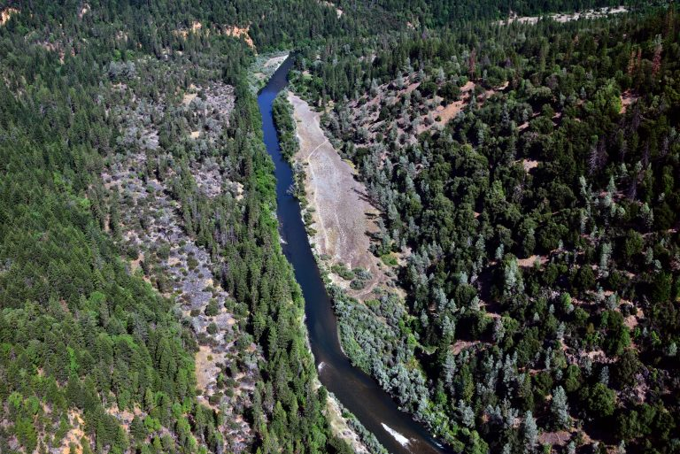
TRRP Refinements:
Progress & Schedule
Comments from PDDC and SPDC members
Q & A
THANKS!

